Slide 1

JurisBot
Justice, Accelerated.
The world's first AI-driven Legal Operating System — connecting citizens in crisis to verified legal experts, instantly.

Slide 2
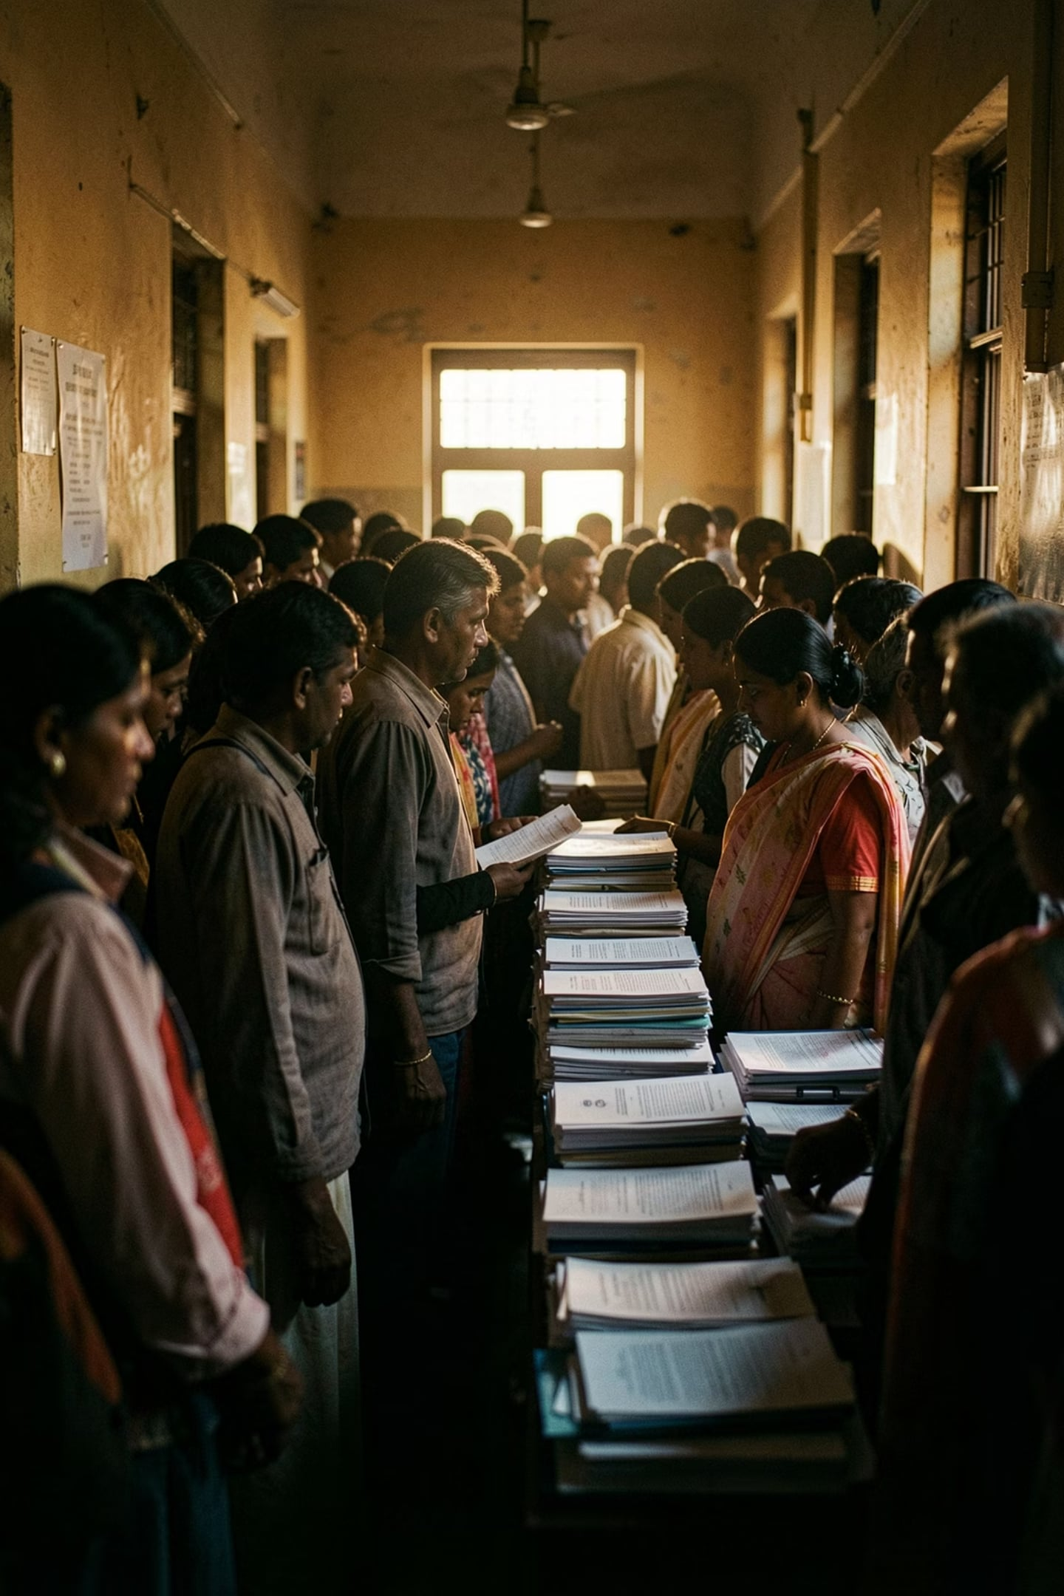
THE PROBLEM
40 Million Cases. Zero Clarity.
For Citizens
For Lawyers
A sudden dispute — property, family, consumer — and no idea what your rights are. Finding an honest lawyer feels like navigating a maze blindfolded.
Brilliant legal minds drowning in admin. Hours lost on basic consultations just to determine if a case is valid — time stolen from actual justice.
The Industry
Fragmented tools — Clio, Calendly, Zoom, WhatsApp — none designed for the citizen. Just admin software dressed up as a solution.

Slide 3
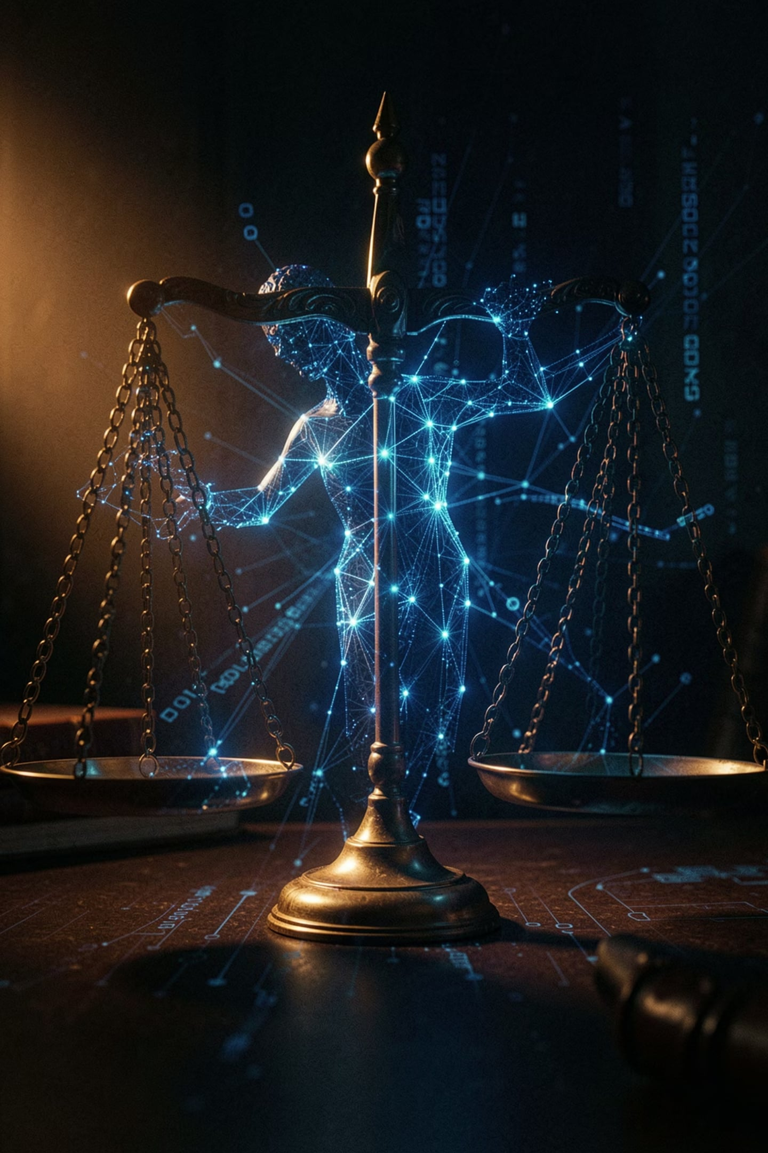
THE SOLUTION
Not an App. An Operating System.
JurisBot is the world's first AI-driven Legal Operating System — a single, unified platform that bridges citizens in crisis directly to verified legal experts, with artificial intelligence orchestrating every step.
Instant Triage
Smart Routing
AI reads actual legal codes and tells citizens their rights — in seconds.
Cases are packaged into professional briefs and matched to verified lawyers.
Secure Resolution
Encrypted video consultations built in. No Zoom. No WhatsApp. All in one place.

Slide 4

HOW IT WORKS
From Panic to Resolution in Three Steps
Describe Issue
Instant Triage
Lawyer Consult
No waiting weeks for appointments. No confusing legal jargon. JurisBot meets citizens where they are — in plain English — and gets them to the right expert, fast.

Slide 5
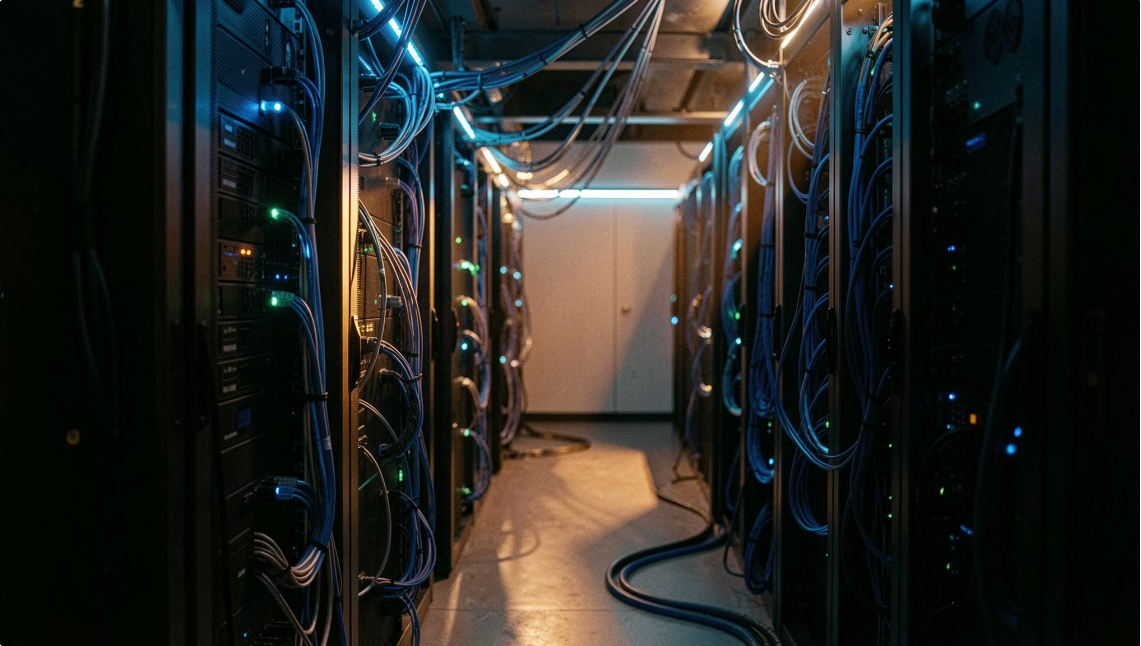

TECHNOLOGY
Enterprise-Ready Architecture
JurisBot runs on a tri-portal architecture — Citizen, Lawyer, and Master Admin — built to scale from day one.
React + Node + Python AI
RAG-Powered AI Brain
Institutional Analytics
A modern, battle-tested stack with lightning-fast WebSockets for real-time alerts.
Retrieval-Augmented Generation means legal advice updates the moment new laws pass — never outdated.
Master Admin dashboard provides real-time oversight across all cases and platform activity.

Slide 6
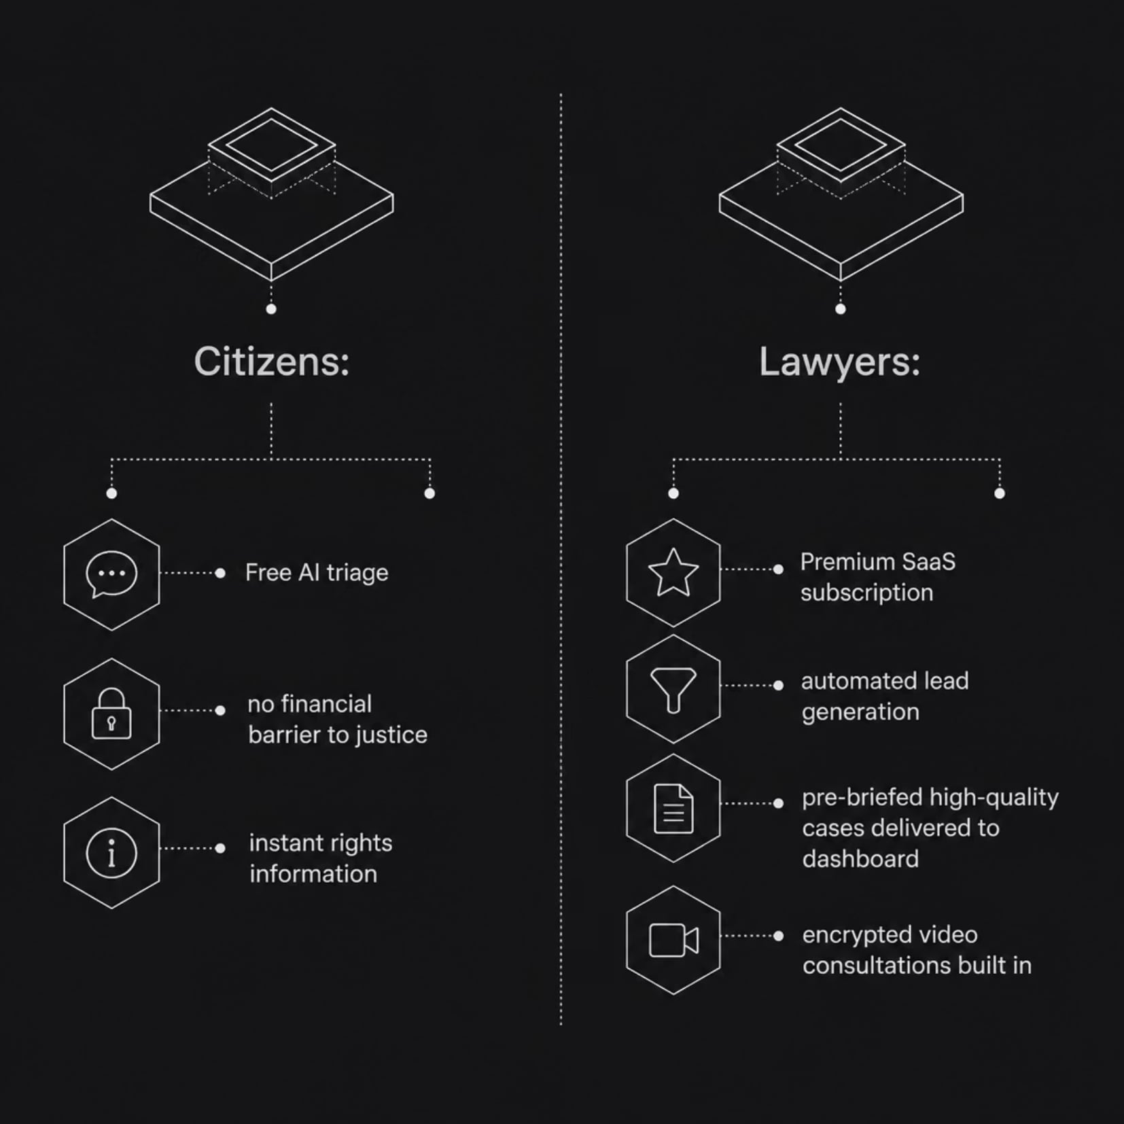

BUSINESS MODEL
Free for Citizens. Premium for Lawyers.
JurisBot removes the financial barrier to justice for citizens while monetizing the supply side. Lawyers pay because JurisBot acts as an automated lead-generation engine — filtering noise and delivering pre-qualified, pre-briefed cases directly to their dashboard.
The more lawyers on the platform, the faster citizens get help. The more citizens, the more valuable the marketplace. A virtuous flywheel.

Slide 7
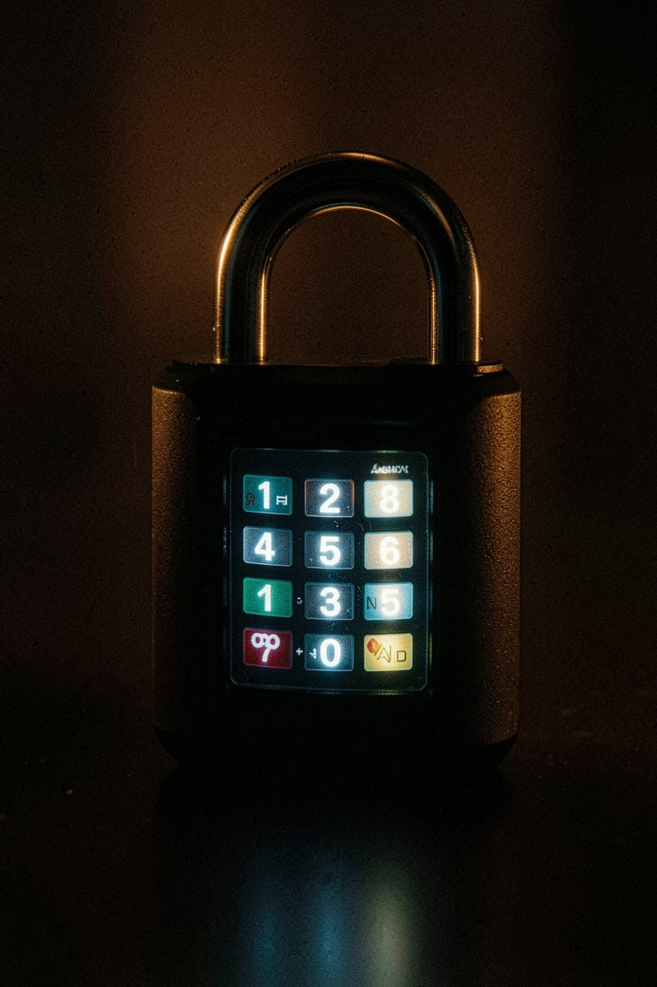



SECURITY & TRUST
We Don't Just Protect Rights. We Protect Data.
Military-Grade Data Sanitation
Every case file, consultation, and document is handled with enterprise-level data hygiene protocols.
End-to-End Encrypted WebSockets
Real-time communication between citizens and lawyers is fully encrypted — no third-party exposure.
Verified Legal Experts Only
Every lawyer on the marketplace is vetted, ensuring citizens receive qualified, trustworthy guidance.

Slide 8
MARKET OPPORTUNITY
One of the Largest Underserved Markets on Earth
40M+
99%
Pending Cases
Without Legal Guidance
In Indian courts alone — a backlog that grows every single day.
Of citizens facing disputes have no idea what their actual rights are.
$0
1
Cost for AI Triage
Unified Platform
JurisBot removes the financial barrier to initial legal guidance entirely.
The only solution connecting citizens, AI, and lawyers in a single system.

Slide 9

WHY NOW
The Timing Has Never Been Better
Three forces are converging to make JurisBot inevitable:
1
AI Maturity
RAG and LLM technology can now parse legal documents with genuine accuracy — a capability that didn't exist 24 months ago.
2
Digital Infrastructure
India's smartphone penetration and digital identity stack (Aadhaar, UPI) create the perfect distribution rails.
3
Regulatory Tailwinds
Government initiatives actively pushing for e-courts and digital legal access accelerate adoption.

Slide 10

The Oldest Problem in Human History — Solved.
By empowering citizens with AI and streamlining workflows for lawyers, we aren't just making the law faster. We are making it fair.
Fully Functional
Scalable Model
Market-ready product. Not a concept. Not a prototype. Built and operational today.
SaaS subscription revenue from lawyers. Zero cost barrier for citizens. A self-reinforcing marketplace.
The Ask
We're raising to scale verified lawyer onboarding, expand AI coverage to additional jurisdictions, and accelerate go-to-market.

