Slide 1
PATIENT CASE SIMILARITY
PIP2001 Capstone Project
Review-1
Batch Number : CDV-02
Roll Number | Student Name
20211CDV0033 | RAJESHWARI C RAIKAR
20211CDV0034 | NISHA L
20211CDV0055 | AMRUTH RAJ
20211CDV0041 | KATTA VINOD KUMAR
20211CDV0056 | K VISHNU VARDHAN
Under the Supervision of,
Mr. RAJAN THANGAMANI
Assistant Professor
School of Computer Science and Engineering
Presidency University
Name of the Program: B.TECH COMPUTER SCIENCE AND TECHNOLOGY [DEVOPS]
Name of the HoD: Dr. S PRAVINTHRAJA
Name of the Program Project Coordinator: SUMA N G
Name of the School Project Coordinators: Dr. Sampath A K / Dr. Abdul Khadar A / Mr. Md Ziaur Rahman

Slide 2
Introduction
Goal:
Find similar patient cases for personalized care.
Data Used:
Analyze both structured data (like patient info) and unstructured data (like clinical notes).
Similarity:
Use Cosine Similarity to measure how close patients are in terms of data.
NLP:
Turn clinical notes into numbers for easy comparison.
Web App:
A Python Flask-based app where doctors can get real-time similarity scores.
Benefit:
Helps doctors make better decisions and provide personalized treatment faster.

Slide 3
Literature Review
Objective:
Use machine learning and NLP to compare patient cases in healthcare.
ML Techniques:
Analyze large datasets and predict outcomes.
Similarity Measures:
Use cosine similarity or Euclidean distance for case comparison.
NLP Models:
BERT improves text analysis of medical terms.
Applications:
Detect rare diseases and predict treatment outcomes.
Challenges:
Address data privacy, integration, and model interpretability.
Future Focus:
Make models more understandable while ensuring data security.

Slide 4
Existing method Drawback
Data Sparsity
Difficulty in Distinguishing Overlapping Symptoms
High Dimensionality and Complexity
Kernel Selection Challenge
Limited Generalization
Context-Dependent Similarity Definitions

Slide 5
Existing method Drawback
Heterogeneous Data Integration
High Data Requirements
Complexity of Medical Text
Data Privacy and Security
Evaluation and Interpretability

Slide 6
Proposed Method
 | Journal | Methodology | Models | Evaluation Metrics | Drawbacks or Challenges
1 | Journal Of Biomedical Informatics | Deep Learning | 1. RNN 2. GNN | Cross validation | Data Sparsity
2 | International Journal of Medical Informatics | Prediction Based | 1. Diagnostic Prediction. 2. Prediction model. | 1. Performance Evaluation for testing [F1 score]. 2. Supervised Metrics. | Model faces difficulties in measuring qualitative similarity due to complexity of EHR data, which includes structured and unstructured data.
3 | Patient Similarity Methods and Application | Clustering | 1. CNN 2. KNN 3. SOM | 1. Accuracy and F1 score. 2. Unsupervised Metrics [Euclidean, K-means, Cosine and Mahalanobis] | 1. Data Heterogeneity and inconsistency. 2. Limited clinical and research. 3. Labeling difficulty. 4. Some data integration methods may result in loss of important information.
4 | Improving Clinical Decision Support Through Patient Case Similarity | Machine Learning | 1. Random Forest 2. Decision Tree 3. SVM 4. Naïve Bayes | Accuracy | 1. Random forests can be computationally expensive due to large number of trees and suffer from overfitting if no. of trees is too high. 2. Selecting right kernel function can be challenging.
5 | Patient Similarity Using Population Statistics and Multiple Kernel Learning | Multiple Kernel Learning | Cumulative Distribution Function (CDF). | Performance Metrics | 1. The definition of patient similarity can be context-dependent, complicating feature relevance. 2. Generalizability of the model may be limited across diverse patient populations. 3. Historical data reliance may introduce biases, affecting adaptability to new cases.

Slide 7
Proposed Method
6 | Similarity Of Patients in Predictive Models Using Medical Data | Multiple Supervised and Unsupervised ML | 1. K-Medoids clustering. 2. Linear Regression. | 1. Mean Squared Error. 2. Root Mean Squared Error. | No Drawbacks
7 | Supervised Patient Similarity Measure of Heterogeneous Patient Records | Supervised Metric Learning | Not mentioned | LSML [Locally Supervised Metric Learning] | 1. To identify the appropriate and effective secondary uses of EHR data. 2. Data Reduction and in summarizing temporal event sequences in HER data into features that can differentiate patients. 3. LSML algorithm and its extension on incremental update face a key challenge in distributed secure environments.
8 | IRJMETS: Patient Case Similarity | Predictive Based | 1. ML 2. NLP | Random Forest Or NN
9 | Deep Patient Similarity Learning for Personalized Healthcare | Deep learning frameworks (CNN) | 1. Triplet loss 2. SoftMax-based learning | 1. Accuracy precision, Recall, F1 score. 2. RI and NMI | Difficulty in distinguishing between diseases with overlapping symptoms due to shared clinical characteristics.
10 | AI – Driven Clinical Decision Support | ML and DL Techniques | 1. Prediction model 2. Cosine Similarity | 1. Top - K Accuracy 2. Precision 3. Recall 4. F - Measure | 1. High Dimensionality and Complexity. 2. Limited Generalization.

Slide 8
Objectives
Clustering Algorithms for Patient Similarity
Similarity Metrics for Various Data Types
Implementation in Python
Web Development
Evaluate the effectiveness of clustering and similarity analysis.
Addressing Limitations and Challenges

Slide 9
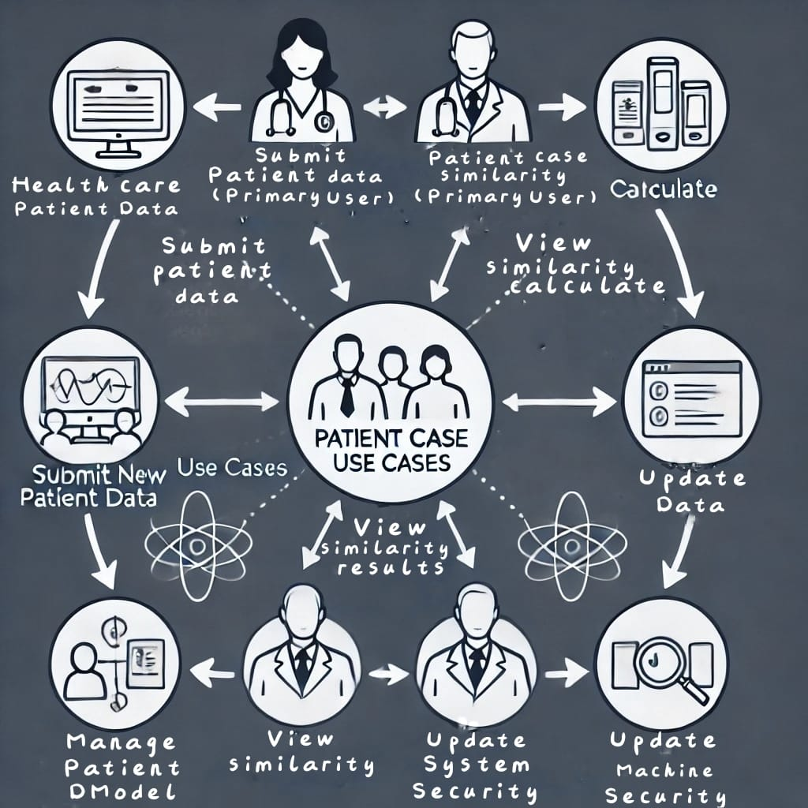
Methodology/Modules
The workflow for a patient case similarity system in healthcare involves:
Submit Patient Data
Similarity Calculation
Results
Update Data
Manage Data Model
System Security
This feedback loop helps healthcare professionals gain actionable insights.

Slide 10
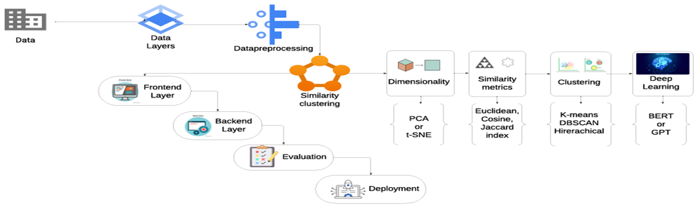
Architecture

Slide 11
Software components
Data Sets: Kaggle
Frontend: HTML, CSS, JS
Backend: Flask
NLP Libraries: TF-IDF, BERT
Machine Learning Frameworks: Scikit-learn
Model Deployment: Docker, AWS , GCP, Azure
Security: OAuth, SSL/TLS, HIPAA compliance
Logging & Monitoring: CloudWatch

Slide 12
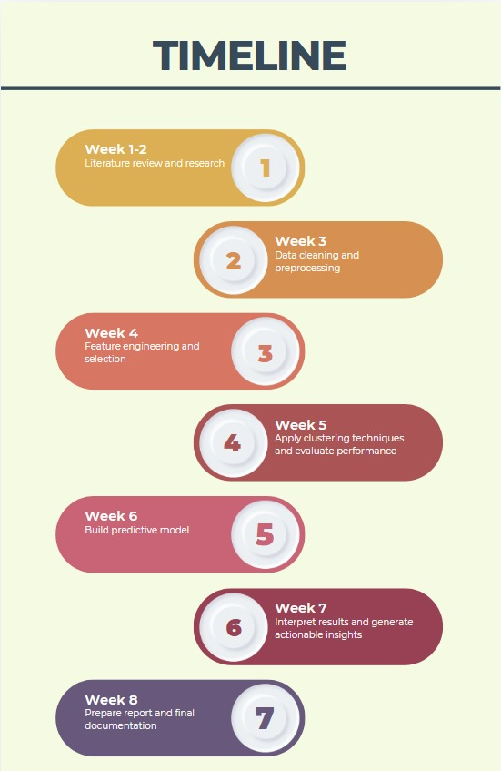
20 days
10 days
10 days
5 days
4 days
7 days
4 days
5 days
3 days
3 days
7 days
2024
2025
Timeline of Project

Slide 13
Expected Outcomes
Groupings of similar patients based on medical data (cluster labels).
Identification of key attributes that define each cluster.
Actionable insights for patient treatment or diagnosis.
A model that can predict similarity for new patients.
Visualizations to illustrate the clusters and their significance.
Report and Documentation. help me to add this points to report

Slide 14
Conclusion
Successfully clustered patients based on medical data.
Identified key features for personalized treatment and diagnosis.
Developed a predictive model to classify new patients into clusters.
Enables data-driven decisions for healthcare providers.
Potential to improve patient outcomes through personalized medicine.

Slide 15
Github Link
https://github.com/Nishalokesh/Capstone_Project.git

Slide 16
References
Dai, L., Zhu, H., & Liu, D. (2020). Patient similarity: Methods and applications. arXiv. https://arxiv.org/abs/2012.01976
Conroy, B., Xu-Wilson, M., & Rahman, A. (2017). Patient similarity using population statistics and multiple kernel learning. Proceedings of Machine Learning for Healthcare 2017 JMLR W&C Track. https://proceedings.mlr.press/v68/conroy17a.html
Siri, D. L., Charitha, K., Varsha, K., & Pramod, K. (2023). Improving clinical decision support through patient case similarity. International Journal of Creative Research Thoughts, 11(12), 680-685. https://www.ijcrt.org/IJCRT2312749
Seligson, N. D., Warner, J. L., Dalton, W. S., Martin, D., Miller, R. S., Patt, D., ... Chen, J. L. (2020). Recommendations for patient similarity classes: Results of the AMIA 2019 workshop on defining patient similarity. Journal of the American Medical Informatics Association, 27(11), 1808–1812. https://doi.org/10.1093/jamia/ocaa159
Mahima, V. B., Jeevinee, V., & Khan, M. S. (2024). Patient case similarity. International Research Journal of Modernization in Engineering Technology and Science, 6(1), 835–838. https://doi.org/10.56726/IRJMETS48246
Jia, Z., Zeng, X., Duan, H., Lu, X., & Li, H. (2020). A patient-similarity-based model for diagnostic prediction. International Journal of Medical Informatics, 135, Article 104073. https://doi.org/10.1016/j.ijmedinf.2019.104073

Slide 17
References
Liu, Y. (2022). A family of algorithms for patient similarity based on electronic health records [Master’s thesis, Concordia University]. Concordia University Library. https://doi.org/10.1109/ACCESS.2022.3142100&#8203;:contentReference[oaicite:0]
Memarzadeh, H., Ghadiri, N., Samwald, M., & Lotfi Shahreza, M. (2022). A study into patient similarity through representation learning from medical records. arXiv. https://doi.org/10.21203/rs.3.rs-1738458/v1&#8203;:contentReference[oaicite:1]
Haboubi, S., & Ben Cheikh, A. (2021). Similarity of patients in predictive models using medical data: Case of auto-prescription drugs for diabetic patients. International Journal of Computers, 6, 33-38. https://www.iaras.org/iaras/journals/ijcOei
R. W., Hsu, W., Lee, M. L., & Tan, N. C. (2023). Using similar patients to predict complication in patients with diabetes, hypertension, and lipid disorder: A domain knowledge-infused convolutional neural network approach. Journal of the American Medical Informatics Association, 30(2), 273–281. https://doi.org/10.1093/jamia/ocac212&#8203;:contentReference[oaicite:0]
Wang, N., Huang, Y., Liu, H., Fei, X., Wei, L., Zhao, X., & Chen, H. (2019). Measurement and application of patient similarity in personalized predictive modeling based on electronic medical records. BioMedical Engineering OnLine, 18(98), 1-15. https://doi.org/10.1186/s12938-019-0718-2

Slide 18


Project work mapping with SDG

Slide 19
Thank You

