Slide 1
Company overview: Goodcabs is cab service company established in 2024 and its operating in tier-2 cities.Primarily it been established in 10 cities in India.good cabs is committed to support local drivers to get sustainable living in their hometown.
Goodcabs has set an target in 2024 and the management team has decided to analyse the company’s performance.They have decided to analyse certain key metrics such as:
Trip volume
Passenger satisfaction
Repeat passenger rate
Trip distribution
Balance between new and repeat passengers etc

Slide 2
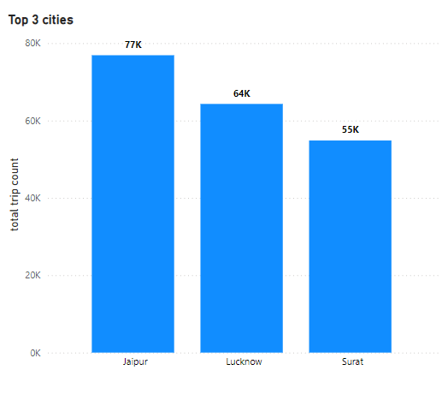
Primary and secondary Analysis: Identify the top 3 and bottom 3 cities by total trip over entire analysis
When taking total trip count into account,Jaipur,lucknow,surat ranks in the top 3 position. Jaipur with 77000 trips is the city with highest number of trips,then comes lucknow with 64000 and surat with 55000 trips.

Slide 3
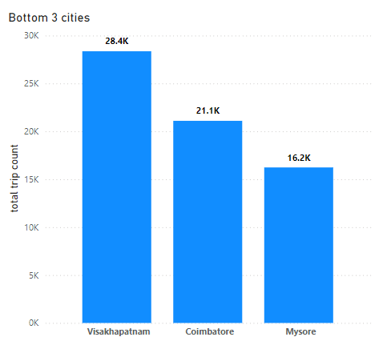
Bottom 3 cities:
Visakapatinam,Coimbatore,mysore cities are the bottom 3 cities with lowest trip count.vizag with 28.4k, Coimbatore with 21.1k and mysore with 16.2k trip count

Slide 4
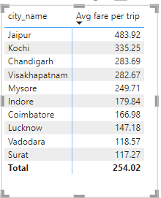
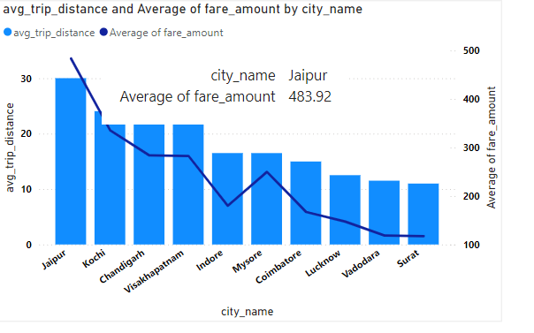
Average fare per trip per city

Slide 5
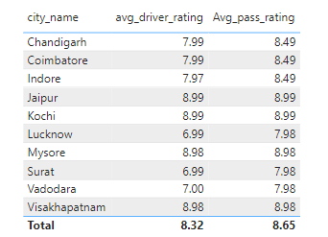
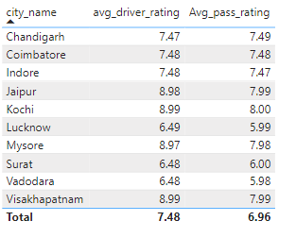
Average ratings by city & passenger type: New passenger ratings vs Repeated passenger ratings

Slide 6
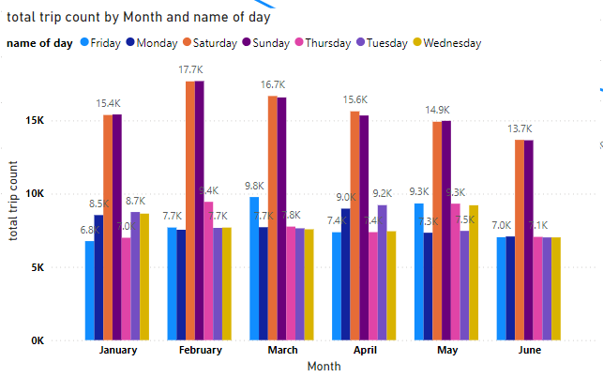
Peak and low demand months: The cab demand is high in month of febrary and march,moderate in January and march.Its low in the month of June.

Slide 7
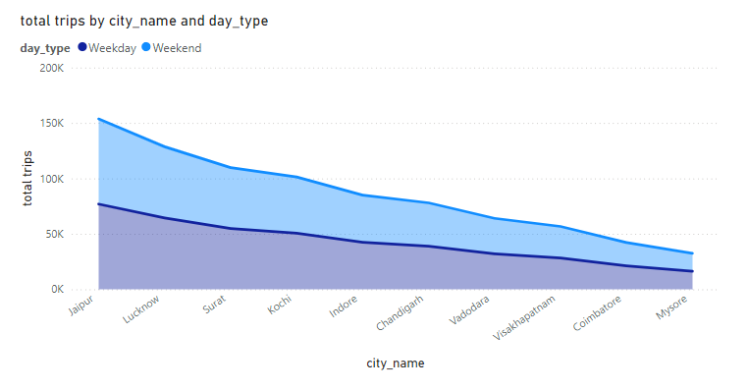
Weekend vs weekday demand:

Slide 8
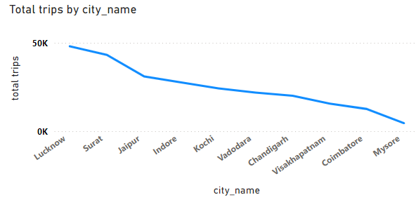
Trip count among cities:

Slide 9
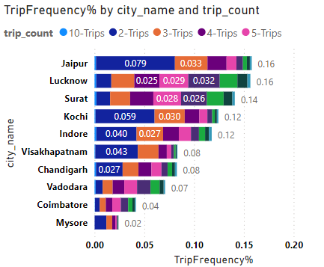
TRIP FREQUENCY %
Jaipur attracts more passengers and passenger travel frequently due to its tourist attractions.Jaipur is known for its historical palaces.Lucknow also attracts more passengers as its has many tourist places and temples.surat and cochin also attracts more tourists in business.But trip frequency is very low for mysore and Coimbatore even though its has tourist and business attractions

Slide 10
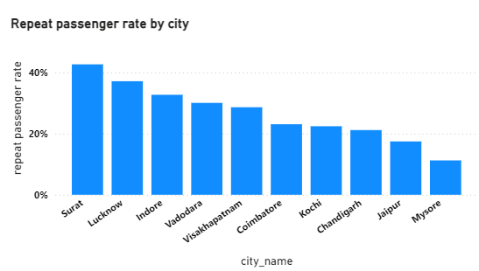
REPEAT PASSENGER RATE:
Surat(42.63%) and lucknow (37.12%) contributes to the highest repeat passenger rate.Jaipur(17.43%) and mysore(11.23%) has the lowest repeat passenger rate

Slide 11
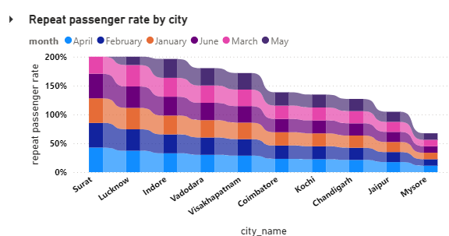
Repeat passenger rate seems to be high in month of April,may,June and its low in month of February

Slide 12
FURTHER ANALYSIS:
The trip count in cities like lucknow ,surat and Jaipur is high.This is due to factors,these cities may attract the customers in view of business.surat and lucknow has a place in business and Jaipur is know for its majestic palaces.
Coimbatore and mysore has lowest trip count.Mysore is famous for its tourist attraction but it failed to attract more passengers .Likewise Coimbatore also did not score more passengers

Slide 13
How can we improve the business
In most frequently visited cities,it is suggested to include more cabs which is also electric vehicle that may reduce the pollution and it will be economical in terms of fuel consumption.
Free wifi in cab may attract the passengers and will not disappoint them in entertainment by enjoying youtube and sending some important mails.
In less demand cities,it is advised to tie up with shops in business areas and with resorts,hotels in tourist cities
And you may give coupon codes to avail discounts that would attract the passengers

Slide 14
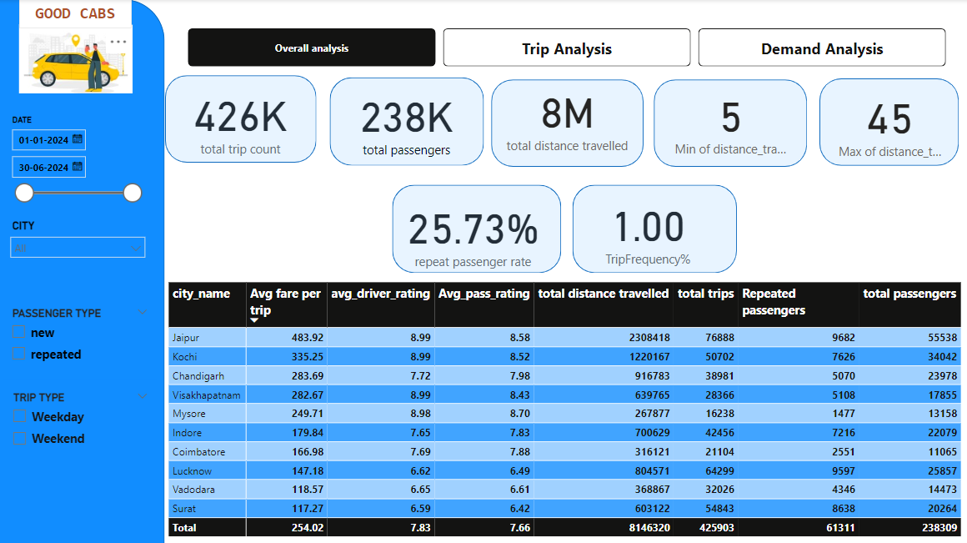

Slide 15
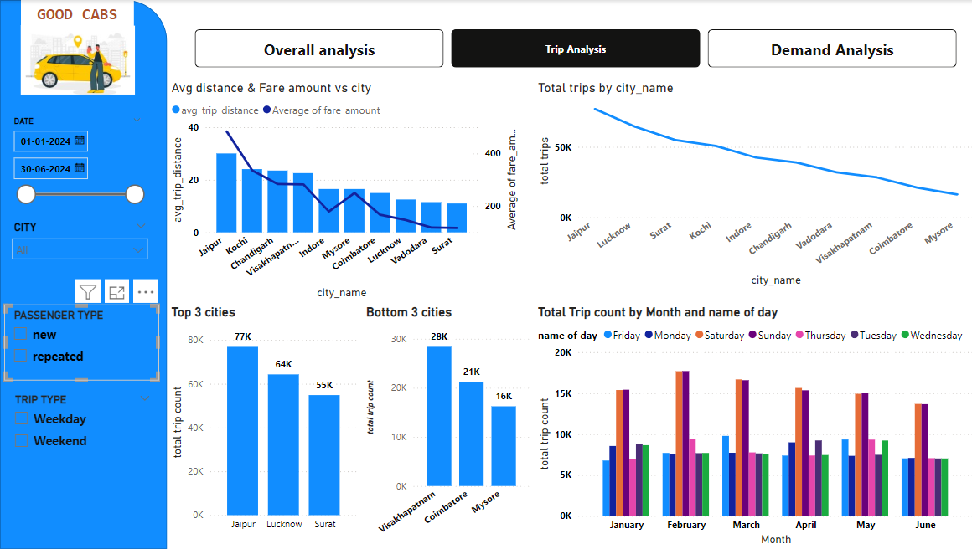

Slide 16
