Slide 1
Referencing and Bibliographies
Mark Unwin

Slide 2
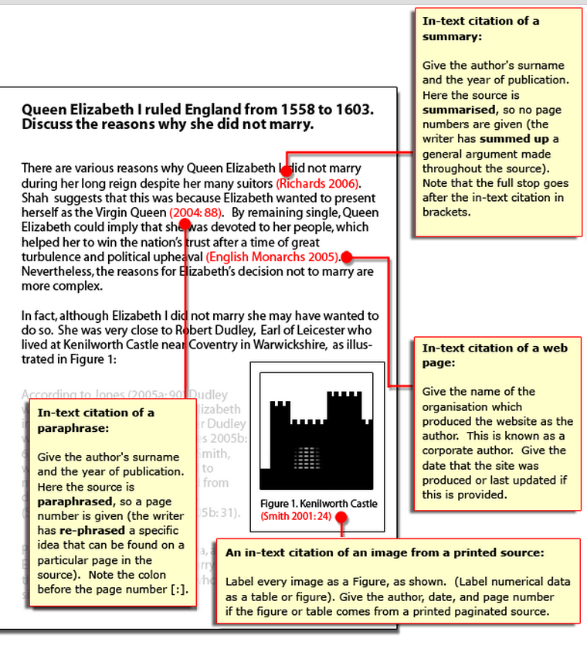
Citation
Means referring to sources
in your work:
Books
Websites
Lectures
Journals
Magazines
Television programmes
Etc

Slide 3
Always cite your sources
It is good to use academically acceptable sources in your assignments.
However, you cannot simply copy/paste from these sources and leave it at that.
If you do this, you will end up with a high similarity score in Feedback Studio (Turnitin).

Slide 4
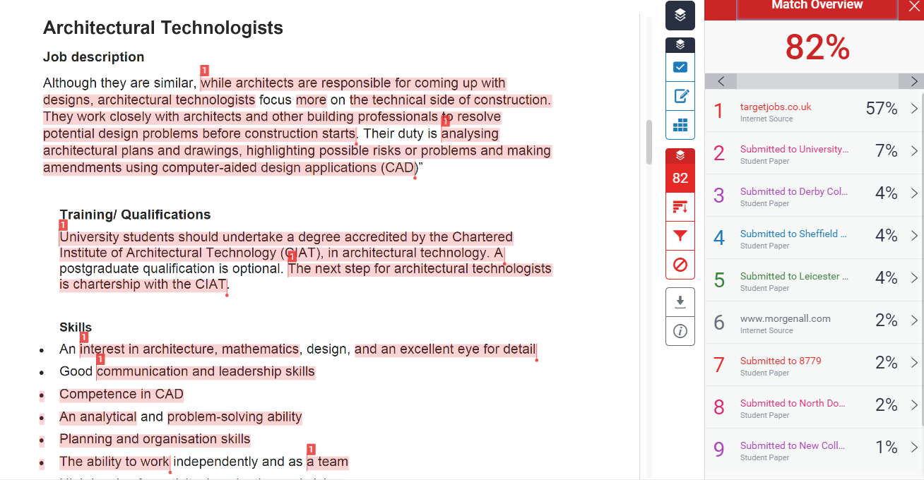
Take note of the Turnitin Similarity score!

Slide 5
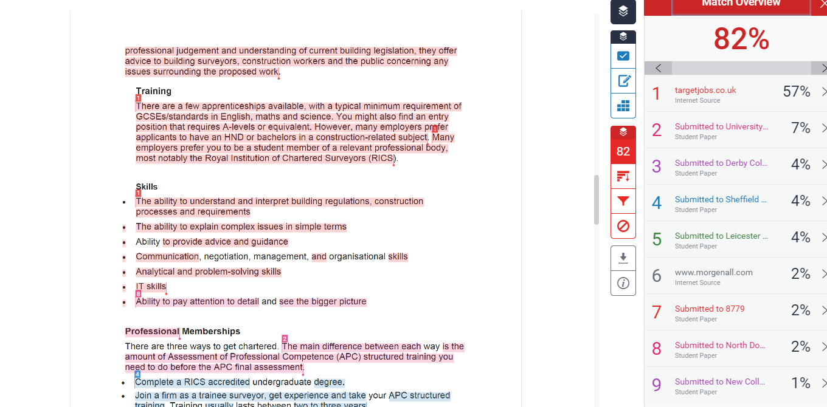

Slide 6
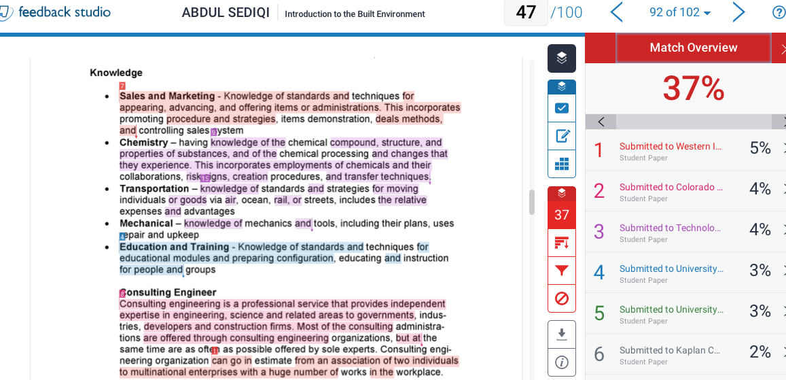
Another example:
Mark Unwin
Feedback Studio has identified the highlighted areas as coming from various sources.
This level of obvious plagiarism is NOT ACCEPTABLE.
This student would either lose marks or even have the whole assignment. In extreme cases, a student who regularly plagiarises may be ejected from university.

Slide 7
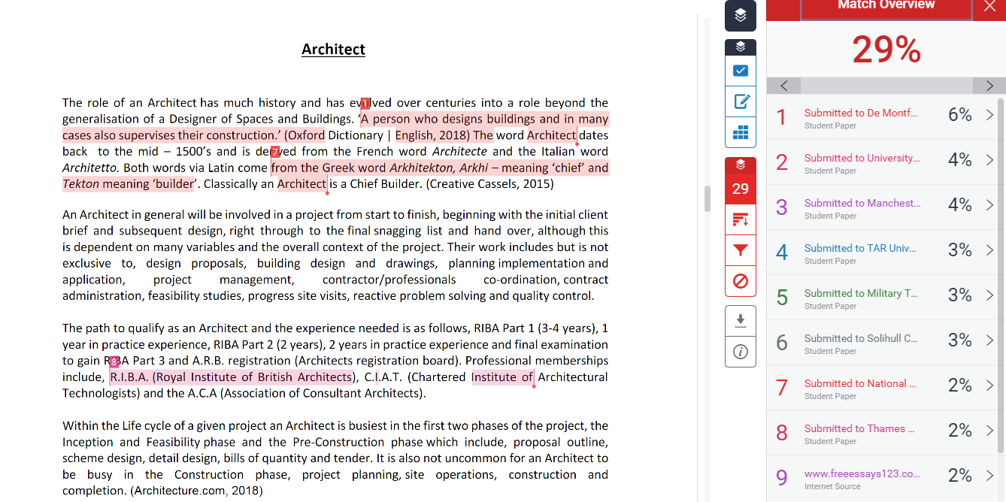
Take a look at this:

Slide 8
Take a look at this:
29% seems high but actually the highlighted sections of the text are correctly cited.

Slide 9
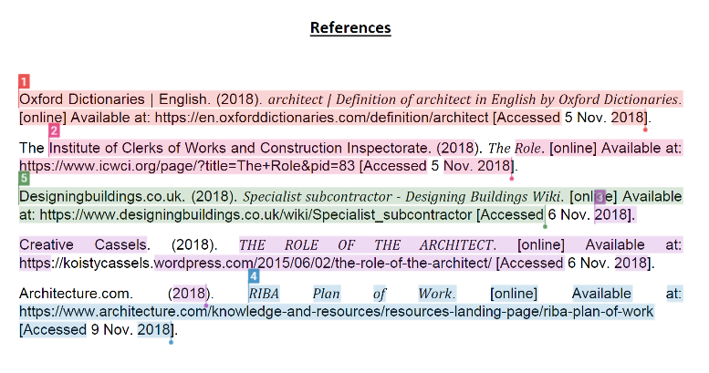
And Turnitin has included the reference list:
So there really is no problem here!

Slide 10

FAILURE TO CITE YOUR SOURCES PROPERLY WILL RESULT IN ACCUSATIONS OF
plagiarism
WHICH COULD RESULT IN YOU BEING DISMISSED FROM THE UNIVERSITY

Slide 11
There are two types of citation:
In-text: In the main body of your work (Yes. That does include the Introduction and conclusion!
End Text: The Reference List or Bibliography at the end of your work
At UEL, we use the
Harvard Referencing System
(as described in latest edition of Cite Them Right)
(Apart from Psychology, who use APA, and Law, who use OSCOLA)

Slide 12
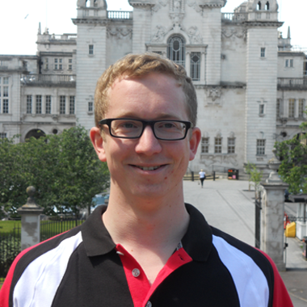
IN-TEXT CITATION :Two Types
‘ ’
Direct
Same words
Indirect
Different words
(summary or paraphrase)
Source text
Your essay

Slide 13
Use author’s ideas but your words
Paraphrase:
Author’s name
Year of publication
Page ref (if avail.)
Summary
Author’s name
Year of publication
Direct Quotation
Indirect Quotation
Use author’s ideas and words
Show it’s a quote – use ‘quotation marks’
Give the right reference:
Author’s name
Year of publication
Page reference

Slide 14
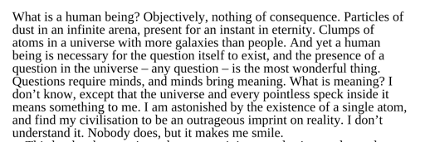
How to avoid Plagiarism: Direct Quotation
If you use somebody else’s words, present them as direct quote (ie put into quotation marks) and cite the source, following Harvard Referencing system
Cox and Cohen (2014, p2) describe a human being as ‘Objectively, nothing of consequence. Particles of dust in an infinite arena, present for an instant in eternity. Clumps of atoms in a universe with more galaxies than people.’
End Text Ref:
Cox, B. and Cohen, A. (2014) Human Universe. London: Harper Collins.

Slide 15
Quotations- different arrangements
Widdowson (1979, p. 5) states that ‘There is a good deal of argument in favour of extending the concept of competence to cover the ability to use language to communicative effect.'
According to Widdowson (1979),‘There is a good deal of argument in favour of extending the concept of competence to cover the ability to use language to communicative effect' (p. 5).
According to Widdowson, ‘There is a good deal of argument in favour of extending the concept of competence to cover the ability to use language to communicative effect' (1979, p. 5).
According to one researcher, ‘There is a good deal of argument in favour of extending the concept of competence to cover the ability to use language to communicative effect' (Widdowson, 1979, p. 5).
(In all cases at end of essay)
References
Widdowson, H. G. (1979). Explorations in applied linguistics. Oxford: Oxford University Press.

Slide 16
Reasons for using direct quotations:
quote if you use another person's words: you must not use another person's words as your own
you need to support your points, quoting is one way to do this
quote if the language used in the quotation says what you want to say particularly well
‘To be or not to be, that is the question’

Slide 17

Missing out or adding words
Original text:
The placebo effect, which had been verified in previous studies, disappeared when behaviours were studied in this manner.

Slide 18
Missing out or adding words
He stated ‘The placebo effect ... disappeared when behaviours were studied in this manner’ (Smith, 1982, p. 276), but he did not clarify which behaviours were studied.
Smith (1982) found that ‘The placebo effect, which had been verified in previous studies, disappeared when [his own and others’] behaviours were studied in this manner’ (p. 276).

Slide 19
Quote within a quote (nested quote)
Unwin (2019) said that ‘to paraphrase Hamlet’s line “To be or not to be, that is the question” would be a mistake.’

Slide 20
Long quotes: Formatting
Long quotes= over two/three lines
According to Smith (1982, p. 276), ‘ The placebo effect, which had been verified in
previous studies, disappeared when behaviours were studied in this manner.
Furthermore, the behaviours were never exhibited again, even when real
drugs were administered. Earlier studies were clearly premature in attributing the
results to the placebo effect.’ Consequently, researchers in the US decided to...
NOT LIKE ABOVE BUT LIKE THIS
According to Smith:
The ‘placebo effect’, which had been verified in previous studies, disappeared when behaviours were studied in this manner. Furthermore, the behaviours were never exhibited again, even when real drugs were administered. Earlier studies were clearly premature in attributing the results to the placebo effect.
(1982, p. 276)
Consequently, researchers in the US decided to...

Slide 21

Overlong quotes do not work!

Slide 22
Use a mix of direct, summary and paraphrase

Slide 23
Reasons for not using quotations:
if the information is well-known in your subject area
If it disagrees with your argument unless you can prove it is wrong
if you cannot understand the meaning of the original source
if you are not able to paraphrase the original
do not use quotations to make your points for you; use them to support your points.

Slide 24

The 80:20 Rule
Your essay should be approximately 80% citation, 20% you
Citation should be approximately 80% Indirect, 20% direct

Slide 25
Indirect Quotation
Most of the essay will be this (remember 80:20 rule!)
Consists of summary and paraphrase
Much more ‘plastic’ and user-friendly!
Take another author’s ideas and express them or summarise them
in you own words
Must remember to say where the ideas came from!

Slide 26
How to avoid Plagiarism
If you choose not to use someone else’s words, you can summarise or paraphrase them.
But you must cite it- these are NOT your ideas:

Slide 27
How to avoid Plagiarism: Indirect Citation
Cox and Cohen (2014, p2) describe a human being as ‘Objectively, nothing of consequence. Particles of dust in an infinite arena, present for an instant in eternity. Clumps of atoms in a universe with more galaxies than people.’
Cox and Cohen (2014) reflect on how infinitesimally small we are in relation to the universe, and, compared to eternity, how brief our lives.
End Text Ref:
Cox, B. and Cohen, A. (2014) Human Universe. London: Harper Collins.

Slide 28
Integral
According to Peters (1983) evidence from first language acquisition indicates that lexical phrases are learnt first as unanalysed lexical chunks.
(At end of essay)
References
Peters, A. (1983). The units of language acquisition. Cambridge: Cambridge University Press.
NOTE: in Integral format author name needs to be part of the sentence ie NOT in brackets.
According to (Peters, 1983) INCORRECT

Slide 29
Non-integral
Evidence from first language acquisition (Peters, 1983) indicates that lexical phrases are learnt first as unanalysed lexical chunks.
Lexical phrases are learnt first as unanalysed lexical chunks (Peters, 1983).
Note: Citation needs to be next to the idea being cited, not placed at the end of the paragraph- unless it relates to the last sentence!

Slide 30
Secondary Sources
According to Jones (1978) (as cited in Smith, 1982, p. 276), the ....
(At end of essay)
References
Smith, G. (1982) ‘The placebo effect’, Psychology Today, 18, pp 273-278.

Slide 31
Books of essays or articles
Within your text cite name of contributory author (ie whoever wrote the chapter/essay/article) not the editor of the whole work.
eg In his work on adolescents, Franklin (2012) states ...
In the reference list at the end of your document, you should include details of both the chapter author and the editor of the entire work eg
Franklin, A.W. (2012) 'Management of the problem', in Smith, S.M. (ed.) The maltreatment of children. Lancaster: MTP, pp. 83–95.

Slide 32

Using internet sources
Treat internet sources
like a book
Include:
Author
Date
(Page ref) – not usually possible
unless pdf or e-book

Slide 33
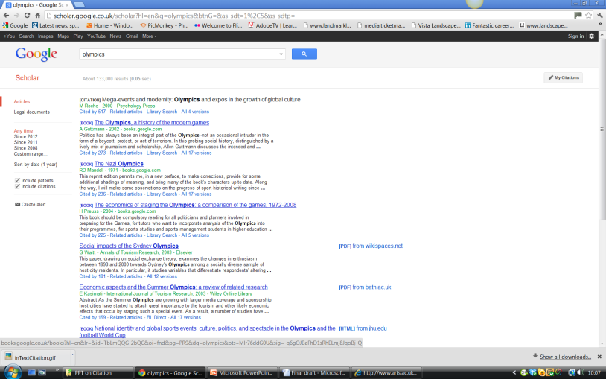
Using internet sources
status | In-text reference
Document on www with author and date | ‘It’s essential you learn how to reference properly’ (Dawson et al, 2002)
Article on www – no author Use name of article | (Problems associated with ageing, 2001)
Document on www, no title and no date Use name of website and nd (no date*) | (RSPB, nd)
* Could also use 1996? Or 1990s?

Slide 34
Harvard Referencing System
Intext
Direct
‘quote’ (Author’s surname, year of pub., page number)
Indirect
Summary (Author’s surname, year of pub.)
Paraphrase (Author’s surname, year of pub., page number)
End
In both cases you need to include a full reference at the end

Slide 35
Reference Lists and Bibliographies
Reference Lists=sources you have referred to (cited) in the main body of your text
All of the sources you have cited in your main body should be here
And
All of the sources listed here should be in your main body.
If not, they should be!!
Bibliography = reference list PLUS sources you have read but not referred to that may have shaped your thinking

Slide 36
Always include a reference list at the end!
All of the sources you have cited in your main body should be here
And
All of the sources listed here should be in your main body
If not, they should be!!
Sources should be listed A-Z by author’s surname

Slide 37
Anatomy of a reference
Year of publication
Place of publication
Author’s surname
Baljon, L. (1992) Designing parks. Woodbridge: Garden Art Press.
Initial
Title of book
Name of publisher

Slide 38
References
Andersson, S.-I. & Hoyer, S. (2001) C.TH. Sorensen: Landscape Modernist. Copenhagen: The Danish Architectural Press.
Baljon, L. (1992) Designing Parks. Woodbridge: Garden Art Press.
Berrizbeita, A. (2009) ‘Key Words and Phrases’, in Hargreaves: The Alchemy of Landscape Architecture. London: Thames and Hudson pp 60-65
Campbell Kelly, L. (2009) ‘A Maximal Practice’, in Hargreaves: The Alchemy of Landscape Architecture. London: Thames and Hudson pp 286-291
Google Maps (2011) Avail. at https://www.google.co.uk/maps/@52.7222303,-1.7373131,14.25z [Accessed on 22/9/11]
Hargreaves (no date) Philosophy. Avail at http://www.hargreaves.com/firm/Philosophy/ [Accessed on 22/09/11]
Hargreaves, G. (2009) ‘Introduction’, in Hargreaves: The Alchemy of Landscape Architecture. London: Thames and Hudson pp 6-8
Hargreaves, G. (2007) ‘Large Parks: A Designer’s Perspective’, in Czerniak, J. and Hargreaves, G. (eds) Large Parks. New York: Princeton Architectural Press, pp 121-173
Johnson,P. & Wigley, M. (1988) Deconstructivist Architecture. New York: Museum of Modern Art
Project for public spaces (No date) Hall of Shame. Avail at http://www.pps.org/great_public_spaces/one?public_place_id=369 [Accessed 27/09/11]
Turner, T. (1994) A review of Parc de la Villette, Paris. Avail, at http://www.gardenvisit.com/history_theory/library_online_ebooks/architecture_city_as_landscape/review_parc_de_la_villette_tom_turner [Accessed 27/09/11]
Treib, M.(2001) ‘The Landscape of Loved Ones’, in Wolschke-Bulmahn, J (ed) Places of commemoration:search for identity and landscape design. Washington: Dumbarton Oaks pp 81-105

Slide 39
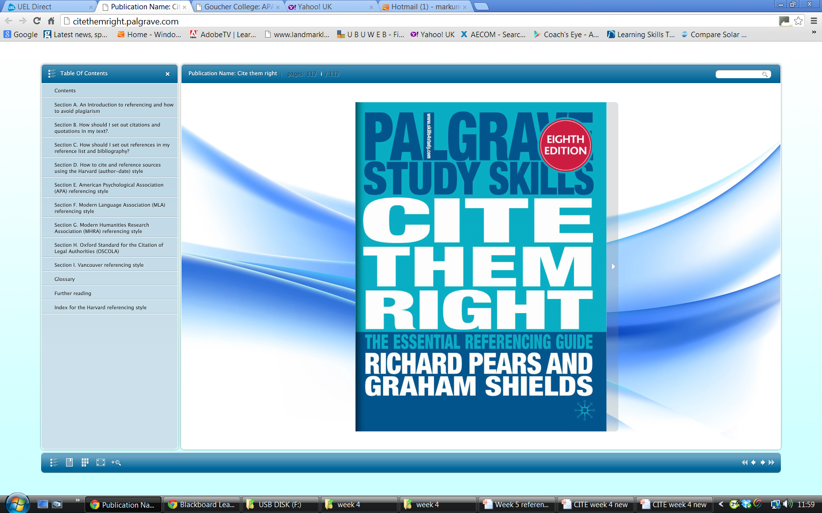
http://www.citethemrightonline.com/Home
Available on Moodle :

Slide 40
This covers much of the basics …and more!
https://www.citethemrightonline.com/Basics/setting-out-citations

Slide 41
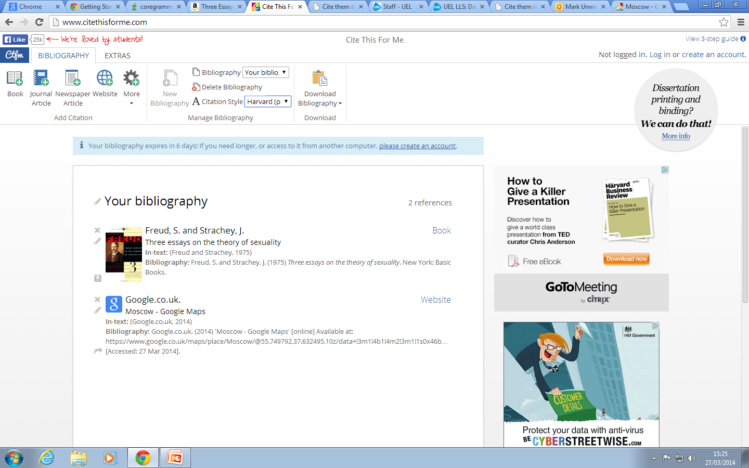
CITETHISFORME.COM

Slide 42

Conclusion
Direct and Indirect
The 80:20 rule
Always cite sources
Use Harvard Ref System
http://www.citethemrightonline.com/Home

