Slide 1
A presentation on Molecular Communication & Its application
Name – Nishan Jain
Roll.no. -19EC01046
subject – project seminar
Supervisor – Dr. Soumya Prakash Dash
Examiner – Dr. Siddhartha S. Borkotoky

Slide 2
Molecular Communication
Molecular communication is a Nano network design strategy where a transmitter emits information molecules that are carried to an intended receiver.
Molecular communications systems use the presence or absence of a selected type of molecule to digitally encode messages.

Slide 3
Basic Component Involve in each phase of Molecular communication
Encoding
Sending
Propagation
Receiving
Decoding

Slide 4
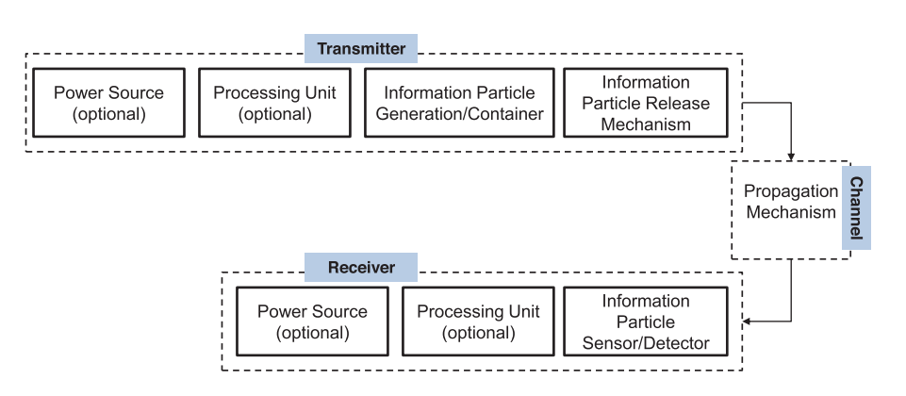
Physical components required for Molecular Communication

Slide 5
Sender And Receiver Nanomachine
Two basic approaches for engineering bio-nanomachines with functionality for communication are the modification of existing biological cells or the production of simplified cell-like structures using biological materials
* Modified biological cells
* Artificial cells

Slide 6
Encoding :
Encoding is the phase during which a sender bio-nanomachine translates information into information molecules that the receiver bio-nanomachine can detect.
Information may be encoded in various forms within the information molecules.
e.g. DNA is formed by the specific sequence of nucleotides

Slide 7
Sending : It is the phase by which a sender bio-nanomachine releases information molecules into the environment. A sender bio-nanomachine may release information molecules by either unbinding information molecules from the sender bionanomachine.
Propagation : It is the phase during which information molecules move from the sender bio-nanomachine through the medium to the receiver bio-nanomachine.

Slide 8
Receiving : It is the phase during which the receiver bio-nanomachine captures information molecules propagating in the environment.
Decoding : Denotes the operation of estimation of the transmitter molecule by the receiver.
Involves new chemical reaction.
May involve the production of new molecules.

Slide 9
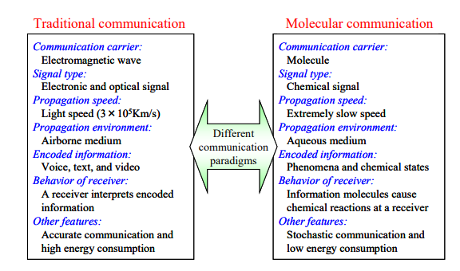
Difference between Traditional & Molecular communication

Slide 10
Informational Molecule :- It carry information and propagate from a sender to receiver bio-nanomachine in the environment. The size and structure of the information molecules may affect how the information molecules propagate in the environment.
Guide and Transport Molecule :- Guide and transport molecules provide reliable mechanisms for propagating information molecules.
A required functionality for these molecules is to direct the propagation of information molecules toward target locations (i.e., receiver bio-nanomachines).

Slide 11
Interface Molecules :- Interface molecules allow bio-nanomachines to transport a variety of information molecules using the same communication mechanism.
Addressing Molecules :- Addressing molecules allow a sender bio-nanomachine to specify the receiver bio-nanomachine according to a generic addressing mechanism.

Slide 12
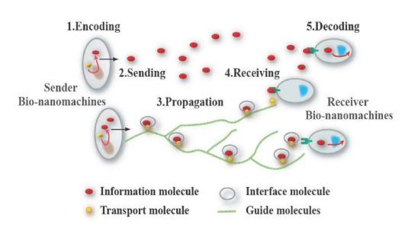
Molecular Communication process Diagram

Slide 13
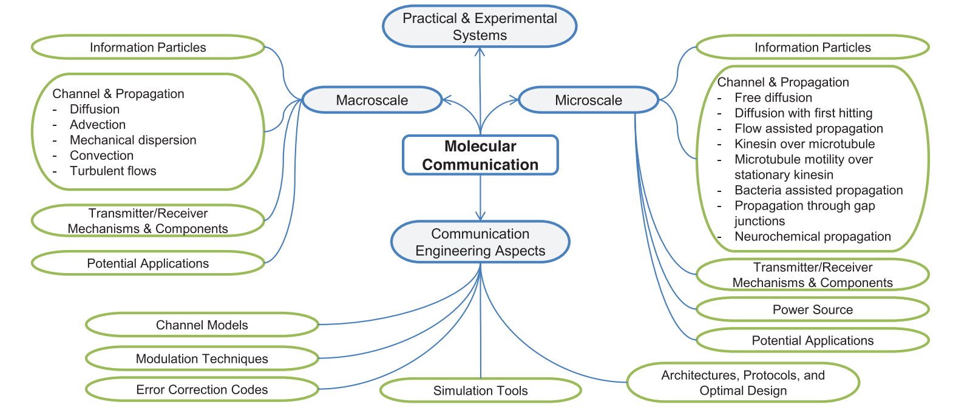
Various aspects of Molecular communication

Slide 14
Advantages of Molecular Communication :-
Biocompatible
Minimally invasive
Ultrafast
Nano scale Devices Used
Minimum Side Effect
Simultaneous Diagnosis & Treatment

Slide 15
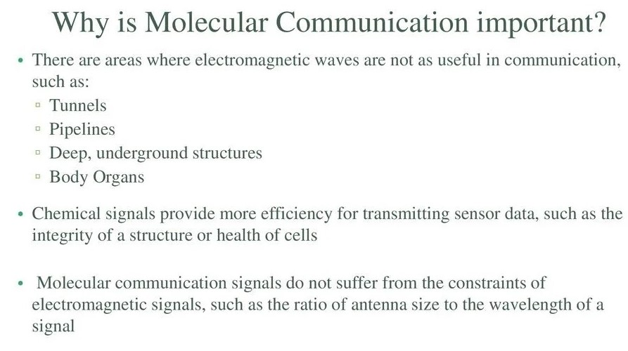

Slide 16
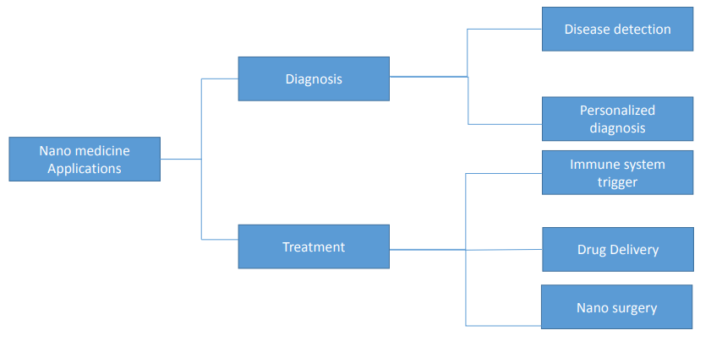
Applications of Molecular communication :- Molecular communication is a completely new paradigm and would potentially enable many new applications in the bio-nanotechnology. -> Used in Nano-Medicines

Slide 17
Future Applications :-
Nanomachine Communication :- Nanomachines are molecular scale objects that are capable of performing simple tasks such as actuation and sensing.
Molecular Computing :- Molecular computing is the science of using individual molecules to build computer programs.
Pinpoint Drug/DNA Delivery System :- The DDS (Drug/DNA Delivery System) has recently been receiving attention as a new method of medical treatment which alleviates undesired side effects . Molecular communication may provide drug carriers and also mechanisms to deliver drugs in a manner that is friendly to the biological systems.

Slide 18
Achievements by researchers :-
Researchers demonstrated the use of evaporated alcohol molecules to carry messages across several meters of open space and successfully decoded the message on the other side.
Molecular signaling is used by plants and animals, such as the pheromones that insects use for long-range signaling.
The world's first text message via molecular transmission was developed by the researchers at the University of Warwick in the United Kingdom and the York University in Canada using alcohol molecules.

Slide 19
Conclusion :- * Very smart way of communication. * It will have so much future Applications as mentioned above. * Have so much bio-logical aspects based on Diagnosis and surgery.

Slide 20
References :- [1] B. Alberts, et al., “Essential Cell Biology – An Introduction to the Molecular Biology of the Cell,” Garland Publishing, 1998. [2] H. Lodish, et al., “Molecular Cell Biology (Fourth Edition),” W. H. Freeman and Company, 2000. [3] G. M. Whitesides, “The Once and Future Nanomachine,” Scientific American, Sep. 2001. [4] T. Aoki, et al., “Enzyme Transistor Circuits,” IEE Proceedings – Circuits, Devices and Systems, vol.145, no.4, pp.264-270, Aug. 1998. [5] M. A. Reed and J. M. Tour, “Computing with Molecules,” Scientific American, Jun. 2000. [6] R. Langer, “Where a Pill Won’t Reach,” Scientific American, Apr. 2003. [7] R. D. Vale, “The Molecular Motor Toolbox for Intracellular Transport,” Cell, vol.112, pp.467-480, Feb. 21, 2003. [8] Tadashi Nakano, Michael J. Moore, FangWei, Athanasios V. Vasilakos, and Jianwei Shuai, “Molecular Communication and Networking: Opportunities and Challenges,” IEEE Trans. on nanobios. 11 (2012) pp. 135-147.

Slide 21
Thank you!!!

