Slide 1

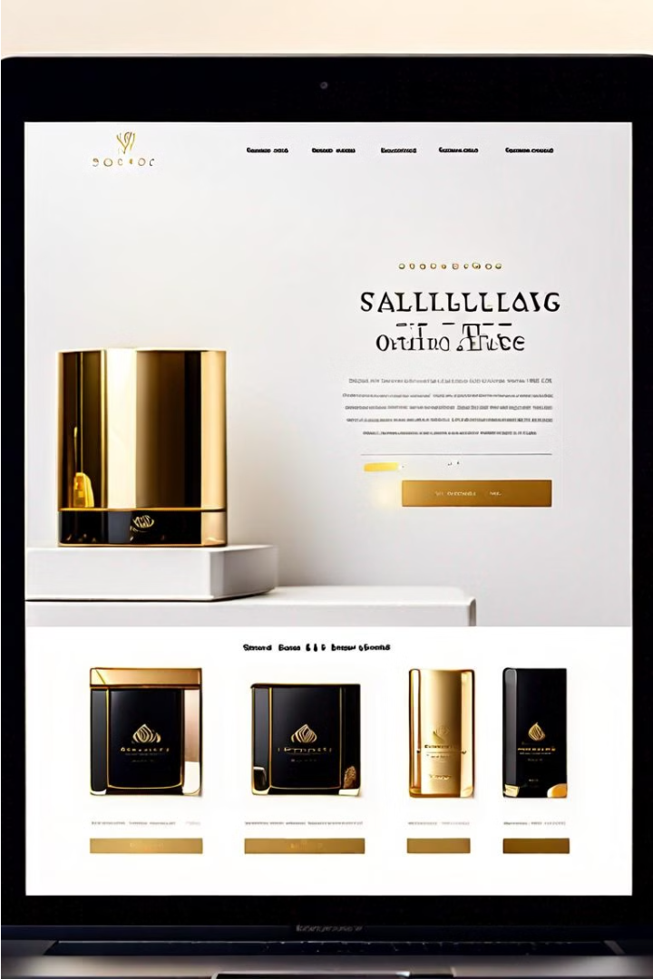


Online Shopping Management System
This presentation showcases the key features and advantages of our comprehensive online shopping management system. With a user-friendly interface, robust inventory tracking, and secure payment processing, our system streamlines the entire shopping experience for both businesses and customers.
by Nishan shah Thakuri

