Slide 1

SMART INDIA HACKATHON 2026
AIRFARE APIx
PROBLEM STATEMENT
SIH26056
Development of a Real-time Airfare Price Index for India through Automated Web Scraping of Airline and Online Travel Aggregator Portals for Augmentation of the Consumer Price Index (CPI)
Theme
Smart Automation
Category
Software
Team ID: __________
Team Name (Registered on portal): __________
Notes:
Airfare APIx measures a fixed basket of Indian domestic airfares and preserves the evidence behind every index value. Fill the registered team ID and team name before export.
Sources: https://raw.githubusercontent.com/vedantchalke36/sih-2026-problem-statements/main/ps_2026/SIH26056.md

Slide 2
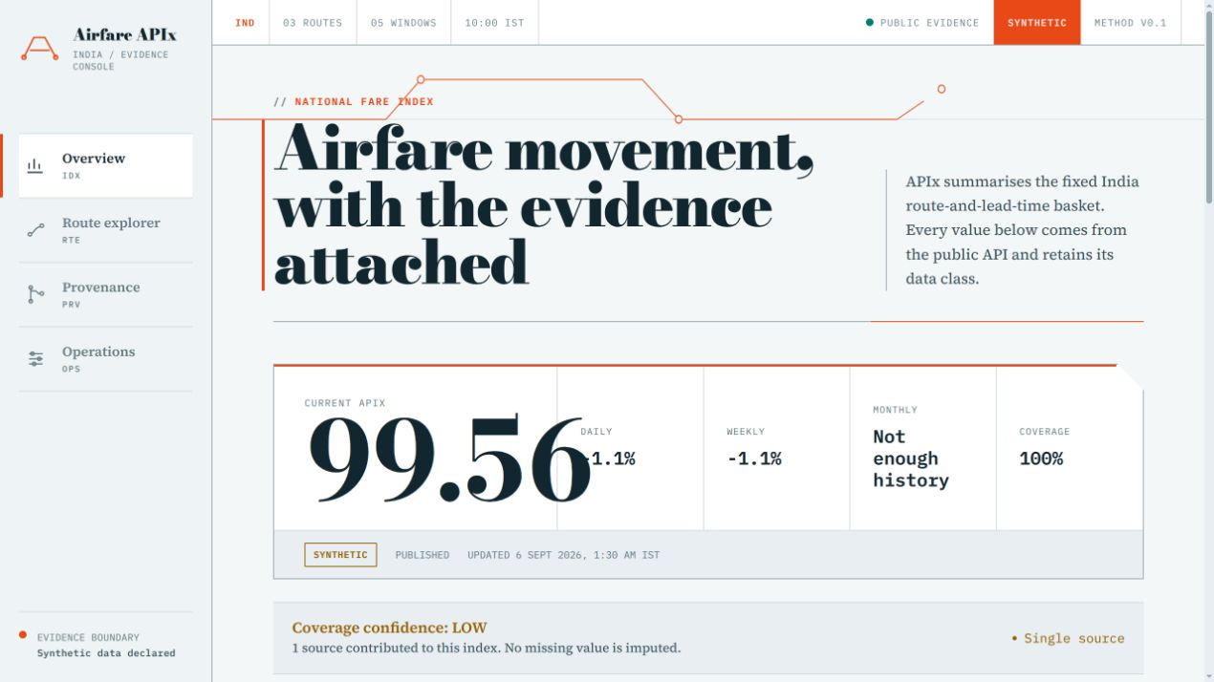
AIRFARE APIx
TEAM NAME
PROPOSED SOLUTION
A controlled daily airfare basket with every number traceable to raw evidence
Same routes, same fare definition and the same advance-booking windows. This makes daily, weekly and monthly movement statistically comparable.
ROUTES
DEL–BOM DEL–BLR BOM–BLR
WORKING PROTOTYPE / LIGHT UI
BOOKING WINDOWS
01
Evidence first
T+1 T+7 T+15 T+30 T+45
Raw quote + collection context remain attached.
02
Honest failures
COMPARABLE FARE
Missing sources reduce coverage, never become zero.
1 adult One-way Economy Non-stop INR
03
One stored truth
Dashboard, API and exports use one result.
Notes:
The five booking windows show how the fare changes as departure approaches. The MVP uses three routes to prove the full method and can expand using DGCA traffic evidence.
Sources: docs/methodology.md; SIH26056 problem statement

Slide 3
TECHNICAL APPROACH
TEAM NAME
01
02
03
04
05
ACCESS
CAPTURE
STANDARDISE
CALCULATE
PUBLISH
→
→
→
→
Approved APIs
Controlled web adapters
Synthetic fixture
Plan route-window jobs
Preserve raw quotes
Stamp parser + time
Match fare scope
Normalize INR
Validate + deduplicate
Median each cell
Frozen-base relative
Fixed weights
PostgreSQL truth
FastAPI
Dashboard + CSV
END-TO-END TRACEABILITY
RAW QUOTE
→
OBSERVATION
→
CELL MEDIAN
→
APIx COMPONENT
→
PUBLISHED INDEX
INDEX METHOD
HONEST FAILURE PATH
Current route-window median
Blocked source
→ job failure + source health
× 100
Frozen base median
Missing basket cell
→ lower coverage + confidence
No failure is silently converted into a zero fare.
Python 3.12 • FastAPI • PostgreSQL • SQLAlchemy • APScheduler • React + Vite • Docker
Notes:
Each source uses the same adapter contract. Raw data is stored before cleaning. Only accepted comparable observations enter the index. The browser only presents stored results.
Sources: docs/architecture.md; docs/methodology.md

Slide 4
FEASIBILITY AND VIABILITY
TEAM NAME
FEASIBILITY
CHALLENGE
MITIGATION
Working locally today
Live fare access
IndiGo/Air India NDC or approved partner feed
Database, scheduler, collection pipeline, normalization, APIx, provenance, dashboard, exports and automated tests.
CAPTCHA and blocking
Record failure; never bypass or hide it
DEMO DATA
Different fare products
Validate cabin, currency, stop count and trip type
Deterministic synthetic fares keep the complete prototype testable without an external service.
Sparse data
Publish coverage and confidence with APIx
PRODUCTION GATE
Larger route basket
Add workers without changing data contracts
Live airline fares require approved API, GDS, aggregator or written web access.
Notes:
Engineering feasibility and live-data permission are separate. The entire prototype works locally. Production collection remains gated by lawful source access.
Sources: docs/final-acceptance.md; docs/source-policy.md; https://developer.goindigo.in/ndcAPI; https://ndc.airindia.com/en/ndc

Slide 5
IMPACT AND BENEFITS
TEAM NAME
A transparent airfare measure for inflation analysis
MEASURABLE OUTPUTS
01
NSO / MoSPI
Higher-frequency airfare evidence for CPI analysis with route and lead-time detail.
5
booking windows
100
02
Researchers
Reproducible exports and raw-to-index provenance for independent checks.
base index
4
dashboard views
03
Public and media
Clear trends that separate route effects from booking-window effects.
Scale next
DGCA-weighted routes and approved live sources.
Notes:
The public value is auditability. A reviewer can see the index movement, its coverage and the exact evidence used. The same design can support a larger DGCA-weighted route basket.
Sources: SIH26056 problem statement; https://esankhyiki.mospi.gov.in/; https://www.dgca.gov.in/

Slide 6
RESEARCH AND REFERENCES
TEAM NAME
01
SIH26056
04
IndiGo NDC
Problem statement and expected solution
Official AirShopping developer documentation
sih.gov.in
developer.goindigo.in
02
MoSPI eSankhyiki
05
Air India NDC
Official CPI data and API documentation
Official direct-connect and partner routes
esankhyiki.mospi.gov.in
ndc.airindia.com
03
DGCA
06
Duffel
Domestic traffic reports for route evidence
Flights API test-mode limitations
dgca.gov.in
duffel.com/docs
DEMO PATH
Overview → Route Explorer → Provenance → Operations
Show the index, inspect a route, trace one quote, then verify collection health.
Notes:
Close the slides here and open the working prototype. Demonstrate Overview, Route Explorer, Provenance and Operations. Keep the synthetic-data label visible.
Sources: https://www.sih.gov.in/; https://esankhyiki.mospi.gov.in/; https://www.dgca.gov.in/; https://developer.goindigo.in/ndcAPI; https://ndc.airindia.com/en/ndc; https://duffel.com/docs/api/overview/test-mode

