Slide 1
Movie Metadata
Presenter – Nishant Sharma

Slide 2
EDA
EDA is the first part of any data science project were we try to draw some analytical insight from the data.
For the movie metadata that had roughly 5000 entries the following insights were significant.
The data had some bias in terms of various features like country of origin, Color of the film, language, content rating and release year.
The graphs below try to explore this biases.

Slide 3
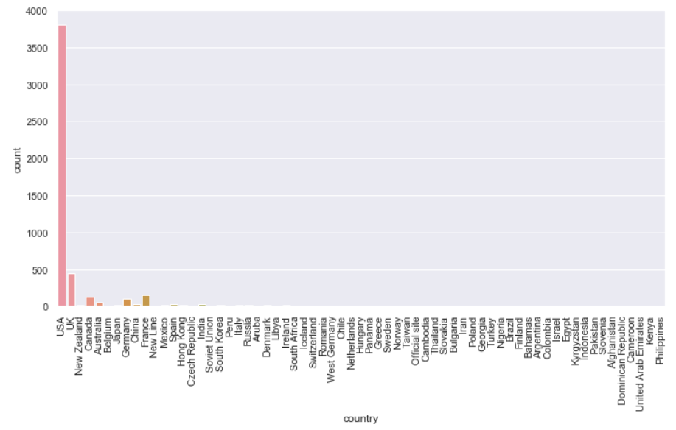
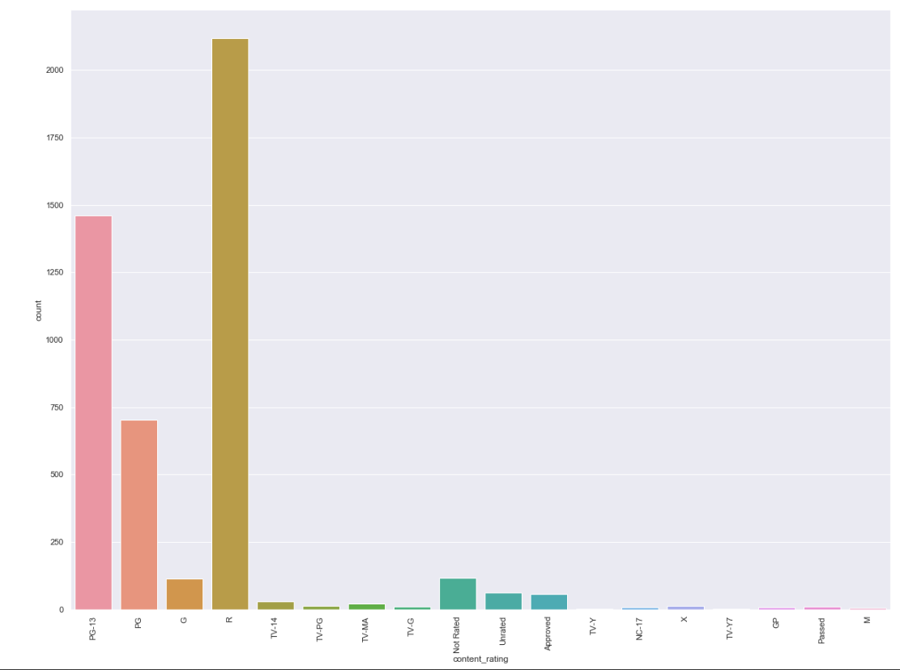
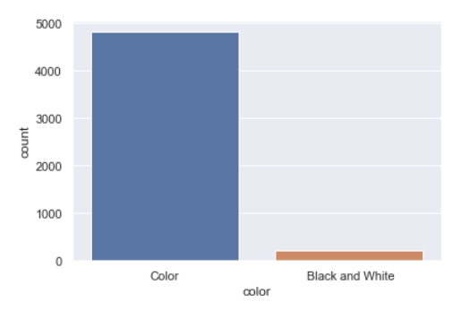
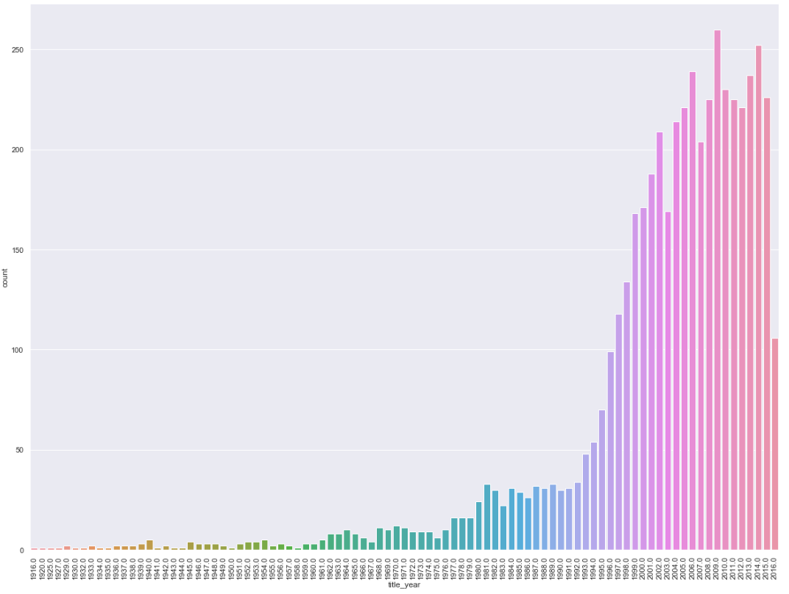

Slide 4
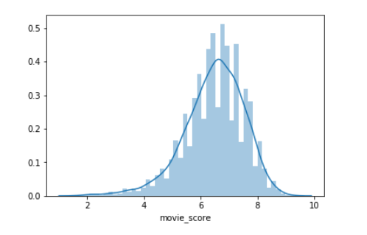
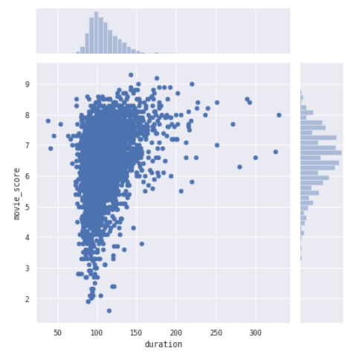
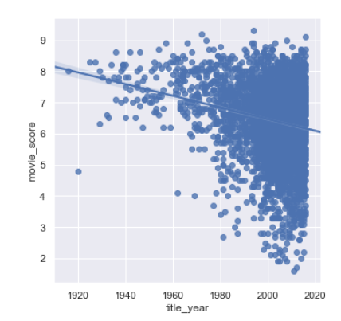
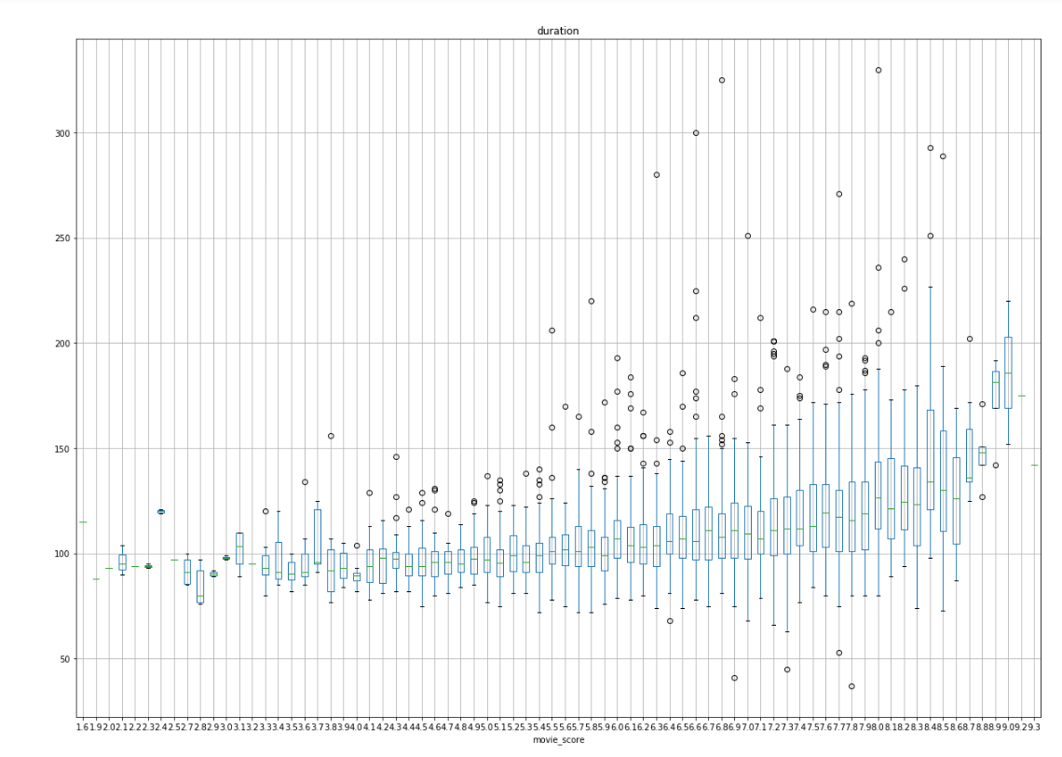
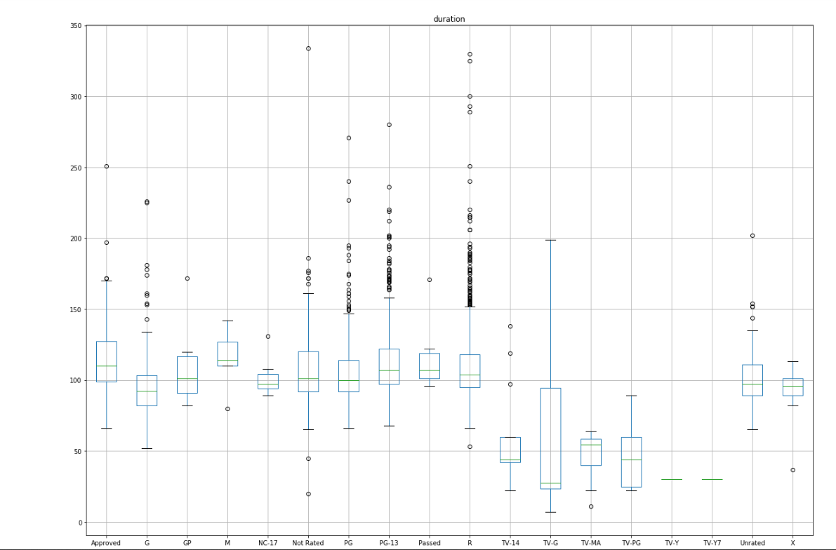

Slide 5
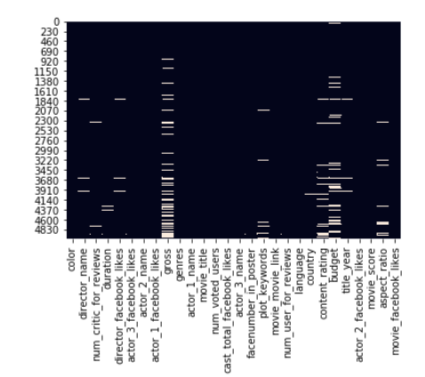
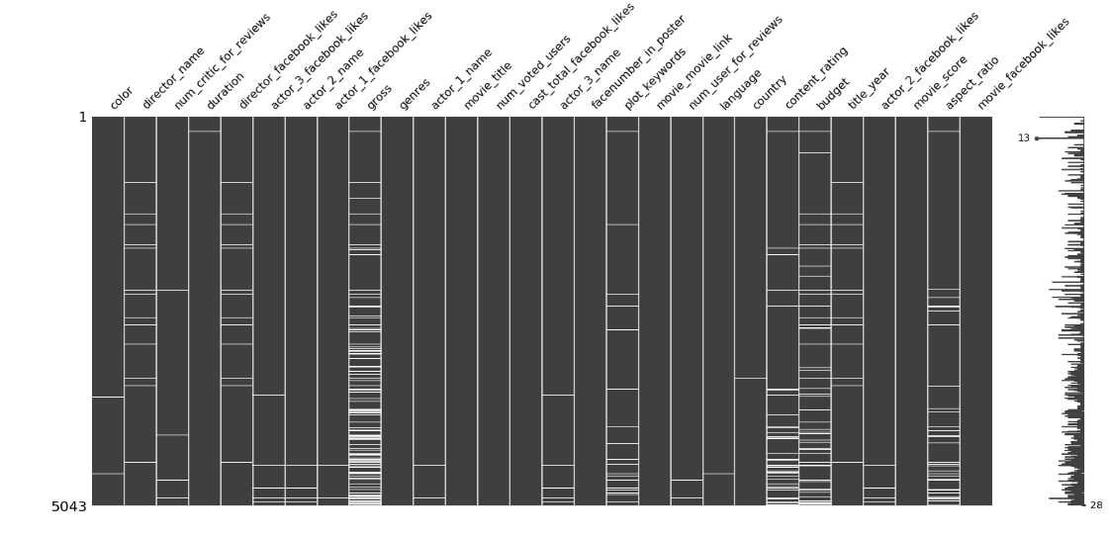
Missing Values
Although we can perform imputation for the missing values for this case I decided to drop the missing values as most of them cannot be imputed
How can you impute gross of film

Slide 6
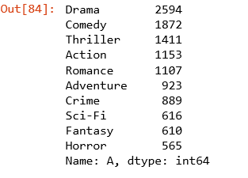
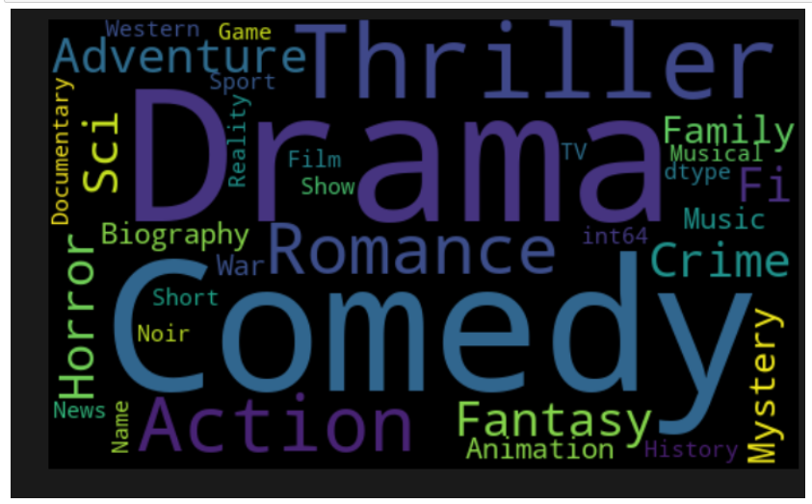
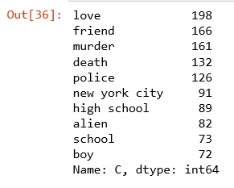
Making the word cloud
Top Movie Genres
Top Plot Keywords
The word cloud was implemented in order to understand the most frequent genres and plot keywords

Slide 7
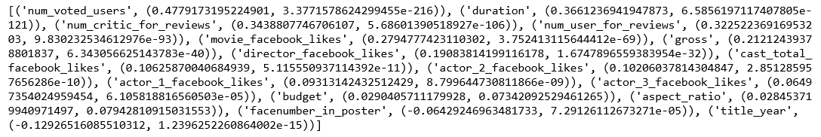
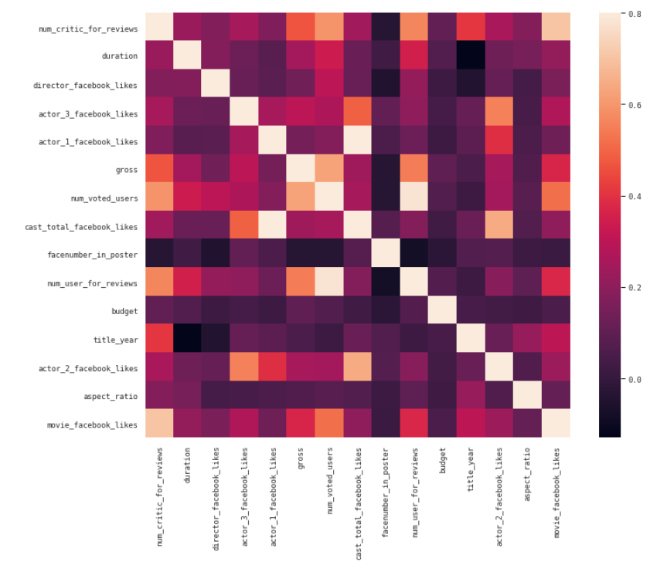
Heatmaps and checking for multicollinearity
Pearson's coefficient with features vs movie score
The heatmap is primary used to shed good light on how the
features are correlated to each other.
If some of the features are highly correlated it may seem that one
Feature is less important then the other feature in explaining the
Predictor variable

Slide 8
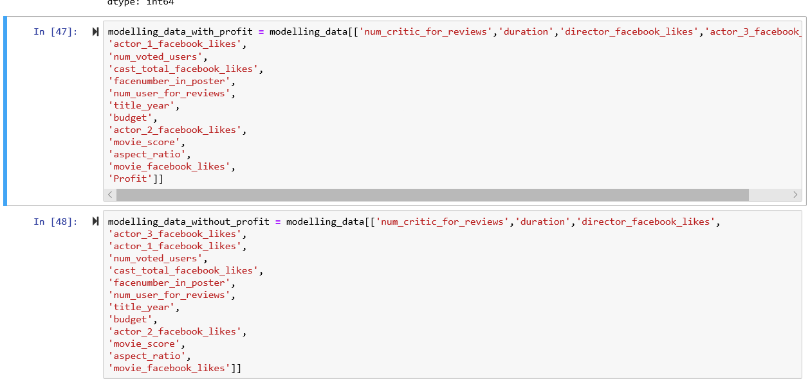
Feature Engineering and Feature Selection
The most important step in any data science project as it directly impacts the performance of model
Various ways exist to select the relevant features
I have used most of the numeric variable to build the model which are listed in the figure below

Slide 9


Feature Engineering and Feature Selection
As it was desired to point out key parameters for a profitable blockbuster movie.
I filtered the data set for movies with score above 7.5 and profit 2 times above the mean value.
The resultant dataset has roughly 1400 observations

Slide 10
Modelling and Results
2 Machine Learning models were implemented after trying some other models in backend like SVR, Neural Network
The two models were Multi Linear Regression and Random forest Regression with 500 trees.
The Model R squared values were 0.31 and 0.32 respectively.
The values are on the lower side stating that there exist unaccountable factors to be considered to improve the prediction
The best features were sorted using the random forest regressor based on minimizing impurity.
The next slide summarizes the best features that should be utilized for creating a blockbuster profitable movie.

Slide 11
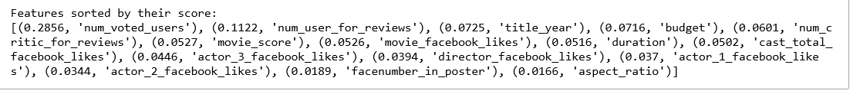
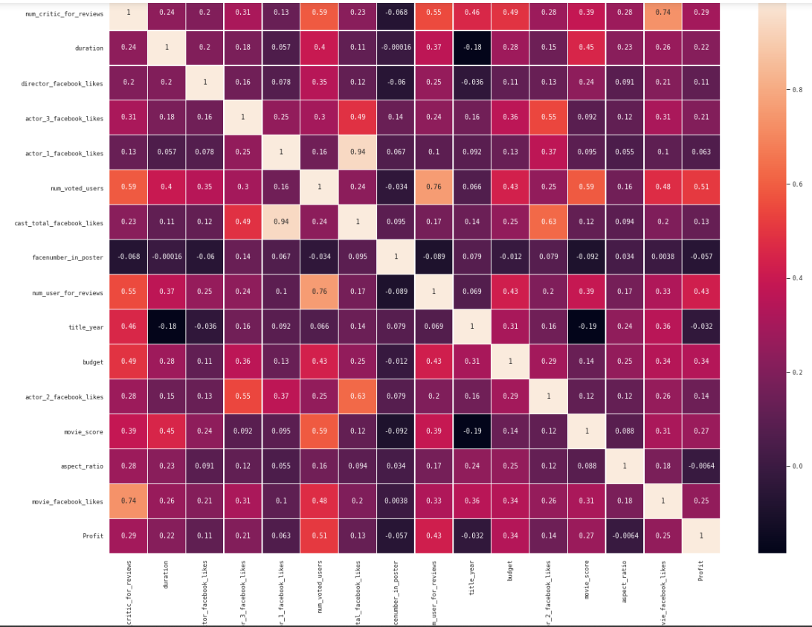
Results
Thus the 5 most important features for creating a
blockbuster profitable movie are:
1) num_voted_users
2) num_user_for_reviews
3) title_year
4) budget
5) num_critics for_reviews

