Slide 1
Annasaheb Dange College of Engineering and Technology, Ashta
Department of Computer Science and Engineering
Mega Project Synopsis Presentation on
Dudhganga Dairy Application for Milk Collectors & Farmers.
By
Mr. Nishant Krushnat Shingate
Miss. Avanti Hanmant Pawar
Mr. Abhishek Maruti Shinde
Miss. Vaishnavi Dinkar Jadhav
Under the Guidance of
Prof. D.R. Kale

Slide 2
ABSTRACT
Milk production- Most important factors for the rural economy of India.
Highly and fast growing sector in India.
India- low cost milk producer due to inexpensive feeding and maintenance cost.
People involved in the milk production sector- Farmer, Milk Collector, Milk Buyer.
Farmers provide milk to milk collectors, but most of the collectors follow unfair regarding weight and fat.
Because of malpractice in measures of milk, there is no transparency between farmers and milk collectors about the accuracy and precision in the accounting and billing.

Slide 3
CONTENT
 | Contents
1. | Introduction
2. | Literature Survey
3. | Problem Statement
4. | Objectives
5. | Methodology
6. | Software and hardware requirements and availability
7. | References

Slide 4
INTRODUCTION
Milk collectors- collect milk and write down the fat and quantity of milk on the paper.
Billing Time- collectors calculate the bill of each customer by using a regular math calculator.
Milk collector keep record of collected milk and milk buyers.
Above process is time consuming process.
We automate this process by using our application.
Time saving for farmer and milk collectors.
Data of milk is correctly updated to farmers on a daily basis.
Payment is directly credited to farmers' bank accounts after the specific period.

Slide 5
PROBLEM STATEMENT
To design and develop a android application for the automation of daily and routine activities of milk collection centers and farmers and milk buyers.

Slide 6
LITERATURE SURVEY
(A) Existing Systems
1.The Subhadra Dairy Management Software
(a) User-friendly billing system.
(b) Add dairy milk details
(c) Customer Management.
(d) Billing Management
2. Meri Dairy
(a) With every entry, Dairy customer will receive a test message (SMS)
(b) TVS mini printer Available to print a daily receipt.
(c) Payment Register
(d) Daily report
(e) Data saved on the server will be secure in case you lost your laptop/mobile.

Slide 7
LITERATURE SURVEY
(B) Articles from International peer reviewed journals
A. Ronak Chudasam, Sagar Dobariya (2017) [1]
This paper addresses the problem of analyzing data collected by the dairy production with the aim of optimizing the supply chain management and maximizing profit in the manufacturing of milk and other dairy items.
B. Jamshed Memon; Maira Sami; Rizwan Ahmed Khan;Mueen Uddin (2020)[2]
This paper explores and develops the design method of Dairy Cow Data Acquisition System based on PDA.

Slide 8
OBJECTIVES
To design and develop the database system for efficient storage and retrieval of data.
To design and develop a user-friendly multilingual user interface for reading of weights and measures of milk at the collection center.
To design and develop a messaging system to provide required alerts to farmers, milk collectors.
To analyze the data, prepare the bills daily/monthly/quarterly/annual reports.
To pay the amount of milk directly into the farmer's account.
To design and develop systems which handle multiple users.

Slide 9
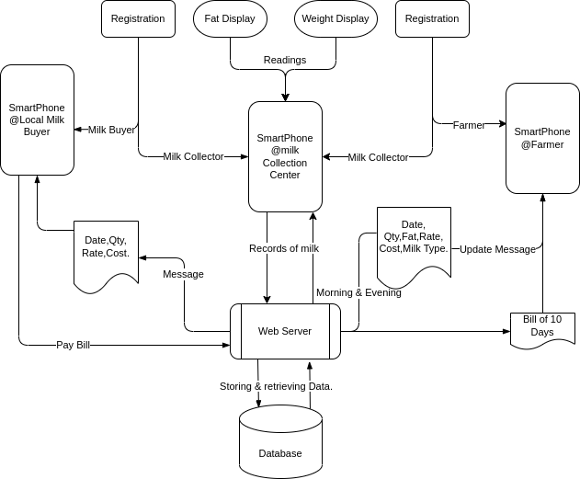
METHODOLOGY

Slide 10
METHODOLOGY
Modules:
1.Record Management
2.Report Generation
3.Data notification
4.Bill Generation
5.Payment

Slide 11
SYSTEM REQUIREMENT
Hardware requirements:
1. 8GB RAM(Minimum)
2. Memory 20GB
3. Core i5 processor
Software requirements:
1. Windows 10/Android/iOS/MacOS/Linux.
2. Android Studio/Visual Studio, Flutter Framework, Firebase
3. Dart Language.
Other requirements- Internet Connection Required

Slide 12
REFERENCES
[1] Ronak Chudasam, Sagar Dobariya (2017), “DAPS: Dairy analysis and prediction system using technical indicators”.
[2] Jamshed Memon; Maira Sami; Rizwan Ahmed Khan; Mueen Uddin (2020) “The dairy cattle data acquisition system based on PDA“

Slide 13
Thank You!

