Slide 1
Annasaheb Dange College of Engineering and Technology, Ashta
Department of Computer Science and Engineering
Mega Project Presentation on
Dudhganga Dairy Application for Milk Collectors & Farmers.
By
Mr. Nishant Krushnat Shingate
Miss. Avanti Hanmant Pawar
Mr. Abhishek Maruti Shinde
Miss. Vaishnavi Dinkar Jadhav
Under the Guidance of
Prof. D.R. Kale

Slide 2
CONTENT
1. | Introduction
2. | Problem Statement
3. | Literature Survey
4. | Objectives
5. | Methodology
6. | Diagrams
7. | Design

Slide 3
INTRODUCTION
Milk collectors- collect milk and write down the fat and quantity of milk on the paper.
Milk collector keep record of collected milk and milk buyers.
Above process is time consuming process.
We automate this process by using our application.
Time saving for farmer and milk collectors.
Data of milk is correctly updated to farmers on a daily basis.
Payment is directly credited to farmers' bank accounts after the specific period.

Slide 4
PROBLEM STATEMENT
To design and develop an android application for the automation of daily routine activities of milk collection centers, farmers and milk buyers.

Slide 5
LITERATURE SURVEY
(A) Existing Systems
1.The Subhadra Dairy Management Software
(a) User-friendly billing system.
(b) Add dairy milk details
(c) Customer Management.
(d) Billing Management
2. Meri Dairy
(a) With every entry, Dairy customer will receive a test message (SMS)
(b) TVS mini printer Available to print a daily receipt.
(c) Payment Register
(d) Daily report
(e) Data saved on the server will be secure in case you lost your laptop/mobile.

Slide 6
LITERATURE SURVEY
(B) Articles from International peer reviewed journals
A. Ronak Chudasam, Sagar Dobariya (2017) [1]
This paper addresses the problem of analyzing data collected by the dairy production with the aim of optimizing the supply chain management and maximizing profit in the manufacturing of milk and other dairy items.
B. Jamshed Memon; Maira Sami; Rizwan Ahmed Khan;Mueen Uddin (2020)[2]
This paper explores and develops the design method of Dairy Cow Data Acquisition System based on PDA.

Slide 7
OBJECTIVES
To design and develop the database system for efficient storage and retrieval of data.
To design and develop a user-friendly multilingual user interface for reading of weights and measures of milk at the collection center.
To design and develop a messaging system to provide required alerts to farmers, milk collectors.
To analyze the data, prepare the bills daily/monthly/quarterly/annual reports.
To develop the method to paly amount of milk directly into the farmer's bank account.

Slide 8
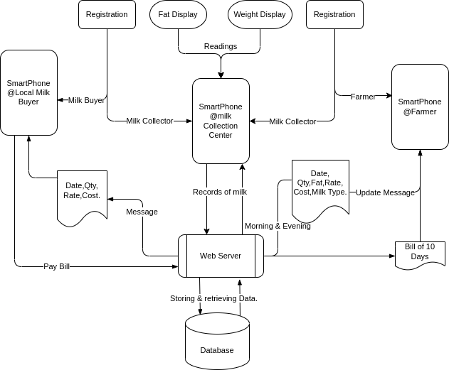
METHODOLOGY

Slide 9
Modules
1.Record Management
2.Report Generation
3.Data notification
4.Bill Generation
5.Payment

Slide 10
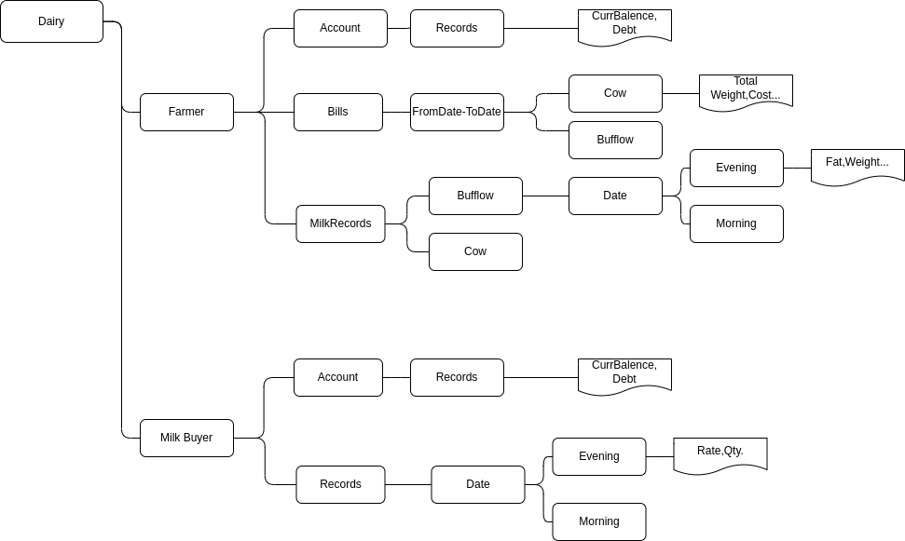
DATABASE DIAGRAM

Slide 11
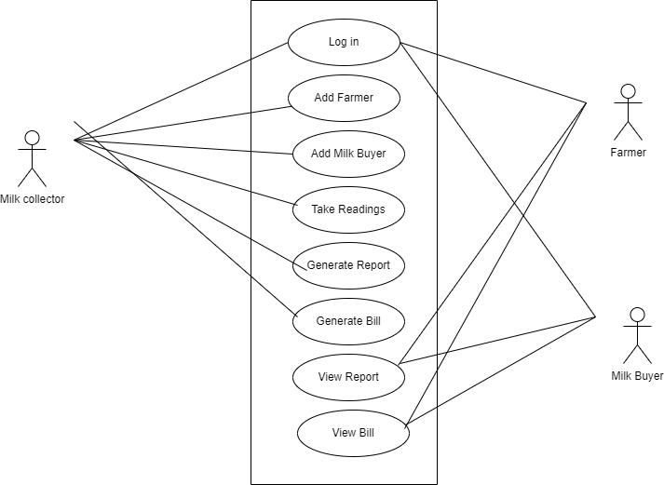
UML DIAGRAMS
1)USE CASE DIAGRAM

Slide 12
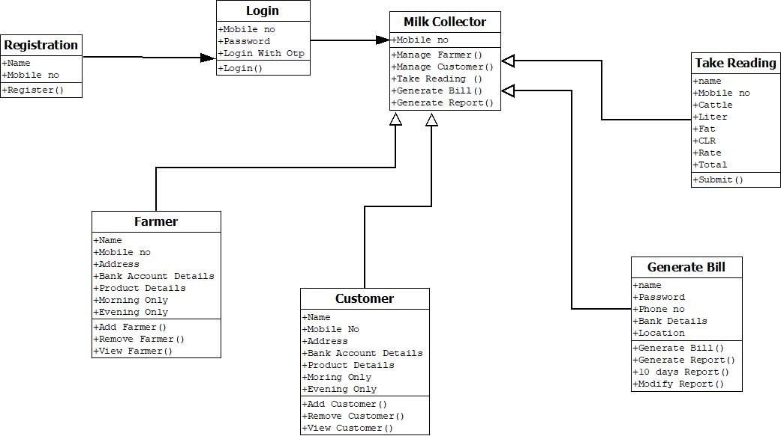
2)CLASS DIAGRAM

Slide 13
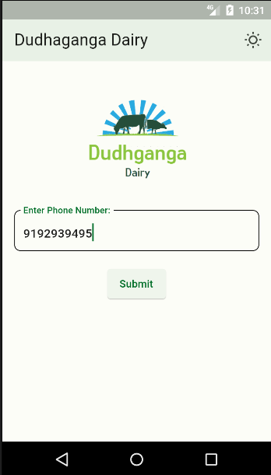
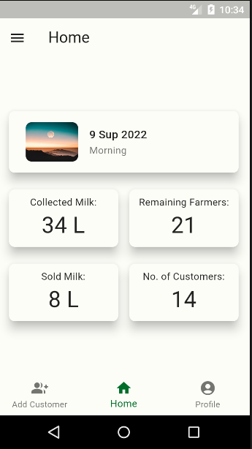
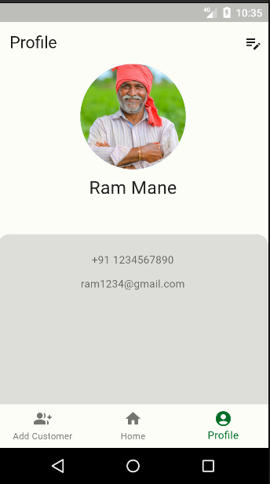
DESIGN

Slide 14
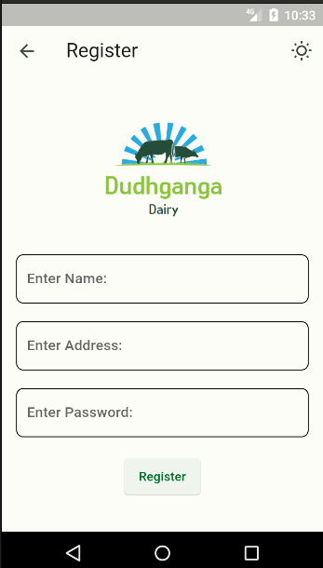
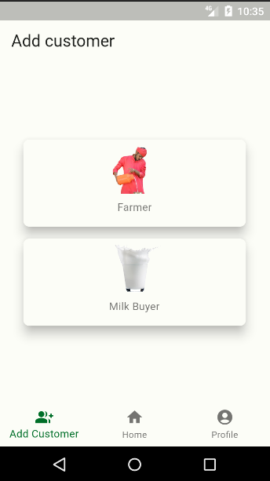
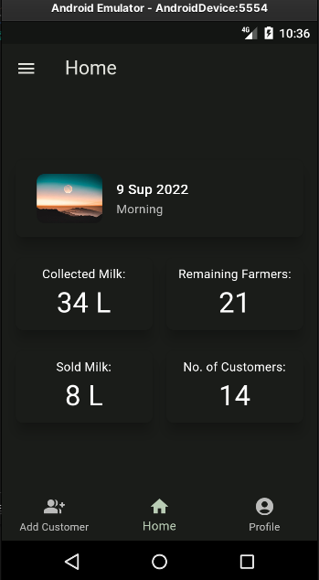

Slide 15
Thank You!

