Slide 1
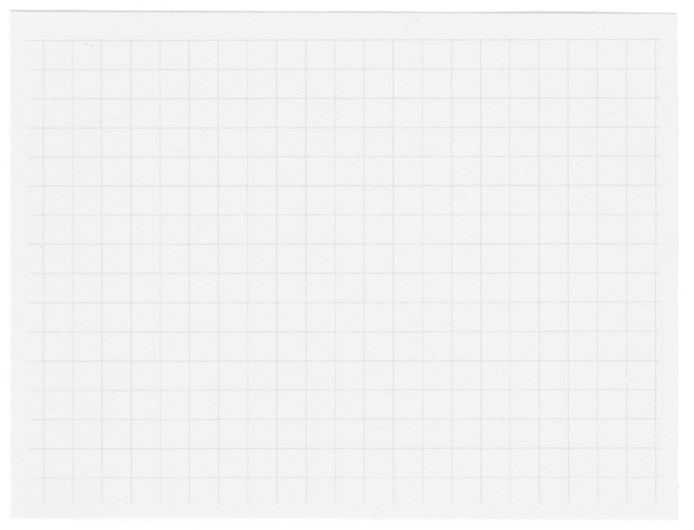













TEAM DNA
Problem Statement:
Kanye’s Web Lab

Slide 2

Evolution
Custom No-Code Website Builder for Creative Expression
Evolution is a no-code website builder designed to empower creative individuals to bring their unique visions to life without coding. With an intuitive drag-and-drop interface, rich customization options, and seamless multimedia integration.
Evolution allows users like Kanye to easily design, personalize, and launch professional websites that reflect their personal brand. The platform also offers live preview and collaboration features, making it easy to create visually striking, fully functional websites tailored for personal branding, product promotions, album releases, and more—without any technical limitations.

Slide 3

Problem Statement
Create a custom no-code website builder that empowers Kanye to design, customize, and publish visually compelling websites that reflect his unique brand and style—without requiring any coding knowledge.
This platform should be intuitive and user-friendly, catering to creative individuals who value self-expression and need a seamless way to bring their ideas to life online. It should offer both basic and advanced customization features, allowing users to build fully functional, professional-quality websites that align with their personal or professional brand.

Slide 4
01.
Simplified Website Creation: It provides an intuitive, all-in-one platform for users to create websites without requiring deep technical knowledge or coding skills. This lowers the barrier to entry for individuals and small businesses who want a professional web presence.
Problem It Solves
Customization Design and Publishing Options: Users can customize and publish websites according to their specific needs and styles, which offers flexibility and control over branding and layout.
02.
In today’s fast-paced digital world, many creative individuals struggle to find website-building platforms that truly meet their needs. While existing solutions offer some degree of flexibility, they often require technical knowledge or lack the customization that artists, entrepreneurs, and brands desire for self-expression.
03.
Team Collaboration: The platform incorporates collaboration features, making it easier for teams to work on web projects together, streamline feedback, and ensure alignment in design and content.
04.
Time constraints: It make it difficult for individuals to create visually appealing websites or learn complex tools and coding languages. We provides an intuitive solution, enabling quick and easy website creation without technical expertise.

Slide 5
Our Solutions
01.
Simplified Website Creation: Evolution provides an all-in-one platform with drag-and-drop functionality, pre-designed templates, and a user-friendly interface. This eliminates the need for coding skills, making it easy for anyone to create a professional-looking website quickly, regardless of their technical background.
02.
Customization, Design, and Publishing Options: The platform offers flexible design tools that allow users to customize their website’s layout, color schemes, fonts, and content. Users have full control over their branding, ensuring their website matches their unique style. Once ready, they can easily publish their site with just a few clicks, streamlining the entire process
Team Collaboration: Evolution includes real-time collaboration tools that let teams work on the same project simultaneously. This feature facilitates smooth communication, feedback sharing, and design alignment, helping ensure that all team members are on the same page, which is especially useful for remote teams or large projects.
03.
Time Constraints: For individuals with limited time or resources, Evolution simplifies the website creation process, making it fast and easy to create a visually appealing website without needing to learn complex tools or programming languages. This saves time and allows users to focus on other aspects of their business or project.
04.

Slide 6







ReactJS
Redux
Tech Stack
Mongo DB
Vite

Slide 7
Services
Tailwind
Archiver
Code Mirror
Multer
Axios
Chrome Laucher
JWT
Lighthouse
Node Mailer
Cloundinary
Google OAuth 2.0
Github OAuth

Slide 8
Drap And Drop
Collabarations
Our
Features
Component Library
SEO Tools
CMS Integration
Interavtive Elements

Slide 9
Hosting And Domain Support
Authentication & Secure Access
Analytics Dashboard
Our
Features
Version Control
Code Export Feature
Custom Javascript and CSS
Element customization
Code Editor

Slide 10
Features in Progress
01
02
03
04
Custom Templates
Easily personalize your website with pre-designed templates tailored to various styles and industries.
Plugin Support
Real Time Collaboration
Multipage Website Building
Enables users to expand their website’s functionality by adding third-party tools, such as e-commerce, analytics, and social media integrations, to meet specific needs without coding
Allows multiple users to work together on a website simultaneously, seeing changes instantly and improving teamwork and productivity.
Easily create and manage multiple pages within a single website, allowing for organized content and seamless navigation.

Slide 11
Features in Progress
05
06
07
08
09
Custom Domain
Code Import
Real Time
Communication
Community Building
Gitsync
Simplified setup for connecting custom domains and email addresses to the website.
The Code Import feature allows users to easily integrate custom HTML, CSS, and JavaScript into their websites. This gives users more control over their website's design and functionality, beyond the default options provided by the platform
The community-building feature allows users to create and engage with a network of other website creators, business owners, or industry professionals within the platform. This feature can include:
Allow user to push and pull there project on github.
Allow users to chat and communicate with each other not just by code and design but by words

Slide 12
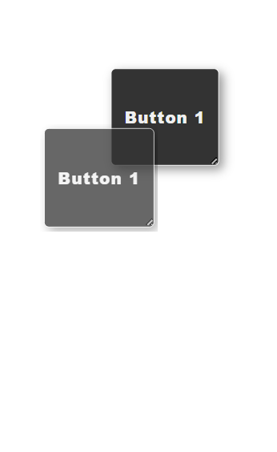
Detailed Solution and Features
Basic implementation and Core Idea of the solution:
For managing the elements on the site we have created an object which stores the elements used on the site as an object which was rendered for frontend every time the changes are made allowing easy changes in the site object #webelements have id of each element and which points to an object which contains id, type, styles, attributes and other properties and children
2. Drag and Drop Feature
For Drag and drop features initially we have implemented by managing two states one state for control changes and other for final implemented state and this done using cursor tracking providing an O(nd) time complexity in the process here n is the updates and d is the distances travel while moving , later this is changed to O(d) by reducing the states to one then it is reduced O(1) by using html5 drag and drop API for this we fetch the initail position and offset and calculates its final position hence increasing performance

Slide 13
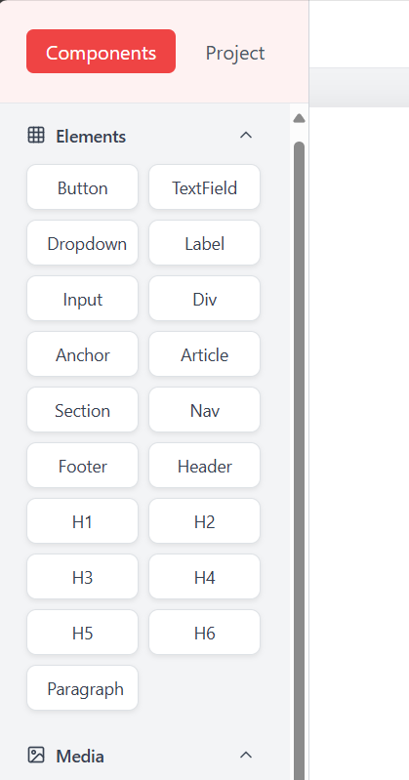
Detailed Solution and Features
3. Component Library:
A component is an predesigned object with some properties like style, attributes, and content and some have children for appending elements inside them
we used a tree data Structure for resolving multiple components inside each other
for this component render function render the components in pre order rendering and through which we are able to integrate relative positioning providing responsive design to the users website.
4. Interactive Elements:
We have added different functionality like resize and color size and many things to make the elements interactive.

Slide 14
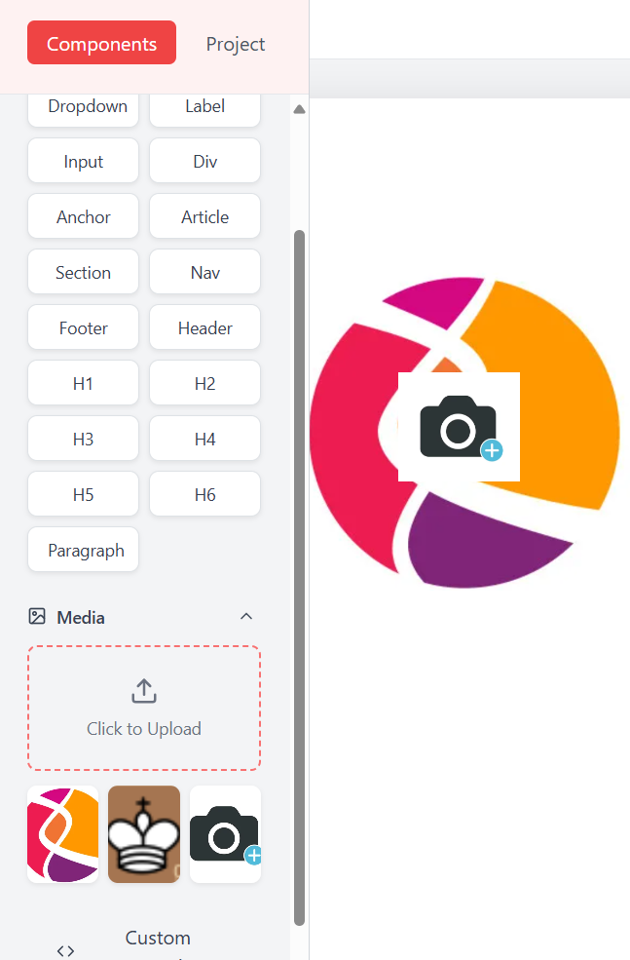
Detailed Solution and Features
5. CMS content management System:
Content management system contains editing the content of the elements and adding Images to it for this contents are directly changed through state management and the images are considered as a separate entity which was used in the website using img tag for this upload is handled through multer for image processing and then cloudinary for storing those images and in the backend we store images specific to the project.

Slide 15
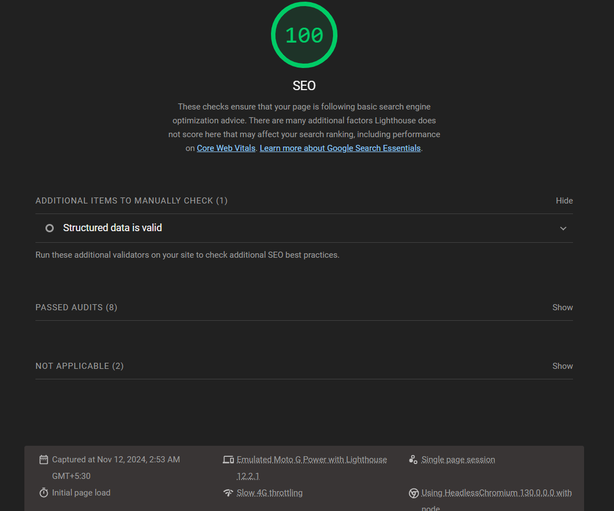
Detailed Solution and Features
7. SEO Tools:
We have components such as <article>, <section>, custom keywords etc. to improve visibility and also allow users to utilize Google Lighthouse to immediately analyze their site. Lighthouse is an open-source, automated tool to help improve the quality of web pages. It can be run on any web page, public or requiring authentication. It has audits for performance, accessibility, progressive web apps, SEO, and more.
8. Hosting And Domain Support:
Evolution simplifies the process of launching a website by providing built-in domain and hosting support. Users can easily connect their custom domain name to their website without needing to manage third-party services. Whether users are starting with a new domain or transferring an existing one, Evolution streamlines the process, ensuring a seamless setup. Additionally, Evolution offers reliable hosting options, providing secure and fast performance for websites, so users don’t have to worry about the technicalities of server management. This all-in-one solution ensures that users can focus on their website’s content and design, while Evolution handles the backend infrastructure.

Slide 16
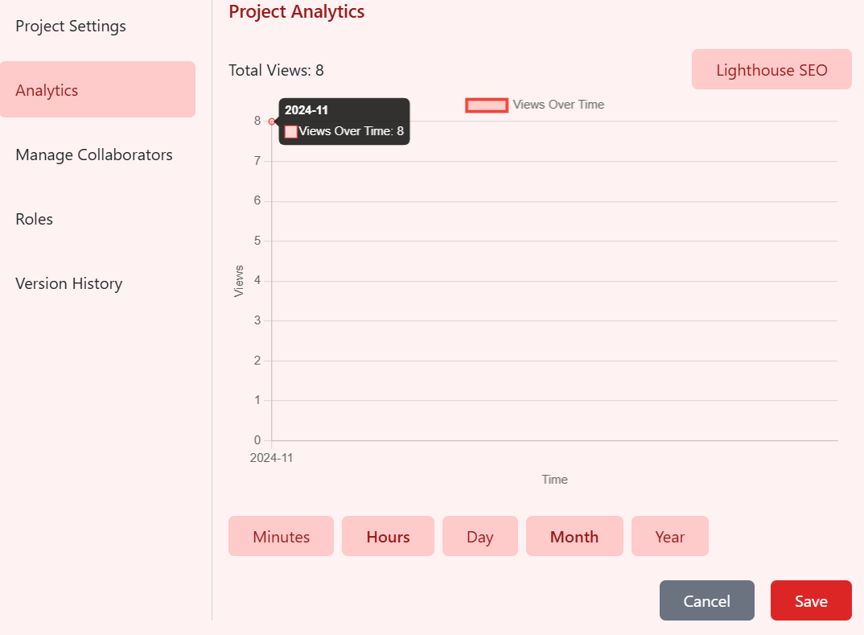
Detailed Solution and Features
9. Analytics dashboard :
We have components such as <article>, <section>, custom keywords etc. to improve visibility and also allow users to utilize Google Lighthouse to immediately analyze their site. Lighthouse is an open-source, automated tool to help improve the quality of web pages. It can be run on any web page, public or requiring authentication. It has audits for performance, accessibility, progressive web apps, SEO, and more.

Slide 17
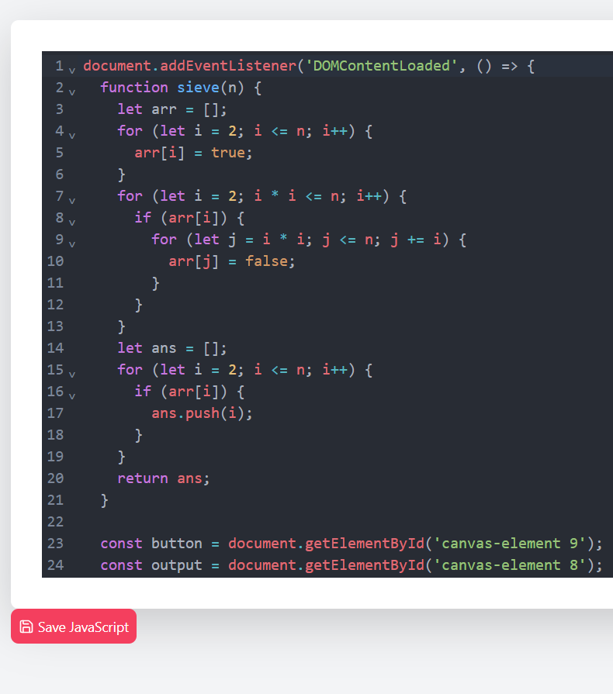
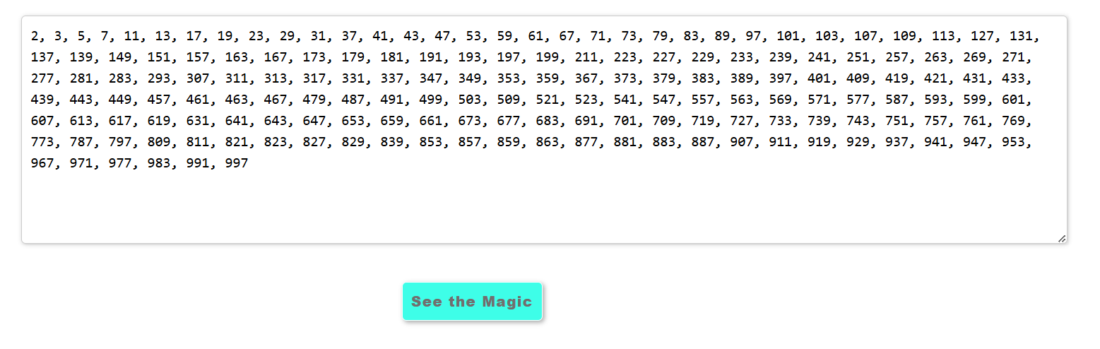
Detailed Solution and Features
10. Code Editor / Code export :
provide Facility to the user to add custorm css and javascript code
which would be directly linked to the users project. it uses codemirror for code editor format for providing custom colour to the text for the better expereince which can be run by the user remortly as user is not provided with the authorization management.

Slide 18
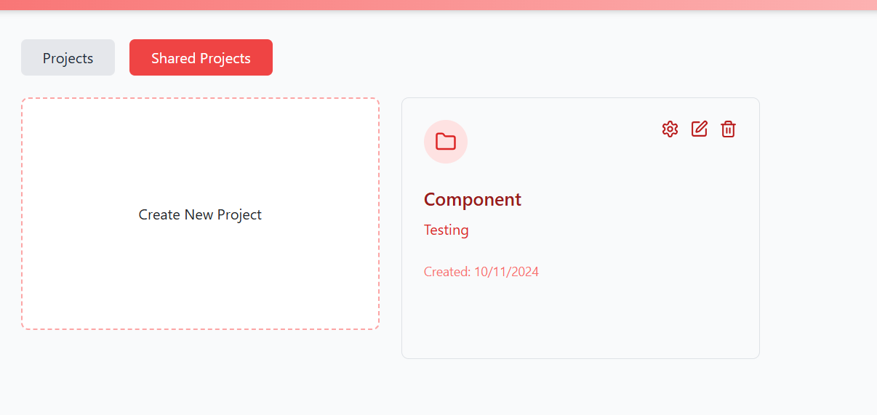
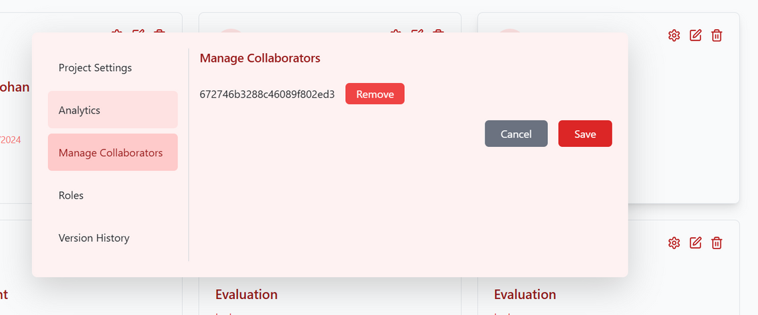
Detailed Solution and Features
11. Collaboration :
Evolution allows users to invite team members with roles like Viewer, Editor, and Admin, each with preset permissions for viewing, editing, deleting, managing members, or settings. Project owners can also customize these permissions. All changes are saved as commits, logging who made each update for streamlined version control and accountability, while allowing rollback.

Slide 19
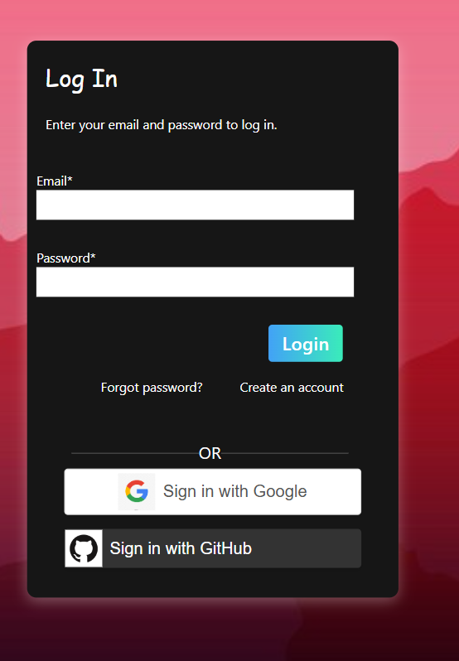
Detailed Solution and Features
12. Authentication :
Authentication are implemented as of 3 types:
Login/signup thorough email it is implemented through the following ways first user registers through email and password then a token is created with expiry of 5min and an html page is send to the user on its email using nodemailer and in the frontend a token is given to the user and now by verifying the token and and otp user gets loged in
Login through google it is implimented through google oauth 2.o here user is redirected to the googles web page with a client id and after accepting the registration in the session an callback is send to the frontend and if user exist it is verified and along with session an jwt token is also created.
GitHub login it works similar to transaction verification where authenticated user is veriefied using token and client secreat.

Slide 20
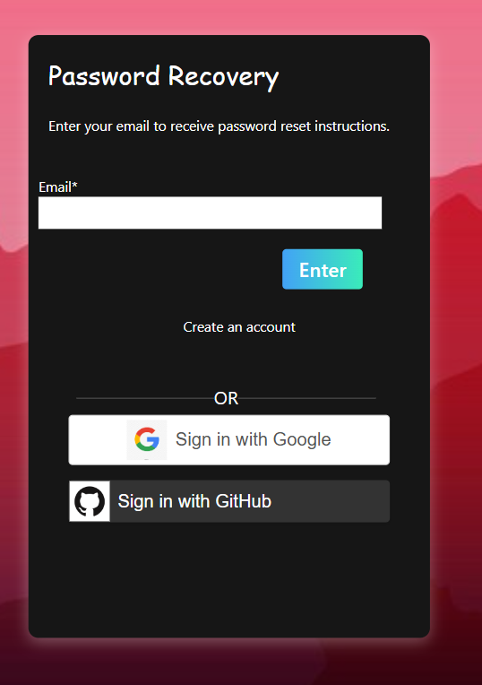
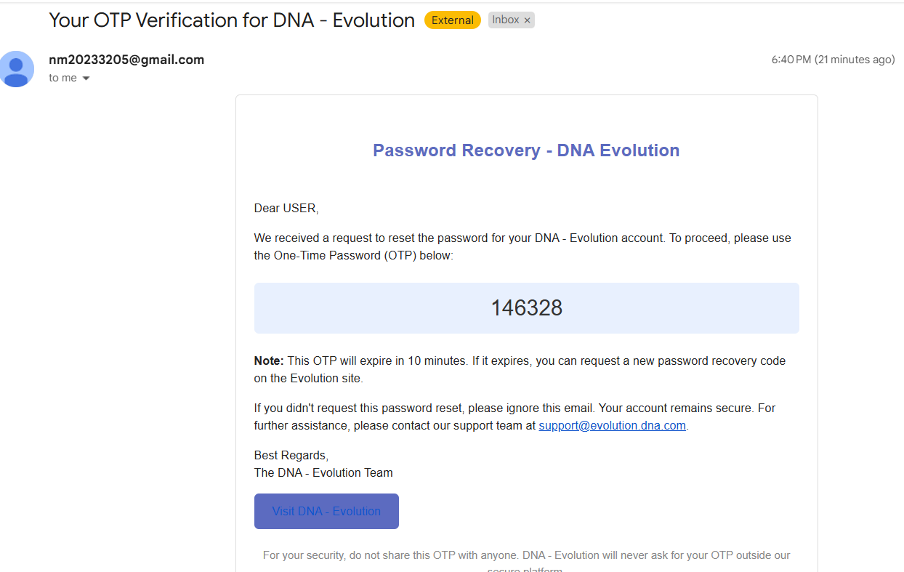
Detailed Solution and Features
Authentication : Password Recovery

Slide 21
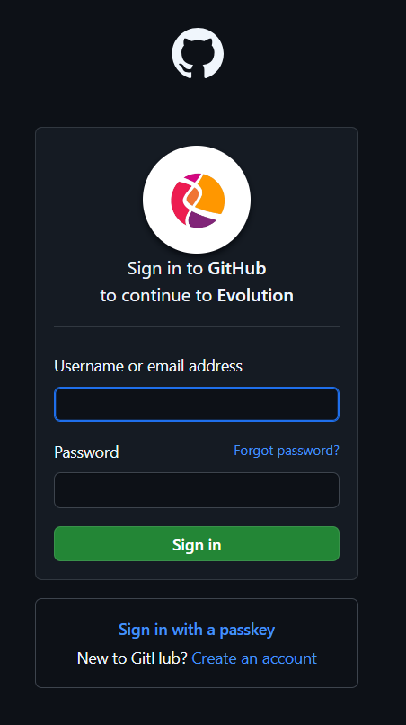
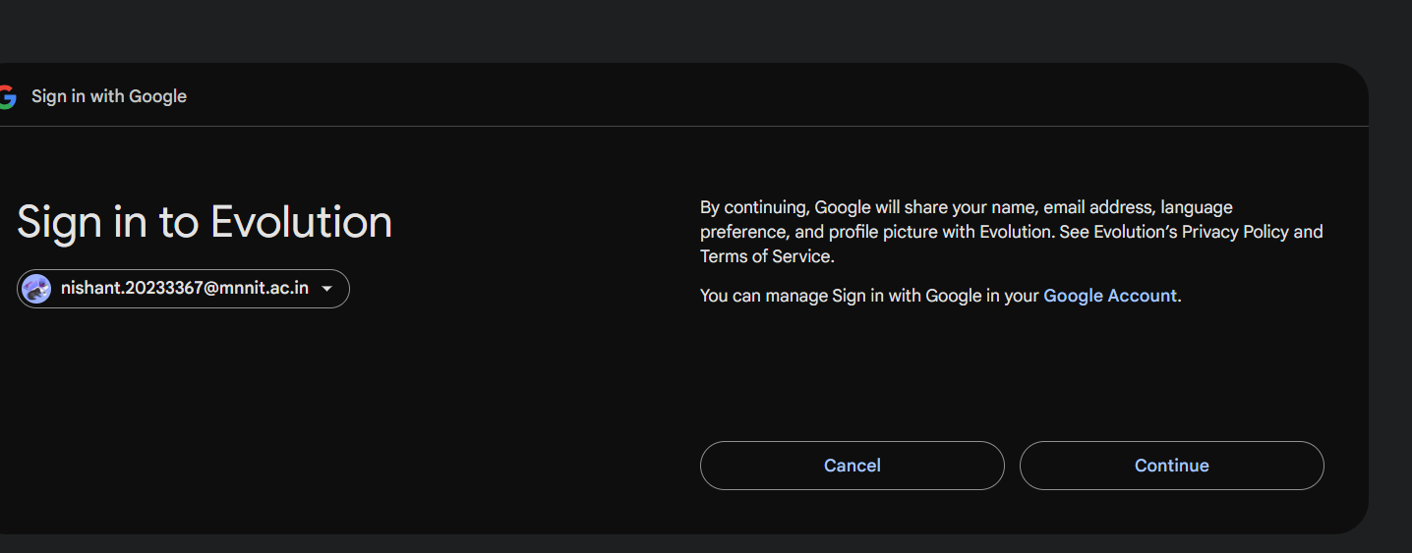
Detailed Solution and Features
Authentication : GitHub and Google Login

Slide 22
Challenges Faced and
their Solutions

Slide 23
Drag And Drop Feature:
Initially, two states are maintained and the offsets are continously calculated and updated to the elements leading a continous loops of useless updation making the time complexity of the solution for n elements and d updates: O(nd)
2. First optimization reduce the states one states with update to the state through managing the
in redux and only changing the element being dragged, time complexity of the solution: O(d)
3. Final Optimization by utilizing the HTML drag and drop API which handles the initial state and an frame
of the element on browser end. When placed, it is moved to correct position by using the offset to that
point through which the drag is started, it results in time complexity of the solution : O(1)

Slide 24
Componet Rendering:
Initial rendering is down through absolute position of elements only which is stored and manipulated through the webElements id rendering as they were changed by the user.
problems:
1. Inability to implement child parent relation in the elements.
2. Through this methodology we are not able to implement relative positioning.
2. Storing web elements in form of a Tree data structure and performing preorder traversal of the tree and
appending child elements to its parent. It solved the problems:
1. Through this child parent relation can be established, and we added dragging elements inside other.
2. Relative positioning was implemented by converting absolute positions to padding/margin.

Slide 25
Undo and Redo :
Initially, Undo Redo is implemented through stack and by maintaining states makes the processing slow due to prop drilling.
2. Solution By using Action creator of React redux (redux-undo). It manages 3 states, a past array recording the
the previous actions which occurs and present which is are present state and then future for redo, as the states
popped from past are stored in the future for redo operation.

Slide 26
Time :
Last Commit Message circulated on 12:48 AM
Solution:
We didn’t sleep for 2 whole days

Slide 27
Thank you very much!

