Slide 1
MONEY MANAGER
By – 20IT068 Pratham Mehta
20IT070 Nishant Miyani
Guided by – Prof. Priyanka Patel

Slide 2
CONTENTS
INTRODUCTION
PROBLEM STATEMENT
DATA FLOW DIAGRAM
PROJECT SCREENSHOTS
FUTURE SCOPE
CONCLUSION

Slide 3
INTRODUCTION
A personal Finance website gives a detailed information about a person’s income and Expenses.
A Dashboard related to the person’s expenses gives a great insight to him/her on how to save money.
A Finance Dashboard also gives a Business great insights like how to cut down their expenses to increase their profits.

Slide 4
PROBLEM STATEMENT
When a person starts earning, he/she doesn’t know how to spend their money accordingly to meet their goals.
More than 60% families in India don’t know how to save and invest their money accordingly.
Using a Financial Dashboard, people can get a clear cut idea on how to cut down their expenses to meet their future goal.

Slide 5
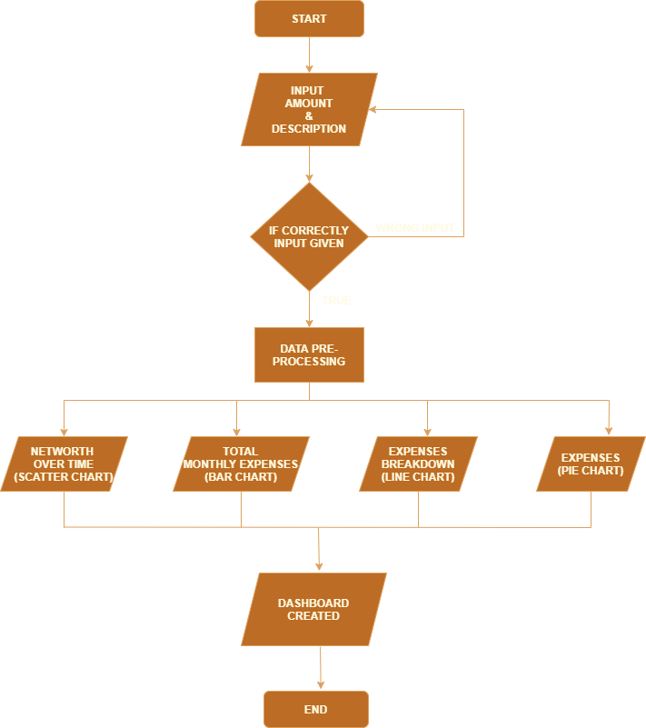
DATA FLOW DIAGRAM

Slide 6
Languages and Libraries
Languages:
Python
Jupyter Notebook
Libraries:
Numpy, Pandas
Plotly
Jupyter Dash

Slide 7
FUTURE SCOPE
In future, we can add a CHATBOT that can give personalised advice to the user about his income, investment and expenses.
The CHATBOT can give information regarding the price of the product that the user has asked for.
We can even build a Voice Assistant system that can take input through user’s voice.
Using Deep learning, we can predict the user’s net worth after a month or two.
We can even give detailed investment advices to the user.

Slide 8
CONCLUSION
Through this tracking system, we can give the user a detailed experience on how can he/she can save money and invest their money to meet their future goals.
It also helps Business’s to reduce their expenses so that they can earn more profit.
It can give the teenager a detailed information about his personal finance.

Slide 9
THANK YOU

