Slide 1

ITIS – 6120 Applied Databases
A Project Presentation
on
Electronic Medical Record System Database based on Dermatology Clinic
Anushka Santosh Padyal – 801379909
Nishant Acharekar – 801363902
Shivangi Saxena – 801372350
Bulbul Roy – 801365911
Due Date: 29th March, 2023

Slide 2
Database Information
The Medical Record System on Dermatology Clinic is an electronic version of storing the patient's medical history, it will maintain the essential clinical and administrative data which is relevant to patients' health care.
The dermatological clinic Electronic Medical Record System (EMRS) database is intended to streamline and manage several areas of patient care, including staff management, insurance information, appointments, payments, prescriptions, tests, and audit trails.
Overall, the EMRS holds the database that seeks to provide a comprehensive, organized, and efficient system.

Slide 3
Information obtained from the database
Our database is intended to organize and streamline multiple areas of a dermatology clinic. It stores critical information regarding patients, employees, appointments, treatments, and medications.
Patient Table centralizes the patient information. Includes the patient's ID, name, gender, contact information, date of birth, and insurance details.
The Staff Table depicts the hospital staff. Contains the staff ID, name, email, designation, and salary.
The Insurance Table manages patient insurance details. Tracks insurance companies and plan names.
The Appointment Table tracks patient visits with providers. Patient ID, doctor ID, appointment hours, and the name of the registration staff member are all recorded.
The Payment Table is used to manage appointment payment details. Captures the payment method, date, and total amount.
The Patient Symptoms Table records patient-reported symptoms. Linked to their respective appointment IDs.

Slide 4
Information obtained from the database
The Patient Diagnosis Table documents patient diagnoses. Includes therapy recommendations.
The Medication Table lists prescription drugs. It is linked to the diagnostic and appointment IDs.
Medicine Availability Table lists available medicines. Name, brand, and price are all included in the details.
The Test/Procedure Availability Table displays the available medical tests and procedures. Descriptions and prices are given.
The Patient Test Table records tests and procedures conducted. Obtains test codes, appointment IDs, and performing doctor IDs.
The Patient Results Table stores results from testing and procedures. Linked to the appropriate test or procedure IDs.
Audit Tables Maintains data integrity and accountability. Captures the history of changes for audit reasons.

Slide 5
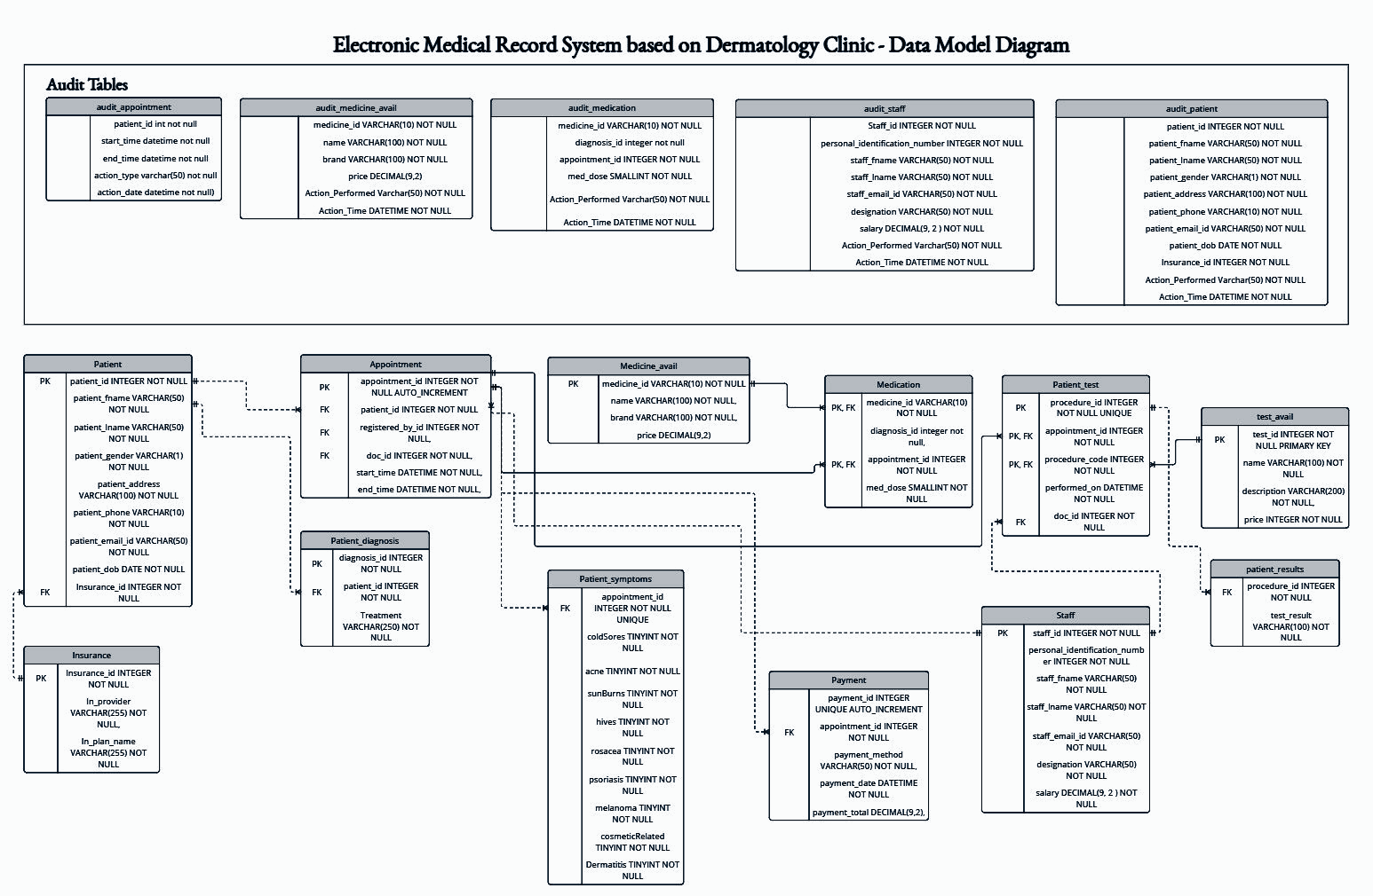
UML Data Model

Slide 6
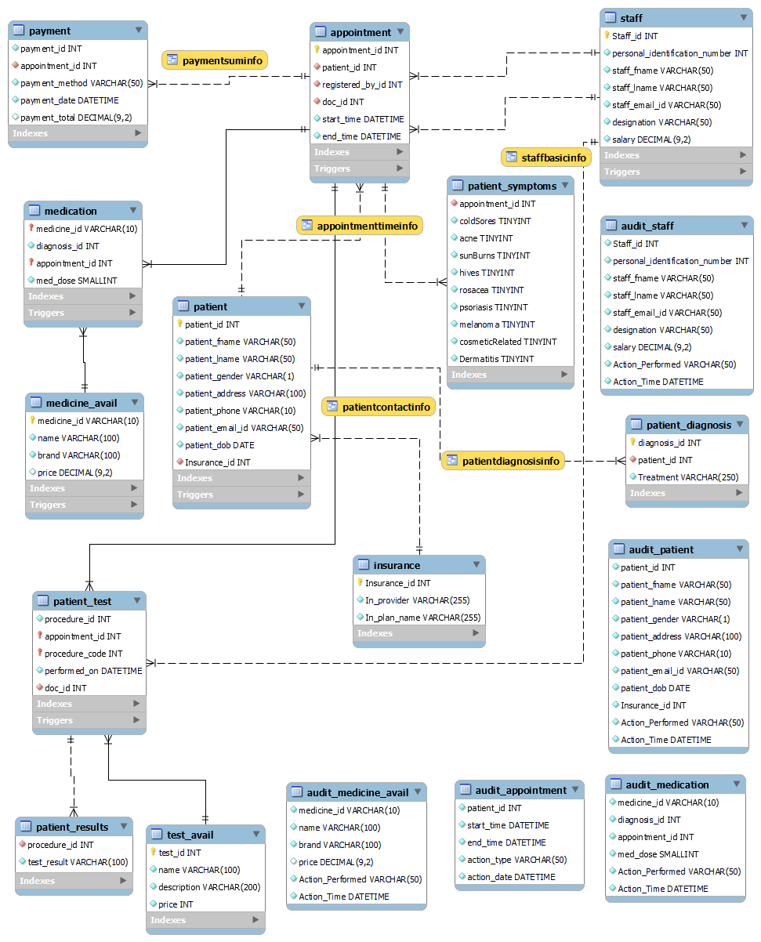
ER Diagram
The tables and entities in this ER diagram, together with their relationships, depict the various components that represents a dermatology clinic system.

Slide 7
Database and Test Data in SQL
UML Class Diagram for Visualization: The UML class diagram can be used to visualize and understand the structure and relationships of these classes in the healthcare system.
Database Design in MySQL Workbench: All required information in the system is presented by creating the entities, attributes and their relationships.
In MySQL workbench we have created the tables such as Patient, Staff, Insurance, Appointment, Payment, and Patient Symptoms, Medication, Medicine Availability, Test/Procedure Availability, Patient Test, Patient Results, and Audit.
Degrees of Cardinality: Each table has its own set of attributes following the degrees of cardinality such as one-to-one, one-to-many, many-to-many.
Ensuring BCNF Compliance: To ensure that each table satisfies BCNF, we uphold data integrity and minimize the risk of data inconsistencies aiming at eliminating redundancy and anomalies.

Slide 8
Supporting Functionalities
Patient Management
Register new patients
Maintain patient records
Appointment Scheduling
Schedule, reschedule, and cancel appointments for patients
Staff Management
Maintain staff records
Assignment of roles and responsibilities to staff members
Insurance Handling
Record and track insurance details
Process insurance claims and handle billing procedures
Medical Record Keeping
Access patient medical records
Payment Processing
Support various payment methods
Generate and provide detailed invoices to patients
Auditing
Support auditing for the user actions and data manipulation

Slide 9
Thank You

