Slide 1
TYPING SPEED TESTER
by
Suryavansh Jaggi(CS-2341553) and Nishant Choudhary(CS-2341518)
B. Tech Computer Science and Engineering
with specialization
in
B.Tech CSE
Name of the Guide
(Dr Surabhi Purwar)
School of Computer Science and Engineering
IILM University Greater Noida

Slide 2
Contents
1.Objectvie of the Minor Project
2. Project overview(How the objective will be achieved)
3.Flow chart of the project
4.Name of Software Development Life cycle adopted(Waterfall/Prototype/Incremental/Agile/Spiral/Rapid Application Development(RAD). Justification
5.Programming language(s) that will be used(all applicable) for project
6.Applications of the project

Slide 3
OBJECTIVE
The objective of the minor project is to create a typing speed tester application using Python and Pygame library.

Slide 4
OVERVIEW
The project aims to develop a typing speed tester application that allows users to test their typing speed and accuracy. The application will display random sentences or user can write their own sentence for the user to type, calculate the words per minute (WPM), and provide feedback on accuracy.

Slide 5
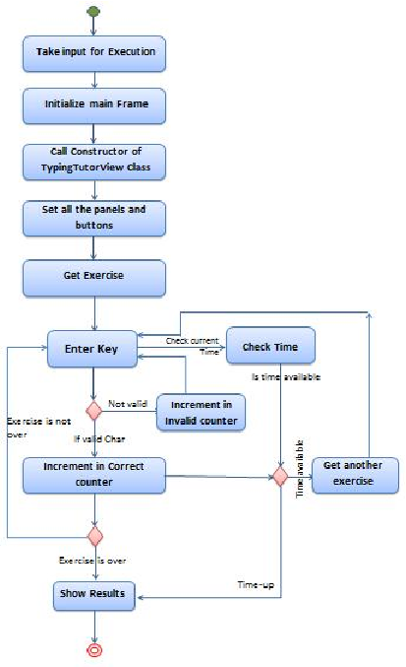
FLOW CHART

Slide 6
NAME OF SOFTWARE DEVELOPMENT LIFE CYCLE
Agile
Justification: Agile methodology allows for iterative development and frequent feedback, which is suitable for this project as it involves continuous improvement and adaptation based on user testing and feedback.

Slide 7
PROGRAMMING LANGUAGE
Python :
-pygame : for UI and graphics
-random : for selecting sentence
-sys : main functionality

Slide 8
FEATURES
A customizable background, splash screen etc by just naming the image of your choice.
Allows the user to input sentences in 2 simple ways : Either by editing sentences.txt or using the input button within the game.
An accuracy checker along with a word per minute count.
Highlights the sentence green if typed correctly, and red if typed incorrectly.

Slide 9
APPLICATIONS OF THE PROJECT
Educational purposes: Helps users improve typing speed and accuracy.
Recruitment assessments: Employers can use it to assess candidates' typing skills.
Personal development: Users can track their progress over time and set goals for improvement.

Slide 10
THANK YOU !

