Slide 1
Bigram Language Model using the of Viterbi Algorithm to classify English sentences as real or not real.
Nishant Das
Stochastic Methods – Final Research Project
IESE Business School
29th March 2019

Slide 2
Order of Content
Project Motivation & Project Definition
Viterbi Dynamic Program Algorithm & Bigram Language Models
Code details & development
User manual to use and run the code
References

Slide 3
Project Motivation & Project Definition

Slide 4
Project Motivation
In online retail and e-commerce, online reviews play a critical role in shaping consumer opinion and consequently market share, etc.
In order to control market opinion, companies can manipulate online reviews (fake reviews) and this results in misinformation.
rise of automated bots and paid-reviewers.
From a business ethics point of view, studying fake reviews becomes a contemporary issue that marketing and management scholars are addressing.
Work done in understanding online reviews falls across various domains:
Linguistics (Language structure and syntax)
Marketing
Computer Algorithms such as Artificial Intelligence, Dynamic Programming, etc.
Online Reviews
Natural Language Processing
Linguistics
Computer Algorithms
Marketing

Slide 5
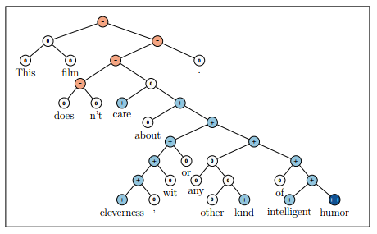
Possible Applications of NLP in understanding online reviews
Language Models
Context free models
Skip Gram Models
Bigram Models, etc.
POS Tagging
Tagging sentences with grammar type, noun, verbs, etc.
Sentence Parsing
Top-Down Parsing
LL Parsing
Recursive descent parser
Bottom-Up Parsing
Shift-Reduce parsing
Sentiment Analysis
Recursive Neural Networks
Naïve Bayes – Support Vector Machines
Word Embedding
Word2Vec
GloVe
Topic Modelling & Text Summarization
Latent Dirichlet Allocation
Etc.
The sentence has been broken down into a tree. With each branch of the tree representing a positive (blue) or negative (orange) sentiment. The overall sentiment of the score is calculated to be negative based on the tree distribution.

Slide 6
Research Project Creating a Language Models
Language Models calculate the probability of a sequence of words.
With this we can model sentences and determine if the a sentence is correct or incorrect given the probability of sequences of words in that given sentence.
If the probability of the sequence of words in a sentence follows a distribution typical of the language (English in this case), we can classify a sentence as being correct or incorrect, or real or not real.
There are many applications of Language models.
Auto-correct - Determining and correcting spellings or grammar is a popular example.
For this project, I have created an algorithm to determine if a sentence given by a user is correct or incorrect.

Slide 7
Viterbi Algorithm & Bigram Language Models

Slide 8
Context of a word ”You shall know a word by the company it keeps” – J.R.Firth, 1957
Languages are ambiguous in nature.
Words typically are used in association with other words.
This is typical when languages have a structure (Noun followed by a verb, etc.).
Hence, by looking at word(t) and word(t+1) occurrences (adjacent word occurrences), we can see how likely a sentence is real or not.

Slide 9
Bigram Language Models
Bigram is a sequence of two consecutive words in a sentence.
For example, in the sentence
“The quick brown fox jumps over the lazy dog.”
The Bigrams are:
The Quick
Quick Brown
Brown Fox
Fox Jumps
Etc.
Bigram models is a form of N-Grams models
Uni-gram models look at words in isolation, without context of the neighboring words
Tri-gram models consider three consecutive words in a sentence.
Trade of between having longer gram models. As the models are trained on previously known sentences,
Longer gram models will lead to over fitting.
While shorter gram models may lose context of a word given a sentence.

Slide 10
The Viterbi Algorithm Dynamic Programming
In this project, I use the Brown Corpus (explained in the code development section) of words to train a Hidden Markov Model that is a variation of Viterbi Algorithm.
The Viterbi Algorithm is a Dynamic Programming algorithm to the the most likely sequence of hidden states – known as the Viterbi path.
Given the model, we can then pass English sentences into the model to predict if the sentence is an actual English sentence or not.
While not addressing how genuine a review is, the model forms the first step of the process by giving insights into how Dynamic Programming can be applied to solve the problem of fake reviews.

Slide 11
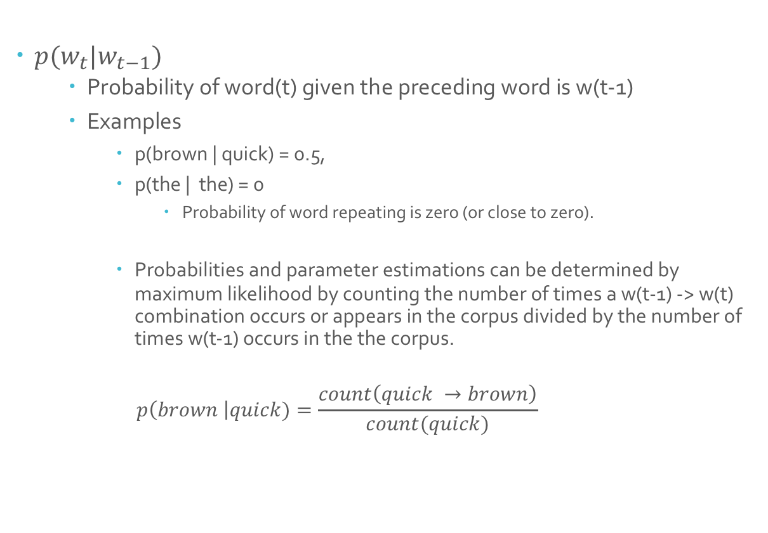
The Bigram Model
$p(w_{t}|w_{t−1})$
Probability of word(t) given the preceding word is w(t-1)
Examples
p(brown | quick) = 0.5,
p(the | the) = 0
Probability of word repeating is zero (or close to zero).
Probabilities and parameter estimations can be determined by maximum likelihood by counting the number of times a w(t-1) -> w(t) combination occurs or appears in the corpus divided by the number of times w(t-1) occurs in the the corpus.
$$p\left(brown \right|quick)=\frac{count\left(quick →brown\right)}{count(quick)}$$

Slide 12
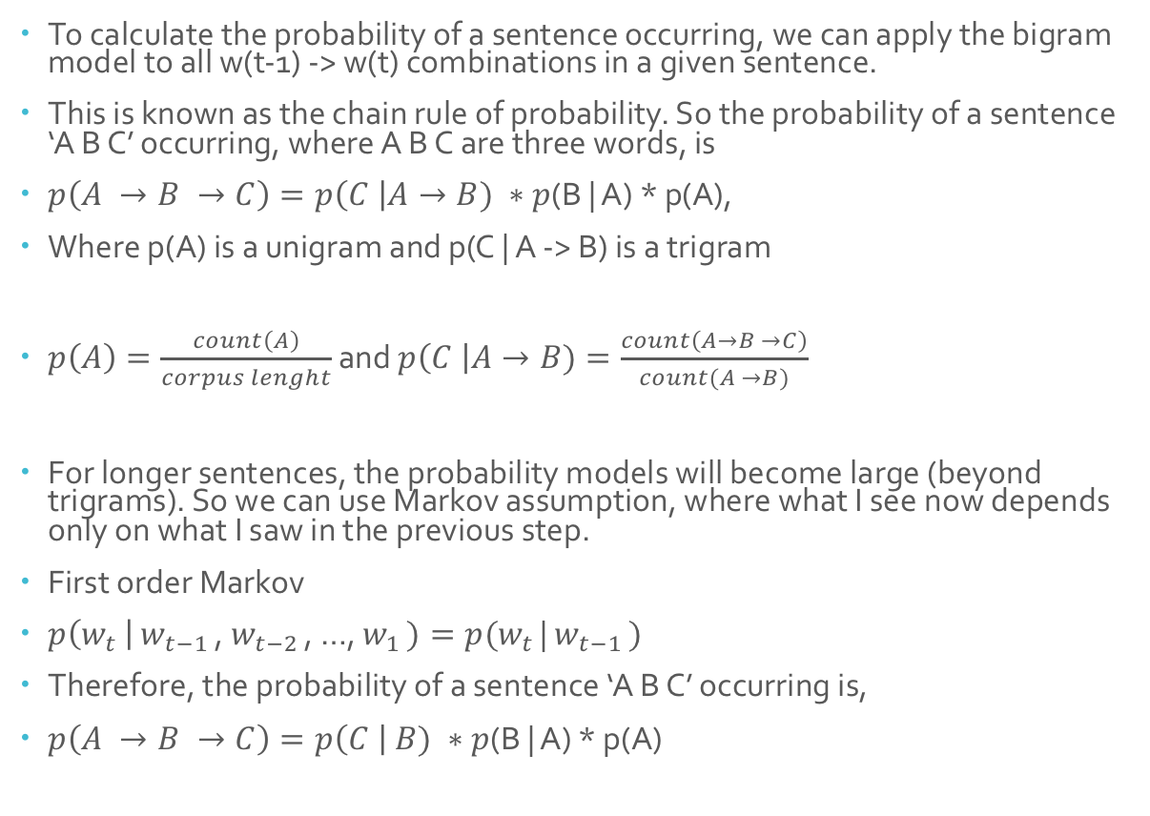
The Bigram Model for sentences Chain Rule of Probability Markov Assumption
To calculate the probability of a sentence occurring, we can apply the bigram model to all w(t-1) -> w(t) combinations in a given sentence.
This is known as the chain rule of probability. So the probability of a sentence ‘A B C’ occurring, where A B C are three words, is
$p\left(A →B →C\right)=p\left(C \right|A→B) ∗p$(B | A) * p(A),
Where p(A) is a unigram and p(C | A -> B) is a trigram
$p\left(A\right)=\frac{count\left(A\right)}{corpus lenght}$ and $p\left(C \right|A→B)=\frac{count\left(A→B →C\right)}{count(A →B)}$
For longer sentences, the probability models will become large (beyond trigrams). So we can use Markov assumption, where what I see now depends only on what I saw in the previous step.
First order Markov
$p\left(w_{t }\right|$ $w_{t−1 }$, $w_{t−2 }$, …, $w_{1 })=p(w_{t }$| $w_{t−1 })$
Therefore, the probability of a sentence ‘A B C’ occurring is,
$p\left(A →B →C\right)=p\left(C \right| B) ∗p$(B | A) * p(A)

Slide 13
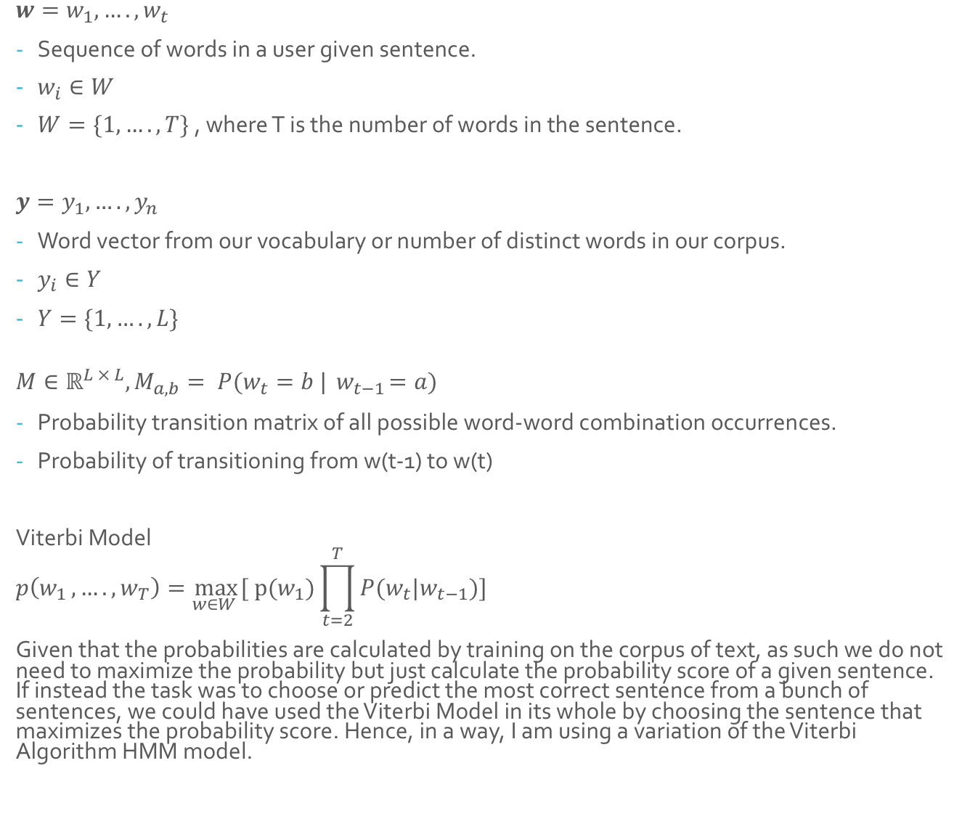
Model Variation of the Viterbi Algorithm & Hidden Markov Model for sequence modelling
$w=w_{1}, ….,w_{t}$
Sequence of words in a user given sentence.
$w_{i}∈W$
$W=\{1, …., T\}$, where T is the number of words in the sentence.
$y=y_{1}, ….,y_{n}$
Word vector from our vocabulary or number of distinct words in our corpus.
$y_{i}∈Y$
$Y=\{1, …., L\}$
$$M∈ℝ^{L × L}, M_{a,b}= P(w_{t}=b |{ w}_{t−1}=a)$$
Probability transition matrix of all possible word-word combination occurrences.
Probability of transitioning from w(t-1) to w(t)
Viterbi Model
$$p\left(w_{1 }, ….,w_{T}\right)=\max_{w∈W }{[ p(w_{1})\prod_{t=2}^{T}{P(w_{t}|w_{t−1})]}}$$
Given that the probabilities are calculated by training on the corpus of text, as such we do not need to maximize the probability but just calculate the probability score of a given sentence. If instead the task was to choose or predict the most correct sentence from a bunch of sentences, we could have used the Viterbi Model in its whole by choosing the sentence that maximizes the probability score. Hence, in a way, I am using a variation of the Viterbi Algorithm HMM model.

Slide 14
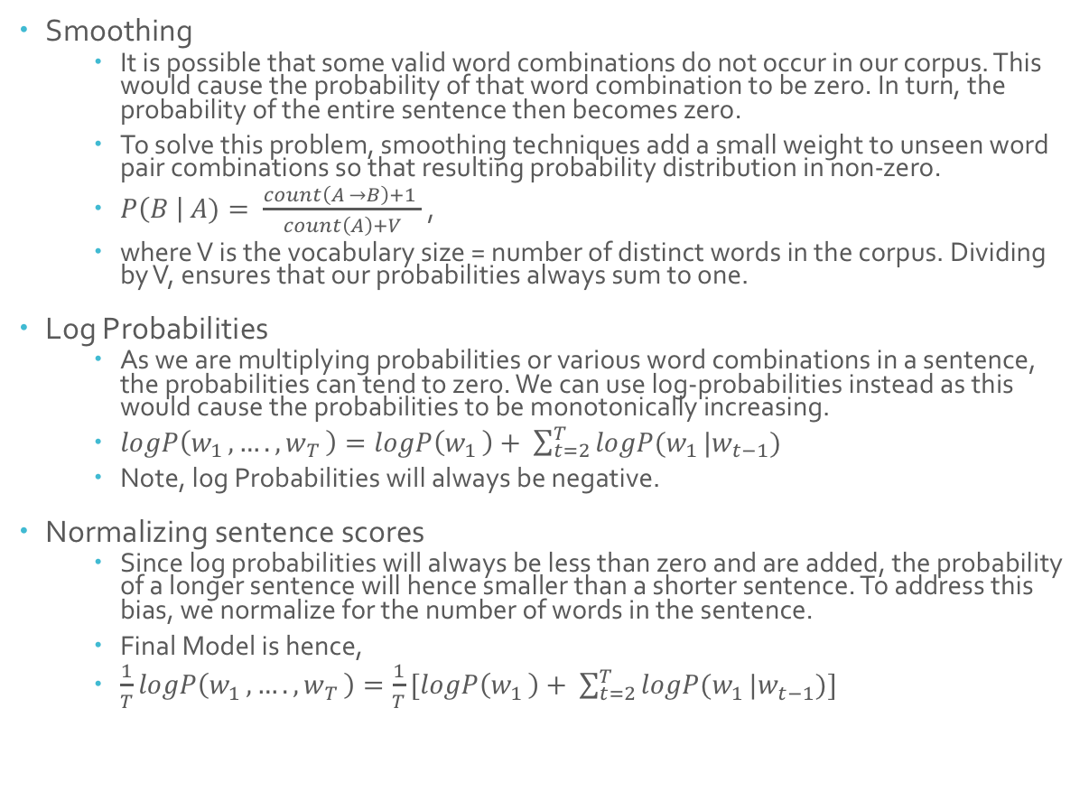
Smoothing , Log Probabilities & Normalizing
Smoothing
It is possible that some valid word combinations do not occur in our corpus. This would cause the probability of that word combination to be zero. In turn, the probability of the entire sentence then becomes zero.
To solve this problem, smoothing techniques add a small weight to unseen word pair combinations so that resulting probability distribution in non-zero.
$P\left(B \right| A)= \frac{count\left(A →B\right)+1 }{count\left(A\right)+V}$ ,
where V is the vocabulary size = number of distinct words in the corpus. Dividing by V, ensures that our probabilities always sum to one.
Log Probabilities
As we are multiplying probabilities or various word combinations in a sentence, the probabilities can tend to zero. We can use log-probabilities instead as this would cause the probabilities to be monotonically increasing.
$logP\left(w_{1 }, ….,w_{T }\right)=logP\left(w_{1 }\right)+ \sum_{t=2}^{T}{logP(w_{1 }|w_{t−1})}$
Note, log Probabilities will always be negative.
Normalizing sentence scores
Since log probabilities will always be less than zero and are added, the probability of a longer sentence will hence smaller than a shorter sentence. To address this bias, we normalize for the number of words in the sentence.
Final Model is hence,
$\frac{1}{T}logP\left(w_{1 }, ….,w_{T }\right)=\frac{1}{T}[logP\left(w_{1 }\right)+ \sum_{t=2}^{T}{logP(w_{1 }|w_{t−1})]}$

Slide 15
Code Details & Development

Slide 16
The Brown Corpus
The Brown University Standard Corpus of Present-Day American English (or just Brown Corpus) was compiled in the 1960s by Henry Kučera and W. Nelson Francis at Brown University, Providence, Rhode Island as a general corpus (text collection) in the field of corpus linguistics.
It contains 500 samples of English-language text, totaling roughly one million words, compiled from works published in the United States in 1961.
Covers 15 generes ranging from adventure, editorial, government, hobbies, lore, religion, news, science fiction, romance, etc.
The Brown Corpus was imported from the NLTK library.

Slide 17
Mapping each word to its index number
Sentences are made up of sequences of words. The Brown corpus has stored each sentences as a list of words.
We will create a vector of all words in the corpus and then one-hot code each word occurrence on the word vector.
Hence, every word will have a unique place (or index) in the word-vector.
With this, we can use the index number of a word in the word vector to make up the sentence.
In essence, we convert sentences of words to sentences of index-numbers from the word-vector.
The word vector is of length 49,817. I.e. there are about 50,000 unique words in the Brown Corpus.
Clearly, there are many words, few of which may not be very frequent and this may increase wait times.
We eliminate infrequent words by keeping say, top 10,000 words only.
This is achieved by a sort in descending order.
Further, a new index of thisq0,000 word vector will be needed and sentences from the old index will need to be updated based on this new index.
Words not included in the 2000 word vector index will be labelled as UNKNOWN.

Slide 18
Getting Bigram Probabilities
This is a simple counting exercise.
Aim is to get the probability matrix of a word being followed another given word in our corpus for all word-word combinations possible in the corpus.
We add our smoothing parameter (1 in our case). This allows for no word(t-1) and word(t) have t0 probability of occurrence.
After the count is complete for all the sentences, we normalize the count along the row to get probabilities of a word being followed by another word in the word vector.

Slide 19
Scoring a user defined sentence
Now, we create a function to score how real or un-real a sentence is.
In essence, we are looking to see how well a user given sentence is framed given similarity to sentences from our corpus.
Given a sentence, we see the sequence of words and pick up the probabilities associated with the sequence of words in that sentence.
We loop through each word in the sentence and calculated the log probabilities of the current bigram and add it to score. The final score, we divide by the length of the sentence to normalize the score.
We take the log probabilities so as to compare the likelihood of real or fake sentences.
Due to limitation in the limited number of words we are using, it is possible that many of the sentences we use to test our model may have not been seen by the model. Hence, these words will not have any associated probabilities with it. In this case, the model will output "Sorry, you entered words that are not in the vocabulary”.

Slide 20
Results
The model works well for sentences that are meaningful. I.e. Resultant score is more positive than for fake sentences.
Translating the score into if a sentence is real or not will require to run a classification model on another corpus of text.
However, based on few runs, typically on average, real sentences have scores of around -5 to -7 while fake sentences have scores from -8.5 to -10. Hence, I set any score above -8.5 as being real.
The next slide as some examples of the output on some sentences that I fed into the program.

Slide 21




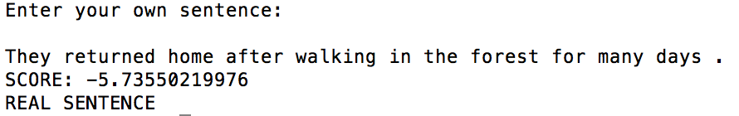



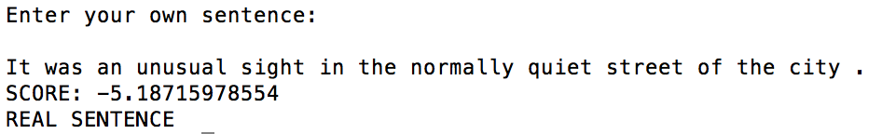


Example of results – some quotes from Harry Potter and other random text

Slide 22
User Manual & References

Slide 23
User manual to running the code (Hopefully you will find the code to be well commented!)
The program was coded using Python 3.
To run the associated code, the user will need to have Python 3 downloaded.
Please note, I minimized the use of exiting pre-built packages and have coded all relevant parts of the algorithm myself.
Exceptions to this is using few data manipulation libraries such as NumPy. Also, the Brown corpus is available with a popular NLP package in python known as the NLTK.
Hence, when running the code for the first time, it will take a few minutes to download the relevant libraries and corpus.
Once the code is run, the user will have see a text input box asking for an input sentence. The user may enter an English sentence.
The output will be the overall score of the sentence which is the probability score of how real or unreal a sentence is.
If the user may wish to continue and test more sentences, the user will require to press Y or y to continue an input another sentence and then can repeat the exercise.
If the user wishes to end the program, the user can type N or n to exit the program.
Also note, it is better to put a full stop (.) after a space when ending the sentence to get better scores. This is due to a limitation in the code and how the model was created.

Slide 24
References used to learn about and create the model
http://www.cs.upc.edu/~horacio/snlp/loglinear.pdf
https://www.cl.cam.ac.uk/teaching/1314/L100/clark_lectures/clark_lecture3.pdf
https://sandipanweb.wordpress.com/2017/04/03/some-natural-language-processing-using-trigram-hidden-markov-models-to-tag-genes-in-biological-text/
https://web.stanford.edu/~jurafsky/slp3/3.pdf
https://web.stanford.edu/class/cs124/lec/languagemodeling.pdf

