Slide 1
Does watching aggressive movies make youth extroverts who consequently spend more on extravagant goods?
Moderated for Gender
Nishant Das
Multivariate Analysis Example
Ambeone DMCC
16th June 2019

Slide 2
Overall Summary
Using Principal Component Analysis, we found that on average,
11% of the extrovert tendencies amongst the youth surveyed can be explained by their preference for watching aggressive movies.
40% of the extravagant spending on consumer goods amongst the youth surveyed can be explained by effect of perceived extrovert tendencies.
Overall, 4.47% of the tendency to spend on extravagant goods amongst extrovert youth surveyed can be explained by their preference of watching aggressive movies.

Slide 3
Graphical Results of Principal Component Analysis

Slide 4
Let's Get Started!

Slide 5
Factor Analysis
A statistical technique used to detech a smaller set of underlying latent factors that explain the covariancce/correlation among a large set of observed variables.
Used to reduce a large number of variables down to a meaningful and manageable number of factors that can reflect most of these variables’ content.
In essense, FA, identifies all the latent variables, preferably based on some theoratical explainations.

Slide 6
Extracting the Factors
Correlation Matrix – correlations among the observed variables (items) to be factor-analysed.
We then focus on the diagonal of this matrix. Various ways to analyze the diagonal such as principal factor (PF), principal compnent factor (PCF), maximum likelihood factor (ML).
The PF extraction method inserts estimates of the common/shared variance (commumality) in the diagonals , instead of 1s
Communality values are obtained by estimating the squared multiple correlation of each variable with all the other variables in the matrix.
In essense, regressing each variable on the remaining variables.

Slide 7
Extracting the Factors
Starting from the initial correlation matrix (with covariance in the diagonals), a series of w and e are calculated iteratively until solution converges (additional vectors are nearly identical to the last one).
The last vector and its eigenvalue are the basis of the first factor.
Eigenvectors are sets of weights (w) that generate factors with the largest possible eigenvlues. Egienvalues (e) are variances captured by these factors.
The common variance that the first factor explains is then subtracted from the correlation matrix, resulting in a residual matrix (with diagonals now smaller).
The second factor is then calculated using step 1 but on the residual matrix.
So on for more factors. Keep doing this till eginvalue >1 or parallel analysis test, where you compare to random data.

Slide 8
Factor Loading
Factor loadings L = eigenvector for a variable multiplied by the square root of the factor eigenvalue.
Sum of eigenvalues is the total amount of common variance (communality) these two facors explain together.
Factor loadings reflect the correlation between obseved variables and their respective factors.
If we square these correlations or factor loadings, the results will show us how much variance of each obseved variable each factor explains. That is, factor 1 explains X% of variance in variable 1.
Summing square of factor loadings of a given variable explains how much variance in the variable is explained by both factors.
The remaning unexplained variance is the uniqueness of the variable and can be thought of as spefic or measurement error.

Slide 9
Model, Theory & Hypothesis
MEDIA PREFERENCES
(Aggressive Movies)
Film preferences may reflect individual differences in personality.
H1 : +
Chamorro-Premuzic et al., 2013
PERSONALITY
(Extrovert Tendencies)
How we see and approach the outside world, including people, objects and activities within it.
H2 : +
M. Wang and Y. Cheng, 2013
SPENDING HABITS
(Extravagant Spending)
The spending of money on and the acquiring of luxury goods and services to publicly display economic power.
H1: The more a youth likes to watch aggressive movies, the more the youth is actively involved in the world of people and things, is socially active and is more aware of what is going on around them. What we will call Extrovert Tendencies.
H2: The more a youth identifies as an extrovert, the more the youth will spend on goods perceived to improve his/her social status. We call this Extravagant Spending.

Slide 10
Proposed Latent Variables
Aggressive Movies
Typically, movies on the higher side of violence ratings.
Involving physical combats, shooting, tense situations, suspense, etc.
Extrovert Tendencies
How outgoing a youth feels.
Spending On Extravagant Goods
Spending behavior related to extravagant goods amongst youth peer group.
For example, spending on branded clothes, etc.

Slide 11
Data
Data Source : Young people survey dataset from Kaggle.
Samples: 1,010 Slovakian Participants, aged between 15-30. (in 2013)
Questions about Movie Preferences and Scale
31 items about movie and music preference
Sample questions:
Horror movies: Don't enjoy at all 1-2-3-4-5 Enjoy very much
Questions about Personalities
57 items about Personalities
Sample questions:
- I take notice of what goes on around me.:
Strongly disagree 1-2-3-4-5 Strongly agree
- I feel lonely in life.: Strongly disagree 1-2-3-4-5 Strongly agree
- Do you lie to others?: Never. - Only to avoid hurting someone. - Sometimes. -Everytime it suits me
Questions about Spending Preferences and Scale
7 items about Spending habits:
Sample Questions:
- I enjoy going to large shopping centres.:
Strongly disagree 1-2-3-4-5 Strongly agree
- I prefer branded clothing to non branded.:
Strongly disagree 1-2-3-4-5 Strongly agree

Slide 12
Exploratory Factor Analysis
Generating Latent Variables

Slide 13
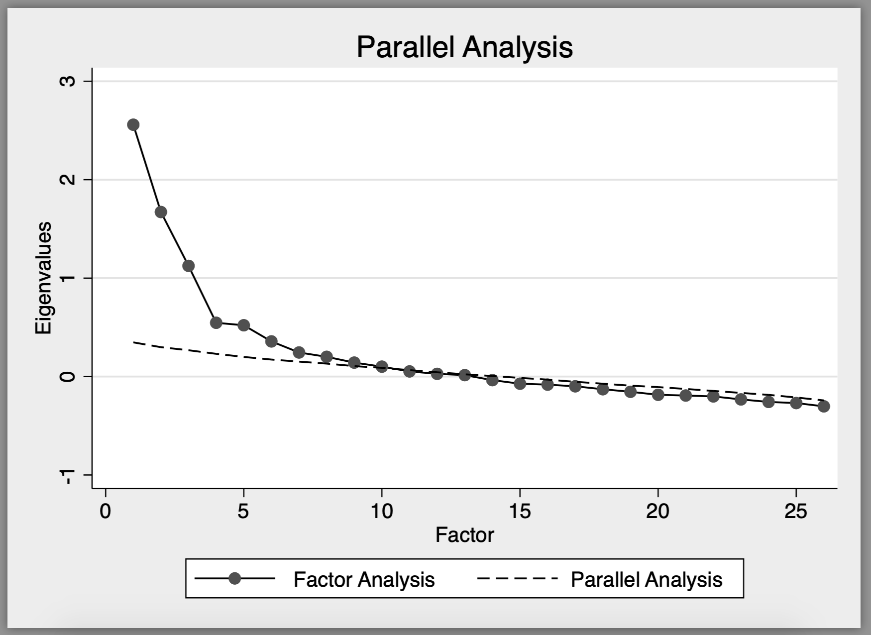
1. Extrovert Tendencies
From the 57 items related to personality, I filtered and selected 26 items that I judged were more aligned to extrovert tendencies for the PCA.
Items finally selected for Extrovert LV:
Number of friends
Socializing
Energy Levels
Happiness In Life
New Environment
What we had also expected:
Awareness of Daily Events
Assertiveness
Others…

Slide 14
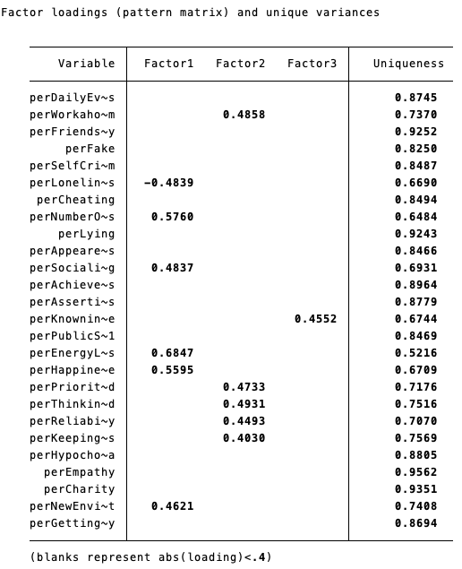
Factor Analysis for Extrovert

Slide 15
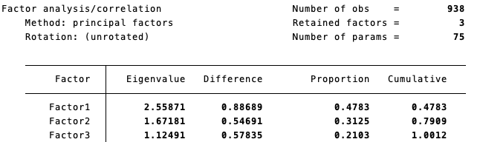
PCA Results - Extrovert

Slide 16
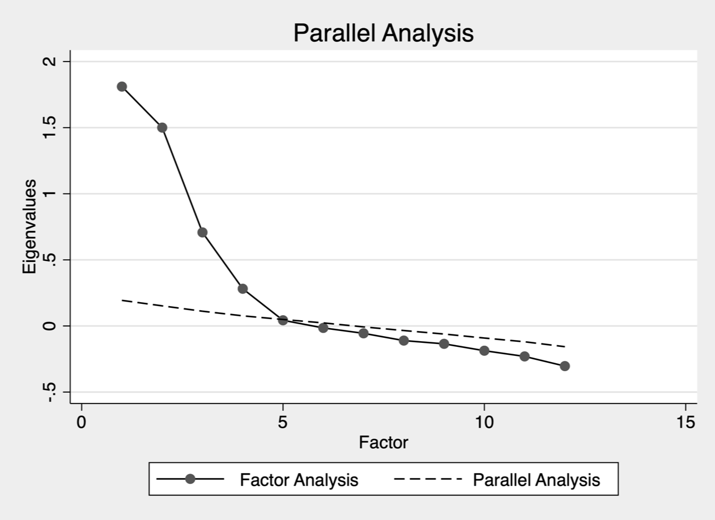
2. Aggressive Movies
Movie genres that got included:
Thrillers
War Movies
Western
Action
Sci-Fi
Genres that did not get included:
Comedy, Romantic, Fantasy, Documentary, Animated, etc.

Slide 17
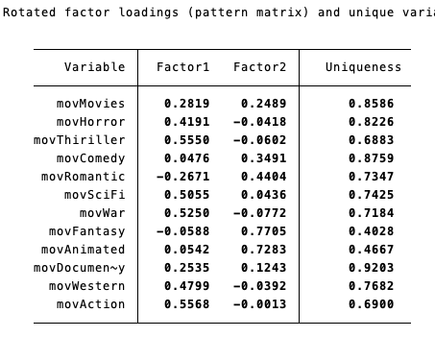
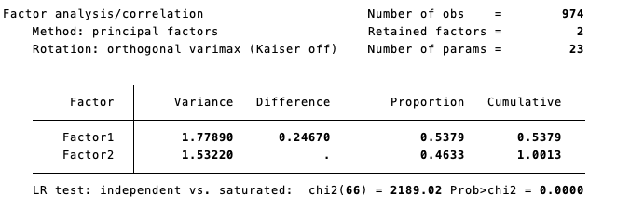
EFA results – Aggressive Movies

Slide 18
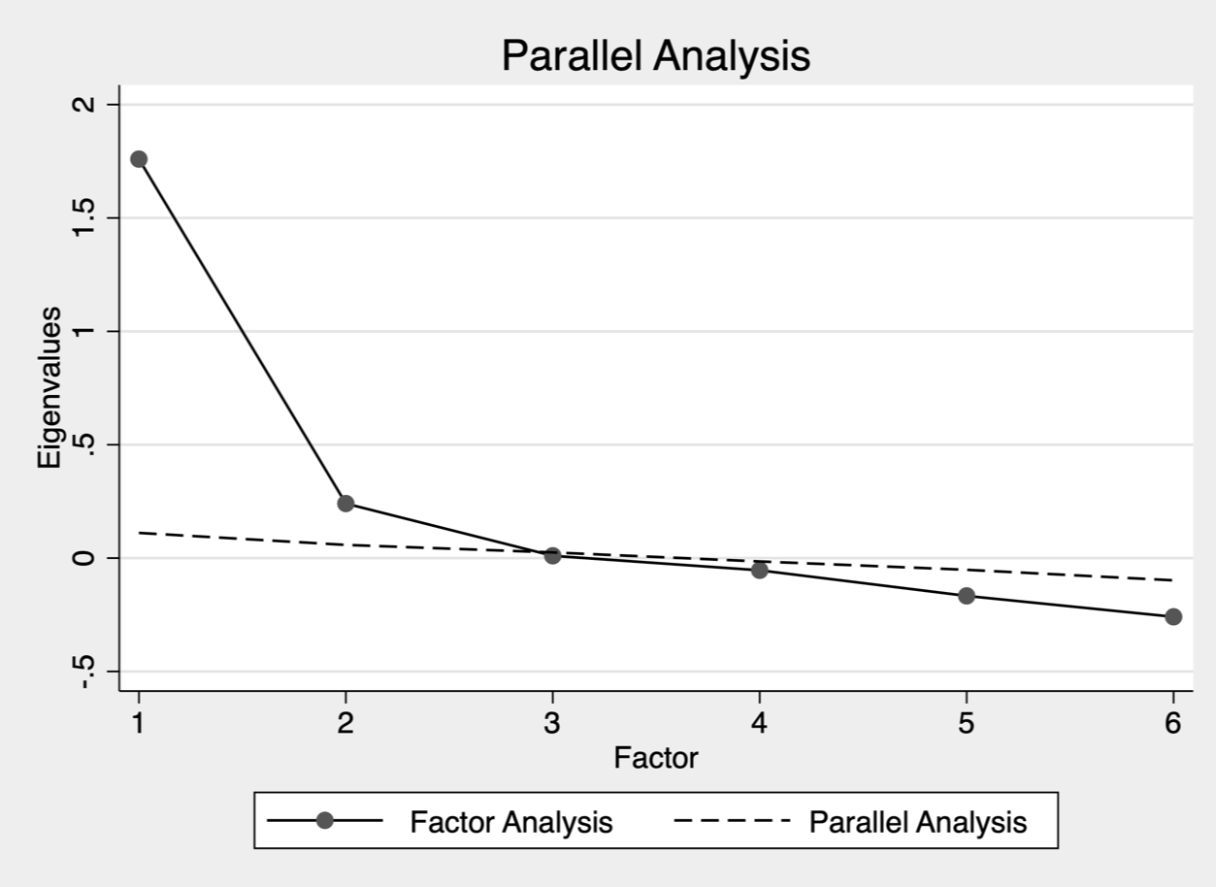
3. Spending Habits
What got included :
Spending in Shopping Centers
Spending on Branded Clothing
Spending on Entertainment
Spending on Looking
Spending on Gadgets
What did not get included:
Saving Money
Spending on Healthy Eating

Slide 19
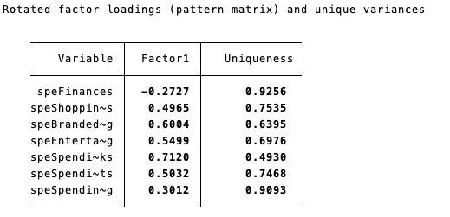
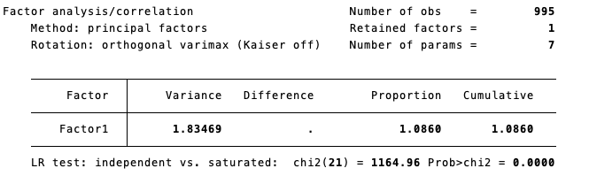
EFA results – Spending

Slide 20
Confirmatory Factor Analysis

Slide 21
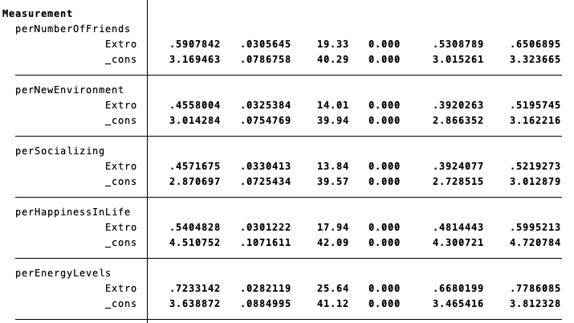
Extrovert Tendencies CFA
Factor loadings hold

Slide 22
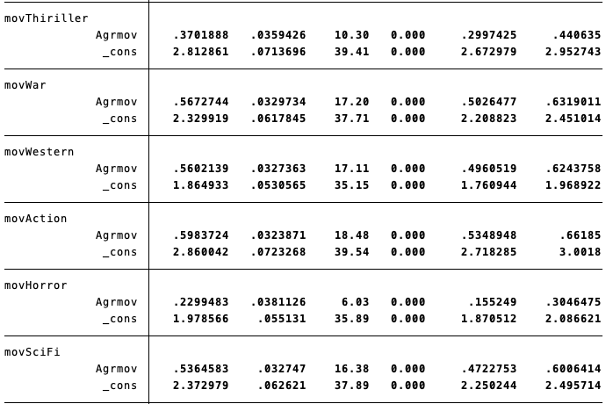
Aggressive Movies CFA
Factor loadings for Thriller and Horror movies drop below 0.4.
However, there is a strong co-variance between them.
We account for this in the LPA.
We re-ran the LPA analysis dropping Horror and the results were very similar.

Slide 23
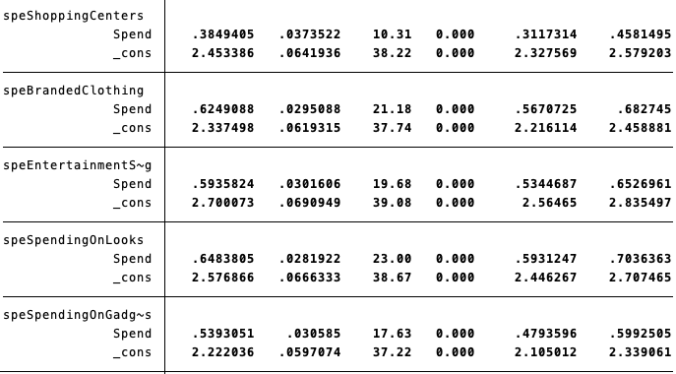
Spending Habits CFA
Factor loadings hold.
Except for Spending in Shopping centers, which drops to just shy of 0.4.

Slide 24
Latent Path Analysis

Slide 25
Covariances which were enabled to improve the model fit.
Thriller and Horror
Makes sense to some extent.
Shopping Centers & Spending on Looks
Most of the shopping in the city happens in shopping centers?
Specially probable amongst the youth.
New Environment & Socializing
The effect of this covariance is very very small.
All horror movies are thrillers?

Slide 26
Standardized Results of LPA

Slide 27
SEM Results
Model Fit
Chi2 = 425, p=0.0000
RMSEA = 0.058 (Less than 0.1)
CFI = 0.888
(Little less than 0.9)
Extrovert tendencies explains on average 40% variance in Extravagant Spending behavior amongst Youth.
Significant (0.000)
Watching Aggressive movies explains on average 11.0% of variance Extrovert tendencies amongst youth.
Significant (0.017)

Slide 28
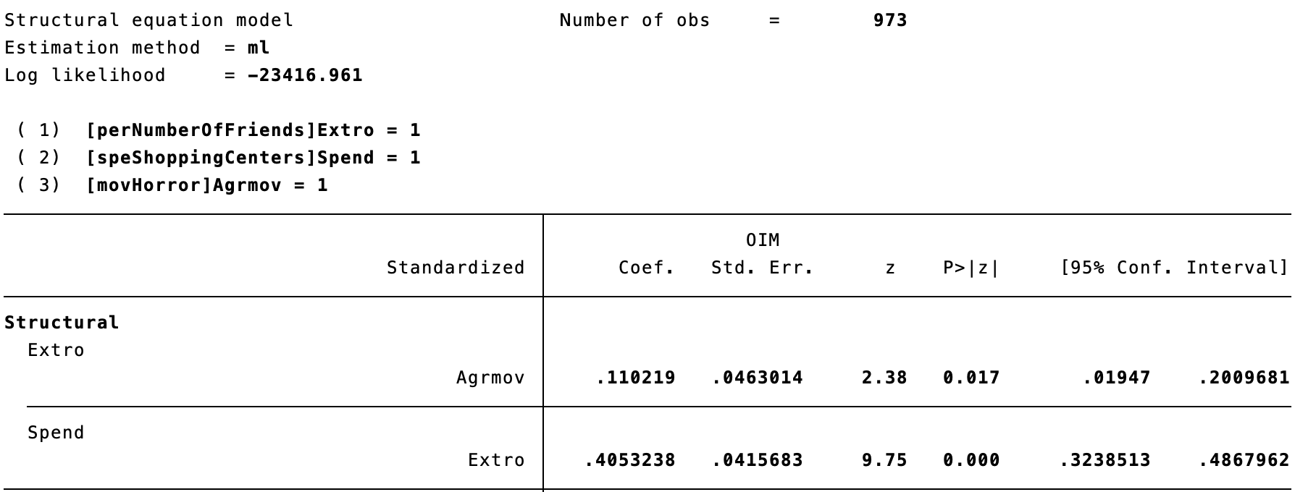
LPA Results

Slide 29
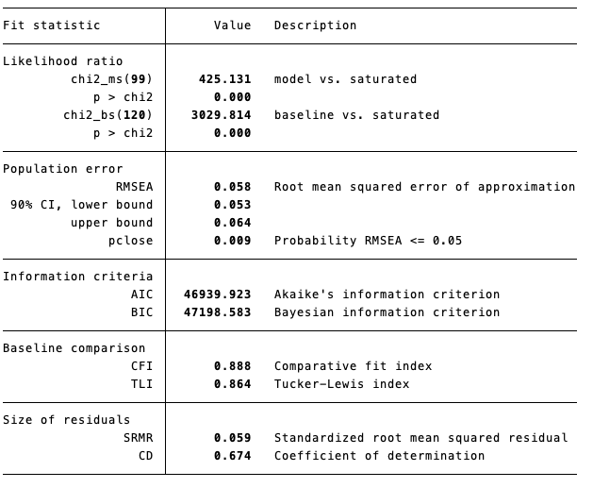
LPA Model Fit

Slide 30
Moderation Effect of Gender

Slide 31
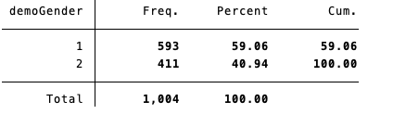
Gender Statistics
Group 1 = Female
Group 2 = Male

Slide 32
Gender Moderated Model Fit
Extrovert Females marginally more likely to spend then extrovert men.
0.408 (f), 0.395 (m).
Significance for both groups 0.000.
Effect of aggressive movies on extrovert reduces when controlling for gender.
From 0.11 for ungrouped to 0.022 (f) & 0.096 (m).
Hence, men more likely to be extrovert watching aggressive movies.
In fact for females, the results are not significant anymore.
Just shy of significance (0.748).
Model Fit : Chi2=736, p(Chi2) = 0.000

Slide 33
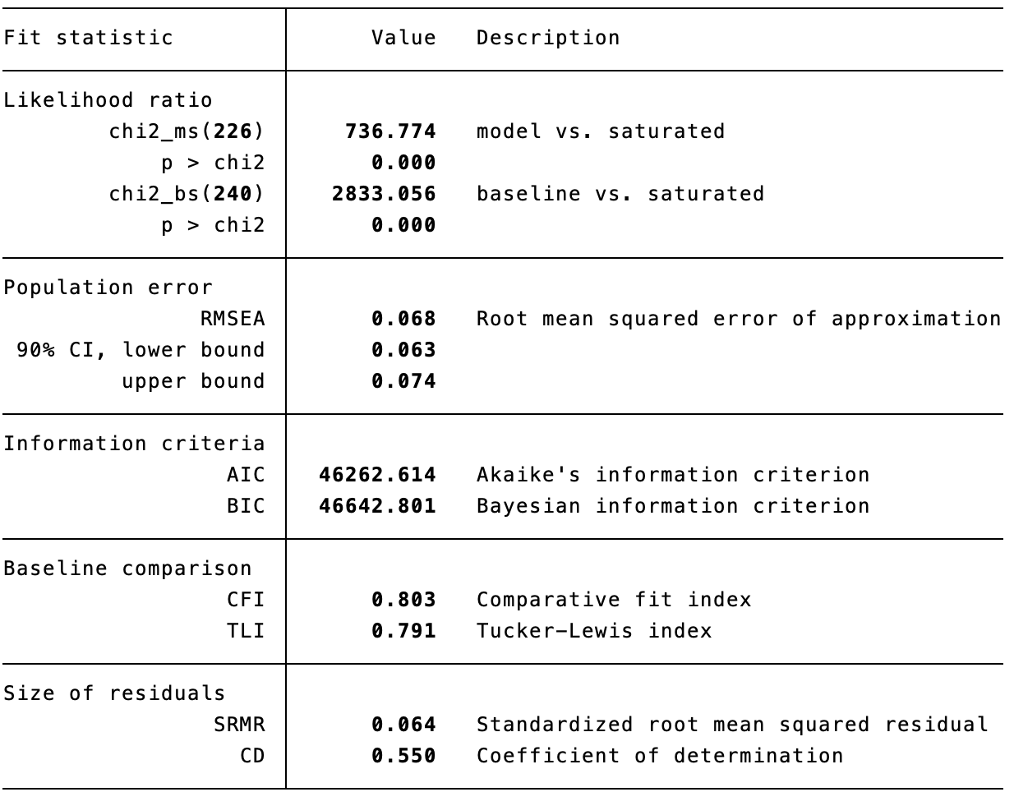
Gender Moderation Effects

Slide 34
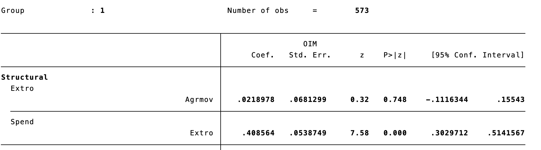
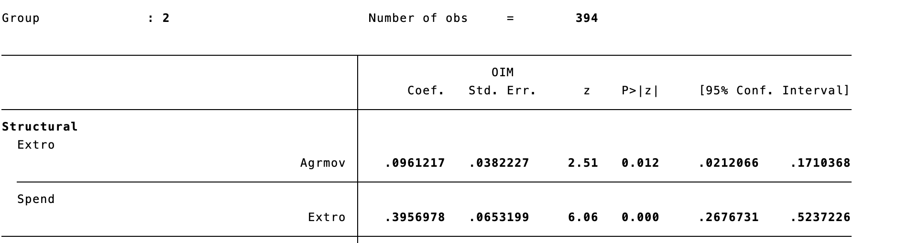
Moderation Model Results

Slide 35
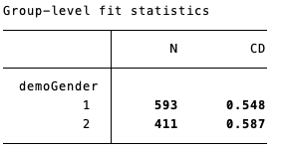
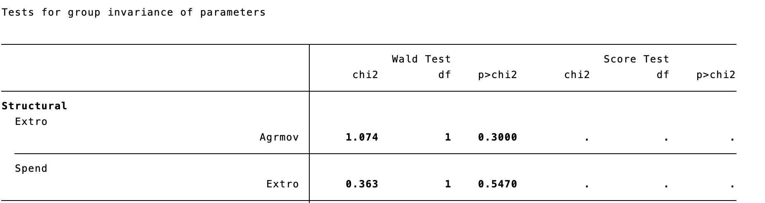
Test for group invariance of paramters
The groups are alike when it comes to the structural paths of the Model.
There is no significant difference in the variance between both groups..
Hence, there is no need to constraint either path.

Slide 36
Conclusion
On average, 4.47% of the tendency to spend on extravagant goods amongst extrovert youth surveyed can be explained by their preference of watching aggressive movies.
On average, about 11% of the extrovert tendencies amongst the youth surveyed can be explained by their preference for watching aggressive movies.
Effect of watching aggressive movies on extrovert tendencies is positive and significant for both genders but for women the effect is not very significant and marginal compared to men.
On average, 40% of the extravagant spending amongst the youth surveyed can be explained by effect of perceived extrovert tendencies. The results are similar and significant for both genders.

Slide 37
Limitations of our model
Indirect mediation effect not controlled for.
We expect if mediation effect exist in the data, direct effects will reduce.
Unobserved items or missing latent variables not controlled for.
Data on spending behavior of extravagant goods is to specific. Maybe include questions that are more elaborate and cover a wider spectrum of spending habits.
Extrovert tendencies is a broad subject and our model may not have addressed sufficient controls variables to be confident of our results.

Slide 38
Thank You!
Questions?

Slide 39
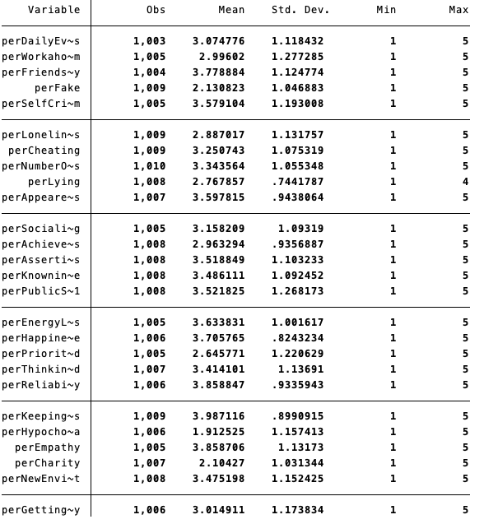
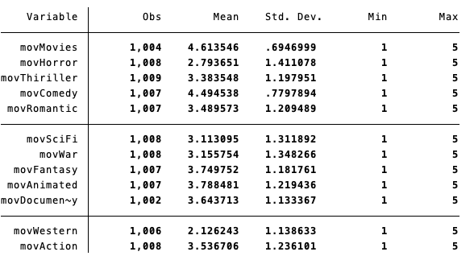
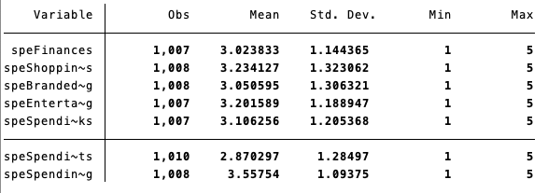
Summary Statistics

Slide 40
