Slide 1
Publications & Promotions Analysis
In Marketing Departments in Top Business School Across Europe
7th Nov 2018

Slide 2
Comments about Data Collection
Base year was taken as either the year of the graduation or year of first publication, whichever came first.
Only for 3 faculty members did the year of first publication come before year of graduation.
Data was collected either from Faculty member CV, LinkedIn, research gate, university newsletters, etc.
In many cases the CV’s were not available and hence LinkedIn, research gate, university newsletters, etc. were used.
In few cases the CV’s were not updated to 2018.
All attempts to get complete, accurate and latest information was made.
Apart from all top Marketing Journals, all Journals used in UT Dallas rankings were accounted for. These include journals from production, operations, strategy, etc.
Top Psychology journals were also counted for most professors.
Visiting Faculty, External Collaborators, etc. were not included.

Slide 3
Comments on Job Levels
Job Levels were taken as follows,
0 = Phd. Student
1 = Just Graduated, Research Fellow, etc.
2 = Assistant Prof.
3 = Associate Prof.
4 = Professor

Slide 4
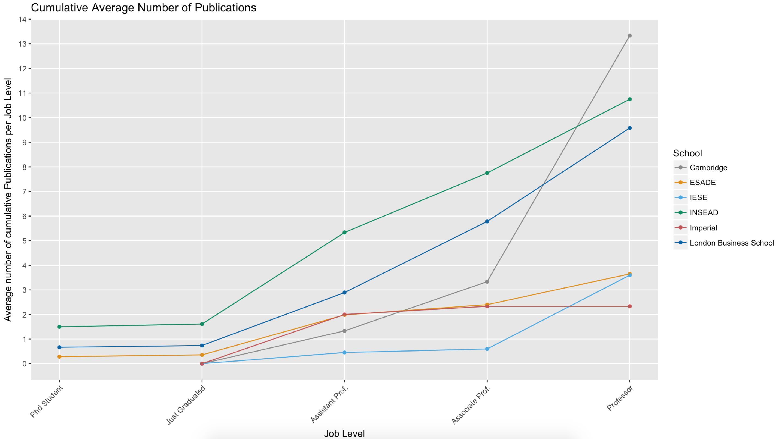
Average Publications = (Total Publication in a given level) / (Total Number of Faculty in that level)

Slide 5
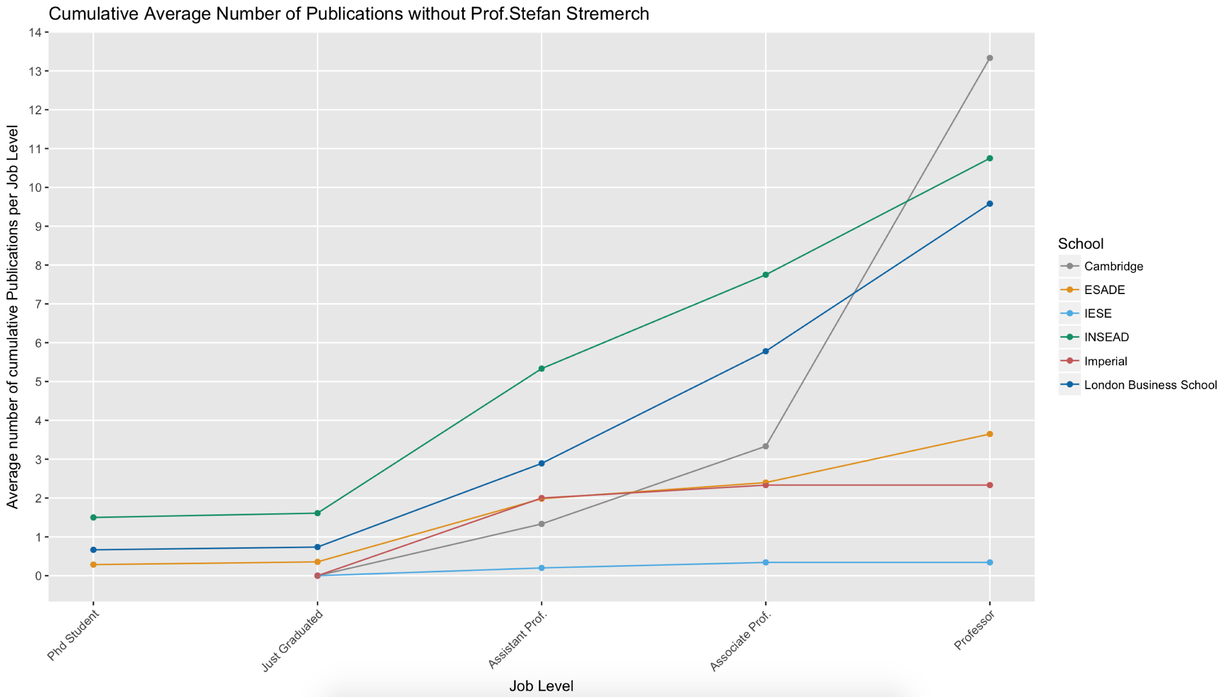
Average Publications = (Total Publication in a given level) / (Total Number of Faculty in that level)

Slide 6
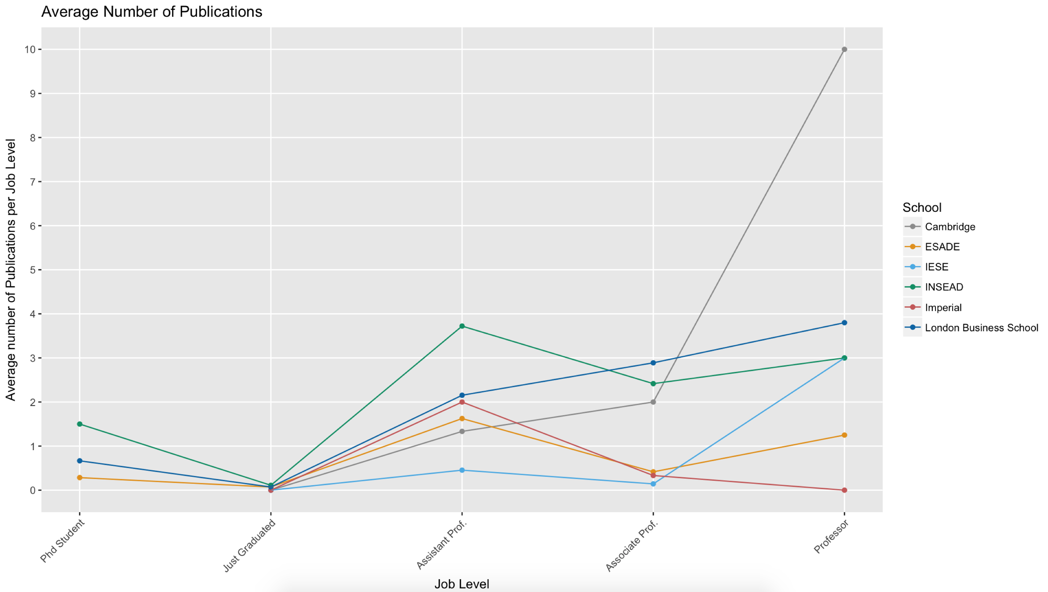
Average Publications = (Total Publication in a given level) / (Total Number of Faculty in that level)

Slide 7
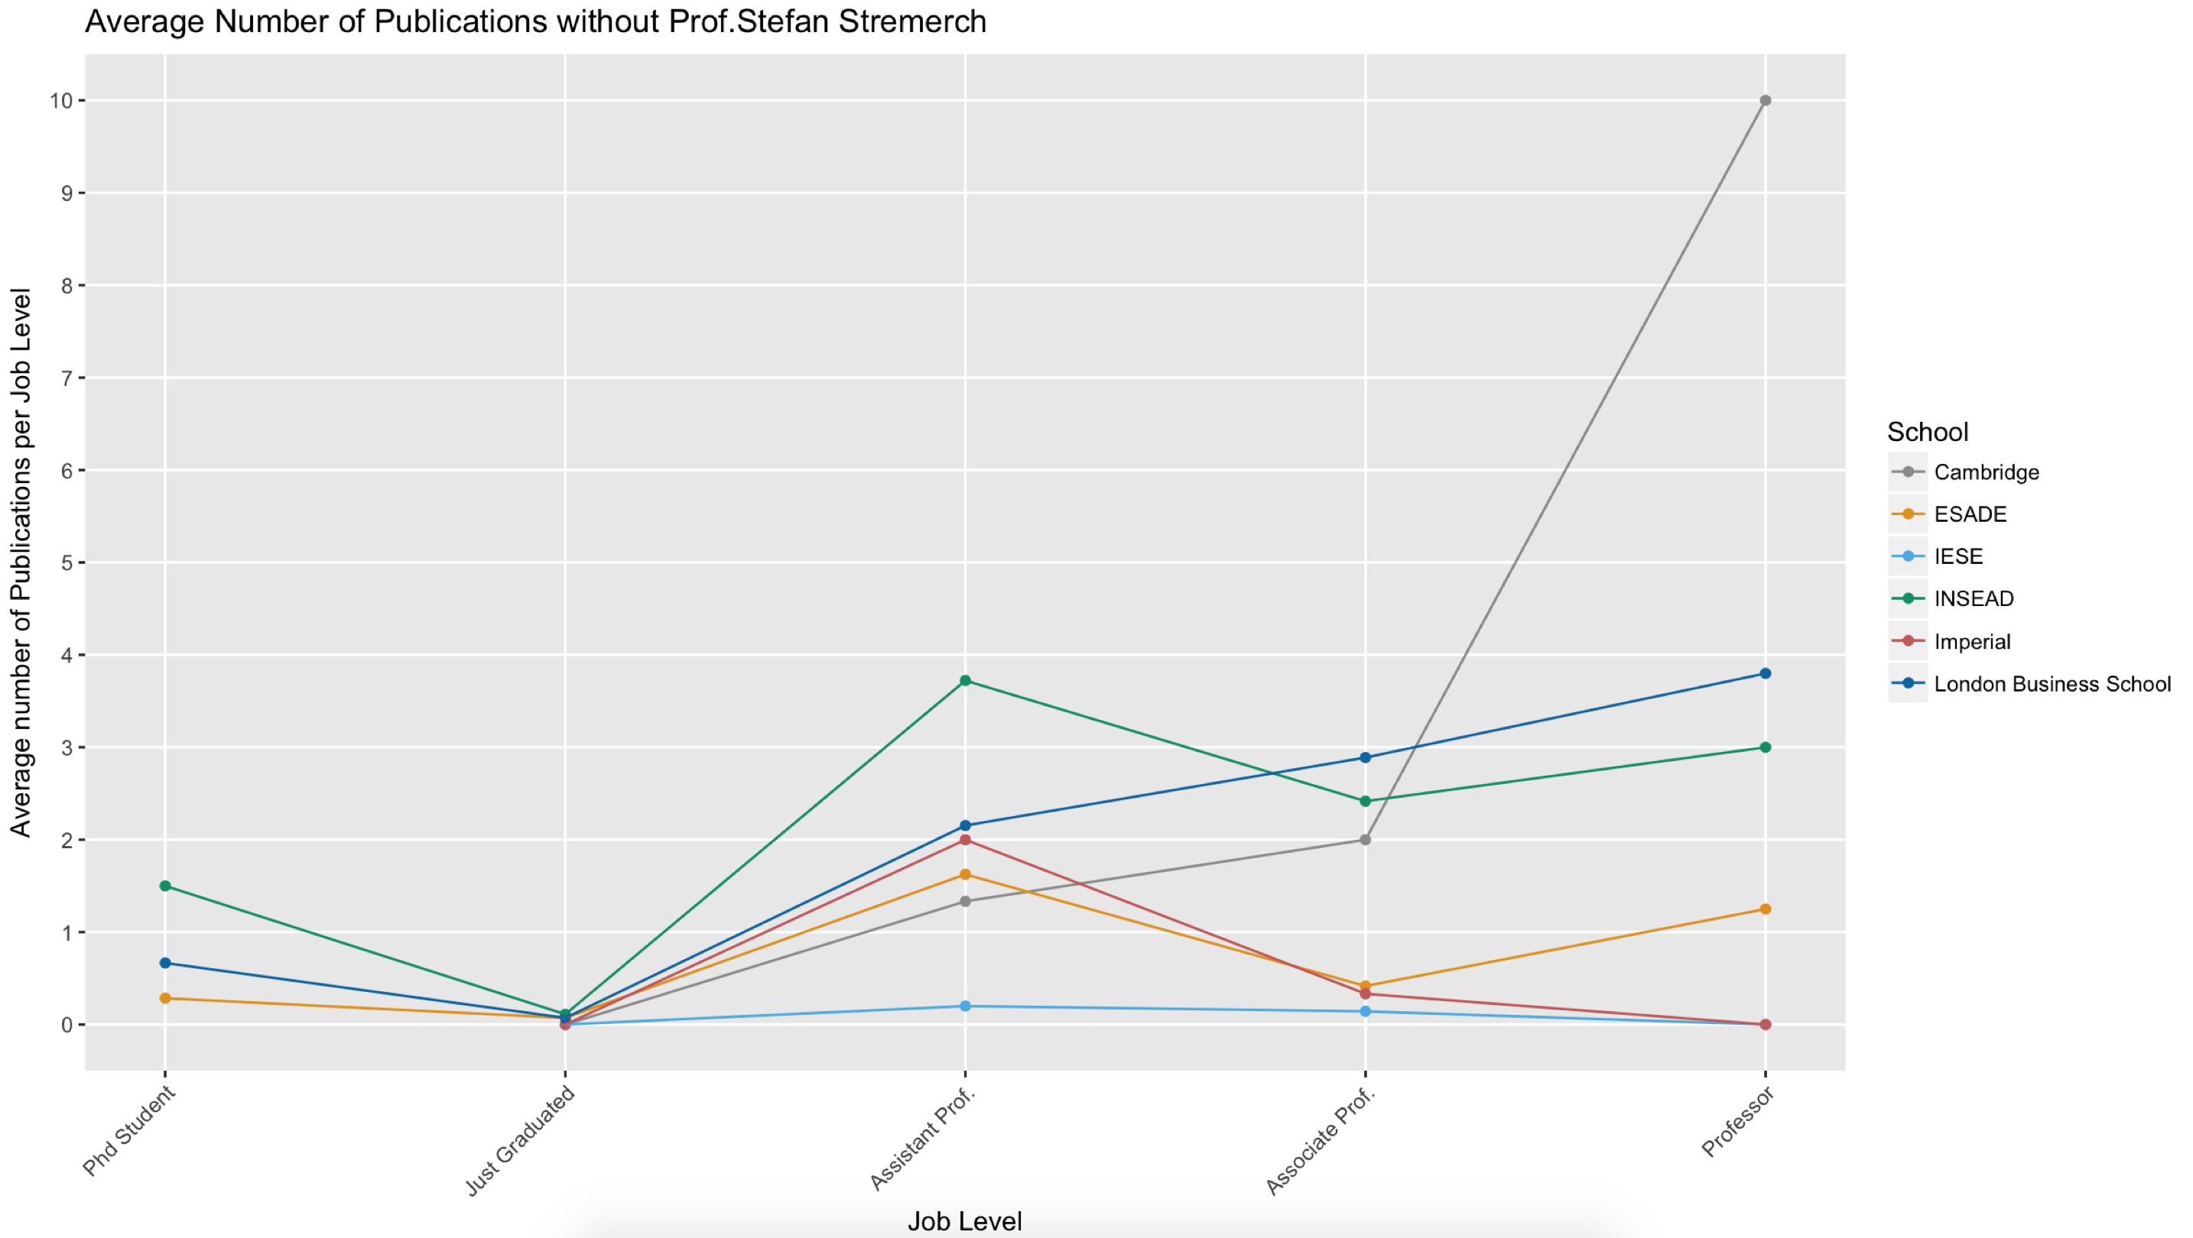
Average Publications = (Total Publication in a given level) / (Total Number of Faculty in that level)

Slide 8
Publications at Promotion
Following table provides average number of publications as Assistant Professor Job when being promoted to Associate Level and as Associate Professor when being promoted to Professor Level.
# | School | Avg. # of Publication as Assistant Prof. at promotion to Associate Prof. | Avg. # of Publications as Associate Prof. at promotion to Prof.
1 | Cambridge | 1.40 | 1.00
2 | ESADE | 2.16 | 1.00
3 | IESE | 0.62 | 0.20
4 | INSEAD | 4.13 | 2.77
5 | Imperial | 2.00 | 0.00
6 | London Business School | 2.80 | 3.20

