Slide 1

Coursera Capstone Project
Clustering and Segmentation of the neighborhoods in Mumbai

Slide 2
This is the final capstone project of the IBM Data Science course. This presentation contains the data and recommendation based on data analysis, the best possible area in Mumbai to open a restaurant or a beverage shop.

Slide 3
Introduction: Business Problem
Mumbai is the financial, commercial and entertainment capital of India and contributes to 6.16% of India's GDP. According to United Nations, Mumbai is the second-most populous city in India after Delhi. Investors and entrepreneurs all over the world want to invest in Mumbai due to it's business opportunities and large labor-force.
Due to it's high population, the food and beverage industry can prosper with a reasonably moderate investment and large profit margins. Thus, this project (report) can provide a perspective to entrepreneurs and investors from all over the world looking to invest in beverage and food industry in Mumbai. The analysis will provide a perspective on various areas (clusters) of Mumbai and will be able to tell where opening a beverage shop or a restaurant can prove profitable to the investor.

Slide 4
Data
The data for the list of neighborhoods in Mumbai is obtained from https://en.wikipedia.org/wiki/List_of_neighbourhoods_in_Mumbai
The different venues and it's queries is obtained from the FourSquare APIs. The dataframe will contain top 10 venues in each cluster of areas and will provide adequate information to make a decision about where to open beverage shops or restaurants. K-means clustering algorithm of machine learning will be used to cluster the areas (districts) of Mumbai with high accuracy and will be used to find pattern between the different districts and clusters.
Thus, the data will be used to meet the following objectives:
Neighborhoods and Areas of Mumbai
Trending Venues of the Areas
Categorizing the venues
Cluster different Areas of Mumbai using K-means algorithm
Then we gather the data from the Wikipedia page and extract the table or the Dataframe from the site using BeautifulSoup package and append it to our Dataframe.

Slide 5
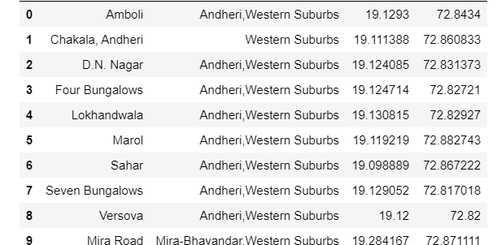

Slide 6
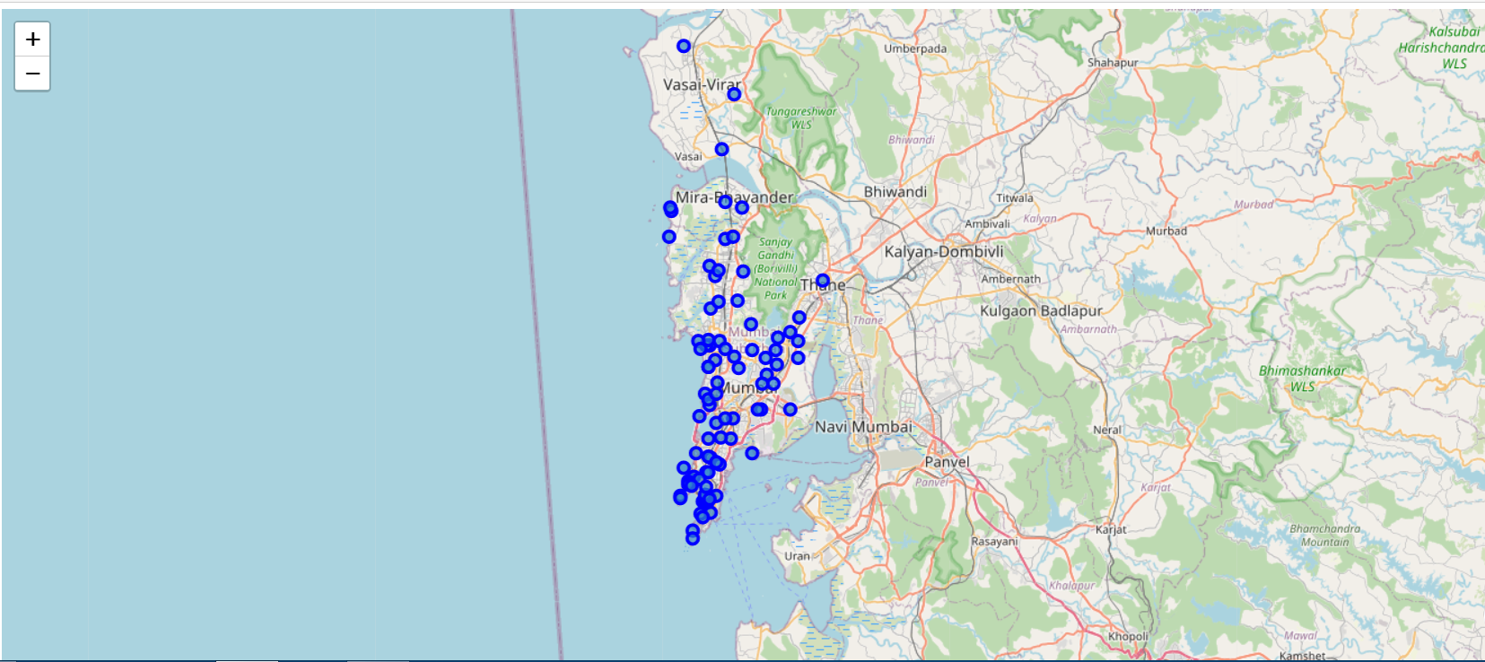
We use the Folium library and geopy library to get the map of Mumbai and all the neighborhoods marked in it.

Slide 7
Methodology
Our objective is to find the best suitable areas in Mumbai to open a restaurant or a beverage shop. We will use the K-means clustering algorithm to achieve our objective.
We will use the one-hot encoding method on the Venues Dataframe and then group it by Neighborhoods. The one-hot encoding will return the venue categories as column per neighborhood, and then it will be grouped together to provide the weighting of venue type occurrence on each neighborhood.
K-means clustering algorithm will help us cluster the neighborhoods based on the top venues in the encoded dataframe and provide cluster labels for similar neighborhoods. We will then observe the clusters one by one to determine it's content and then provide the appropriate recommendation.

Slide 8
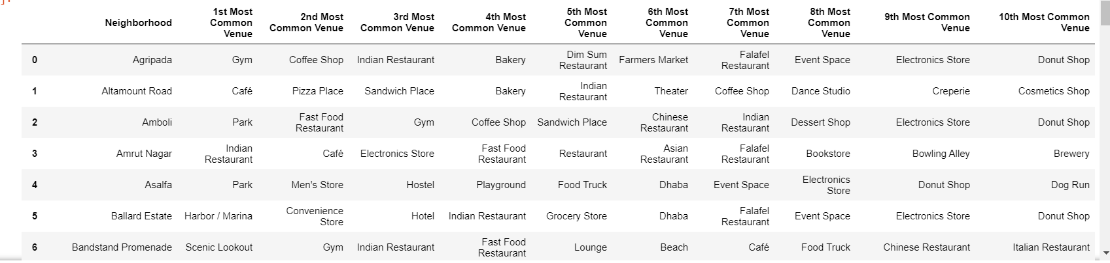
Data Analysis
We use the one-hot encoding approach to analyze each neighborhood and then group it by neighborhoods and get the 10 most popular and common venues around each neighborhood in the boroughs of Mumbai.

Slide 9
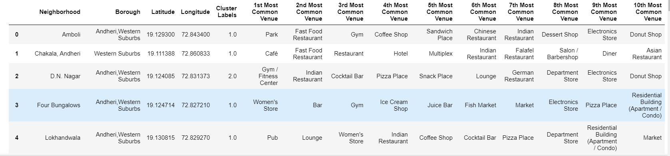
Machine Learning K-means Clustering Algorithm
We use K-means clustering method to cluster the neighborhoods. We assign the number of clusters to be 4 (at elbow point). We get a new Dataframe with cluster labels assigned to each neighborhood.

Slide 10
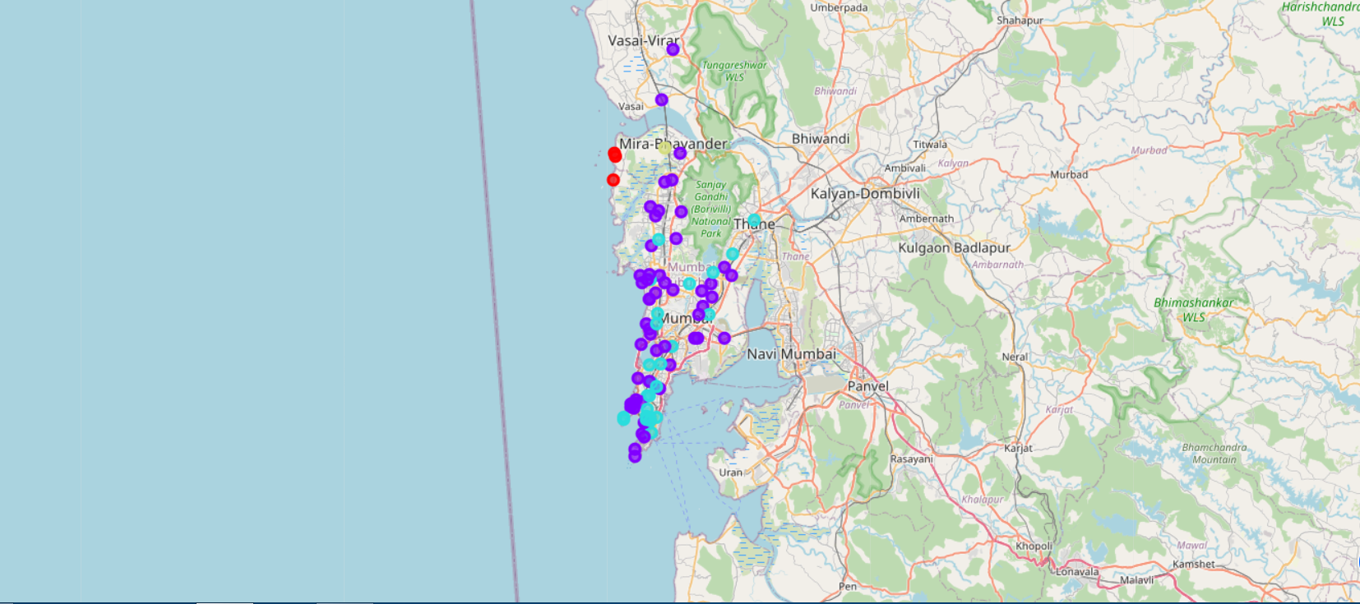
Data Visualization
We use the Folium library to visualize the clusters based on the cluster labels assigned to the neighborhoods.

Slide 11
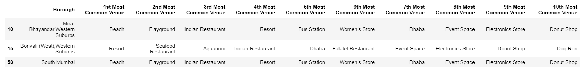
Results Section
Cluster 1
Looking at Cluster 1 we can say that there is an abundance of restaurants of different cuisines (Indian, Dhaba, Seafood, Falafel (Greek), Donut Shop) but they are lacking in beverage shops like a coffee shops or cafe's.

Slide 12
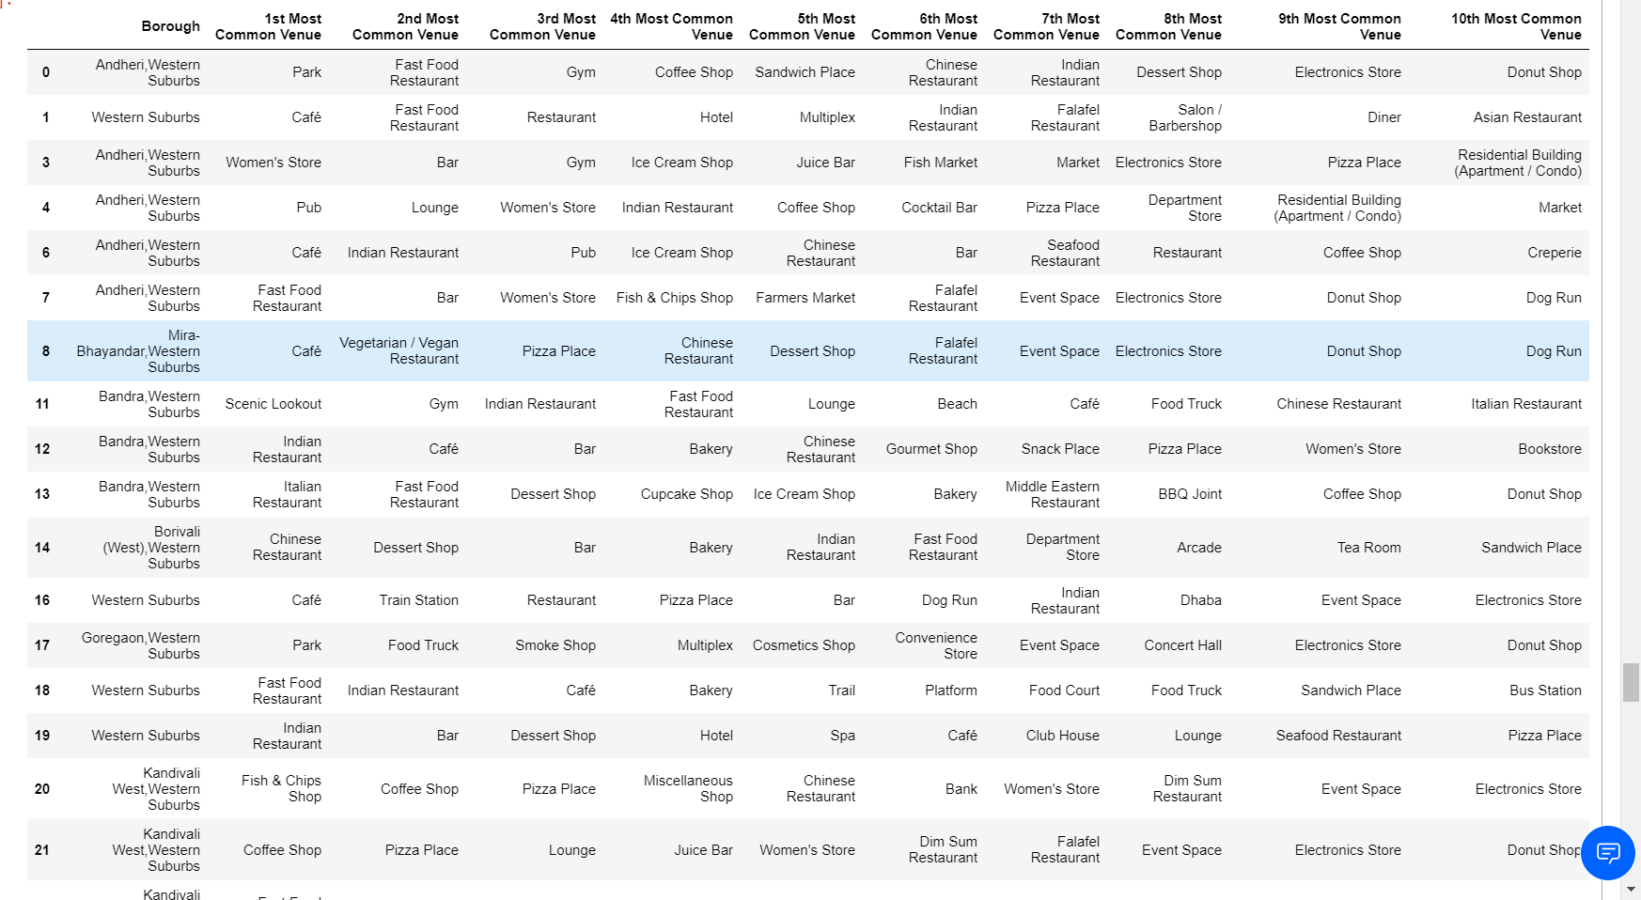
Cluster 2
This is the most extensive cluster spread across the entire map. While the Western Suburbs have plenty of restaurants of many cuisines and beverage shops of different kinds, the Eastern Suburbs and the Harbour Suburbs look to have a deficiency in good Chinese restaurants.

Slide 13
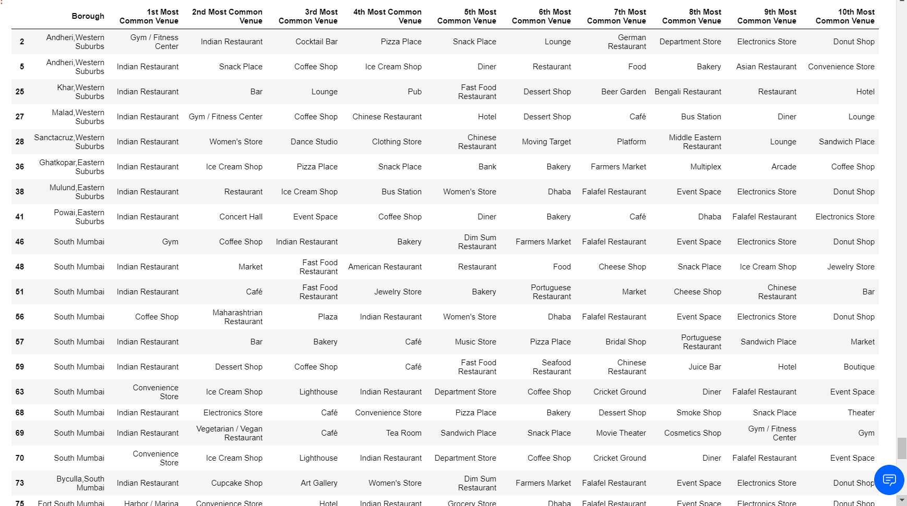
Cluster 3
While the South Mumbai areas have a lot of restaurants, bars and beverage shops, there is a deficiency in Andheri (Western Suburb area) in terms of coffee shops and cafe's.

Slide 14
Cluster 4
This a single cluster and has many good restaurants nearby but not enough beverage shops.

Slide 15
Discussion Section
In Cluster 1 we observe that there is a certain deficiency in beverage shops. Looking at other clusters and seeing the variety of beverage shops like bars, pubs, coffee shops and cafe's being one of the most popular venues, it would be viable for an investor or an entrepreneur to open a beverage shop of their liking.
Cluster 2 is the most extensive cluster of all and covers a lot of the map of Mumbai especially central and southern Mumbai. While the western suburbs have a lot of restaurants and beverage shops, it would not be profitable to open either of them without facing stiff competition. The harbour suburbs lack in Chinese cuisine based restaurants and thus that could be a good investment for a lot less competition. The same can be said about eastern suburbs but due to less foot traffic, the profit margin might not be substantial and can face a little competition from a few chinese restaurants placed there.
Cluster 3 is concentrated in the south of Mumbai and traverses a little towards the western areas of Mumbai. This cluster shows that South Mumbai although may not be lacking in terms of restaurants and coffee shops, it is still a commercial side of Mumbai and thus foot traffic will be high and hence can provide to be a market for a good restaurant or beverage shop depending on intricate places where the investor wants to open the restaraunts or beverage shops. The Andheri area in the western suburb is a stand out in that cluster as the presence of coffee shops and cafe's is scarce and thus can provide a good, less competitve market for investors.
Cluster 4 contains only one borough, and thus looking at the popular venues we can safely suggest that the area is deficient in terms of beverage shops and options like a cafe, coffee shop, restobar, pub can all prove to be successful with less-hassle.

Slide 16
Conclusion
Investors and entrepreneurs may particularly find the South Mumbai region in cluster 3 and harbour suburbs in cluster 2 to be the most finanicially, and economically viable as the foot traffic in these areas is high with many commercial sites and offices situated in these areas and hence we can conclude this by saying that the investors will find it profitable to invest in a restaurant or a beverage shop in certain parts of Mumbai and be successful.
Note: Due to COVID-19 pandemic the FourSquare calls to get the most popular and nearby venues in all the neighborhoods of boroughs in Mumbai, may not be 100% accurate as the calls depend on the time when the call is made and also on the foot traffic which can prove to be less than the usual days because of the pandemic situation in Mumbai and also in the world. Although I still feel that the results we got will be accurate with a very low error rate.

