Slide 1
Hello, Everyone!

Slide 2
Backend Development
What is backend development?
What is API, exactly?
How is it related to Backend development?

Slide 3
API (Application Programming Interface)
Some important concepts first!
JSON, HTTP, Web Browser🦊
Have you used APIs before? Share some examples

Slide 4
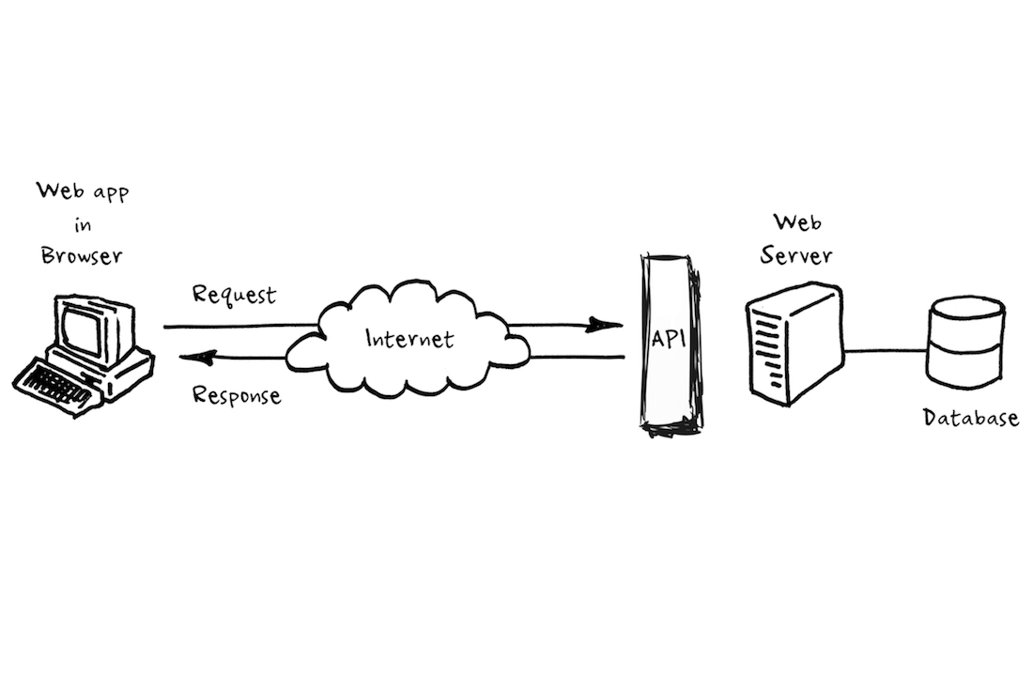

Slide 5




REST of API
By the way, REST stands for (REpresentational State Transfer)
GET
POST
PUT
DELETE

Slide 6
With me so far?
if (questions) {
ask();
} else {
write_it_down();
ask_later();
}
Even I don’t know all about this topic.
We both might learn something new!

Slide 7
Why are you here?
To work with APIs? Right? Or is there more?
How can we use *these* APIs??
Tools:
Python.requests (programming alert! 👩‍💻)
Postman (getpostman.com 🚀)
cURL (Linux ✨)
And Finally,
Your Web Browser🦊

Slide 8
Let’s make a API
How?
With Flask
What is Flask?
Python Web Framework, to build a web-server

Slide 9

What you can make
Your limitation, is only your imagination
You like working with AI/ML
Make an API to host your AI models online
Maybe scrape data from websites for training
Etc.
You like working with IoT
Make a API to receive/send data to IoT devices
Make WebSocket's for continuous data transfer
Etc.
You like working with Cybersecurity
There is no making here😂
Work with exploits that are there with APIs
Maybe you can find something new.
Etc.
Something unique

Slide 10
References
GET https://github.com/NishantJoshi00/api-seminar-material

