Slide 1
Convolutional Encoder & Trellis Coding / Decoding

Slide 2
Introduction
Convolutional codes map information to code bits sequentially by convolving a sequence of information bits with “generator” sequences
A convolutional encoder encodes K information bits to N>K code bits at one time step
Convolutional codes can be regarded as block codes for which the encoder has a certain structure such that we can express the encoding operation as convolution
Convolutional codes are characterized by three parameters: (n, k, m)
Where: n = Number of output bits
K = Number of input bits
m= Number of memory registers

Slide 3
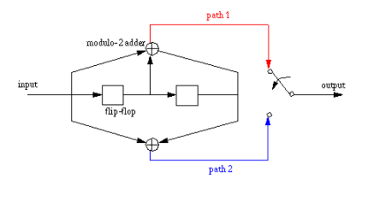
k =1, n = 2 , (2,1) Rate-1/2 convolutional code
Two-stage register ( M=2 )
Each input bit influences the output for 3 intervals (K=3)
K = constraint length of the code = M + 1

Slide 4
+
+

Slide 5
Input data: 111
Encoded Output: 11 _ _ _ _
+
1
1
0
0
+
1

Slide 6
Input data: 111
Encoded Output: 11 01 _ _
+
0
1
1
0
+
1

Slide 7
Input data: 111
Encoded Output: 11 01 10
+
1
1
1
1
+
0

Slide 8
1
+
c₂
Input
Output
1 0 1
0
0
c₁
+
1

Slide 9
Rate ½ Convolutional Encoder
1
+
c₂
Input
Output
1 0 1
1
0
1 1
c₁
+
0

Slide 10
Rate ½ Convolutional Encoder
0
+
c₂
Input
Output
1 0 1
0
1
1 1 10
c₁
+
0

Slide 11
Rate ½ Convolutional Encoder
+
c₂
Input
Output
1 0 1
1
0
11 10 00
c₁
+

Slide 12
0/00
S₀
b₀
b₁
0/11
1/11
S₂
1/00
S₁
0/01
0/10
1/10
States (b₀b₁)
s₀ 00
s₁ 10
s₂ 01
s₃ 11
S₃
1/01
Input 0
Input 1

Slide 13
Trellis Representation
00
00
00
00
00
00
s₀ (0 0)
0/00
11
11
11
11
11
11
S
0
0/11
1/11
s₁ (1 0)
11
11
11
11
1/00
00
00
00
00
S
2
S
1
0/01
01
01
01
01
01
0/10
1/10
s₂ (0 1)
S
3
10
10
10
10
10
1/01
10
10
10
10
s₃ (1 1)
01
01
01
01
Input: 101➔ Output:
111000

