Slide 1


SMART INDIA HACKATHON 2024
RAIL MADAD
Problem Statement ID – 1711
Problem Statement Title- Enhancing Rail Madad with Al-powered Complaint Management
Theme- Smart Automation
PS Category- Software
Team ID-
Team Name : Code TRAINers

Slide 2
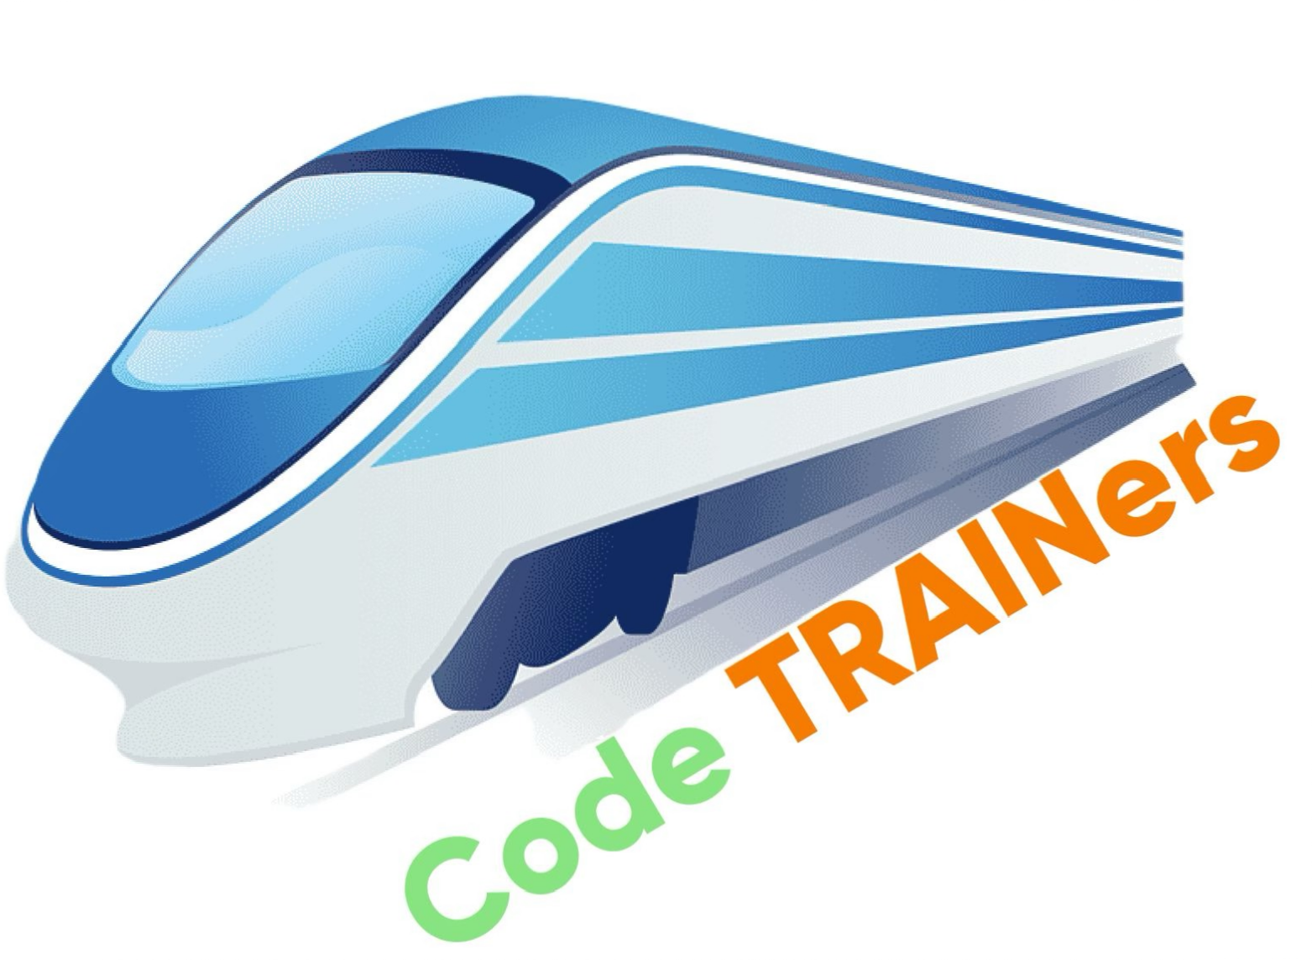
RAIL MADAD
Proposed Solution
Automated Complaint Categorisation:
Leverage AI to recognise and classify complaints based on images, videos, or text. Complaints are automatically categorised into predefined groups such as cleanliness, infrastructure damage, staff behaviour, and service issues, enabling quicker and more accurate routing to relevant departments and reducing manual work.
Urgency-Based Prioritisation:
AI evaluates the severity of complaints by analysing their content, allowing critical issues like safety threats, medical emergencies, or major disruptions to be prioritised over less urgent matters for faster resolution.
Legitimacy Verification:
Use metadata such as location, timestamp, and user patterns to validate the authenticity of complaints. This helps in filtering out false reports, duplicate complaints, or irrelevant feedback, ensuring that only legitimate concerns are addressed.
Dynamic Rating System:
Continuously adjust ratings for trains and stations based on complaint frequency and the sentiment of feedback. This provides a real-time measure of performance, highlighting areas that need improvement and motivating service upgrades.
SOS Button:
A dedicated emergency feature for passengers in distress (e.g., security threats, medical emergencies) that sends verified, real- time notifications directly to the TTE (Train Ticket Examiner) or relevant authorities for immediate action.

Slide 3
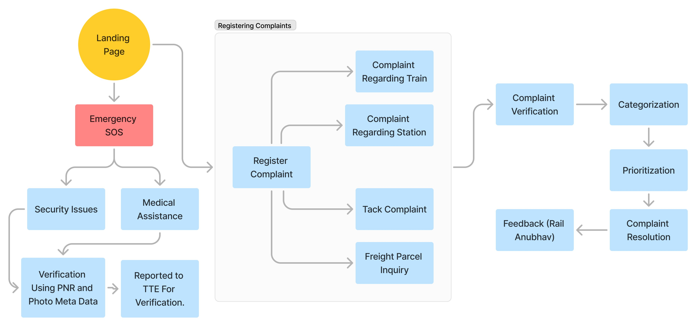
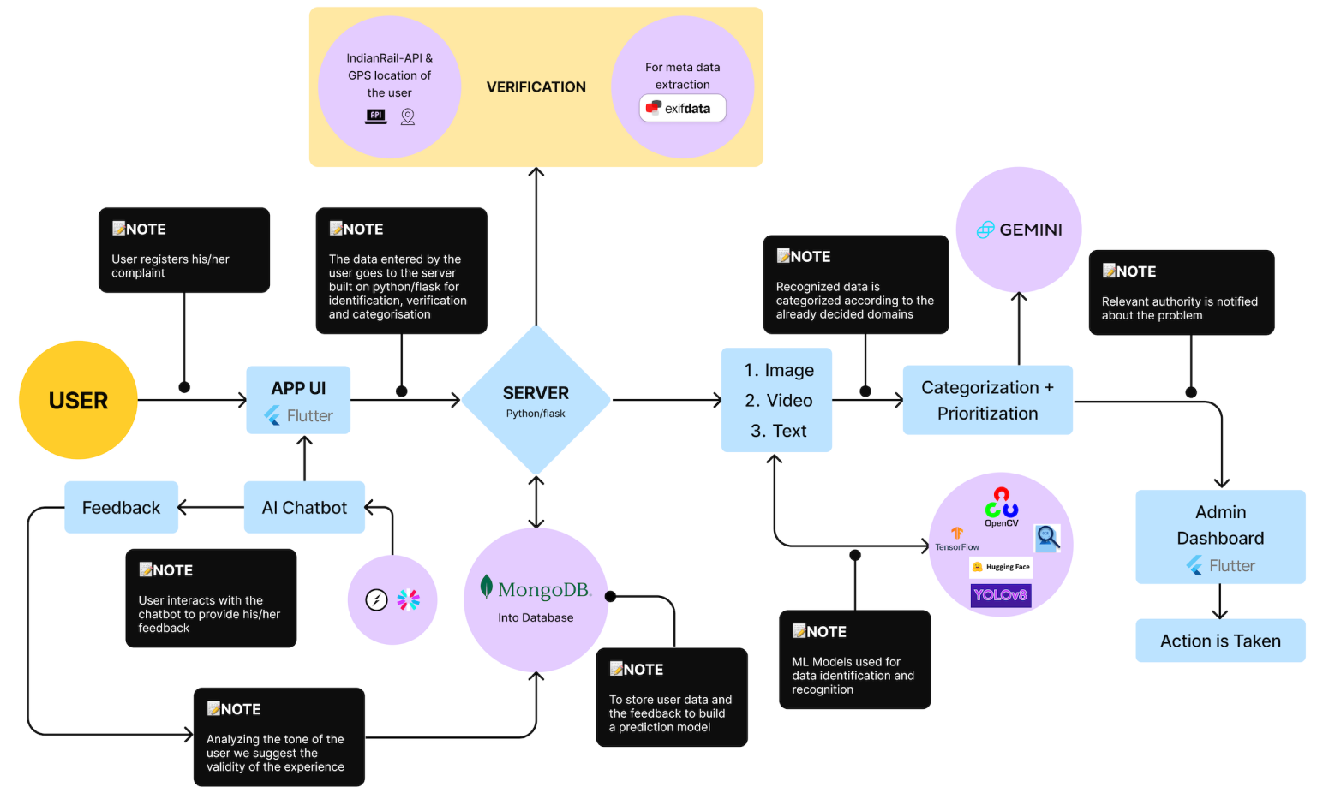












TECHNICAL APPROACH
Database-driven web applications.
Machine learning & AI
Building and training machine learning models
Object detection ,image and video recognition
To know the Current Location of the Train
For scaling the Application
Computation & manipulation of data inPython
MongoDb will be used for storing data of the users
Building microservices & restful API’s
For creating the Front-end of the App
Framework for Front-end
For Dynamic AI-ChatBot

Slide 4
FEASIBILITY AND VIABILITY
Technological Feasibility
AI models for text, image, and video recognition are mature and readily available.
Integration with existing infrastructure (Rail Madad backend) is achievable with modern APIs and cloud services.
Scalability ensured through cloud-based solutions, allowing for real-time processing of large complaint volumes.
Operational Feasibility
Minimal disruption to current workflows as our Models can work alongside human operators for verification.
Training The models on existing complaint data ensures smooth implementation without overhauling the system.
Staff training on new features like urgency prioritisation and SOS button is straightforward.
Financial Viability
Initial setup costs for AI integration can be offset by improved efficiency and reduced manual workload.
The system’s ability to reduce false complaints and prioritise urgent issues will enhance resource allocation, improving overall service quality.
Long-term cost savings through reduced processing time and improved passenger satisfaction.
Market Viability
Growing demand for AI-driven solutions in public service makes this a forward-thinking upgrade.
Positive public perception as AI improves complaint resolution speed and transparency, enhancing passenger trust in Indian Railways.

Slide 5
IMPACT AND BENEFITS
Faster Complaint Resolution
AI-driven categorisation and prioritisation streamline the process, ensuring quicker response times and improving passenger satisfaction.
Increased Accuracy
AI validates complaints using metadata, reducing false reports and ensuring genuine issues are addressed promptly.
Improved Resource Allocation
Urgency-based prioritisation ensures that critical issues (e.g., safety, emergencies) receive immediate attention, optimising resource use.
Data-Driven Insights
Continuous feedback through the dynamic rating system provides actionable insights, helping Indian Railways to enhance service quality across trains and stations.
Enhanced Passenger Safety
The SOS button allows real-time communication for emergencies, leading to faster interventions and increased passenger security.
Boost in Public Trust
Transparent, AI-powered systems foster trust in the complaint resolution process, enhancing the reputation of Indian Railways.

Slide 6
RESEARCH AND REFERENCES
https://medium.com/@kiprotich01/how-to-build-a-predictive-model-using-machine-learning-500be787127d
https://www.e3s-conferences.org/articles/e3sconf/pdf/2024/07/e3sconf_star2024_00085.pdf
https://www.sciencedirect.com/science/article/abs/pii/S2210970621000317
https://www.researchgate.net/publication/377716736_YOLOv8-CAB_Improved_YOLOv8_for_Real- time_object_detection
https://www.sciencedirect.com/science/article/pii/S2210970621000317?via%3Dihub
https://www.e3s-conferences.org/articles/e3sconf/abs/2024/07/e3sconf_star2024_00085/ e3sconf_star2024_00085.html
Survey Form: https://docs.google.com/forms/d/1-peST1ENsNNcfmmprCyujmVktQ2eG1O4YMOqZlVcY6k/edit
App Prototype: https://www.figma.com/proto/0c11PbbA3Opx3dsK3BDdTw/SIH-APP-prototype?page- id=0%3A1&node-id=9-345&viewport=-206%2C332%2C0.36&t=Bnv53zRaS9trcIJF-1&scaling=scale- down&content-scaling=fixed
Problem Categorization Chart: https://drive.google.com/drive/folders/17oRQ-wautShc-Oi-kOC-D5S4LPtIBsHN

