Slide 1
NON-INVASIVE GLUCOSE · NEAR-INFRARED SPECTROSCOPY
EarSpectro: predicting blood glucose from earlobe NIR spectra
ML / DL framework, end-to-end pipeline, formulas, architectures and first results on synthetic data
1050
1200
1450
1550
1650
nm · the five EarSpectro LED wavelengths
github.com/Nishanth-nishu/glycemico-pred · October 2026
Notes:
Overview deck of the EarSpectro glucose-prediction framework: formulas, architecture, pipeline, data and first results. All results come from synthetic data.

Slide 2
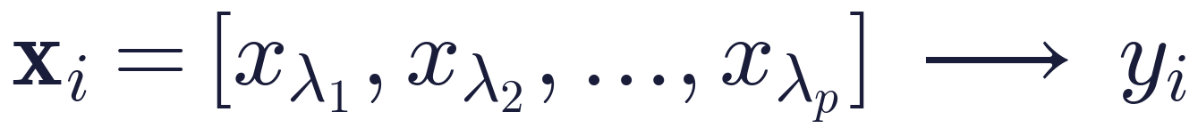
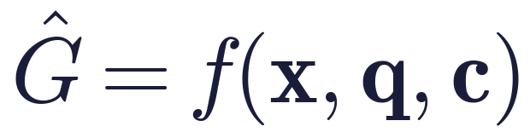
PROBLEM
Can earlobe NIR spectra predict glucose in people the model never saw?
Do multi-wavelength NIR measurements from the earlobe carry reproducible glucose information for subject-independent prediction, and which preprocessing, wavelength set, model and calibration give the most robust mapping from ear spectra to reference glucose?
Regression formulation
What the model should really learn
x: absorbance at p wavelengths (5 LEDs: 1050, 1200, 1450, 1550, 1650 nm)
y: reference blood glucose (mg/dL)
Glucose changes absorbance by ~0.1% of the total signal
x: the spectrum
q: signal-quality information (QC score Q)
c: calibration / subject information
Output target: (Ĝ, Q, U), the prediction, quality and uncertainty
EarSpectro · glycemico-pred · synthetic-data study
2
Notes:
The task is framed as spectral disentanglement and generalisation, not plain regression.

Slide 3
SUMMARY
Five findings so far, on synthetic data
0.54
< 0
0.38
-0.09
R² on unseen subjects (positive control)
R² with 5 LEDs at realistic glucose strength
R² with a dense 1000–1700 nm spectrum
FFNN R² on unseen subjects
The pipeline finds glucose when the signal is there
No model beats predicting the mean
Same physiology, many more channels
Same model scores 0.60 on a random split: random splits overstate accuracy
5
Calibration gain is mostly the reference level. A spectra-free control (mean of the calibration readings) matches every calibrated model on 5 LEDs. On the dense spectrum the optical model adds ~4 mg/dL on top.
EarSpectro · glycemico-pred · synthetic-data study
3
Notes:
Synthetic results validate the pipeline and probe design questions. They are not device accuracy.

Slide 4
01
Pipeline, data and methods
Signal model · dataset · QC · preprocessing · features · models · evaluation · calibration

Slide 5
ARCHITECTURE
End-to-end pipeline: from raw ear spectrum to (Ĝ, Q, U)
1
2
3
4
5
6
Ear NIR acquisition
Reference sync
Quality control
Preprocessing
Representation
Feature / λ selection
5 LEDs · repeats
nearest G within 5 min
Q score · reject < 0.5
SG · SNV · MSC · d1/d2
Track A spectrum · B features
corr · mRMR · RFE · nested
data/io.py
data/io.py
qc.py
preprocessing.py
features.py
selection.py
12
11
10
9
8
7
Output
Explainability
Calibration
Subject-level validation
Neural nets
Classical ML
Ĝ + Q (+ U planned)
permutation · SHAP
0 / 1 / 2 / 3 / 5 points
random · subject · session
FFNN · 1-D CNN
PLSR · SVR · RF · XGB · CatBoost
metrics.py · plots.py
explain.py
calibration.py
splits.py
models/nets.py
models/classical.py
Dark boxes: the stages that most affect whether results generalise (quality gate, subject-level validation, calibration).
EarSpectro · glycemico-pred · synthetic-data study
5
Notes:
Each box is a module in the earspectro package. Everything after the split is fitted on training subjects only.

Slide 6
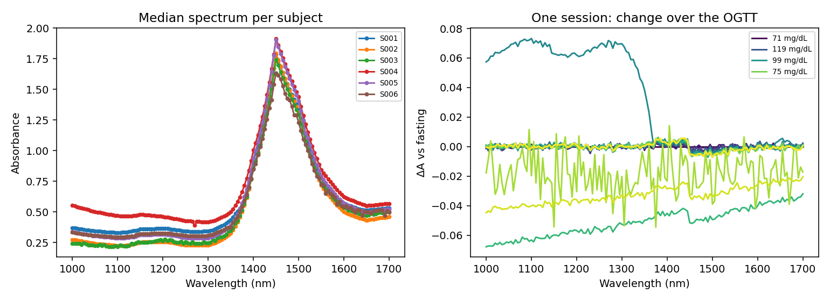
SIGNAL MODEL
The measured spectrum is a mixture; glucose is a tiny part of it
s_glucose
C–H/O–H overtones ~1530–1690 nm, ~1130 nm
s_water
dominant; 1450 nm band, shifts with temperature
s_tissue
lipid ~1210 nm, protein ~1180/1500 nm
s_Hb
falls off smoothly above 1000 nm
s_scatter
a·(λ/1000)^-b, varies per subject
Left: subjects differ by far more than glucose ever moves the spectrum. Right: change in one session over the glucose test, mostly water/temperature.
s_motion / s_sensor
offsets, gain, tilt, ambient light
EarSpectro · glycemico-pred · synthetic-data study
6
Notes:
Glucose adds roughly 0.002 OD per 100 mg/dL at its strongest band, against ~0.1 OD of between-subject tissue variation.

Slide 7
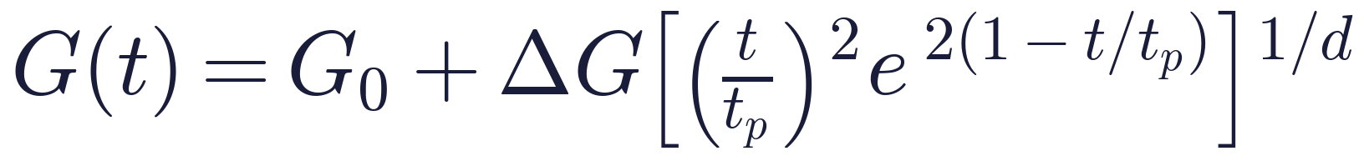
DATASET
Synthetic ear-NIR generator (stand-in until real recordings exist)
L_s path length · w, l, p, h tissue fractions · δT skin-temperature shift · γ glucose band strength · g_s subject response · a, b scatter · o, τ gain and tilt · ε sensor noise
Glucose trajectory: OGTT-shaped
Level | What varies
Subject (40) | path length, tissue, Hb, scatter, glucose response, age, sex, skin tone
Session (2 per subject) | LED gain, placement tilt, temperature offset, glucose curve
Timepoint (16 × 10 min) | glucose, temperature drift
Repeat (3 per timepoint) | sensor noise; 3% motion / ambient / saturation / dropout
Normoglycaemic: G₀ ≈ 92, ΔG ≈ 55, peak ≈ 45 min
Diabetic (30%): G₀ ≈ 140, ΔG ≈ 110, peak ≈ 70 min
Reference meter error: 5% CV
Confounder: skin temperature drifts after the glucose load
40 × 2 × 16 × 3 = 3,840 spectra per dataset
EarSpectro · glycemico-pred · synthetic-data study
7
Notes:
Modified Beer–Lambert style absorbance with subject, session and timepoint effects. Glucose band strength gamma is a free parameter.

Slide 8
DATASET
Three dataset variants, each answering a different question
ear5
dense
control_ear5
The device as designed
What a spectrometer would see
Positive control
5 LEDs: 1050–1650 nm
γ = 2×10⁻⁵ OD per mg/dL
noise 1.5×10⁻³ OD
temperature confounder on
141 points, 1000–1700 nm, 5 nm step
same physiology and γ
same confounder
5 LEDs
γ = 1×10⁻⁴ (5× stronger)
confounder off
proves the pipeline can find signal
Where the numbers come from
Glucose NIR band positions: Amerov, Chen & Arnold (2004), Applied Spectroscopy 58(10) — molar absorptivities of glucose, first overtone and combination regions
Water absorption magnitudes: rough literature values (e.g. Hale & Querry, 1973; citation not auto-verified)
Lipid, protein, Hb, scatter terms: generic NIR tissue-optics shapes, deliberately approximate
No real EarSpectro recordings yet. Real data plugs in through the same CSV schema (next slide)
EarSpectro · glycemico-pred · synthetic-data study
8
Notes:
Band positions follow published NIR assignments; values are approximations, not measured spectra.

Slide 9
DATA CONTRACT
One row per spectrum, paired with its reference glucose
Column | Meaning
subject_id, session_id | identifiers (required)
timestamp | acquisition time (required for sync)
glucose_ref | reference glucose, mg/dL (target)
A_1050 … A_1650 | absorbance per wavelength, −log₁₀(I/I₀)
timepoint, repeat | repeated-measurement structure
age, sex, skin_tone, … | metadata for subgroup analysis only
Reference synchronisation
Pair X(t) with G(t), never X(t₁) with G(t₂)
Spectra with no reading within 5 min are dropped
The lag is kept as ref_lag_s for error analysis
Same format for real data: DATA=real.csv sbatch slurm/run_all.sh reruns every experiment on it.
EarSpectro · glycemico-pred · synthetic-data study
9
Notes:
Metadata is retained for confounding and subgroup analysis and is never fed to the models.

Slide 10
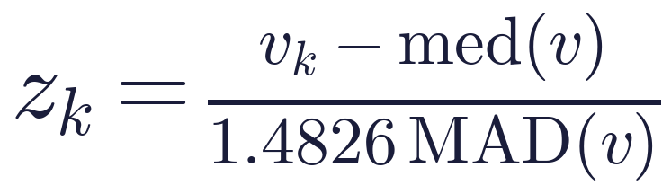
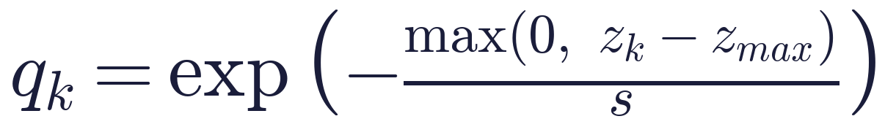
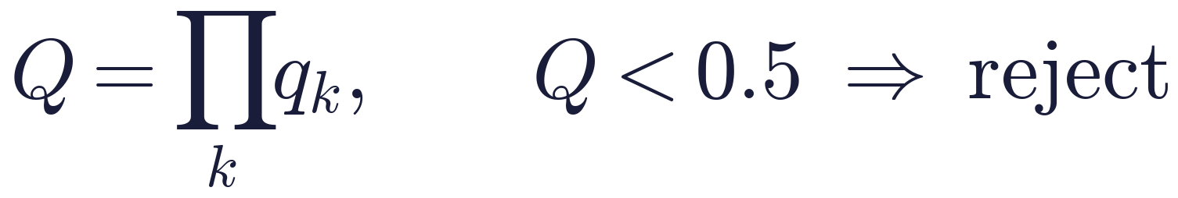
STAGE 2 · QUALITY CONTROL
A quality score Q gates every spectrum before modelling
missing wavelengths
absorbance out of range
saturation (clipped values)
abnormal amplitude
spectral discontinuity
disagreeing repeats
Clean spectra rejected: 0.05% (2 of 3,732).
EarSpectro · glycemico-pred · synthetic-data study
10
Notes:
All checks are unsupervised and fitted on the training fold. One bad property is enough to reject a spectrum because Q is a product.

Slide 11
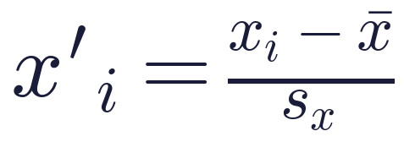
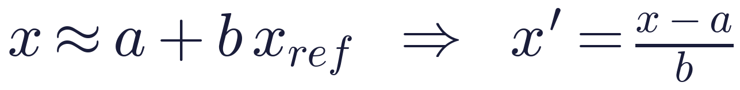
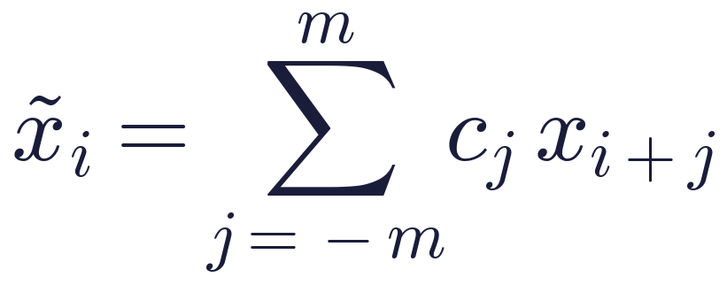
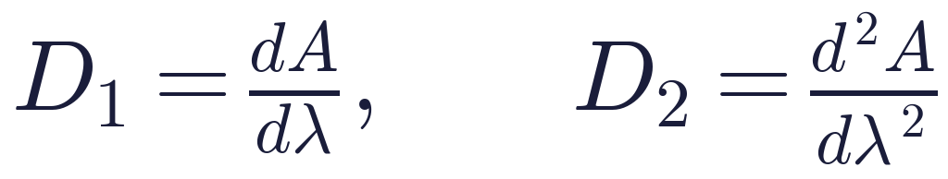
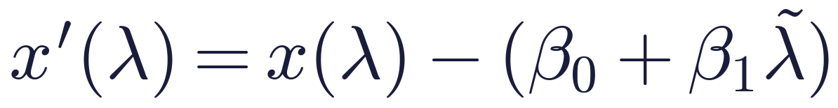
STAGE 3 · PREPROCESSING
Ten preprocessing variants, compared rather than assumed
SNV
MSC
Savitzky–Golay
removes per-spectrum offset and scale (Barnes et al., 1989)
regress each spectrum on the training mean (Geladi et al., 1985)
local polynomial smoothing (Savitzky & Golay, 1964)
Derivatives
Detrend
Variants tested
raw · detrend · sg · snv · msc · d1 · d2 · sg+snv · sg+msc · d1+snv
remove broad baselines, sharpen bands; amplify noise
remove a linear baseline in λ per spectrum
On the sparse 5-LED grid, SG windows shrink to the available points and derivatives use finite differences on the true wavelength spacing.
EarSpectro · glycemico-pred · synthetic-data study
11
Notes:
All transforms run inside the sklearn Pipeline, so anything with state (MSC reference) is fitted on training subjects only.

Slide 12
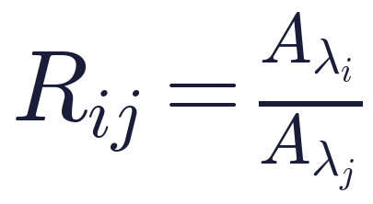
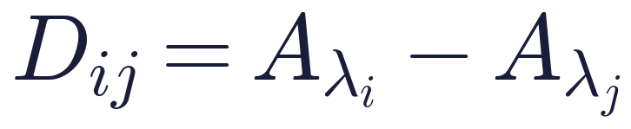
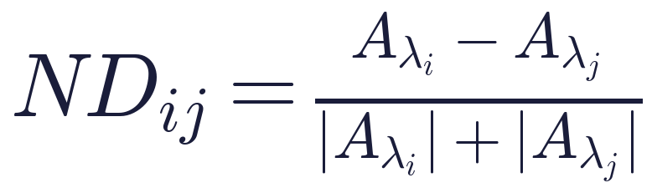
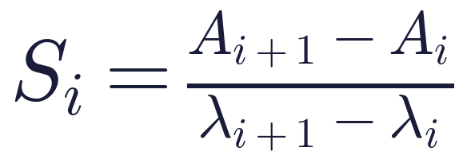
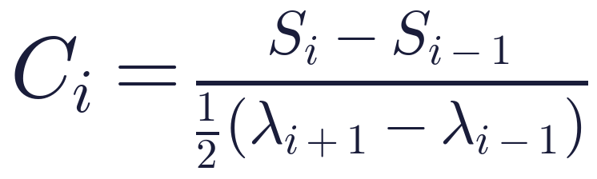
STAGE 4 · REPRESENTATION
Two tracks: learn from the spectrum, or from engineered features
Track A · full spectrum
Track B · engineered features (45 for 5 λ)
X = [A₁₀₅₀, A₁₂₀₀, A₁₄₅₀, A₁₅₅₀, A₁₆₅₀] or 141 dense points
ratio
difference
Used by every model, including the 1-D CNN
Keeps spectral order for convolution
Preprocessing applied first
normalised difference
local slope
local curvature
+ band area, mean, std; dense spectra are first averaged into 8 bands
EarSpectro · glycemico-pred · synthetic-data study
12
Notes:
For 5 wavelengths Track B gives 45 features: 5 raw, 30 pairwise, 4 slopes, 3 curvatures, area, mean and std.

Slide 13
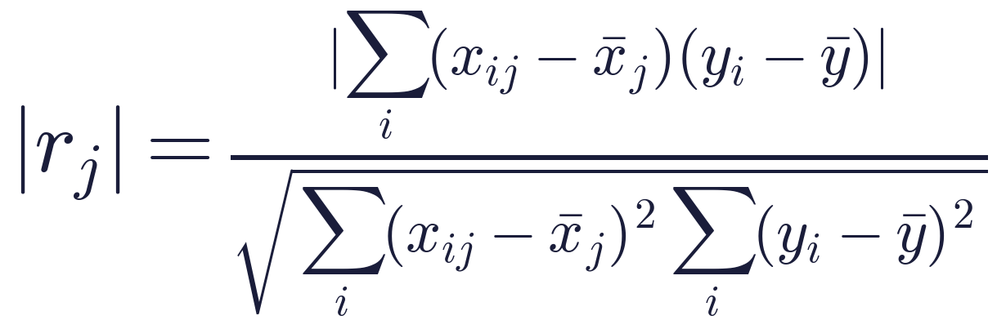
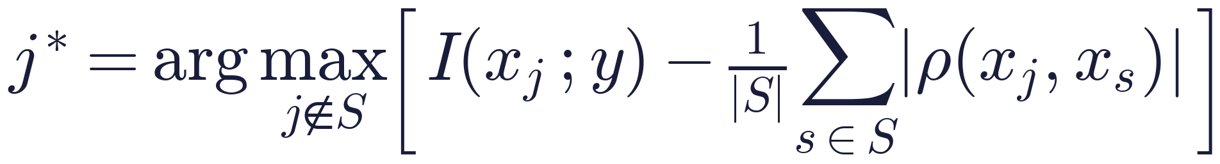
STAGES 5–6 · SELECTION
Feature and wavelength selection always happen inside training folds
Feature selection methods
Wavelength experiments (5 LEDs)
Correlation filter: keep top-k by
A
Single wavelength
5 models: 1050 → G, …, 1650 → G
B
Pairs
mRMR (greedy): relevance minus redundancy
10 models: (λᵢ, λⱼ) → G
C
Growing sets
all 31 subsets, sizes 1 → 5
RFE: drop the weakest 20% by extra-trees importance, refit, repeat
Nested selection (honest curve)
outer fold: hold out subjects
inner 3-fold CV picks best subset of size k
score it on held-out subjects
EarSpectro · glycemico-pred · synthetic-data study
13
Notes:
The all-subsets table is descriptive only. Picking its best row would be selection on the test folds.

Slide 14
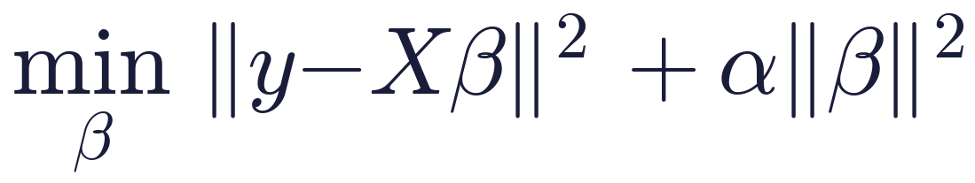
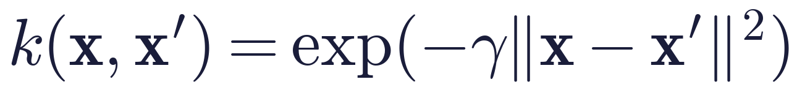

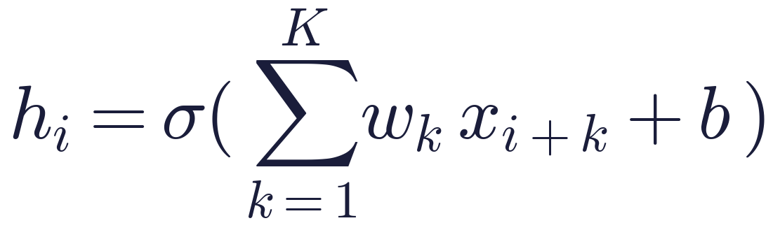
STAGES 7–9 · MODELS
A model ladder: each rung asks whether extra complexity pays off
Mean
reference: Ĝ = mean(G)
Linear / Ridge
is the relation roughly linear?
PLSR
linear, built for correlated spectra (Wold et al., 2001)
SVR (RBF)
does a nonlinear kernel help?
RF · XGBoost · CatBoost
do feature interactions help?
FFNN
does a learned representation beat engineering?
1-D CNN
can local spectral shape be learned directly?
Transfer learning (rung 8) is planned once a relevant pretraining spectral corpus is chosen.
EarSpectro · glycemico-pred · synthetic-data study
14
Notes:
Hyper-parameters for PLSR (components) and SVR (C, gamma) are tuned with inner GroupKFold over training subjects.

Slide 15
STAGES 8–9 · NEURAL NETWORKS
FFNN and 1-D CNN architectures
FFNN (baseline network)
Input
Dense 128
Dense 64
Dense 32
Output
p
ReLU + Dropout 0.2
ReLU
ReLU
Ĝ
1-D CNN (main deep model)
Spectrum
Conv 32
Conv 64
MaxPool 2
Conv 64
Global pool
Dense 64
Output
1 × p
k=7 (3 if p<15) BN ReLU
k=3 BN ReLU
if p ≥ 8
k=3 BN ReLU
mean ‖ max
ReLU, Drop 0.2
Ĝ
Training: AdamW (lr 1e-3, wd 1e-4), SmoothL1 loss (β = 0.5) on standardised glucose, batch 64, ≤ 400 epochs, ReduceLROnPlateau, early stopping (patience 40) on a held-out 15% of the training subjects.
EarSpectro · glycemico-pred · synthetic-data study
15
Notes:
Both are wrapped as sklearn regressors. Inputs and targets are standardised inside fit.

Slide 16
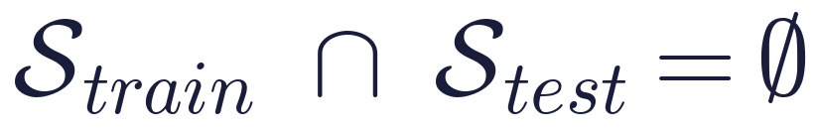
STAGES 10 · VALIDATION
Three evaluation scenarios; unseen subjects is the primary result
A · Random split
measurements shuffled; same subject in train and test
sanity check only
B · Subject split
GroupKFold on subject_id; test people never seen
primary result
C · Session split
train on day 1, test on day 2 of the same people
wearable reality
■ train ■ test top row: session 1 · bottom row: session 2 · 10 example subjects
Leak check aborts the run if any subject is in both train and test
Preprocessing, QC, scalers, selectors and tuning are all fitted inside each training fold
EarSpectro · glycemico-pred · synthetic-data study
16
Notes:
Squares stand for subjects. Random splits put the same person in train and test, so a model can memorise the person instead of glucose.

Slide 17
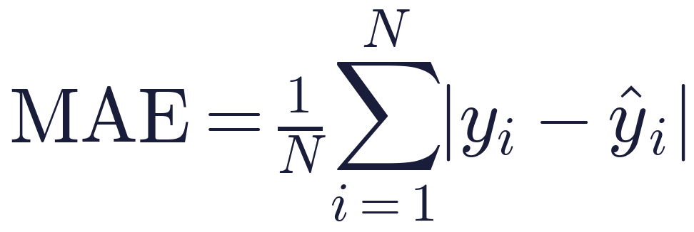
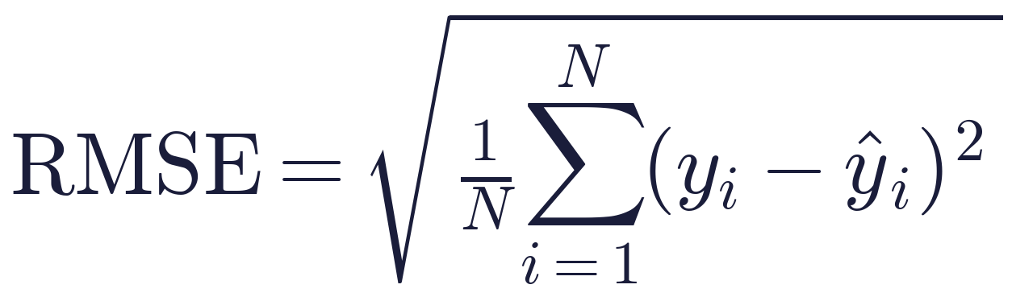
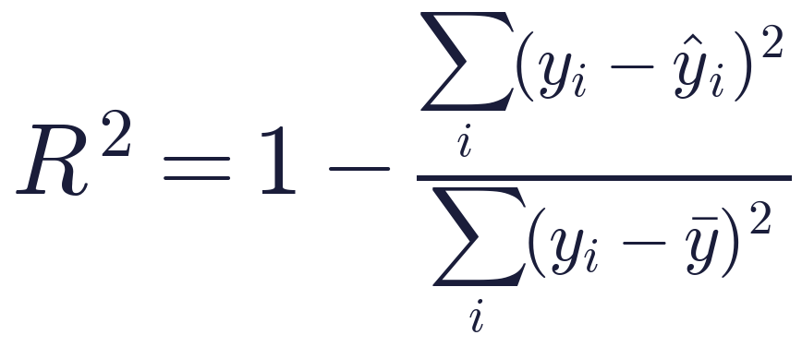
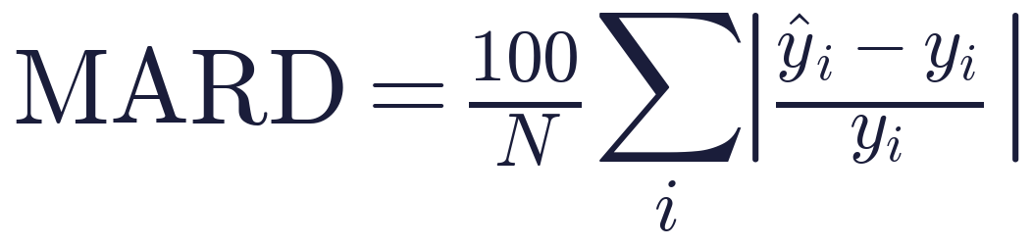
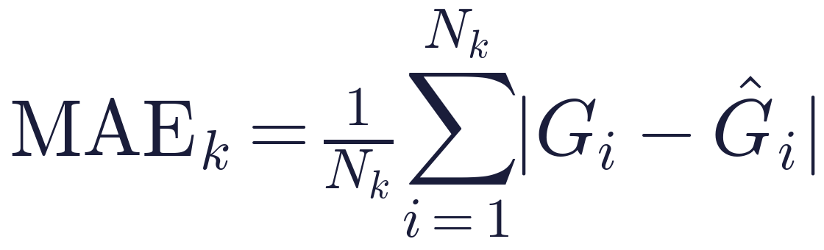
METRICS
Accuracy, agreement and clinical-risk metrics
Mean absolute error
Root mean squared error
Coefficient of determination
Mean absolute relative difference
Bland–Altman agreement
Subgroup MAE
Clarke error grid (Clarke et al., 1987): zone A within ±20% (or both < 70 mg/dL) · B benign · C–E would lead to wrong treatment. Per-subject MAE (median, 90th percentile) is reported too.
EarSpectro · glycemico-pred · synthetic-data study
17
Notes:
R² alone can hide clinically unacceptable errors, so every result also reports Clarke zones and per-subject error.

Slide 18
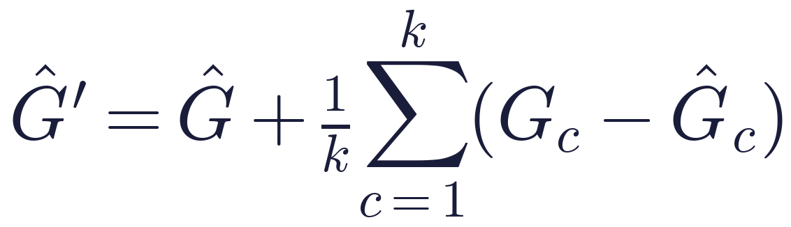
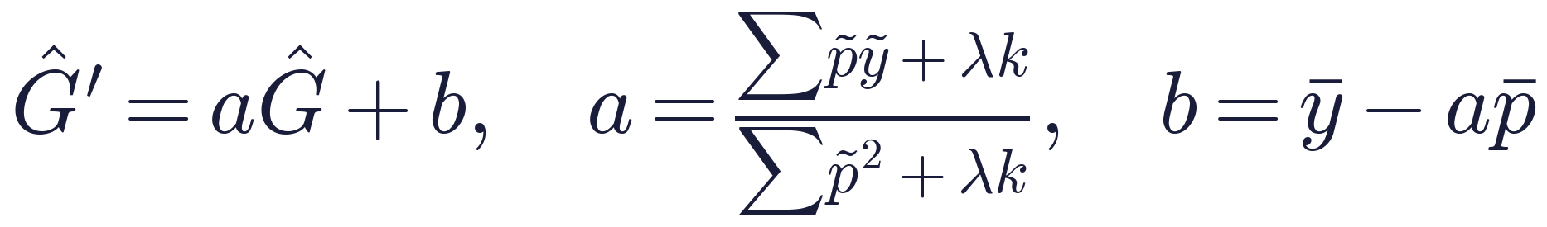
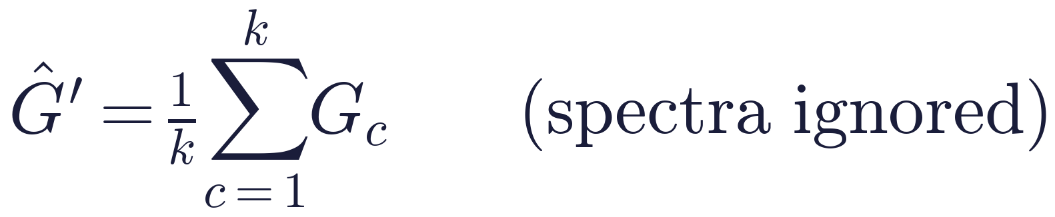
STAGE 11 · CALIBRATION
Per-session calibration, with a control that ignores the spectra
Offset (k ≥ 1)
Protocol on one OGTT session
Shrunk linear (k ≥ 2), λ = 50
first k used to calibrate
timepoints 5–15: scored for every k
k ∈ {0, 1, 2, 3, 5} reference readings per session
Repeats at a timepoint are averaged into one calibration point
Sensor is re-placed each day, so calibration is per session
The question is the calibration burden, not the lowest error
ref_only control
If a calibrated model doesn't beat ref_only at the same k, the gain came from knowing the recent glucose level, not from the optics.
EarSpectro · glycemico-pred · synthetic-data study
18
Notes:
Every k is scored on the same evaluation timepoints (index 5 onward), so the curves are comparable.

Slide 19
02
Results (synthetic data)
Validation scenarios · signal strength · preprocessing · wavelengths · calibration · explainability · clinical view

Slide 20
H5 · EVALUATION SCENARIO
Random splits flatter models; unseen subjects tell the truth
0.60 → -0.09
FFNN R², random → unseen subjects
CatBoost: 0.51 → −0.43
Only PLSR stays positive on new people (0.23)
A random split rewards memorising the person
EarSpectro · glycemico-pred · synthetic-data study
20
Notes:
Dense-spectrum dataset. Positive R² on a random split turns negative for most models on unseen subjects.

Slide 21
H2 · SIGNAL AND CHANNELS
Five LEDs can't untangle glucose; a dense spectrum partly can
Control works: linear models and SVR reach R² ≈ 0.5, so the pipeline does find signal.
ear5 fails: 5 channels vs ~8 nuisance factors leaves glucose unidentifiable at realistic strength.
Dense helps: best R² 0.38 (linear, detrend). Design lever: more wavelengths or a reference channel.
EarSpectro · glycemico-pred · synthetic-data study
21
Notes:
Unseen-subject R² for the same models across the three datasets. Mean predictor shown as zero line.

Slide 22
H1 · PREPROCESSING
Preprocessing barely moves linear models but makes or breaks trees
Best dense results use detrend or d1+SNV. d1+SNV is what makes the tree models competitive at all (CatBoost 48.2 → 32.6).
EarSpectro · glycemico-pred · synthetic-data study
22
Notes:
Spread = worst minus best MAE across the 10 preprocessing variants, unseen subjects, dense spectrum.

Slide 23
H2 · WAVELENGTH COUNT
With 5 LEDs, more wavelengths don't help at realistic signal
Every subset stays at or above the mean predictor; the nested picks change fold to fold, a sign there is no stable informative subset.
EarSpectro · glycemico-pred · synthetic-data study
23
Notes:
Nested curve: the best subset of each size is chosen on inner folds of training subjects, then scored on held-out subjects. Dashed level: mean predictor (MAE 43.1).

Slide 24
H6 · CALIBRATION
Calibration gains: mostly the reference level, a little optics
ear5: ref_only (32.8) matches calibrated PLSR (33.6) at k = 5, so the gain is the reference level. Dense: calibrated PLSR reaches 25.5 vs 29.7 for ref_only, about 4 mg/dL from the optics.
EarSpectro · glycemico-pred · synthetic-data study
24
Notes:
PLSR, unseen subjects. ref_only predicts the mean of the calibration readings and ignores spectra.

Slide 25
EXPLAINABILITY
What the models lean on: water-band flank more than glucose bands
Peak at 1440–1500 nm (water band flank, temperature-sensitive) rather than the 1590 nm glucose band: part of the signal is the confounder.
SHAP says 1450 nm matters, yet permuting any wavelength improves MAE on new people.
EarSpectro · glycemico-pred · synthetic-data study
25
Notes:
Permutation importance on held-out subjects, averaged over 5 folds. Dense PLSR peaks at 1440–1500 nm, the flank of the water band where the temperature confounder acts.

Slide 26
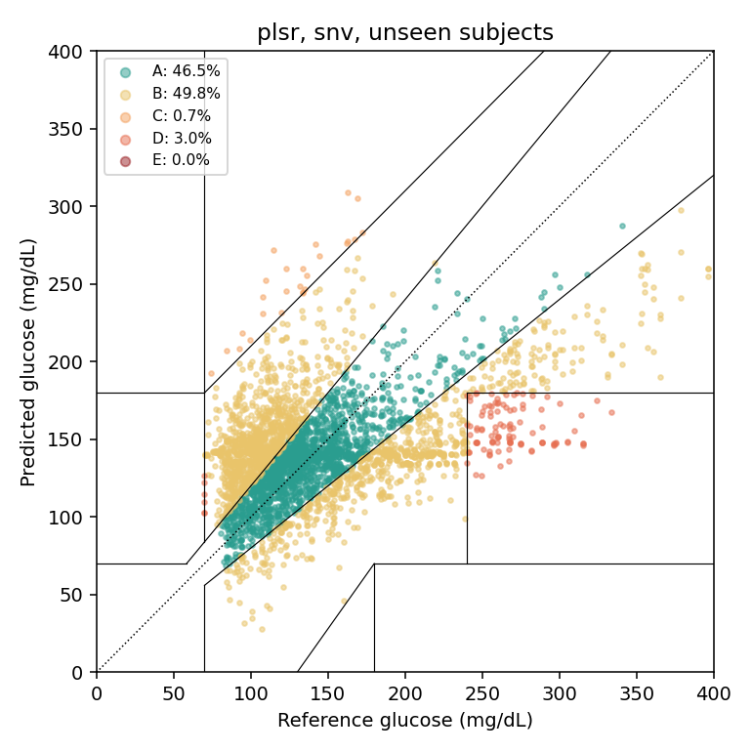
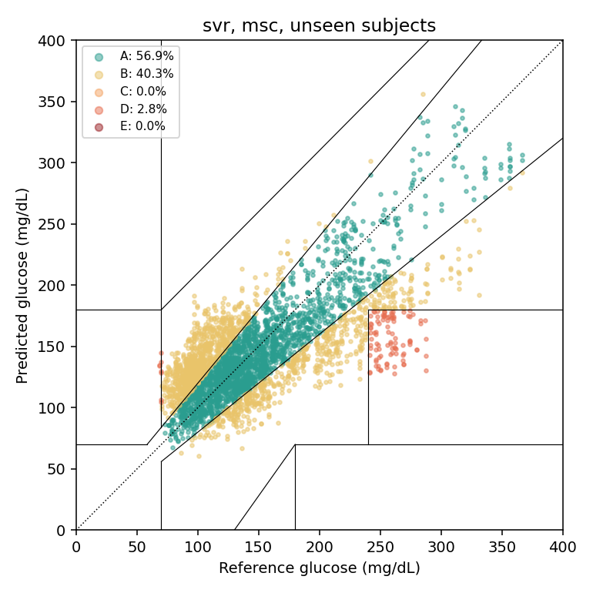
CLINICAL VIEW
Clarke error grid on unseen subjects
Dense spectrum · PLSR (SNV): 47% in zone A
Positive control · SVR (MSC): 57% in zone A
EarSpectro · glycemico-pred · synthetic-data study
26
Notes:
Zone A: clinically accurate; B: benign; C–E: would lead to wrong treatment decisions.

Slide 27
SCORECARD
Hypotheses H1–H7: where the evidence stands
 | Hypothesis | Synthetic evidence | Status
H1 | Preprocessing beats raw | Small for linear (2–4 mg/dL), large for trees (7–16) | Partly
H2 | A wavelength subset is as good as all 5 | Nothing beats the mean on ear5; dense spectrum helps | Open
H3 | Nonlinear beats linear / PLSR | Not with 40 subjects; trees fit identity | Not supported
H4 | 1-D CNN helps with enough data | CNN R² −0.28 on dense, below PLSR | Not yet
H5 | Unseen subjects score worse than random split | FFNN 0.60 → −0.09, CatBoost 0.51 → −0.43 | Supported
H6 | A little calibration helps | Mostly the reference level; ~4 mg/dL optical gain on dense | Partly
H7 | Interference-robust training generalises | Transfer learning not run yet | Not tested
EarSpectro · glycemico-pred · synthetic-data study
27
Notes:
Synthetic evidence only; every row must be re-tested on real EarSpectro recordings.

Slide 28
PLAN
Next steps
1
Collect real ear spectra
2
Test more channels on hardware
subject ID, timestamp, reference glucose; run the same suite unchanged
add wavelengths or a temperature / reference channel
3
Measure skin temperature
4
Uncertainty output U
use it as a model input; it is the largest confounder in the simulation
conformal intervals on subject-level residuals
5
Transfer learning (H7)
6
GPU runs
pretrain the 1-D CNN on a public NIR corpus, fine-tune on ear data
install CUDA torch on gnode118 for larger CNN sweeps

Slide 29
REFERENCES
References and sources
Amerov, A. K., Chen, J., & Arnold, M. A. (2004). Molar absorptivities of glucose and other biological molecules in aqueous solutions over the first overtone and combination regions of the NIR spectrum. Applied Spectroscopy. doi:10.1366/0003702042336136
Barnes, R. J., Dhanoa, M. S., & Lister, S. J. (1989). Standard normal variate transformation and de-trending of NIR diffuse reflectance spectra. Applied Spectroscopy. doi:10.1366/0003702894202201
Clarke, W. L., et al. (1987). Evaluating clinical accuracy of systems for self-monitoring of blood glucose. Diabetes Care. doi:10.2337/diacare.10.5.622
Geladi, P., MacDougall, D., & Martens, H. (1985). Linearization and scatter-correction for NIR reflectance spectra of meat. Applied Spectroscopy. doi:10.1366/0003702854248656
Lundberg, S. M., & Lee, S.-I. (2017). A unified approach to interpreting model predictions. NeurIPS. arXiv:1705.07874
Prokhorenkova, L., et al. (2018). CatBoost: unbiased boosting with categorical features. NeurIPS. arXiv:1706.09516
Savitzky, A., & Golay, M. J. E. (1964). Smoothing and differentiation of data by simplified least squares procedures. Analytical Chemistry. doi:10.1021/ac60214a047
Wold, S., Sjöström, M., & Eriksson, L. (2001). PLS-regression: a basic tool of chemometrics. Chemometrics and Intelligent Laboratory Systems. doi:10.1016/S0169-7439(01)00155-1
Hale, G. M., & Querry, M. R. (1973). Optical constants of water in the 200-nm to 200-µm wavelength region. Applied Optics (not auto-verified)
From the EarSpectro survey (cited as named there): Gusev et al.; Susana et al.; Satter et al.; Adigüzel et al.; Naresh et al.; Habibullah et al.; Liao, Lo & Yang.
EarSpectro · glycemico-pred · synthetic-data study
29
Notes:
Methods references verified against OpenAlex except Hale & Querry (not found by the lookup). Survey papers are cited as named in the EarSpectro literature survey.

