Slide 1
NON-INVASIVE GLUCOSE · NEAR-INFRARED SPECTROSCOPY
EarSpectro: predicting blood glucose from earlobe NIR spectra
Can multi-wavelength ear spectra predict glucose in people the model has never seen, and which preprocessing, wavelengths, model and calibration make that work?
1050
1200
1450
1550
1650
nm · the five EarSpectro LED wavelengths
github.com/Nishanth-nishu/glycemico-pred · October 2026
Notes:
EarSpectro: predicting blood glucose from multi-wavelength earlobe NIR spectra. All results so far come from synthetic data.

Slide 2
ARCHITECTURE
End-to-end pipeline: raw ear spectrum to glucose, quality and uncertainty
Ear NIR + glucose sync
Quality control
Preprocessing
1
2
3
nearest reading within 5 min
score Q, reject Q < 0.5
SG · SNV · MSC · d1 · detrend
Models
Selection
Representation
6
5
4
PLSR · SVR · RF · XGB · CatBoost · FFNN · 1-D CNN
corr · mRMR · RFE · nested λ subsets
spectrum, or 45 engineered features
Validation
Calibration
Explain + output
7
8
9
random · unseen-subject · unseen-session
0–5 reference points per session
permutation · SHAP → (Ĝ, Q)
Dark boxes decide whether results generalise: the quality gate, subject-level validation and calibration.
EarSpectro · glycemico-pred · synthetic-data study
2
Notes:
Each box is a module of the earspectro package. Everything after the split is fitted on training subjects only.

Slide 3
SIGNAL MODEL AND DATA
Glucose is a tiny part of a mixed spectrum; data is synthetic for now
Simulates: subject anatomy · sensor placement and gain · OGTT glucose curves · temperature confounder · artifacts · 5% meter error
ear5
dense
control
5 LEDs, realistic glucose strength
1000–1700 nm every 5 nm, same physiology
5 LEDs, 5× stronger glucose, no confounder
Each dataset: 40 subjects × 2 sessions × 16 timepoints × 3 repeats = 3,840 spectra
Glucose band positions: Amerov, Chen & Arnold (2004), Applied Spectroscopy, doi:10.1366/0003702042336136
No real EarSpectro recordings yet; real data plugs into the same CSV format
EarSpectro · glycemico-pred · synthetic-data study
3
Notes:
Glucose adds about 0.002 OD per 100 mg/dL at its strongest band, against about 0.1 OD of between-subject tissue variation.

Slide 4
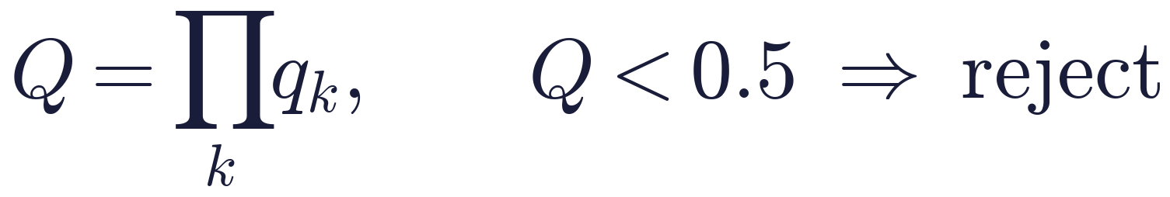
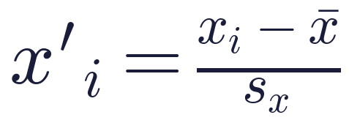
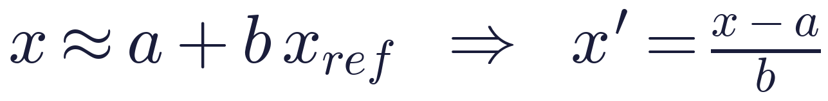
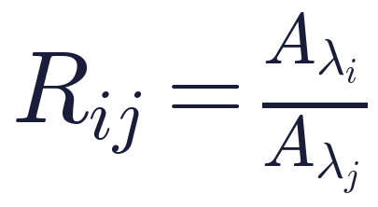
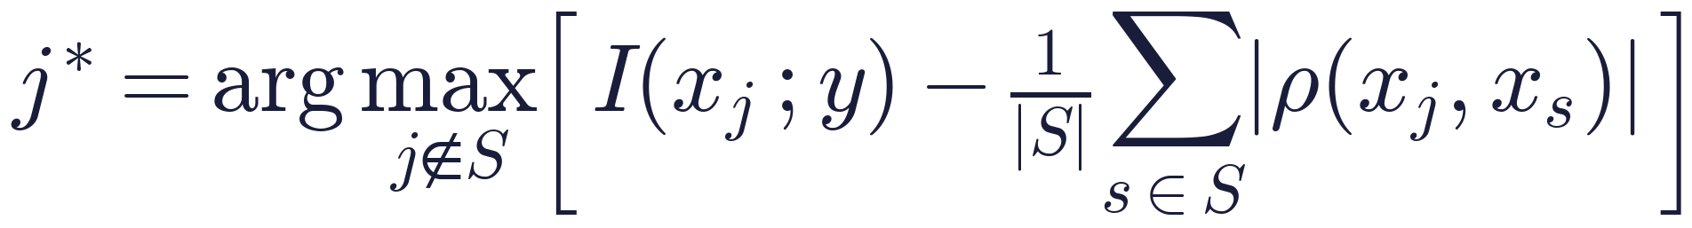
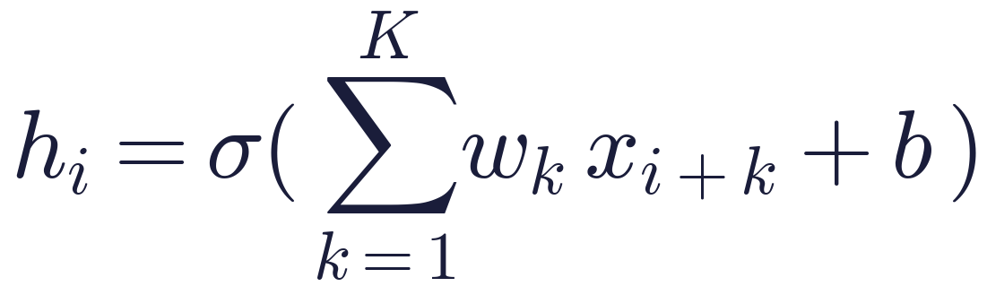
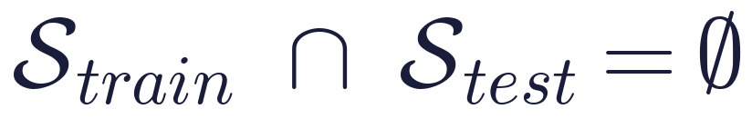
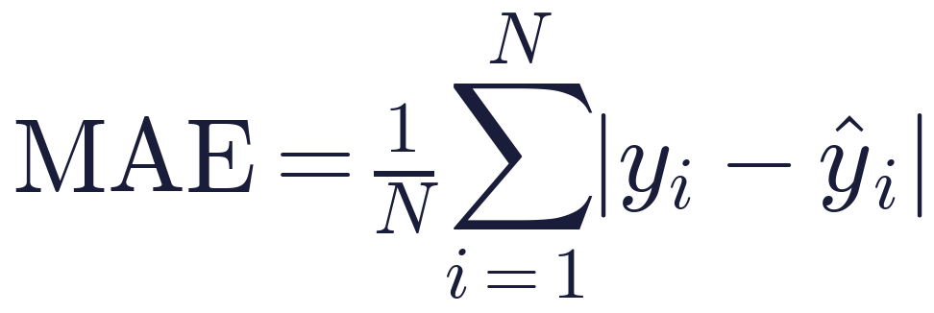
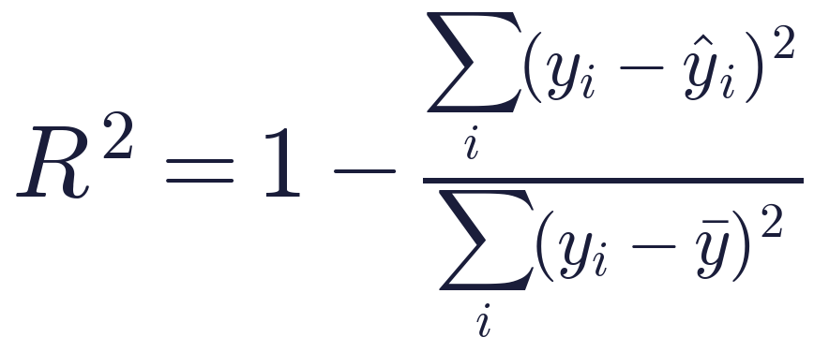
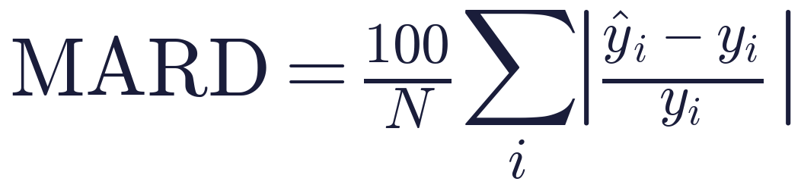
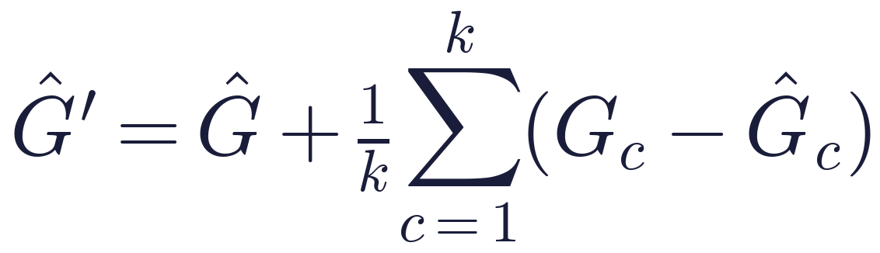
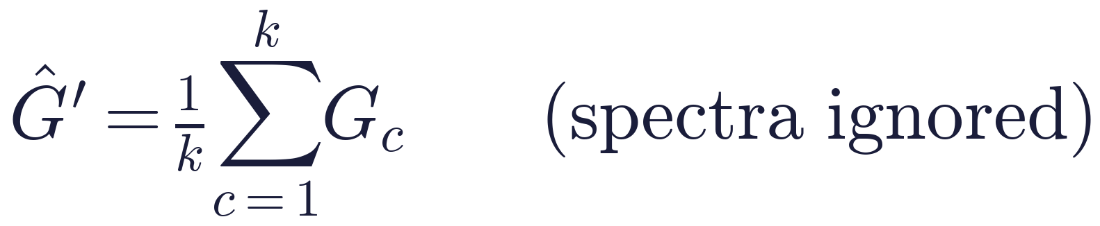
METHODS
Key formulas: quality, preprocessing, features, evaluation and calibration
Quality score
SNV
MSC
Feature ratio
mRMR selection
1-D convolution
Leak-free split
Accuracy
Fit
Clinical relative error
Offset calibration
Control: ignore spectra
EarSpectro · glycemico-pred · synthetic-data study
4
Notes:
Every transform, selector and tuning step is fitted inside training folds only.

Slide 5
RESULTS
Random splits flatter models; 5 LEDs can't untangle glucose
FFNN drops from 0.60 to -0.09 on new people. Only linear PLSR stays positive: with 40 subjects, nonlinear models learn the person.
The control proves the pipeline finds real signal (R² ≈ 0.5); 5 LEDs at realistic strength find none.
EarSpectro · glycemico-pred · synthetic-data study
5
Notes:
Left: dense spectrum, R² by split type. Right: R² on unseen subjects across datasets.

Slide 6
RESULTS
Calibration, preprocessing, wavelengths, QC and explainability
At 5 points optics add ~4 mg/dL (25.5 vs 29.7); with 5 LEDs, none.
Linear barely moves; d1+SNV rescues trees (CatBoost 48 → 33).
No subset of the 5 LEDs beats predicting the mean.
QC
Explainability
Clinical
Next
96–100% of artifacts rejected; 0.05% of clean spectra
PLSR leans on 1440–1500 nm (water band, temperature), not the 1590 nm glucose band
Clarke zone A on unseen subjects: 47% dense PLSR, 57% control SVR
real ear data · more wavelengths · skin-temperature sensor · uncertainty U
EarSpectro · glycemico-pred · synthetic-data study
6
Notes:
All panels: errors on unseen subjects. ref_only = mean of calibration readings, spectra ignored.

