Slide 1
Joins

Slide 2
Join Types
INNER JOIN
LEFT JOIN (or LEFT OUTER JOIN)
RIGHT JOIN (or RIGHT OUTER JOIN)
FULL OUTER JOIN
CROSS JOIN (or Cartesian Join)
SELF JOIN

Slide 3
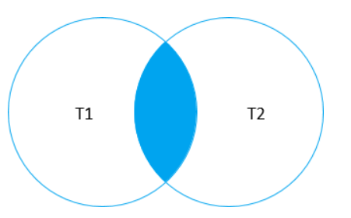
Inner Join
SELECT
select_list
FROM
T1
INNER JOIN T2
ON join_condition;

Slide 4
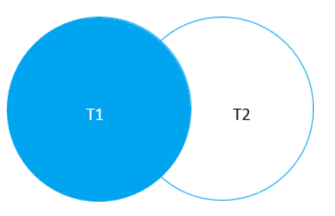
Left Join
SELECT
select_list
FROM
T1
LEFT JOIN T2
ON join_condition;

Slide 5
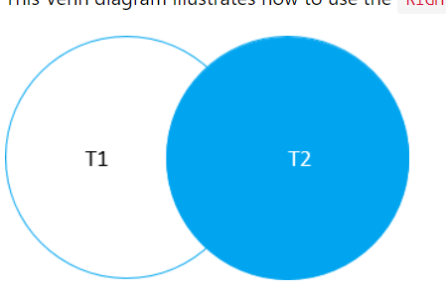
Right Join
SELECT
select_list
FROM
T1
RIGHT JOIN T2
ON join_condition;

Slide 6

Full Outer Join
SELECT
b.title,
p.name AS publisher
FROM
books b
FULL OUTER JOIN publishers p
ON p.publisher_id = b.publisher_id
ORDER BY
b.title NULLS FIRST,
publisher;

Slide 7
Cross Join
SELECT
select_list
FROM
T1
CROSS JOIN T2;

