Slide 1
Data Engineering

Slide 2
DataEngineering
Who is Data Engineer?
A data engineer is an IT worker whose primary job is to prepare data for analytical or operational uses. These software engineers are typically responsible for building data pipelines to bring together information from different source systems. They integrate, consolidate and cleanse data and structure it for use in analytics applications.

Slide 3
DataEngineering Activities
Data Ingestion
Data Transformation
Data Storage
Data Pipeline Management
Data Governance and Security
Metadata Management
Performance Monitoring and Optimization

Slide 4


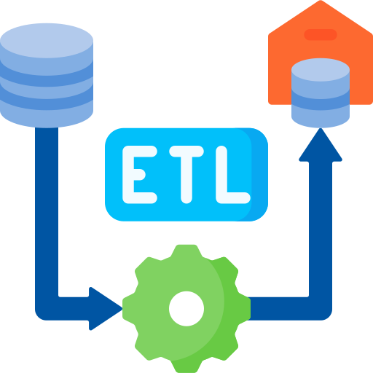



Data Pipeline

Slide 5
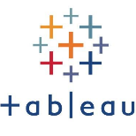

Database
A database collection of data which is grouped in form of schema,tables,views etc.
End Users
Application Programs

Slide 6
Components of Database
Data
Tables
Schema
Queries
Indexes
Relationships
Database Management System (DBMS)
Security and Access Control
Backup and Recovery
Transactions
Data Models
Views

Slide 7
Database Types
Relational Databases (RDBMS)
NoSQL Databases
Columnar Databases

Slide 8
SQL VS No SQL
Metric | Relational Database | Non Relational Database
How Datastored | Structured (Rows And Columns) | Unstructured (Json,docs,graphs)
Usage | OLTP | OLAP
Size | Small Scale | Large Scale
Scaling | Horizontal | Vertical
eg | MYSQL,SQLServer | Mongodb

Slide 9
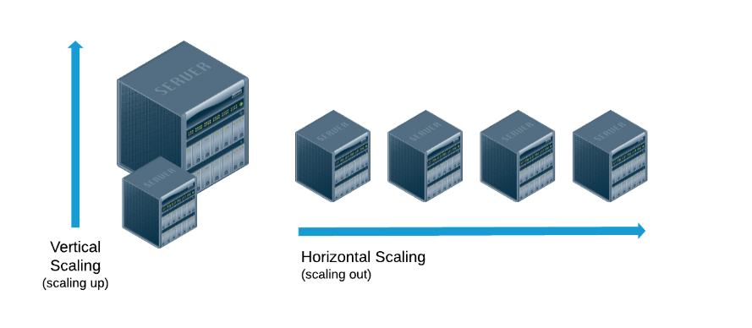
SQL VS No SQL

Slide 10
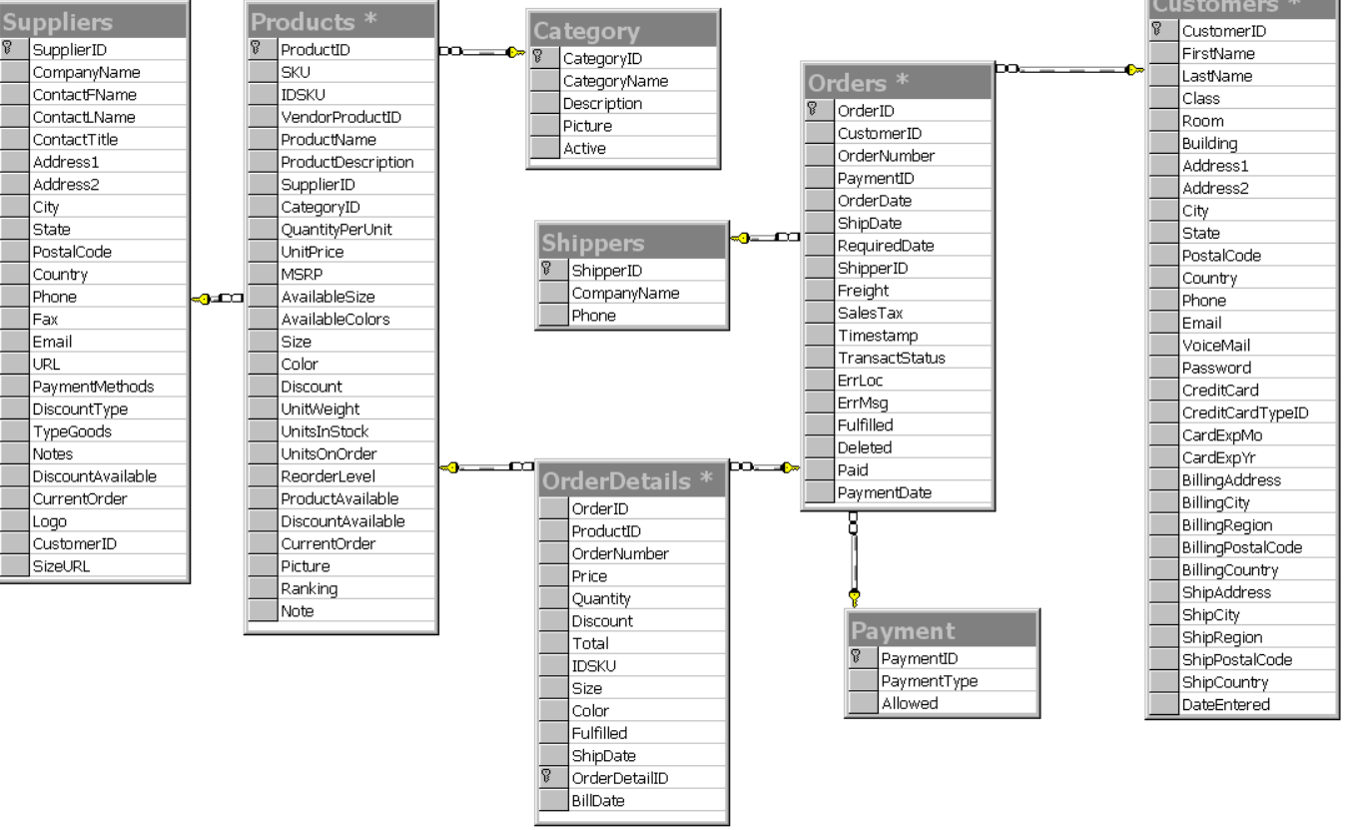
How Data is Stored In SQL Databases?
OrderID | CustomerID | ProductID | QTY
1 | C1010 | P2001 | 1
1 | C1010 | P2001 | 1
2 | C1011 | P2002 | 1
3 | C1012 | P2003 | 1
4 | C1013 | P2004 | 1

Slide 11
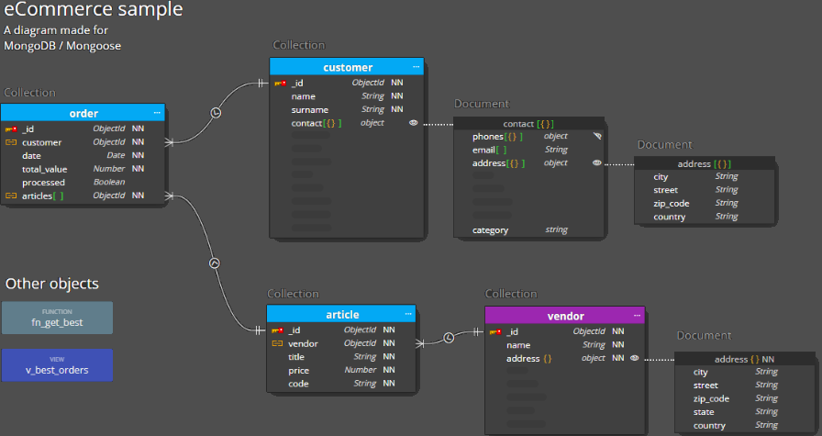
How Data is Stored In No SQL Databases?
OrderID | CustomerID | Product
1 | C1010 | [{"productID": P2001,"qty":"3"},{"productid":"P2002","qty":'5'}]
5 | C1014 | [{"productID": P2002,"qty":"3"}]
2 | C1011 | [{"productID": P2003,"qty":"3"}]
3 | C1012
4 | C1013

Slide 12
RDBMS VS Datawarehouse
https://docs.google.com/spreadsheets/d/1EBSzY2fQMalX_NtPjl-vlGfv3Sv1o24oYxIGgGyY6Zk/edit#gid=917710106

Slide 13
Limitations
Limited Support for Unstructured Data
Performance Issues
Scalability Challenges
Complexity of Joins
Vendor Lock-In

