Slide 1
Data Engineering

Slide 2
DataEngineering
Who is Data Engineer?
A data engineer is an IT worker whose primary job is to prepare data for analytical or operational uses. These software engineers are typically responsible for building data pipelines to bring together information from different source systems. They integrate, consolidate and cleanse data and structure it for use in analytics applications.

Slide 3
DataEngineering Activities
Data Ingestion
Data Transformation
Data Storage
Data Pipeline Management
Data Governance and Security
Metadata Management
Performance Monitoring and Optimization

Slide 4
Expectation for Freshers or Lateral Entries
DataStructures (Array,list,set,dict,linkedlist) and Algorithm
Programing Language(Python Prefered)
SQL
Knowledge about cloud platform

Slide 5






Data Pipeline

Slide 6


Database
A database collection of data which is grouped in form of schema,tables,views etc.
End Users
Application Programs

Slide 7
Components of Database
Schema
Tables
Views
Queries
Indexes
Relationships
Database Management System (DBMS)
Security and Access Control
Backup and Recovery

Slide 8
Database Types
Relational Databases (RDBMS)
NoSQL Databases
Columnar Databases

Slide 9
SQL VS No SQL
Metric | Relational Database | Non Relational Database
How Datastored | Structured (Rows And Columns) | Unstructured (Json,docs,graphs)
Usage | OLTP | OLAP
Size | Small Scale | Large Scale
Scaling | Vertical | Horizontal
eg | MYSQL,SQLServer | Mongodb

Slide 10
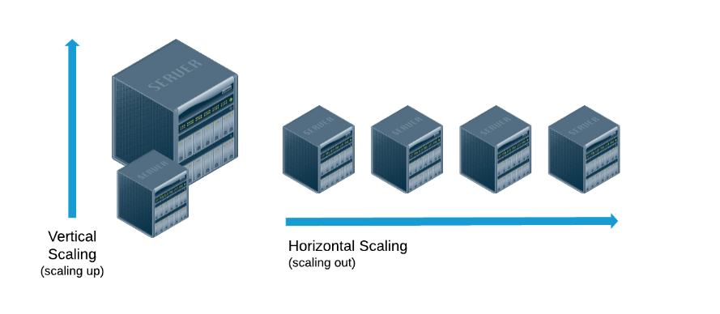
SQL VS No SQL

Slide 11
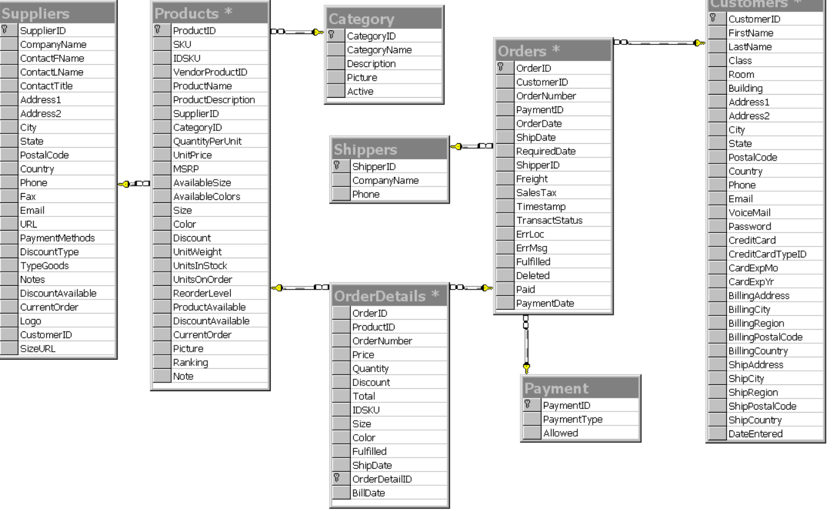
How Data is Stored In SQL Databases?
OrderID | CustomerID | ProductID | QTY
1 | C1010 | P2001 | 1
1 | C1010 | P2001 | 1
2 | C1011 | P2002 | 1
3 | C1012 | P2003 | 1
4 | C1013 | P2004 | 1

Slide 12
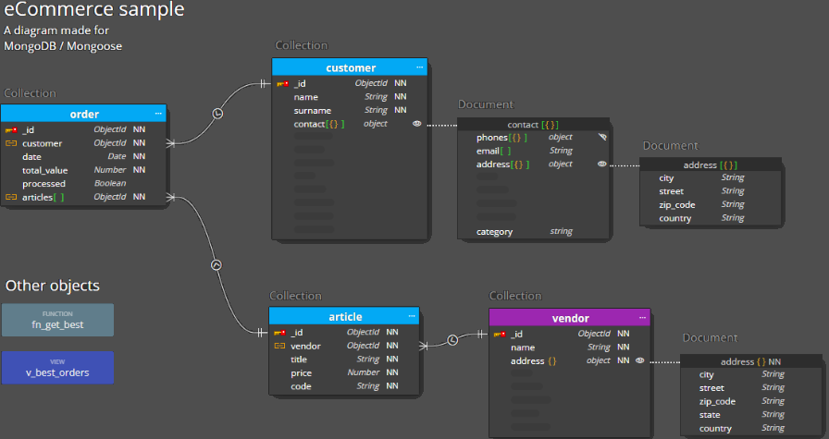
How Data is Stored In No SQL Databases?
OrderID | CustomerID | Product
1 | C1010 | [{"productID": P2001,"qty":"3"},{"productid":"P2002","qty":'5'}]
5 | C1014 | [{"productID": P2002,"qty":"3"}]
2 | C1011 | [{"productID": P2003,"qty":"3"}]
3 | C1012
4 | C1013

Slide 13
RDBMS VS Datawarehouse
https://docs.google.com/spreadsheets/d/1EBSzY2fQMalX_NtPjl-vlGfv3Sv1o24oYxIGgGyY6Zk/edit#gid=917710106

Slide 14
Limitations
Limited Support for Unstructured Data
Performance Issues
Scalability Challenges
Complexity of Joins
Vendor Lock-In

