Slide 1
HTML

Slide 2
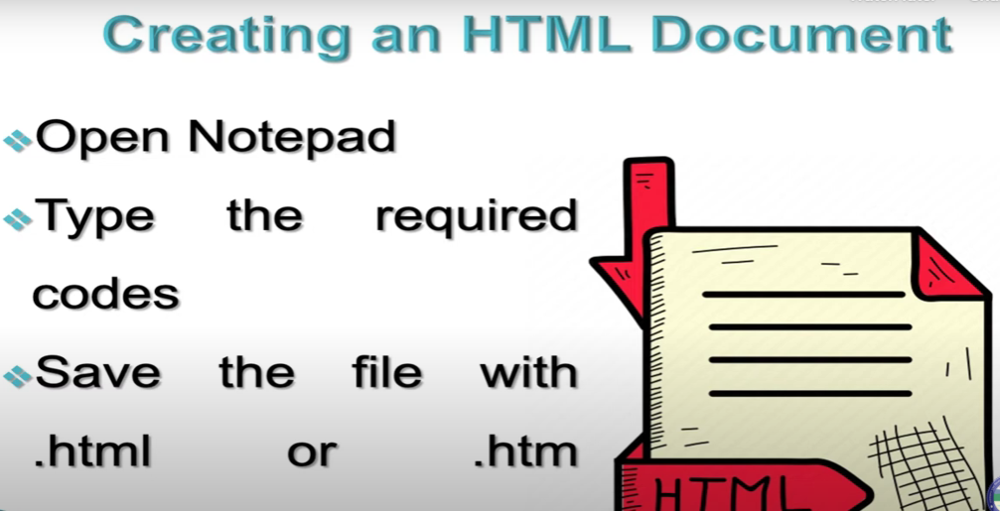

Slide 3
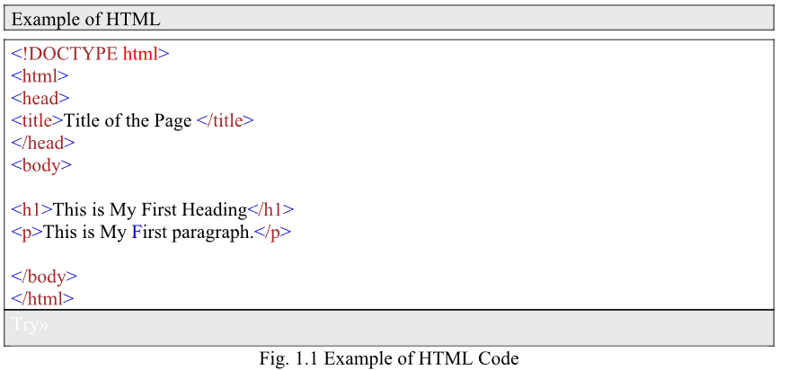

Slide 4
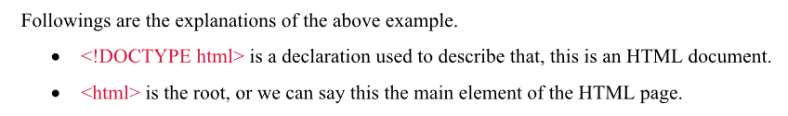
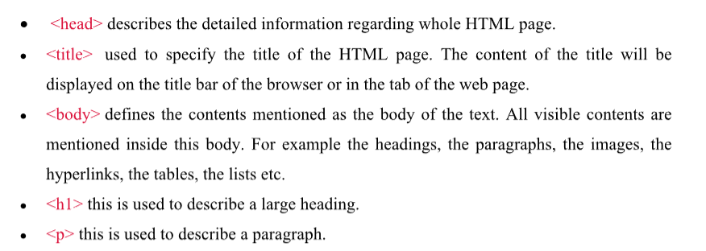

Slide 5
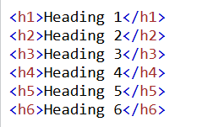
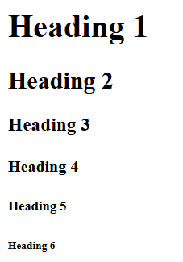
Headings

Slide 6
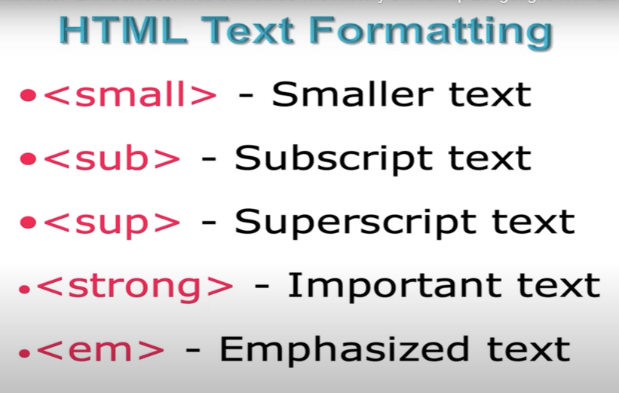

Slide 7
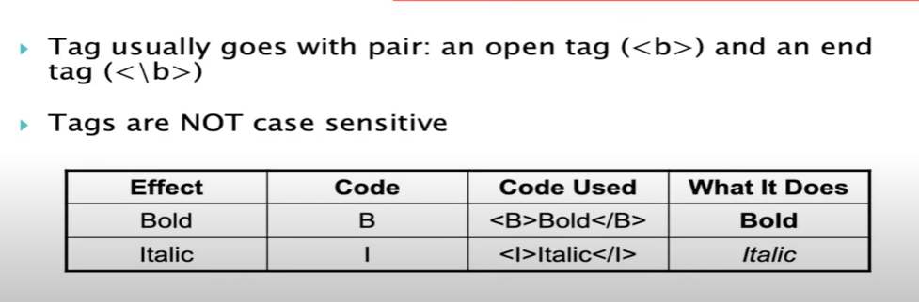
HTML Tag

Slide 8
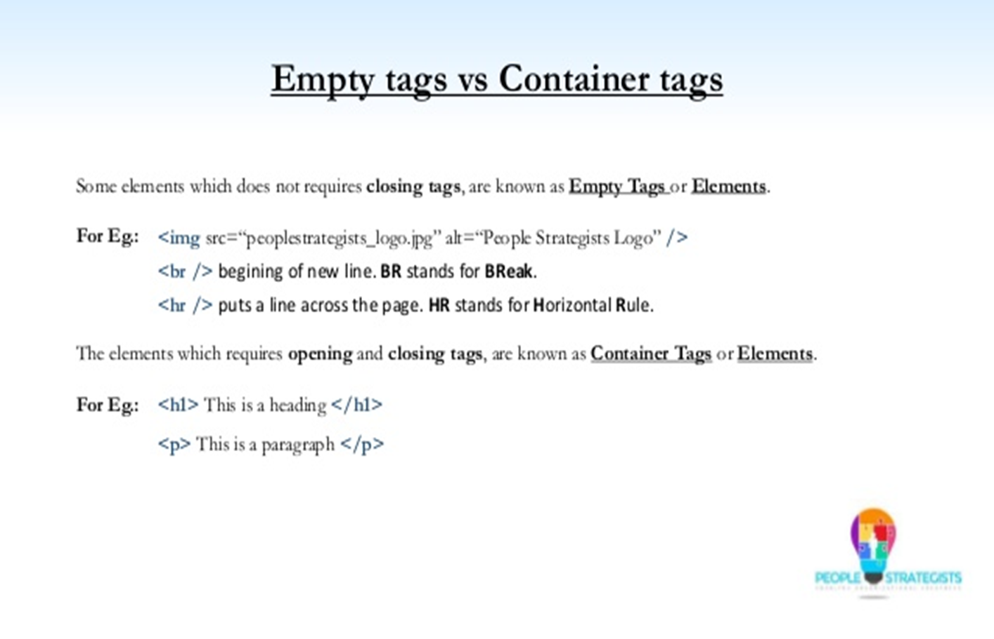

Slide 9
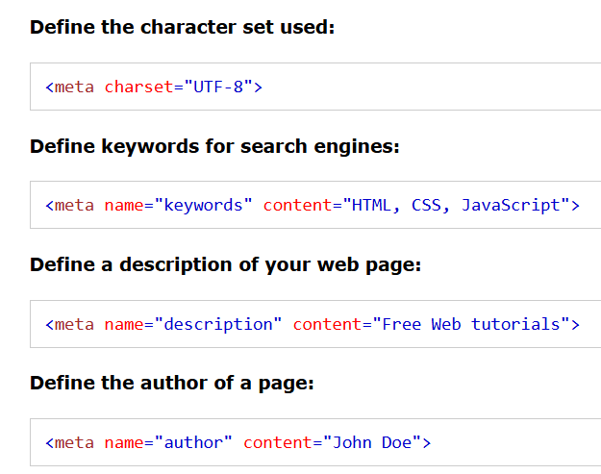
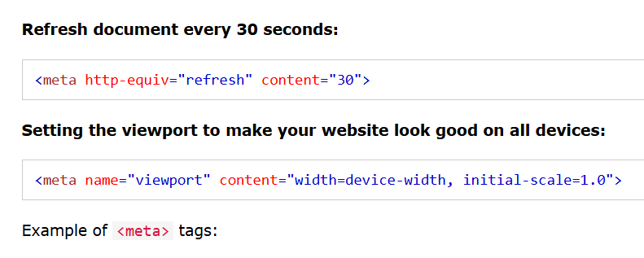
<head> elements
The <meta> element is typically used to specify the character set, page description, keywords, author of the document, and viewport settings.
The metadata will not be displayed on the page, but is used by browsers (how to display content or reload page), by search engines (keywords), and other web services.

Slide 10
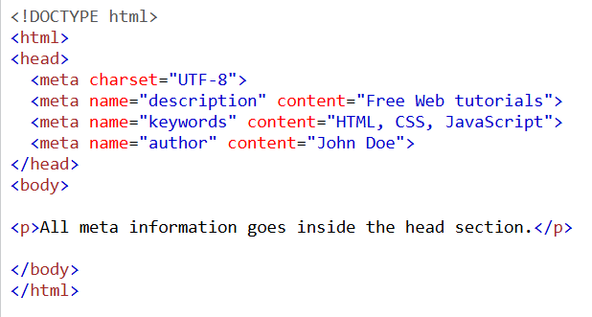

Slide 11
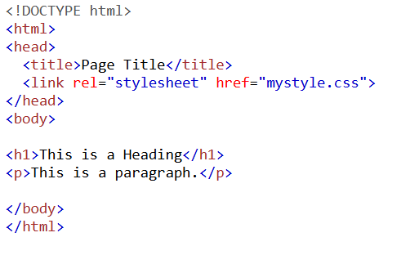
HTML <link> Element
The <link> element defines the relationship between the current document and an external resource.
The <link> tag is most often used to link to external style sheets

Slide 12
Writing text and formatting
These tags are used within <body> section. These are the frequenctly used elements of the content.
The <p> (paragraph) tag
The <p> tag with align attribute set to “right” or “center”
The <strong> (bold) tag
The <em> (emphasis/italics) tag
The <sup> tag (superscript)
The <sub> tag (subscript)
The <br /> (line break) tag
The <hr /> (horizontal ruler) tag

Slide 13
Nested Tags
Whenever you have HTML tags within other HTML tags, you must close the nearest tag first
Example:
<H1> <I> The Nation </I> </H1>

Slide 14
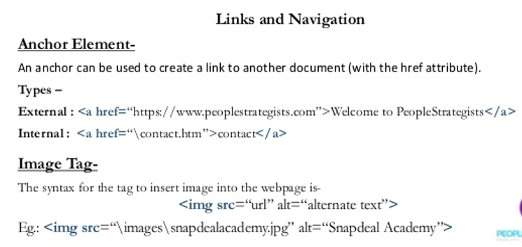
Hyperlinks

Slide 15
Graphics
To have a graphic appear on a webpage, web designers must to put the <IMG> tag in with the address where the graphic "lives":
<IMG SRC="http://www.someplace.com/images/fish.gif">
<img src=“http://www.someplace.com/images/fish.gif" alt=“fish" width="500" height="600">
Graphics attributes:
alt="text": insert a description of the graphic for those who are using browsers that cannot process images (e.g., page readers for the blind)
width="xx/xx%": width in pixels/percentage
height="xx/xx%": height in pixels/percentage
border="xx": pixel length of the border surrounding the image.
hspace="xx": places a buffer of space horizontally around the image
vspace="xx": places a buffer of space vertically around the image
align="top/middle/bottom/right/left": aligns image in relation to the text (see next 2 slides)

Slide 16
Graphics (cont.)
<img src="http://www.someplace.com/images/fish.gif" align="top">All about Fish
<img src="http://www.someplace.com/images/fish.gif" align="middle">All about Fish
<img src="http://www.someplace.com/images/fish.gif" align="bottom">All about Fish
All about Fish
All about Fish
All about Fish

Slide 17
Graphics (cont.)
<img src="http://www.someplace.com/images/fish.gif" align="left">
<img src="http://www.someplace.com/images/fish.gif" align="right">

