Slide 1

Future Sales Prediction
Nishanth Vanipenta UID : 116409605

Slide 2
Introduction
Machine learning techniques are used by all businesses in future prediction of sales.
The data set provided by a Russian Company 1C contains daily historical sales data of different shops and items sold
The main objective of this project is to predict total sales for each item and store in the next month with the given time-series data set
As the baseline method Linear regression and the LightBgm methods were implemented.
Finally, a more sophisticated model of grouping the sales data for each shop was classified which led to performing XGBOOST algorithm on individual shop and the corresponding item.

Slide 3
Method Followed
Problem
Exploratory Data Analysis
Feature Engineering Techniques
Training Models
Determine and Visualize
Create

Slide 4
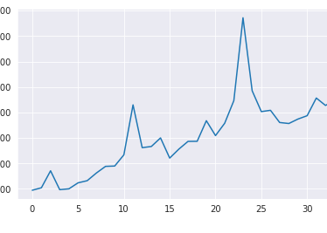
Data Analysis
Item count for each month
The Train data after the classification is observed to be of the shape ( 4712400, 24 )
The train and the validation is split into 70 and 30%
Added the missing values in the test data as zeros that are not in train data.

Slide 5

Model 1 : Linear Regression
Upon analysis of the data, the data was classified into Train and validation data.
Using sklearn, a linear regression model was trained and the training data provided to predict the item count sold for each shop and each item in the testing data provided.
The RMSE value that’s observed for the training and the validation set is observed to be 0.366 and 0.368.
For the test data the out of sample Error is observed to be 1.2448
Number | Value
Error in sample ( E_in) | 0.366
Error out ( E_out ) | 1.2488
Error_Valida ( E_Val) | 0.368
Overall Standing | 4681

Slide 6
Model 2: LightGBM
LightBGM the data was split into Train data and the validation data using the inbuilt pandas split function
This model was implemented with sklearn using the LGBMRegressor by tuning the hyper parameters.
I’ve picked two models and the metric that’s observed for the two models were observed to be of the same value which are 1.9918 and 1.1971.
The out of sample data is observed to be more than the linear regression error.
Number | Value
Error in sample ( E_in) | 0.366
Error out ( E_out ) | 1.1918
Error_Valida ( E_Val) | 0.187
Overall Standing | 4841

Slide 7
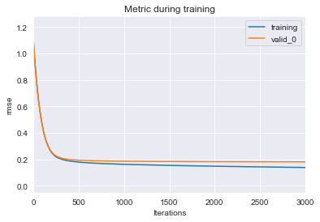
Model 3: XGboost
Training this, we observed a significant change in RMSE value to that of the other two models
I’ve tuned the hyper parameters for two models and observed a consistent result for this model
The out of sample data is observed to be less than that of the other two models.
This model consumes lot of data storage and needs GPU.
Number | Value
Error in sample ( E_in) | 0.2014
Error out ( E_out ) | 1.10503
Error_Valida ( E_Val) | 0.1824
Overall Standing | 3891

Slide 8
Conclusion
Modelled three approaches to predict future sales, XGBoost model performed better when compare with that of the other two models
XGBoost model outperforms because it formulates a strong relation between item and consecutive months number for a given shop.
To device a better approach for strong model training mechanism , we need to generate more features and consider the regression model for each shop and item combination as well as the holiday features.
Can be made more robust if neural networks are modelled using a deep learning models
Generated the excel files for the three models as the part of submission.

Slide 9
References
https://www.kaggle.com/plasticgrammer/future-sales-prediction-playground
https://towardsdatascience.com/a-beginners-guide-to-xgboost-87f5d4c30ed7

Slide 10
Thank You

