Slide 1

THREAT CLASSIFICATION & PREDICTIVE
INTELLIGENCE DASHBOARD
Using Microsoft Power BI
Nishanth T

Slide 2














Incident Data
PROJECT OVERVIEW
Threat Analysis
Geospatial & Temporal Analysis
Transform incident data into actionable intelligence.
Risk Assessment
Predictive Intelligence
Executive Decision Support

Slide 3
























DATA & DASHBOARD ARCHITECTURE
POWER BI PROCESS
DATA SOURCES
Clean
Connect
Analyze
Visualize
Incident
POWER BI
Transforming raw data into actionable intelligence
KEY COMPONENTS
Location
Response
Power BI
DAX
Interactive Dashboards
KPI Cards
Charts & Maps

Slide 4




Milestone 1 & 2
Threat & Geospatial Intelligence: Summary of first two milestones
KEY INSIGHT
MILESTONE 1
MILESTONE 2
Incident & Threat Analysis
Geospatial Intelligence
Accident is the most common incident type.
Incident analysis
Geographic analysis
Severity classification
City-wise risk
KPI dashboards
Interactive maps
Medium severity incidents are the most frequent.
Basic trend analysis
Drill-through analysis

Slide 5



Milestone 3
TEMPORAL ANALYTICS
RESPONSE ANALYTICS
Monthly trends
Response time
Seasonal patterns
Resolution performance
Daily & weekly trends
Team comparison
Emerging threats
City comparison
KEY INSIGHT
Incident activity and response performance vary across time, location and severity.

Slide 6


MILESTONE 4
Security Risk & Predictive Intelligence
Assess today’s risk. Anticipate tomorrow’s threats.
Move from historical analysis to proactive risk management.
RISK ASSESSMENT
PREDICTIVE ANALYSIS
Threat Exposure
Risk Prediction
Operational Vulnerability
Incident Forecast
Risk by Location
Emerging Risk
Resource Gaps
High-Risk Zones

Slide 7

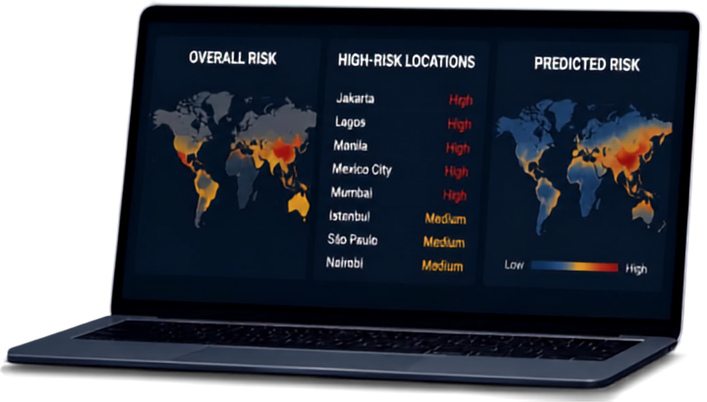





EXECUTIVE
DASHBOARD
OVERALL RISK
HIGH-RISK LOCATIONS
PREDICTED RISK
Jakarta
High
Lagos
High
Manila
High
Mexico City
High
Mumbai
High
Istanbul
Medium
One view. Clear insight. Better decisions.
São Paulo
Medium
Nairobi
Medium
Low
High
INTERACTIVE FILTERS
Year
City
Severity
Category
Operational Unit
Risk Level
PREDICT FUTURE THREATS
ALLOCATE RESOURCES
IMPROVE RESPONSE
IDENTIFY RISKS

Slide 8


THANK YOU
Questions & Discussion
Threat Classification & Predictive Intelligence Dashboard
Power BI
Analytics
Prediction

