Slide 1
BFRB Detection System
Preliminary UI & Database Design Update
ENEB453 — Web-Based Application Development
Nishanth S. | University of Maryland | Spring 2026
01
Wireframe — User Interface Design
02
Entity-Relationship Diagram (ERD) — Normalized to 3NF
Due: Mon Apr 13, 2026
03
Populated Database — Schema + Demo Queries

Slide 2
Project Overview
What this system does and why it matters
Nishanth S. | ENEB453 | University of Maryland
What It Is
BFRB Behaviors Detected
A web application that uses a webcam or uploaded video to detect Body-Focused Repetitive Behaviors (BFRBs) in real time using Google MediaPipe computer vision. The system watches hand and face movements, identifies when a person is performing behaviors like hair pulling or nail biting, logs every event to a database, and lets users define custom new behaviors.
Hair Pulling
Fingertip near scalp/forehead landmark
Nail Biting
Fingertip near upper lip landmark
Skin Picking
Fingertip near cheek/forehead landmark
Nose Picking
Index tip near nose tip landmark
Professor's Analogy
Lip Picking
Thumb tip near lip landmarks
Custom (User-Def.)
User configures any landmark pair
Like a store security system that detects shoplifters by recognizing their specific nervous walking pattern — this system detects BFRB behaviors by recognizing specific hand-to-face movement patterns.
How Detection Works
MediaPipe tracks 21 hand landmarks + 468 face landmarks per frame. The system measures the Euclidean distance between a hand fingertip and a target face region. If within the threshold for 10+ consecutive frames (~0.33 sec), a detection event is confirmed and saved to MySQL.
Technology Stack
Python Flask · MediaPipe Holistic · MySQL · Docker · HTML/CSS/JS

Slide 3
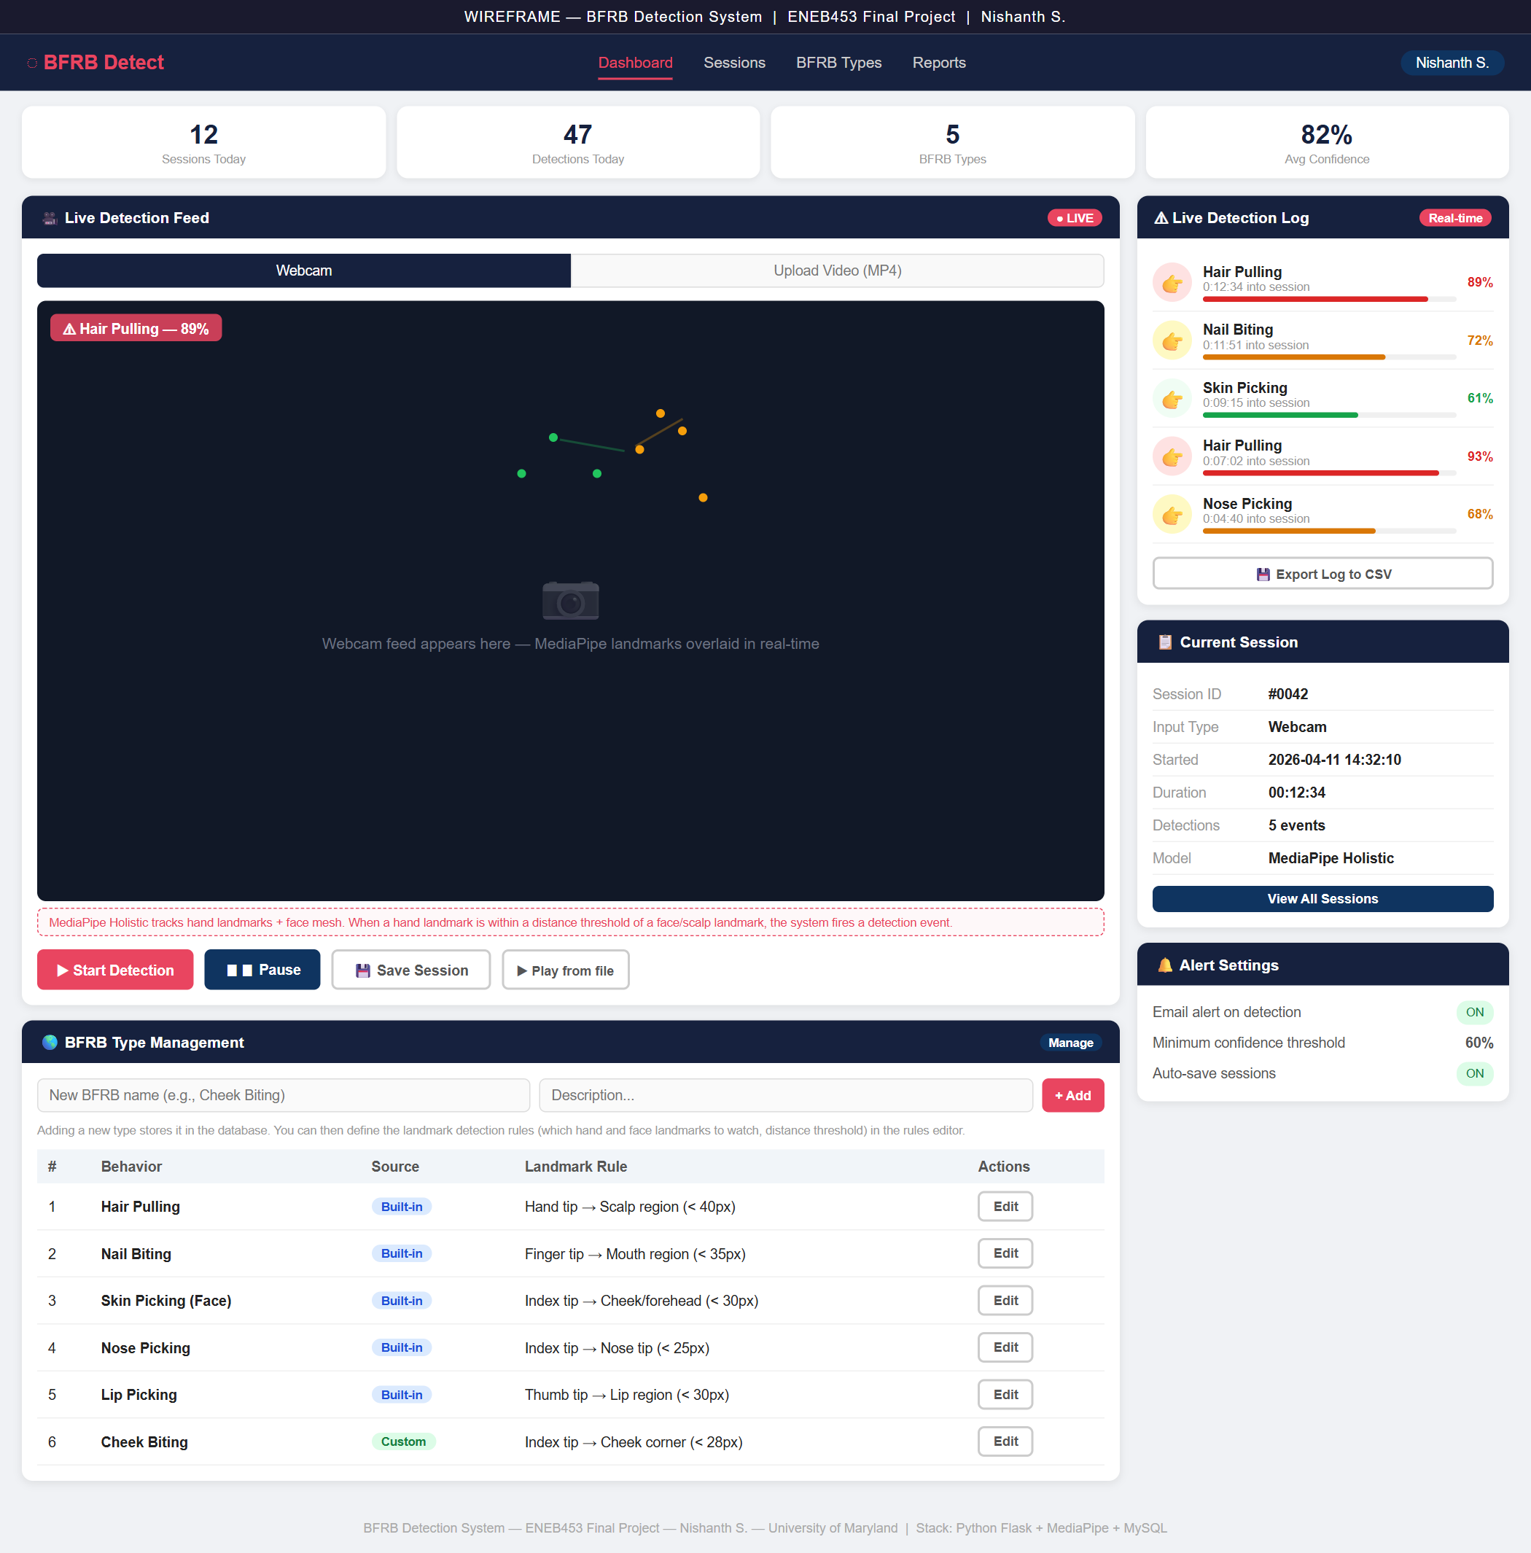
UI Wireframe
Dashboard layout — the webpage the user sees
Nishanth S. | ENEB453 | University of Maryland
Built with HTML/CSS — Open wireframe.html in browser

Slide 4
Wireframe — Key Components
What each section of the UI does
Nishanth S. | ENEB453 | University of Maryland
Navigation Bar
Dashboard · Sessions · BFRB Types · Reports — routes to all major features of the app.
Stats Row
4 live counters at top: Sessions Today, Detections Today, BFRB Types defined, Average Confidence score.
Video Feed Panel
Left side. Tabs for Webcam vs Upload Video (MP4). Shows live camera with MediaPipe skeleton overlay drawn on top. Active detection label appears in top-left corner of the feed.
Live Detection Log
Right side. Every BFRB event fires here in real time — behavior name, timestamp, confidence bar, confidence percentage.
Current Session Info
Right side, below log. Shows session ID, input type (webcam/video), start time, duration, total events this session.
BFRB Type Management
Bottom section. Table of all built-in and custom BFRB types. Form to add a new behavior — name, description, landmark rule. Each row has an Edit button.
Alert Settings
Right column, bottom. Toggle email alerts on/off. Set minimum confidence threshold. Toggle auto-save sessions.

Slide 5
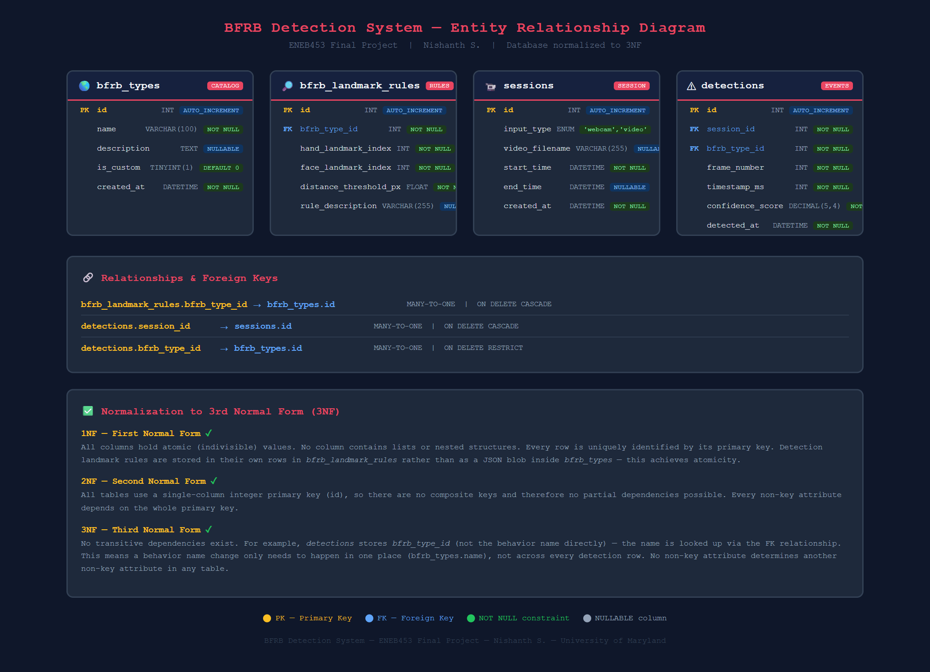
Database ERD — Normalized to 3NF
4 tables · 3 foreign key relationships
Nishanth S. | ENEB453 | University of Maryland

Slide 6
Database Schema — Table Breakdown
Why each table exists and what it stores
Nishanth S. | ENEB453 | University of Maryland
bfrb_types
Catalog of every BFRB behavior — both built-in (from Kaggle dataset) and user-defined custom ones. Stores the name, description, and a flag marking whether it's custom.
bfrb_landmark_rules
The MediaPipe detection rules for each BFRB type. Stores which hand landmark index and which face landmark index to measure, plus the distance threshold in pixels. Separated from bfrb_types to satisfy 1NF — no JSON blobs.
sessions
One row per detection run. Records whether input was webcam or a video file, the filename if applicable, and the start/end timestamps. End_time is NULL while a session is still running.
detections
One row per detected BFRB event. Foreign keys to both sessions and bfrb_types. Stores the video frame number, millisecond timestamp into the session, and a confidence score (0.0–1.0).
Relationships
→ bfrb_landmark_rules.bfrb_type_id → bfrb_types.id (MANY-TO-ONE, ON DELETE CASCADE)
→ detections.session_id → sessions.id (MANY-TO-ONE, ON DELETE CASCADE)
→ detections.bfrb_type_id → bfrb_types.id (MANY-TO-ONE, ON DELETE RESTRICT)

Slide 7
Normalization to 3rd Normal Form (3NF)
Why the schema satisfies 3NF
Nishanth S. | ENEB453 | University of Maryland
1NF — First Normal Form
✓ Satisfied
Every column holds a single atomic value — no lists, no nested data. The detection landmark rules are stored as individual rows in bfrb_landmark_rules rather than as a JSON blob inside bfrb_types. Each table has a clear primary key (id).
2NF — Second Normal Form
✓ Satisfied
All tables use a single-column integer primary key, so composite keys don't exist and partial dependencies are impossible. Every non-key attribute in each table depends on the full primary key, not just part of it.
3NF — Third Normal Form
✓ Satisfied
No transitive dependencies exist. Example: detections stores bfrb_type_id (the FK), not the behavior name directly. If a behavior name changes, only one row in bfrb_types needs updating — not thousands of detection rows. No non-key attribute determines another non-key attribute in any table.

Slide 8
Populated Database — Tables & Seed Data
Run via Docker MySQL · bfrb_detection database
Nishanth S. | ENEB453 | University of Maryland
Database: bfrb_detection | User: bfrb_user | Engine: MySQL 8.0 via Docker
bfrb_types
bfrb_landmark_rules
sessions
detections
6 rows
11 rows
3 rows
17 rows
rows
rows
rows
rows
5 built-in (Hair Pulling, Nail Biting, Skin Picking, Nose Picking, Lip Picking) + 1 custom (Cheek Biting)
11 MediaPipe landmark rules mapping hand fingertips to face regions with distance thresholds
2 webcam sessions + 1 video file session with start/end timestamps
17 BFRB detection events spread across 3 sessions with frame numbers, timestamps, confidence scores
CREATE TABLE Schema (abbreviated)
Seed Data Sample — bfrb_types
CREATE TABLE bfrb_types ( id INT AUTO_INCREMENT PRIMARY KEY, name VARCHAR(100) NOT NULL UNIQUE, is_custom TINYINT(1) NOT NULL DEFAULT 0 ); CREATE TABLE detections ( id INT AUTO_INCREMENT PRIMARY KEY, session_id INT NOT NULL, -- FK → sessions bfrb_type_id INT NOT NULL, -- FK → bfrb_types confidence_score DECIMAL(5,4) NOT NULL );
id name is_custom ───────────────────────────────── 1 Hair Pulling 0 2 Nail Biting 0 3 Skin Picking (Face) 0 4 Nose Picking 0 5 Lip Picking 0 6 Cheek Biting 1 ← custom

Slide 9
Demo Queries — Query 1 & 2
Populated database query results
Nishanth S. | ENEB453 | University of Maryland
Query 1 — All detections with behavior name, session type, timestamp, confidence
SELECT bt.name, s.input_type, CONCAT(FLOOR(timestamp_ms/60000),'m ',FLOOR((timestamp_ms%60000)/1000),'s') AS time, ROUND(confidence_score*100,1) AS pct FROM detections d JOIN sessions s ON d.session_id=s.id JOIN bfrb_types bt ON d.bfrb_type_id=bt.id ORDER BY d.detected_at;
name input_type time pct ───────────────────────────────────────────────── Hair Pulling webcam 0m 4s 89.1% Nail Biting webcam 0m 11s 72.3% Hair Pulling webcam 0m 22s 91.5% Skin Picking (Face) webcam 0m 29s 61.0% Nose Picking webcam 0m 34s 80.0% Lip Picking video 0m 6s 74.2% Hair Pulling video 0m 15s 88.1% ... (17 rows total)
Query 2 — Detection count and average confidence per BFRB type
behavior custom total_detections avg_confidence_pct max_confidence_pct ────────────────────────────────────────────────────────────────────────────────────── Hair Pulling 0 5 91.5% 94.0% Nail Biting 0 3 77.3% 82.3% Lip Picking 0 2 75.4% 76.6% Skin Picking (Face) 0 2 63.2% 65.4% Nose Picking 0 2 84.5% 89.0% Cheek Biting 1 1 71.0% 71.0% ↑ custom behavior also tracked

Slide 10
Demo Queries — Query 3, 4 & 5
Session summary · Custom BFRB rules · High-confidence alerts
Nishanth S. | ENEB453 | University of Maryland
Query 3 — Session summary (LEFT JOIN, GROUP BY, TIMESTAMPDIFF)
session_id input_type source start_time end_time duration_min total_detections ────────────────────────────────────────────────────────────────────────────────────────────────────────────────────────── 1 webcam webcam 2026-04-08 10:05:00 2026-04-08 10:22:00 17 7 2 video study_session_01.mp4 2026-04-09 14:00:00 2026-04-09 14:18:00 18 5 3 webcam webcam 2026-04-10 16:30:00 2026-04-10 16:47:00 17 5
Query 4 — Custom BFRB types with their MediaPipe landmark rules
custom_behavior hand_landmark_index face_landmark_index distance_threshold_px rule_description ────────────────────────────────────────────────────────────────────────────────────────────────────── Cheek Biting 8 127 28.0 Index fingertip within 28px of left cheek corner
Query 5 — High-confidence detections only (confidence ≥ 85%) — alert-worthy events
behavior input_type confidence_pct detected_at ────────────────────────────────────────────────────────────────────────────── Hair Pulling webcam 93.0% 2026-04-10 16:30:36 Hair Pulling webcam 90.0% 2026-04-10 16:30:10 Hair Pulling video 88.1% 2026-04-09 14:00:15 Hair Pulling webcam 89.1% 2026-04-08 10:05:04 Nose Picking video 89.0% 2026-04-09 14:00:37 Hair Pulling webcam 91.5% 2026-04-08 10:05:23

Slide 11
Next Steps — Build Plan
From checkpoint to final submission (May 4, 2026)
Nishanth S. | ENEB453 | University of Maryland
This Week (Apr 14–18)
Flask backend + MediaPipe Holistic integration. Live webcam feed with landmark overlay working. Basic detection logic firing events.
Week 2 (Apr 21–25)
Full frontend UI. Video file upload + annotated output. MySQL integration — every detection saved. Add new BFRB form working.
Week 3 (Apr 28–May 3)
Polish, testing, presentation build. Full demo rehearsal. Teaching notes prepared so I can answer any question in the 1-on-1.
May 4 — Presentation
Live demo of full working system. Q&A with professor. Show wireframe → ERD → working app progression.
Final deliverable: fully working web app · live demo · presentation

