Slide 1

Implementation of LLM-based Applications: QuesPDF, Youtube Video Summarization, PDF MCQ Generator
VIT-AP University
Nishanth Gadey
Mohith Tadi

Slide 2
CONTENTS
Slide Number | About
3 | Problem Statement and Description
4 | Introduction
5-6 | Model Description
7 | RAG
8-15 | Methodology and Implementation
16-19 | Results
20 | Github Link and Conclusion

Slide 3
Problem Statement: There is a need for an efficient solution that can dynamically interact with PDF documents and YouTube videos, answer related queries, summarize video content, and generate quizzes from a PDF document.
Description: The project, GenAIStudy, addresses this problem by leveraging Large Language Models (LLMs) to provide three distinct features: QuesPDF, Youtube Video Summarizer, and PDF Quiz Generator. The QuesPDF module employs the Llama 70 B chat model to answer questions related to a PDF document’s content dynamically. The Youtube Video Summarizer uses OpenAI models to provide concise summaries based on a given YouTube video’s English transcript. The PDF Quiz Generator, powered by the Llama 2 70 B model, generates sets of five multiple-choice questions and answers from a provided PDF, enhancing educational content creation. The project showcases the potential of advanced language models in providing diverse and useful functionalities and offers valuable insights for future developments in natural language processing and AI-driven content manipulation. The implementation involves the use of Replicate and OpenAI APIs. This solution caters to users seeking efficient solutions for PDF-based queries, video content summarization, and quiz generation.

Slide 4
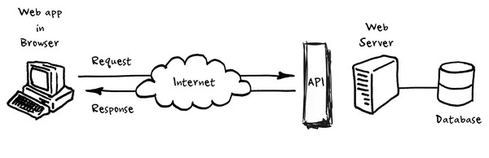
Introduction: Welcome to GenAIStudy, a groundbreaking web application designed to revolutionize the study experience. This innovative platform is powered by Large Language Models (LLMs) and offers a suite of AI-based tools aimed at enhancing the accessibility and understanding of digital resources.
Key Features:
QuesPDF Module: Utilizing the llama 70 B chat model, this feature allows interactive querying of PDF documents, providing instant and accurate responses to user questions.
Youtube Video Summarizer: This feature simplifies video-based learning by generating concise summaries from the English transcripts of YouTube videos.
PDF Quiz Generator: Powered by the llama 2 70 B chat model, this feature generates multiple-choice quizzes from PDF documents, aiding both educators and students.
GenAIStudy is more than just a tool; it’s a study companion that understands the demands of modern education. By harnessing the capabilities of AI, we aim to optimize study time, encourage exploration of educational content, and contribute to academic success. Welcome to a new era of learning with GenAIStudy—your AI-driven study companion for a brighter academic future.

Slide 5
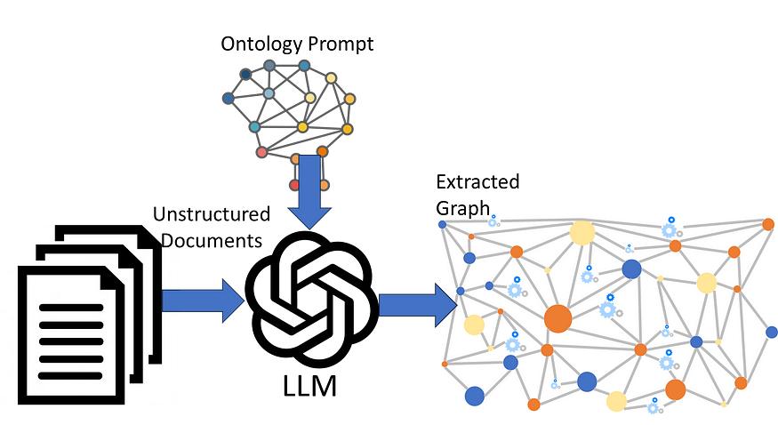
Large Language Models (LLMs): A Revolution in Communication
A large language model (LLM) is a type of artificial intelligence algorithm that can perform various natural language processing tasks, such as generating text, translating languages, or answering questions. LLMs use a lot of data and parameters to learn the patterns and structures of human languages. One of the key components of LLMs is the transformer model, which is a neural network architecture that uses self-attention to focus on the most relevant parts of the input.
LLMs are AI models that simulate human-like communication. They use deep learning and vast training data to understand and generate language. Key models include GPT-3, GPT-4, LaMDA, BLOOM, LLaMA, and more.
Applications: LLMs power various daily applications such as:
Chatbots
AI search engines
Content generation tools
Impact: LLMs are transforming industries, streamlining workflows, and creating new artistic content. They are shaping a future where communication with machines is as seamless as human-to-human interaction. This revolution is not just about smarter gadgets or efficient software; it’s about redefining our expectations from technology.

Slide 6
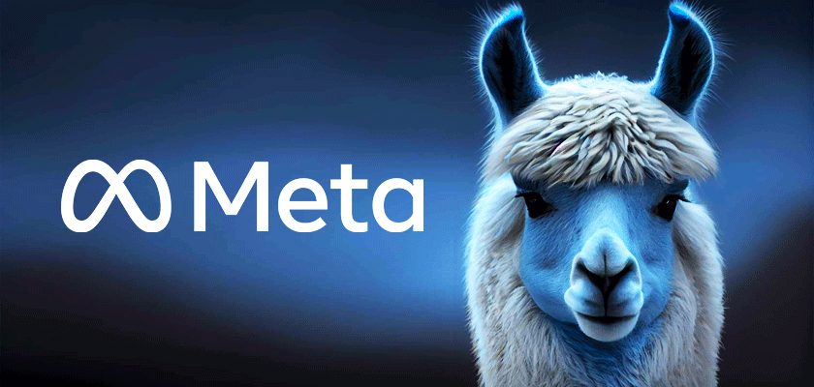
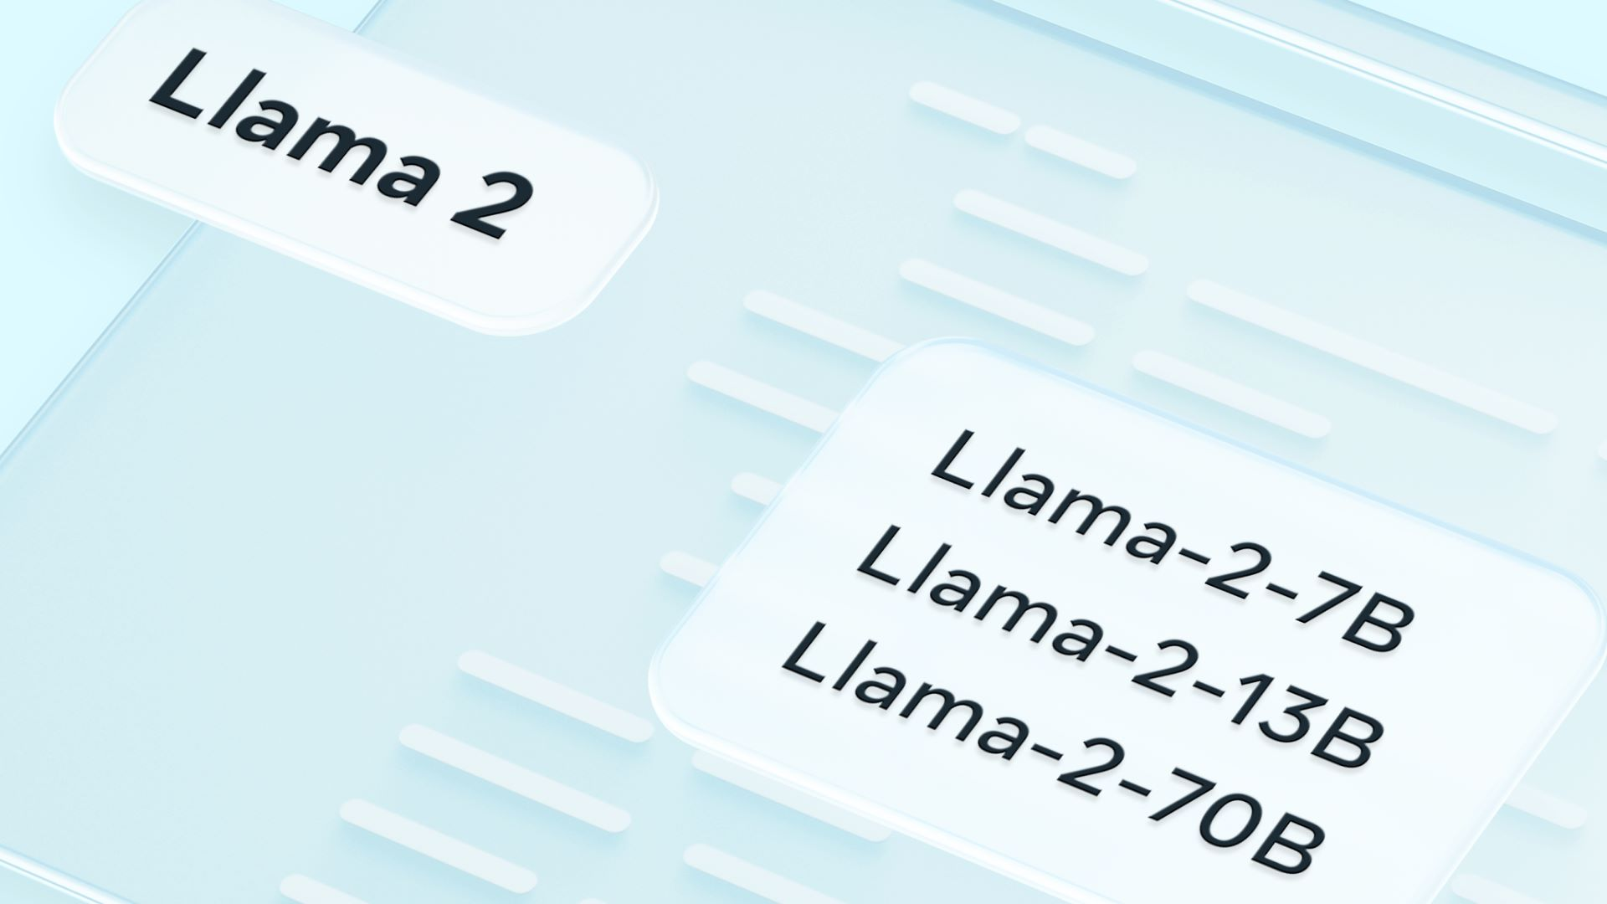
Llama 2 70B-Chat Model:
Llama 2-70B-Chat is a 70 billion parameter language model developed by Meta. It’s part of the Llama 2 family of large language models (LLMs), which range in scale from 7 billion to 70 billion parameters. This model is optimized for dialogue use cases and has been converted for the Hugging Face Transformers format. It uses an optimized transformer architecture and is trained using supervised fine-tuning (SFT) and reinforcement learning with human feedback (RLHF) to align with human preferences for helpfulness and safety. The model was trained between January 2023 and July 2023, and it was published by Meta on July 18th, 2023
Llama 2-70B-Chat, specifically designed for chat scenarios, excels in understanding human questions and providing responses tailored to the context. This model, recently developed, has demonstrated impressive results compared to other LLMs. Its proficiency in generating human-like responses in conversational settings makes it a standout choice for chat applications.
I have selected the Llama 2-70B-Chat model for its advanced capabilities in dialogue understanding and generation. The model's recent development and its remarkable performance among other large language models emphasize its suitability for achieving high-quality responses in chat-based interactions.

Slide 7
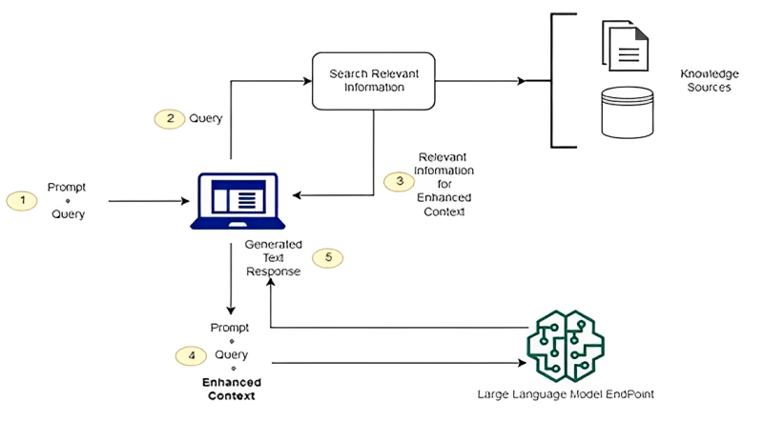
Retrieval-Augmented Generation (RAG):
Retrieval-Augmented Generation (RAG) is a technique that optimizes the output of a large language model by referencing an authoritative knowledge base outside of its training data sources before generating a response.
Benefits: Cost-effective implementation, greater control over text output, and insight into response generation.
Addressing LLM Limitations: LLMs can present false or outdated information, or create responses from non-authoritative sources. RAG retrieves relevant information from authoritative sources, addressing these issues. RAG has the potential to redefine LLMs, paving the way for more accurate, context-aware, and reliable AI communication.

Slide 8


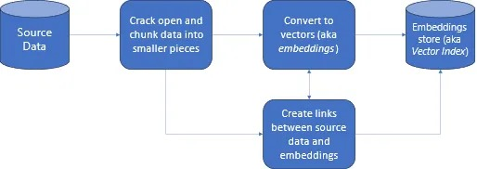
Methodology
Ques PDF - Interactive PDF-Questioning Application
Comprehensive approach for building an interactive PDF-questioning application. LLAMA (Language Model for Many Applications) integrated with RAG technique. Leverages "llama-2-70b-chat" for context-aware question answering.
Development:
Platform: Developed using Streamlit for user-friendly interaction.
Functionality: Users can upload PDFs, extracting text organized into Document objects.
Indexing: Basis for VectorStoreIndex to optimize question-response retrieval.
User-Interaction:
Query Process: Users pose questions related to PDF content, initiating a query process.
Response Generation: LLAMA model generates informative responses.
Efficiency: Methodology prioritizes seamless integration for a user-friendly and efficient system.

Slide 9
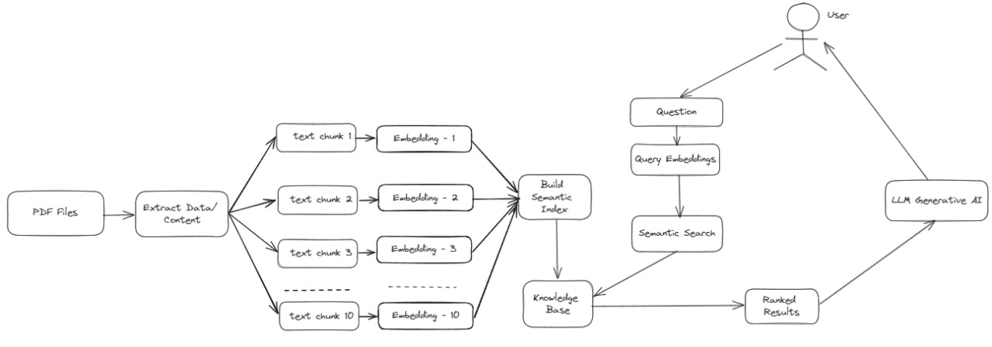

Slide 10
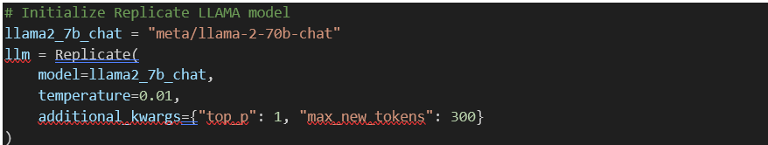
Replicate API Token Setup
To access the Replicate API, the project sets the required API token using the os.environ method.
Initialization of LLAMA Model
The LLAMA model, specifically "llama-2-70b-chat," is initialized using the Replicate class. Parameters such as temperature and additional keyword arguments for model configuration are set.

Slide 11
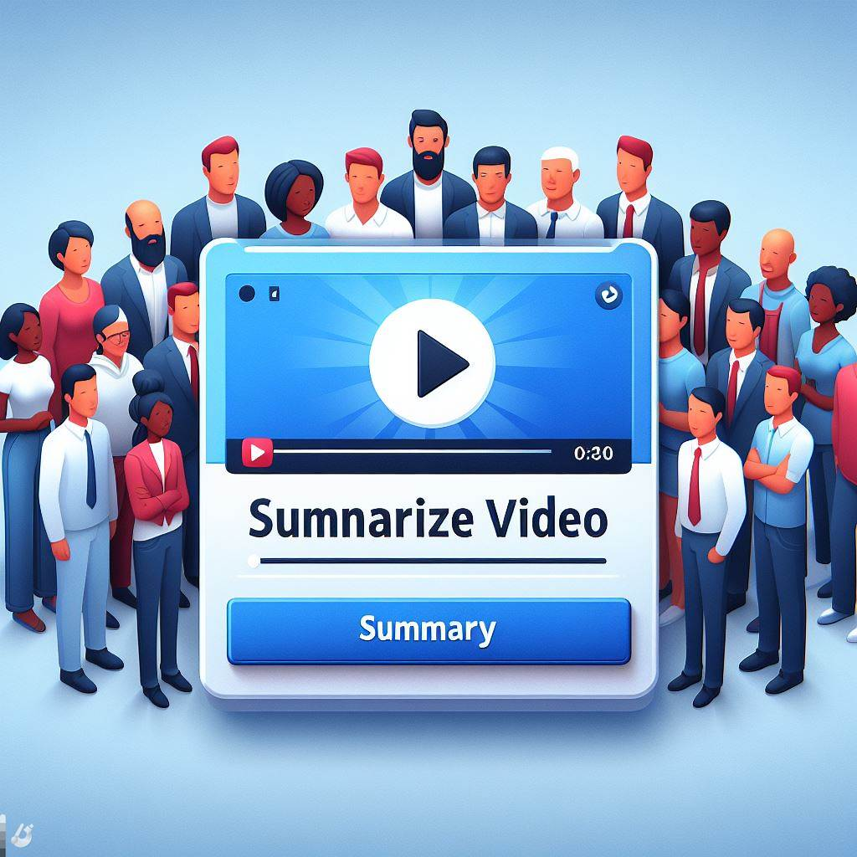
YouTube Video Summarizer
Prioritizes user experience with a Streamlit interface. Sets up OpenAI API key for seamless communication. Users input YouTube video links via a text field.
User Interaction:
Feedback Mechanism: Provides clear feedback for invalid links. Prompts users to input a valid link.
Synergy and Presentation:
LangChain and Streamlit: Facilitates a fluid summarization process. Presents users with a coherent summary.
Design Philosophy:
User-Friendly Design: Enhances experience with a transparent approach. Balances language processing, user interaction, and summarization.
Outcome:
Effective Summarizer: Delivers insights from YouTube videos with a focus on user satisfaction.

Slide 12

OpenAI Language Model: The OpenAI language model is loaded with a specified temperature parameter (0.6), influencing the randomness of the model's responses.
User Input: Users are prompted to enter a YouTube video link using the st.text_input method.
Display video metadata if link is provided and "Submit" was clicked
Summarization: The LangChain library is employed to build a summarization chain. The chain utilizes the OpenAI language model in a 'map_reduce' configuration to summarize the video content.

Slide 13
MCQ Generator:
Utilizes LangChain library and Streamlit framework for streamlined MCQ generation from PDFs. Streamlit allows easy PDF uploads for processing.
Processing Pipeline:
Text Extraction: PyPDFLoader extracts textual content from uploaded PDFs.RecursiveCharacterTextSplitter strategically segments content into manageable chunks.
MCQ Generation: Utilizes LangChain's Replicate model tailored for MCQ generation.Summarization chain orchestrates a dual-phase process: initial MCQ creation and refinement based on additional context.
Presentation through Streamlit: Generated MCQs are presented in the Streamlit interface.Offers educators and professionals an intuitive platform for creating meaningful questions.
System Cleanliness:
Efficiency: Temporary files are removed after processing for a seamless user experience.
User Interaction, Language Modeling, Summarization: Harmonizes these elements for a comprehensive MCQ generation solution.
Outcome-Effortless Question Creation: Provides a user-friendly and efficient way to generate high-quality MCQs from study materials. Harmonizes user interaction, advanced language modeling, and summarization techniques.

Slide 14
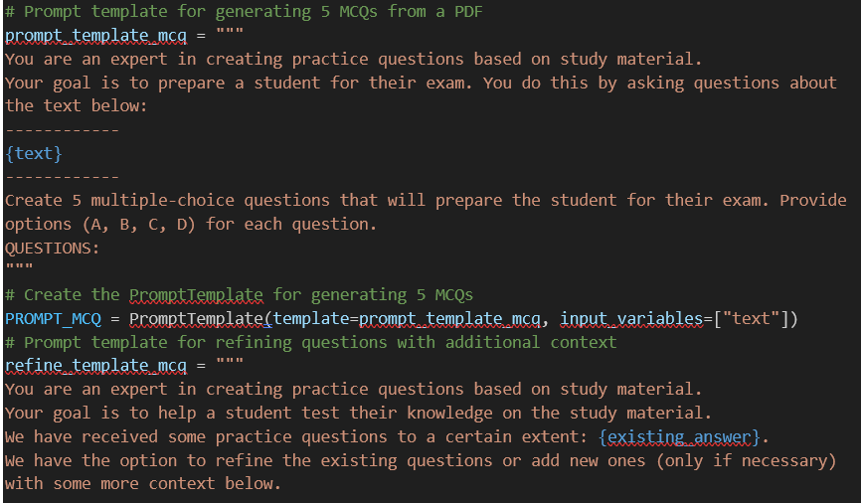
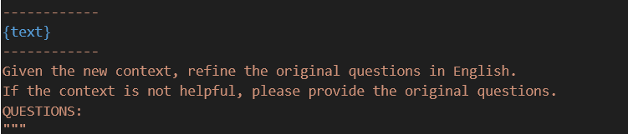
Prompt Templates: Define prompt templates using PromptTemplate for generating and refining multiple-choice questions.

Slide 15
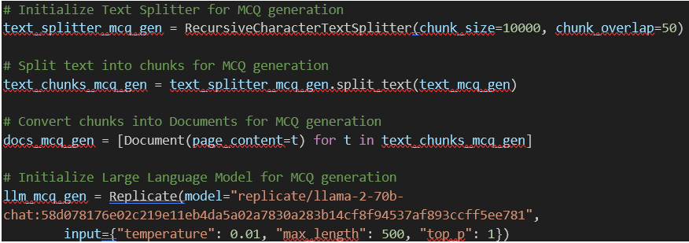
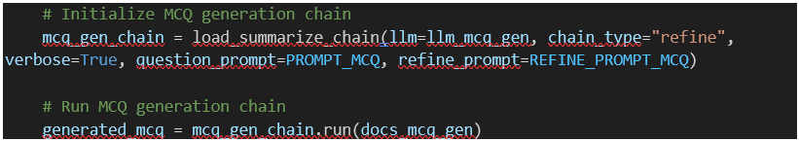
Large Language Model Initialization: Initialize the Large Language Model (llama-2-70b-chat) using the Replicate API.
MCQ Generation Chain Setup: Set up the MCQ generation chain using the loaded language model and prompt templates.

Slide 16
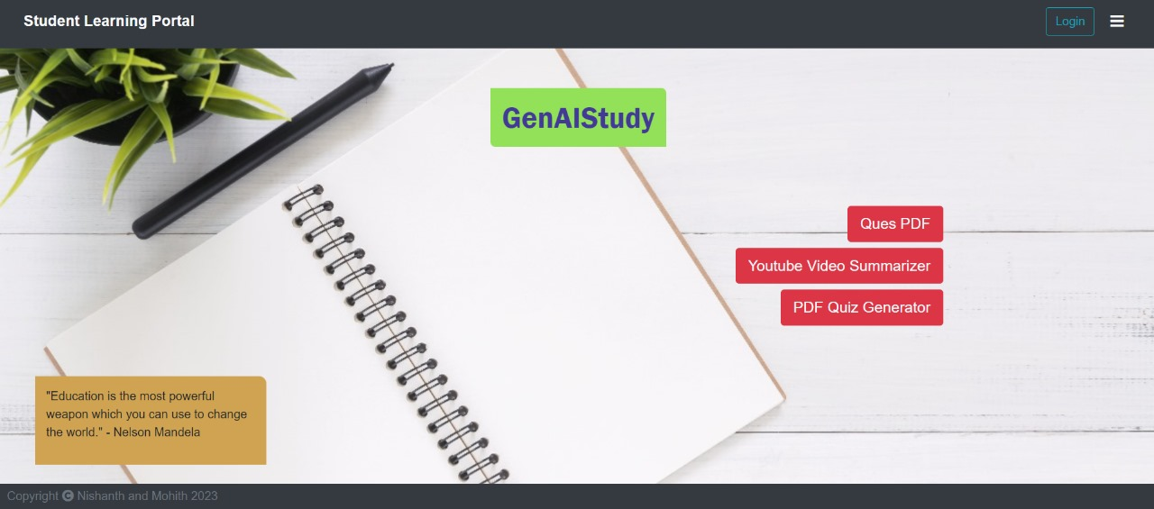
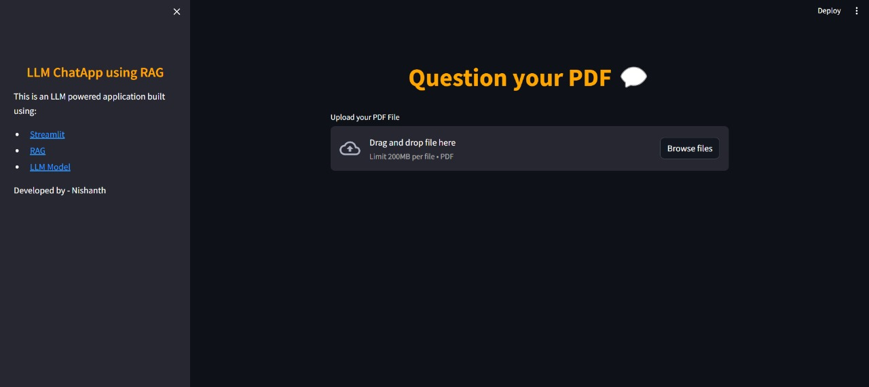
Results:

Slide 17
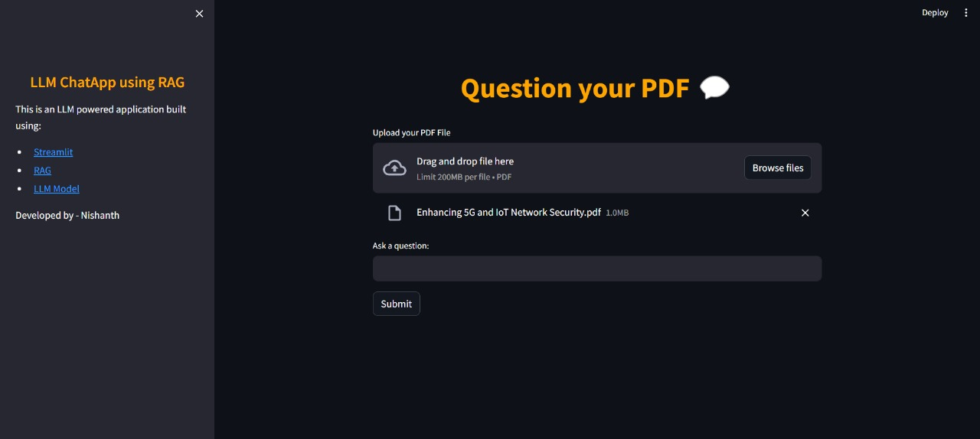
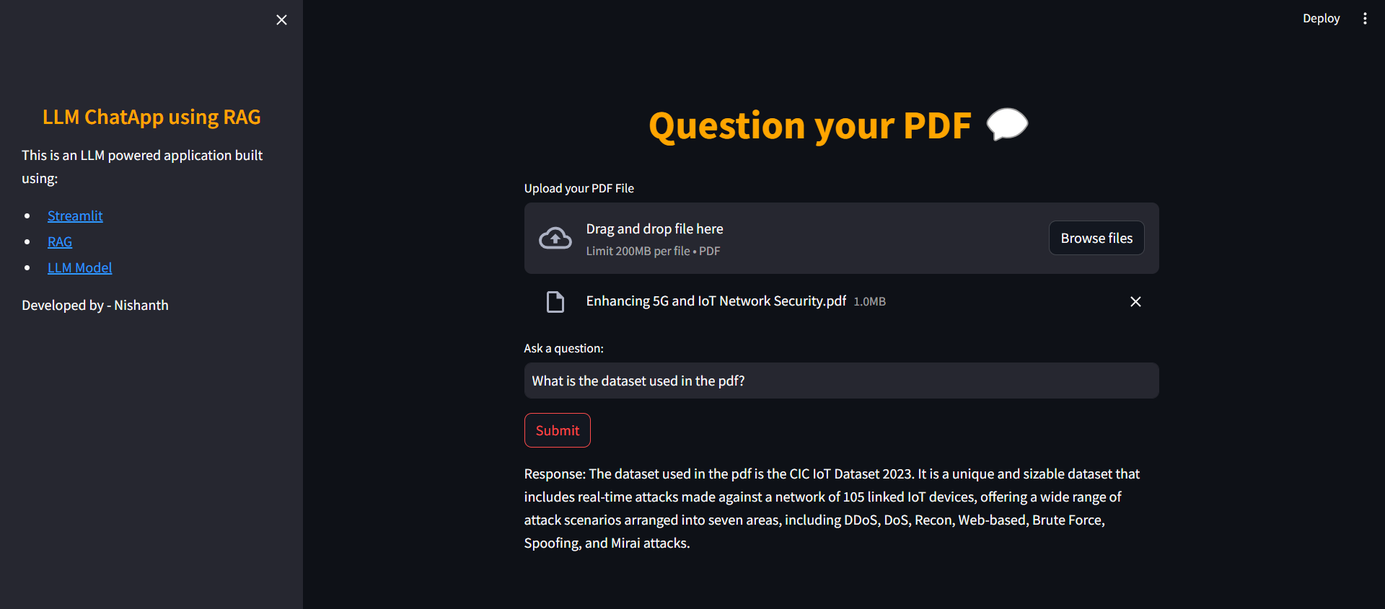

Slide 18
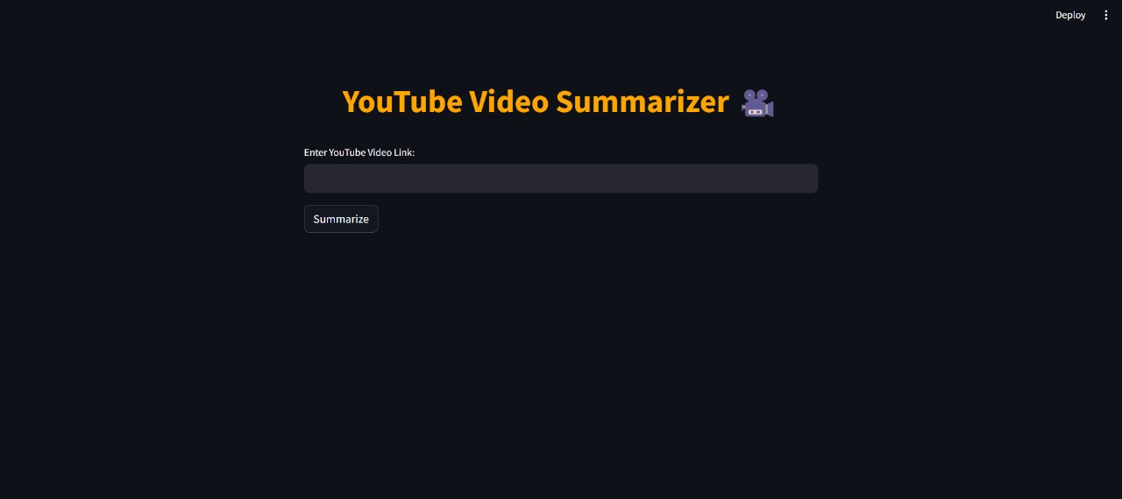
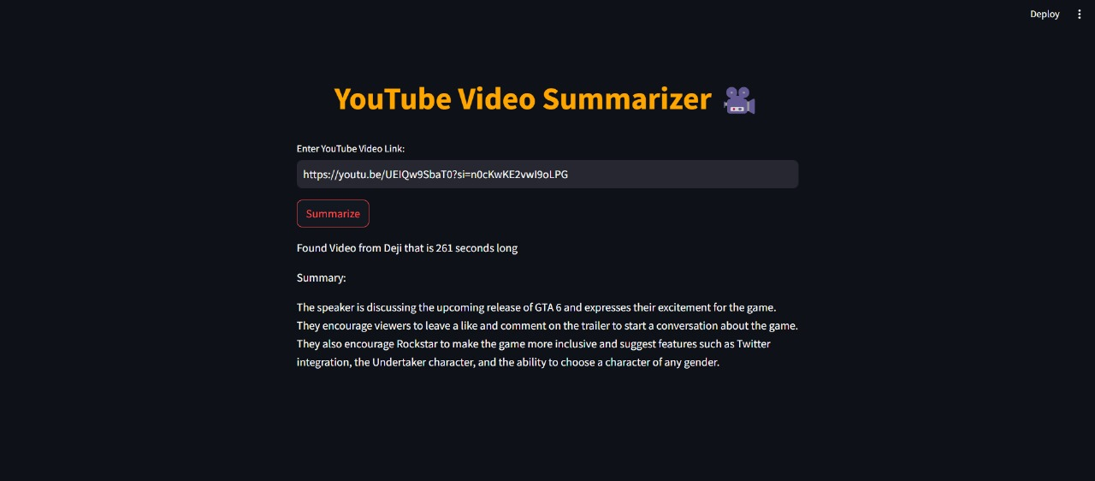

Slide 19
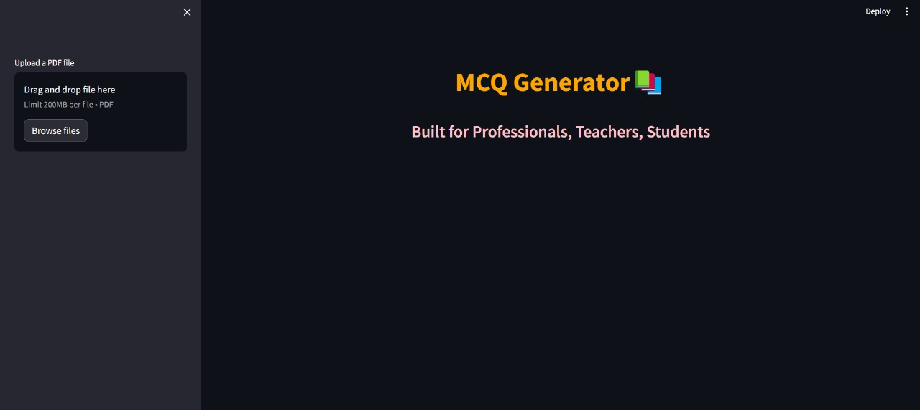
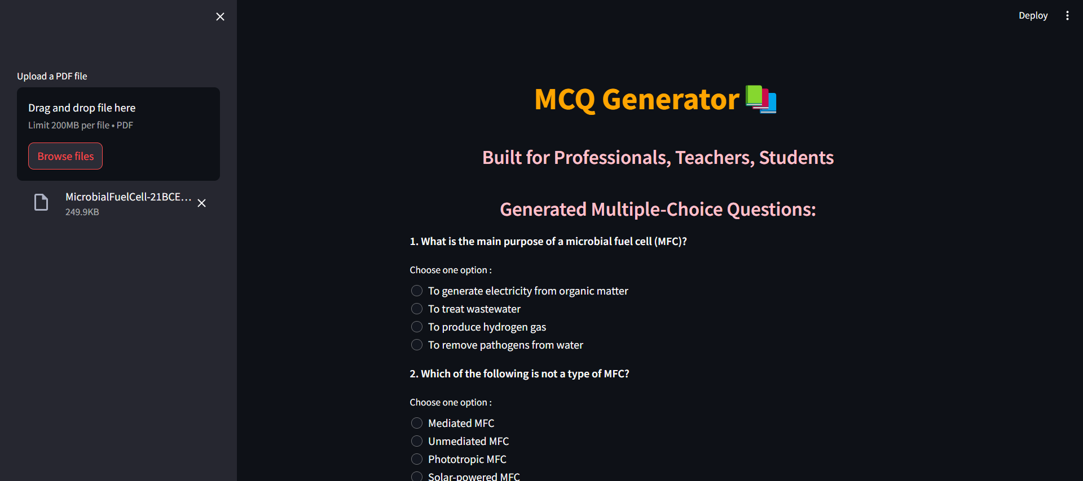

Slide 20
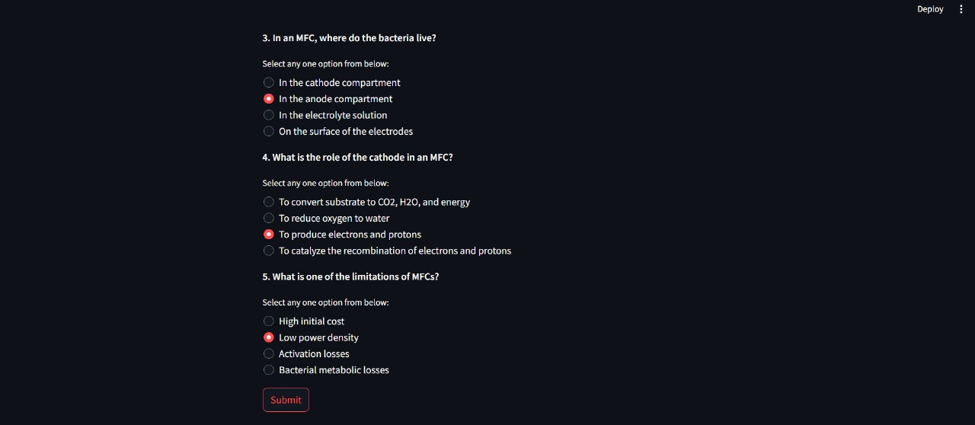
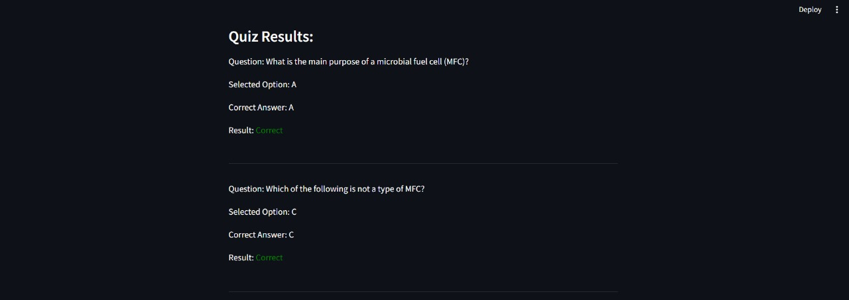

Slide 21
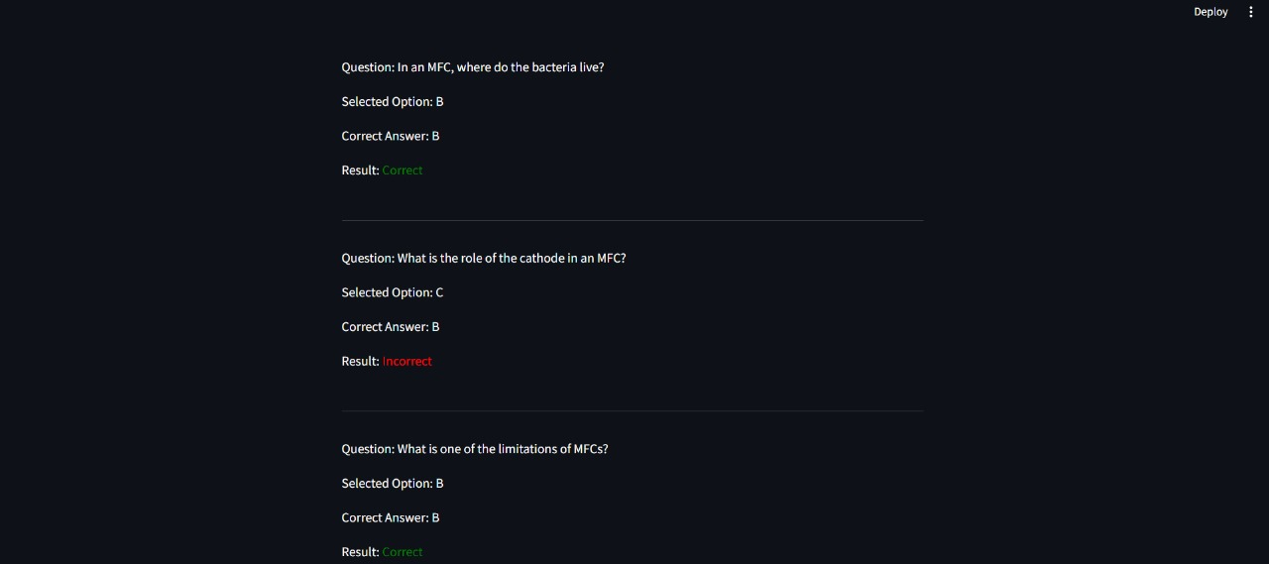
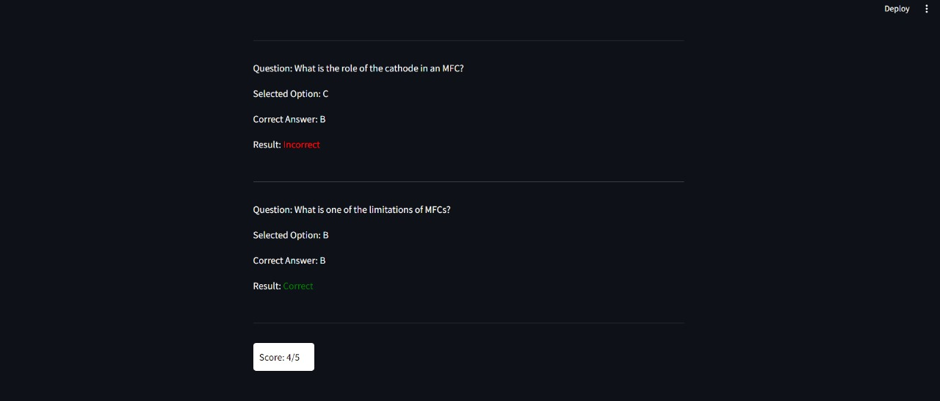

Slide 22
GitHub - https://github.com/Nishanth456/LLM-based-GenAIStudy-webapp.git
Conclusion:
GenAIStudy is an innovative educational platform that leverages AI to enhance the learning experience. It comprises three key features: QuesPDF, YouTube Video Summarization, and PDF Quiz Generator.
QuesPDF employs the llama-2-70b-chat model to provide dynamic question-answering capabilities based on uploaded PDFs, fostering an interactive learning environment. The YouTube Video Summarization feature harnesses OpenAI models to distill key insights from YouTube videos into concise summaries, proving invaluable for efficient information absorption during time-constrained study sessions. The PDF Quiz Generator uses the llama-2-70b model to generate diverse multiple-choice questions from PDF content, reinforcing learning objectives and enhancing the assessment process.
Future enhancements include refining the question generation algorithms for more diverse and complex questions, implementing user feedback mechanisms for continual improvement, and expanding support for a wider range of content formats and sources.
GenAIStudy represents a significant stride in utilizing AI for educational support. It not only addresses immediate study needs but also sets the foundation for future advancements in line with the evolving educational technology landscape, contributing to a more effective and engaging learning experience.

