Slide 1
NEIL GOGTE INSTITUTE OF TECHNOLOGY
DEPARTMENT OF COMPUTER SCIENCE AND ENGINEERING
Chef Guru: A Hybrid RAG and Fine-Tuning Framework for Personalized AI-Powered Recipe Generation
Presented By:
Marneni Nishanth 245322733097
Mohd Fahad Ahmed 245322733098
Mohith Sai Koganti 245322733099
Under the Guidance
Of
Mr. P.Suresh Babu
Assistant Professor​
Notes:
1

Slide 2
INTRODUCTION
This project presents Chef Guru, a domain-specific artificial intelligence system designed for personalized recipe generation from ingredient-only inputs. The system addresses limitations of generic large language models, which often produce recipes with missing steps, inconsistent ingredient usage, or unrealistic cooking procedures.
To improve reliability and contextual grounding, the system adopts a hybrid architecture combining Retrieval-Augmented Generation (RAG) with parameter-efficient fine-tuning (QLoRA). Relevant recipes are retrieved from a large recipe dataset using semantic embeddings stored in a ChromaDB vector database, followed by cross-encoder re-ranking to select the most relevant examples. These retrieved recipes are incorporated into a structured prompt that guides the fine-tuned Phi-3-mini model to generate coherent and practically usable recipes.
The platform is implemented using a microservices-based backend with MongoDB and Redis for data management and caching, along with a React-based frontend that enables users to select ingredients, generate recipes, and interact with the system efficiently. Additionally, the system supports step-by-step culinary explanations and recipe history management, improving usability and helping users better understand cooking processes. This combination of retrieval, fine-tuning, and scalable system design enables Chef Guru to deliver reliable and practical AI-powered cooking assistance.

Slide 3
PROBLEM STATEMENT
Many individuals face difficulty deciding what to cook using the ingredients they already have at home. In many cases, the available ingredients are limited, making it challenging to find recipes that match them exactly. Most online recipe platforms suggest dishes that require additional ingredients, forcing users to either modify recipes manually or spend extra time searching for alternatives.
This problem becomes more challenging for beginners or individuals with limited cooking experience, as they may not know how to effectively combine or substitute ingredients. Without proper guidance, users may struggle to transform simple ingredients into complete meals. As a result, they often spend considerable time browsing through multiple recipes before finding one that is suitable.
Furthermore, the lack of personalized recipe recommendations that align with the ingredients already available in the kitchen leads to inefficient meal planning. Ingredients that remain unused for long periods may eventually spoil, resulting in unnecessary food wastage. Therefore, there is a growing need for intelligent systems that can analyze available ingredients and generate relevant and practical recipe suggestions.

Slide 4
OBJECTIVES
To design and implement an intelligent recipe recommendation system that suggests dishes based on the ingredients available to users.
To enable users to generate complete recipes from a limited set of ingredients available in their kitchen.
To apply advanced recommendation techniques such as content-based filtering and collaborative filtering to improve the relevance of recipe suggestions.
To incorporate retrieval-based methods that help the system identify recipes similar to the ingredients provided by the user.
To improve the accuracy and quality of generated recipes by leveraging modern artificial intelligence and language models.
To develop a scalable, production-ready system that can be deployed and used by users in real-world scenarios.

Slide 5
EXISTING SYSTEM
Existing recipe recommendation systems primarily rely on rule-based methods or simple database retrieval techniques, which often suggest recipes requiring additional ingredients not available to the user. Recent advancements have introduced AI and large language model-based approaches capable of generating recipes automatically, but these systems may produce unrealistic cooking steps, inconsistent ingredient usage, or hallucinated instructions. To address these issues, newer methods use Retrieval-Augmented Generation (RAG) and fine-tuning techniques to improve contextual grounding and recipe quality. However, many existing solutions rely on either retrieval or generation alone, limiting their ability to balance accuracy, creativity, and practical usability. Therefore, there is a growing need for intelligent systems that integrate both retrieval and generation methods to produce more reliable, context-aware, and practically usable recipes based on the ingredients available to users.

Slide 6
LIMITATIONS IN EXISTING WORK
Many existing recipe systems rely on simple rule-based methods or keyword matching, which limits their ability to generate flexible recipes from diverse ingredient combinations.
Generic LLM-based recipe generators often produce hallucinated or unrealistic cooking steps, reducing the practical reliability of generated recipes.
Lack of contextual grounding, as many systems generate recipes without referencing real recipe datasets or culinary knowledge.
Poor ingredient consistency, where generated recipes may introduce new ingredients or fail to utilize the ingredients provided by the user.
Limited personalization and adaptability, as most systems do not effectively consider user preferences or available ingredients when recommending recipes.

Slide 7
Technologies and Methods Used in Earlier Systems
Method Type | Techniques Used | Advantages | Limitations
Rule-Based Recipe Systems | Recipes generated using predefined templates and ingredient rules | Simple to implement and produces structurally consistent recipes. | Lack flexibility and cannot handle diverse or unusual ingredient combinations.
Sequence-to-Sequence Neural Models | Use neural networks to generate recipe text automatically from input ingredients. | Improve linguistic fluency and allow automatic recipe generation. | Often produce ingredient inconsistencies or omit ingredients in instructions.
Large Language Models (LLMs) | Advanced AI models used to generate human-like recipe instructions. | Generate natural, detailed, and creative cooking instructions. | May hallucinate cooking steps or produce unrealistic recipes without grounding.
Retrieval-Based Systems | Retrieve similar recipes from large recipe databases using ingredient similarity. | Provide contextually relevant recipes based on real data. | Limited creativity and cannot generate new recipes beyond retrieved results.
Parameter-Efficient Fine-Tuning (LoRA / QLoRA) | Fine-tunes pre-trained models for domain-specific tasks using fewer parameters. | Reduces training cost and enables adaptation of large models efficiently. | Without retrieval grounding, models may still produce hallucinated outputs.

Slide 8
PROPOSED SYSTEM
Chef Guru is an AI-powered recipe generation system that creates recipes from ingredient-only inputs.
It uses a hybrid architecture combining Retrieval-Augmented Generation (RAG) and QLoRA fine-tuning to improve accuracy and reliability.
The system retrieves relevant recipes from a ChromaDB vector database using semantic embeddings and refines them through cross-encoder re-ranking.
A fine-tuned Phi-3-mini language model generates complete recipes with ingredients and step-by-step cooking instructions.
The system uses query expansion techniques to enrich ingredient inputs and improve retrieval relevance.
A microservices backend with MongoDB and Redis manages authentication, caching, and data persistence.
A React-based frontend interface allows users to input ingredients, generate recipes, and interact with the system easily.

Slide 9
KEY INNOVATIONS
Ingredient-Based Recipe Generation Automatically generates complete recipes based on the ingredients provided by the user, enabling personalized cooking suggestions.
Hybrid Retrieval and Generation Approach Combines Retrieval-Augmented Generation (RAG) with QLoRA fine-tuned language models to produce contextually grounded and reliable recipes.
Semantic Recipe Retrieval Uses SentenceTransformer embeddings and a ChromaDB vector database to retrieve relevant recipes based on ingredient similarity.
Cross-Encoder Re-Ranking for Accuracy Applies a cross-encoder model to refine retrieved recipes and select the most relevant ones before generation.
Step-Level Culinary Explanation Provides explanations for each cooking step, helping users understand the cooking process, techniques, and ingredient interactions.

Slide 10
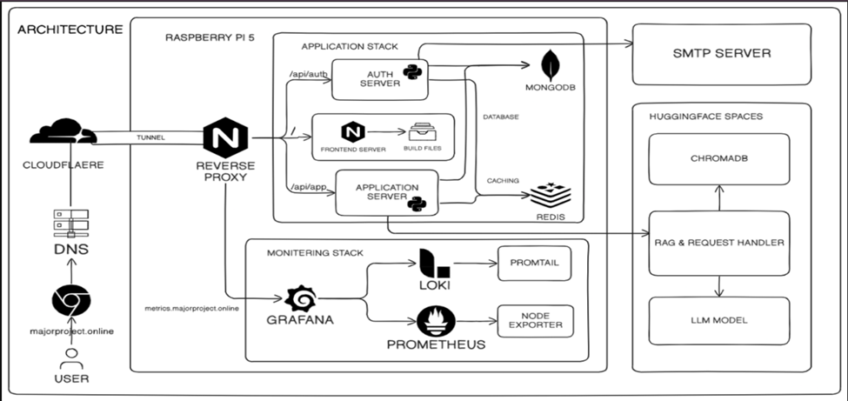
SYSTEM ARCHITECTURE

Slide 11
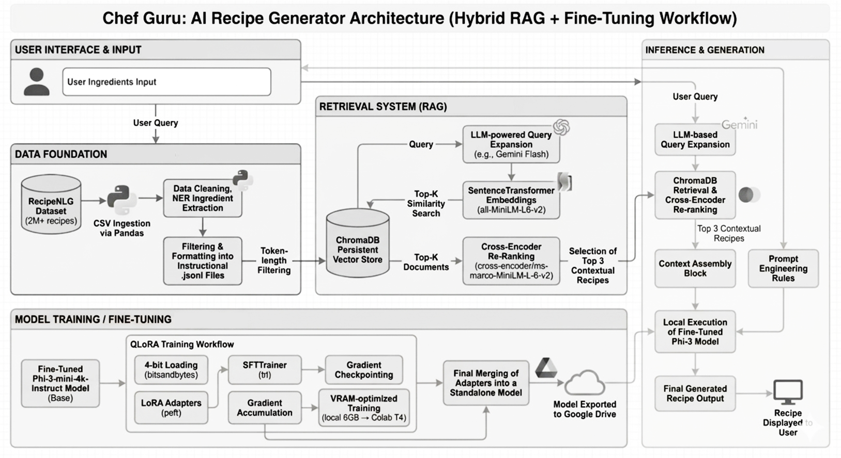
SYSTEM ARCHITECTURE
to

Slide 12
SYSTEM ARCHITECTURE
Input Layer
Accepts ingredient inputs from users through the application interface.
Supports manual ingredient entry and structured ingredient selection.
Acts as the entry point for the recipe generation pipeline.
Preprocessing Layer
Performs ingredient normalization and validation.
Handles duplicate removal, spelling correction, and format standardization.
Applies query expansion to enrich ingredient input with related culinary context.
Ensures the input is aligned with the retrieval and generation model requirements.
Retrieval and Re-Ranking Layer
Uses SentenceTransformer embeddings to retrieve similar recipes from ChromaDB.
Applies cosine similarity search to identify candidate recipes.
Implements cross-encoder re-ranking to refine and select the most relevant recipes.
Improves overall recipe generation accuracy by providing contextual grounding for the model.

Slide 13
SYSTEM ARCHITECTURE
Generation Layer
Uses a QLoRA fine-tuned Phi-3-mini language model for recipe generation.
Combines user ingredients with retrieved recipes to form a structured prompt.
The model generates a complete recipe including title, ingredient list, and step-by-step cooking instructions.
Ensures the generated recipe is ingredient-consistent, coherent, and practically usable.
Culinary Explanation Layer
Provides step-level cooking explanations for generated recipes.
Explains the purpose of each step, cooking techniques, and ingredient interactions.
Improves user understanding, transparency, and learning of cooking processes.
Helps users follow recipes correctly and avoid common cooking mistakes.
Output Layer
Displays the generated recipe with structured sections (title, ingredients, instructions).
Shows step-by-step explanations and cooking guidance to the user.
Stores generated recipes in MongoDB with Redis caching for faster retrieval.
Results are displayed on the React-based user interface with options to view history and save recipes.

Slide 14
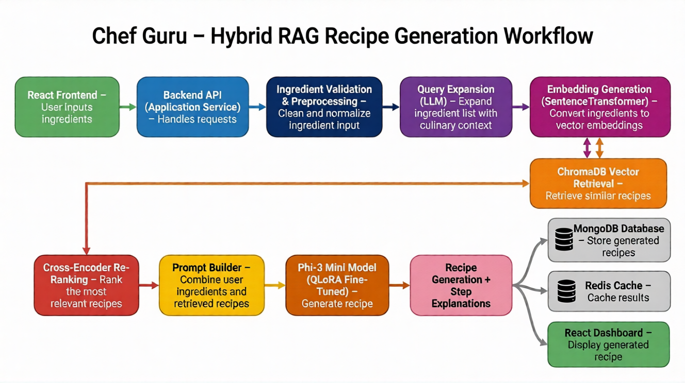
WORKFLOW

Slide 15
WORKFLOW
React Frontend (App.jsx)
Provides the user interface for the Chef Guru dashboard.
Allows users to select or input ingredients for recipe generation.
Sends ingredient data to the backend through API requests.
Displays the generated recipe, step explanations, and recipe history.
Backend API (Application Service)
Handles requests through the recipe generation endpoint.
Processes ingredient input using validation and preprocessing modules.
Acts as the central controller connecting frontend, retrieval pipeline, and AI model.
Manages communication between vector database, generation model, and storage services.
Ingredient Validation & Preprocessing
Validates the ingredient list submitted by the user.
Performs data cleaning, normalization, and duplicate removal.
Ensures ingredient inputs match the format required for retrieval and embedding models.
Prepares the input for query expansion and vector embedding generation.

Slide 16
WORKFLOW
Query Expansion & Retrieval
Expands ingredient queries using an LLM to include related culinary context.
Converts ingredients into vector embeddings using SentenceTransformer.
Retrieves similar recipes from the ChromaDB vector database.
Applies cross-encoder re-ranking to select the most relevant recipes.
Recipe Generation Model
Uses the Phi-3 Mini model fine-tuned with QLoRA for domain-specific recipe generation.
Combines user ingredients with retrieved recipes through a prompt builder.
Generates a complete recipe including title, ingredients, and step-by-step instructions.
Produces contextually grounded and ingredient-consistent outputs.
Output & Storage
Provides step-level culinary explanations to improve user understanding.
Stores generated recipes in MongoDB for persistent storage.
Uses Redis caching to improve performance and reduce repeated computation.
Displays the final recipe and explanations on the React dashboard interface.

Slide 17
SYSTEM MODULES
Ingredient Input Module
Accepts ingredient input from users through the React frontend interface and sends the data to the backend API for processing.
Input Validation Module
Validates ingredient entries, checks for empty or invalid inputs, and ensures the format is suitable for further processing.
Ingredient Preprocessing Module
Performs ingredient normalization, duplicate removal, and formatting to align with the dataset and embedding model requirements.
Query Expansion Module
Expands the ingredient list using an LLM to include related culinary context and improve retrieval accuracy.
Recipe Retrieval Module
Uses SentenceTransformer embeddings and ChromaDB vector database to retrieve recipes similar to the user’s ingredient list.

Slide 18
SYSTEM MODULES
Re-Ranking Module
Applies a cross-encoder model to rank retrieved recipes and select the most relevant ones for generation.
Recipe Generation Module
Uses the QLoRA fine-tuned Phi-3 Mini model to generate complete recipes with ingredients and step-by-step instructions.
Culinary Explanation Module
Provides explanations for each cooking step, describing the purpose, technique, and ingredient interactions.
Output Module
Returns the generated recipe along with step explanations and displays it on the React dashboard.
Database Module
Stores generated recipes, user inputs, and recipe history in MongoDB, while Redis caching improves response time and performance.

Slide 19
TECHNOLOGY STACK
Category | Technologies Used
Programming Languages | Python, JavaScripts
Tools | VS Code, Jupyter Notebook, Docker, Git ,Pandas, Chroma DB
Frameworks | React.js, Flask / FastAPI, Hugging Face Transformers, SentenceTransformers
Database | MongoDB, Redis
APIs | REST APIs (FastAPI Endpoints), Hugging Face API
Hardware | Intel i5/i7 Processor, 8GB RAM (16GB recommended), 50GB Storage, NVIDIA GPU 16 GB RAM.

Slide 20
METHODOLOGY
Ingredient Input & Validation: Accepts ingredient input from the user through the React frontend and validates the format to ensure the ingredients are suitable for processing.
Ingredient Preprocessing: Cleans and normalizes ingredient inputs by removing duplicates, correcting formatting, and preparing the data for further processing.
Query Expansion: Expands the ingredient list using a lightweight language model to add related culinary context and improve retrieval accuracy.
Semantic Retrieval: Generates ingredient embeddings using SentenceTransformer and retrieves similar recipes from the ChromaDB vector database.

Slide 21
METHODOLOGY
Re-Ranking: Uses a cross-encoder model to rank the retrieved recipes and select the most relevant ones for recipe generation.
Recipe Generation: Combines user ingredients with retrieved recipes through a prompt builder and uses the QLoRA fine-tuned Phi-3 Mini model to generate a complete recipe.
Culinary Explanation: Provides step-level explanations describing cooking techniques, ingredient interactions, and preparation guidance.
Storage & Display: Stores generated recipes in MongoDB, caches results using Redis, and displays the final recipe with explanations on the React dashboard.

Slide 22
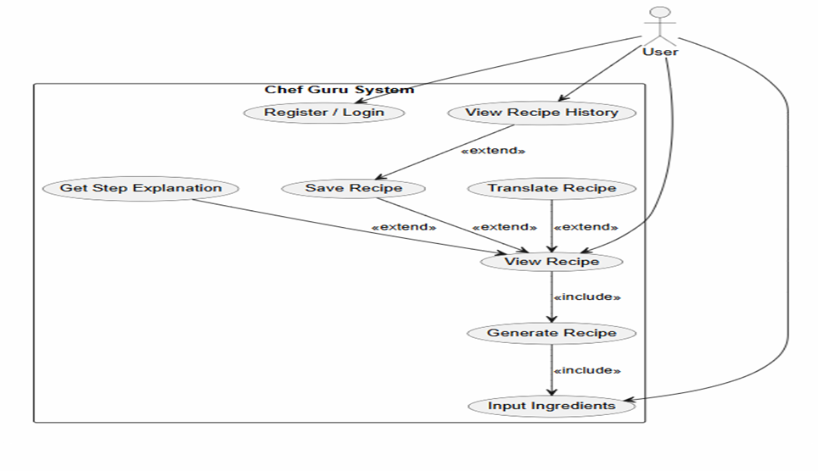
USE CASE DIAGRAM

Slide 23
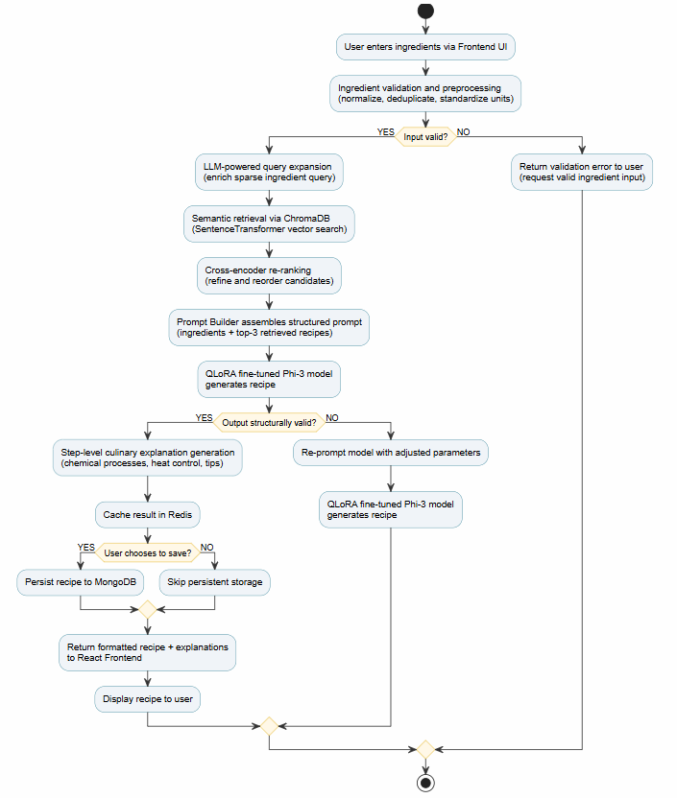
ACTIVITY DIAGRAM

Slide 24
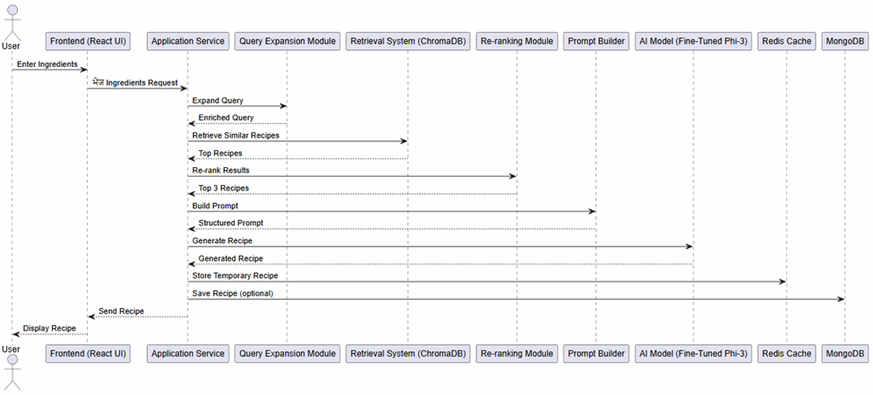
SEQUENCE DIAGRAM

Slide 25

IMPLEMENTATION

Slide 26
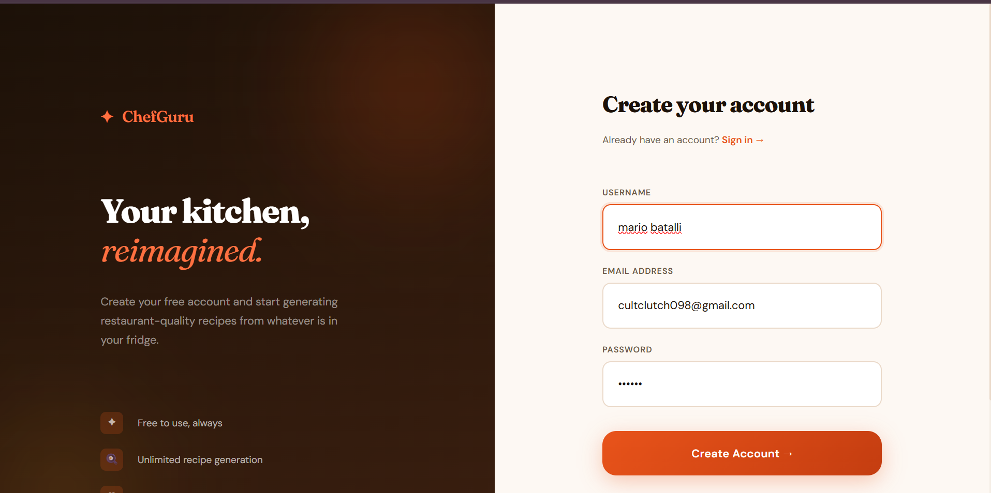
IMPLEMENTATION

Slide 27
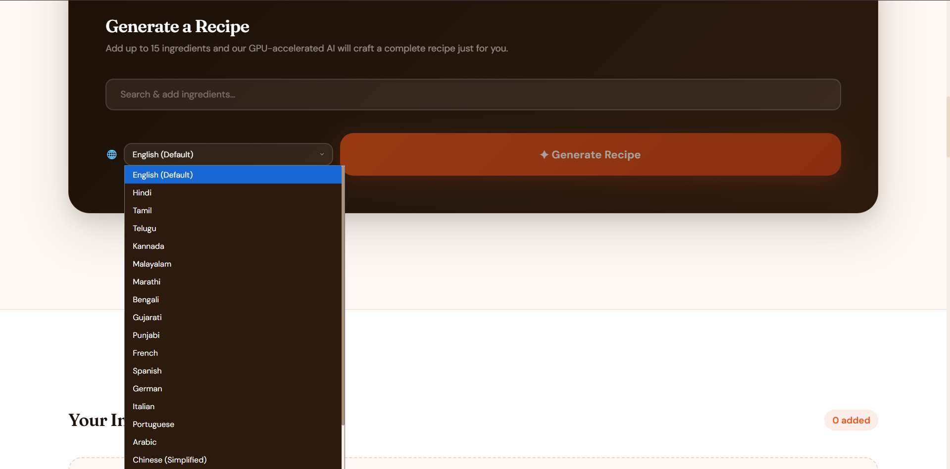
IMPLEMENTATION

Slide 28
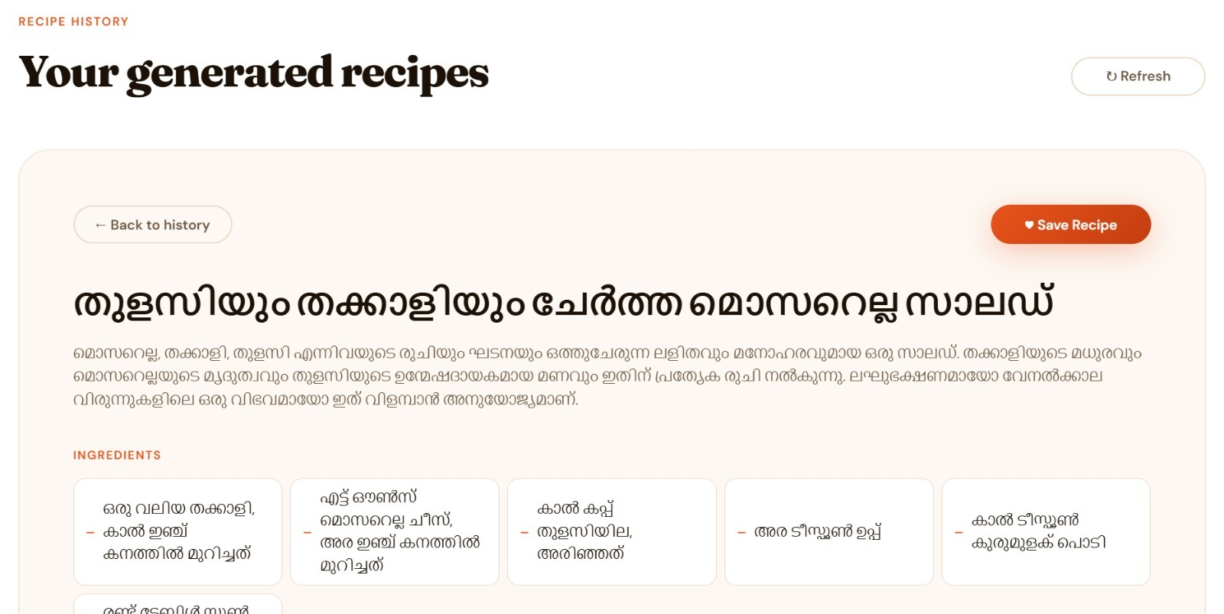
IMPLEMENTATION

Slide 29
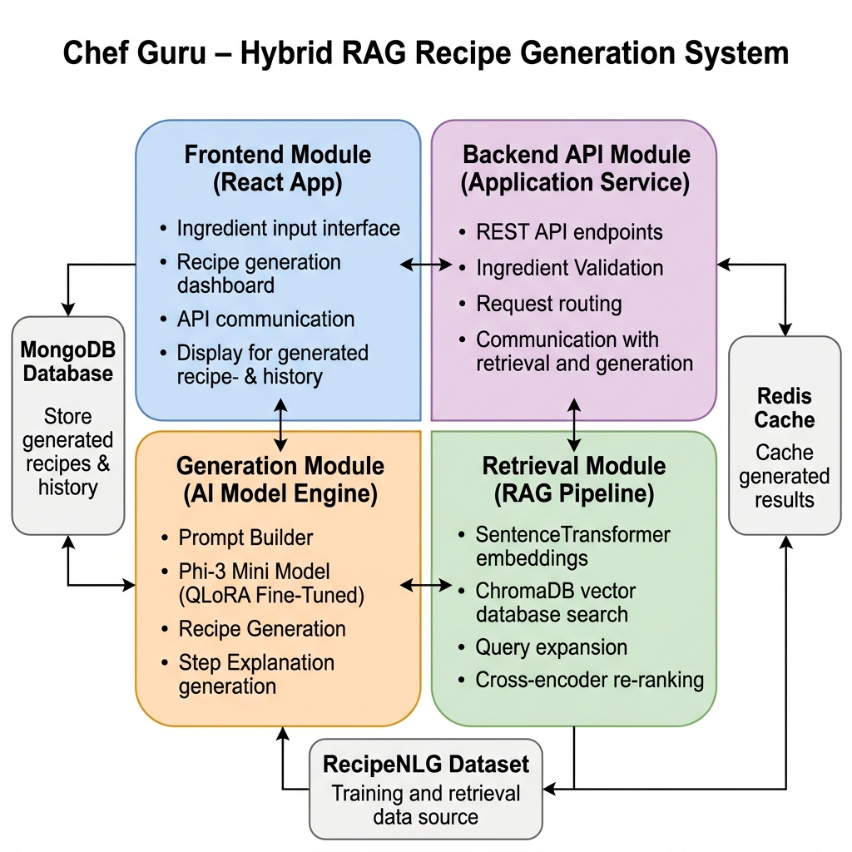
CODE
MODULES

Slide 30
TESTING
Test Case ID | Description | Input | Expected Output | Result
TC - 01 | Valid Ingredients | ['eggs', 'cheese', 'spinach'] | Complete recipe with title, ingredients, and steps. | Pass
TC - 02 | Empty ingredient input | Blank Field | Validation error | Pass
TC - 03 | User registration | Valid username, email, password | Account is created and a success response is returned. | Pass
TC - 04 | User login | Valid credentials | JWT token is returned | Pass
TC - 05 | Invalid login | Incorrect password | Error message | Pass
TC - 06 | Recipe history storage | Authenticated user generates a recipe | Recipe is stored in DB and appears in the history. | Pass
TC - 07 | Query expansion | ['tomato', 'basil', 'pasta'] | Expanded query describes a pasta dish with tomato and herb flavors | Pass
TC - 08 | Recipe retrieval count | Expanded query for a pasta dish | ChromaDB returns 10 candidate recipes ranked by cosine similarity. | Pass

Slide 31
Validation approach
Functional Validation
Model Validation
Validates ingredient inputs for missing or incorrect entries and ensures preprocessing steps such as normalization and query expansion are correctly applied before recipe generation.
Performance Validation
Evaluates the ability of the system to generate accurate and relevant recipes from different ingredient inputs. Ensures the reliability and consistency of the retrieval and generation pipeline across diverse ingredient combinations.
Integration Testing
Measures system efficiency by evaluating recipe generation time for ingredient inputs and overall processing time of the retrieval and generation pipeline, ensuring responses are delivered without significant delay.
Evaluation Metrics
Verifies seamless communication between the React frontend, backend API, and AI modules, ensuring smooth data flow, correct API responses, and proper synchronization of generated recipes.
Assesses system performance by evaluating the relevance, coherence, and ingredient consistency of generated recipes to ensure reliable and practical outputs.

Slide 32
COMPARISON OF PROPOSED MODEL WITH EXISTING SYSTEMS
System / Model | Approach | Accuracy (%) | Key Limitation
Gao et al. (2024) | Retrieval-Augmented Generation (RAG) | ~88 | Retrieval quality depends heavily on dataset coverage
Wang et al. (2023) | Query Expansion with LLM | ~86 | Limited control over generated query context
Nogueira & Cho (2020) | Cross-Encoder Re-Ranking | ~90 | Computationally expensive for large datasets
Hu et al. (2021) | LoRA Fine-Tuning | ~89 | May still require large base models
Proposed Model (Ours) | Hybrid RAG + QLoRA Framework | 91–94 | Improved recipe relevance, grounding, and ingredient consistency

Slide 33
CHALLENGES FACED
Technical Issues
Faced challenges in integrating multiple components such as the retrieval system, vector database, and language model while maintaining a smooth workflow. Solution: Implemented a modular architecture separating preprocessing, retrieval, and generation stages to ensure consistent data flow and easier integration..
Debugging Problems
Errors occurred during API communication between the React frontend, backend services, and the AI model pipeline. Solution: Applied structured logging, API validation checks, and modular debugging to identify issues in the retrieval and generation pipeline efficiently.
Data Limitations
The RecipeNLG dataset contained noisy entries, inconsistent ingredient formats, and duplicate recipes; Solution: applied preprocessing techniques such as ingredient normalization, duplicate removal, filtering incomplete recipes, and format standardization.
Scalability & Performance
Processing large recipe datasets and running retrieval and generation models caused latency during recipe generation. Solution: Optimized the pipeline using vector embeddings with ChromaDB for faster retrieval and implemented Redis caching to improve response time and system performance.

Slide 34
APPLICATIONS
Home Cooking Assistance:
The system helps users decide what to cook using the ingredients already available in their kitchen by generating personalized recipes.
Dietary Planning & Nutrition:
It can be used to examine historical data from medical devices and wearable systems to identify potential cyber threats and ensure the security of sensitive patient information.
Culinary Learning & Education:
The platform provides step-by-step cooking instructions and explanations, helping beginners understand cooking techniques and ingredient interactions.
Restaurant & Food Service Innovation:
Chefs and food service professionals can experiment with new dish ideas by generating recipes from different ingredient combinations.
Recipe Recommendation Platforms:
The system can be integrated into food applications and recipe platforms to provide intelligent ingredient-based recipe recommendations.
AI Research & Development:
The framework can support research in AI-driven recipe generation, Retrieval-Augmented Generation (RAG), and domain-specific language model fine-tuning.

Slide 35
FUTURE SCOPE
Real-Time Data Integration:
Extend the system to support real-time ingredient data from smart kitchen devices or inventory systems to generate recipes dynamically based on available ingredients.
Advanced AI Models:
Incorporate more advanced models such as larger transformer-based architectures or multimodal AI to improve recipe generation quality and contextual understanding.
Enhanced Explainability
Integrate additional explainable AI techniques to provide deeper insights into how the system selects ingredients, cooking methods, and recipe steps.
Nutritional & Dietary Intelligence:
Extend the system to include nutritional analysis, calorie estimation, allergen detection, and personalized dietary recommendations.
Edge & Smart Kitchen Integration:
Optimize the system to run on edge devices or integrate with smart kitchen appliances to assist users during real-time cooking.
Mobile/Web Application Expansion:
Develop a mobile application or enhanced web interface for easier ingredient input, recipe browsing, and personalized cooking assistance.

Slide 36
CONCLUSION
The project successfully develops an advanced AI-powered recipe generation system by integrating Retrieval-Augmented Generation (RAG) with QLoRA-based fine-tuning of the Phi-3 Mini language model. By combining semantic retrieval using SentenceTransformer embeddings and ChromaDB with a fine-tuned generative model, the system improves recipe relevance, coherence, and ingredient consistency. The use of cross-encoder re-ranking further refines the retrieval process by selecting the most relevant recipes from the dataset, ensuring that the generated outputs are contextually grounded and practically usable. The system also provides step-level culinary explanations, offering insights into cooking techniques and ingredient interactions to enhance user understanding. Furthermore, a React-based dashboard interface allows users to input ingredients, generate recipes, and view structured results through an interactive platform. Overall, the system demonstrates a practical and scalable approach to AI-driven recipe generation, effectively bridging the gap between ingredient availability and personalized meal preparation.

Slide 37
Current Limitations
Lack of Real-Time Processing: The system currently relies on user-provided ingredient inputs and a pre-collected recipe dataset. It does not integrate with real-time kitchen inventory systems or smart appliances to automatically detect available ingredients.
Limited Edge Deployment: The current implementation depends on backend servers and AI model inference resources, making it challenging to deploy directly on low-power devices or run fully offline without sufficient computational support.
No Automated Response Mechanism: The performance of the system depends heavily on the quality and diversity of the RecipeNLG dataset. Rare or culturally specific ingredient combinations that are underrepresented in the dataset may affect recipe relevance.
Dependence on Data Quality: Certain components such as language models and translation services rely on external APIs or hosted inference services, which may introduce latency or availability constraints..

Slide 38
REFERENCES
[1] T. Dettmers et al., “QLoRA: Efficient Finetuning of Quantized LLMs,” NeurIPS, 2023. Introduces QLoRA, a parameter-efficient method for fine-tuning large language models with reduced memory and computational requirements.
[2] Y. Gao et al., “Retrieval-Augmented Generation for LLMs: A Survey,” 2024. Provides an overview of RAG architectures that combine retrieval mechanisms with language models to improve contextual grounding.
[3] L. Wang et al., “Query2doc: Query Expansion with Large Language Models,” 2023. Proposes a query expansion technique using LLMs to improve semantic retrieval performance.
[4] R. Nogueira and K. Cho, “Passage Re-ranking with BERT,” 2020. Introduces cross-encoder re-ranking to improve retrieval accuracy by evaluating query-document relevance.
[5] M. Bień et al., “RecipeNLG: A Cooking Recipes Dataset,” 2020. Presents the RecipeNLG dataset used for training and evaluating recipe generation models.
[6] E. J. Hu et al., “LoRA: Low-Rank Adaptation of Large Language Models,” ICLR, 2021. Introduces LoRA, a parameter-efficient technique for adapting large language models using low-rank matrices.

Slide 39
ANY
QUESTIONS?

Slide 40
THANK YOU

