Slide 1
AI-DRIVEN
ESTIMATION AUTOMATION
DRAWINGS
AI / VISION
ENGINEERING
QUANTITIES

Slide 2
1. Construction Estimation Scope
Major construction materials / work categories identified with the Estimation Team
1. Concrete & Shuttering
HIGH PRIORITY | Current development Focus | Beam & Slab
2. Steel
HIGH PRIORITY | Current development Focus | Beam
3. Blockwork
Wall / block quantities
4. Tiles & Granite
Floor / wall finishes
5. Plastering
Internal / external surfaces
6. Painting
Paintable surfaces
7. Waterproofing
Wet areas / terraces
8. Doors & Windows
Openings / glazing
9. Earthwork
Excavation / filling quantities
10. Landscaping
Landscape / external works
11. Plumbing & Electrical
Plumbing / electrical works
12. MS Grill Work
Grill / metal fabrication works
Highlighted focus areas: High Priority - Steel & Concrete
AI Construction Estimation | 2

Slide 3
2. Major Structural Components
The structural estimation framework is organized around these core components
1. Beam
Concrete ✓
Shuttering✓
Steel✓
Current development focus
2. Slab
Concrete ✓
Shuttering ✓
Steel
Current development focus
3. Column
Concrete
Steel
Structural member
4. Foundation
Concrete
Steel
Foundation estimation
5. Shear Wall
Concrete
Steel
Vertical structural wall
6. Retaining Wall
Concrete
Steel
Earth-support structure
Highlighted focus areas: High Priority - Beam & Slab
AI Construction Estimation | 3

Slide 4
3. What Does Construction Estimation Involve?
From engineering information to measurable, reviewable quantities
INPUT
• Drawings
• Schedules
• Notes
• Revisions
INTERPRET & MEASURE
• Geometry
• Dimensions
• Areas
• Lengths
• Counts
CALCULATE
• Engineering rules
• Formulas
• Project practices
VALIDATE
• Quantity checks
• Anomalies
• Estimator review
OUTPUT
• Quantity take-off
• BOQ-ready data
• Excel
AI Model aims to reduces repetitive effort — engineering logic remains central to quantity calculation.
AI Construction Estimation | 4

Slide 5
4. Current AI Development Focus
CONCRETE — BEAM & SLAB
• Beam concrete
• Beam shuttering
• Slab concrete
• Slab shuttering
• Deterministic calculation
• LLM assistance for ambiguous inputs
STEEL — BEAM
• Reinforcement drawing understanding
• Beam matching / ownership
• Reinforcement parsing
• Hybrid CAD + Vision
• Deterministic engineering authority
• Diameter wise Steel Calculations
• Steel quantity + BBS
AI Construction Estimation | 5

Slide 6
5. Concrete Beam & Slab Estimation
Concrete Beam & Slab Estimation Model Link - http://13.201.15.89
DRAWING
DXF framing drawing
Member detection
Geometry / dimensions
ENGINEERING
Concrete volume
Shuttering area
Rules & calculations
OUTPUT
Excel quantity report
Review sheet
Flagged items
• Standard drawings can be processed deterministically.
• LLM assistance is used only when information such as slab thickness, tags, beam dimensions or bounded regions is missing / ambiguous.
• Estimation Team validation demonstrated meaningful productivity improvement; quantity accuracy still requires further improvement.
AI Construction Estimation | 6

Slide 7
6. Concrete POC - Estimation Team Validation
1
ACCURACY
2
PRODUCTIVITY
3
WHAT THIS MEANS
Current Model Performance
Time Reduction
Key Takeaways
Comparison with manual estimation (Estimation Team)
Reduction in time required for quantity take-off
(compared to manual method)
PROCESSING EFFORT REDUCED
Work Item
Concrete
Accuracy
Shuttering
Accuracy
Automation delivers clear time savings for quantity take-off.
Slab
29%
Slab
69%
73%
time saving
ACCURACY STILL REQUIRES IMPROVEMENT
Beam
67%
Current quantities are not yet accurate enough for direct use.
Beam
78%
81%
time saving
MANUAL VERIFICATION IS CURRENTLY REQUIRED
Results need to be reviewed and corrected by the Estimation Team.
POC CONCLUSION
Automation demonstrated considerable time savings; however, current accuracy requires further development and manual verification before production use.
AI Construction Estimation | 6

Slide 8
7. Steel Beam — Hybrid Estimation Architecture
DXF DRAWING
DETERMINISTIC CAD GEOMETRY PIPELINE
RENDER / VISION PIPELINE
CAD geometry • Beam geometry • Span / engineering facts
Context + Detail View → Claude Vision → Semantic Reinforcement
ENGINEERING FACTS
VISION INTERPRETATION
Geometry • cover • spacers • lengths
Bar count • diameter • main/extra • stirrups
HYBRID RESOLUTION
Combine vision + engineering facts
DETERMINISTIC ENGINEERING ENGINE
Rules • calculations • quantities • validation
CUT LENGTH + DL
PIECE GENERATION
STEEL QUANTITY
BBS
EXCEL
AI Construction Estimation

Slide 9
9. End-to-End Steel Estimation Workflow
1.
Upload drawing package
2.
Understand drawing
3.
Extract geometry & context
4.
Identify components / material regions
5.
Route to estimation engine
10.
BOQ / BBS / Excel
9.
Validation & review
8.
Deterministic quantity calculation
7.
Hybrid resolution
6.
AI / Vision where required
AI Construction Estimation | 10

Slide 10
10. Steel Beam — Internal Accuracy Testing
Steel Beam Estimation Model
http://13.127.104.99/
Current model testing result • Subject to Estimation Team validation
Beam BBS — Automation vs Estimated
All quantities in KGS
Inizio 9th framing
Description
UOM
8
10
12
16
20
25
32
Total
Estimated / Manual
KGS
1,561.1
9,375.2
9,171.8
2,871.9
12,026.0
22,638.4
1,152.0
58,796.3
Automated
KGS
931.1
3,917.6
2,599.0
3,374.8
10,205.7
13,794.8
1,185.3
36,008.4
Difference in quantity
KGS
630.0
5,457.6
6,572.7
502.9
1,820.3
8,843.5
33.4
22,787.9
Error Scale
Underestimate
Underestimate
Underestimate
Overestimate
Underestimate
Underestimate
Overestimate
Underestimate
% Accuracy
-
60%
42%
28%
82%
85%
61%
97%
61%
Key Observations from Estimation Team
01
BAR DIAMETER
Top bars specified as 16 mm in the drawing are sometimes read as 20 mm in the output.
02
STIRRUPS
Number of stirrups calculation is incorrect in some cases.
03
SPACER BARS
Spacer diameter and quantity are not consistently taken as per General Notes; same beam may be counted twice.
04
BEAM SIZE
Beam length is not always as per the framing plan, causing slight underestimation.
AI Construction Estimation | Steel Beam

Slide 11
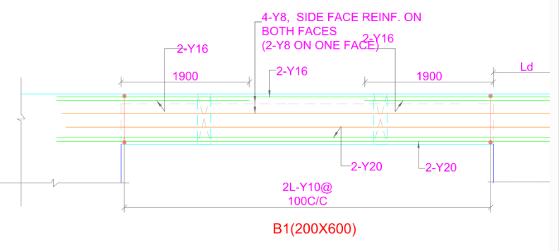
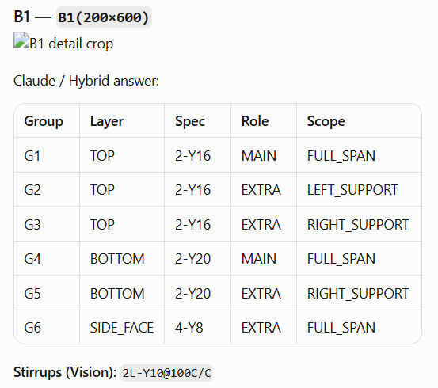
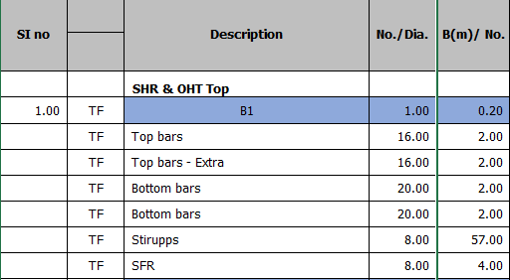
Cropped Beam Image Sent to Claude
Claude/ Hybrid Answer
Estimator Interpretation

Slide 12
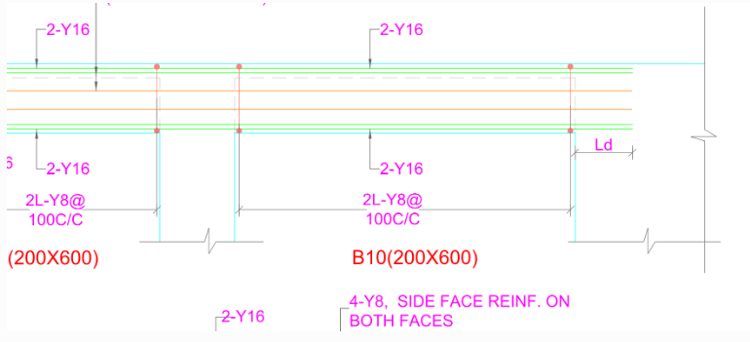
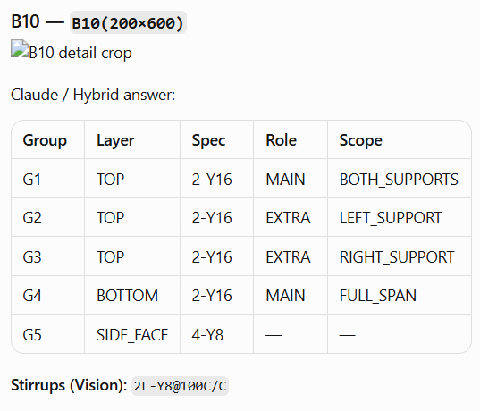
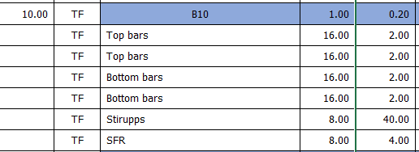
Cropped Beam Image Sent to Claude
Claude/ Hybrid Answer
Estimator Interpretation

Slide 13
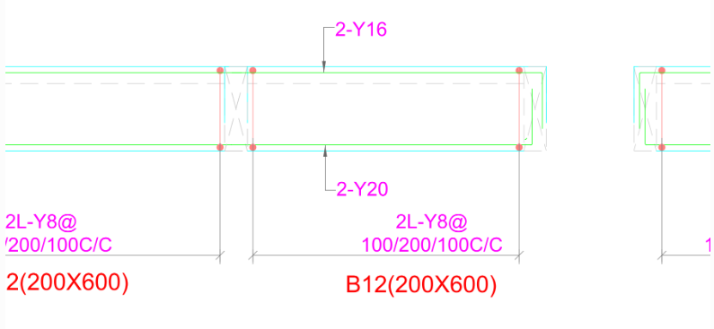
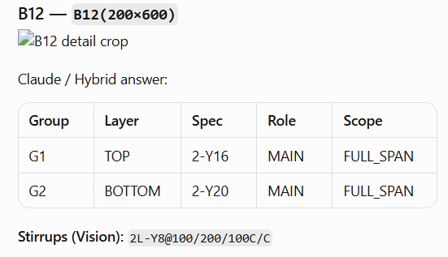
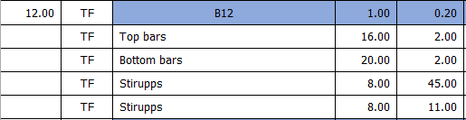
Cropped Beam Image Sent to Claude
Claude/ Hybrid Answer
Estimator Interpretation

Slide 14
Why Estimation Automation Takes Significant Time
Development effort varies by work item • Engineering understanding + diagnostics + validation
1. Engineering Complexity
2. Drawing Understanding
3. Root-Cause & Diagnostics
Different drawings, structural rules, quantity logic and calculation methods for each work item.
Trace incorrect results through multiple stages to identify the actual source of the problem.
Understand how information is represented, connected and interpreted in real construction drawings. This must be transferred to the System.
4. Solution & Iteration
5. Validation & Reliability
Implement possible solutions and test them across different drawing conditions and edge cases.
Validate outputs against engineering expectations before the automation can be trusted.
Development time = Understanding → Diagnosis → Solution → Iteration → Validation
AI Construction Estimation | Development

