Slide 1
AI-DRIVEN ESTIMATION AUTOMATION
DRAWINGS
AI / VISION
ENGINEERING
QUANTITIES

Slide 2
1. Construction Estimation Scope
Major construction materials / work categories identified with the Estimation Team
1. Concrete
HIGH PRIORITY | Current development Focus | Beam & Sab
2. Steel
HIGH PRIORITY | Current development Focus | Beam
3. Blockwork
Wall / block quantities
4. Tiles & Granite
Floor / wall finishes
5. Plastering
Internal / external surfaces
6. Painting
Paintable surfaces
7. Waterproofing
Wet areas / terraces
8. Doors & Windows
Openings / glazing
9. Earthwork
Excavation / filling quantities
10. Landscaping
Landscape / external works
11. Plumbing & Electrical
Plumbing / electrical works
12. MS Grill Work
Grill / metal fabrication works
Highlighted focus areas: High Priority - Steel & Concrete
AI Construction Estimation | 2

Slide 3
2. Major Structural Components
The structural estimation framework is organized around these core components
1. Beam
Concrete ✓
Steel ✓
Current development focus
2. Slab
Concrete ✓
Current development focus
3. Column
Concrete
Steel
Structural member
4. Foundation
Concrete
Steel
Foundation estimation
5. Shear Wall
Concrete
Steel
Vertical structural wall
6. Retaining Wall
Concrete
Steel
Earth-support structure
Highlighted focus areas: High Priority - Beam & Slab
AI Construction Estimation | 3

Slide 4
3. What Does Construction Estimation Involve?
From engineering information to measurable, reviewable quantities
INPUT
• Drawings
• Schedules
• Notes
• Revisions
INTERPRET & MEASURE
• Geometry
• Dimensions
• Areas
• Lengths
• Counts
CALCULATE
• Engineering rules
• Formulas
• Project practices
VALIDATE
• Quantity checks
• Anomalies
• Estimator review
OUTPUT
• Quantity take-off
• BOQ-ready data
• Excel
AI reduces repetitive interpretation effort — engineering logic remains central to quantity calculation.
AI Construction Estimation | 4

Slide 5
4. Current AI Development — What Has Been Built
CONCRETE — BEAM & SLAB
• Beam concrete • Beam shuttering • Slab concrete • Slab shuttering • Deterministic calculation • LLM assistance for ambiguous inputs
STEEL — BEAM
• Reinforcement drawing understanding • Beam matching / ownership • Reinforcement parsing • Steel quantity + BBS • Hybrid CAD + Vision • Deterministic engineering authority
Common foundation: reusable drawing intelligence → material/component-specific estimation engines
AI Construction Estimation | 5

Slide 6
5. Concrete Beam & Slab Estimation
Concrete Beam & Slab Estimation Model Link - http://13.201.15.89
DRAWING
DXF framing drawing Member detection Geometry / dimensions
ENGINEERING
Concrete volume Shuttering area Rules & calculations
OUTPUT
Excel quantity report Review sheet Flagged items
• Standard drawings can be processed deterministically.
• LLM assistance is used only when information such as slab thickness, tags, beam dimensions or bounded regions is missing / ambiguous.
• Estimation Team validation demonstrated meaningful productivity improvement; quantity accuracy still requires further improvement.
AI Construction Estimation | 6

Slide 7
6. Concrete POC - Estimation Team Validation – Accuracy & Time Saving
Beam Concrete
Accuracy - 78%
Beam Shuttering
Accuracy - 81%
Beam Productivity
67% time saving
Slab Concrete
Accuracy - 69%
Slab Shuttering
Accuracy - 73%
Slab Productivity
29% time saving
Estimation Team conclusion: processing effort is reduced, but current quantities still require accuracy improvement.
AI Construction Estimation | 7

Slide 8
7. Steel Beam Estimation — Hybrid AI Architecture
AI perception + deterministic engineering calculation
DETERMINISTIC ENGINEERING
Geometry Beam model Spans / Dimensions Cover Engineering rules
AI VISION
Reinforcement groups Bar count / Diameter Top/ Bottom/ Main / Extra Support scope Visual stirrups
HYBRID RESOLUTION
Combine semantic interpretation with deterministic facts and project rules before quantity computation.
VISION “What reinforcement exists?” → HYBRID RESOLUTION → ENGINEERING “How is it quantified?”
AI Construction Estimation | 8

Slide 9
8. Steel Beam Model — Engineering Intelligence Stack
Drawing Architecture
Identity • drawing sets • beam index • versioning
Geometry Intelligence
Regions • sketches • text • leaders • blocks
Detail & Match
Multi-view recognition • context • candidate ranking • confidence
Ownership
Text / leader / bar / stirrup / shared ownership
Reinforcement Parsing
Longitudinal bars • stirrups • side-face • laps • hooks • curtailment
Quantity & Output
Cut lengths • unit weights • steel quantity • BBS • Excel
AI Construction Estimation | 9

Slide 10
9. End-to-End Steel Estimation Workflow
1.
Upload drawing package
2.
Understand drawing
3.
Extract geometry & context
4.
Identify components / material regions
5.
Route to estimation engine
10.
BOQ / BBS / Excel
9.
Validation & review
8.
Deterministic quantity calculation
7.
Hybrid resolution
6.
AI / Vision where required
AI Construction Estimation | 10

Slide 11
10. Steel Beam — Internal Accuracy Testing
Current model testing result • Subject to Estimation Team validation
Steel Beam Estimation Model Link - http://13.127.104.99/
Diameter (mm) | Automated (MT) | Estimated (MT) | Difference | Error Scale | % Error | % Accuracy
Y8 | 0.55 | 0.43 | 0.12 | Overestimate | 27.57% | 72.43%
Y10 | 0.91 | 1.18 | -0.27 | Underestimate | -23.12% | 76.88%
Y12 | 2.31 | 2.78 | -0.47 | Underestimate | -16.98% | 83.02%
Y16 | 3.51 | 2.57 | 0.94 | Overestimate | 36.49% | 63.51%
Y20 | 3.00 | 2.33 | 0.67 | Overestimate | 28.54% | 71.46%
Y25 | 1.31 | 1.12 | 0.19 | Overestimate | 17.25% | 82.75%
TOTAL | 11.58 | 10.41 | 1.17 | Overestimate | 11.24% | 88.76%
Internal testing Result: 70-80% Overall Accuracy • Final performance subject to Estimation Team validation.
AI Construction Estimation | Steel Beam 11

Slide 12
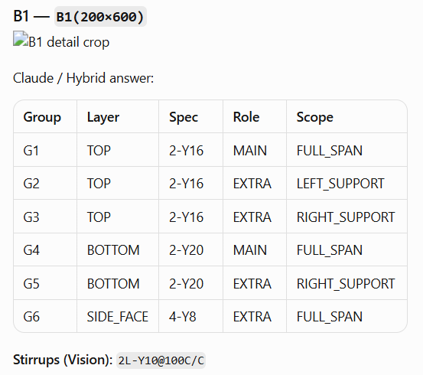
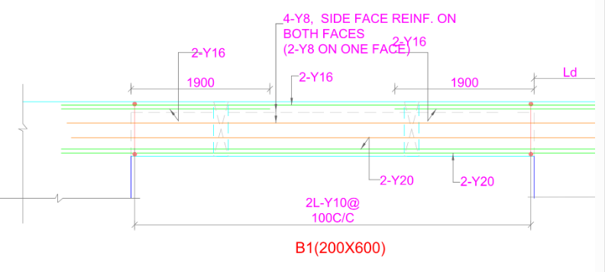
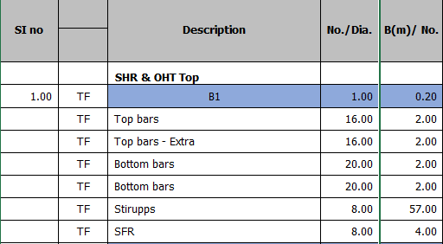

Slide 13
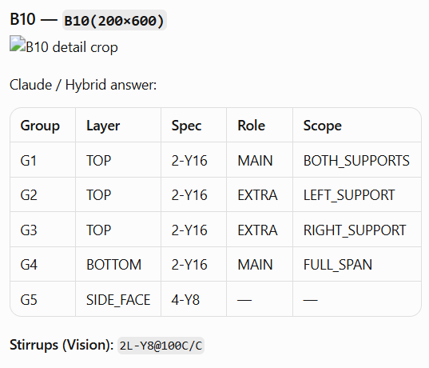
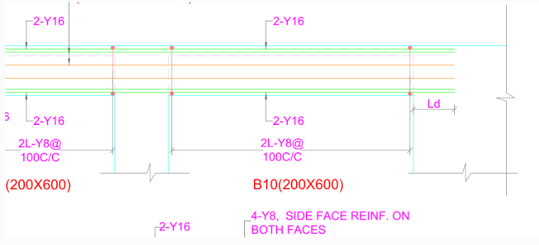
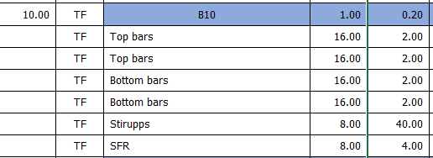

Slide 14
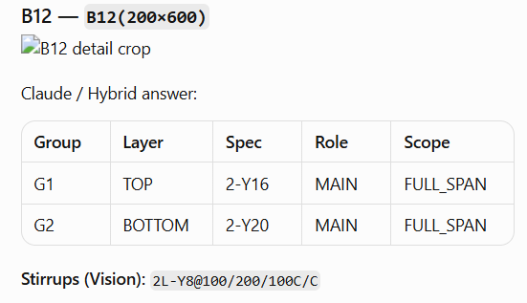
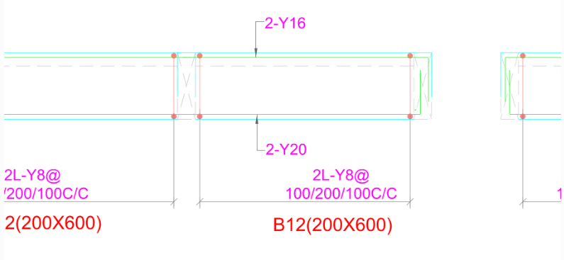
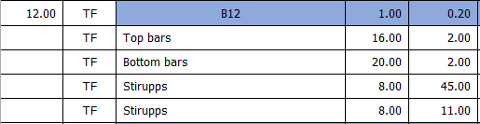

Slide 15
Why Estimation Automation Takes Significant Time
Development effort varies by work item • Engineering understanding + diagnostics + validation
1. Engineering Complexity
2. Drawing Understanding
3. Root-Cause & Diagnostics
Different drawings, structural rules, quantity logic and calculation methods for each work item.
Trace incorrect results through multiple stages to identify the actual source of the problem.
Understand how information is represented, connected and interpreted in real construction drawings. This must be transferred to the System.
4. Solution & Iteration
5. Validation & Reliability
Implement possible solutions and test them across different drawing conditions and edge cases.
Validate outputs against engineering expectations before the automation can be trusted.
Development time = Understanding → Diagnosis → Solution → Iteration → Validation
AI Construction Estimation | Development

