Slide 1

Ideathon Business Competition
By
Name of the Idea:
Team Name (if applicable)
Participants’ Names
Date & Event Name

Slide 2
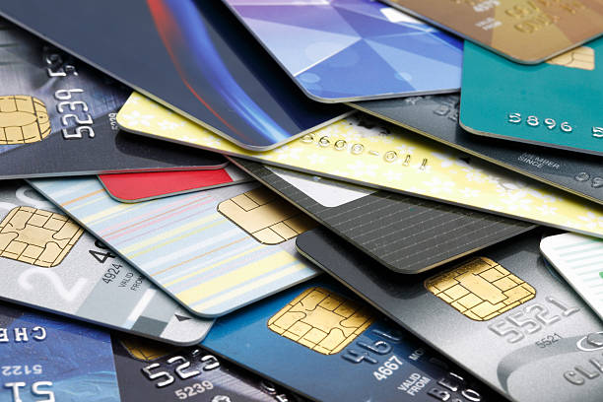
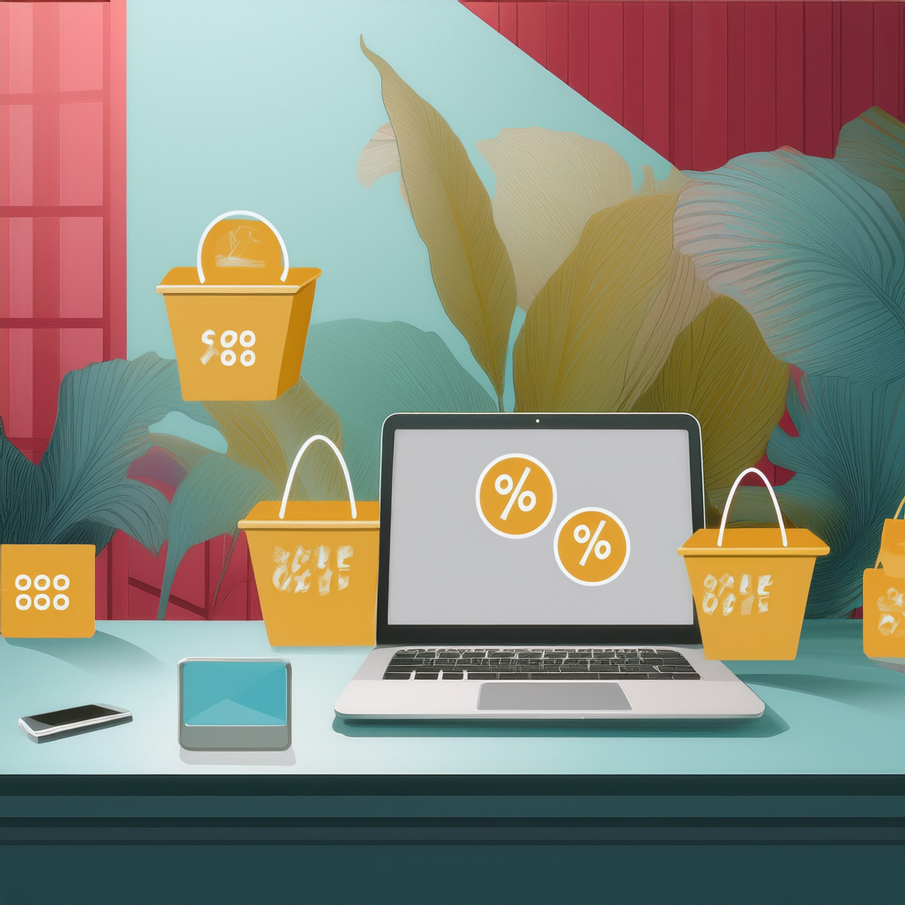
Problem Statement
What is the problem you are solving?
Many online shoppers in India miss out on exclusive credit card discounts because they:
Don’t own premium credit cards (like HDFC, SBI, ICICI, Amex, etc.).
Are not eligible for certain cards due to income, CIBIL score, or banking restrictions.
Why is it important?
Our idea is important because it addresses a real financial gap in online shopping and provides a win-win solution for users and businesses.
Millions of Indians shop online, but only ~6% use credit cards.
our solution makes these discounts accessible to everyone, helping them save money instantly.

Slide 3
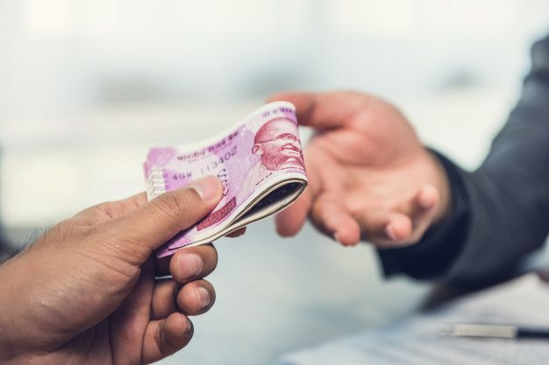
Solution Overview
Brief description of your idea:
Our idea is a Credit Card Discount Access Platform that allows users to take advantage of exclusive credit card discounts on online purchases without owning the actual card.
Many shoppers in India miss out on these discounts because they don’t qualify for premium credit cards or don’t want multiple cards.
Our platform solves this by purchasing the product on behalf of the user using our credit card, applying the available discount, and passing the savings to them.
How does it solve the problem?
Users pay us first
We complete the purchase at a lower price, ensuring they get instant savings.
We earn through service fees, cashback, and partnerships.

Slide 4
Uniqueness & Innovation
What makes your idea different from existing solutions?
On-Demand Credit Card Discounts – Users don’t need to apply for multiple cards; they just use our platform.
No Credit Score or Bank Approval Needed – Unlike BNPL or credit cards, no eligibility requirements.
Instant Savings Without Loans or EMI – Unlike BNPL, users pay in full but still enjoy credit card discounts.
Flexibility Across Multiple Cards – Users can choose discounts from different credit cards.
Revenue Model Through Commission – You earn money from transactions, not through late fees or interest.

Slide 5
Market/Target Audience
Who will benefit from your solution? (Users/Customers)

Slide 6
Implementation Plan
How will you develop and execute your idea?
We act as a bridge between shoppers and credit card benefits.
✅ Step 1: User Finds a Discount They Want A shopper sees a 10% discount on an HDFC Credit Card but doesn’t own the card.
✅ Step 2: They Place an Order Through Our PlatformInstead of missing out, they come to our platform and enter the product details.We show them the final discounted price (including our small service fee).
✅ Step 3: User Pays Us FirstThe user sends the money (discounted amount) via UPI, Wallet, or Net Banking.This ensures security and avoids misuse.
✅ Step 4: We Purchase the Product for ThemWe buy the product using our credit card, applying the discount.The product is shipped directly to the user’s address.
✅ Step 5: User Saves Money & We Earn RewardsThe user gets the product at a lower price, without needing the card.We earn cashback from the credit card & a small service fee from the user.

Slide 7
Feasibility & Challenges
Is the solution realistic?
Possible challenges and how to overcome them

Slide 8
Business Model (If Applicable)
Revenue generation strategy
Cost estimation & funding needs

Slide 9
Future Scope & Scalability
How can the idea grow or evolve over time?
Any potential expansions?

Slide 10
Conclusion & Call to Action
Summary of key points
What do you need from the audience (support, funding, feedback)?

Slide 11

Thank You

