Slide 1
Multi-Scale edge based text extraction from complex images
Digital Image Processing Lab – Mini Project
Submitted By:
Aditya Narayan – 13EC35010
Adarsh Kumar Kosta – 13EC35008

Slide 2

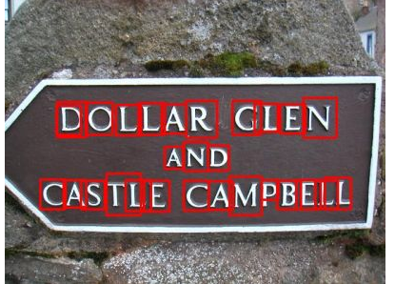
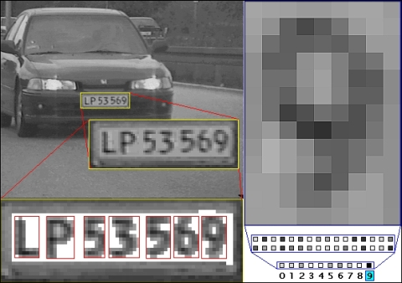
Introduction: Why Text extraction from images?
Text that appears in images contains important and useful information about the image.
It can be used for a variety of applications such as:
Number plate detection
Document retrieving
Label Products in stores
Mobile robot navigation etc.

Slide 3
Methodology
Candidate text region detection
Text region localization
Character Extraction
This stage aims to build a feature map by using three important properties of edges: Edge strength, Density and Variance of orientations.
This approach utilizes the property that text in images appears in clusters, and applys a global thresholding to separate text regions from other regions creating a binary image. The blobs corresponding to text containing regions are extracted.
Here, an Optical Character recognition (OCR) engine is run onto the processed image to extract the characters within it.

Slide 4
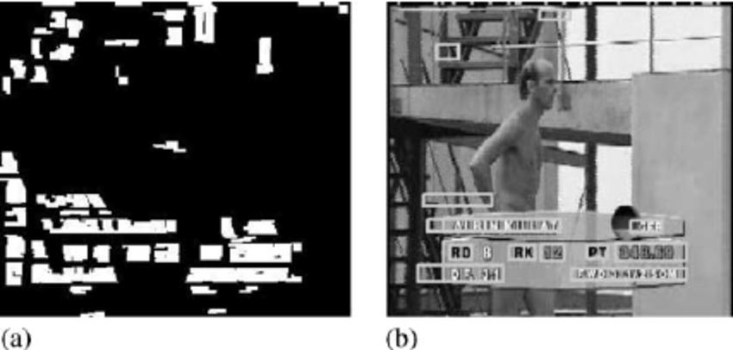
Candidate Text region detection
The approach involves exploiting the edge strength, density and variance of orientations properties of the image to detect candidate text regions.
This approach involves two steps:
Multi-scale edge detector
Feature map generation

Slide 5
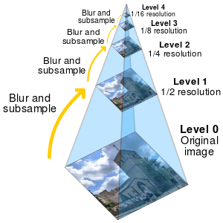
Gaussian Pyramid
The image is first passed through a Gaussian pyramid down-sampler and low-pass filter, which reduces the image resolution and adds blur to the image.
A 4-level Gaussian pyramid is used creating a total of 4 different resolution Mutiscale-images.

Slide 6
Multi-scale edge detector
For edge detection, magnitude of the second derivative of intensity as a measurement of edge strength.
The edge density is calculated based on the average edge strength within a window.
The edge detection is carried out in 4 orientations (Vertical, Horizontal, Diagonal, Off-diagonal)
-1 | -1 | -1
2 | 2 | 2
-1 | -1 | -1
-1 | -1 | 2
-1 | 2 | -1
2 | -1 | -1
0 kernel
45 kernel
-1 | 2 | -1
-1 | 2 | -1
-1 | 2 | -1
2 | -1 | -1
-1 | 2 | -1
-1 | -1 | 2
90 kernel
135 kernel
Compass Operators

Slide 7
Feature Map Generation
The Multi-scale edge detection is carried out on all 4 images generated from the Gaussian pyramid and their outputs are merged after proper up/down – sampling.
Regions with text in them will have significantly higher values of average edge density, strength and variance of orientations than those of non-text regions.
These three characteristics are utilized to generate a feature map which suppresses the false regions and enhances true candidate text regions

Slide 8
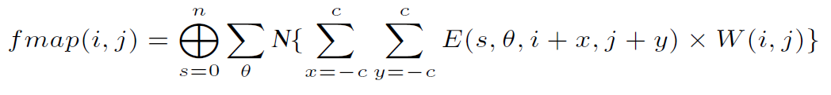
Feature Map Generation
fmap is the output feature map
n is the highest level of scale
N is a normalization operation
(i, j) are coordinates of an image pixel
W(i, j) is the weight for pixel(i, j), more the edge orientations higher the value
c is the window size

Slide 9
Calculation of W(i, j)
Getting the strong and weak edges Strong edges is obtained by OTSU thresholding of the edges in the vertical direction. Weak edges are obtained by the difference of dilated and closed morphology of the vertical edges.
Labelling edges The edges are labelled in proportion to the area of the connected component they belong to.
Filtering out strong edges The labelled edges having very high area of connected component are filtered out. By employing this non linear weight filtering, the proposed method distinguishes text regions from texture-like regions, such as window frames, wall patterns, etc.

Slide 10
Text Region Localization
This approach exploits the fact that text appears in clusters.
The intensity of the feature map represents the possibility of text, a simple global thresholding is employed to highlight those with high-text possibility regions resulting in a binary image.
The close-by regions are connected by employing a morphological dilation operator with a 7x7 structuring element to get text blobs.
1 | 1 | 1 | 1 | 1 | 1 | 1
1 | 1 | 1 | 1 | 1 | 1 | 1
1 | 1 | 1 | 1 | 1 | 1 | 1
1 | 1 | 1 | 1 | 1 | 1 | 1
1 | 1 | 1 | 1 | 1 | 1 | 1
1 | 1 | 1 | 1 | 1 | 1 | 1
1 | 1 | 1 | 1 | 1 | 1 | 1
7x7 Square Structuring Element

Slide 11
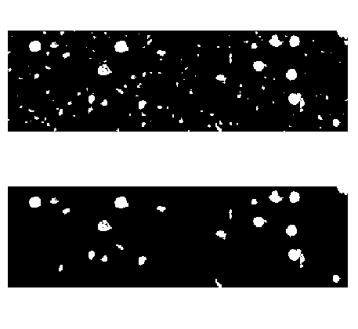
Text Region Localization
To filter out blobs not containing text, following two constraints are used:
Filter out very small and isolated blobs below a certain area threshold.
Filter out those blobs whose widths are much smaller than their corresponding heights.
The coordinates of vertices of the rectangles enclosing the blobs are determined with some padding.

Slide 12


Results

Slide 13
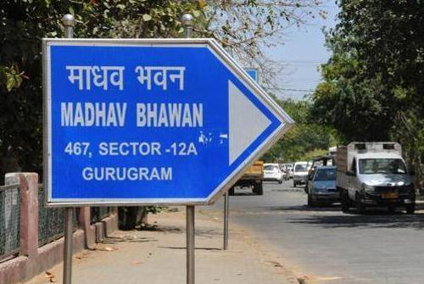
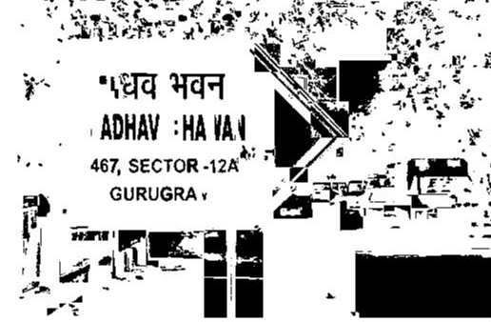
Results

Slide 14
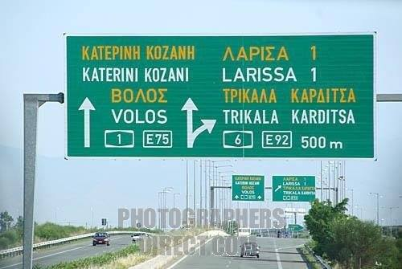
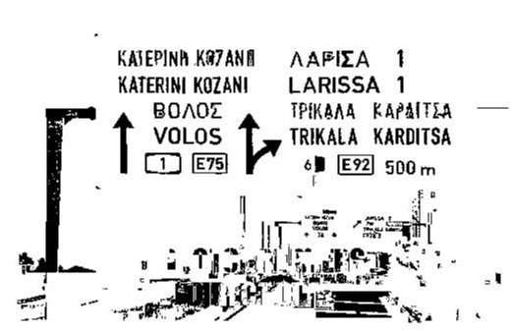
Results

Slide 15
Conculsions
The employed technique for Multi-scale Edge based text extraction from images, proves to be a viable solution for the job.
It is able to segregate the text regions fairly significantly from the textured regions.
However, with some images where the edge density is very high in textured regions too, the algorithm seems to breakdown and fail.
In case of outdoor images, some structures are also detected as part of text such as poles, tree branches etc.

Slide 16
References
KongqiaoWang and Jari A. Kangas, “Character location in scene images from digital camera,” Pattern Recognition, vol. 36, no. 10, pp. 2287–2299, 2003.
X. Liu and J. Samarabandu, "Multiscale Edge-Based Text Extraction from Complex Images," 2006 IEEE International Conference on Multimedia and Expo, Toronto, Ont., 2006, pp. 1721-1724. doi: 10.1109/ICME.2006.262882
A Survey on text extraction techniques in Complex images and videos (http://airccse.org/journal/ijcses/papers/3412ijcses03.pdf)
X. Liu and J. Samarabandu, “An edge-based text region extraction algorithm for indoor mobile robot navigation,” in Proc. of the IEEE International Conference on Mechatronics and Automation (ICMA 2005), Niagara Falls, Canada, July 2005, pp. 701–706.

Slide 17
Thank You

Slide 18
Q & A

