Slide 1
5 Dof Delta-type parallel robot
Batch – B
Group – 7

Slide 2
The Team!
1
3
2
4
S.Nishanth
Shruthi.R
CB.EN.U4AIE22149
CB.EN.U4AIE22154
Sarvesh.K
Praatosh.B
CB.EN.U4AIE22153
CB.EN.U4AIE22160

Slide 3
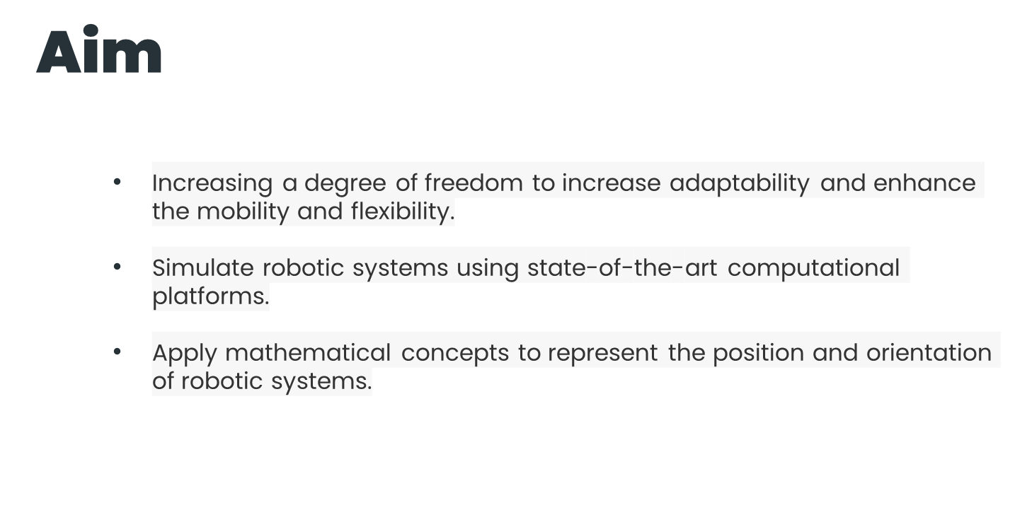

Slide 4
Procedure
Matlab
Robot modelling was done using MATLAB codes.
Each joint was positioned using co-ordinate positions
The model was exported as a URDF file.
It was simulated on a webpage using three.js.
WEBPAGE
On loading the page, the model will be simulated on the left, with interactive controls and a Homogeneous transformation matrix on the right.
All controls of the gripper joint is controlled using the interactive panel.
Homogeneous transformation matrix shows the rotation and translation in the robot

Slide 5
Forward Kinematics
Forward Kinematics (FK) addresses a critical problem in robot arm control: determining the end-effector pose (position and orientation) given the robot's joint configuration (set of joint angles or displacements). It essentially establishes a mathematical mapping between the joint space (joint variables) and the task space (end-effector pose). This mapping enables the calculation of the end-effector's location in 3D space based on the known joint values.

Slide 6
Screw Theory:
Combined Motion: It treats a rigid body's movement as a combination of linear and angular motion, represented by a single entity called a "screw.
Screw Axis and Pitch: The screw has an axis – a line defining the rotational direction – and a pitch, which determines how much the body advances along the axis for each unit of rotation. Pure rotation has a zero pitch, while combined motion has a finite pitch.
Twist Systems: A twist system is a collection of "screws" representing all the possible instantaneous motions a robot body can make considering its joint constraints. Screw theory allows efficient analysis by adding, subtracting, and scaling these screws to understand complex robot movements.

Slide 7
What is a twist system ?
• Twist Systems: Represent the complete set of instantaneous motions (linear and angular) possible for a robot body, considering its joint constraints.
• Each motion is represented by a "screw" (screw axis and pitch) within the system.
• Twist systems allow analysis of complex robot movements by adding, subtracting, or scaling individual screw motions.
• The twist system approach simplifies calculations and provides a comprehensive understanding of a robot's motion capabilities.

Slide 8
Wrenches
•Wrenches: In the context of screw theory and twist systems for robots, wrenches represent the forces and torques (moments) acting on the robot body.
• Analogy: Similar to a screw combining linear and angular motion, a wrench combines the linear force (push or pull) and angular torque (twisting force) acting on a point in the robot.
• 6D Vector: Wrenches, like twists, are represented by a 6-dimensional vector, efficiently capturing both the force and torque components.

Slide 9
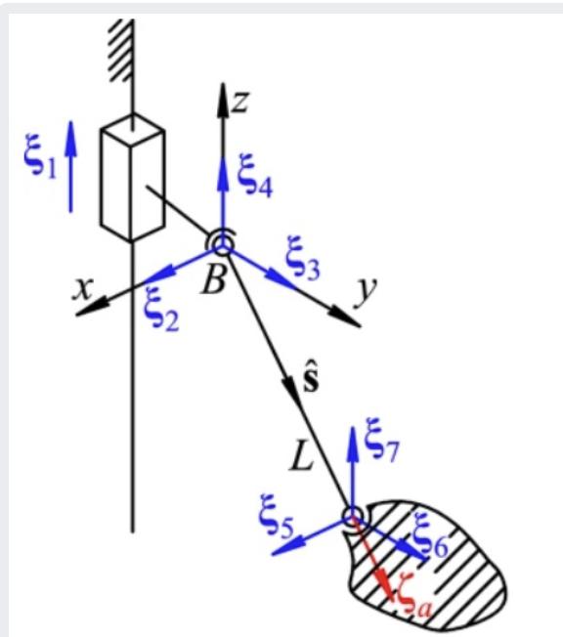
Relevance with our project
The twist system represents the possible motions of the chain relative to the Rxyz frame.
It considers two cases - when there is relative slider motion (s) and when there is no slider motion.
With relative slider motion, the twist system comprises 7 twists (ξ1 to ξ7) capturing both rotational and translational motions.
Without relative slider motion, the twist system simplifies to 7 constant twists with only rotational components.
The twists are represented as matrices combining the rotational (0s and 1s) and translational components (Ls terms) into a single mathematical entity.

Slide 10
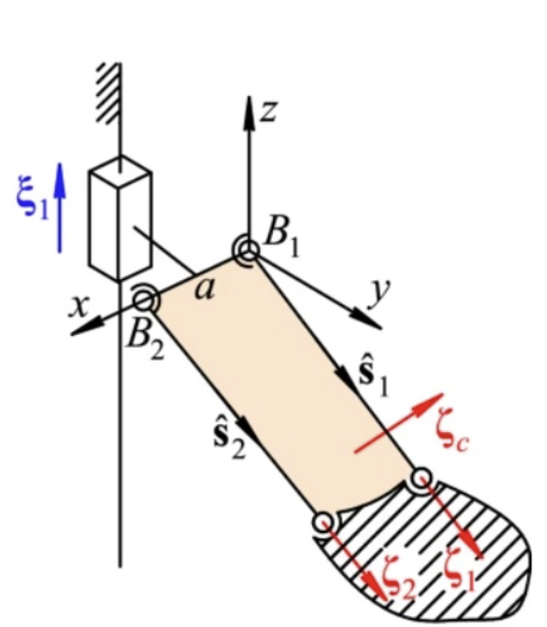
Relevance with our project
The image depicts the twist system for the chain PS2 in relation to the gripper frame.
There are three constraint wrenches (ζc, ζ1, ζ2) represented in this system, limiting the possible motions.
The wrench ζc is formulated as [0 0 0 aszlsz2 -aszlsy2], preventing rotational movement about axes orthogonal to the platform movement.
The constraint wrenches arise from the parallel nature of vectors s1 and s2, which gives s1xs2=0.
The expression for ζc utilizes the vector s2, indicating its role in restricting rotational motion around axes perpendicular to the platform's motion.

Slide 11
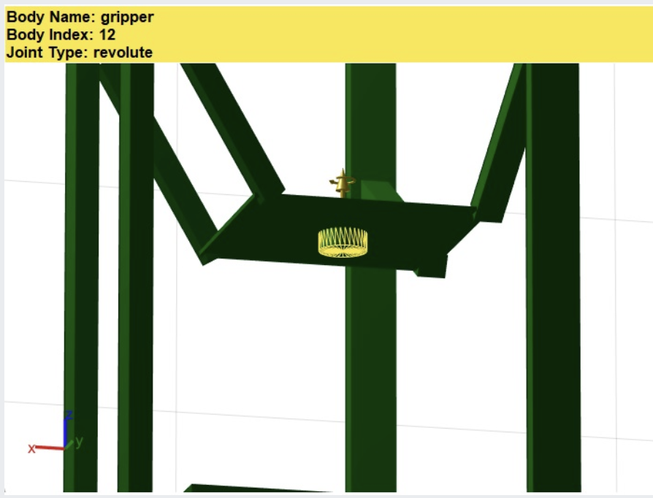
Relevance with our project
The image shows the twist system for the end revolute joint, which rotates only around one axis.
The twist system is represented as ξ1 = [0 0 0 0 1], indicating that angular velocity is possible only along the z-axis.
The value 1 in the twist system signifies that there is angular velocity allowed about the z-axis.
This twist system is described as "straight-forward" since the joint revolves around a single axis.
The yellow line in the image visually represents the twist system along the z-axis for this revolute joint.

Slide 12
Inverse Kinematics
Inverse kinematics involves determining the joint parameters that achieve a desired position and orientation of the robot's end-effector. It is often more complex than forward kinematics due to the possibility of multiple solutions or no solution at all.
Here we will be using analytical method for identifying height of the slider when the set of coordinates is given.

Slide 13
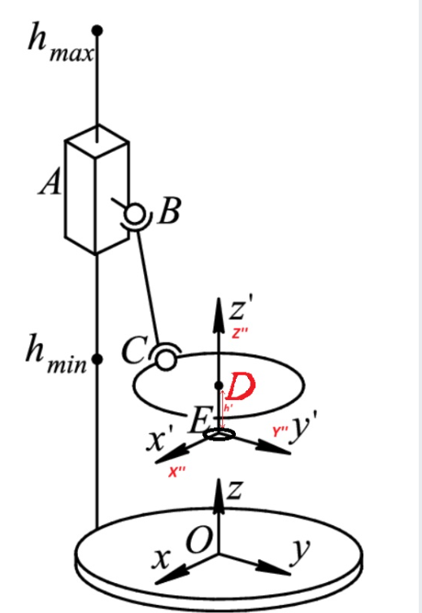
Thus, the inverse kinematics aims to find position h of the slider (point A) given a set of these coordinates.

Slide 14
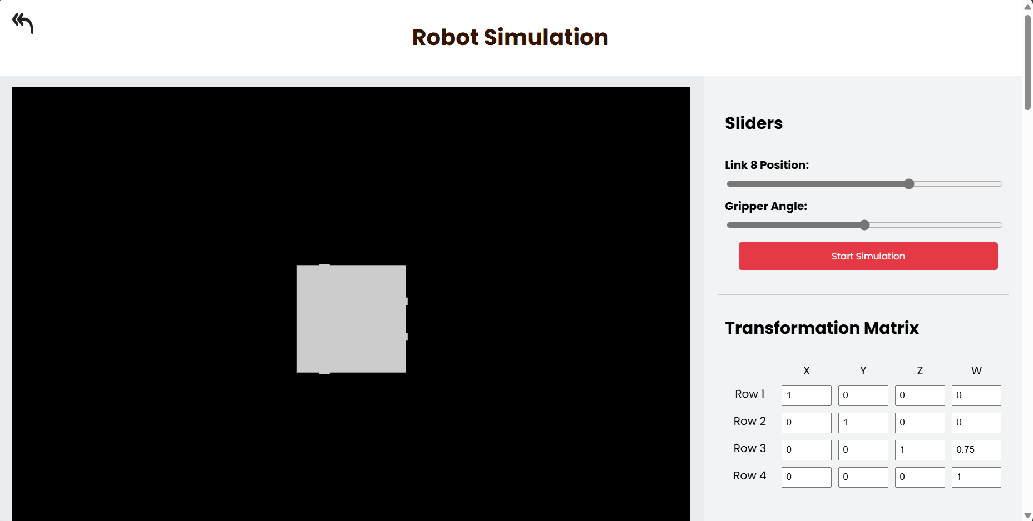
The Workings
Code explanation……

Slide 15


Website
5 DOF and Hybrid Planar Robot (nishanthsaravanamurali.github.io)

Slide 16
Resources
https://link.springer.com/article/10.1007/s40430-023-04128-7#Sec7 Kinematic and singularity analysis of a 4-DOF Delta-type parallel robot Technical Paper Published: 24 March 2023
http://vlabs.iitkgp.ac.in/mr/exp0/index.html# Virtual Labs - PUMA 560 sample
https://in.mathworks.com/help/robotics/manipulator-modeling.html Manipulator Modeling – MATLAB
Robotics,Vision and Control Fundamental Algorithms in MATLAB Peter Corke Twist system

Slide 17
Thanks!
Please keep this slide for attribution

