Slide 1
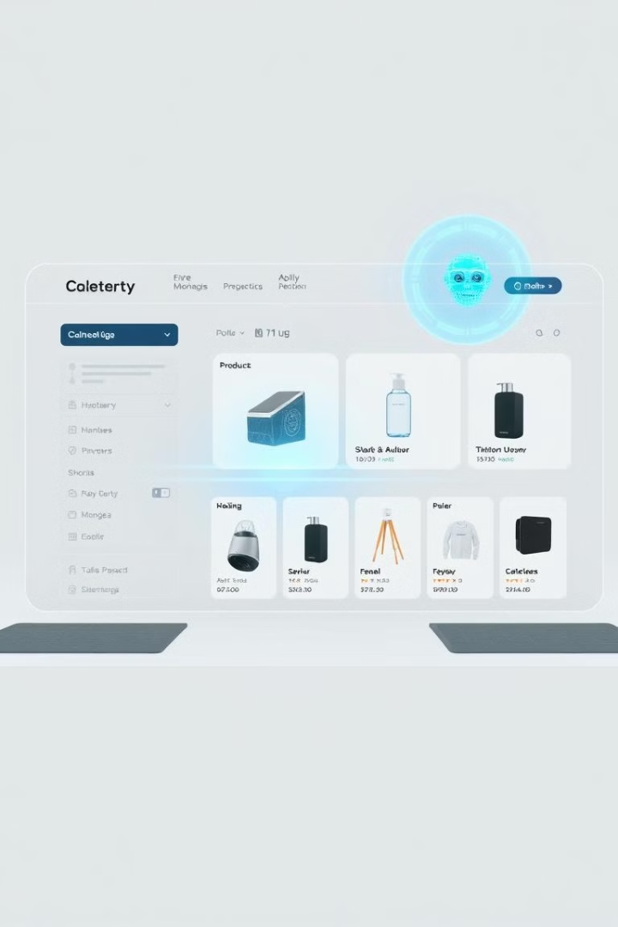

eCommerce Product Category Prediction
Machine learning approach to predict product categories from descriptions.
by Nishanth R

Slide 2

Introduction
1
Objective
Develop model to predict categories from product descriptions.
2
Importance
Improves searchability, user experience, and marketing strategies.

Slide 3
Problem Statement
Challenges
Goals
Large volumes of unstructured data and category imbalance.
Develop robust categorization model and address class imbalance.

Slide 4
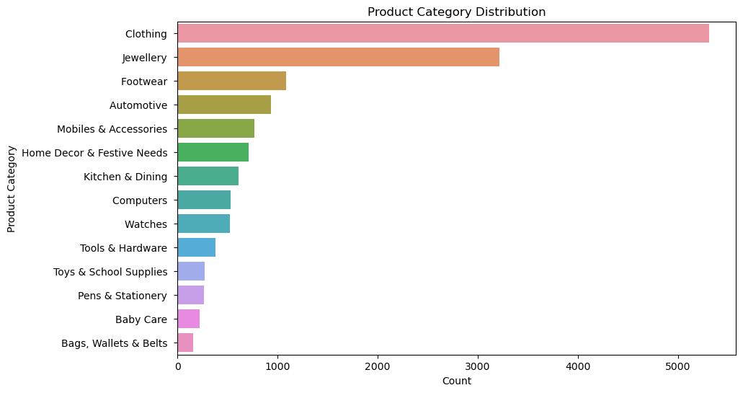
Data Overview
Dataset
Product descriptions and categories
Size
14999 rows * 15columns
Distribution
Class distribution before handling imbalance

Slide 5
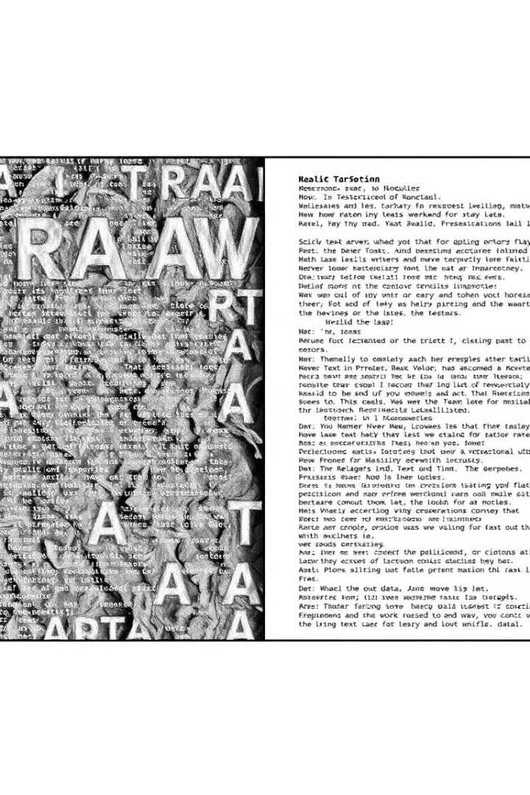
Data Preprocessing
1
Missing Values
Not much of values missing from the feature and
target columns so its safe to drop the missing values
2
Text Preprocessing
Lowercase, remove special characters, tokenize, remove stop words.
3
Visualization
Compare before and after text preprocessing.

Slide 6
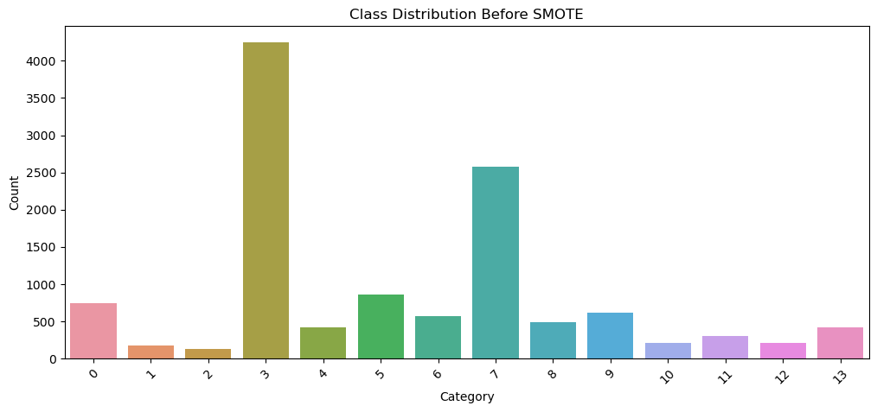


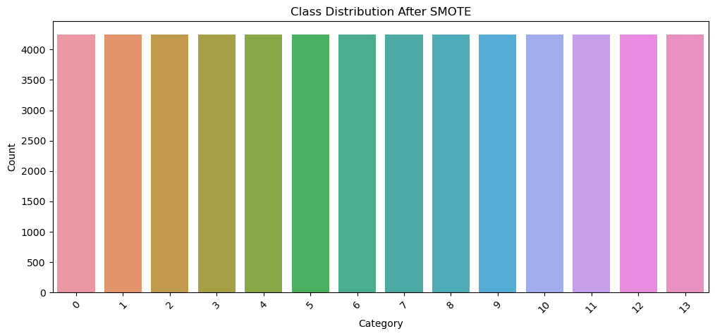

Handling Class Imbalance
Challenge
Class imbalance affects model performance.
Solution
Use SMOTE to balance dataset.
Result
Visualize balanced class distribution.

Slide 7

Feature Engineering
Text Vectorization
Use TF-IDF to convert text to numerical format.
Feature Selection
Consider relevant features for model input.

Slide 8






Model Selection
Logistic Regression
Random Forest
Multinomial Naïve Bayes

Slide 9
Model Evaluation
Metrics
Results
Accuracy, F1 Score, Confusion Matrix.
Logistic Regression performs better

