Slide 1

IPL Data Analysis & Strategic Insights for RCB Performance Analysis, Team Strategy & Auction Recommendations
Presented By: Nishanth Srinivas
Tools Used: MySQL WorkBench, Excel
Objective: Analyze IPL data to identify performance trends and inform auction strategy decisions.

Slide 2
Business Objective :
This analysis was conducted to examine historical IPL data and identify the key factors that influence team success and player performance. As a Sports Data Analyst for RCB, the objective is to evaluate batting, bowling, venue, and match-winning patterns to understand RCB’s strengths and weaknesses, compare its performance with successful IPL teams, and identify players who can contribute consistently. The insights from this study will support data-driven decision-making for team strategy, future auctions, and the selection of an ideal playing XI capable of improving RCB’s chances of winning an IPL title.

Slide 3
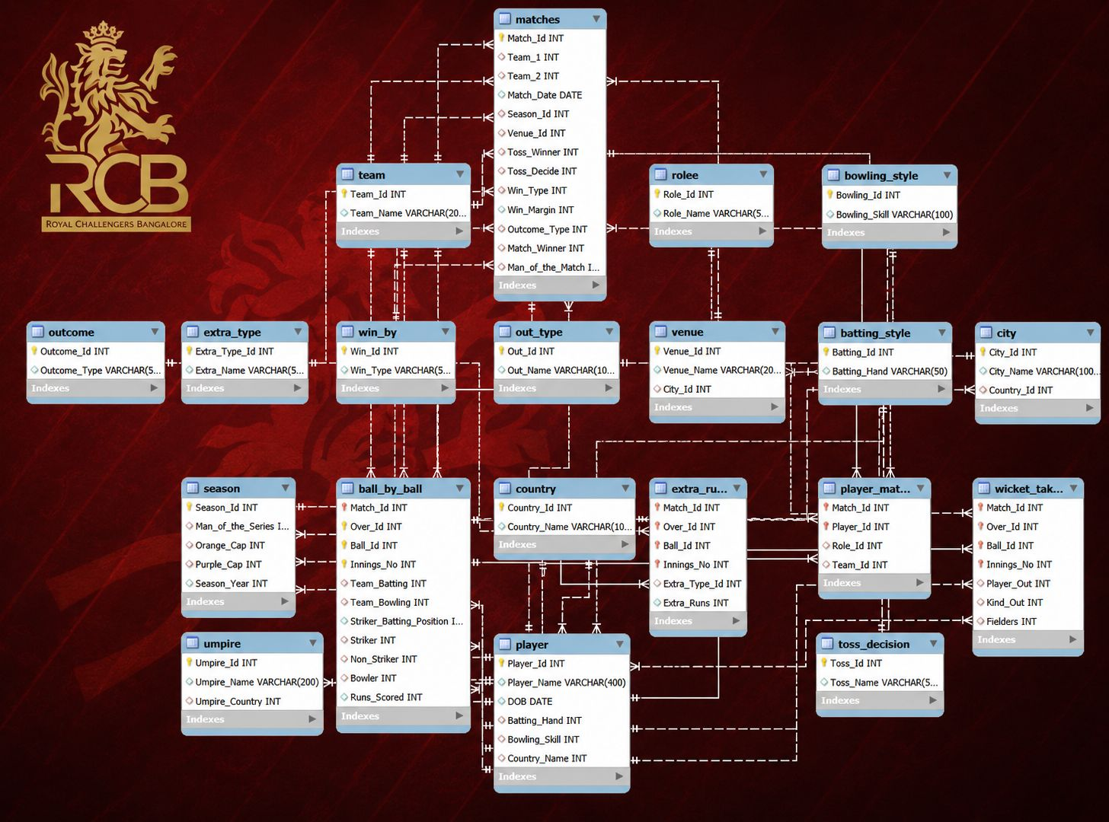
Database Architecture & Data Model

Slide 4
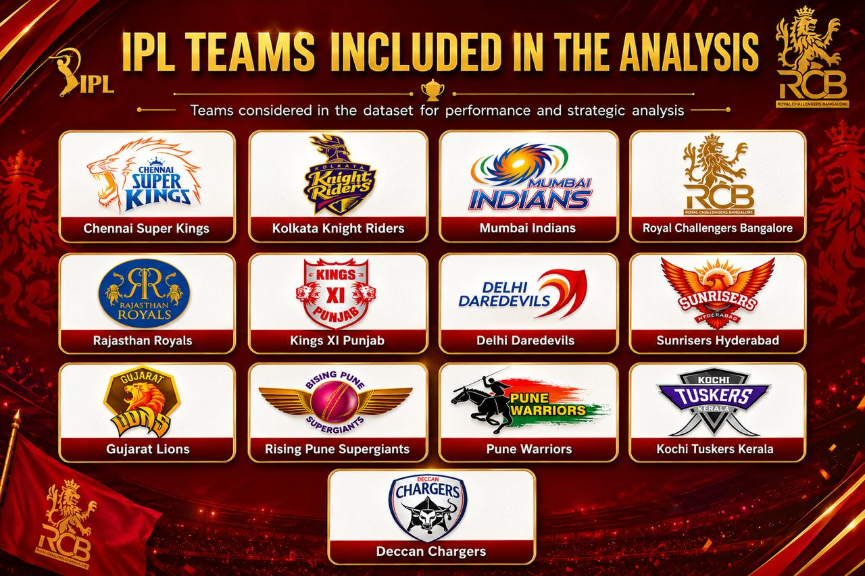

Slide 5
Player Participation Analysis (Season 2014)
The analysis of IPL 2014 shows that 89 players were above the age of 25, indicating that most teams preferred experienced players. These players provided stability, handled pressure better, and contributed consistently in important matches. At the same time, successful teams maintained a good balance between experienced players and young talent. This suggests that combining experience with emerging players is an effective strategy for building a strong and competitive IPL team.

Slide 6
Consistent Player Performance
Virat Kohli was the most consistent and highest run scorer, reaching nearly 1,000 runs in 2016.
David Warner showed steady improvement across multiple seasons.
AB de Villiers consistently increased his run tally year after year.
Suresh Raina and Rohit Sharma maintained stable performances across the seasons.
Consistently performing players contribute more to long-term team success than players who perform well only occasionally.

Slide 7
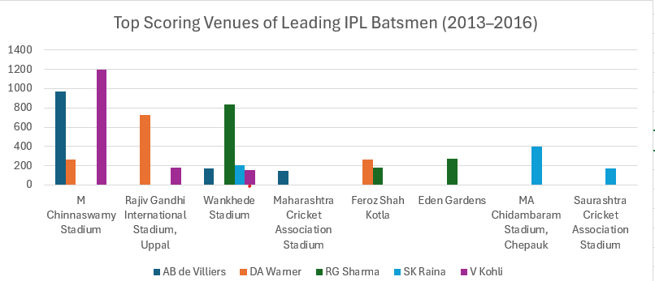
Top Scoring Venues of Leading IPL Batsmen (2013–2016)
Virat Kohli scored his highest runs (~1,200) at M. Chinnaswamy Stadium.
AB de Villiers scored around 960 runs at M. Chinnaswamy Stadium and 170 runs at Wankhede Stadium.
David Warner recorded his highest score (~720 runs) at Rajiv Gandhi International Stadium.
Rohit Sharma scored around 830 runs at Wankhede Stadium and 270 runs at Eden Gardens.
Suresh Raina performed best at M. A. Chidambaram (Chepauk) Stadium with ~400 runs.
Venue conditions and home advantage significantly influence batting performance.

Slide 8
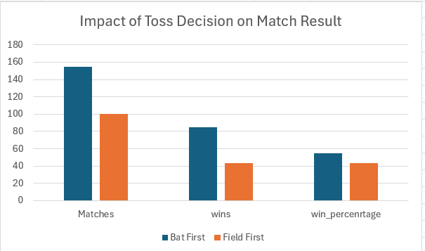
Impact of Toss Decision on Match Outcomes
Key Findings
Teams batting first won 54.84% of matches, compared to 43.00% for teams fielding first.
Batting first offered an 11.84% higher win rate, indicating a moderate advantage.
Toss impact varied by venue, with Sheikh Zayed Stadium (71.43%) showing the highest influence and Punjab Cricket Association IS Bindra Stadium (28.57%) the lowest.
Strategic Insight
Use the toss decision based on venue and pitch conditions, not as the primary winning strategy.
RCB should build a balanced team capable of performing well regardless of the toss outcome.
Key Takeaway
The toss provides a slight advantage, but team performance and adaptability remain the key factors in winning matches.

Slide 9
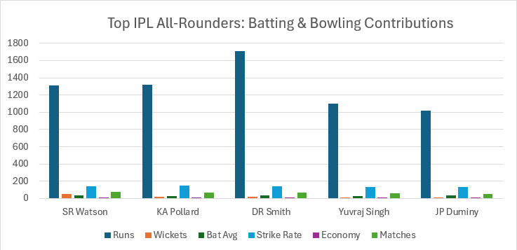
Top All-Rounders – Batting & Bowling Contributions
Key Findings
Shane Watson scored 1,315 runs and took 54 wickets, making him the top all-rounder.
Dwayne Smith scored the highest runs (1,707) and also claimed 15 wickets.
Kieron Pollard contributed 1,320 runs and 19 wickets, while Yuvraj Singh and JP Duminy each scored 1,000+ runs with 13 wickets.
These players provided strong contributions with both bat and ball, improving team balance.
Strategic Insight
Prioritize quality all-rounders to strengthen both batting and bowling.
A balanced squad offers greater flexibility and match-winning options.
Key Takeaway
All-rounders play a crucial role in building a balanced and competitive IPL team.

Slide 10
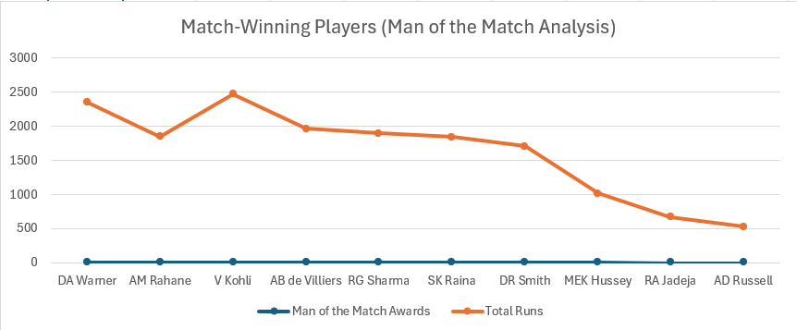
Match-Winning Players (Man of the Match Analysis)
Key Findings:
David Warner led with 11 Man of the Match awards and 2,348 runs, making him the most impactful player.
Ajinkya Rahane earned 10 awards, followed by Virat Kohli and AB de Villiers with 9 awards each.
Rohit Sharma received 8 awards, while Suresh Raina and Dwayne Smith secured 7 awards each.
Players with 7–11 Man of the Match awards consistently influenced match outcomes and contributed significantly to their teams' success.
Strategic Insight
Prioritize proven match-winners during player retention and auctions.
Build the team around players who consistently perform in high-pressure situations.
Key Takeaway
Consistent match-winning players are valuable assets and form the foundation of a championship-winning IPL team.

Slide 11
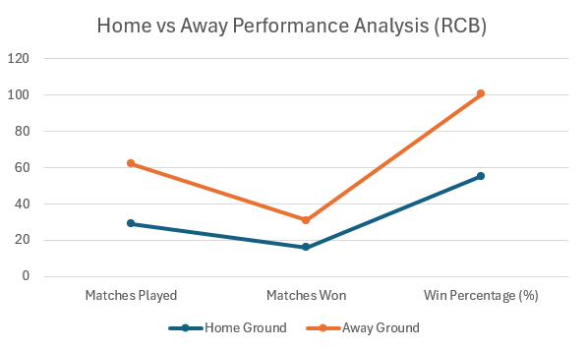
Home vs Away Performance Analysis (RCB)
Key Findings:
RCB won 55.17% of matches at home (16 wins in 29 matches).
Away win percentage dropped to 45.45% (15 wins in 33 matches).
Home advantage improved RCB's performance by 9.72% compared to away matches.
Away performances were less consistent, affecting overall tournament success.
Strategic Insight
Develop strategies for different pitch and weather conditions.
Prioritize adaptable players who can perform consistently in away matches.
Key Takeaway
Home advantage boosts RCB's performance, but improving away results is essential for winning the IPL.

Slide 12
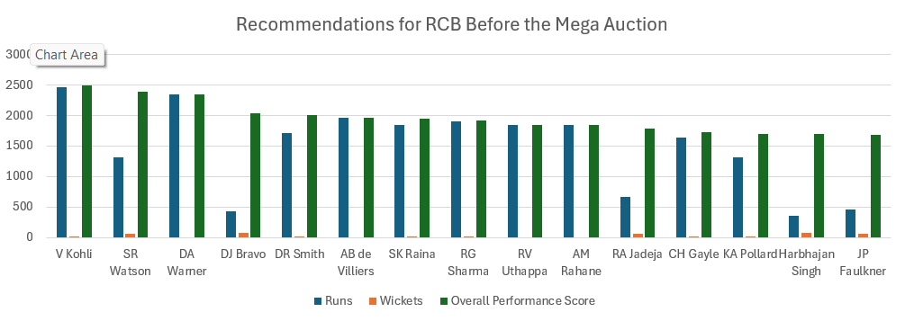
Recommendations for RCB Before the Mega Auction
Key Findings
Top-ranked players combined high run-scoring ability with wicket-taking contributions.
All-rounders received higher Player Scores, reflecting their value in multiple departments.
Players with consistent batting and bowling performances ranked highest.
A balanced mix of top-order batsmen, quality bowlers, and all-rounders is essential for long-term success.
Strategic Insight
Retain consistent performers and proven match-winners.
Invest in quality all-rounders and reliable bowlers to build a balanced squad.
Key Takeaway
A balanced squad built around consistent performers and impactful all-rounders gives RCB the best chance of winning future IPL titles.

Slide 13
Final Recommendations for RCB
Key Recommendations
Retain consistent performers such as Virat Kohli and AB de Villiers, who have delivered reliable performances across seasons.
Target quality all-rounders like Shane Watson and Kieron Pollard to strengthen both batting and bowling.
Select players based on venue performance to maximize success in different playing conditions.
Improve away-match performance, where RCB's win rate (45.45%) was lower than at home (55.17%).
Build a balanced squad with experienced players, match winners, and adaptable performers.
Final Takeaway
A data-driven approach to player selection, retention, and match strategy will help RCB build a balanced squad capable of consistently competing for the IPL title.

Slide 14
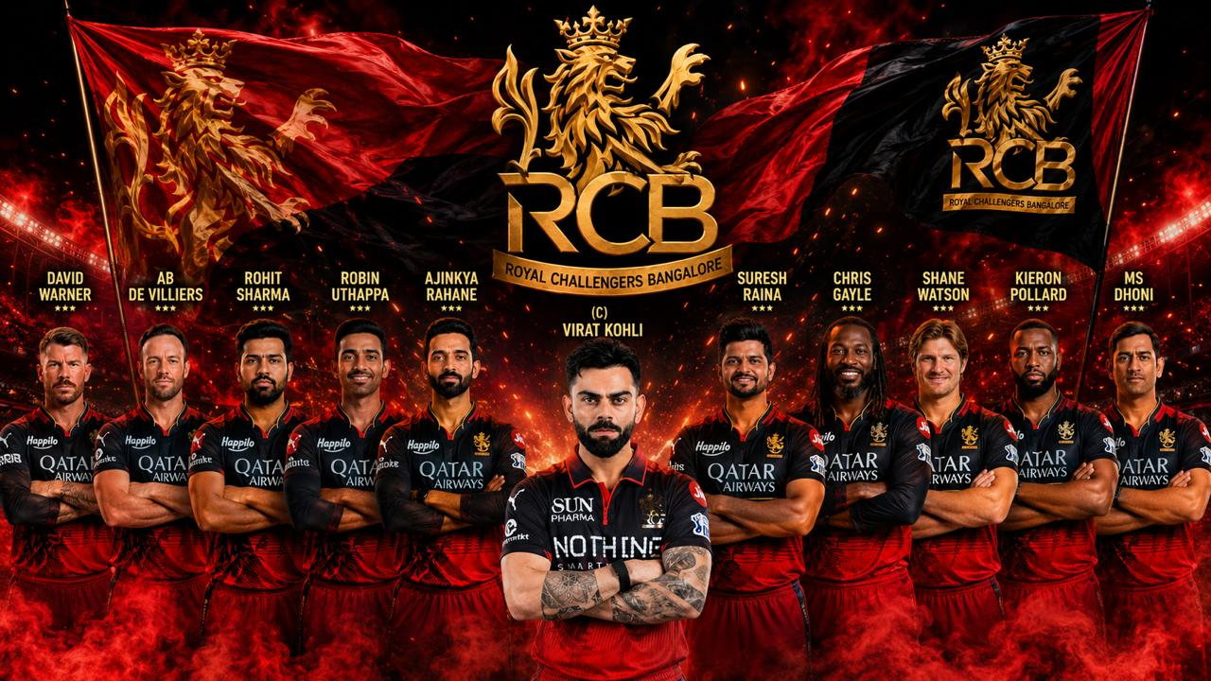
Recommended RCB Playing XI

