Slide 1

Reading and translating any document
OCR and machine translation from deep learning to vision-LLMs: where they break around the world, which methods help, and a live demo
October 2026
Notes:
- Welcome. One hour, no machine-learning background needed: we talk about what these systems do and where they fail, not how the maths works.
- Two technologies are merging: machines that read pages (OCR, optical character recognition) and machines that translate.
- Every number in this talk comes from a published study or a documented news report; the sources are in these notes.
TIMING PLAN (about 50 slides; the language slides take about a minute each)
- 0:00 Opening, why it matters (slides 1–5)
- 0:04 Part 1, how we got here, 2012 to now (slides 6–13)
- 0:13 Part 2, where it breaks around the world (slides 14–31)
- 0:34 Part 3, the methods for doing better, and how each performs (slides 32–40)
- 0:43 Part 4, our approach, Agentic Translator (slides 41–46)
- 0:48 Live demo (slides 47–48), backup screenshots at the end
- 0:56 Close and questions
- Short on time? Skip the slides marked OPTIONAL in their notes.

Slide 2
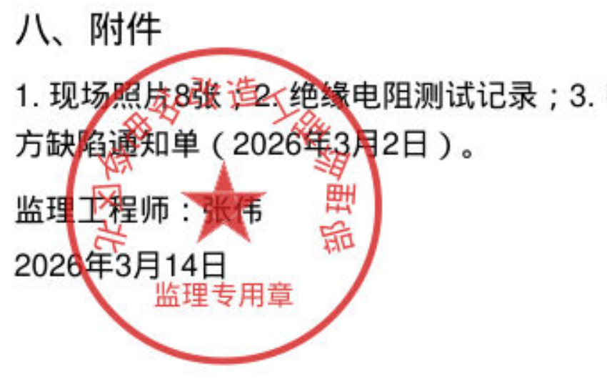
What does this red seal say?
A Chinese site-supervision notice, scanned. The seal sits on top of the attachments list and the signature.
Most people who review translations can't read it. Most clients can't either.
So who checks what the machine read?
Notes:
- Start with a question for the room: does anyone read this? (Usually nobody does.)
- It's a typical kind of document: a supervision notice from a construction project, scanned, with a red seal stamped over the text. (This one is a fictional sample we made for testing.)
- Before anything can be translated, a machine has to read it. If the reading is wrong, the translation is a perfect translation of the wrong text.
- Next slide: what published studies find when today's AI readers meet text like this.

Slide 3




Today's AI readers fail by sounding right
“Student Union” → “Happy Birthday”
“$?.00” → “$5.00”
Bengali street text · the best AI reader tested · 2026
A receipt with the first digit covered · 2025
A wall slogan became a greeting, and the year 2025 became 2023.
Asked to read hidden characters, models wrote a number instead of “unreadable”.
“rigorously enforced” → “merely enforced”
A failing answer → a perfect one
18th-century English books · 2026
Transcribing students' handwritten maths · 2026
The AI made half as many mistakes as older OCR, but its mistakes were real words.
GPT-4o silently corrected the student's working: 14/100 became 100/100.
Old OCR failed with garbage, which anyone notices. Today it fails with something plausible. That's the thread through this talk.
BanglaWild 2026 · KIE-HVQA (He et al.) 2025 · Vesalainen et al. 2026 · Seong et al. 2026
Notes:
- So who checks? Here is what published studies found when today's AI readers meet text they can't read cleanly. None of these outputs looks broken.
- Bengali street signs (BanglaWild, 2026, 2,535 photos): the best system read the wall slogan ছাত্র ইউনিয়ন (Student Union) as শুভ জন্মদিন (Happy Birthday) and a festival year 2025 as 2023.
- Receipts and IDs with characters blurred or covered (KIE-HVQA, 2025): models usually answer confidently instead of marking the text unreadable: "$5.00" where the first digit was covered, "15mg" for a hidden first digit, a full name where two letters were hidden.
- 18th-century English books (Vesalainen et al., 2026): a vision-LLM made fewer errors than a dedicated OCR model, but its errors are real words: "rigorously" became "merely", and old spellings were silently modernised. A spell-checker can't catch that.
- Students' handwritten maths with deliberate mistakes (Seong et al., 2026): every model quietly corrected the student in 42–66% of transcriptions; GPT-4o turned a 14/100 answer into 100/100.
- Also: on Uruguayan human-rights archive pages (2026), AI readers made fewer typos than old OCR, but sometimes added names to lists of people that were never on the page.
- Old OCR produced broken characters that anyone notices. Modern AI produces a believable answer that nobody notices. Keep that in mind for the whole talk.
Sources: Shiper et al., BanglaWild, arxiv.org/abs/2608.03884 (Table 10). He et al., "Seeing is Believing? Mitigating OCR Hallucinations in Multimodal Large Language Models", arxiv.org/abs/2506.20168 (Figs. 1–2, Table 1). Vesalainen et al., "Error Patterns in Historical OCR", arxiv.org/abs/2602.14524 (Tables 1, 6). Seong et al., "When VLMs 'Fix' Students", arxiv.org/abs/2604.22774 (Fig. 12, Fig. 14). Gardella et al., arxiv.org/abs/2607.24077 (Figs. 6–8). All preprints.

Slide 4




When translation goes wrong, people pay
“Good morning” → “attack them”
“Hold the kidney medicine” → “keep taking it”
Arabic → Hebrew · Facebook · Israel, 2017
Google Translate · Spanish and Chinese · hospital study, 2019
A worker's photo caption was auto-translated. He was arrested before anyone who reads Arabic looked at it.
Reviewers rated it life-threatening. “Hold” means pause.
“I” → “we”
“Can I search your car?” → “Can I find the car?”
Pashto · an asylum statement · USA, 2023
Spanish · a police stop · Kansas, 2018
Her written story no longer matched her interview. The claim was denied.
The judge ruled the driver hadn't consented and threw out the evidence.
Every one of these outputs was fluent. Nothing on the screen said it was wrong.
Notes:
- Four documented cases from four regions. Same pattern each time: a fluent machine output, and nothing to say it was wrong.
- Good morning: October 2017, a Palestinian construction worker posted a photo next to a bulldozer captioned "good morning" in Arabic. Facebook's translation showed "attack them" in Hebrew and "hurt them" in English. Police arrested and questioned him, then released him hours later.
- Kidney medicine: a 2019 study of real emergency-room discharge notes. Google Translate turned "Hold the kidney medicine until you speak to your kidney doctor" into "keep taking" it, in both Spanish and Chinese. Overall 92% of Spanish sentences and 81% of Chinese were accurate; 2% and 8% could have caused harm.
- I → we: an Afghan woman's asylum statement, machine-translated from Pashto, said "we" where she said "I", so it no longer matched her interviews. Journalism, one case, not a measured rate.
- Search your car: a Kansas trooper used Google Translate to ask a driver for consent to search. "Buscar" can mean search for or look for; a court interpreter found at least nine points where the driver didn't understand. The federal judge suppressed the evidence (US v. Cruz-Zamora, 2018).
Sources: The Jewish Chronicle, 23 Oct 2017, thejc.com/news/world/palestinian-arrested-after-posting-good-morning-on-facebook-rzbaf1fl; AFP via Inquirer, 22 Oct 2017. Khoong et al., JAMA Internal Medicine 2019, pmc.ncbi.nlm.nih.gov/articles/PMC6450297. Rest of World, 19 Apr 2023, restofworld.org/2023/ai-translation-errors-afghan-refugees-asylum. TechCrunch, 15 Jun 2018, techcrunch.com/2018/06/15/judge-says-literal-but-nonsensical-google-translation-isnt-consent-for-police-search; Criminal Legal News, Sep 2018.

Slide 5
What we'll cover
01
How we got here
02
Where it breaks
Reading and translating, 2012 to now
Around the world, language by language
03
Doing better
04
Our approach
Seven methods, and what the studies found
Agentic Translator, then a live demo
Notes:
- Part 1: a short history from 2012, when deep learning arrived, to AI that can see a page, plus how quality is measured.
- Part 2: the longest part. Where reading and translation still break, language by language, with published numbers.
- Part 3: the methods people use to do better (more context, self-checking, teams of agents, quality scores, asking a person) and what the studies found for each.
- Part 4: our tool, built on those findings, and a live demo. If the demo misbehaves, there are backup screenshots at the end.

Slide 6
How we got here
01
Reading and translating, from deep learning to vision-LLMs
Notes:
- Machine translation and OCR are both decades old, but for most of that time they were rule books and statistics.
- Around 2012 they started learning from examples instead, and things moved fast. That's where we start.

Slide 7

2012 to now: two technologies, one direction
2012–15
Computers learn to see
2016–19
Neural everything
2020–22
Language models
2023–26
Vision-LLMs and agents
2014 Neural networks learn to translate whole sentences
2016 Google switches to neural translation: ~60% fewer errors
2017 The Transformer, the design behind today's AI; DeepL launches
2022 One model for 200 languages (Meta); ChatGPT: translate by asking
2024 Translation agents: translate, critique, improve
Translation
2012 A neural network that sees (AlexNet) wins the big image contest
2015 Point your phone at a sign: camera translation
2018 Open-source OCR (Tesseract) switches to a neural network
2021 Transformers read text lines (TrOCR) and whole documents (Donut)
2023 GPT-4V: a chat model reads images
2025 Vision-LLMs made for documents: Mistral OCR, PaddleOCR-VL, DeepSeek-OCR
Reading (OCR)
Notes:
- Read it column by column: the two rows move in step.
- 2012–15: in 2012 a neural network called AlexNet beat everything else at recognising images by a wide margin. Computers learned to see by looking at millions of examples. In 2014 the same idea was applied to translation. By January 2015 you could point the Google Translate app at a sign and see it in English.
- 2016–19: Google moves its translator to neural networks in 2016 and reports about 60% fewer errors on major language pairs. In 2017 Google researchers publish the Transformer, the design behind every modern AI model, and DeepL launches. In 2018 Tesseract, the open-source OCR engine, switches to a neural network too; Google's own numbers had Thai errors falling from 60 to 8 per 100 characters.
- 2020–22: models get much bigger. In July 2022 Meta releases one model covering 200 languages, three quarters of them low-resource. In November 2022 ChatGPT makes translation something you ask for in plain words.
- 2023–26: in September 2023 GPT-4 learns to look at images. In 2025 a wave of vision-language models built for documents arrives. Translation agents appear: Andrew Ng's open-source translate–critique–improve agent came out in June 2024.
Sources: AlexNet: en.wikipedia.org/wiki/AlexNet (ILSVRC-2012, 15.3% top-5 error vs 26.2%); seq2seq and attention: arxiv.org/abs/1409.3215, arxiv.org/abs/1409.0473; camera translation: blog.google/products/translate/hallo-hola-ola-more-powerful-translate (14 Jan 2015); GNMT: arxiv.org/abs/1609.08144; Transformer: arxiv.org/abs/1706.03762; DeepL: techcrunch.com/2017/08/29/deepl-schools-other-online-translators-with-clever-machine-learning; Tesseract 4: github.com/tesseract-ocr/tesseract (Thai 60.5 → 7.7: Google's DAS 2016 tutorial slides, not peer-reviewed); NLLB-200: ai.meta.com/blog/nllb-200-high-quality-machine-translation; ChatGPT: openai.com/index/chatgpt; TrOCR: arxiv.org/abs/2109.10282; Donut: arxiv.org/abs/2111.15664; GPT-4V: openai.com (25 Sept 2023); Mistral OCR: mistral.ai/news/mistral-ocr; PaddleOCR-VL: arxiv.org/abs/2510.14528; translation agent: github.com/andrewyng/translation-agent.

Slide 8


How do you score a reading, or a translation?
Reading
Translation, judged by people
Translation, judged by machines
Mistakes per 100 characters
Professionals mark every error
Automatic scores
Under 1: excellent
About 10: a wrong letter in every other word
Over 100: the AI wrote more than the page holds
Each error weighted: minor 1, major 5, critical 25 (MQM)
Or: which of two versions is better?
Slow and expensive, but the reference
Overlap with a human translation (BLEU, chrF)
Or a model trained to agree with professionals (COMET)
Fast and cheap, but fooled by fluent text
Fluent is not the same as correct. The findings that matter most in this talk come from people checking.
Notes:
- Three kinds of numbers come up in this talk. It helps to know which is which.
- Reading: the character error rate, which I'll say as "mistakes per 100 characters". Under 1 is excellent. About 10 means a wrong letter in roughly every other word. It can go above 100 when a model loops or invents text.
- Translation by people: professional reviewers mark each error and weight it: minor 1, major 5, critical 25. That's MQM, the industry standard and what our own tool uses. Or people simply choose the better of two versions.
- Translation by machines: BLEU and chrF count overlap with one human translation; COMET is a model trained to agree with professional raters. Useful for development, but a fluent wrong sentence can score well. Later we'll see a system that topped every automatic leaderboard in 2025 and ranked far lower with human judges.

Slide 9




Neural networks: fluent, one line at a time
1
2012–2019
“A very fast reader with no memory of the previous sentence.”
Reading (OCR)
Translation
Learns letter shapes from examples: any font, noisy scans, handwriting
Reads the whole sentence before writing: fluent English for the first time
Reads line by line: two columns get stitched together, tables fall apart
One sentence at a time: no idea who “he” is, or what a term meant two pages ago
In numbers Google's 2016 switch cut errors by about 60% on big language pairs, and the same system turned “recent events have unnerved investors” into French for “have attracted investors”.
Notes:
- How it works, in one line: show a neural network millions of examples (letters, or sentence pairs) and it learns the patterns itself. No rule books.
- What it got right: OCR reads any font and even handwriting. Translation became fluent for the first time. Google's raters judged that more than half the errors disappeared on major pairs when it switched in 2016; Chinese still lagged.
- Where it broke: fluent and wrong. The same Google paper shows "unnerved investors" becoming "attracted investors": perfect French, opposite meaning. And "a dog walker" became "a dog sled".
- Starved of data, it doesn't say "I don't know": a 2017 study trained one on too little data and got "List of a strategy to fight against the election of leaves of Ohio" for a headline about Obama's re-election.
- Both worked in small pieces: OCR line by line (two columns get mixed), translation sentence by sentence (no idea who "he" is).
Sources: Wu et al. (Google) 2016, arxiv.org/abs/1609.08144 (abstract; Table 10 human ratings; Table 11 examples). Koehn & Knowles 2017, "Six Challenges for Neural Machine Translation", arxiv.org/abs/1706.03872 (Fig. 4).

Slide 10
“Human parity” in 2018? Not for whole documents
In 2018 Microsoft reported that its Chinese → English news system had reached “human parity”.
Researchers re-ran the test with professional translators, once sentence by sentence and once with whole articles.
With context, the human won.
The machine named the same app three different ways in one article.
Läubli, Sennrich & Volk, EMNLP 2018 (arxiv.org/abs/1808.07048). Remaining votes: no preference.
Notes:
- In 2018 Microsoft announced "human parity" for Chinese to English news translation: raters couldn't tell its output from professional translations.
- Läubli, Sennrich and Volk re-ran the evaluation with professional translators. Judging isolated sentences, they preferred the machine 50% to 41%, not a significant difference. Judging whole articles, they preferred the human 52% to 37%, a significant difference.
- Why: the mistakes only show across sentences. The machine called the same app three different names in one article, and pronouns and terms didn't line up.
- Lesson for the rest of the talk: judge documents, not sentences. Our tool reads the whole document before translating for exactly this reason.
- (Related: Popel et al. 2020 in Nature Communications found the Czech system CUBBITT more accurate on meaning than human translators, yet professionals still preferred the human version 56% to 32% overall.)
Sources: Läubli, Sennrich & Volk, "Has Machine Translation Achieved Human Parity? A Case for Document-level Evaluation", EMNLP 2018, arxiv.org/abs/1808.07048. Hassan et al. 2018 (Microsoft), arxiv.org/abs/1803.05567. Popel et al. 2020, pmc.ncbi.nlm.nih.gov/articles/PMC7463233.

Slide 11
Language models: translation you can talk to
2
2020–
“A well-read assistant who has read the whole document, and never admits uncertainty.”
Reading (OCR)
Translation
Can clean up OCR text: rejoin broken lines and hyphenated words
Whole documents, a style guide, a glossary; it can explain and ask
Text only: it can't see the page, so it “fixes” what it can't check
Confident inventions; drifts into the wrong language where data is thin
In numbers In 2024 experts counted major errors on the same texts: GPT-4 3.7, junior translators 3.3, senior translators 1.8. About as good as a junior; half as good as a senior.
Notes:
- How it works: a model trained on a huge share of the internet. It translates because you ask it to, and you can ask in plain words: "formal register, British spelling, use this glossary".
- What it got right: context. Given the whole document it knows who "he" is and keeps terms consistent. In 2024 the annual translation competition found English to Spanish "close to flawless".
- Where it broke: it never says "I'm not sure". For small languages it can answer in the wrong language: in a 2023 test across 200 languages, ChatGPT answered in the requested language only 72% of the time.
- The numbers: Yan et al. 2024 had expert translators mark errors in GPT-4's output and in human translators' output on the same texts. Major errors (length-normalised): GPT-4 3.71, junior translators 3.27, senior translators 1.83. Its typical fault: too literal.
- And it can't see the page: if the OCR before it misread a word, it translates the mistake fluently.
Sources: Yan et al. 2024, "Benchmarking GPT-4 against Human Translators", arxiv.org/abs/2411.13775. Kocmi et al., WMT24 findings, aclanthology.org/2024.wmt-1.1. Robinson et al., WMT 2023, arxiv.org/abs/2309.07423.

Slide 12
Vision-LLMs: one model reads and understands the page
3
2023–
“A reader who sees the whole page, and fills the gaps with what sounds right.”
Reading (OCR)
Translation
Sees the whole page: columns, tables, stamps, headers, many scripts
Can read and translate in one pass, keeping the layout
When unsure, it writes a plausible word instead of garbage
A misread word gets translated fluently, and nobody notices
In numbers A 2026 test of 158 writing systems: the best model read 95% of Latin-alphabet sentences almost perfectly, and under 8% across the 148 rarer scripts.
Notes:
- How it works: the language model gets eyes. It looks at the page image and writes out what's there, with structure: headings, tables, reading order.
- What it got right: layout and breadth. A small 2025 model (PaddleOCR-VL, 0.9 billion parameters) claims 109 languages and topped a major document benchmark.
- Where it broke: when it can't read something, it doesn't fail visibly. GlotOCR Bench (April 2026) tested 14 current models on 158 scripts. Best model: 95.3% of Latin sentences read with at most 5 mistakes per 100 characters; 7.7% averaged over 148 less common scripts.
- Old OCR errors looked broken; new ones look right, like the examples at the start of the talk.
Sources: Kargaran et al., "GlotOCR Bench: OCR Models Still Struggle Beyond a Handful of Unicode Scripts", arxiv.org/abs/2604.12978 (Table 2, Fig. 1). Cui et al., PaddleOCR-VL, arxiv.org/abs/2510.14528.

Slide 13
2024–25: big languages solved, small ones not
≈ flawless
English → Spanish: “close to flawless”, the easiest pair of 2024
WMT24 findings
10 pairs
where Gemini 2.5 Pro matched or beat professional translators in 2025
WMT25 findings
9.8 / 100
the best system into Maasai in 2025: “largely unusable”, often answering in Swahili
WMT25 findings
Notes:
- WMT is the annual machine-translation competition; professional raters score every system on the same texts.
- 2024: Claude 3.5 Sonnet won the most language pairs (9 of 11). English to Spanish was "close to flawless". But English to Icelandic, a small European language: the professional translator scored 93, Claude 82, GPT-4 66, Llama 3 41.
- 2025: harder test sets. Gemini 2.5 Pro was on par with or better than professionals in 10 language pairs. For Maasai the best score was 9.8 out of 100, and systems often wrote Swahili instead. Asked for Egyptian Arabic, systems tended to write formal Standard Arabic.
- Also from 2025: the system that topped every automatic leaderboard ranked far lower with the human judges. Automatic scores can be gamed.
- The pattern: the more text a language has online, the better the machine. Part 2 shows why.
Sources: Kocmi et al., "Findings of the WMT24 General MT Shared Task: The LLM Era is Here but MT is Not Solved Yet", aclanthology.org/2024.wmt-1.1 (Icelandic ESA scores, Appendix D). Kocmi et al., WMT25 findings, aclanthology.org/2025.wmt-1.22.

Slide 14
Where it breaks, around the world
02
Data, scripts and meaning: language by language, with published numbers
Notes:
- Part two, the longest. First three overview slides: how much data each language has, what that does to translation quality, and what the script does to reading.
- Then a tour: twelve slides, about a minute each. Each one has what breaks when reading, what breaks when translating, one number from a study, and one real case.

Slide 15
The data gap: how much of the web each language has
Share of pages in Common Crawl, the web text most AI is trained on (2026). Each gridline is 10× more.
≈ 25,000 : 1
English
41.9%
Russian
6.7%
English pages for every Yoruba page
German
5.7%
Japanese
5.2%
Spanish
4.7%
Common Crawl, CC-MAIN-2026-39
French
4.7%
Chinese
4.2%
49.5%
Arabic
0.67%
Thai
0.36%
of websites are in English; Hindi, Swahili and Yoruba are each under 0.1%
Hebrew
0.26%
Hindi
0.21%
W3Techs, Oct 2026
Bengali
0.11%
Tamil
0.045%
21.5 bn vs 3.6 bn
Swahili
0.011%
Amharic
0.0046%
Hausa
0.003%
clean training sentences: English alone vs ~150 low-resource languages combined
Yoruba
0.0017%
0.001%
0.01%
0.1%
1%
10%
Meta NLLB, 2022
Notes:
- AI learns languages from text, mostly scraped from the web. This is how much of that text exists, per language. Note the scale: each step to the left is ten times less.
- English is 42% of the pages in Common Crawl. Japanese, Spanish, French and Chinese are around 4–5% each. Hindi, one of the most spoken languages in the world, is 0.2%. Swahili is 0.01%. Yoruba is 0.0017%: about 25,000 English pages for every Yoruba page.
- Websites tell the same story: half are in English.
- Meta's NLLB project had 21.5 billion clean English sentences, against 3.6 billion for about 150 low-resource languages combined.
- Keep this chart in mind: almost every failure in this section lines up with it.
- (Speaker counts deliberately left out: we didn't verify them.)
Sources: Common Crawl language statistics, crawl CC-MAIN-2026-39, commoncrawl.github.io/cc-crawl-statistics/plots/languages (retrieved 13 Oct 2026). W3Techs content languages, w3techs.com/technologies/overview/content_language (12 Oct 2026). NLLB Team, "No Language Left Behind", 2022, Table 9, arxiv.org/abs/2207.04672.

Slide 16
Same tool, same instructions, seven languages
“You can take ibuprofen as needed for pain”
→ “You may take anti-tank missile as much as you need for pain”
Armenian
“Your Coumadin level was too high today”
→ “Your soybean level was too high today”
Chinese (Coumadin is a blood thinner)
2025, a hospital's AI translator
Sections with an error that could affect care: Spanish 7% (the same as professionals); Somali 92% (professionals 13%).
Taira et al., J Gen Intern Med 2021 · Martos et al., JAMA Network Open 2025
Notes:
- The cleanest comparison I know: one study took the same 20 emergency-room discharge instructions and ran them through Google Translate into seven languages. Native speakers checked whether the meaning survived.
- Spanish 94%, Tagalog 90%, Korean 82.5%, Chinese 81.7%, Vietnamese 77.5%, Farsi 67.5%, Armenian 55%. Compare with the data-gap chart.
- The errors are not subtle: ibuprofen became an "anti-tank missile" in Armenian; the blood thinner Coumadin became "soybean" in Chinese; in Farsi, "do not blow your nose" became "do not explode your nose".
- Newer tools are better but the gradient is still there. A 2025 study at a children's hospital compared Microsoft's AI translator with professional translators on 34 real discharge instructions: sections with a clinically impactful error were 7% for Spanish (same as the humans), 52% Chinese, 41% Vietnamese and 92% Somali, against 13–20% for the professionals.
- And the hopeful bit for later: in another 2025 study, an AI draft edited by a professional was as good as or better than professional translation in all six languages tested, in under half the time.
Sources: Taira et al., "A Pragmatic Assessment of Google Translate for Emergency Department Instructions", J Gen Intern Med 2021, pmc.ncbi.nlm.nih.gov/articles/PMC8606479 (Tables 2–3; data collected 2019–20). Martos et al., "Accuracy of Artificial Intelligence vs Professionally Translated Discharge Instructions", JAMA Netw Open 2025, pmc.ncbi.nlm.nih.gov/articles/PMC12444566 (Azure AI Translator). Brewster et al., npj Digital Medicine 2025, pmc.ncbi.nlm.nih.gov/articles/PMC12552660.

Slide 17
Reading depends on the script, and on the model
95% → 8%
best model: Latin script vs the average over 148 rarer scripts
97 vs 1
Armenian: the choice of model matters as much as the script
−18%
photograph a page instead of scanning it (another 2026 test, 17 languages)
GlotOCR Bench, Kargaran et al., April 2026 (clean, computer-rendered lines) · MDPBench, March 2026
Notes:
- GlotOCR Bench (April 2026) rendered sentences in 158 of Unicode's writing systems and asked 14 current models to read them. The bars show the share of sentences each model read almost perfectly.
- Latin: 95% for the best model. Cyrillic, Devanagari and Chinese: still good. Thai, Hebrew, Arabic and Bengali: one sentence in three or more has errors. Burmese, Khmer, Amharic, Tibetan: mostly wrong. Over the 148 least common scripts the best model averaged 7.7%.
- The model matters as much as the script: Armenian 97% for Gemini, 1% for GPT-4.1. GPT-4.1 read no Amharic, Khmer or Tibetan sentence correctly. (For balance: GPT-4.1 scored 98 on Japanese and 93 on Korean on these clean lines.)
- These are clean, computer-rendered lines; real documents are harder. MDPBench (March 2026, 17 languages, 3,400 real documents) found phone photos scored on average 17.8% lower than clean digital pages, and non-Latin scripts 14% lower than Latin ones, even for the newest models.
Sources: Kargaran et al., "GlotOCR Bench", arxiv.org/abs/2604.12978 (Table 2, Table 5). Li et al., "MDPBench: A Benchmark for Multilingual Document Parsing in Real-World Scenarios", arxiv.org/abs/2603.28130 (Table 2, Sec. 4.1). Both are 2026 preprints.

Slide 18
When an AI can't read something, it rarely says so
68%
6%
8–59%
of answers on unfamiliar scripts were fluent text in the wrong script
were left blank: the honest answer
of deliberate misspellings on signs silently “corrected”, across 15 models
GlotOCR Bench, 2026
GlotOCR Bench, 2026
SceneFaith, 2026
Unknown script in, a familiar one out
A sign beside a leopard
Maldivian (Thaana) came back as Arabic
Gujarati came back as Hindi letters
Hebrew came back as Thai
ieopard → leopard
The sign says “ieopard”. GPT-5.2, Gemini, Claude and Qwen all read “leopard”. Cropped to the word alone, all four read it right.
Notes:
- The thread from the opening, now with numbers. Old OCR failed visibly: garbage characters. Modern AI readers fail invisibly.
- GlotOCR Bench (2026): when models met a script they didn't know, 68.4% of outputs were confident text in a different script; only 6% were left blank. Maldivian came back as Arabic, Gujarati as Devanagari (Hindi letters), Hebrew often as Thai.
- SceneFaith (2026): signs with a deliberate misspelling next to a scene that suggests the right word. Every model sometimes wrote what it expected rather than what was printed: from 8% to 59% of cases across 15 models. Blur made it worse (GPT-5.2: 30% → 61%). Cropping the word out of the scene mostly fixed it.
- Another version of the same habit: a study replaced document text with random letters. Qwen2.5-VL-72B dropped from 98.7% to 56.8%, while a classic OCR pipeline barely moved: much of the AI's accuracy comes from guessing likely words.
- A digital fossil, if you want a story: the nonsense phrase "vegetative electron microscopy" is now in about 22 published papers. It started when OCR read across two columns of a 1950s journal; in Farsi, "scanning" and "vegetative" differ by one dot; and AI models learned it.
Sources: GlotOCR Bench, arxiv.org/abs/2604.12978 (Table 3, Sec. 5.6). Cheng et al., "When VLMs Trust Context" (SceneFaith), arxiv.org/abs/2609.34781 (Tables 1–3, 14; Fig. 2). DeepSeek-OCR critique: Liang et al., "Visual Merit or Linguistic Crutch? A Close Look at DeepSeek-OCR", arxiv.org/abs/2601.03714. The Conversation, 15 Apr 2025, theconversation.com/a-weird-phrase-is-plaguing-scientific-papers-and-we-traced-it-back-to-a-glitch-in-ai-training-data-254463; Retraction Watch, 4 Mar 2025.

Slide 19


Chinese: one stroke, a different word
中文
Reading breaks on
≈ 3×
Thousands of characters, many a stroke apart; dense pages; seals and stamps printed over the text.
more text errors on Chinese pages than on English ones for GPT-4o (0.41 vs 0.14)
Chinese (Simplified and Traditional)
OmniDocBench, CVPR 2025
已 · 己 · 巳
Translating breaks on
52% vs 20%
“already” · “self” · a zodiac sign: one stroke closes further
No tenses, dropped pronouns, Mainland vs Taiwan vocabulary (软件 / 軟體, “software”).
of discharge-note sections with a risky error: hospital AI vs professionals
未 · 末
Martos et al., JAMA Netw Open 2025
“not yet” · “end”: which line is longer
In the real world
千 → 干
“Hold the kidney medicine” became “keep taking the kidney medicine” in Chinese (and in Spanish). Overall, 8% of Chinese sentences could have caused harm, against 2% of Spanish.
“thousand” read as “dry”: a real misread in a reading contest
Khoong et al., JAMA Internal Medicine 2019
Notes:
- Reading: thousands of distinct characters, and many differ by one short stroke: 已 already, 己 self, 巳 a zodiac sign; 未 not yet, 末 end. In the ICDAR street-sign contest data, 千 (thousand) was read as 干 (dry).
- OmniDocBench (CVPR 2025): on the same benchmark of real PDF pages almost every system reads English better than Chinese. GPT-4o's page text error was 0.144 on English pages and 0.409 on Chinese pages, about three times worse. A Chinese-built engine (PaddleOCR) beat GPT-4o on Chinese text blocks (0.055 vs 0.224): who built the reader matters.
- Translating: no tenses or plural endings, subjects and pronouns often dropped (26.55% of pronouns are dropped in Chinese dialogue), and different vocabulary in Mainland China and Taiwan.
- Real world: the 2019 emergency-room study: 81% of Chinese sentences accurate vs 92% Spanish; 8% potentially harmful vs 2%. The 2025 hospital study: 52% of Chinese sections had a clinically impactful error from the AI translator vs 20% from professionals. And remember Coumadin → soybean.
Sources: Ouyang et al., OmniDocBench, CVPR 2025, arxiv.org/abs/2412.07626 (Tables 2, 8). Real misreads (千 → 干, ボイ → ホイ): Bušta et al., E2E-MLT, arxiv.org/abs/1801.09919 (Table 7). Wang et al., "A Survey on Zero Pronoun Translation", ACL 2023, arxiv.org/abs/2305.10196 (App. Table 5). Khoong et al. 2019, pmc.ncbi.nlm.nih.gov/articles/PMC6450297. Martos et al. 2025, pmc.ncbi.nlm.nih.gov/articles/PMC12444566.

Slide 20
Japanese and Korean: direction and politeness
日本語 · 한국어
Reading breaks on
1 → 56
Three scripts in one sentence; look-alikes across them; novels, newspapers and signs written vertically.
mistakes per 100 characters for GPT-4.1: horizontal vs vertical Japanese pages
Japanese · Korean
Sasagawa et al., 2025
ロ 口 · エ 工 · カ 力
Translating breaks on
29% vs 74%
katakana ro, e, ka vs kanji “mouth”, “craft”, “power”
Subjects are usually left out; politeness is built into the grammar. English “you” has no level at all.
formal Japanese from two commercial translators: same input, opposite habits
ボイ → ホイ
CoCoA-MT, NAACL Findings 2022
two small dots missed: a real misread
In the real world
밥 먹었어? · 식사하셨어요?
Osaka Metro put Bing Translator output on its website unchecked: the Sakaisuji Line (堺筋線) became the “Sakai Muscle Line”, because 筋 also means “muscle”. The pages came down within days.
both “Have you eaten?”: to a friend, and to an elder
ITmedia NEWS, 20 Mar 2019; SoraNews24, 21 Mar 2019
Notes:
- Reading Japanese: kanji, hiragana and katakana mixed in one sentence. Katakana ro, e, ka look almost exactly like the kanji for mouth, craft and power (illustrative examples). In the ICDAR street-sign data, ボイ was read as ホイ: two small dots missed.
- Vertical text is the big one. Sasagawa et al. (2025): GPT-4.1 makes about 1 mistake per 100 characters on a two-column horizontal page, and 56 per 100 on the same kind of page written vertically. GPT-5: 66. On real vertical government documents, GPT-5 scored 70 mistakes per 100.
- Translating: the subject is usually left out ("saw it yesterday": I? we? she?), and politeness levels are grammar. CoCoA-MT: given the same English, one commercial system was formal in Japanese 29% of the time, the other 74%.
- Korean: each syllable block stacks 2–4 letters; signs are often vertical. In a 2024 benchmark Claude 3.5 Sonnet scored 58.7 on Korean against 76.8 on French. Speech levels are grammatical too: 밥 먹었어 (to a friend) and 식사하셨어요 (to an elder) are both "have you eaten?". In the 2021 hospital study, Korean kept its meaning 82.5% of the time.
- Real world: Osaka Metro, March 2019: Sakaisuji Line → "Sakai Muscle Line"; Tengachaya → "World Teahouse". ITmedia found the engines got the name right inside a full sentence but not as a stand-alone label: context matters.
Sources: Sasagawa, Kurita, Kawahara, "Evaluating Multimodal LLMs on Vertically Written Japanese Text", arxiv.org/abs/2511.15059 (Tables 2–3). Nădejde et al., CoCoA-MT, arxiv.org/abs/2205.04022 (Table 4). Yang et al., CC-OCR, arxiv.org/abs/2412.02210 (Table 3). Taira et al. 2021 (above). ITmedia NEWS, 20 Mar 2019, itmedia.co.jp/news/article/1903/20/1190320091; SoraNews24, soranews24.com/2019/03/21/japanese-twitter-users-make-osaka-metros-english-translation-mistakes-into-running-joke-memes.

Slide 21
Vietnamese: the marks are the meaning
Tiếng Việt
Reading breaks on
≈ 3×
Latin letters with one or two stacked marks on almost every syllable; drop or swap one and it's another word.
average text error vs English (0.30 vs 0.10); the best reader is close to English
Vietnamese
SEA-Vision, 2026
ma · má · mà · mả · mã · mạ
Translating breaks on
77.5%
ghost · mother · but · grave · horse · rice seedling
Text typed without marks is ambiguous; pronouns are family words (anh, chị, em) that English flattens to “you”.
of emergency instructions kept their meaning via Google Translate (Spanish 94%)
Taira et al., J Gen Intern Med 2021
đảm đang · dâm đãng
In the real world
At a children's hospital, 41% of Vietnamese discharge-note sections from an AI translator had an error that could affect care. Professional translators: 14%.
“capable” · “lustful”: the same letters without their marks
Martos et al., JAMA Network Open 2025
Notes:
- Reading: Vietnamese uses Latin letters, but almost every syllable carries a vowel mark and one of five tone marks. ma, má, mà, mả, mã, mạ are six different words (illustrative). A paper on restoring Vietnamese accents gives "Cô ấy rất đảm đang" (she is very capable) vs "Cô ấy rất dâm đãng" (she is very lustful): identical once the marks are gone.
- SEA-Vision (2026), document readers on 11 Southeast Asian languages: averaged over the systems tested, Vietnamese pure-text error was 0.297 against 0.096 for English. The best system (Gemini 2.5 Pro) was close to English. One reader in another benchmark decided a Vietnamese page was Chinese.
- Translating: text typed without marks (common online) is genuinely ambiguous. Pronouns are kinship words (anh older brother, chị older sister, em younger sibling) that carry age and relationship; English "you" loses all of it.
- Real world: Taira 2021: 77.5% of instructions kept their meaning. Martos 2025: 41% of Vietnamese sections with a clinically impactful error from the AI translator vs 14% from professionals.
Sources: SEA-Vision, arxiv.org/abs/2603.15409 (Table A5). Pham, Pham & Le-Hong, IALP 2017, arxiv.org/abs/1709.07104 (accent example). MDPBench, arxiv.org/abs/2603.28130 (Sec. 4.1). Taira et al. 2021; Martos et al. 2025 (above).

Slide 22
Thai, Lao, Khmer, Burmese: no spaces, little data
ไทย · ລາວ · ខ្មែរ · မြန်မာ
Reading breaks on
0.17 vs 0.64
No spaces between words; vowels and tone marks above and below; Khmer and Burmese stack letters under letters.
average page error of 13 readers: English vs Khmer (Lao 0.58, Burmese 0.48)
Thai · Lao · Khmer · Burmese
SEA-Vision, 2026
ขาว · ข่าว · ข้าว
Translating breaks on
35 of 50
“white” · “news” · “rice”: one tone mark apart
Finding the word boundaries; pronouns that don't mark gender, so English has to guess.
gender-neutral Thai job sentences that ChatGPT translated with “he”
Ghosh & Caliskan, AIES 2023
ตากลม
In the real world
Facebook's Burmese translator didn't know Xi Jinping's name, so it guessed a similar-sounding word: during his 2020 state visit, Aung San Suu Kyi's official page called him a vulgar insult in English.
ตาก-ลม “air-dry” or ตา-กลม “round eyes”: where does the word end?
Reuters via The Wire; Global Voices, 20 Jan 2020
Notes:
- Reading: Thai has no spaces between words, and vowels and tone marks sit above, below and around the consonant. ขาว white, ข่าว news, ข้าว rice differ by one tone mark (illustrative). Khmer and Burmese stack consonants under consonants; very little training data.
- SEA-Vision (2026), 13 document readers: average page error English 0.172, Thai 0.374, Burmese 0.484, Lao 0.579, Khmer 0.639. Some specialist tools read essentially nothing in Khmer and Lao. GlotOCR: GPT-4.1 read 0% of Khmer, Burmese and Lao sentences correctly. Google's own numbers for Tesseract on Thai: 60.5 → 7.7 mistakes per 100 characters after the 2016 neural upgrade.
- Translating: ตากลม can be split ตาก-ลม (air-dry) or ตา-กลม (round eyes), a textbook example. Thai pronouns don't mark gender: ChatGPT made 35 of 50 neutral job sentences "he".
- Real world: January 2020, Facebook rendered Xi Jinping's name from Burmese as "Mr Shithole" (say "a vulgar insult" if you prefer). Facebook said the name wasn't in its Burmese data, so the system guessed; Google Translate didn't make the mistake. Facebook apologised and paused Burmese-to-English translation.
Sources: SEA-Vision, arxiv.org/abs/2603.15409 (Tables 2, A5). GlotOCR Bench (Table 5). Ghosh & Caliskan, arxiv.org/abs/2305.10510 (Table 2). ตากลม example: Damrongkamoltip et al. 2024, citing Haruechaiyasak et al. 2008. Reuters via The Wire, m.thewire.in/article/world/facebook-says-technical-error-caused-vulgar-translation-of-chinese-leaders-name; Global Voices, globalvoices.org/2020/01/20/facebook-apologizes-for-translating-chinese-leader-xi-jinpings-name-as-mr-shithole.

Slide 23
South Asia: many scripts, very different results
हिन्दी · বাংলা · தமிழ் · తెలుగు
Reading breaks on
7 vs 70
Vowel signs before, after, above and below the letter; hundreds of clusters; a dozen scripts with little data.
mistakes per 100 characters on Telugu book pages: Gemini 2.5 Flash vs GPT-4o
Hindi · Bengali · Tamil · Telugu
IndicVisionBench, 2025
क्ष · त्र · ज्ञ
Translating breaks on
54% vs 1%
letters fuse into clusters under one top bar
Verbs show the speaker's gender; three levels of “you”; English mixed in; spoken and written Tamil differ.
of English test sentences that needed a gender choice: in Hindi vs in German
ந · ன · ண
CoCoA-MT, NAACL Findings 2022
three different Tamil n's
In the real world
Arvind → Aravid
Reading Bengali street text, the best AI system turned a wall slogan, “Student Union”, into “Happy Birthday”, and changed the year 2025 to 2023. Fluent, plausible, wrong.
one dropped vowel sign changes a name (a real misread)
BanglaWild benchmark, 2026
Notes:
- Reading: Indian scripts hang letters from a top bar; vowel signs go before, after, above or below; consonants fuse into hundreds of clusters (क्ष, त्र, ज्ञ, illustrative). Tamil has three different n's (ந ன ண).
- IndicVisionBench (2025), proofread book pages from Wikisource: Gemini 2.5 Flash made 1.8 mistakes per 100 characters on Marathi, 5.9 Hindi, 4.0 Bengali, 3.0 Tamil, 7.2 Telugu. GPT-4o: 35–78 on the same pages, and its error went over 100% on 13% of pages. Another 2026 benchmark found Odia scored zero for six of seven open models.
- MDPBench: Hindi vowel signs get dropped, so "Arvind" comes out as "Aravid".
- Translating: in Hindi the verb shows the speaker's gender (मैं जा रहा हूँ / जा रही हूँ, "I am going", man/woman). CoCoA-MT: 54% of English test sentences needed a gender choice in Hindi, 1% in German. Hallucinations: over 1 in 8 Tamil hallucinations in one study contained toxic text. Cost: the same text takes 7.65 times as many GPT-4 tokens in Tamil as in English.
- Real world, translation: in 2014, Google Translate turned "Your husband had a cardiac arrest" into Marathi for "an imprisonment of heart", and "Your wife needs to be ventilated" into Bengali for "your wife wind movement needed" (pre-neural system).
- Real world, reading: BanglaWild (2026), 2,535 photos of Bengali text: ছাত্র ইউনিয়ন (Student Union) → শুভ জন্মদিন (Happy Birthday); উৎসব ২০২৫ → ২০২৩.
Sources: IndicVisionBench, arxiv.org/abs/2511.04727 (Tables 4, 13). MORE (ICML 2026), arxiv.org/abs/2607.02956. MDPBench (Sec. 4.1). CoCoA-MT (Table 12). Guerreiro et al., TACL 2023, arxiv.org/abs/2303.16104. Petrov et al. 2023, arxiv.org/abs/2305.15425. Patil & Davies, BMJ 2014, pmc.ncbi.nlm.nih.gov/articles/PMC4266233. Shiper et al., BanglaWild, arxiv.org/abs/2608.03884 (Table 10).

Slide 24
Arabic: dots, joins and dialects
العربية
Reading breaks on
13 · 31 · 54
Right to left; letters join and change shape; dots tell letters apart; numbers inside run left to right.
mistakes per 100 characters: Gemini 2.0 Flash · GPT-4o · Tesseract
Arabic
KITAB-Bench, ACL Findings 2025
ب ت ث ن ي
Translating breaks on
66 vs 8
one letter shape, only the dots differ: b, t, th, n, y (read right to left)
Formal Standard Arabic differs from the dialects people write in; vowels and gender have to be inferred.
Google Translate score on formal Arabic vs the Mauritanian dialect (BLEU)
TARJAMAT, ArabicNLP 2023
كتب
In the real world
A construction worker captioned a photo “good morning”. Facebook translated it as “attack them”. Police arrested him before anyone who reads Arabic checked the post.
kataba “he wrote” or kutub “books”: short vowels aren't written
The Jewish Chronicle, 23 Oct 2017; AFP, 22 Oct 2017
Notes:
- Reading: right to left, letters join up and change shape by position, and many letters share one shape, told apart only by dots: ب ت ث ن ي (illustrative). Numbers inside the text run left to right. Two-column Arabic pages were read in the wrong column order in a 2026 benchmark.
- KITAB-Bench (ACL Findings 2025), 3,760 Arabic images: mistakes per 100 characters: Gemini 2.0 Flash about 13, GPT-4o about 31, Tesseract about 54. Some open models scored over 100: more wrong characters than the text contains. (The paper's appendix gives different totals for some models; these are its main table.) Another open-source document tool scored 1 out of 100 on Arabic in MDPBench.
- Translating: short vowels are usually not written, so كتب can be kataba "he wrote" or kutub "books" (the TARJAMAT paper's example). People write in dialects that differ a lot from formal Arabic: Google Translate scored BLEU 66 on Modern Standard Arabic, 7.7 on Mauritanian, 11.9 on Algerian. In WMT25, systems asked for Egyptian Arabic tended to write formal Arabic instead.
- Real world: the Facebook "good morning" arrest, October 2017 (from the opening).
Sources: Heakl et al., KITAB-Bench, arxiv.org/abs/2502.14949 (Table 6). Kadaoui et al., TARJAMAT, arxiv.org/abs/2308.03051 (Table 3, Sec. 5). WMT25 findings, aclanthology.org/2025.wmt-1.22. MDPBench (Table 2, Fig. 7). The JC and AFP (opening slide).

Slide 25
Persian, Urdu, Pashto: one alphabet, many hands
فارسی · اردو · پښتو
Reading breaks on
93% vs 26–41%
Urdu is set in Nastaliq: words slope diagonally, letters stack, dots drift away from their letters.
Urdu characters read right: Urdu-built reader vs readers built for Latin text
Persian (Farsi, Dari) · Urdu · Pashto, written right to left
UTRNet, ICDAR 2023
ب پ ت ث
Translating breaks on
67.5%
Persian b, p, t, s (right to left): the same skeleton, different dots
One pronoun for he and she; Dari and Pashto have very little data; kinship terms and ranks don't map to English.
of emergency instructions kept their meaning in Farsi (Spanish 94%)
Taira et al., J Gen Intern Med 2021
او
In the real world
A translation app turned “I” into “we” in an Afghan woman's Pashto asylum statement. It no longer matched her interviews, and her claim was denied.
Persian “u”: he or she
Rest of World, 19 Apr 2023 (journalism about one case)
Notes:
- Reading: Persian uses the Arabic alphabet plus extra dotted letters; ب پ ت ث share one skeleton and differ only in their dots. Urdu is usually printed in Nastaliq, where words hang diagonally from a sloping baseline and dots drift away from their letters.
- UTRNet (ICDAR 2023), real Urdu book scans: a purpose-built Urdu reader got 93% of characters right; modern readers designed for Latin text got 26–41%. The losses cluster on letters that differ only by dots. GPT-4o got about half of Urdu words wrong at 12-point size in another study.
- Translating: Persian او means he or she: ChatGPT made 39 of 50 neutral Farsi job sentences "he". Pashto is very low-resource: into Pashto, ChatGPT scored 20 (chrF) where Meta's specialist model scored 39. Dari kinship terms and military ranks were reported as untranslatable by the tools.
- Real world: Rest of World, April 2023: an Afghan refugee's asylum claim was denied partly because a machine translation of her Pashto statement said "we" where she said "I". This is journalism about one case; the "40%" sometimes quoted is one translator's estimate, not a measurement.
- Also Persian: the "vegetative electron microscopy" fossil: in Farsi, "scanning" and "vegetative" differ by a single dot.
Sources: Rahman et al., UTRNet, arxiv.org/abs/2306.15782 (Table 3, Fig. 2). Ghosh & Caliskan 2023 (Table 2). Robinson et al. 2023 (Table 11). Taira et al. 2021 (Table 2). Rest of World, restofworld.org/2023/ai-translation-errors-afghan-refugees-asylum.

Slide 26
Hebrew: no vowels, letters a corner apart
עברית
Reading breaks on
61% vs 42%
Right to left; vowels usually omitted; letters differ by a corner or a gap. Unsure models even answer in Thai.
Hebrew sentences read almost perfectly: Gemini vs GPT-4.1 (Latin: 95% vs 83%)
Hebrew
GlotOCR Bench, 2026
ד ר · ה ח · ו ז ן
Translating breaks on
76% vs 38%
right to left: d / r, h / ch, v / z / final n: a corner, a gap or a stroke apart
Verbs and nouns carry gender; without vowels, male and female forms can be spelled the same.
gender right for Google Translate on stereotypical vs non-stereotypical roles
WinoMT, ACL 2019
ספר
In the archives
On historical handwritten Hebrew, the best system read about 4 characters in 10 correctly; GPT-5 fewer than 1 in 10. Hebrew sits with Sanskrit and Khmer as the hardest of 21 languages tested.
sefer “book” · sapar “barber” · safar “counted” · siper “told”
CHURRO benchmark, 2025
Notes:
- Reading: right to left, vowels usually left out, and letters that differ by a corner (ד/ר), a gap (ה/ח) or a stroke length (ו/ז/ן) (illustrative). GlotOCR: Gemini read 61% of Hebrew sentences almost perfectly, GPT-4.1 42%, one specialist model 0%. The most common wrong output script for Hebrew input was Thai.
- Old documents: on historical handwriting (CHURRO, 21 languages), the best zero-shot system got under 40% of Hebrew characters right (Azure OCR 38.6%), GPT-5 8.1%.
- Translating: without vowels one spelling is several words: ספר can be book, barber, counted or told (illustrative). Gender lives in verbs and nouns; the WinoMT paper notes that male and female "baker" are spelled identically without vowel marks. Google Translate got the gender right 76% of the time when the role matched the stereotype and 38% when it didn't: the largest gap of the eight languages tested.
Sources: GlotOCR Bench (Tables 5–6, Sec. 5.3). CHURRO, arxiv.org/abs/2509.19768 (Table 2). Stanovsky, Smith & Zettlemoyer, "Evaluating Gender Bias in Machine Translation", ACL 2019, arxiv.org/abs/1906.00591 (Figure 2, Sec. 3.4).

Slide 27
One word for “he” and “she”: the machine picks “he”
Türkçe · Magyar · Suomi
Reading breaks on
≈ 10%
Latin script, read well; watch letters a dot apart, like Turkish ı and i.
of Turkish queries to Google Translate were gender-ambiguous in 2018
Turkish · Hungarian · Finnish, and also Persian, Tagalog, Indonesian, Bengali
Google Research blog, Dec 2018
O bir doktor.
Translating breaks on
39 of 50
“He is a doctor” or “She is a doctor”: Turkish doesn't say
English must choose a gender the source never stated, so systems fall back on stereotypes.
neutral jobs from Turkish, Persian, Tagalog made “he” by ChatGPT; never “they”
Ghosh & Caliskan, AIES 2023
ı · i · I · İ
In the real world
Hungarian, 2021: Google Translate turned gender-neutral sentences into “She is beautiful. He is clever. He makes a lot of money. She cooks.” The both-genders feature didn't apply to several sentences at once.
dotless ı, dotted i and their capitals: four different Turkish letters
Google Research blog 2018 and 2020; Vanmassenhove 2024 (arXiv 2401.10016)
Notes:
- Many languages have one pronoun for he and she: Turkish o, Hungarian ő, Finnish hän, Persian u, Tagalog siya, Indonesian dia, Bengali se. English forces a choice.
- Google, 2018: about 10% of Turkish queries were gender-ambiguous; Translate had picked "he" for doctor and "she" for nurse. It started showing both versions for single sentences, then in 2020 extended this to Finnish, Hungarian and Persian; its first fix missed up to 40% of eligible queries.
- Viral Hungarian example, 2021: Ő szép → She is beautiful; Ő okos → He is clever; Ő sok pénzt keres → He makes a lot of money; Ő főz → She cooks. Pasting several sentences at once bypassed the both-genders feature.
- LLMs too: ChatGPT (2023) made 39 of 50 neutral job sentences "he" from Turkish, Persian and Tagalog, 35 from Thai, 29 from Bengali, and never used "they". With no gender cue, systems chose the male form 75–94% of the time (Sant et al. 2024).
- Reading note: Turkish dotless ı and dotted i are separate letters (illustrative): a dropped dot changes the word.
- This is exactly the kind of decision our tool turns into a question instead of a guess.
Sources: Johnson, Google Research blog, 10 Dec 2018, research.google/blog/providing-gender-specific-translations-in-google-translate; 22 Apr 2020, research.google/blog/a-scalable-approach-to-reducing-gender-bias-in-google-translate. Vanmassenhove 2024, arxiv.org/abs/2401.10016 (Table 1). Ghosh & Caliskan, arxiv.org/abs/2305.10510. Sant et al. 2024, arxiv.org/abs/2407.18786.

Slide 28
Russian and Ukrainian: look-alike letters, close cousins
Русский · Українська
Reading breaks on
11.5%
Look-alike letters get output as Latin ones, invisibly; old documents use letters that were abolished in 1918.
questions on Russian text in photos GPT-4o got right (French 41%, people 76%)
Russian · Ukrainian
MTVQA, 2024
а с е о р
Translating breaks on
≈ 38%
Cyrillic letters drawn exactly like Latin a c e o p
Past-tense verbs show gender (я опоздал / опоздала, “I was late”); two close languages pull on each other.
gender right for Google Translate into Russian (37.7%) and Ukrainian (38.4%)
WinoMT, ACL 2019
неділя · неделя
In the real world
In January 2016, for about a day, Google Translate rendered “Russian Federation” from Ukrainian as “Mordor”, and the foreign minister's surname as “sad little horse”, picked up from online slang. Google fixed it.
Ukrainian “Sunday” · Russian “week”
RFE/RL, 5 Jan 2016; ITPro, 7 Jan 2016
Notes:
- Reading: several Cyrillic letters are pixel-identical to Latin ones (Unicode lists them as confusable). MDPBench (2026) found models outputting Cyrillic look-alikes as Latin letters: it looks right but breaks search and terminology. On 18th-century Russian, GPT-4o inserted medieval letters that had been abolished long before into 59% of files.
- MTVQA (2024), questions about text in real photos: native speakers 76% right on Russian; GPT-4o 11.5% (French: 41%). In CC-OCR, Claude 3.5 Sonnet scored 51 on Russian, its lowest language.
- Translating: past-tense verbs carry gender (я опоздал / я опоздала, illustrative). WinoMT: Google Translate got the gender right 37.7% of the time into Russian, 38.4% into Ukrainian. A 2025 study of emergency instructions: GPT-4 was right on 89% of Russian sentences vs Google's 80%, but 56% of GPT-4's Russian instruction sets still had at least one error.
- Ukrainian and Russian are close: неділя is Sunday in Ukrainian, неделя is week in Russian (illustrative). Drift from Ukrainian into Russian is widely reported, but we found no paper that measures it, so don't quote a rate.
- Real world: January 2016, Google Translate: Російська Федерація → "Mordor"; Lavrov → "sad little horse", learned from Ukrainian social media slang. Google apologised and fixed it.
Sources: Tang et al., MTVQA, arxiv.org/abs/2405.11985 (Table 2). CC-OCR, arxiv.org/abs/2412.02210. MDPBench (Sec. 4.1). Stanovsky et al. 2019 (Table 2). Kong et al., BMJ Qual Saf 2026, pmc.ncbi.nlm.nih.gov/articles/PMC12252260. RFE/RL, rferl.org/a/ukraine-russia-google-translates-funny/27468516.html; ITPro, itpro.com/strategy/25817/google-translate-glitch-brands-russia-mordor.

Slide 29
German, French, Spanish, Portuguese: solved? Mostly
Deutsch · Français · Español · Português
Reading breaks on
1.3 vs 30
Modern print is essentially solved. Old typefaces (blackletter Fraktur, the long s) and old scans are not.
mistakes per 100 characters on 18th–19th-c. German Fraktur: Gemini vs Tesseract
Western Europe
Greif et al., 2025
du · Sie tu · vous
Translating breaks on
46% vs 46%
informal or formal “you”: English has one word
English → Spanish is now “close to flawless”; the hard part is register, gender and regional vocabulary.
formal vs informal German from one commercial translator: a coin toss
ônibus · autocarro
CoCoA-MT, NAACL Findings 2022
“bus” in Brazil and in Portugal
In the real world
beſt → beft
Kansas, 2018: a trooper used Google Translate to ask “Can I search your car?”; it came out closer to “Can I find the car?”. The judge ruled there was no real consent and threw out the evidence.
old print: the long s read as f (Google Books)
US v. Cruz-Zamora (D. Kan. 2018); TechCrunch, 15 Jun 2018
Notes:
- The good news first: for big European languages machine translation is very good. WMT24 called English to Spanish "close to flawless"; a 2025 study found GPT-4o's Spanish patient instructions statistically as good as professional medical translators'.
- Reading: modern print is solved; old print isn't. Greif et al. (2025), German city directories from 1753–1870 in Fraktur: Tesseract's own Fraktur model made about 30 mistakes per 100 characters, Gemini 2.0 Flash about 1.3. Google's Ngram Viewer documents the long s (ſ) read as f, so "best" became "beft". In France's national library, about 7% of commonly searched words can miss documents because of OCR errors.
- Translating: register (du/Sie, tu/vous: one commercial system was formal in German 45.7% of the time and informal 46.0%), gender (with no cue, systems choose masculine 75–94% of the time), and regional vocabulary (Brazilian vs European Portuguese: ônibus/autocarro; Google Translate was 50% accurate on region-specific words).
- Real world: US v. Cruz-Zamora, Kansas, 2018. A court interpreter found at least nine points where the driver didn't understand; the court held that relying on Google Translate for consent to a search was not reasonable.
Sources: WMT24 findings (above). Ray et al., JAMA Pediatrics 2025, DOI 10.1001/jamapediatrics.2025.1729. Greif et al., arxiv.org/abs/2504.00414 (Table 2). Google Books Ngram Viewer info page; Chiron et al., JCDL 2017. CoCoA-MT (Table 4). Sant et al. 2024. FRMT (Riley et al. 2023). TechCrunch, techcrunch.com/2018/06/15/judge-says-literal-but-nonsensical-google-translation-isnt-consent-for-police-search.

Slide 30
Africa: where the data runs out
Kiswahili · Yorùbá · Hausa · አማርኛ · Soomaali
Reading breaks on
0% vs 65%
Tone marks and under-dots in Yoruba; the Ge'ez script of Amharic has 280+ syllable signs; very little training data.
Amharic sentences read almost perfectly: GPT-4.1 vs dots.ocr (Gemini 19%)
Swahili · Yoruba · Hausa · Amharic · Somali
GlotOCR Bench, 2026
ede
Translating breaks on
71 vs 11
Yoruba without its marks: èdè language · edé crayfish · ẹdẹ a town · ẹ̀dẹ trap · ẹ̀dẹ̀ balcony
Little text online; tone marks often dropped; systems drift into a bigger neighbouring language.
ChatGPT translating the same sentences into French vs into Yoruba (chrF, 0–100)
Robinson et al., WMT 2023
ለ ሉ ሊ ላ ሌ ል ሎ
In the real world
2014: “Your child is fitting” (having a seizure) came out in Swahili as “Your child is dead”. 2025: a hospital's AI translator had a risky error in 92% of Somali discharge-note sections; professionals 13%.
one Amharic consonant, seven vowel forms: 280+ syllable signs
Patil & Davies, BMJ 2014; Martos et al., JAMA Network Open 2025
Notes:
- The data-gap chart in one region: Swahili 0.011% of web pages, Amharic 0.0046%, Hausa 0.003%, Yoruba 0.0017%.
- Reading: Yoruba writes tones with accents and under-dots, often left out online; ede can be five different words (the paper's example). Amharic uses the Ge'ez script: each consonant has seven vowel forms, 280+ signs. GlotOCR: GPT-4.1 read 0% of Amharic sentences correctly, Gemini 19%, the specialist dots.ocr 65%.
- Translating: Robinson et al. (2023), same sentences, ChatGPT: 71 into French, 11 into Yoruba, 10 into Amharic (chrF, 0–100). Meta's specialist model beat ChatGPT on 84% of 201 languages. Google Translate into Yoruba scored 3.7 BLEU vs 22.4 out of it, and 1.74 out of 5 for getting the tone marks right. WMT25: the best system into Maasai scored 9.8/100, often writing Swahili instead.
- Invented text: one study found translations unrelated to the source in 0.00–0.03% of sentences for high-resource languages and 11–15% for low-resource ones. In 2018, typing "dog" 19 times into Google Translate from Maori produced a doomsday prophecy; repeated "ag" from Somali produced Bible-like text.
- Real world: BMJ 2014, Google Translate, 26 languages: 57.7% of medical phrases correct overall; Swahili 10%, Portuguese 90%. Martos 2025: Somali 92% of sections with a clinically impactful error vs 13% for professionals.
Sources: Adelani et al., MT Summit 2021, arxiv.org/abs/2103.08647. GlotOCR Bench (Table 5; Ethiopic). Robinson et al., arxiv.org/abs/2309.07423 (Table 11). Guerreiro et al., TACL 2023, arxiv.org/abs/2303.16104. VICE Motherboard, 20 Jul 2018, vice.com/en/article/j5npeg/why-is-google-translate-spitting-out-sinister-religious-prophecies. Patil & Davies, BMJ 2014, pmc.ncbi.nlm.nih.gov/articles/PMC4266233. Martos et al. 2025.

Slide 31


The pattern: data, scripts and meaning
Less data, more errors
Unusual writing breaks reading
Meaning breaks translation everywhere
Yoruba has one web page for every 25,000 in English. Risky errors: Spanish 7%, Somali 92%.
Vertical text, no spaces, dots and stacked marks, rare scripts: 95% read well in Latin script, under 8% across 148 others.
Gender, politeness, dialects and terms: hard in every language, even when the reading is perfect.
And the new failure is invisible: fluent, plausible output that nothing flags. The job is finding those few places and putting a person there.
Notes:
- Three takeaways from the tour.
- Data: the languages with less text online break first, for reading and for translating. Same study, same tool: Spanish 7% risky sections, Somali 92%.
- Writing systems: anything unusual (vertical, right to left, no spaces, dots, stacked marks, rare scripts) is where reading breaks, and the choice of model matters as much as the script.
- Meaning: even with a perfect reading, the hard part of translation is unchanged. Gender the source never stated, politeness, dialects, legal terms. That's professional judgement.
- The new failure is the dangerous one: it looks right. So the realistic goal isn't a machine that's always right; it's a workflow that finds the few risky spots and puts them in front of a person. Part 3: what the research says about how to do that.

Slide 32
Doing better: seven methods compared
03
From one prompt to agents and people: what the studies found
Notes:
- Part three. If plain machine translation breaks in these ways, what do people do about it? There are roughly seven families of methods, from a single prompt to teams of agents and a person in the loop.
- For each, the best published result, what it costs, and how it fails. The setups in these papers differ from ours, so read them as directions, not exact predictions.

Slide 33
Seven ways to translate with AI
1
One pass
One engine call, or one prompt to a language model
1 call
2
More context
The whole document, your glossary, your past translations
Longer prompts
3
Check your own work
Translate, critique, refine
+1 to +10 calls
4
Step by step
Research, draft, refine, proofread, like a human translator
≈ 5 calls
5
Teams of agents
Several AI roles: translator, editor, reviewer, judge
5–15× the tokens
6
Score and select
Make several versions and keep the best; flag doubtful sentences
Many versions
7
Ask the human
Ask about what's ambiguous; a person accepts each change
+ a person's minutes
Notes:
- The menu, roughly in order of how much machinery each adds.
- 1 One pass: what most people use. 2 More context: same pass, better inputs. 3 Check your own work: the model critiques and fixes its draft. 4 Step by step: imitate a human translator's process. 5 Teams of agents: several AI roles. 6 Score and select: generate several versions, pick by a quality score, or use the score to flag sentences. 7 Ask the human: let a person resolve what the text can't, and accept or reject changes.
- The right-hand column is the price. Agent teams can use 5–15 times the tokens of a single call (Briva-Iglesias & Dogru 2025).
- Next slides: the best result for each, and its catch.

Slide 34
One pass, and one pass with more context
80.0 vs 77.4
Chinese → English rated by professionals: one GPT prompt vs the best competition systems
1
One pass
Hendy et al. (Microsoft), 2023
Source → model → translation
−23 / −25
points behind the best systems into Icelandic and Hausa: same prompt, same raters
Nothing extra: one engine call or one prompt. Strong for big languages.
Hendy et al. (Microsoft), 2023
71% · 83%
professionals preferred translating a whole paragraph at once: over sentence by sentence · over Google Translate
2
More context
Karpinska & Iyyer, WMT 2023
44% → 99%
client glossary terms used correctly, without vs with the glossary (single sentences)
Document + glossary + memory
The same single pass, given the whole document, your termbase and your approved past translations.
WMT25 Terminology task
The catch small languages need more than a prompt; across 2,000-word reports, even the best systems missed 1 required term in 5.
Notes:
- One pass: Hendy et al. (Microsoft, 2023) had professionals rate a single GPT-3.5 prompt against the best systems of the annual competition. Chinese→English: 80.0 vs 77.4, as good or better. English→Icelandic: 69.2 vs 92.1; English→Hausa: 55.5 vs 80.2. Same method, opposite result, depending on the language.
- More context: Karpinska & Iyyer (2023): professional translators in 18 language pairs preferred paragraph-at-a-time GPT translation over sentence-by-sentence 71% of the time, and over Google Translate 83% of the time. Sentence-level translations had 12 times more inconsistency errors.
- Your own data: Moslem et al. (2023): showing the model 5–10 of your approved past translations lifted English→Spanish from 84 to 92 (COMET), above Google (87) and DeepL (86). It wasn't enough for Kinyarwanda.
- Glossaries: WMT25 terminology task: the best system used the required term 44% of the time without the glossary and 99% with it, for single sentences. Across long finance reports with up to 1,000 glossary entries, the best stayed around 79–84%.
- Takeaway: context is the cheapest big win. Our tool reads the whole document first and puts the termbase and memory into every step.
Sources: Hendy et al., arxiv.org/abs/2302.09210 (Table 13). Karpinska & Iyyer, arxiv.org/abs/2304.03245 (§5.2, Table 12). Moslem et al., EAMT 2023, arxiv.org/abs/2301.13294. Semenov et al., WMT25 Terminology findings, aclanthology.org/2025.wmt-1.30 (Tables 2, 3, 10, 11).

Slide 35
Check your own work, and step by step
38% vs 16%
revisions that pointed at the exact error: won vs lost with professional raters. A vague “please improve” made German worse
3
Check your own work
LLMRefine, Xu et al. 2024
Translate → critique → refine
1 round
self-correction helped once; more rounds added nothing. GPT-4 chose to change only 7 of its own 50 translations
The model reviews its draft for errors, then fixes them. Works best when the critique names the exact problem.
TEaR, Feng et al. 2024
76.5% vs 2%
revised text preferred for fluency (accuracy: 50% vs 16%, one model), in a study of over a million words
4
Step by step
Tan et al. 2026
4 of 4
models did worse with the four-step recipe than with their own first draft, in professional review
Research → draft → refine → proofread
Imitates a human translator's process, one model call per step.
Tan et al. 2026 (recipe: Briakou et al., Google 2024)
The catch “fixing” translations that were already right made them worse, and a weaker model revising a stronger one's work cost about 10 points.
Notes:
- Check your own work: LLMRefine (Google/UCSB, 2024): when a trained error-spotter told the model where and what the error was, refinement won 38% and lost 16% with professional raters. A generic "improve your translation" prompt lowered English→German quality (MetricX 83.1 → 78.9).
- TEaR (2024): translate, estimate, refine. One round helped; rounds 2–5 added nothing. GPT-4 flagged only 7 of 50 of its own translations as needing changes.
- Over-editing: Ki & Carpuat (2024): asked to "improve" translations that reviewers had marked error-free, a 7B model made them worse (English→Russian COMET 0.92 → 0.85).
- The largest human check: Tan et al. (2026), 9 models, 7 language pairs, over a million words judged by professional vendors. Refinement mostly improved fluency (preferred 76.5% vs 2%); accuracy also improved for the model tested pairwise (50% vs 16%) but gains in error counts were small and inconsistent across models. A weaker model refining a stronger one's translation dropped quality by 9.8 points.
- Step by step: Google's research → draft → refine → proofread pipeline (Briakou et al. 2024) improved automatic scores in all 9 languages, but had no human evaluation. When Tan et al. checked with professionals, it scored below the first draft for all four models. Another 2025 study found "please translate again" did as well.
- Takeaway: one focused review round that names specific errors; then stop. That's how our review step works.
Sources: Xu et al., LLMRefine, arxiv.org/abs/2311.09336 (Tables 3–5). Feng et al., TEaR, arxiv.org/abs/2402.16379 (Tables 12, 14–15). Ki & Carpuat 2024, arxiv.org/abs/2404.07851. Tan et al. 2026, arxiv.org/abs/2605.13368 (Tables 4–6). Briakou et al. 2024, "Translating Step-by-Step" (WMT24). Wu, Aycock & Monz 2025.

Slide 36
Teams of agents: readable, expensive, leaky
52% vs 40%
readers preferred an AI “publishing house” over the professional translation of Chinese web novels
5
Teams of agents
TransAgents, Wu et al. 2024
Translator · editor · reviewer · judge
$487 vs $42
and 13 hours vs 1 for the same books: the agent team vs one GPT-4 pass. It also skipped sentences
Several AI roles pass the work along, like a translation agency: one drafts, others review style, terms and accuracy, a judge decides. Andrew Ng's open-source agent (2024) is the best-known simple version.
TransAgents, Wu et al. 2024
≈ 5× tokens
Andrew Ng's translate–reflect–improve agent vs one GPT-4o call; rated about level with Google Translate (one small study)
Briva-Iglesias & Dogru 2025
68% · 93%
readers preferring the human translation to a 2026 agent pipeline: into English · into other languages
Ferstler et al. 2026
The catch more agents isn't automatically better: 5–15× the tokens, dropped content, worse on short texts, and AI judges that favour their own model.
Notes:
- TransAgents (2024) modelled a publishing house: CEO, editors, translator, localiser, proofreader. On Chinese web novels, US readers preferred it over the professional reference 52% to 40% (low agreement between raters). But it scored lowest of all systems on BLEU, skipped sentences, did worse on short texts, and cost $487 and 13.1 hours against $42 and 1.1 hours for one GPT-4 pass.
- Multi-agent debate (2023): two GPT-3.5s arguing beat GPT-4 on tricky sentences, 3.78 vs 3.41 out of 5 with professional raters (e.g. "eat up an enemy division"), but adding more debaters made it worse.
- Andrew Ng's translation agent (June 2024), the one that made "agentic translation" famous, publishes no scores; its README says it is "sometimes competitive with, but also sometimes worse than" commercial tools. The one independent check (two texts, about 650 words) found it about level with Google Translate at about 5 times the tokens of one GPT-4o call. Agent workflows used 5–15 times the tokens with no consistent gain.
- Ferstler et al. (2026): an elaborate agent pipeline (Claude Code with Claude Opus 4.6 plus Codex with GPT-5.4: style guide and glossary first, chunked translation, parallel reviews, acceptance gates, global revision) translated 15 novel openings. Readers couldn't reliably tell it from the human translation, but preferred the human one in 68% of close-reading comparisons, and 93% when translating into Spanish, French, Polish and Japanese. And it only narrowly beat a simple "translate the whole excerpt, then post-edit" prompt.
- Takeaway: structure helps, but the evidence doesn't support piling on agents. Spend the effort on context and on the person.
Sources: Wu et al., TransAgents, arxiv.org/abs/2405.11804 (Tables 2, 7; App. C). Liang et al., multi-agent debate, arxiv.org/abs/2305.19118. github.com/andrewyng/translation-agent (README). Briva-Iglesias & Dogru 2025, arxiv.org/abs/2505.01560. Ferstler et al. 2026, arxiv.org/abs/2606.26040.

Slide 37
Let a score choose, or let it point
−23%
errors in professional review when many versions were generated and a metric picked the best (English → German)
6
Score and select
Freitag et al. (Google), TACL 2022
Many versions → score → pick or flag
49 → 80
critical errors when the pick was made by a quality-estimation score alone (English → Russian)
Generate several translations and keep the one a quality metric prefers, or score each sentence to show reviewers where to look.
Fernandes et al., NAACL 2022
71 s → 31 s
reviewer time per error found when AI pre-marks likely errors; about 25% of review could be skipped
Zouhar, Kocmi & Sachan, 2025
Auto #1
in 2025, the system that topped every automatic leaderboard ranked far lower with the human judges
WMT25 findings
The catch optimise the score and you get the score, not the translation. Scores are good at pointing people at problems, bad at deciding.
Notes:
- Freitag et al. (2022): generate many candidates and pick the one a neural metric expects to be best (MBR decoding). Professional MQM error scores fell 23% for English→German. Cost: lots of compute per sentence.
- Fernandes et al. (2022): picking by a reference-free quality score alone raised automatic scores but professionals found more critical errors in English→Russian: 49 → 80. Another paper found a quality score rating a hallucinated translation above the correct one.
- Zouhar, Kocmi & Sachan (2025): 21 professional translators reviewing with AI pre-marked error spans found each error in 31 seconds instead of 71, and segments the AI cleared could be skipped, saving about 25% of review.
- WMT25: Shy-hunyuan-MT placed first on the automatic rankings for all but one language pair; human evaluation put it considerably lower. It had been trained on the scoring metrics themselves.
- Takeaway: use scores to route attention (review queues, flags), not as the final judge. In our tool, QA checks and an MQM score feed a review queue; a person decides.
Sources: Freitag et al., TACL 2022 (Tables 2–4). Fernandes et al., "Quality-Aware Decoding", NAACL 2022, arxiv.org/abs/2205.00978 (Table 3). Zouhar, Kocmi & Sachan, arxiv.org/abs/2406.12419. Kocmi et al., WMT25 findings, aclanthology.org/2025.wmt-1.22 (p. 357, §7.3).

Slide 38
Ask the human
77 · 68 · 54%
gender right: after one clarifying question · given all the background · Google Translate (simulated user)
7
Ask the human
Pilault et al. (Google), 2023
Ask → answer → translate → accept
1 in 3
ambiguous words translated with the wrong sense by the best engine (DeepL); Google 42%
The system asks about what the text alone can't decide (gender, formality, a term's sense), and a person accepts or rejects each change. The person stays accountable.
Iyer, Chen & Birch, WMT 2023
46.5% vs 28.4%
AI draft + professional edit preferred over professional translation alone, 6 languages, in 7 minutes instead of 17
Brewster et al., npj Digital Medicine 2025
−34% time
for 30 licensed translators using suggest-and-accept AI reviewers instead of a chatbot, with slightly higher quality
CHORUS, ICMI 2026
The catch gains depend on the language and the person: over 90 million words, editing machine drafts was 66% faster on average, but −7% for Swedish and +130% for French.
Notes:
- Pilault et al. (Google, 2023): a model that first asks one clarifying question ("what does 'it' refer to?", "formal or informal you?") got the gender right 77% of the time, better than the same model handed all the background (68%) and Google Translate (54%). Google Translate chose masculine 92% of the time on a 50/50 test set. Caveat: the person answering was simulated by another model.
- Iyer, Chen & Birch (2023): on sentences built around ambiguous words, the best engine (DeepL) picked the right sense 66% of the time, Google 58%. So the ambiguity is real and frequent.
- Brewster et al. (2025): 20 discharge instructions in 6 languages (Arabic, Armenian, Bengali, Chinese, Somali, Spanish), 42 evaluators. AI alone (ChatGPT-4o) was worst for Armenian and Somali; AI draft plus a professional linguist's edit was as good as or better than professional translation in every language, preferred 46.5% vs 28.4%, in 7.1 vs 16.8 minutes.
- CHORUS (ICMI 2026): seven reviewer agents, one per error type, suggest; the translator accepts or rejects. 30 licensed translators were 33.8% faster than with a GPT chat window, with slightly higher quality and lower workload.
- Productivity varies: Terribile (2023), 90 million words at one agency: post-editing 66% faster than translating from scratch on average, from +130% (French) to −7% (Swedish).
- Takeaway: this is the strongest evidence in the whole section, and it's the core of our design.
Sources: Pilault et al., arxiv.org/abs/2301.10309 (Table 2, Fig. 6). Iyer, Chen & Birch, WMT 2023 (Tables 3–4). Brewster et al. 2025, pmc.ncbi.nlm.nih.gov/articles/PMC12552660. Wang et al., CHORUS, arxiv.org/abs/2602.19016. Terribile 2023, arxiv.org/abs/2312.12660.

Slide 39
The seven methods side by side
Method | Best published gain | Cost | Main risk
1 One pass | As good as the best systems for big languages (Chinese → English 80.0 vs 77.4) | 1 call | 23–25 points behind for Icelandic and Hausa
2 More context | Whole paragraphs preferred 71%; glossary terms 44% → 99% | Longer prompts | Content dropped in long outputs; 1 term in 5 missed in long reports
3 Check your work | Pointing at the exact error: won 38%, lost 16% | +1 to +10 calls | Stops helping after one round; “fixing” good text makes it worse
4 Step by step | Better automatic scores in all 9 languages | ≈ 5 calls | Worse than the first draft in professional review (4 of 4 models)
5 Teams of agents | Readers preferred it to a professional 52% vs 40% | 5–15× tokens; $487 vs $42 | Skipped sentences; no consistent gain over one strong model
6 Score and select | −23% errors; review time per error 71 s → 31 s | Many versions | Score-only picks raised critical errors 49 → 80
7 Ask the human | Gender right 77% vs 54%; AI draft + edit beat professionals in half the time | + a person's minutes | Depends on the person and the language
Notes:
- One slide to take a photo of. Every number is from a study with human evaluation, except row 4's automatic scores (flagged in the notes of that slide).
- Read down the risk column: one pass fails on small languages; context and glossaries are cheap and strong but miss things in long documents; self-checking plateaus; recipes and agent teams cost a lot for uneven gains; scores can be gamed.
- The most robust gains come from three things: more context (the whole document, your terms, your past translations), feedback that names a specific error, and a person who decides. Agent teams and score-maximising cost more and help less reliably.
Sources: see the five previous slides.

Slide 40


Where reading and translation are heading
Reading and translating merge
Smaller, cheaper, private
One vision model reads layout and text. A 2025 model with 0.9 billion parameters claims 109 languages.
An open 7B reader: a million pages for $176, against $6,240 for GPT-4o at batch prices.
PaddleOCR-VL, Baidu 2025
olmOCR, AllenAI 2025
More languages, unevenly
People decide, agents do the work
Meta's 2026 system covers about 1,600 languages; about 130 reach “good” quality.
AI drafts plus a professional's edit beat both alone, in under half the time.
Omnilingual MT, Meta 2026
Brewster et al. 2025
Notes:
- OPTIONAL: skip if short on time.
- Convergence: OCR and translation used to be separate products. Now one vision model reads a scan, keeps its structure and understands it. PaddleOCR-VL (Oct 2025): 0.9 billion parameters, 109 languages, top of a major document benchmark, though with big gaps between scripts.
- Cheaper and private: olmOCR (AllenAI, 2025), a 7-billion-parameter open model, scored higher than GPT-4o on its own benchmark and reads a million pages for about $176 vs $6,240 for GPT-4o in batch mode (English only). Clients who can't send contracts to a public API can run this kind of model in-house.
- More languages, unevenly: Meta's Omnilingual MT (2026) covers about 1,600 languages, but only about 130 reach "good" quality; the staircase from the data-gap slide persists.
- And the human role shifts from typing to deciding: which reading, which term, which change. That's skilled work, and the tool should make it fast and visible.
Sources: Cui et al., PaddleOCR-VL, arxiv.org/abs/2510.14528. Poznanski et al., olmOCR, arxiv.org/abs/2502.18443 (Tables 4, 6). Omnilingual MT Team (Meta), arxiv.org/abs/2603.16309 (Section 9). Brewster et al. 2025 (above).

Slide 41
Our approach: Agentic Translator
04
Built on the evidence: read, check, ask, translate, review, and a person decides
Notes:
- Part four: what we built. A document comes in, in any language, and a reviewed English translation comes out, with every change traceable.
- Built for professional translators and agencies, including people who don't read the source language. Each design choice maps to something we just saw in the research.

Slide 42

From the evidence to our design
The evidence
What Agentic Translator does
AI readers write plausible text they can't see
GlotOCR, SceneFaith 2026
A source check before translating: you compare page and reading, and new source text must be read off the page
Whole documents beat sentences
Läubli 2018; Karpinska & Iyyer 2023
Analyse the whole document first: a brief and the key terms; each page is translated with the one before
Your glossary and past translations lift quality
WMT25 Terminology; Moslem 2023
The project's termbase and translation memory in every step; exact matches need no model call
Asking beats guessing
Pilault 2023; Iyer 2023
Ambiguous terms become questions in plain English, before anything is translated
One focused review helps; endless loops don't
LLMRefine 2024; TEaR; Tan 2026
A second model reviews with error categories; targeted fixes, at most two rounds
Scores should point; people decide
Fernandes 2022; Brewster 2025; CHORUS 2026
QA and an MQM score build a review queue; every change is a proposal you accept or reject
Notes:
- This is the pitch in one slide: each design choice answers a finding from parts 2 and 3.
- Plausible readings: the opening examples. Every scan pauses for a source check; the chat may only add source text that the vision model read off the page.
- Whole documents: the analysis step reads everything first, writes a brief (what the document is, who the parties are, what abbreviations mean) and picks the key terms. Translation goes page by page with the previous page as context.
- Your data: the project termbase (with "never use" variants) and translation memory go into every step; exact memory matches skip the model entirely.
- Asking: terms whose options mean different things become questions with plain-English explanations, before translating, so the first draft already uses the answer.
- One focused review: a second model reviews with MQM error categories; a refiner fixes only what it found, at most two rounds. No open-ended self-improvement loops.
- Scores point, people decide: QA checks and an MQM score produce a review queue, and every agent change is a proposal with a diff that you accept or reject.
- Note what we didn't build: a big team of agents debating each other. The evidence says context and a person are worth more.

Slide 43

The pipeline: six agent steps, two human checkpoints
You
You
Read
Check
Analyse
Ask
Translate
Review
Polish
Ready
A vision model reads each page; a layout model finds pictures and seals
You compare the reading with the page and fix it by chatting
The whole document: a brief and the key terms
You decide the ambiguous terms
Memory first, then page by page with context
A second model reviews; a refiner fixes
Repeated sentences unified, termbase applied
Versions, quality score, next steps
Built on Google ADK workflows, FastAPI and Next.js. Each step can use a different model.
Text files skip Read and Check; questions found later appear as cards and don't block the run.
Notes:
- Read: a vision model transcribes each page as structured text. PP-DocLayoutV3 finds pictures, charts and seals so they're kept as figures. A guarded check applies small corrections and lists doubtful ones.
- Check (you): every scan or PDF pauses. You see the page and the reading side by side and fix problems by chatting. Nothing is translated yet, so a fix costs nothing.
- Analyse: one pass over the whole document writes a brief (what the document is, who the parties are, what abbreviations mean) and picks the key terms.
- Ask (you): terms whose options differ in meaning become questions. One pause, all questions at once.
- Translate: the translation memory goes first; exact matches cost no model call. Then page by page, carrying the brief, the previous page and the agreed terms.
- Review: a second model reviews with MQM categories, a refiner fixes what it found, up to two rounds. Polish makes repeated sentences consistent and applies the termbase.
- Ready: versions saved, a quality score, and next-step buttons.

Slide 44
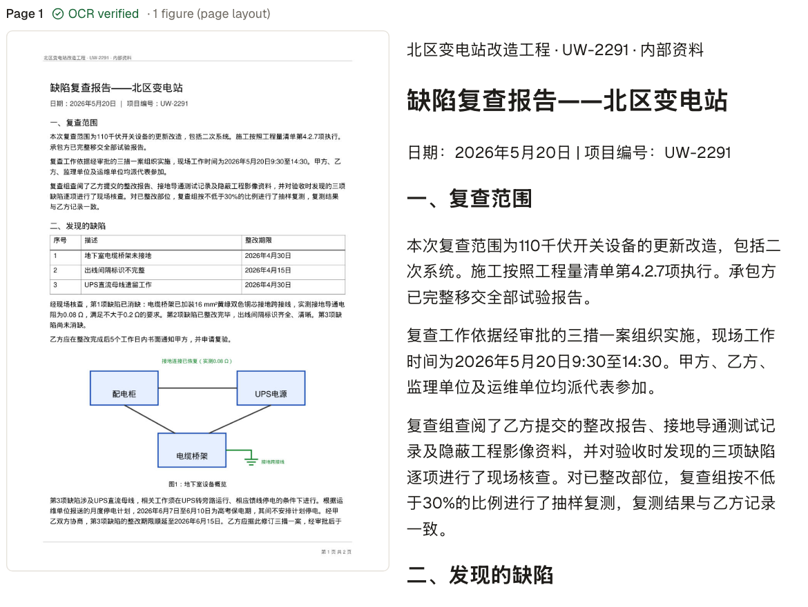
Reading the page, with a person checking
A vision model reads each page into structured text: headings, tables, headers and footers
PP-DocLayoutV3 finds pictures, charts and seals
A guarded check applies small fixes and lists doubtful ones
Every scan pauses: describe a problem in plain English and the chat proposes a page fix, with a list of every word it changes
New source text must be read off the page. The chat can't type it in.
Notes:
- Screenshot: a Chinese inspection report, scanned. Left: the page image. Right: what the vision model read, as structured text.
- The layout model found the diagram, so it's kept as a figure and its labels are translated as a legend.
- The check after reading is guarded: a small fix inside a word is applied, but a changed number or a different word is only listed for a person.
- The source check is the key feature for scans. You don't need to read Chinese: you can see that a stamp sits over the text, or that two columns were mixed up, and say so in English.
- When the chat fixes the page, it has the OCR model read it again. Any text that didn't come from a reading is refused, and the card lists every word added or removed so you can check before accepting.

Slide 45
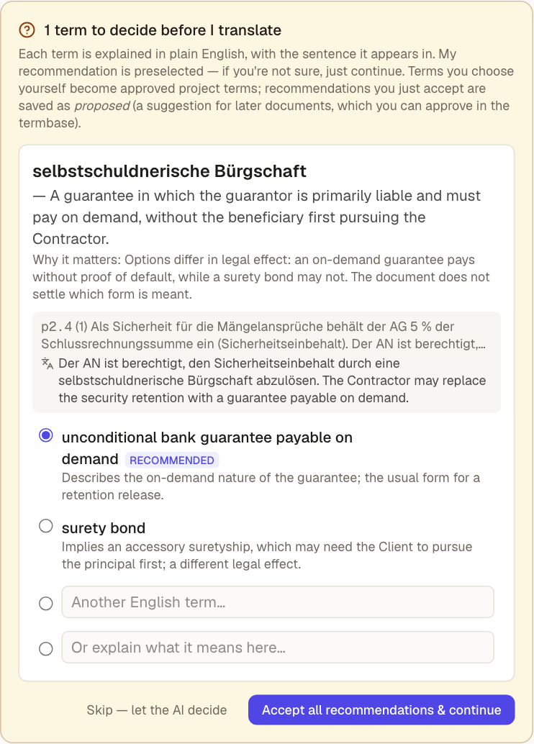
Questions anyone can answer
The term explained in plain English, and why it matters
The sentence, with an English gist
2–3 English options with notes, and a recommendation
Your answer becomes a project term, and the first draft already uses it
Why ask first:
a model that asked one clarifying question got gender right 77% of the time, against 54% for Google Translate (Pilault et al. 2023). The agent frames the decision; the expert makes it.
Notes:
- The analysis reads the whole document and decides most terms itself. Only terms whose options mean different things become questions.
- Each card has the meaning in plain English, the sentence with an English gist, the options with notes, and a preselected recommendation. If you're not sure, Accept all is a safe default.
- The screenshot is a German contract term, selbstschuldnerische Bürgschaft (a guarantee where the guarantor gives up the right to make the creditor pursue the contractor first). The options really do differ in meaning, so a person should decide: a legal translator can type their own term instead of the recommendation.
- Why ask at all: Pilault et al. (2023) found a model that asks one clarifying question got gender right 77% of the time vs 54% for Google Translate; Iyer et al. (2023) found even the best engine picked the wrong sense of an ambiguous word a third of the time.
- That's the point: the agent finds the decision and frames it, and the expert makes it.
- Answers are saved to the project termbase: approved if you chose, proposed if you just accepted the recommendation.

Slide 46



A full translation workbench underneath
Projects & style guides
Termbase
Translation memory
One client, one source language, shared instructions
Approved terms and “never use” variants, checked automatically
101%, 100% and fuzzy matches; exact matches need no model call
Segment editor
Quality
Versions & downloads
CAT-style grid with statuses, shortcuts, comments and locks
Automatic QA checks and an MQM quality score, with a review queue
Every change diffable; Word and Markdown output
Notes:
- Under the agents is a translator's workbench, so this fits how LSPs already work.
- Projects hold the style guide, termbase and memory for one client.
- The termbase has forbidden variants. Using one is a QA error.
- The translation memory only learns from segments a person confirmed one by one, so it stays trustworthy.
- The segment editor works like a CAT tool: statuses, Ctrl+Enter to confirm, TM panel, term highlighting.
- Quality: automatic checks (numbers, terms, tags, consistency) and an MQM score per 1000 words, with a pass threshold.

Slide 47

Live demo
A Chinese scan and a German contract, into English
Notes:
BEFORE THE TALK (about 30 minutes ahead)
- Start the backend, the frontend and the layout server (README, "Running it"). Check the model keys are set.
- Seed the demo projects: cd backend && uv run python scripts/seed_demo.py --reset
- Pre-run fucha-baogao-scanned.pdf into the Chinese project (北区变电站改造 – UW-2291): press Continue at the check and let it finish (about 6–8 minutes). This is the finished document you show in steps 5–6.
- Pre-stage samples/vertragsauszug.pdf in the German project (Acme Energie – Umspannwerk Nord): press Continue at the check, and leave it waiting at its question. A paused question survives a server restart.
- Have the backup slides open in presenter view in case anything fails.
DURING THE DEMO (about 10 minutes): see the run sheet on the next slide.

Slide 48
Demo run sheet
1
The project
2
Upload a Chinese scan
Style guide, termbase with “never use” variants, translation memory
jianli-tongzhi-shuanglan-scanned.pdf: two columns and a red seal; watch it read
3
Fix the reading by chatting
4
Answer a question
Compare page and reading; ask for a re-read; check the word list; accept
German contract: a legal term explained in English; choose or type your own
5
The finished translation
6
Edit, check, download
Memory reuse, the reviewer's fixes, segment editor, side by side
Ask for a change in the chat, accept the diff, run LQA, download Word
Notes:
1. THE PROJECT (1 min). Sidebar → 北区变电站改造 – UW-2291. Show Style guide, then Termbase: 15 terms, the red "never use" variants (乙方 is "Contractor", never "Party B"), then Translation memory. Say: this is what an LSP already has for a client; the agents use all of it.
2. UPLOAD A CHINESE SCAN (1 min). New translation → project 北区变电站改造 → file samples/review/jianli-tongzhi-shuanglan-scanned.pdf. The step bar shows Read; reading one page takes about a minute. Talk over it: a vision model reads the page, a layout model finds the seal.
3. FIX THE READING (2–3 min). It stops at Check. The message lists where to look first: the seal. Right panel: page image next to the reading. Point at the red seal over the attachments line (八、附件). Type: "Under the red seal, the attachments line (八、附件) looks misread — please read page 1 again and keep the seal out of the text. Keep the title and section headings as headings, and the running header as the header." A page fix appears, marked read again, with the words it adds or removes. Show that attachment 1 now reads 现场照片8张 (8 site photos). Accept, then Continue to translation.
WATCH OUT: in rehearsal, "Check the pages for me" on this scan proposed a seal line with a real company's name taken from the first reading. The word list flagged the added characters. If that happens live, use it: point at the word list, click Reject, and say this is exactly why the person decides. Then type the prompt above.
4. ANSWER A QUESTION (1–2 min). Open vertragsauszug.pdf (German project), already waiting. The card explains the term in English. In rehearsal it asked about "selbstschuldnerische Bürgschaft" and recommended "payable on demand". Type "directly enforceable guarantee" in Another English term, then Continue with my 1 change. The question can differ between runs; if none appears, explain from the backup slide.
5. THE FINISHED TRANSLATION (2 min). Open the pre-run fucha-baogao-scanned.pdf. In the chat: "Translation memory: 5 segments reused (40 words, no model call)", then the reviewer's fixes as version 2. Segments tab: statuses, TM 85% match, QE scores, underlined terms (hover one). Document → Side by side.
6. EDIT, CHECK, DOWNLOAD (2 min). In the chat type: Where it says a defect "has been cleared", write "has been remedied" instead. It proposes a diff for two segments and notes that the termbase says otherwise. Accept → History shows the diff between versions. Quality → Run LQA (in rehearsal: 97.9, pass). Download → Word document.
IF SOMETHING FAILS: don't debug live. Say "let me show you the run from this morning" and jump to the Backup section; the slides follow the same order.

Slide 49


Next steps for us
Models
Integrations
Product
Move reading and review onto our own GPUs (vLLM)
Test models per step on real client documents
Connect client systems through request headers
Exchange with the CAT tools agencies already use
Keep the original page layout in downloads
Users and sign-in; more target languages
Notes:
- Adjust this slide to the audience; it reflects the README's known limitations.
- Models: published results (olmOCR, PaddleOCR-VL) suggest small open models can do the reading step on our own GPUs; we would confirm that on real client documents before switching. The config already supports our own vLLM servers.
- Integrations: every model request can carry custom headers, and incoming request headers can be passed through, which is the hook for client systems. CAT-tool exchange formats are the obvious next integration for agencies.
- Product: downloads are reflowed Word and Markdown today, without the original layout. It's single-user, with English as the only target.
- Ask the audience: which of these matters most for your workflow?

Slide 50
Agents read, ask and check. People decide.
Questions?
Notes:
- Recap in one line: since 2012 machines became fluent readers and translators; the studies say the next gains come from context, focused review and a person who decides. Agents read, ask and check; people decide.
- Questions. If time allows, take requests: upload one of the 21 language samples (samples/languages/) live.

Slide 51
Backup: demo screenshots
B
From a rehearsal run, in demo order. Use these if the live demo misbehaves.
Notes:
- Say: "Let me show you the run we did this morning." Then step through in order; each slide's notes say what to point at.

Slide 52
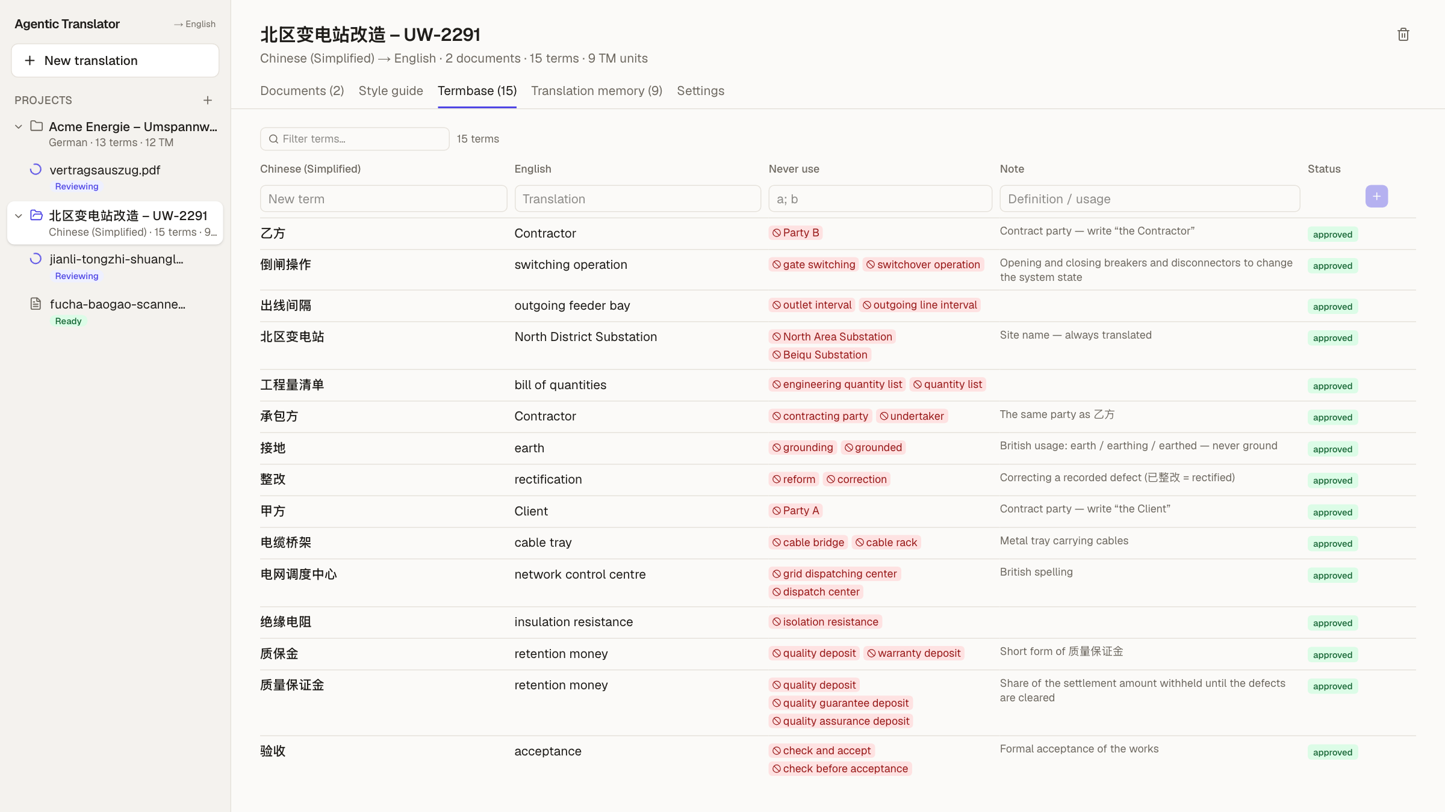
1 · The project: style guide, termbase, memory
1
15 approved terms for this client
2
“Never use” variants in red, checked by QA
3
Notes explain usage
Notes:
- The Chinese project: 15 approved terms, each with forbidden variants (red), e.g. 乙方 is "Contractor", never "Party B".
- The style guide and the translation memory (9 units) sit in the neighbouring tabs.
- The agents use all of it: prompts get the terms that occur on each page, and QA flags forbidden variants.

Slide 53
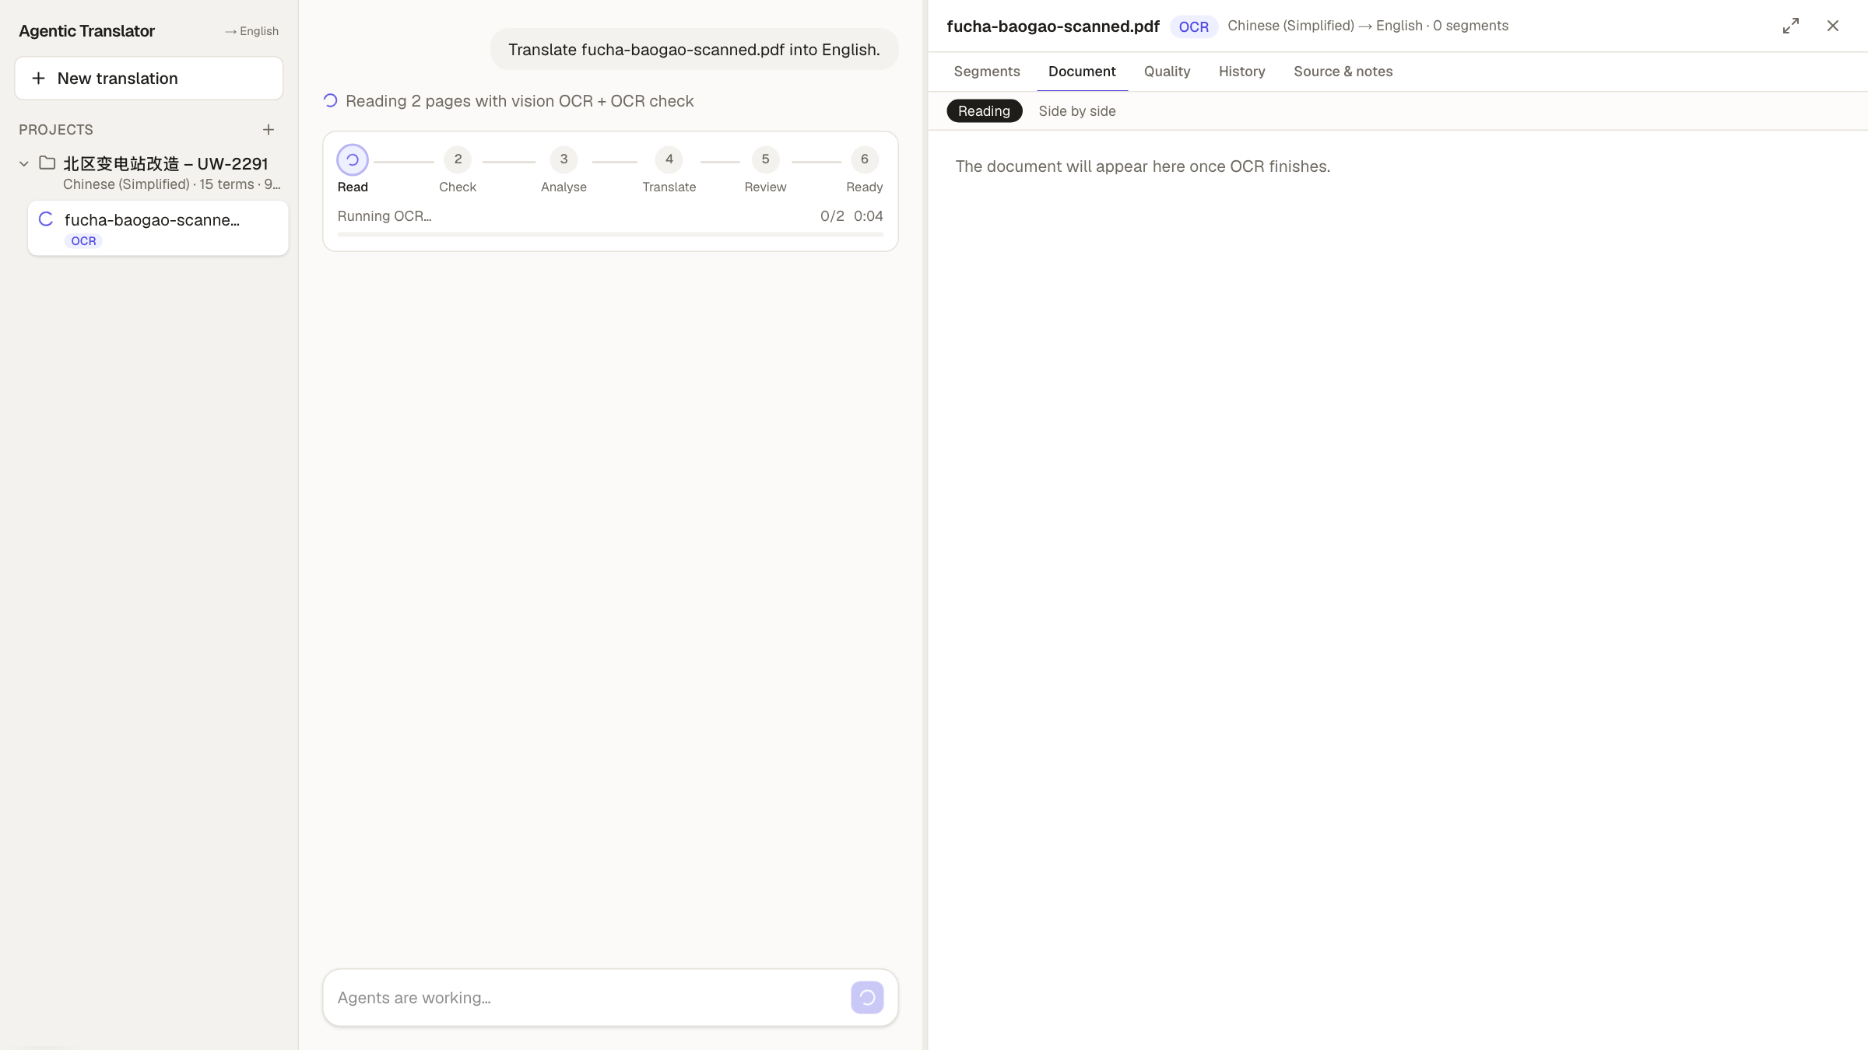
2 · Upload a scan: the pages are read
1
The step bar: Read, Check, Analyse, Translate, Review, Ready
2
A vision model reads each page, then checks the reading
3
About a minute for two pages
Notes:
- A scanned Chinese re-inspection report, 2 pages, uploaded into the project.
- The step bar shows where the run is. Reading uses a vision model per page plus a guarded check.
- PDFs and images stop after reading, for the source check.

Slide 54
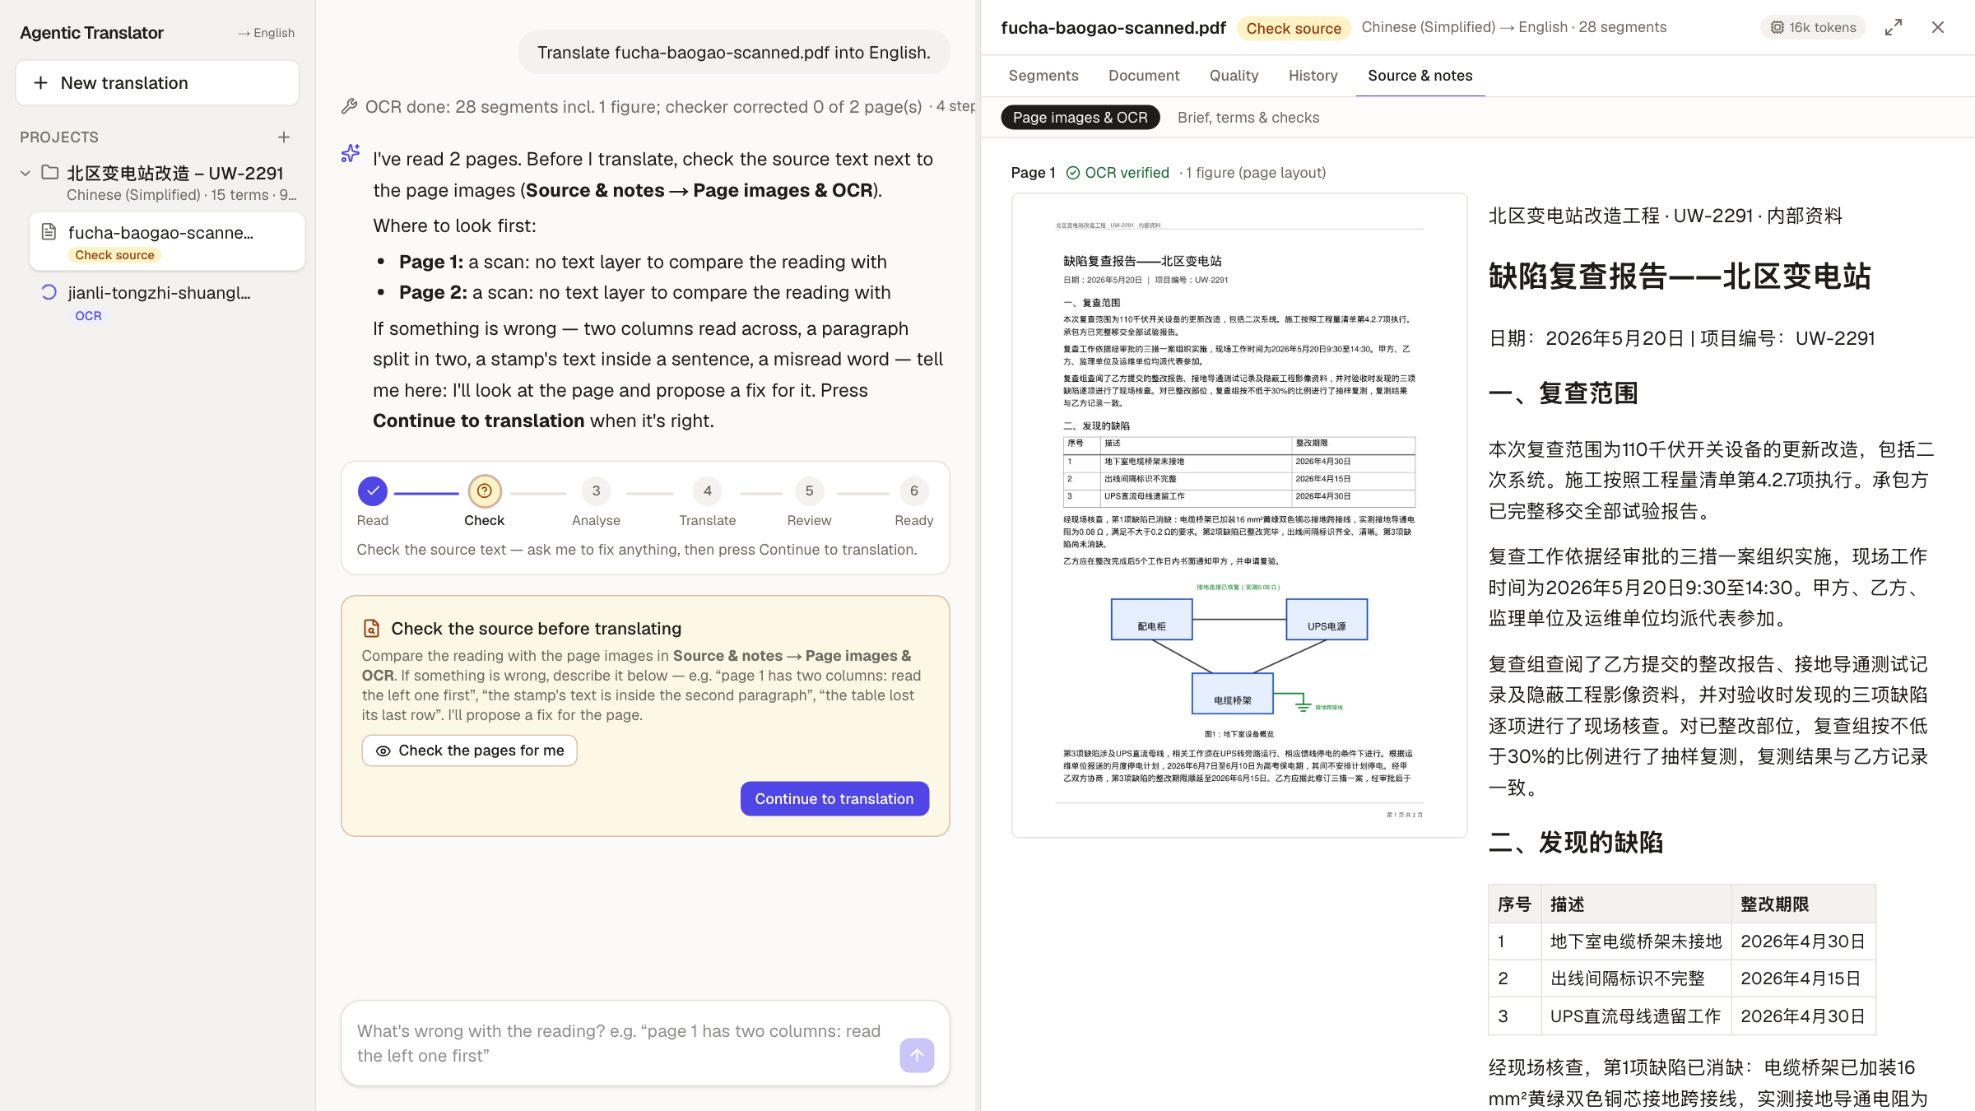
3 · The source check: before anything is translated
1
The page image next to the reading
2
“Where to look first” per page
3
Fix it by chatting, or press Check the pages for me
Notes:
- The run pauses. Nothing is translated yet, so fixing the source costs nothing.
- Right: the page image and what was read, side by side. The diagram was kept as a figure.
- You can describe a problem in English, or ask the chat to check the pages itself.

Slide 55
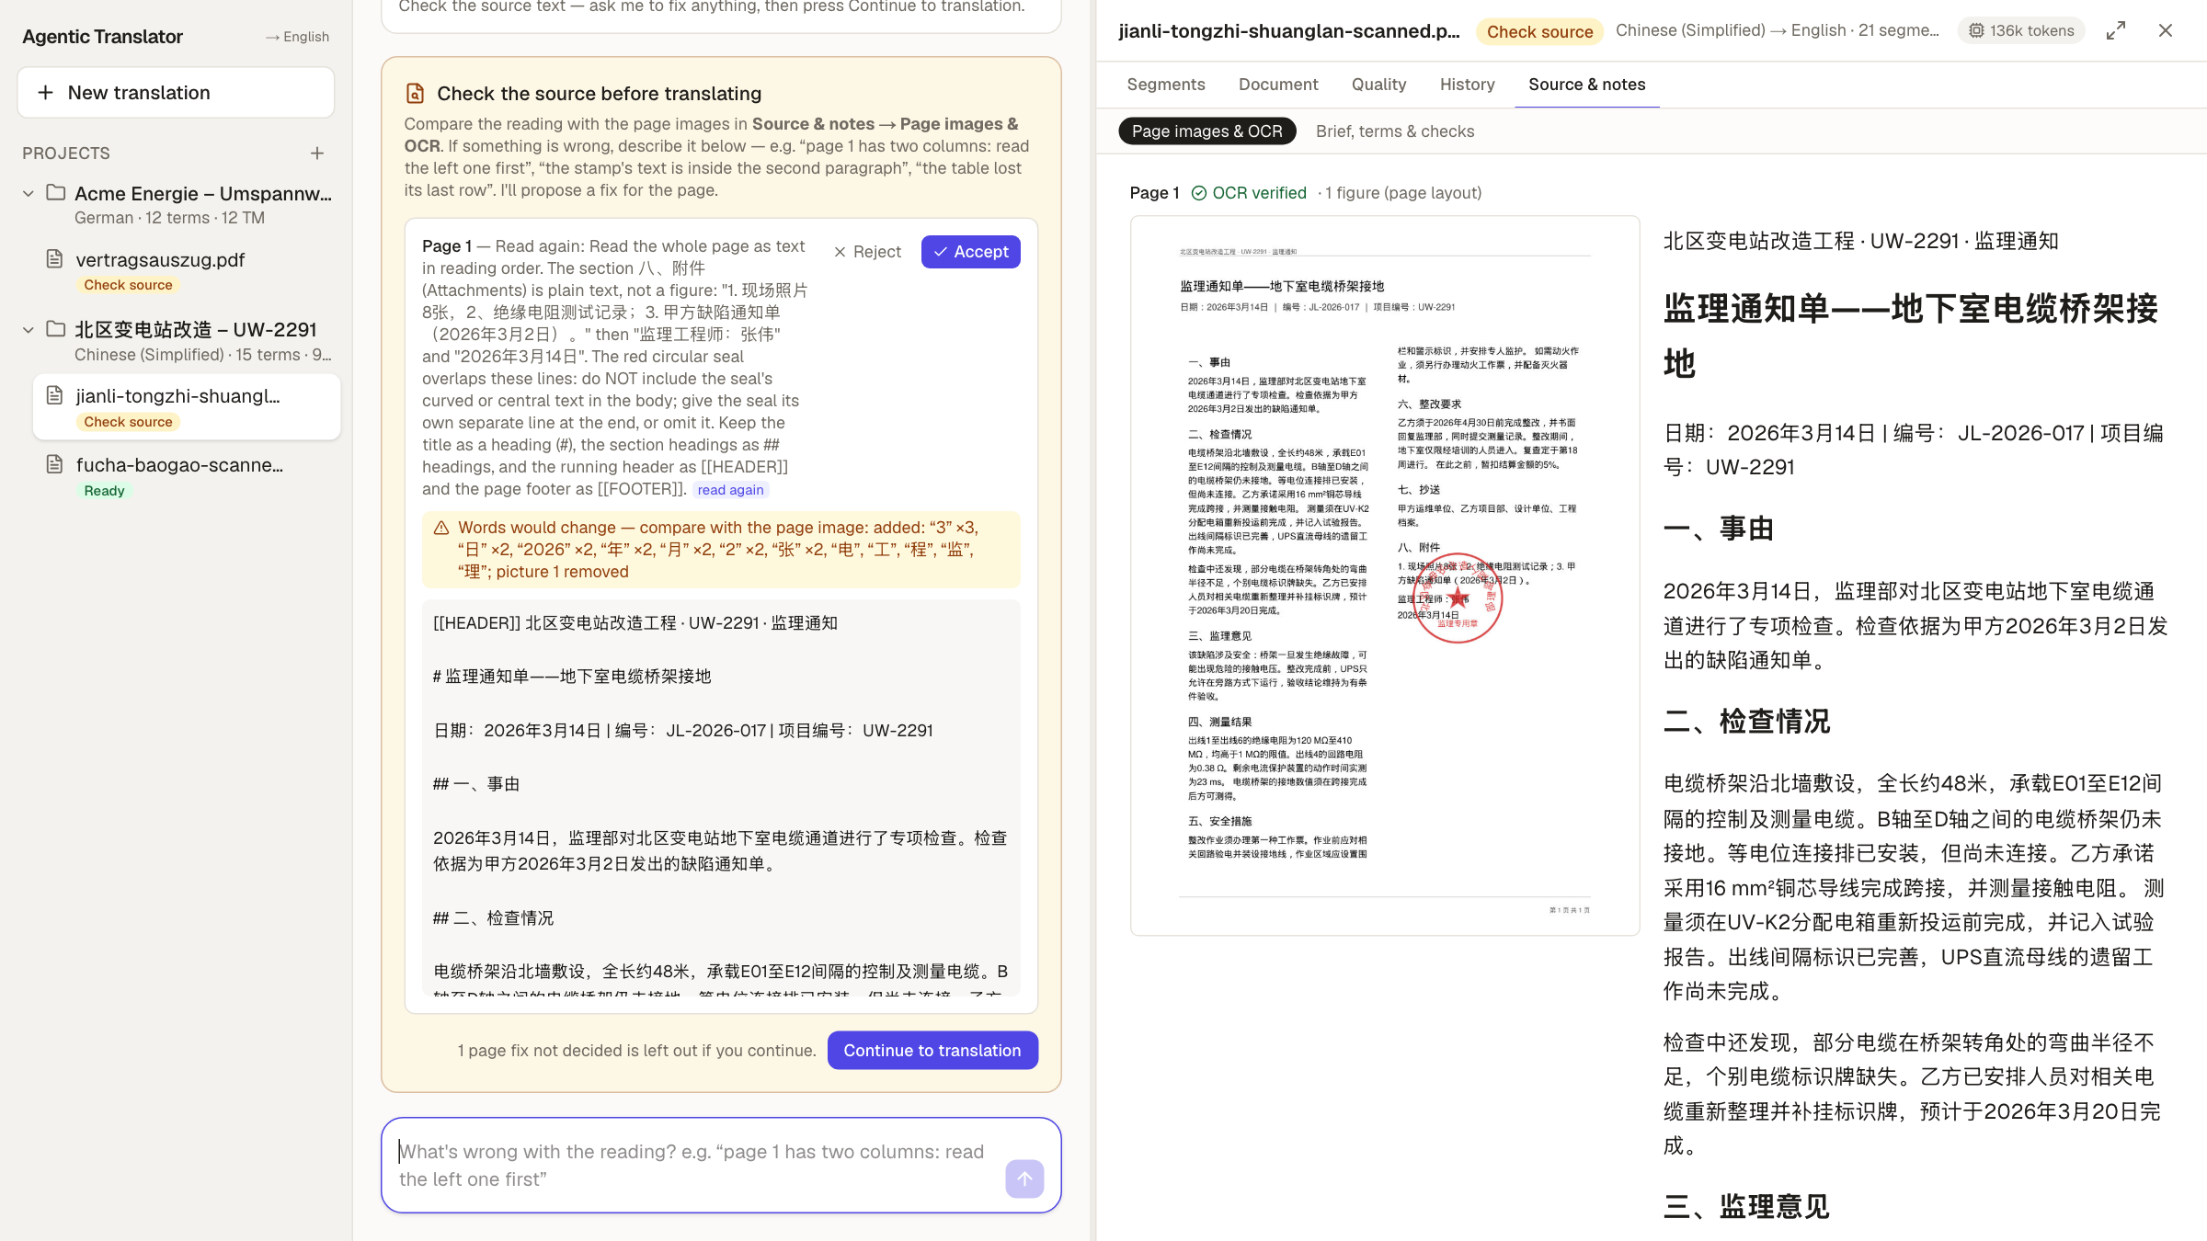
4 · A page fix: read again, with a word list
1
The OCR model read page 1 again, with your instruction
2
Every added or removed word is listed
3
Accept or reject; nothing changes until you do
Notes:
- A different scan: two columns and a red seal over the attachments line.
- We asked in English for the attachments line to be re-read without the seal. The chat had the vision model read the page again.
- The yellow box lists every word that would change, so you can check before accepting. Attachment 1 now says 8 site photos.
- Rehearsal note: an earlier automatic check wrote a wrong company name for the seal. The word list showed it and we rejected it. That's why the person decides.

Slide 56
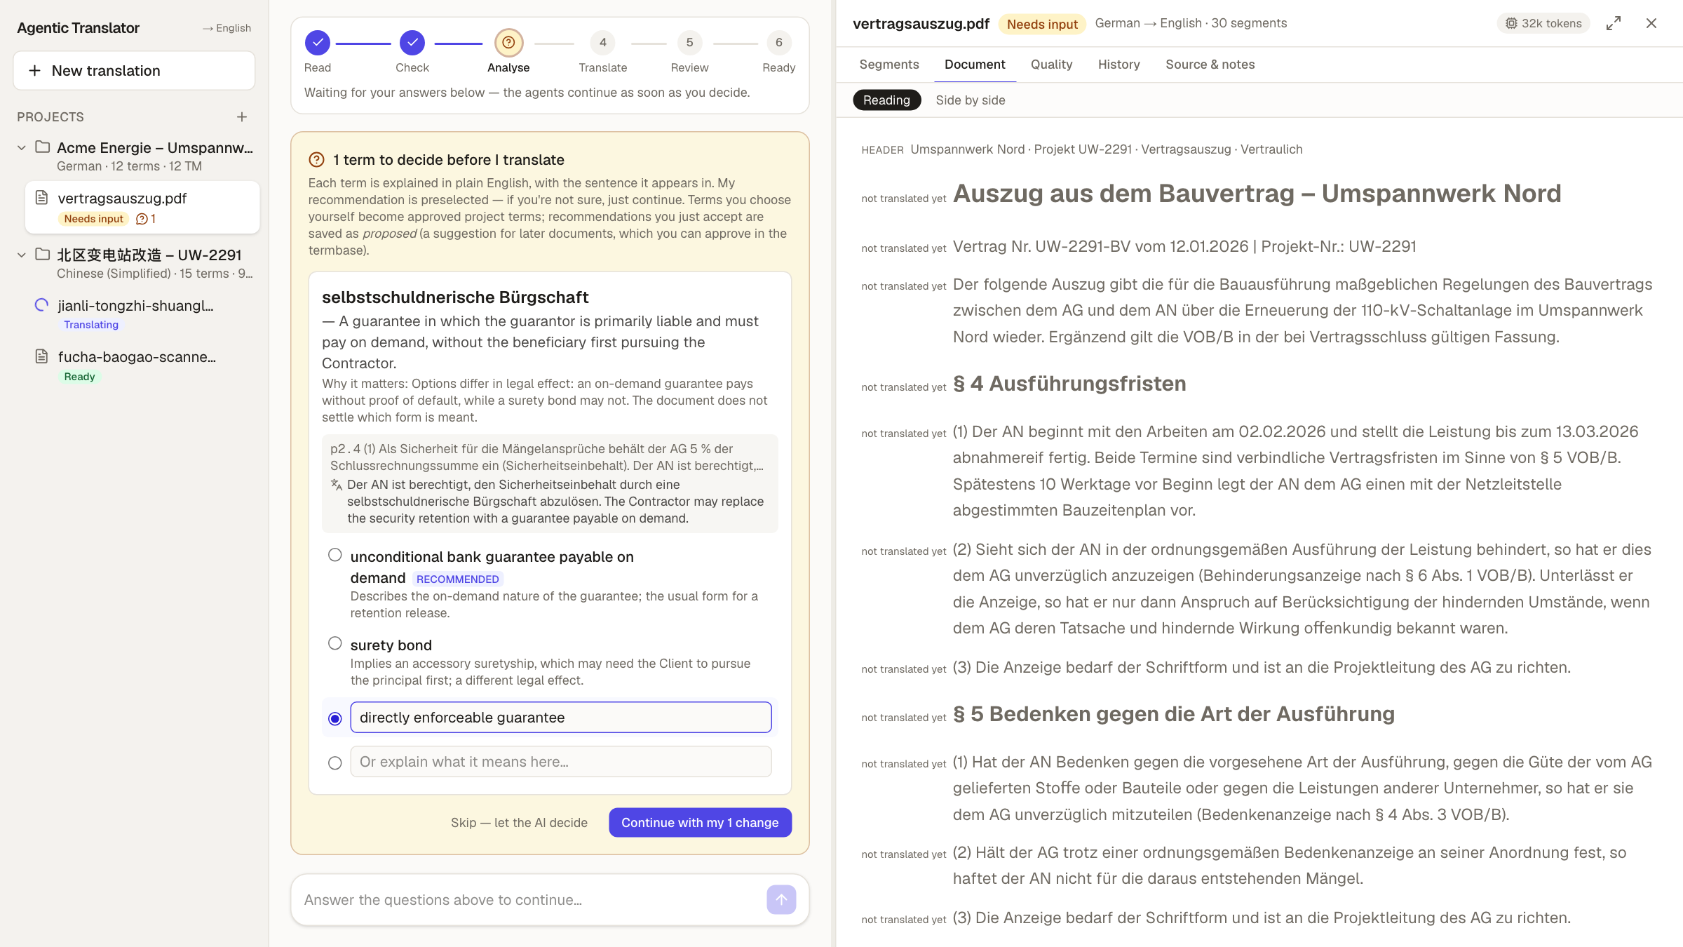
5 · A question before translating
1
The term in plain English, and why it matters
2
The sentence with an English gist
3
We overrode the recommendation with our own term
Notes:
- German contract. The analysis found one term that needs a decision: selbstschuldnerische Bürgschaft.
- The recommendation, "payable on demand", is a different legal instrument. A legal translator knows that, so we typed "directly enforceable guarantee".
- The draft then used it: "…replace the security retention with a directly enforceable guarantee issued by a credit institution authorised within the European Union."

Slide 57
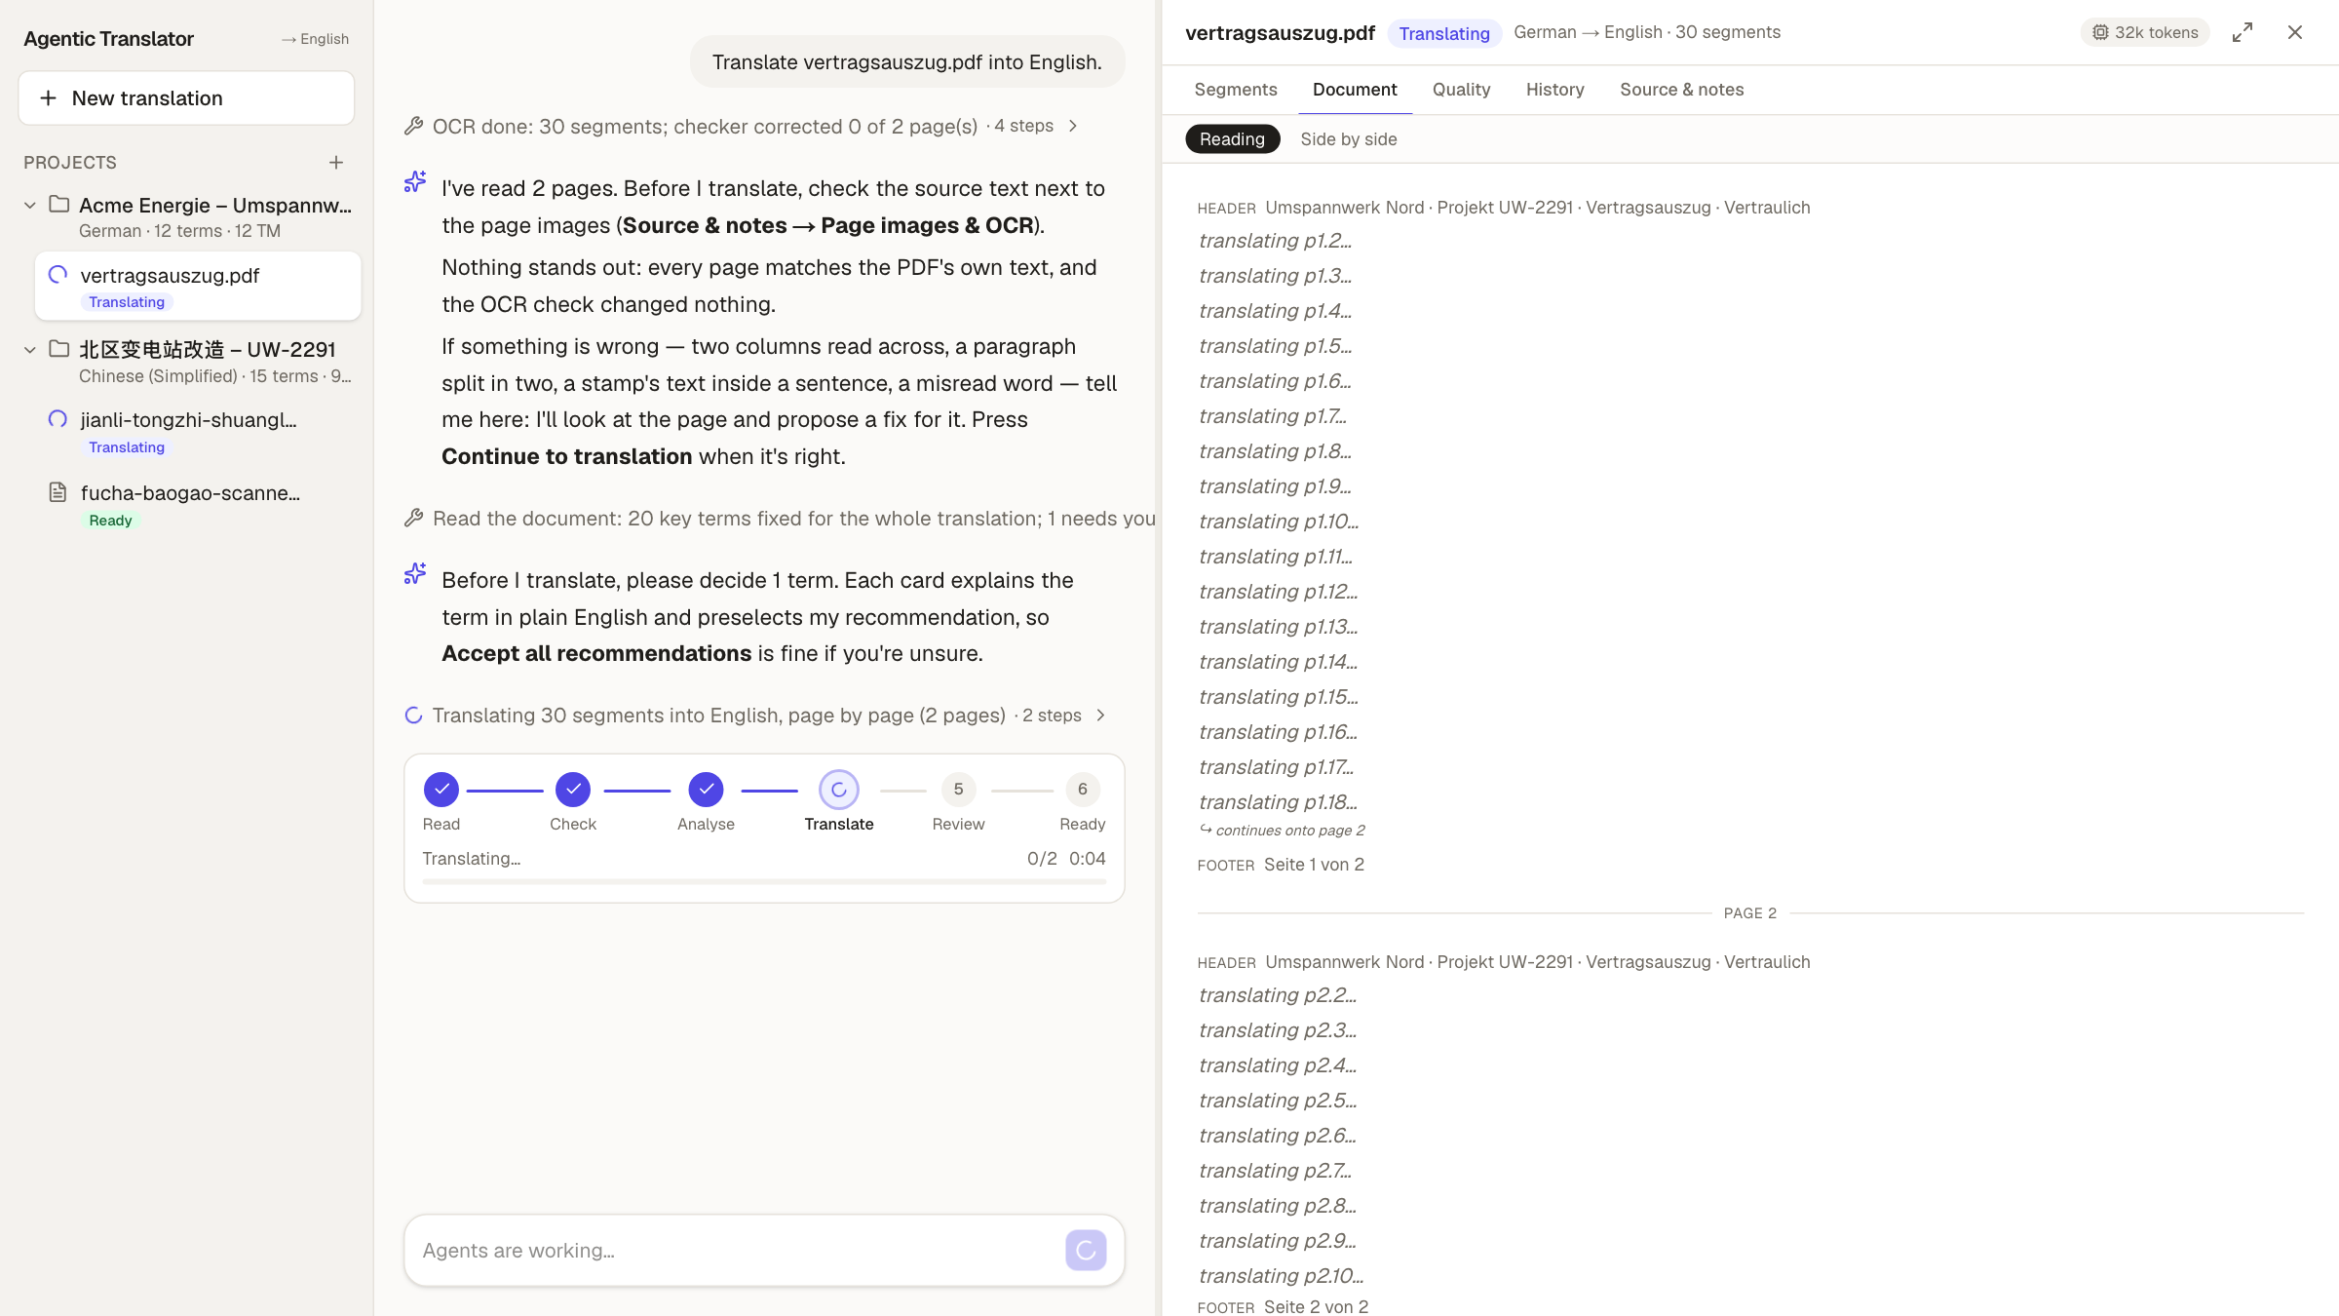
6 · Translating page by page
1
Questions answered, translation running
2
Each page carries the brief, the previous page and the agreed terms
3
Placeholders fill in as pages finish
Notes:
- After the answer, translation starts at once. Pages go in order so each one knows what came before.
- The memory pass runs first: exact matches are filled in with no model call.

Slide 58
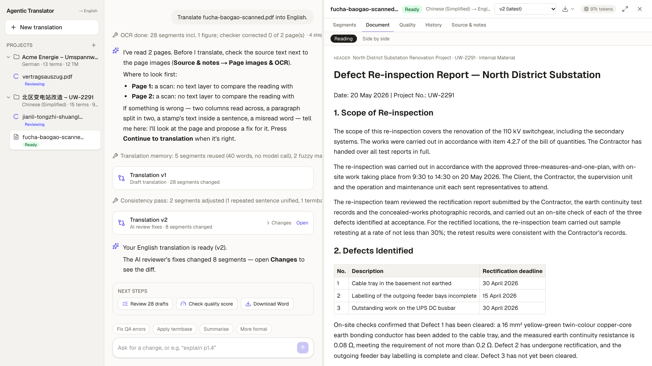
7 · Ready: memory reuse, review, next steps
1
5 segments reused from memory, no model call
2
The reviewer's fixes saved as version 2
3
Next steps: review drafts, check quality, download
Notes:
- Back to the Chinese report, finished.
- The chat log is the audit trail: OCR, memory reuse (5 segments, 40 words, no model call), draft v1, consistency pass, reviewer fixes in v2.
- Next steps offers the obvious actions.

Slide 59
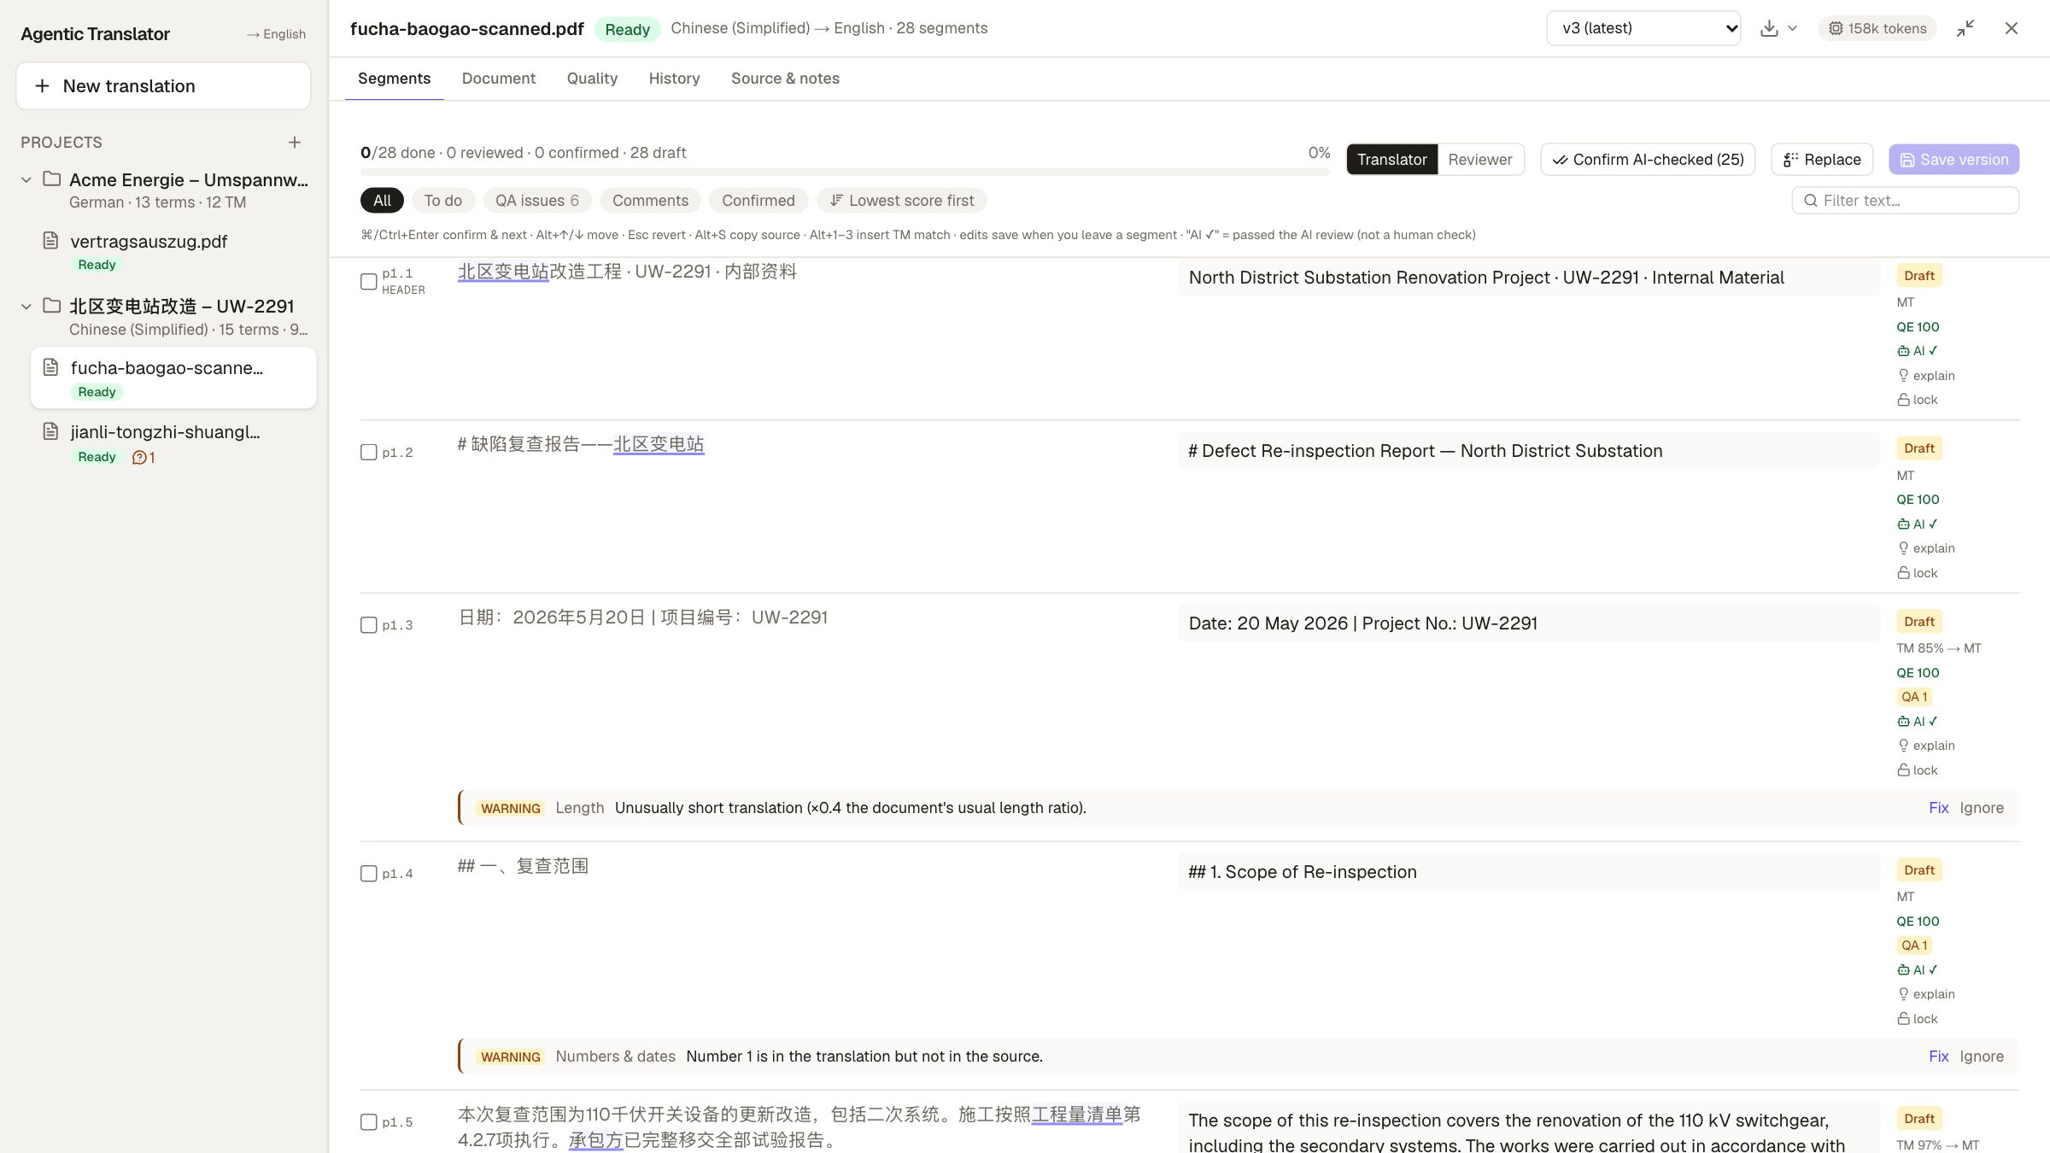
8 · The segment editor
1
Source and translation per segment, with status
2
Memory match % and AI quality estimate
3
QA warnings with Fix and Ignore
Notes:
- The CAT-style grid, full width. Each row has its status (Draft until a person confirms), where it came from (TM 85% → MT), and an AI quality estimate.
- QA warnings sit under the row, with Fix (the agent proposes a fix) and Ignore.
- Terms from the termbase are underlined in the source; hovering shows the approved translation.
- Ctrl+Enter confirms a segment and stores it in the translation memory.

Slide 60
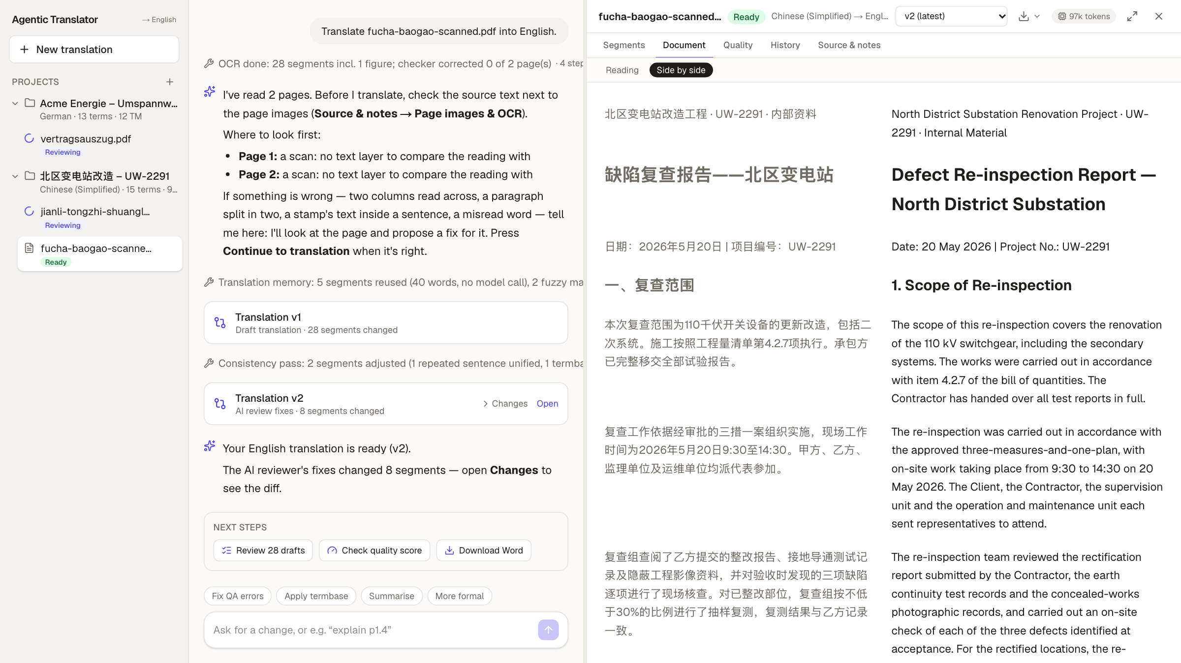
9 · Side by side
1
Source and English, paragraph by paragraph
2
Headings, tables and figures kept
3
Click a passage to reference it in the chat
Notes:
- The reading view, side by side. Structure from the OCR is kept: headings, the defects table, the diagram.
- Hovering a passage lets you reference it in the chat ("make p1.6 more formal") without copying text.

Slide 61
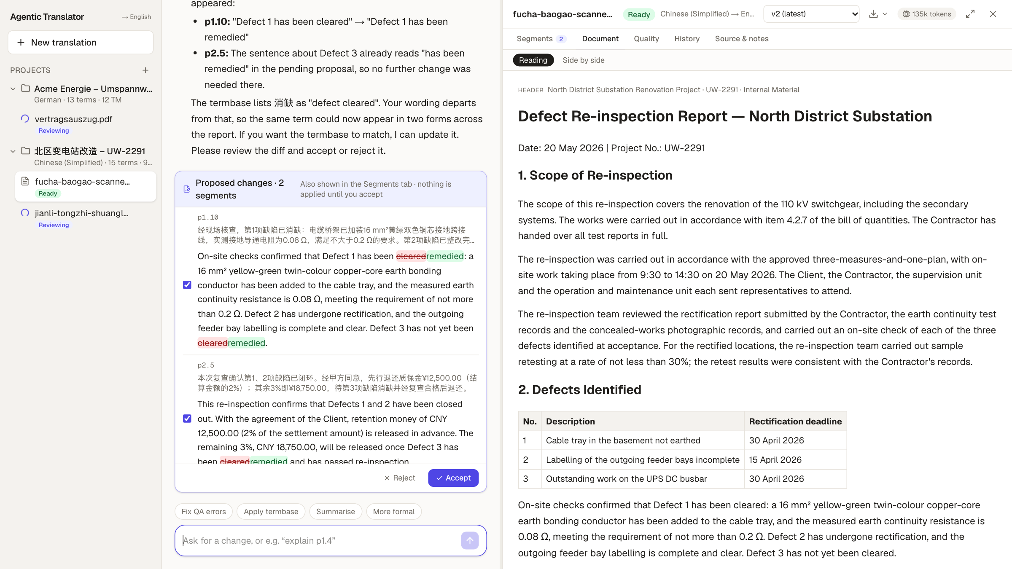
10 · Editing by chat: a proposal with a diff
1
A plain-English request
2
A diff per segment, and a note on the termbase
3
Accept or reject; nothing applied until then
Notes:
- We typed: Where it says a defect "has been cleared", write "has been remedied" instead.
- The chat found both places and proposed a diff for each. It also pointed out that the termbase lists 消缺 as "defect cleared" and offered to update it.
- Nothing is applied until you accept.

Slide 62
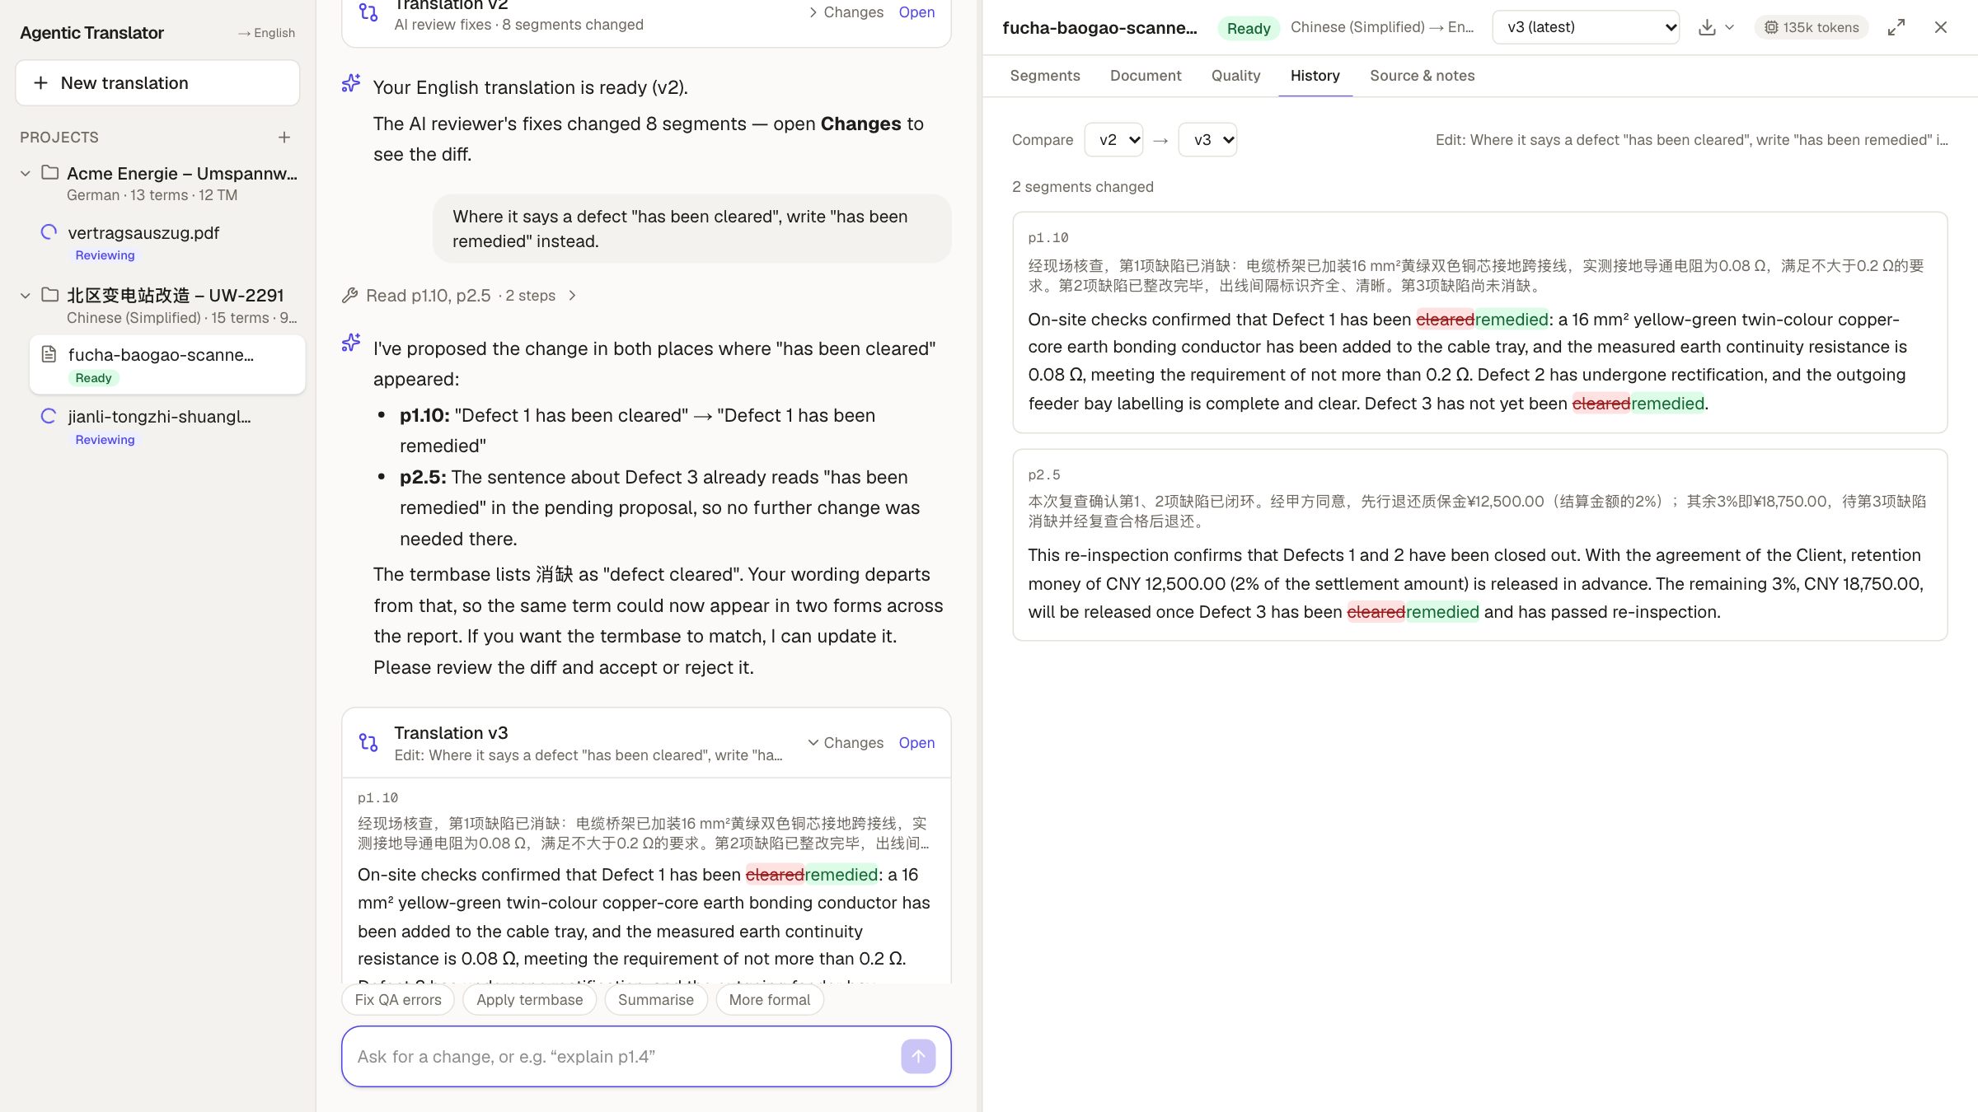
11 · History: every change is a version
1
Compare any two versions
2
Only the changed segments are shown
3
Each version says who changed what
Notes:
- After accepting, version 3. The History tab compares v2 and v3: two segments changed, cleared → remedied.
- Every agent run and every accepted proposal is a version, so you can always see and undo what changed.

Slide 63
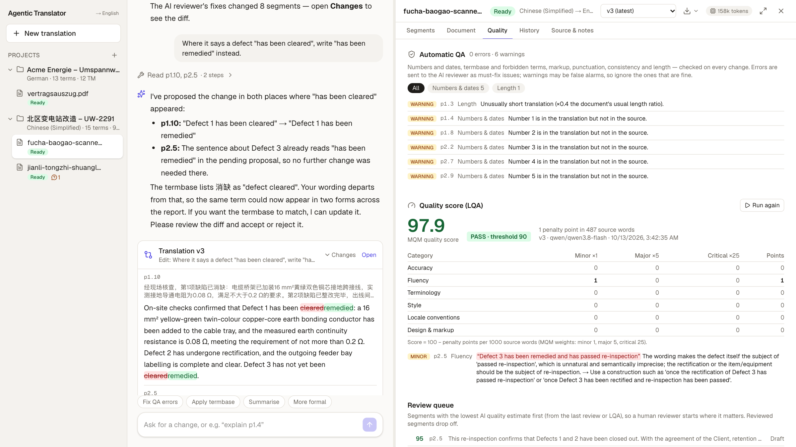
12 · Quality: QA checks and an MQM score
1
0 errors, 6 warnings from automatic QA
2
LQA score 97.9: pass (threshold 90)
3
Scorecard by category and severity
Notes:
- Automatic QA: numbers, terms, tags, consistency. Here 0 errors and 6 warnings, mostly section numbers the check can't match in Chinese.
- LQA: an independent model scores the translation with MQM categories. 97.9, a pass, with one minor fluency issue explained.
- The review queue lists the lowest-scoring segments first, so a reviewer starts where it matters.

Slide 64
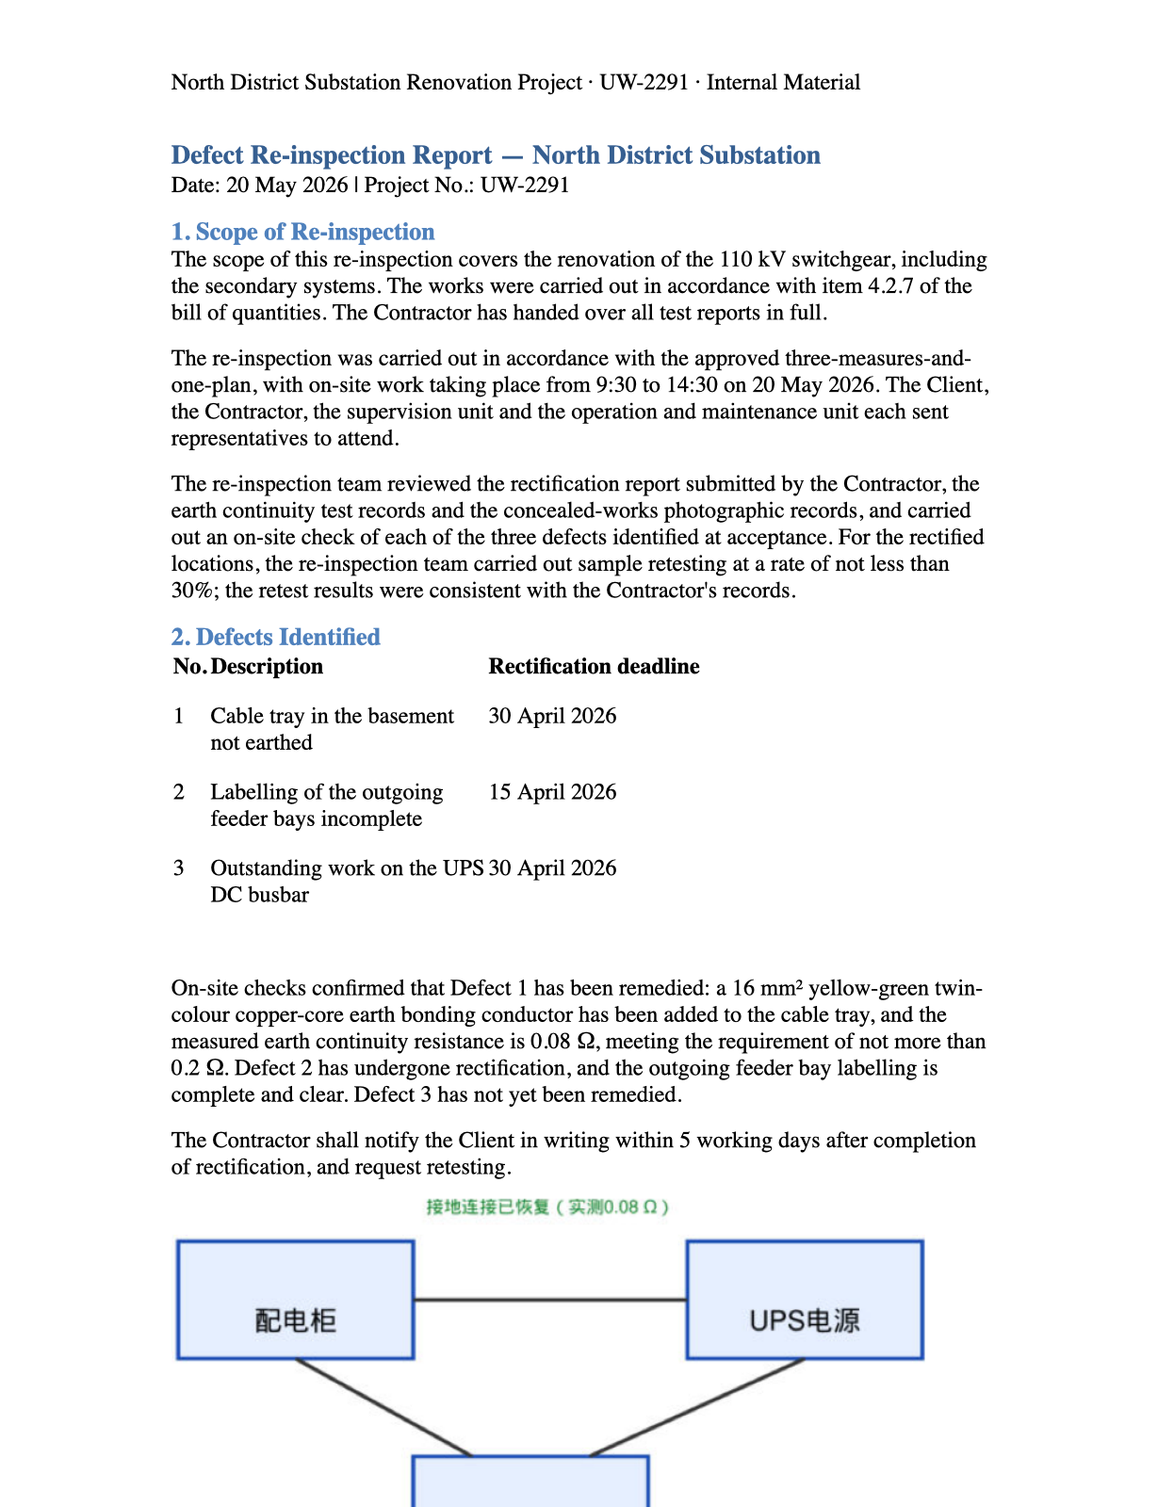
13 · Download: a Word document
Reflowed Word document: headings, tables, figures
Running header and footer with page numbers
Figures keep their pixels; their text is translated as a legend
Also: Markdown, with the figures in a zip
Notes:
- The Word download of the finished report: the English text with its headings, the defects table, and the diagram.
- The diagram keeps its original pixels; the labels inside it are translated as a legend under it.
- The original page layout isn't reproduced yet; that's on the next-steps slide.

Slide 65
Backup: runs on the models you choose
config/pipeline.yaml
Any OpenAI-compatible server: our own vLLM GPUs or a hosted provider
A model per step: a cheap one for reading, a stronger one for translating
Steps that look at pages must use vision models, checked at startup
Custom headers on every request, ready for gateways and client integrations
default: claude-haiku
steps:
ocr: qwen-flash # reads pages
ocr_check: qwen-flash # checks them
review: qwen-flash # 2nd opinion
lqa: qwen-flash # scores
Models are listed in models.yaml: a URL, a model name, a key from .env.
Notes:
- Every step can point at a different model. Today: a small hosted Qwen model reads and reviews, Claude Haiku translates and runs the chat.
- Any OpenAI-compatible endpoint works: vLLM on our own GPUs, or a hosted provider. Switching is a config change, not code.
- Steps that look at page images (reading, the OCR check, the chat) must use a model marked as vision. The server refuses to start otherwise.
- Headers can be added to every model request, or passed through from the incoming API request, for gateways, tenant IDs and request tracing.
- Keys stay in .env. The models file is not committed.

