Slide 1


Online Plant Nursery Application
JEE with Cloud AWS API Development Batch 1

Slide 2
Team Members
Group-6
Sharyu Anantwar
Nishant Sahu
Prajakta Amrutsagar
Anjali Jadhav
Aditi Kamble
Nikita Gote
Mentor
Janmejaya Padhiary

Slide 3
Table of Contents
Introduction to Problem Statement
Technology Used
Spring Boot Architecture
Modules/Services
CRUD functionalities
Diagrams
Annotations
Project Design
Swagger Results
Advantages of Spring Boot
Conclusion

Slide 4
Introduction
Our project entitled “Online Plant Nursery Application” is an application intended for online retailers. This application will provide online shoppers with an interface through which they will be able to purchase plants/saplings from the seller.
The main aim of our project is to develop an application that can be used by XYZ Company admin and their Customer for online shopping.
This application will help customers to buy the products and view order details.
Customers can register themselves and log in. Add the plants and seeds to the cart and purchase them.
This application will help Admin to search plant and seeds lists, add new plants and seeds, remove plants and seeds, and update the order.

Slide 5




Technology Used
Java
Spring Boot
JPA
Swagger UI
Maven
PostgreSQL

Slide 6
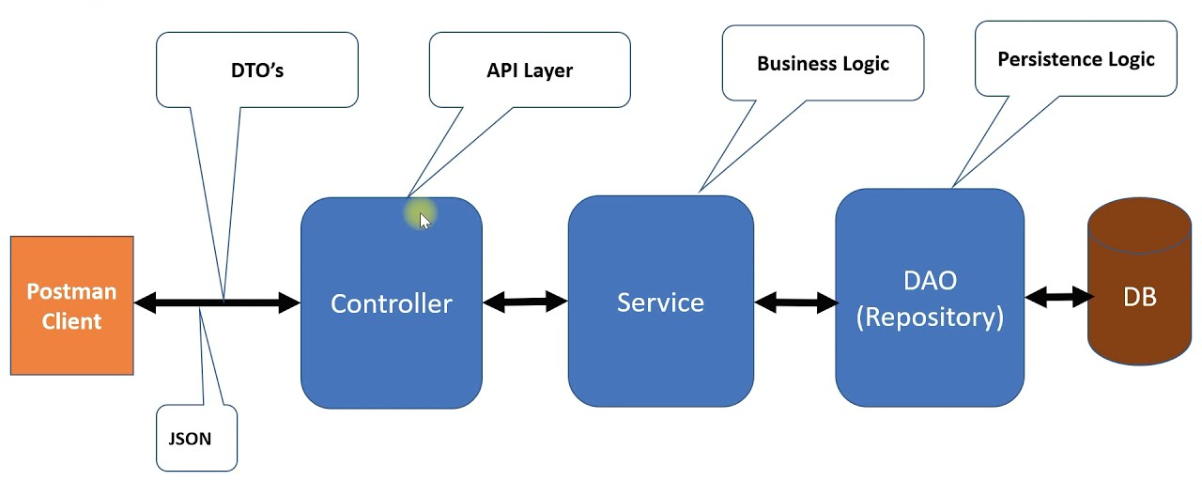
Spring Boot Architecture

Slide 7
Modules/Services
Login Module
Customer Module
Plant Management Module
Seed Managemnt Module
Planters Management Module
Order Booking Management
Module

Slide 8
Crud Functionalities
Add/Delete User Details
Add/Delete a Customer
Add/Delete an Address
Add/Delete Plant from Order
Add/Delete an Order
Add/Delete Seed
View details of the order, customers, plants, seeds, planters
Update details of the order, customer, plants, seeds, planters

Slide 9
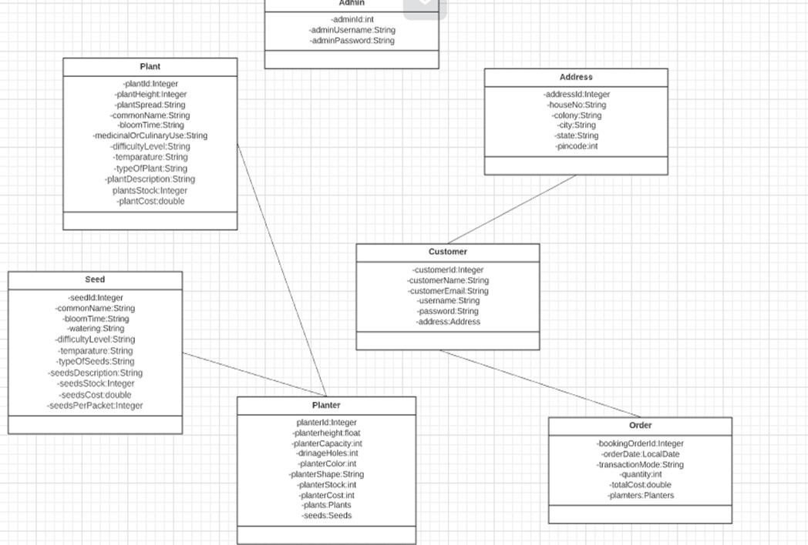
E-R Diagram (Entity-Relation)

Slide 10
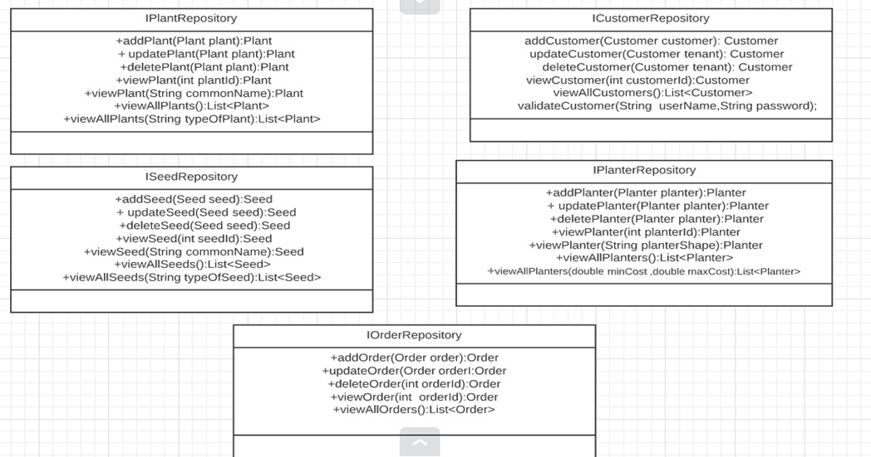
Repository Interface

Slide 11
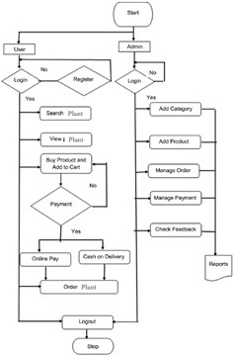
Data Flow Diagram

Slide 12
Annotations
@Id
@Entity
@Table
@Columns
@JoinColumns
@OneToOne
@OneToMany
@RestController
@Service
@Autowired
@RequestBody
@PathVariable
@PutMapping
@GetMapping
@PostMapping
@DeleteMapping
@SpringBootApplication
@OpenAPIDefination

Slide 13
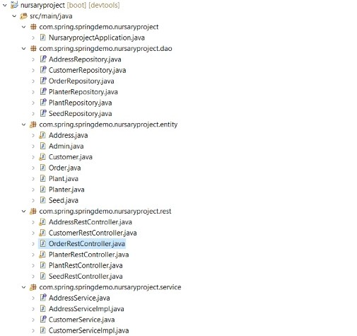
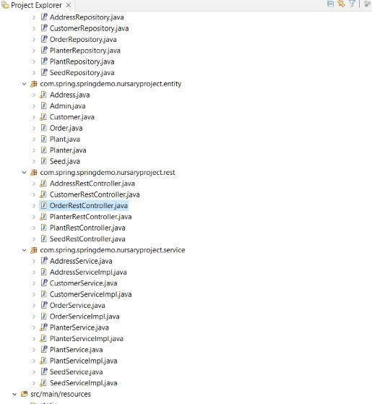
Project Design

Slide 14
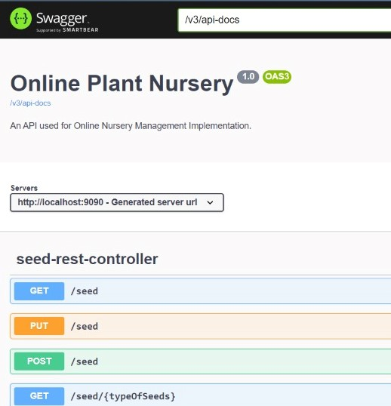
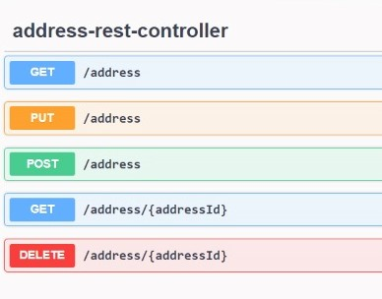
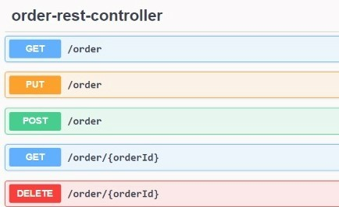
Swagger(API Calls)

Slide 15

Advantages of Spring Boot
Fast and easy development of Spring-based applications;
No need for the deployment of war files;
The ability to create standalone applications;
Helping to directly embed Tomcat, Jetty, or Undertow into an application;
No need for XML configuration;
Reduced amounts of source code;
Simple setup and management;

Slide 16
Conclusion
A Online Plant Nursery Application is where one can buy products in their comfort and has more choices to prefer.
This application is specially designed for the nurseries to sell their plants.
This application has made searching, viewing, and selection of a product easier for any user along with providing security for all the data.

Slide 17

Thank you

