Slide 1
SYNCHRONY HACKATHON · PROBLEM STATEMENT 2
Pratyaya
Explainable, fairness-audited credit assessment for thin-file and new-to-credit borrowers
Deterministic decisions
Cited reasons
Actionable recourse
LIVE pratyaya-beta.vercel.app CODE github.com/Nishantttt-ui/pratyaya
Pratyaya (प्रत्यय) — Sanskrit for trust. The word credit descends from Latin credere, to believe.
Both name the same thing: a lender's belief that a borrower will repay.
Notes:
Open here. The name is the argument in miniature: credit is belief, and for a thin-file borrower the problem is not that the belief is misplaced, it is that nobody has ever looked.

Slide 2
Underwriting reads a file that does not exist
An applicant who has never borrowed formally has no bureau record. They are declined not for being risky, but for being unobserved — and because they are declined, they never generate the history that would let them be seen next time.
59%
70.6 / 51.0
67.5 / 51.8
of the portfolio is new-to-credit
women vs men, new-to-credit
rural vs metro, new-to-credit
No bureau score, no credit history length. Nothing for a traditional model to read.
Absence of evidence is not evenly distributed, so a bureau-led model inherits the skew wholesale.
The same mechanism on a second axis. The exclusion is self-sealing.
Figures from the project's reference population of 30,000 applicants
Notes:
The key word is unobserved. This is a measurement failure that looks like a risk judgement.

Slide 3
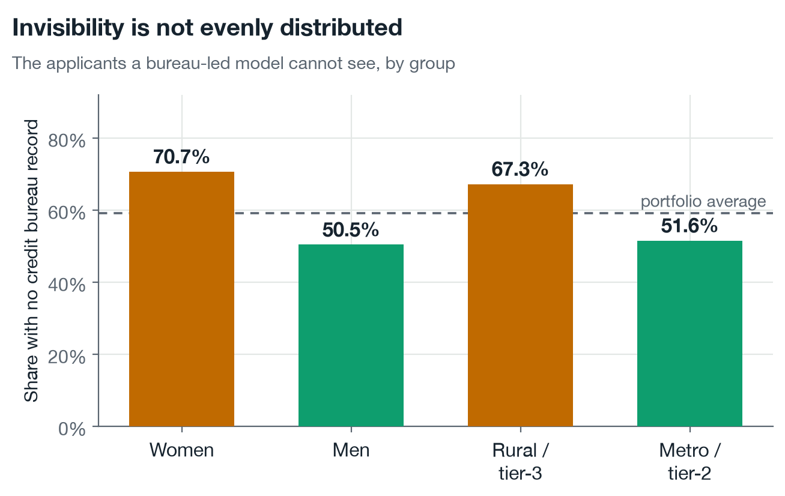
The people a bureau-led model cannot see
Share of applicants with no credit bureau record at all, by group. Nothing here is about repayment — it is about visibility.
Women are new-to-credit 70.6% of the time against 51.0% for men; rural and tier-3 applicants 67.5% against 51.8% in metros. A model leaning on the bureau record inherits that gap wholesale, before it has learned anything about risk.
Notes:
Women are new-to-credit 70.6% of the time against 51.0% for men; rural and tier-3 applicants 67.5% against 51.8% in metros. A model leaning on the bureau record inherits that gap wholesale, before it has learned anything about risk.

Slide 4
THE INSIGHT THE WHOLE BUILD RESTS ON
The bias is not in the algorithm.
It is in the evidence.
Women and rural applicants in this population repay at the same rate as everyone else — 11.8% against 12.2%. What differs is how much of their financial life the lender can see. Fix the evidence and you fix the disparity, without ever touching the decision rule.
Notes:
This reframes the whole problem. Most fairness work treats bias as a property of the model and reaches for a constrained optimiser. Here the model is behaving reasonably on the data it has. The data is the problem.

Slide 5
THE ARCHITECTURAL DECISION
The language model sits on the explanation path, never the decision path
1
2
3
What decides
What narrates
What this buys
A calibrated gradient-boosted model. Deterministic, auditable, reproducible. Its output is final before any language model is called.
A language model rewrites the finished notice more warmly, grounded in retrieved regulation, and only if its output passes a guardrail.
A hallucination, an outage, an exhausted quota or a change of vendor can alter how a decision is described. None can alter what it is.
The system returns a complete, compliant decision with reasons, recourse and citations even with no API key configured at all. That is not a fallback bolted on late; it is the ordering of the pipeline.
Notes:
If they remember one slide, it should be this one. In regulated lending, a model that cannot be held to its output cannot be on the decision path.

Slide 6
System architecture
Green components are load-bearing: the decision and the compliant notice depend only on them. Amber is optional and can fail without consequence.
React + TypeScript — applicant view
React + TypeScript — underwriter view
CLIENT
decision, reasons, recourse, citations
adds probability, SHAP contributions, provenance
JWT auth + roles
Pydantic validation
Rate limiting
Role projection
Structured logging
API
DecisionService — decide, explain, retrieve, render, then optionally narrate
SERVICE
the ordering is the architecture: a complete compliant answer exists before any model is called
HistGradientBoosting
TreeSHAP
Counterfactual search
DECISION
calibrated, handles NaN natively
exact reason codes, error 5e-15
recourse re-scored by the model
PostgreSQL + pgvector
bge-small-en-v1.5 (ONNX)
KNOWLEDGE
Neon, Singapore · HNSW index · 37 provisions
embeddings computed locally, no text leaves the host
Guardrails
Provider abstraction — Gemini · Groq · Ollama · Bedrock
AI LAYER
PII · injection · contradiction
selected by one environment variable; rejected output falls back to the deterministic notice
Applicant population
Regulatory corpus
Model artifacts
DATA
generated, documented causal structure
5 instruments, paraphrased and cited
calibrated model, SHAP background
Every layer shown is running: /health reports model ready, 37 provisions, vector_store pgvector, llm_provider gemini
Notes:
Walk down the bands. The point to land: everything green completes before anything amber is called, so the amber row can fail entirely and the applicant still receives a correct, compliant, cited decision.

Slide 7
What happens when an application arrives
Ten steps. The first six are deterministic and complete in about ten milliseconds. Only then is a language model consulted, and only about wording.
DETERMINISTIC · COMPLETES IN ~10 MS · NO MODEL INVOLVED
Validate
1
Score
2
Reason codes
3
Recourse
4
Retrieve
5
Render notice
6
422 on out-of-range
or identifier fields
calibrated PD
3.2 ms
exact TreeSHAP
+0.34 ms
counterfactuals
re-scored
pgvector
provisions
complete and
compliant
THE DECISION, THE REASONS, THE RECOURSE AND THE CITATIONS ARE NOW FINAL
OPTIONAL · WORDING ONLY · ~2 S · MAY FAIL WITHOUT CONSEQUENCE
Guardrail in
7
Narrate
8
Guardrail out
9
Project by role
10
scan the assembled
prompt
the model rewrites
the notice
contradiction, PII,
guarantees
underwriter sees more
than the applicant
If steps 7 to 9 fail for any reason — outage, rate limit, a guardrail firing — the applicant receives the notice rendered at step 6. Measured on a flaky free tier, that happened to half of all requests, and every one of them was still correct.
Notes:
The black bar is the slide. Everything above it is finished before anything below it runs.

Slide 8
The data, and why it is synthetic
No public dataset joins Account Aggregator-style alternative data to realised loan outcomes for Indian borrowers — that data is personal financial information and is not published. So the population is generated openly, with its assumptions written down and tested, rather than sourced from a proxy dataset and quietly relabelled.
A
B
C
Causal, not correlational
Two seeded biases
Guarded by tests
Default is driven by latent repayment capacity and willingness plus a large idiosyncratic shock. Observable features are noisy consequences of those latents — never rescaled copies of the label.
Bureau records go missing more often for women and rural applicants; declared income is depressed for women. Neither touches true repayment.
Maximum feature-to-label correlation 0.49. Equal true default rates across groups. Both asserted in the suite, so they fail loudly rather than drifting silently.
Knowing the ground truth is what makes the result provable. On a real portfolio a rejected applicant's counterfactual repayment is never observed, so the central claim could be argued but not measured.
Notes:
Expect to be challenged on synthetic data. The answer is that the alternative is not real data, it is a US or Czech dataset relabelled as Indian. And ground truth is what lets us prove the mechanism.

Slide 9
The same pipeline, run on real credit data
The obvious objection to a synthetic population is that the result could be an artefact of the generator. So the identical code path - design matrix, booster, calibration, TreeSHAP, fairness audit - was run over two real public datasets with genuinely observed defaults.
Dataset | Rows | AUC | KS | Calibration err | TreeSHAP error
German Credit (Statlog) | 1,000 | 0.7464 | 0.3752 | 0.0772 | 2.7e-15
Taiwan Default of Credit Card Clients | 30,000 | 0.7829 | 0.4391 | 0.0222 | 4.0e-15
This project, synthetic | 30,000 | 0.7797 | 0.4127 | 0.0073 | 5.2e-15
Dataset
Rows
AUC
KS
Calibration err
TreeSHAP error
Our synthetic population's difficulty sits between the two real datasets, which is the answer to “you tuned it to a flattering level”. TreeSHAP stays exact on real data. The audit also found a genuine violation rather than rubber-stamping: age band on German Credit fails the 80% rule at 0.783.
What this does NOT establish: neither dataset carries alternative data, so the inclusion finding cannot be reproduced on them. That claim rests on the synthetic population, and this deck says so.
Notes:
Lead with this when challenged on synthetic data. The machinery is validated on real defaults; only the inclusion comparison needs the generator. Note we report the scope limit ourselves.

Slide 10
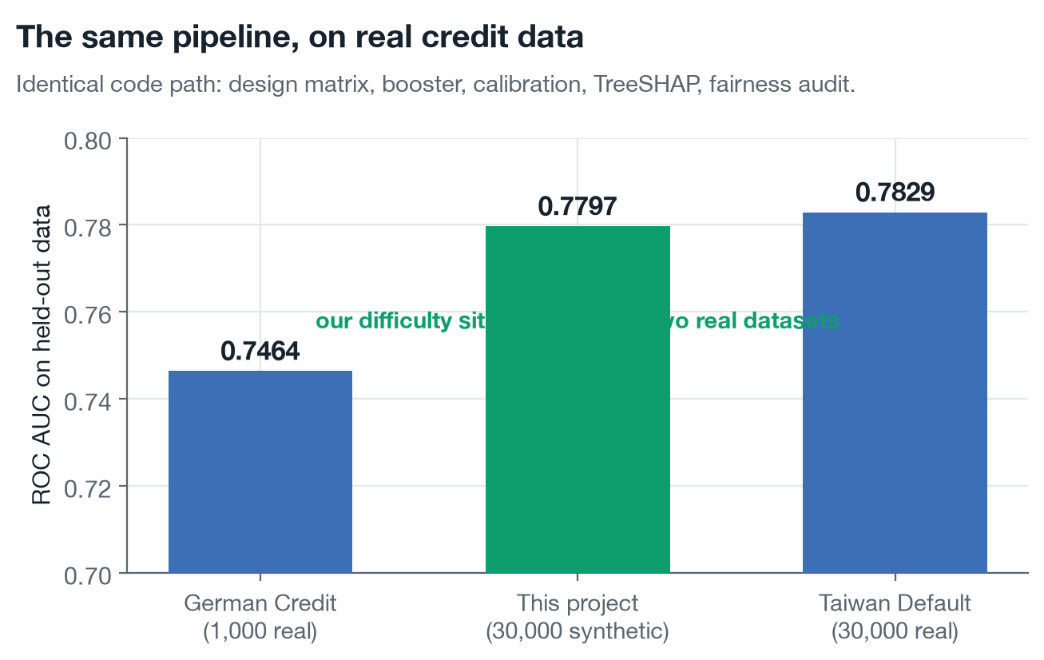
Our difficulty sits between two real datasets
The identical pipeline — design matrix, booster, calibration, TreeSHAP, fairness audit — run over real credit data with observed defaults.
This is the answer to “you tuned the generator to a flattering level”. A synthetic population easier than reality would score above both; one built to flatter would not calibrate to 0.0073 either.
Notes:
This is the answer to “you tuned the generator to a flattering level”. A synthetic population easier than reality would score above both; one built to flatter would not calibrate to 0.0073 either.

Slide 11
THE EXPERIMENT
Two models. Same data, same splits, same approval rate.
Traditional
Inclusive
Application details and the credit bureau record only — the information a conventional underwriter sees.
The same, plus consented alternative data: UPI cash-flow behaviour, utility punctuality, telecom tenure.
Approval rate is pinned at 70% for both, so the comparison is like-for-like. Any difference is the information, not the risk appetite.
Notes:
Holding approval rate constant matters. Otherwise a model could look fairer simply by approving more people.

Slide 12
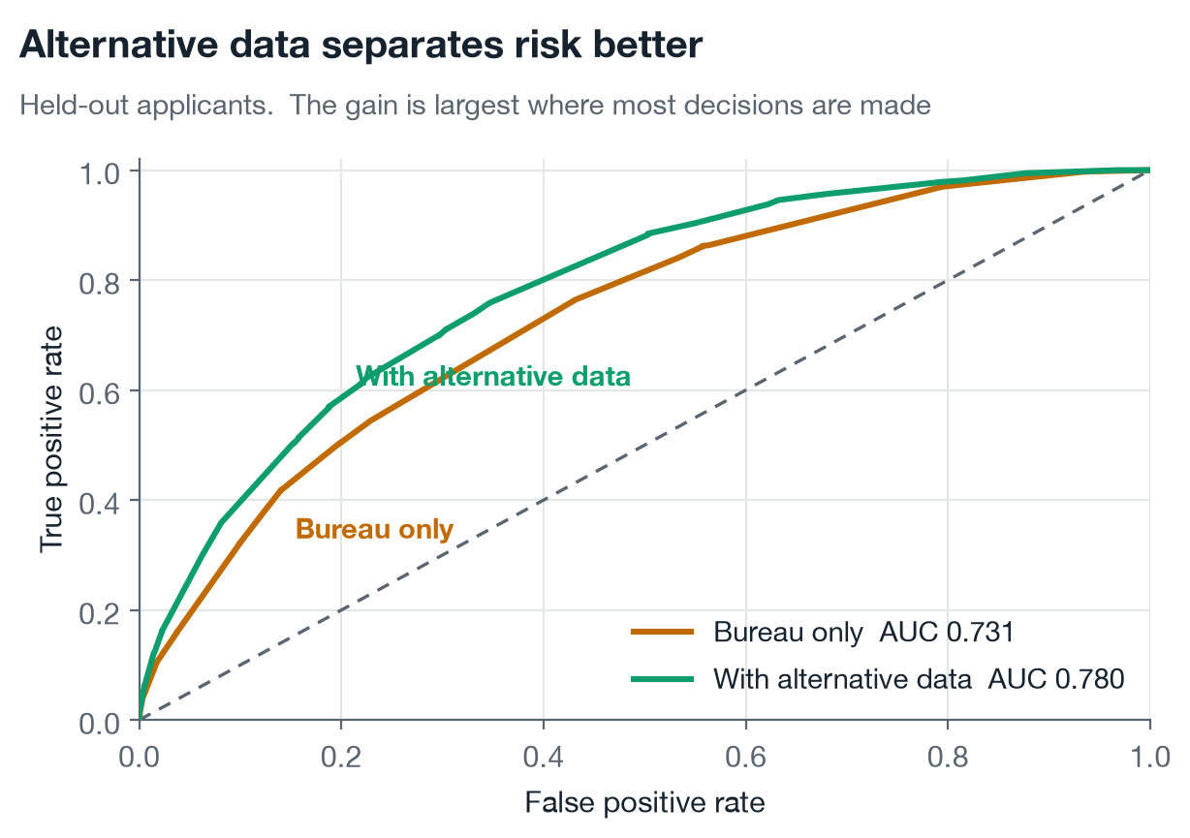
Accuracy, risk and fairness moved together
Measured on held-out data, approval rate pinned at 70% | Bureau only | + Alternative data | Change
ROC AUC | 0.7314 | 0.7797 | +0.048
KS statistic | 0.3365 | 0.4127 | +0.076
Bad rate among approved | 0.0746 | 0.0623 | − 0.012
Creditworthy NTC approved | 0.7189 | 0.7361 | +0.017
Disparate impact, gender | 0.869 | 0.964 | +0.095
Qualified-approval gap | 0.1083 | 0.0341 | − 0.074
Held out, approval pinned at 70%
Bureau only
+ Alt data
Change
There is no accuracy-versus-fairness trade-off here — which is the point. The disparity was never a property of the algorithm, so it did not have to be bought back with accuracy.
Notes:
Note the bad rate falling. The inclusive model approves a fairer mix and takes on less risk doing it, because it is seeing more.

Slide 13
Where the extra evidence actually pays
ROC curves on held-out applicants. The gain is largest in the region where most lending decisions are actually made.
Notes:
ROC curves on held-out applicants. The gain is largest in the region where most lending decisions are actually made.

Slide 14
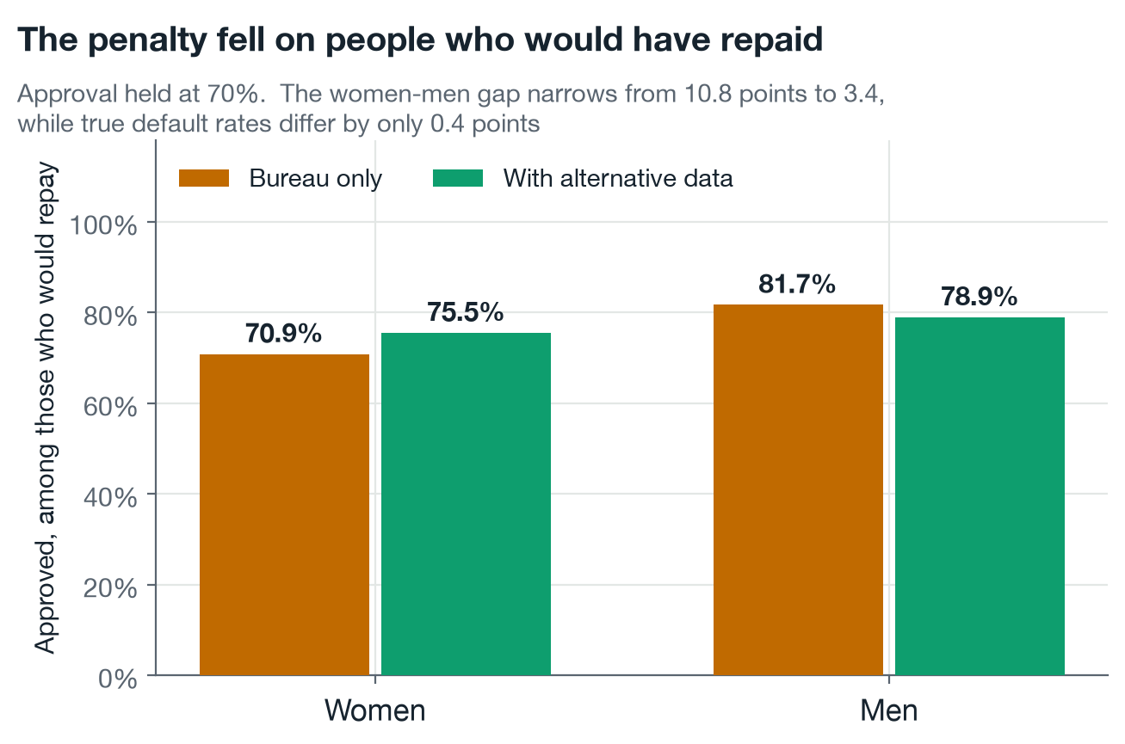
THE SAME RESULT, STATED AS PEOPLE
Among applicants who would have repaid
10.8 → 3.4
percentage-point gap between creditworthy women and men. A 69% reduction.
More creditworthy women approved. Fewer defaults among those approved. The people the old model missed were not bad risks — they were invisible ones.
Notes:
This is the slide to slow down on. It converts a fairness metric into a sentence about people, which is what a credit committee actually decides on.

Slide 15
We tried the algorithmic remedies too
Claiming the disparity lives in the evidence rather than the algorithm is only worth something if the standard algorithmic fixes were actually run. They were, at an identical approval rate.
Strategy | AUC | Bad rate | Disparate impact | Reads gender to decide?
Baseline, bureau only | 0.731 | 0.0698 | 0.879 | no
Alternative data (this project) | 0.765 | 0.0616 | 0.957 | no
CorrelationRemover | 0.727 | 0.0708 | 0.990 | YES
ThresholdOptimizer | 0.677 | 0.1200 | 1.000 | YES
ExponentiatedGradient | degenerate | 0.1191 | 0.996 | no
Strategy
AUC
Bad rate
Disparate impact
Reads gender to decide?
Every algorithmic remedy bought fairness with accuracy or with risk. Widening the evidence was the only one that improved discrimination, risk and fairness together — and the only one needing the protected attribute at neither training nor decision time.
Two failures recorded rather than smoothed over: CorrelationRemover cannot accept a missing bureau score, the very signal that defines a thin-file applicant. ExponentiatedGradient collapsed to approving 99% of everyone across five constraint tightnesses and three constraint types — at a 12% base rate, approving everyone satisfies parity exactly.
Notes:
The 'reads gender to decide' column is the point a fair-lending reviewer will care about. A remedy that applies a different threshold by group is disparate treatment, not a cure for it.

Slide 16
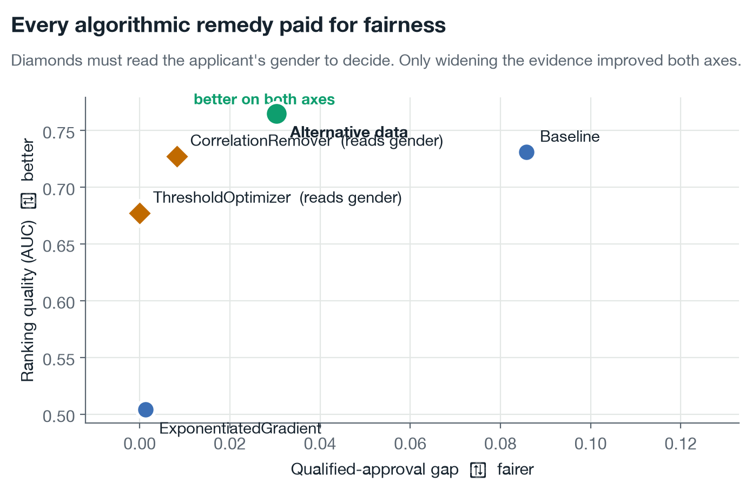
Only one intervention improved both axes
Every strategy at an identical approval rate. Up is a better model; left is a fairer one. Diamonds must read the applicant’s gender to decide.
The algorithmic remedies sit down and to the left: they buy fairness with accuracy. Widening the evidence is the only point that moved up and left together, and the only one that never reads a protected attribute.
Notes:
The algorithmic remedies sit down and to the left: they buy fairness with accuracy. Widening the evidence is the only point that moved up and left together, and the only one that never reads a protected attribute.

Slide 17
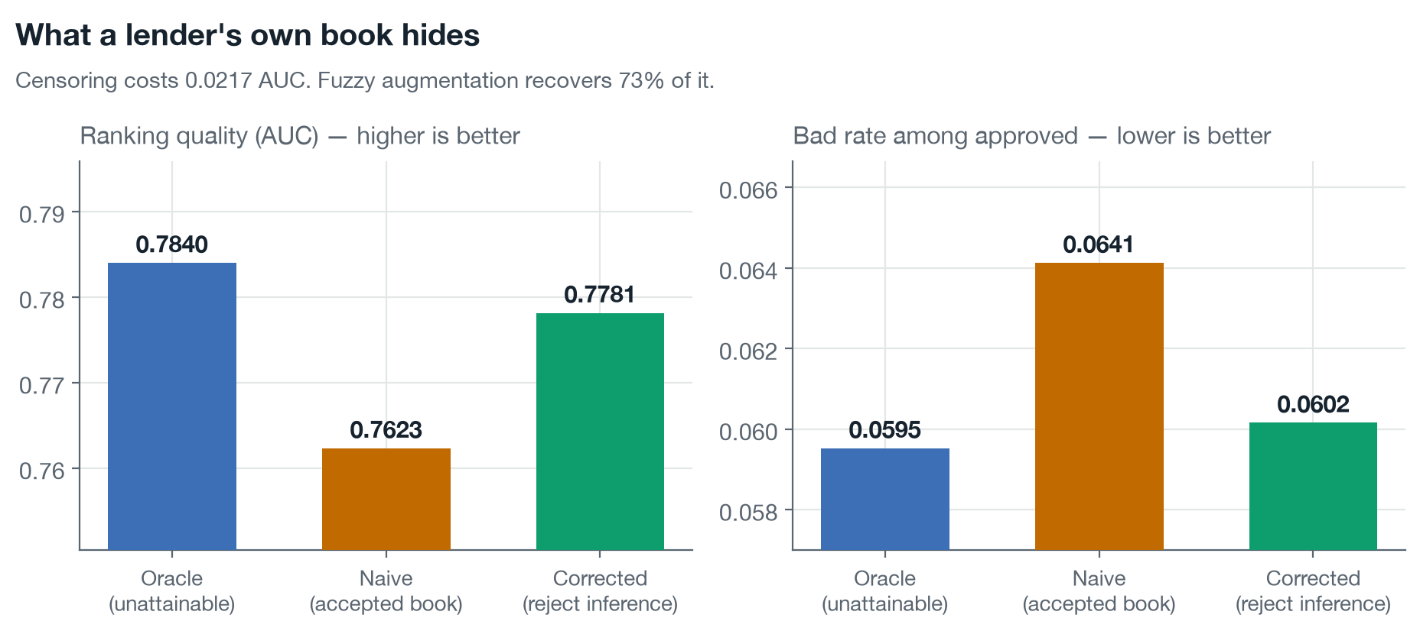
What a lender’s own book hides
Repayment is observed only for applicants a previous policy approved, so the training data is censored. On a real book the damage is unmeasurable. Here it is not.
The accepted book shows a 5.77% bad rate against a true pool rate of 12.00% — a lender reading their own data sees a portfolio six points safer than the one they are underwriting. Fuzzy augmentation recovers 73% of the lost ranking quality.
Notes:
The accepted book shows a 5.77% bad rate against a true pool rate of 12.00% — a lender reading their own data sees a portfolio six points safer than the one they are underwriting. Fuzzy augmentation recovers 73% of the lost ranking quality.

Slide 18
Reason codes that faithfully decompose the model
A real decline. Contributions in log-odds, aggregated back to features a person recognises.
1. Days with very low balance 40 of 90
5.2 × 10⁻¹⁵
TreeSHAP additivity error
2. Utility bill punctuality 35%
The reason codes sum exactly to the model's output. They are the decomposition, not an approximation of it.
3. Income regularity 26%
An earlier build let the booster split categoricals natively. TreeSHAP mis-attributed those splits by up to 0.24 log-odds — enough to reorder an applicant's reasons. One-hot encoding every split cost 0.001 AUC and made the attribution exact. Under the Fair Practices Code an unfaithful reason is a compliance failure, not a cosmetic one.
In favour · declared income ₹5,000
Notes:
The 0.24 story is worth telling. It shows the difference between a system that displays an explanation and one that can defend it.

Slide 19
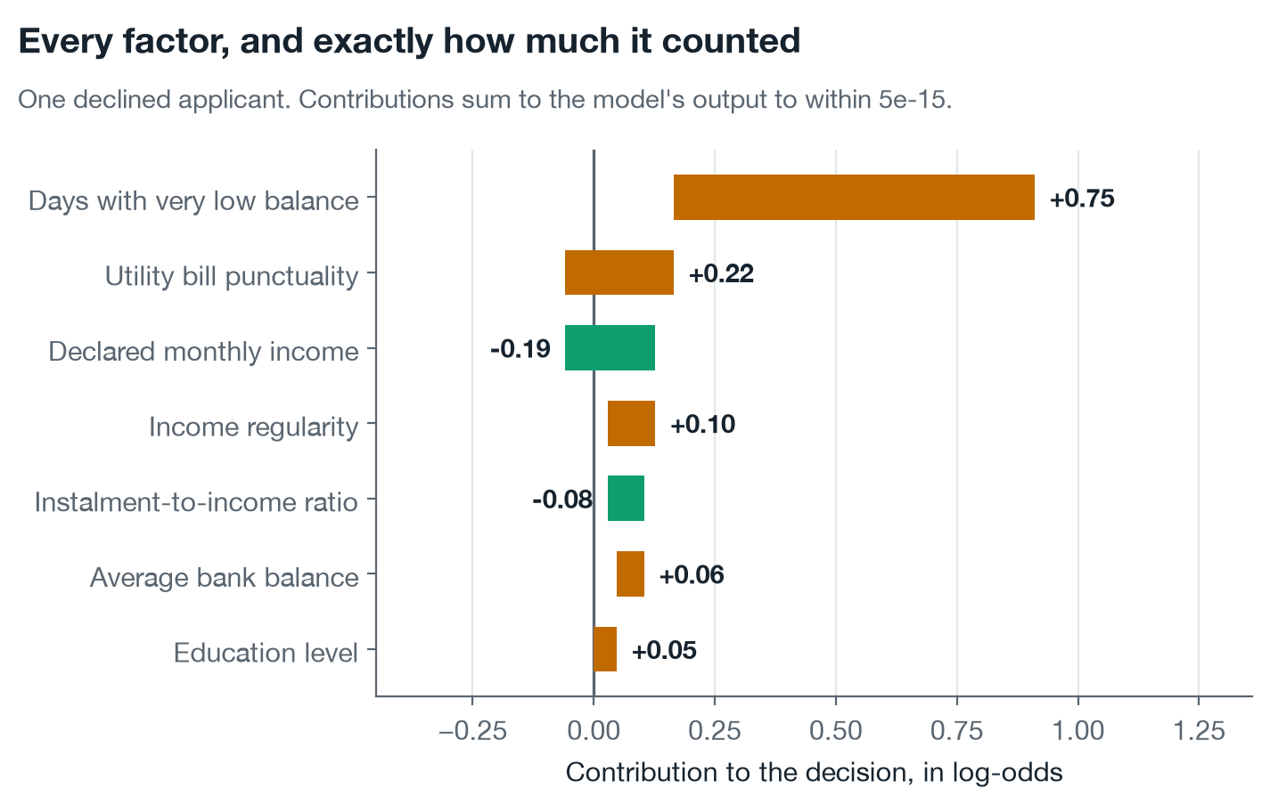
Every factor, and exactly how much it counted
One declined applicant, decomposed. Bars to the right pushed toward decline; bars to the left pushed toward approval.
These are not importances or approximations. They are the model’s output taken apart and put back together, summing to within 5×10⁻¹⁵ of the score itself.
Notes:
These are not importances or approximations. They are the model’s output taken apart and put back together, summing to within 5×10⁻¹⁵ of the score itself.

Slide 20
A decline that comes with a plan
Every option below is a genuine counterfactual: the feature is moved, the applicant is re-scored by the same model, and only changes that actually flip the decision are shown.
₹
⏱
↑
Requested amount
₹97,300 → ₹43,100
Tenure
6 months → 14 months
Recharge regularity
34% → 40%
Requesting less lowers the monthly instalment.
A longer term reduces each instalment.
A consistent recharge schedule builds this signal. Takes one to three months.
Only what they can move. Age, education and employment sector are never suggested. Advising someone to be older is not recourse.
Only what they can reach. Targets are capped at the 85th percentile of the population, and “no attainable change” is reported honestly rather than padded.
Derived features are excluded deliberately: “lower your instalment-to-income ratio” is not an action; borrow less and repay over longer are, and both are offered
Notes:
Derived features are excluded deliberately. Lower your instalment-to-income ratio is not an action; borrow less and repay over longer are, and both are offered.

Slide 21
The regulation demanded the feature anyway
37 provisions from five Indian instruments, embedded locally and retrieved per decision, so every notice cites the rule that governs it.
1
2
3
4
5
RBI Fair Practices
RBI Digital Lending
DPDP Act 2023
Account Aggregator
CIC Act 2005
Reasons for rejection must be conveyed — automated or not
Need-based data, Key Fact Statement, explainable models
Consent, purpose limitation, minimisation, erasure
The consented rail alternative data legally travels on
Absence of a bureau record is not adverse history
RETRIEVED FOR A LIVE DECLINE
[FPC-01] Reasons for rejection must be communicated [DL-04] Borrower's right to reject data collection [CIC-04] Absence of a bureau record is not evidence of poor credit conduct
Provisions are labelled paraphrases citing the real instrument — seeding a corpus with invented quotations would be the hallucination this design prevents
Notes:
CIC-04 is the one to point at: the regulation itself says absence of history is not adverse history. The architecture is enforcing something the law already asserts.

Slide 22
What the applicant actually reads
Produced live by Gemini from the finished decision. Every figure in it comes from the facts block; the model added no numbers of its own.
Narrated by
We are writing to inform you that your loan application has been declined. As you are new to formal credit, we assessed your application based on your financial habits rather than a credit bureau record [CIC-04].
Our assessment identified a few areas that prevented approval. Your monthly instalment amount is currently too high relative to your income of
Rs 19,600. Additionally, we noted that your utility bills are often paid late and your mobile recharge pattern is irregular.
To improve your chances for future applications, you could request a smaller loan amount, such as
Rs 43,098, or choose a longer repayment period of approximately 14 months. Both steps would lower your monthly instalment.
In accordance with the RBI Fair Practices Code, we are providing these reasons for your application's decline in writing
[FPC-01].
gemini-3.1-flash-lite
End to end
3.7 seconds
Guardrails
passed
Citations
CIC-04 · FPC-01 · DL-04
Invented facts
none
Rs 43,098 and 14 months are the recourse targets the model computed, re-scored against the real decision boundary — not figures the language model chose
Notes:
Point at the two bracketed citations and the two rupee figures. The citations come from retrieval; the figures come from counterfactual search. The language model supplied only the sentences around them.

Slide 23
What the guardrails actually stop
1
2
3
Decision contradiction
Prompt injection
Personal data leaving
If the model declined and the generated text congratulates the applicant, the lender has mis-communicated a credit decision. Rejected, and the deterministic notice is served instead.
Applicant-influenced values reach the prompt. The system prompt states that the facts block is data, never instruction, and the assembled prompt is scanned before it is sent.
Aadhaar, PAN, phone and email patterns are detected inbound and outbound — and the guardrail's own log records the kind found, never the value.
The stronger guarantee is structural
The prompt is assembled only from the decision object, never from the applicant record. There is no code path by which a name, PAN or Aadhaar could reach a third-party model — and the API refuses a request carrying one with a 422. Data minimisation by construction, not by promise.
Notes:
Detection is defence in depth. The real guarantee is that the sensitive data is never in the room.

Slide 24
Guardrails, demonstrated against the live model
Five scenarios run against the real service. In every blocked case the applicant still received the decision, the reasons, the recourse and the citations — the guardrail removes the wording, never the substance.
1
Normal decline
allowed
Gemini narrates. Nothing blocked.
2
Injection in a field that is not a top reason
never reached it
The prompt carries only the top reason codes, so the poisoned value never reaches the model.
3
Injection in a field that IS a top reason
blocked
The value reaches the prompt and the inbound guardrail rejects it.
4
Model contradicts the decision
blocked
A provider congratulates an applicant the model declined.
5
Model leaks a phone number
blocked
A provider puts an identifier into applicant-facing text.
Writing this demonstration corrected a claim we had wrong: scenario 2 was first recorded as a guardrail failure. It is not — nothing needed blocking, because nothing got through.
Notes:
Scenario 2 is the interesting one. Data minimisation is the primary defence and the guardrail is the backstop. Say that we found this by testing rather than by assuming.

Slide 25
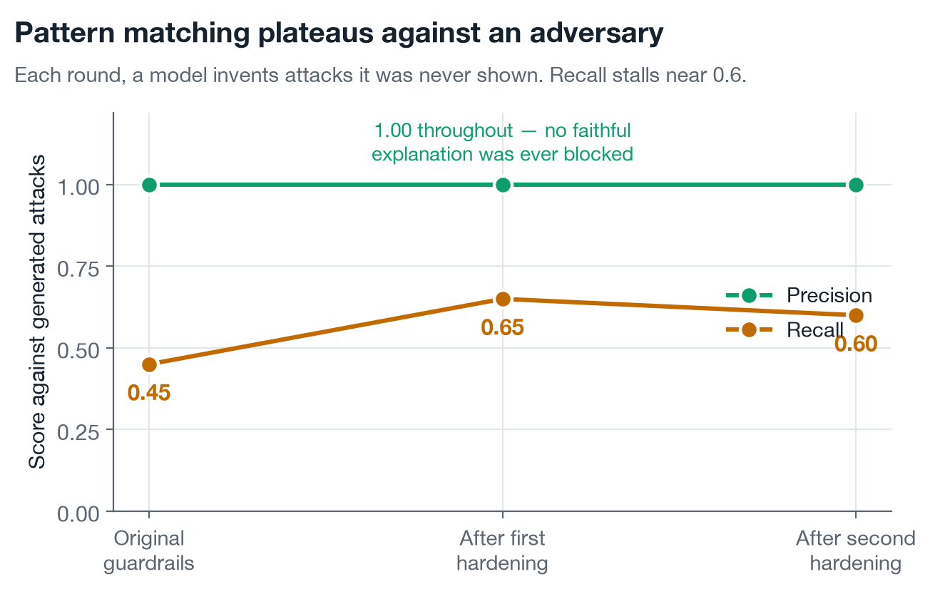
We asked a model to attack the guardrails
Each round, a language model invents attacks it has never been shown, and is not told what the detectors look for. The guardrails are then hardened and tested again on fresh attacks.
Recall does not climb toward 1.0 — it plateaus near 0.6. Patching catches that round’s phrasings; the next round finds new categories. Pattern matching is an arms race a regular expression does not win, and the honest score is 0.6, not the 1.000 our own test set reports.
Notes:
Recall does not climb toward 1.0 — it plateaus near 0.6. Patching catches that round’s phrasings; the next round finds new categories. Pattern matching is an arms race a regular expression does not win, and the honest score is 0.6, not the 1.000 our own test set reports.

Slide 26
Measured, not asserted
An evaluation harness turns the system's claims into numbers, regenerable in one command, with no API key or database required.
100%
1.000
0.0073
103
Relevant provision in top 3
Guardrail F1
Expected calibration error
Tests, 89% coverage
Across 28 golden queries. 92.9% at rank 1, MRR 0.958. The two rank-1 misses are listed in the report.
Over 23 adversarial and benign cases. Benign cases count equally — a guardrail that blocks valid explanations breaks the duty to give reasons.
A stated 8% risk lands within 0.7 points of the observed rate, so the probability is usable for pricing, not just ranking.
Defending the invariants that were expensive to get right, not asserting that code runs.
Stated plainly: that guardrail F1 is on 23 cases I wrote myself. It shows the guardrails catch the attacks I anticipated — not that they catch all attacks.
Notes:
Volunteer the caveat before anyone asks. A candidate who marks their own homework and says so is more trustworthy than one reporting a perfect score.

Slide 27
Explainability is not a latency trade
A decision is made while an applicant waits, so the cost of every guarantee is a product constraint rather than a footnote. Measured per applicant on CPU, p50.
Score only
3.18 ms
Score + exact SHAP reason codes
3.52 ms
Retrieve the governing provisions
2.93 ms
Render the full compliant notice
3.68 ms
Search for actionable recourse
75.92 ms
Exact reason codes cost 0.34 ms. A complete, explained, cited decision lands in about 10 ms — about 86 ms when it also computes recourse.
The language model is excluded. It is off the decision path and its latency belongs to a third-party API. Measured separately: 2.8 s mean, 10 of 10 live calls.
Notes:
The 0.34 ms number is the one to say out loud. It kills the assumption that a lender trades latency for explainability.

Slide 28
Engineering decisions worth defending
→
✕
∅
FastAPI, under “or equivalent”
No compiled system dependency
Missingness is signal
Same layered shape as Spring Boot: router → service → repository, Pydantic DTOs, generated OpenAPI. Chosen to be defensible in review, not to avoid Java.
LightGBM and XGBoost link libomp on macOS and fail without Homebrew — for us and for a grader. scikit-learn installs anywhere.
An absent bureau score is not a data defect to impute away — it is the defining fact about a thin-file applicant. It reaches the model as NaN.
☁
⚿
◉
Bedrock-ready, honestly labelled
Security posture
Embeddings run locally
Four providers behind one interface, selected by env var. The Bedrock adapter is wired but never run live — we had no AWS access, and this deck says so.
No secret has a default; a placeholder JWT secret fails startup. Role-scoped responses omit internals rather than nulling them.
ONNX on CPU: no text leaves the machine, no per-query cost, and deterministic vectors so an audited retrieval can be reproduced later.
Notes:
Each of these is a trade-off with a reason attached. That is what separates a considered build from a generated one.

Slide 29
How alternative data legally reaches a lender in India
The Account Aggregator framework is the consented rail this data travels on. Modelling it properly is what separates “we use alternative data” from a system a regulator would recognise.
Applicant
Account Aggregator
Banks and FIPs
Lender (FIU)
E3F0E9
FFFFFF
FFFFFF
E3F0E9
grants consent, and may revoke it at any time
moves the data and may not read, store or resell it
release only what the consent artefact names
may use it only for the purpose recorded
THE CONSENT ARTEFACT RECORDS
Purpose
Data types
Duration
Frequency
Revocation
credit assessment, and nothing else
only the accounts named
an expiry, not indefinite
how often it may be pulled
withdrawable at any time
[DL-02] Data collection must be need-based and consented
[AA-05] Purpose limitation binds the recipient
[DPDP-04] Only the personal data necessary may be collected
[DPDP-05] Consent is freely revocable
The system never receives an identifier: no name, PAN, Aadhaar or phone number, and the API refuses a request that carries one
Notes:
This slide is the India domain knowledge. Most submissions will say they use alternative data; almost none will name the rail it legally travels on or model the consent artefact.

Slide 30
Security and privacy, by construction
Each of these is a structural property rather than a policy someone has to remember.
1
No identifier can reach a third party
2
The API refuses data it does not need
The prompt is assembled only from the decision object, never the applicant record. There is no code path by which a name, PAN or Aadhaar could be sent to a provider.
extra="forbid" on the request schema, so an application carrying a PAN is rejected with a 422 rather than quietly accepted and ignored.
3
No secret has a usable default
4
Roles omit rather than blank
A placeholder JWT secret fails startup. Demo passwords absent from the environment are generated per run and printed once.
An applicant response carries no trace of the probability, threshold, contributions or provenance — the fields are absent, not nulled.
5
Failures do not leak internals
6
Embeddings never leave the host
Unhandled exceptions are logged in full and returned as a bare 500. Stack traces and file paths never cross the HTTP boundary.
Applicant-facing text is embedded locally through ONNX, so retrieval involves no third-party call at all.
Notes:
The phrase that matters is by construction. Every one of these is enforced by the shape of the code, not by a rule someone has to follow.

Slide 31
What this is not
1
The population is synthetic
Absolute figures describe this population, not the Indian credit market. The direction of the result follows from a mechanism — bureau absence correlates with gender and region while true risk does not — that is well documented in the real world.
2
The regulatory corpus is paraphrased
Plain-language summaries citing real instruments, labelled as such. Production would ingest the official texts with per-clause identifiers; the retrieval machinery is unchanged by that substitution.
3
The cloud layer is designed, not provisioned
No live deployment, and the Bedrock adapter has never run against a real endpoint. Both are stated in the README rather than implied away.
Notes:
Saying this out loud is a strength. Every limitation here is one a reviewer would find in ten minutes anyway.

Slide 32
Everything in this deck is running, and open
Not a prototype on a laptop. Every figure quoted here regenerates from a committed script, and the system serves real decisions over the public internet.
THE RUNNING SYSTEM
pratyaya-beta.vercel.app
Sign in as underwriter / demo-underwriter-pw for the full decision, or applicant / demo-applicant-pw for the view a borrower receives.
THE CODE
github.com/Nishantttt-ui/pratyaya
Public. 34 commits, CI green on every push, 136 tests, README with setup for the API and the interface, and a model card.
136
10
37
0
tests passing
charts
provisions
secrets committed
guarding the invariants that were expensive to get right
each regenerated from a committed measurement file
indexed in pgvector and cited per decision
every credential read from the environment
The API is on a free tier that sleeps when idle; a scheduled request every ten minutes keeps it warm, so the link responds immediately
Notes:
Read both links out. This is the slide that turns a deck into something they can verify for themselves in the room.

Slide 33
WHERE THIS GOES NEXT
Five things I would do with a real portfolio
1
Re-run the inclusion experiment on real data. The finding is a hypothesis with supporting evidence, not a measurement of the market.
2
Handle reject inference. Repayment is only observed for those past policy approved, so the training population is censored.
3
Monitor alternative-data drift. UPI behaviour shifts within a quarter; bureau data does not.
4
Champion/challenger against a WOE scorecard. The format Indian credit teams actually review and sign off.
5
Ingest official regulatory texts. With per-clause identifiers and effective dates, so citations carry versions.
The decision is auditable
The reasons are exact
The applicant gets a plan
LIVE pratyaya-beta.vercel.app CODE github.com/Nishantttt-ui/pratyaya
Notes:
Close on the three chips. They are the promise of the system in nine words.

