Slide 1

Customer Shopping Behavior Analysis
A BI Case Study: From Raw Data to Actionable Dashboard
PROJECT
SCOPE
TOOLS
NISHANTTXX / CUSTOMER_BEHAVIOUR-
DATA ENGINEERING &
POWER BI | SQL |
_DASHBOARD
VISUALIZATION
PYTHON

Slide 2

From business question to dashboard
PHASE 01
PHASE 02
PHASE 03
PHASE 04
Business Brief
Data Engineering
Exploratory Analysis
BI Delivery
Defining the problem: understanding shopping patterns to drive retention and spend.
Interactive Power BI dashboard for real-time stakeholder decision support.
SQL exploration and Python preprocessing to clean 3,900 customer records.
Notebook-based profiling of categories, seasons, and behavioral segments.

Slide 3

The dataset at a glance
3,900
18
Key Dimensions for Analysis
TOTAL RECORDS
DATA DIMENSIONS
Customer ID
Age & Gender
Item & Category
Purchase Amount
Location
Size & Color
50
25
Season
Review Rating
Subscription Status
Shipping Type
US LOCATIONS
ITEM CATEGORIES
Discount Applied
Payment Method
The analysis covers a diverse customer base (Ages 18-70) across multiple behavioral segments, including subscription status, discount usage, and purchase frequency.

Slide 4
The baseline: a $233K customer sample
$233,081
$59.76
3.75 / 5
TOTAL REVENUE
AVG. PURCHASE
AVG. REVIEW RATING
68%
27%
43%
43%
Male Demographic
Subscribers
Discount Usage
Promo Code Adoption

Slide 5

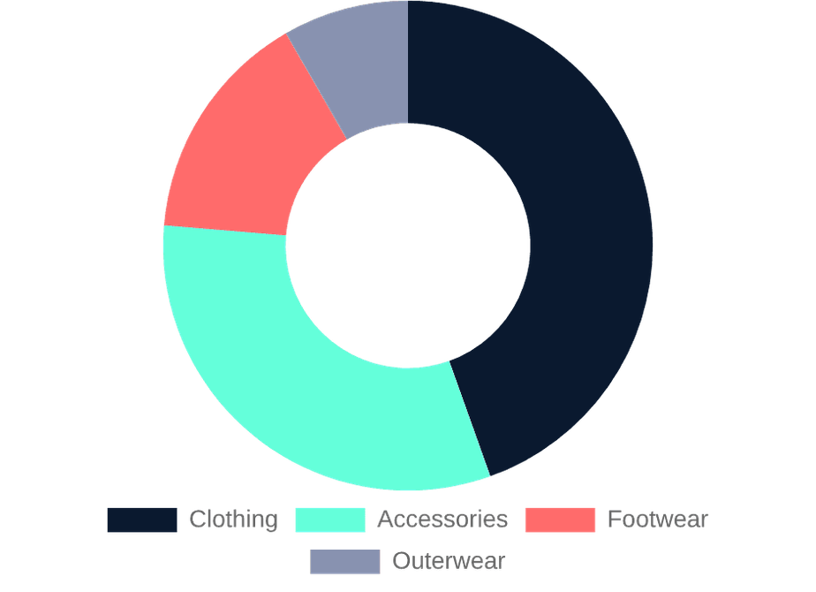
Clothing carries the business
CATEGORY
VOLUME
TOTAL SPEND
Clothing
1,737
$104,264
Accessories
1,240
$74,200
Footwear
599
$36,093
Outerwear
324
$18,524
Clothing accounts for 44.7% of total volume and 44.5% of revenue, maintaining a consistent average spend of ~$60 across all major categories.

Slide 6

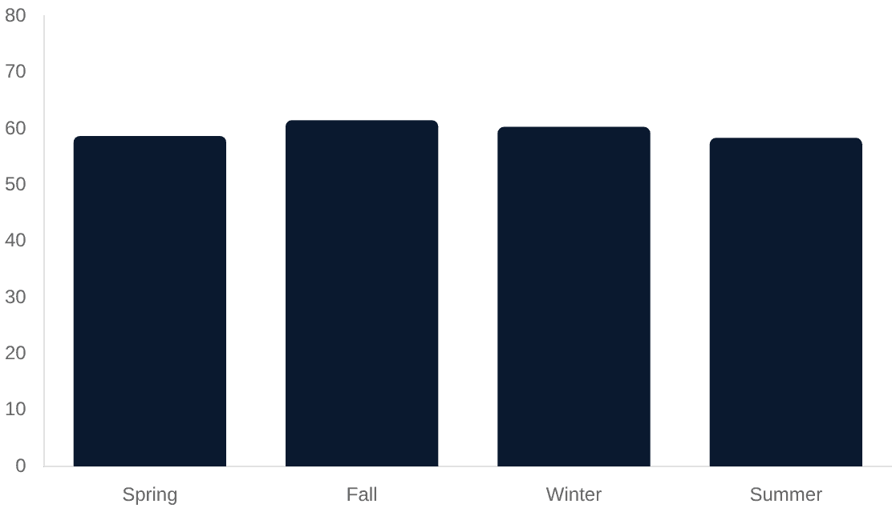
The strongest signals are behavioral
Subscription Parity
Subscribers spend $59.49 on average vs $59.86 for non-subscribers, suggesting subscription is a convenience play rather than a high-spend driver.
Seasonal Stability
Purchase volume is remarkably stable across seasons, with Spring (999) and Fall (975) leading slightly.
Payment Preferences
PayPal and Credit Cards lead, but the split is nearly even across 6 methods, indicating a flexible checkout is critical.

Slide 7
What the dashboard enables
01
Real-time Segmentation
Filter by Age, Gender, and Location to identify high-value pockets instantly.
02
Retention Tracking
Monitor subscription vs. non-subscription spend trends to evaluate loyalty programs.
Power BI Integration
03
Inventory Optimization
The .pbix file in the repository provides the interactive layer for these capabilities, connecting the SQL-processed data to visual KPIs.
Cross-reference Season and Category to predict stock needs for upcoming cycles.

Slide 8

A solid foundation for the next decision
This project demonstrates a complete analytics lifecycle, turning raw shopping data into a structured asset for business intelligence.
Connect
Predict
Act
Integrate live sales feeds to move from static analysis to real-time monitoring.
Apply ML models to the cleaned dataset to forecast individual customer LTV.
Launch targeted A/B tests for the identified "Subscription Parity" segment.

