Slide 1



Slide 2

Team information
Team Name – The Futurists
Name – Kedar Birajdar (Leader)
Branch - CSE
Phone No. – 9552233712
College – N.K.Orchid College of Engineering & Tech Solapur.
Team Member Details:-
1.Name-Piyush Jha Branch - CSE
2.Name-Anil Mali Branch - CSE
3.Name-Nishant Wale Branch - CSE

Slide 3
Problem Statement
Development of AI enabled Battery Management System (BMS).
According to our problem statement we are developing an BMS which was more efficient and more reliable for the commercial & industrial purpose.
As we know that in any electronic device as well as in mainly EV’s the BMS is a main component hence the maximum utilization of power as well as time is important hence we are developing the AI enabled BMS for the maximum efficiency.
We are mainly focusing on power loss in ordinary BMS is 10-15% by using our AI enabled BMS it may reduce and only power loss is approximately 2-8% of the battery backup.

Slide 4
Idea/Approach Details/Solution:-
The aim of this project is to develop an Battery Management System (BMS) for an efficiently power management.
By making some changes in BMS we can interconnect BMS & Raspberry Pi 4 with AI and monitor more efficiently and hence generate more positive output as compared.
For creating BMS we are using Raspberry Pi 4 as a centralized computer for monitoring all activities of BMS.
By using Raspberry Pi 4 OS and AI we can analyse data and by using this data we can estimate Predictive Maintenance with more accuracy and hence reduce cost of maintenance.
Individual battery monitoring is possible by using this AI enabled BMS.
Also by using display the monitoring is possible for offline servicing of the BMS.
Our prototype is Software+Hardware combination.

Slide 5
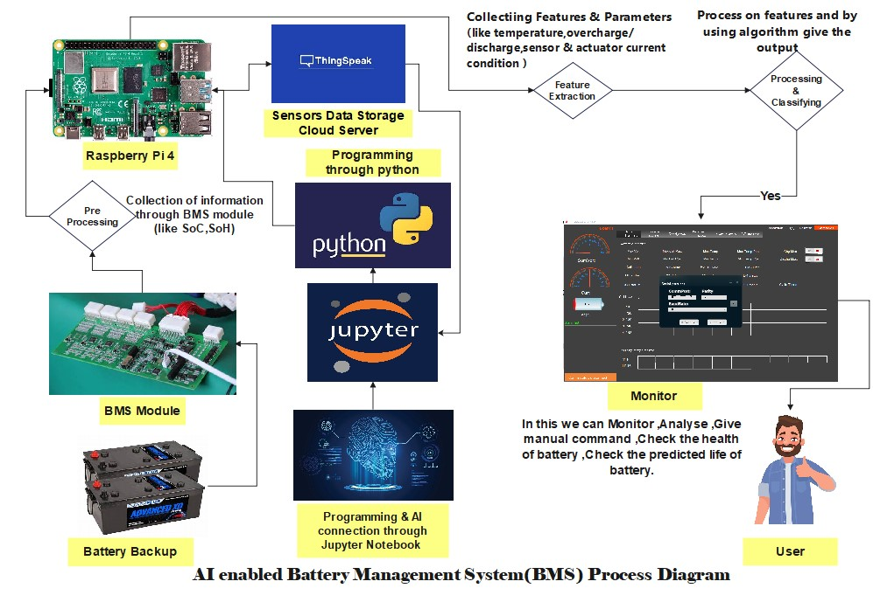

Slide 6

Business ModelB
DEVELOPMENT OF PRODUCT IN FACTORY
DIRECT SERVICE TO THE CUSTOMER(24*7) B2C
FREE MAITENANCE
(ANNUAL SUBSCRIPTIONS)

Slide 7
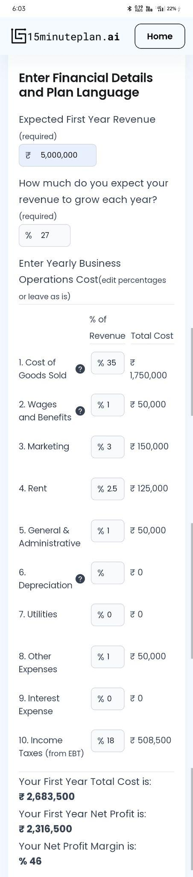

Slide 8
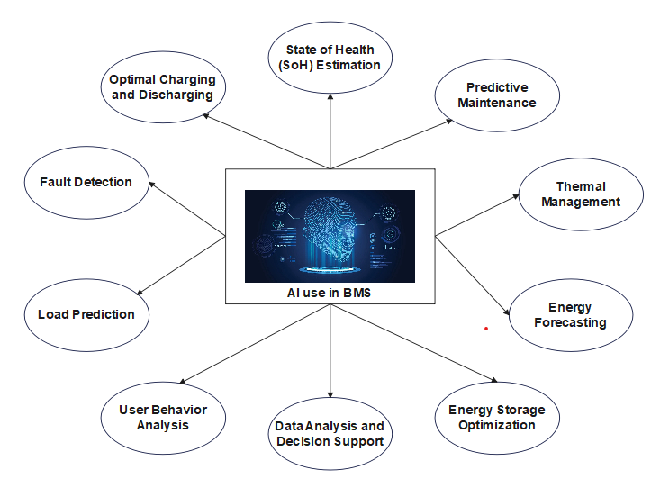

Slide 9
General Problem faced by BMS
Cost: BMS systems can be expensive to implement, especially in large-scale applications.
Power Consumption: BMS components consume power, reducing overall system efficiency.
Size and Weight: BMS components can add bulk and weight to the system.
Fault Tolerance: BMS can be a single point of failure, impacting system safety and performance.
Limited Lifespan: BMS components themselves have a limited operational lifespan.
False Alarms: BMS may trigger false alarms, causing disruptions.
Individual battery monitoring: If we want to detect the failure of an individual battery, then we need to monitor each battery individually.
Microcontroller/Processor: Code is typically written for microcontrollers or processors.
State of Charge (SoC) and State of Health (SoH) Estimation: Algorithms estimate battery health and charge status.
Cell Balancing: Code implements cell balancing algorithms.
Overcharge and Overdischarge Protection: Code controls charging and discharging to prevent overcharging and overdischarging.
Temperature Controal: Code may control cooling or heating systems.
Emergency Shutdown: Code for emergency shutdown procedures.

Slide 10
IMPACT
This will directly impact on the consumption of battery in our day to day lives as well as the battery used for heavy loads(such as in satellites).
Our BMS will help users in many ways from less battery consumption to many more things.
Our BMS will inform the current status of the battery to the user.
Also, if there will be any kind of overload on the battery then our AI will be capable of handling it.
The ordinary BMS power loss in BMS is 10-15% of the battery backup.
By using our BMS it may reduce and only power loss is approximately 2-8% of the battery backup.
It will give expected output like protect from over charge/discharge, false alarm trigger and fault tolerance.
Major factor is safety, Customization, Real time system monitoring and Longevity.

Slide 11
FUTURE SCOPE
AI-enabled battery management systems offer a wide range of potential applications and future prospects. They optimize battery usage in electric vehicles, grid energy storage, renewable energy integration, consumer electronics, and industrial settings. These systems enhance energy efficiency, predict battery health, and enable autonomous decision-making. Future advancements may include more sophisticated predictive analytics, integration with IoT, autonomous optimization, and personalized energy management. Additionally, they will contribute to resilience, reliability, and sustainability in energy systems across various sectors, promising a transformative impact on how we generate, store, and utilize power.
Future Updations:-
1.Automated Distilled Water Filling Mechanism for Lead Acid Batteries.
2.Ideal Temperature Mechanism for different regions.
3.Matlab Analysis using ThingSpeak Colud Data.

Slide 12
CONCLUSION
In the previous BMS which we saw, we had fixed programs and based on those programs there had a limited range and prediction of parameters like SoC,SoH,cell balancing, overcharge/discharge and false alarms.
Our BMS will be capable of reducing the power consumption from less loaded (day to day)to high loaded batteries (high consumptions batterie used in satelite).
Which will mainly focus on the reduction of battery consumption and also managing the battery load..
Now,to overcome these issues we are introducing AI enabled BMS.

