Slide 1
Spotify Analytics Dashboard Report
Music Streaming Insights & Trends
Power BI Project

Slide 2
Introduction & Objective
This project leverages Power BI to analyze Spotify’s music data and transform it into meaningful visual insights. By examining key attributes such as track popularity, artist performance, genre trends, and listener behavior, the dashboard provides a comprehensive view of music consumption patterns on digital streaming platforms. The analysis highlights how data visualization can support better understanding of content performance and audience preferences.
The primary objective of this project is to:
Analyze Spotify music data to identify trends in song popularity and artist influence
Evaluate genre-wise performance and listener engagement patterns
Understand the relationship between track characteristics and popularity
Demonstrate the use of Power BI dashboards for data-driven decision-making in digital music platforms

Slide 3
Tools Used
• Power BI Desktop
• Excel / CSV Dataset
• Data Modeling & Visualization Techniques

Slide 4
Data Structure
The dataset consists of structured Spotify music data capturing key attributes related to tracks, artists, albums, genres, and popularity metrics. It is designed to support multi-level analysis across content performance and listener trends.
Key Components of the Dataset:
Track-level details: track ID, track name, duration (minutes), explicit flag
Artist information: artist name, artist popularity score, follower count
Album attributes: album name, album type (single, album, compilation)
Genre classification: primary and combined genre labels
Popularity metrics: track popularity and artist popularity scores
Time dimension: release year for trend-based analysis
This structured format enables trend analysis, correlation studies, and KPI-based reporting in Power BI.

Slide 5
Data Validation & Cleaning
To ensure accuracy, consistency, and reliability of insights, the dataset underwent a systematic validation and cleaning process before visualization.
Validation & Cleaning Steps Performed:
Verified missing and null values, especially in genre and popularity fields
Standardized track duration values into minutes for consistency
Validated popularity score ranges to ensure logical limits
Identified and categorized undefined or mixed genres (N/A)
Checked consistency between artist popularity and follower count
Ensured uniform formatting of text fields (artist names, genres, album types)
Removed duplicate or inconsistent records where applicable
Outcome:
A clean, reliable dataset ready for Power BI modeling, enabling accurate KPI calculation and meaningful visual insights.

Slide 6
KPI Overview

Slide 7
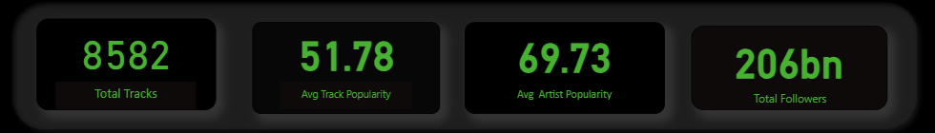
The KPI section provides a high-level summary of Spotify’s music dataset, highlighting key metrics that represent content volume, popularity, artist influence, and track characteristics. These indicators help in quickly assessing overall platform performance and content trends.
Total Tracks – representing the overall volume of songs available in the dataset
Average Track Popularity – indicating the overall popularity level of tracks
Average Artist Popularity – reflecting artist influence and listener engagement
Total Artist Followers – measuring the cumulative audience reach across artists

Slide 8
Visualizations

Slide 9
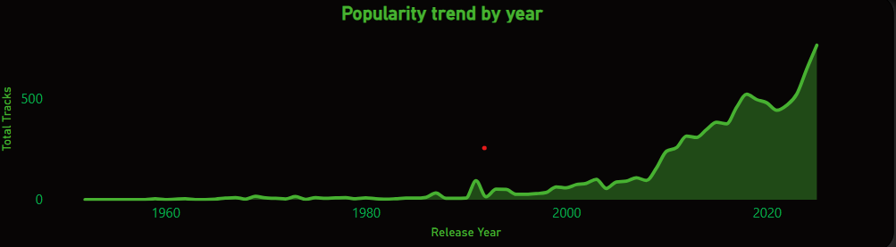
Analysis 1: Popularity Trend by Year
Steady rise in track releases from the late 1990s Reflects growing accessibility of digital music creation and distribution.
Sharp surge after 2000 Driven by the MP3 revolution, online downloads, and global digital reach.
Major acceleration between 2010–2020 Streaming platforms like Spotify dominate, encouraging frequent releases—especially singles.
Rise of independent artists Lower entry barriers allow more creators to publish music without traditional labels.
Recent years show content saturation High volume of releases but tougher competition for visibility and popularity.
Only a small fraction of tracks achieve high popularity Highlights the competitive nature of modern music streaming.

Slide 10
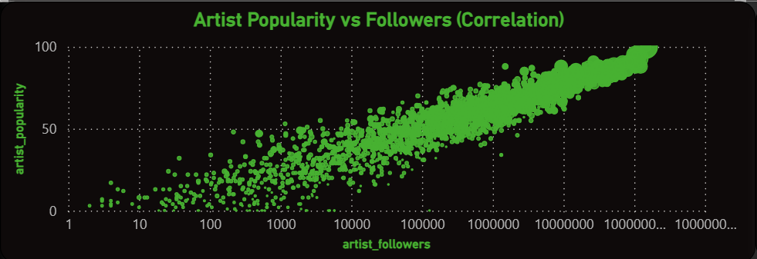
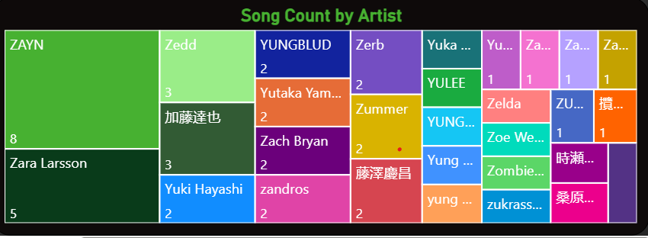
Analysis 2: Artist Performance Analysis
Key Observations
🎤 Top Artists by Followers Taylor Swift, The Weeknd, and Ariana Grande lead in follower count, reflecting strong global fan bases.
📈 Popularity vs Followers Correlation Artists like Billie Eilish and Drake show high popularity scores aligned with large follower counts, while others like Nirvana have lower popularity despite legacy status.
📦 Discography Size vs Popularity A large number of tracks doesn’t always mean higher average popularity — strategic releases matter more than volume.
🔍 Genre Influence on Artist Popularity Artists with genre versatility (e.g., Post Malone, Lady Gaga) maintain strong engagement across diverse audiences.
🧠 Emerging Artists with High Popularity Olivia Rodrigo and Tate McRae demonstrate how newer artists can achieve high popularity with fewer releases.

Slide 11
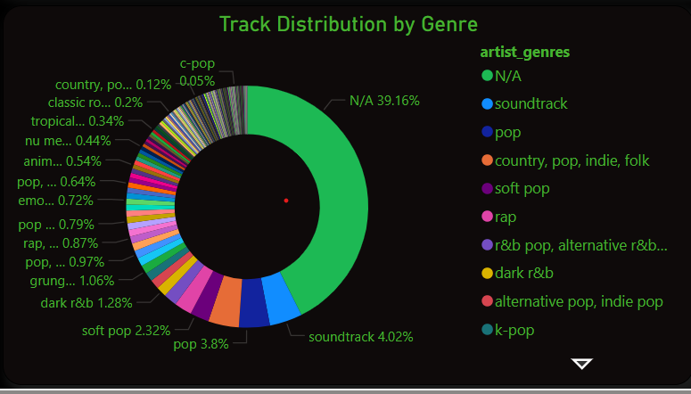
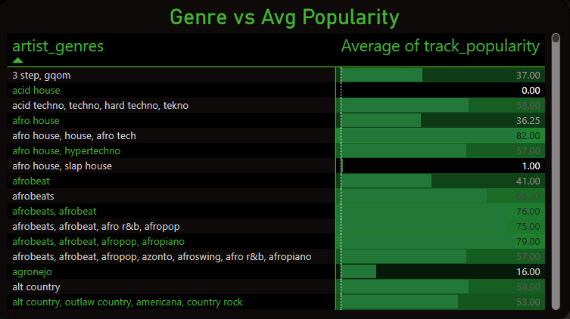
Analysis 3 :Genre Insights
Key Observations:
🎶 Pop, Rock, R&B, and Afrobeats lead in average popularity These genres consistently attract strong listener engagement and dominate top-performing tracks.
📊 Mixed and undefined genres (N/A) form the largest share of total tracks Indicates diverse or blended genre tagging, common in modern music classification.
🔍 High‑popularity niche genres exist Categories like pop soul, alternative R&B, and soft pop show strong average popularity despite smaller track counts.
🌍 Regional and cultural genres show varied performance Genres like Brazilian funk, corrido, and Afrobeat demonstrate strong popularity within their listener communities.
🎧 Genre does influence popularity, but not exclusively Some genres with lower track volume still achieve high average popularity, showing that artist influence and release strategy also play major roles.
🧩 Soundtrack and K‑pop categories show strong distribution presence These genres contribute significantly to track volume, reflecting their global fanbases and media-driven demand.

Slide 12
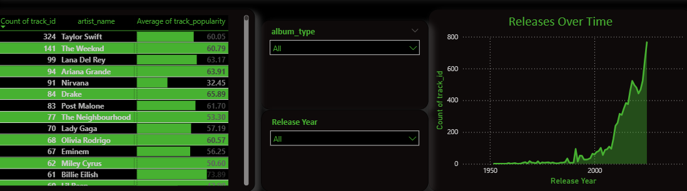
Analysis 4: Album Type Analysis
Key Observations:
💿 Albums have the highest average popularity Full-length albums outperform singles and compilations, indicating stronger listener engagement with complete bodies of work.
🎧 Singles show consistent but moderate popularity They attract steady attention, often used by artists to maintain visibility between major releases.
📉 Compilations have the lowest popularity scores These releases tend to be less impactful, possibly due to mixed content or lower promotional focus.
📊 Track volume varies significantly by artist Artists like Taylor Swift, The Weeknd, and Lana Del Rey contribute heavily to album-based releases, influencing overall popularity trends.

Slide 13
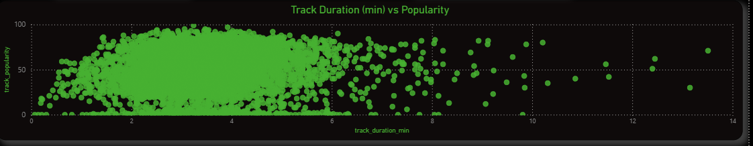
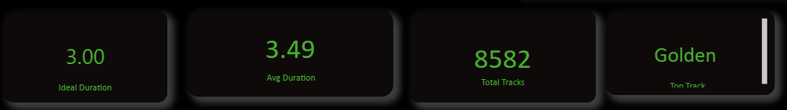
Track Duration vs Popularity
⏱️ Ideal track duration is around 3 minutes This length consistently aligns with higher popularity scores across genres.
• 🎯 Most popular tracks fall between 2.5 to 4 minutes This range balances listener engagement and streaming optimization.
• 📉 Extremely short (<2 min) or long (>6 min) tracks underperform These tend to have lower popularity due to reduced replay value or listener fatigue.
• 📊 Average track duration is 3.49 minutes Slightly above the ideal, indicating a trend toward longer compositions.

Slide 14
Power BI Dashboard

Slide 15
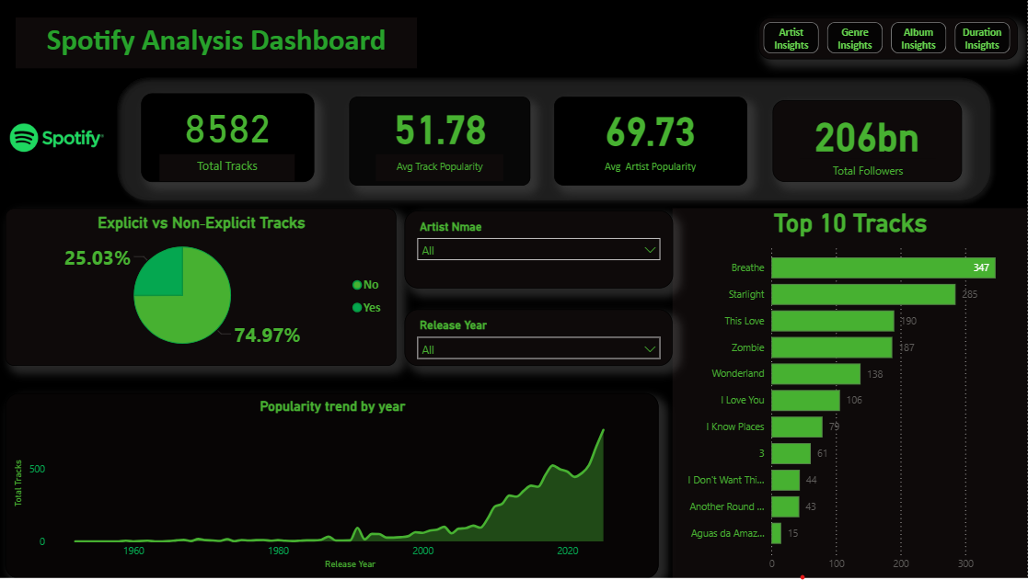

Slide 16
Key Insights
🎤 Artist brand strongly influences popularity Top artists with strong fan bases consistently achieve high popularity scores.
🚫 Non-explicit content dominates the platform Over 74% of 0tracks are non-explicit, indicating broader audience targeting.
📈 Track releases surged post-2000 Reflects the impact of digital distribution and streaming platforms.
💿 Albums outperform singles and compilations Full-length releases show higher average popularity.
⏱️ Ideal track duration is around 3 minutes Tracks between 2.5–4 minutes perform best in terms of popularity.
🎶 Pop, Rock, R&B, and Afrobeats lead genre popularity These genres consistently attract strong listener engagement.
🧠 Content saturation in recent years High release volume makes it harder for tracks to stand out.

Slide 17
Recommendations
Optimize track duration around 3 minutes Tracks between 2.5–4 minutes perform best and gain higher listener engagement.
Strengthen genre tagging for better discoverability Many tracks fall under mixed or undefined genres; clearer tagging improves recommendations and reach.
Encourage new artists to release singles first Singles help build visibility before investing in full albums.
Leverage high‑performing genres like Pop, R&B, and Afrobeats These genres consistently attract strong popularity and can guide release strategy.
Focus on artist branding and audience engagement Strong artist identity directly correlates with higher popularity and follower growth.
Monitor release timing to avoid content saturation Strategic release planning helps tracks stand out in high‑volume periods.

Slide 18
THANK YOU!

