Slide 1


K.RAMAKRISHNAN COLLEGE OF TECHNOLOGY
(AUTONOMOUS), TRICHY
COLLEGE HOSTEL BOOKING SYSTEM
PRESENTED BY SUPERVISOR
NISHAR AHAMED S Mrs.K.Valli Priyadharshini M.E., (PhD),
2303811710421108 AP/CSE.

Slide 2
PRESENTATION OVERVIEW
Objective
Project Introduction
Problem Statement
Methodologies (Programming concepts relevant to problem statement)
Architecture of the proposed system
List of Modules
Merits
Results and Discussion
Queries

Slide 3
OBJECTIVE
To create a College Hostel Booking System that enables students to view available rooms, manage bookings in real-time, prevent overbooking, and provide an admin interface for efficient room management, ensuring transparency and efficiency in the booking process.

Slide 4
PROJECT INTRODUCTION
The College Hostel Booking System is designed to streamline the process of room allocation in college hostels. The system provides an interactive platform for students to check the availability of rooms, book them, and view real-time updates to prevent overbooking. By prioritizing booking requests based on the application date or specific requirements, it ensures fair allocation of rooms.

Slide 5
PROBLEM STATEMENT
Develop a Java application that allows students to view available rooms in real-time. Implement a booking management module that updates room availability upon confirmation of a booking and prioritizes requests based on criteria such as application date or special requirements. Ensure that room assignments are updated in real-time to prevent overbooking.

Slide 6
METHODOLOGIES
Encapsulation: Keeps room data and booking methods together in a class, protecting the data.
Inheritance: Allows sharing common features between Admin and User classes.
Polymorphism: Handles actions like booking or viewing rooms in a consistent way for both Admin and User.
Event Handling:Responds to user actions (like button clicks) for tasks like booking or logging in.

Slide 7
METHODOLOGIES
GUI Programming (AWT):Uses buttons and text fields for easy user interaction.
Exception Handling:Handles errors, ensuring smooth program execution with user-friendly messages.

Slide 8




ARCHITECTURE OF THE PROPOSED SYSTEM
College Hostel Booking System
User Authentication
Login As Admin
Login As User
Booked Rooms
Name
Payment
View Available Rooms
Contact
View Available Rooms
Check-In
Room No
Book Room
Check-Out
Duration

Slide 9
LIST OF MODULES
User Authentication Module
Room Booking Module
View Available Rooms Module
Admin Control Module
Logout Module

Slide 10
MERITS
Allows students to view available rooms in real-time.
Students can book rooms based on availability.
Updates room availability immediately to prevent overbooking.
Provides a login system for both students and administrators.
Administrators can manage room bookings and release rooms.
Handles errors like incorrect inputs.

Slide 11
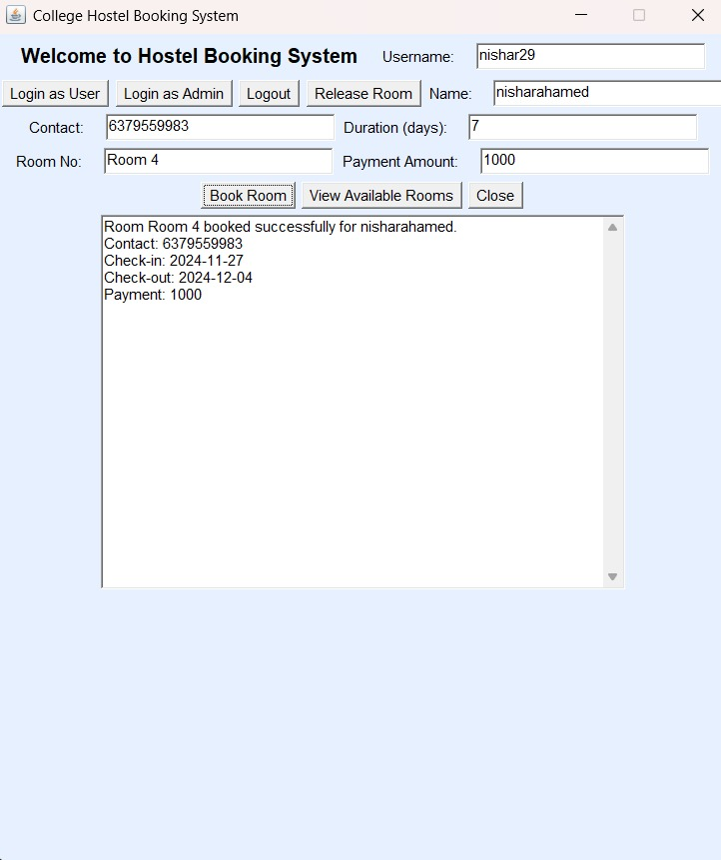
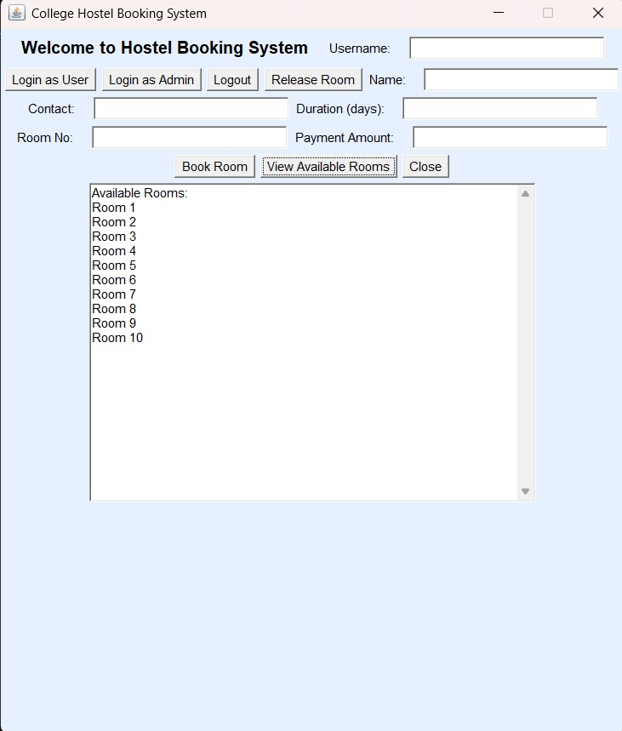
RESULTS AND DISCUSSION
Hostel Room Booking Confirmation Screen
College Hostel Booking System Interface to check the availability of rooms

Slide 12
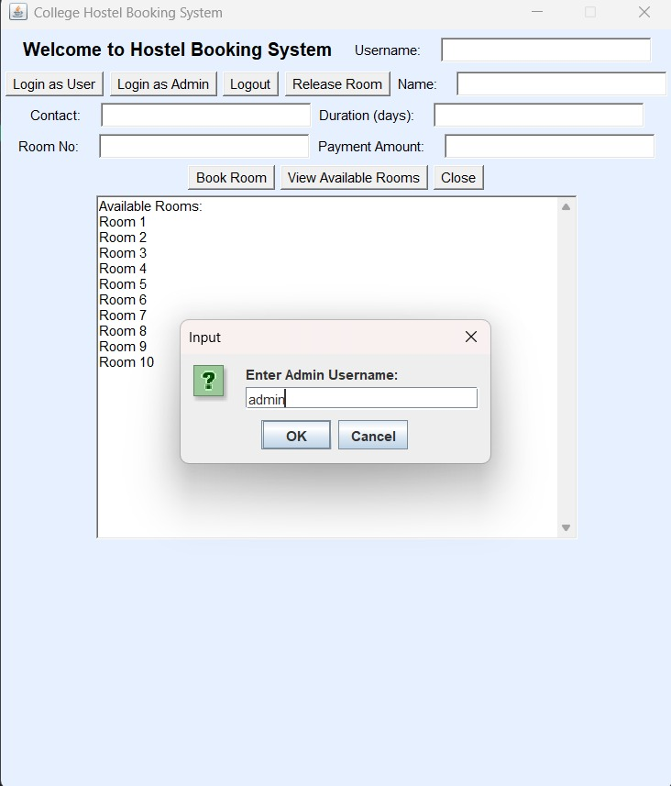
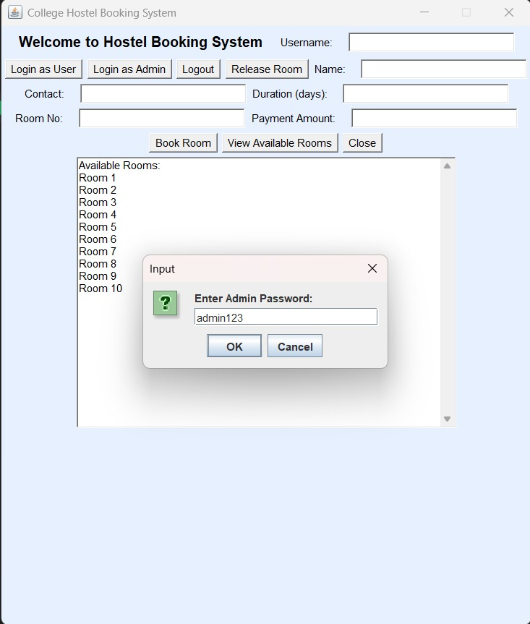
RESULTS AND DISCUSSION
Admin login

Slide 13
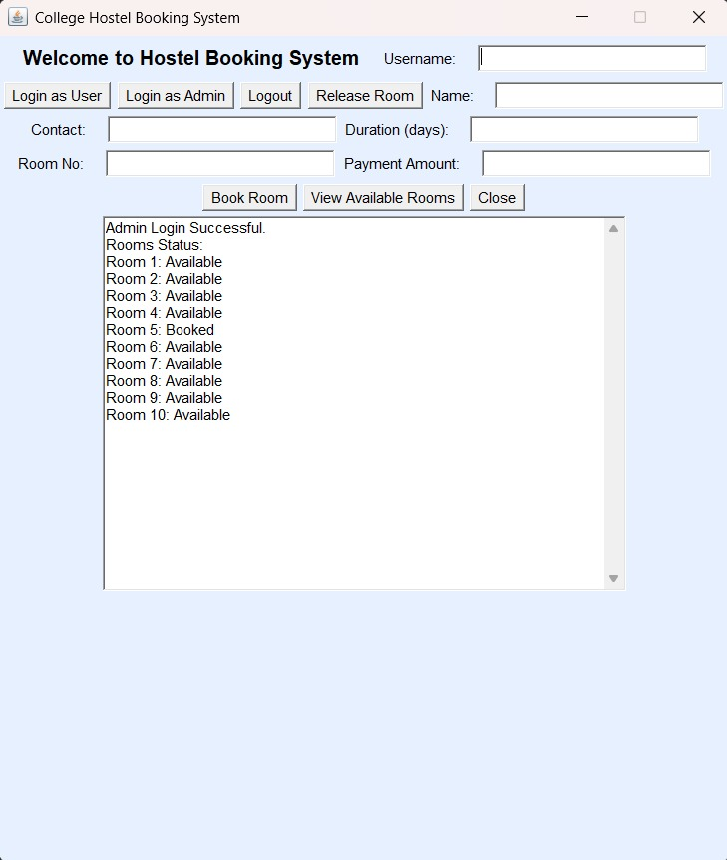
RESULTS AND DISCUSSION
Admin login availability check

Slide 14
QUERIES ?

