Slide 1
Entity Relationship Diagram

Slide 2
What is ER Diagram?
ER Diagram stands for Entity Relationship Diagram, also known as ERD is a diagram that displays the relationship of entity sets stored in a database.
ER Diagrams contain different symbols that use rectangles to represent entities, ovals to define attributes and diamond shapes to represent relationships.

Slide 3
Why use ER Diagrams?
Helps you to define terms related to entity relationship modeling
Provide a preview of how all your tables should connect, what fields are going to be on each table
Helps to describe entities, attributes, relationships
ER diagrams are translatable into relational tables which allows you to build databases quickly
ER diagrams can be used by database designers as a blueprint for implementing data in specific software applications

Slide 4
ER Diagrams Symbols & Notations
Rectangles: This Entity Relationship Diagram symbol represents entity types
Ellipses : Symbol represent attributes
Diamonds: This symbol represents relationship types
Lines: It links attributes to entity types and entity types with other relationship types
Primary key: attributes are underlined
Double Ellipses: Represent multi-valued attributes

Slide 5
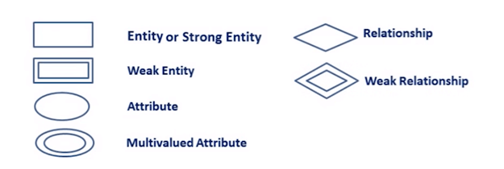

Slide 6
Components of the ER Diagram
Entities
Attributes
Relationships

Slide 7
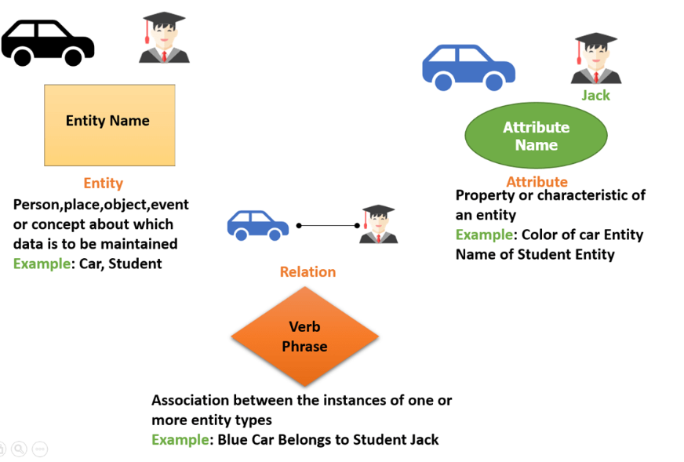

Slide 8
WHAT IS ENTITY?
An entity can be place, person, object, event or a concept, which stores data in the database. The characteristics of entities are must have an attribute, and a unique key. Every entity is made up of some ‘attributes’ which represent that entity.

Slide 9
WHAT IS Attributes?
It is a single-valued property of either an entity-type or a relationship-type.
For example, a lecture might have attributes: time, date, duration, place, etc.
An attribute in ER Diagram examples, is represented by an Ellipse

Slide 10
Types of Attributes Description
Simple attribute Simple attributes can’t be divided any further. For example, a student’s contact number. It is also called an atomic value.
Composite attribute It is possible to break down composite attribute. For example, a student’s full name may be further divided into first name, second name, and last name.
Derived attribute This type of attribute does not include in the physical database. However, their values are derived from other attributes present in the database. For example, age should not be stored directly. Instead, it should be derived from the DOB of that employee.
Multivalued attribute Multivalued attributes can have more than one values. For example, a student can have more than one mobile number, email address, etc.

Slide 11
WHAT IS Cardinality?
Defines the numerical attributes of the relationship between two entities or entity sets.
One-to-One Relationships
One-to-Many Relationships
May to One Relationships
Many-to-Many Relationships

