Slide 1
Mutual Fund Analytics Platform
Bluestock Fintech Capstone Project

Slide 2
Problem Statement & Objectives
Problem Statement
Mutual fund data is fragmented across multiple sources.
Investors struggle to compare funds using risk-adjusted metrics.
Benchmark performance tracking is limited.
Investor behavior insights are often unavailable.
Objectives
Build an automated ETL pipeline.
Design a relational database.
Perform fund performance analysis.
Develop interactive Power BI dashboards.
Generate actionable investment insights.

Slide 3
Data Sources
Datasets Used
Fund Master
NAV History
AUM by Fund House
Monthly SIP Inflows
Category Inflows
Industry Folio Count
Scheme Performance
Investor Transactions
Portfolio Holdings
Benchmark Indices
Sources
AMFI India
mfapi.in
NSE India
BSE India

Slide 4
System Architecture
Data Sources
Data Extraction
Data Cleaning & Transformation
SQLite Databases
EDA & Analytics
Power BI Dashboard
Business Insights

Slide 5
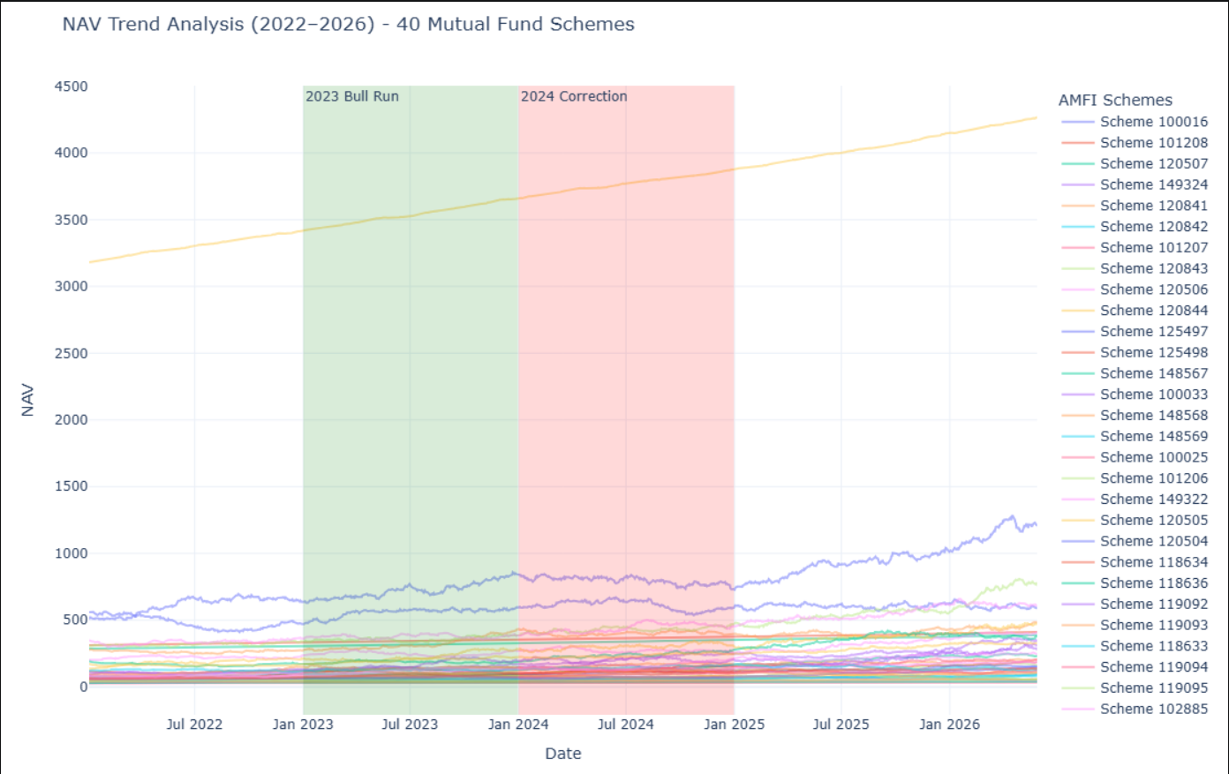
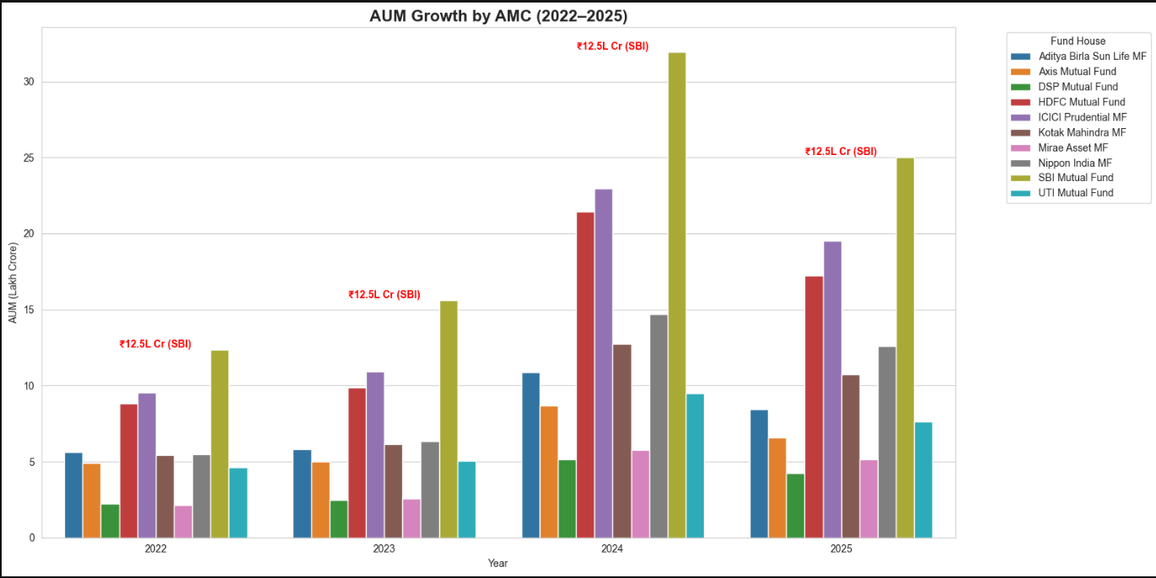
EDA Highlights – NAV & AUM Analysis
NAV Trend Analysis
Analyzed NAV performance from 2022–2026.
Most equity funds showed long-term growth.
Market corrections followed by recovery phases.
AUM Analysis
SBI Mutual Fund remained the largest AMC.
Strong AUM growth observed across fund houses.

Slide 6
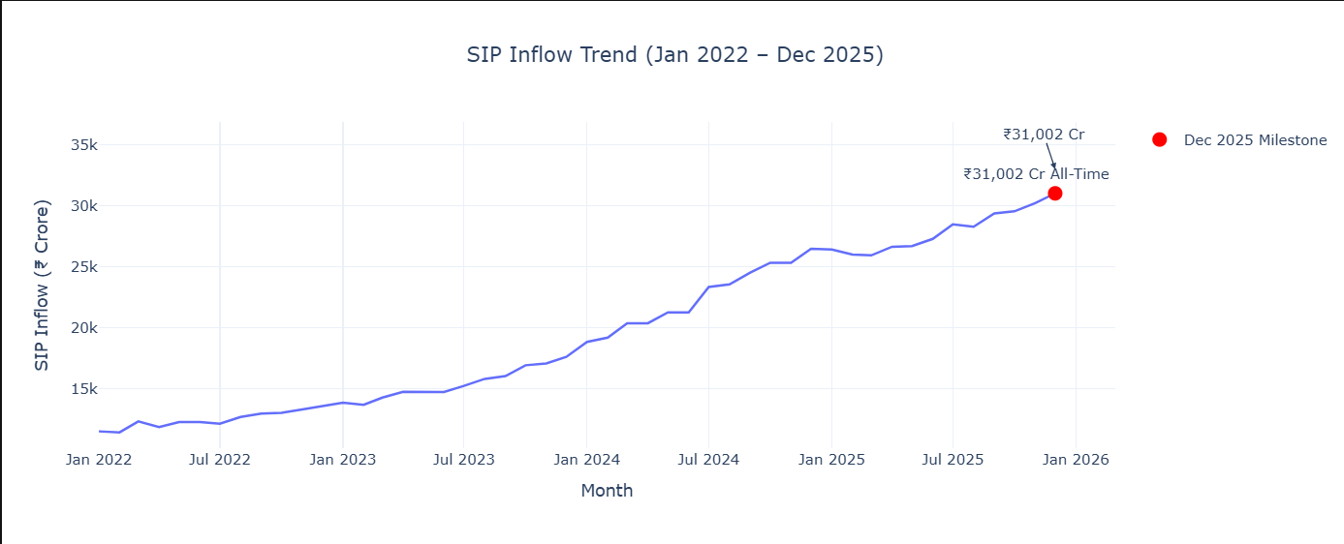
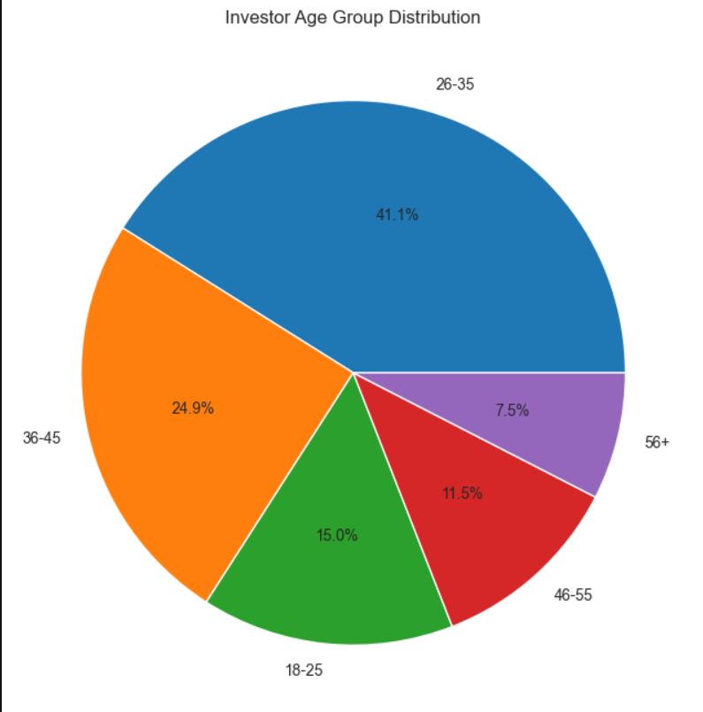
EDA Highlights – SIP & Investor Analysis
SIP Growth
Consistent increase in SIP inflows.
Record SIP inflow of ₹31,002 Crore in Dec 2025.
Investor Analysis
Age group 25–40 contributed most investments.
Maharashtra, Karnataka, and Delhi led transaction volumes.

Slide 7
Fund Performance Metrics
Metrics Calculated
Annualized Return: Measures the average yearly return generated by a fund.
CAGR: Shows the compounded annual growth rate over a specific period.
Sharpe Ratio: Measures risk-adjusted return using total volatility.
Sortino Ratio: Measures risk-adjusted return considering only downside risk.
Alpha: Indicates a fund's excess return compared to its benchmark.
Beta: Measures the fund's sensitivity to overall market movements.
Purpose
Evaluate return generation and risk-adjusted performance.

Slide 8
Advanced Risk Metrics
Risk Analysis
Maximum Drawdown: Largest decline from a fund's peak NAV.
Tracking Error: Measures deviation from benchmark returns.
Value at Risk (VaR): Estimates the maximum expected loss at a 95% confidence level.
Conditional VaR (CVaR): Measures the average loss beyond the VaR threshold.
Advanced Analytics
Rolling Sharpe Ratio: Tracks risk-adjusted performance over time.
Investor Cohort Analysis: Compares investment behavior across investor groups.
SIP Continuity Analysis: Identifies investors at risk of SIP discontinuation.
Sector Concentration Analysis: Evaluates portfolio diversification and concentration risk.

Slide 9
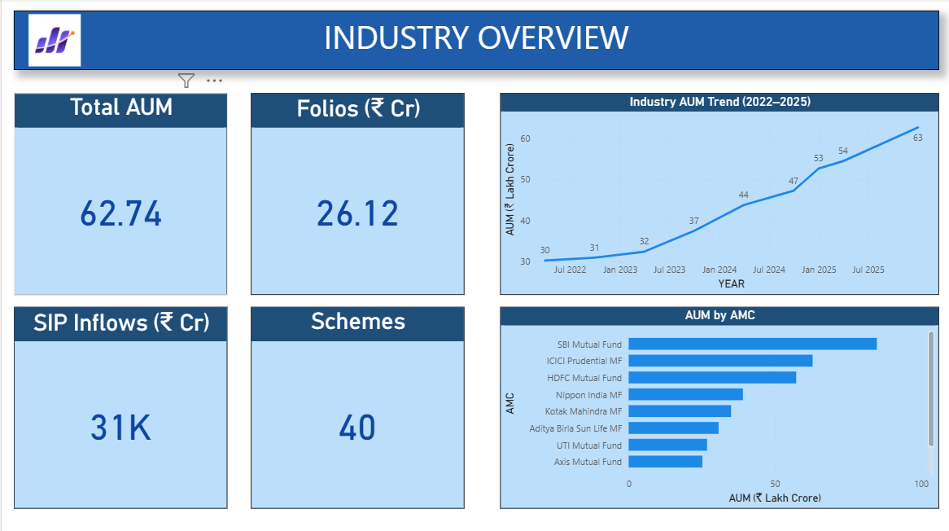
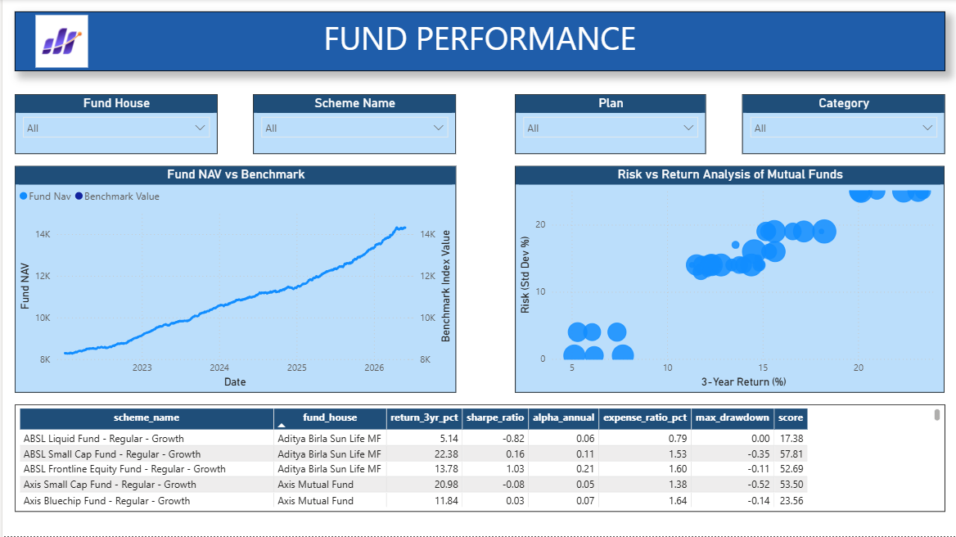
Dashboard – Industry Overview & Fund Performance

Slide 10
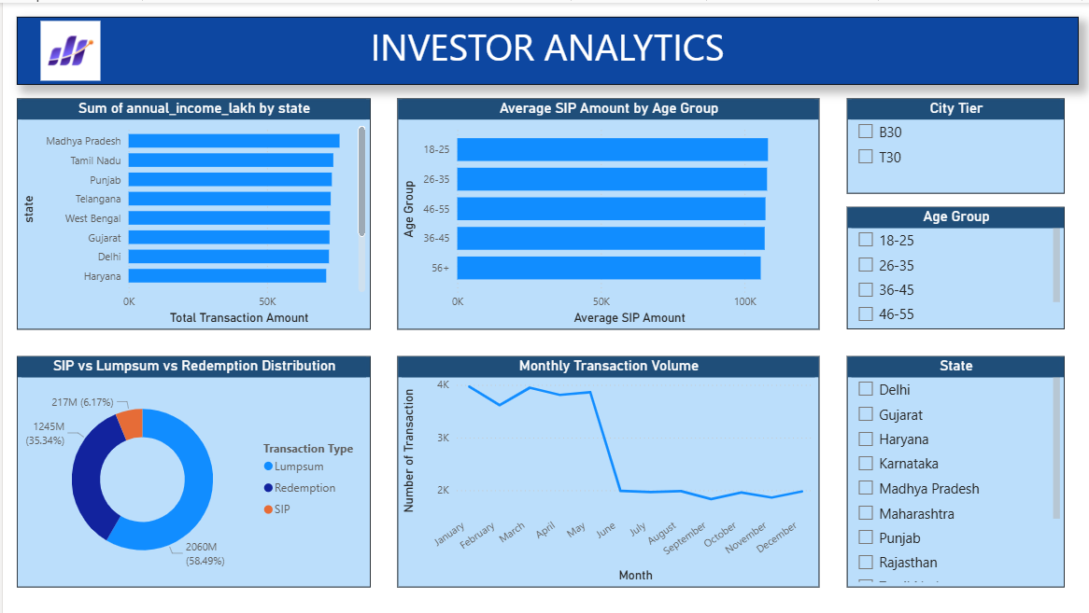
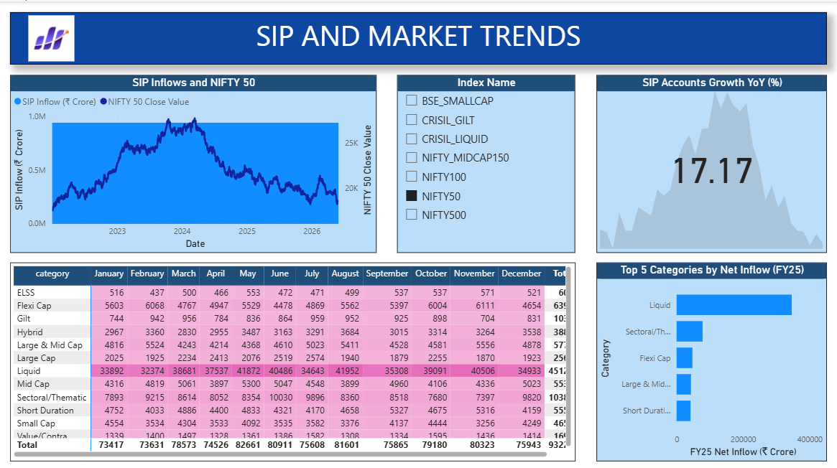
Dashboard – Investor Analytics & SIP and Market Trends

Slide 11
Key Findings
Industry AUM increased significantly from 2022–2025.
SIP inflows reached record levels.
Equity funds generated strong long-term returns.
Younger investors preferred SIP investments.
Several funds demonstrated strong risk-adjusted performance.
Sector concentration analysis identified diversification risks

Slide 12
Thank You !

