Slide 1


CSE 424: PATTERN RECOGNITION
Topic: Pattern Detection and Recognition
Author: S. H. UNGER
Presented by:
Nishat Zerin
23341114

Slide 2
Motivation
Explore possibilities of pattern detection and recognition with digital computers.
Investigate the potential of digital computers in replicating human visual feats.
Understand the capabilities of machines in dealing with visual images.
Aim to bridge the gap between human and machine pattern recognition abilities.
Hypothesize that leveraging digital computers can lead to advancements in replicating human-like visual tasks.

Slide 3
Contribution
Successful implementation of recognition and detection programs on an IBM 704 computer.
Illustrates the potential of digital computers to effectively perform pattern detection and recognition tasks.
Contributes to the exploration of machines replicating human abilities in visual image processing, with a focus on pattern processing.

Slide 4
Methodology
The paper's methodology involves programming an IBM 704 computer to mimic a spatial computer, consisting of a master control unit overseeing logical modules.
The computer is designed to execute pattern detection and recognition tasks, utilizing specific characteristics to differentiate among categories within a finite set.
Input comprises free-hand-drawn figures on coordinate paper, simulated by a key-punch operator through IBM cards.
The program employs logical operations like local averaging, spatial differentiation, and blob counting to identify and classify patterns.
The effectiveness of the methodology is assessed by analyzing the program's results.

Slide 5
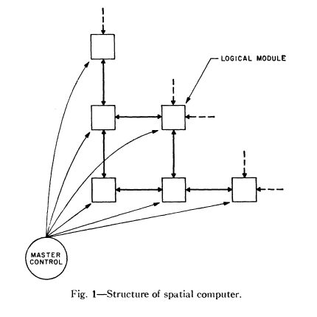
SPAC

Slide 6
L-detection program and the process of detecting L-shaped figures from the input.
IBM 704 computer - simulate SPAC
Quantizing patterns on a grid
36x36 array
Smoothing
Edge sequences
Output- smoothed L-shaped figures.

Slide 7
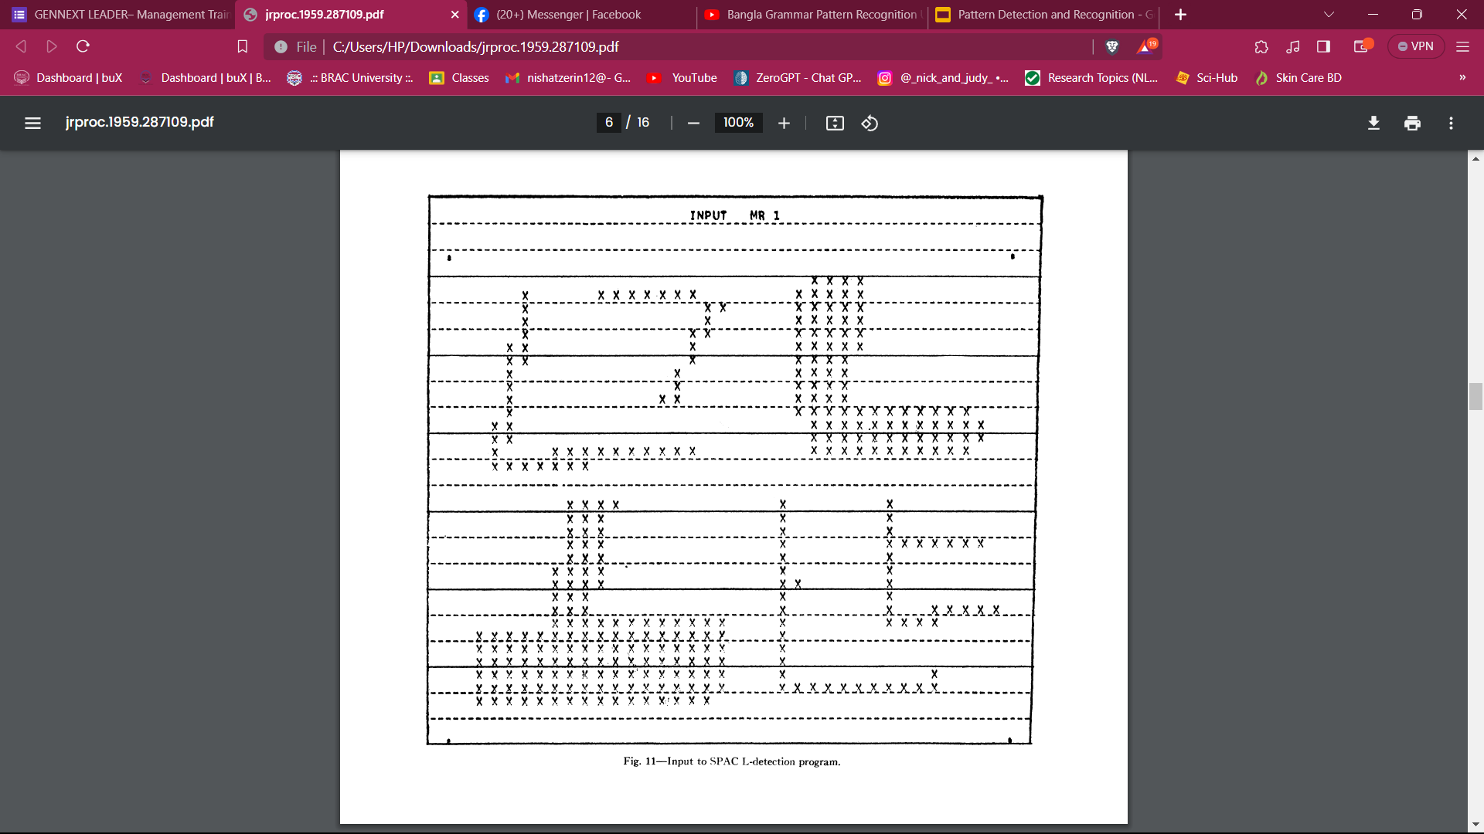
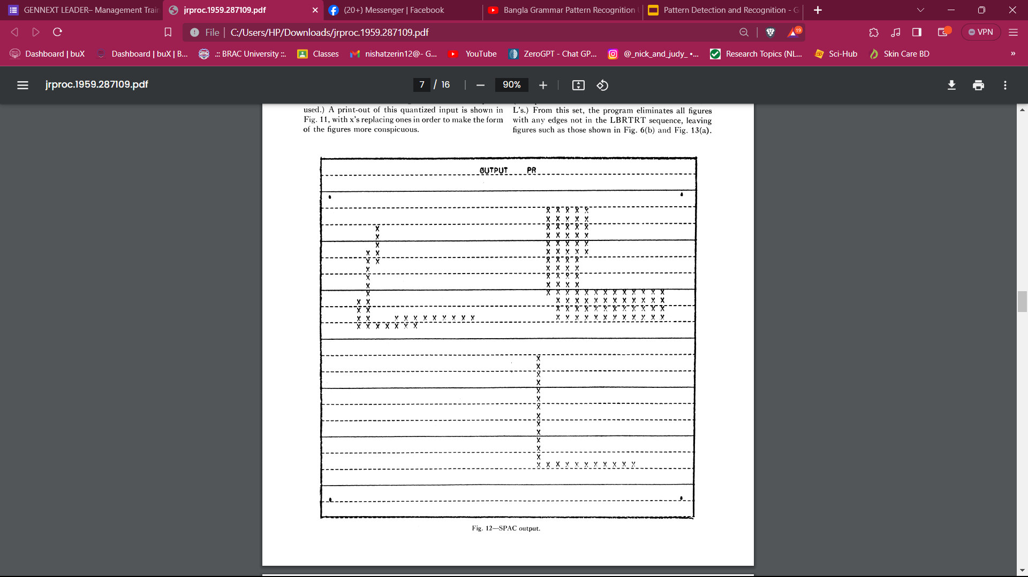
L-detection program and the process of detecting L-shaped figures from the input.
Input to SPAC L-detection program.
SPAC output.

Slide 8
Pattern Recognition
Identifies figures in a finite category set.
Categories have distinguishing characteristics.
Characteristics determine a figure's category.
Questions relate to features (holes, edges).
Sequential process narrows down categories with each question.
Goal: Halve remaining categories per question.
Average questions ≈ log2(number of categories).
Logarithmic approach minimizes questions with equal category likelihood.
t

Slide 9
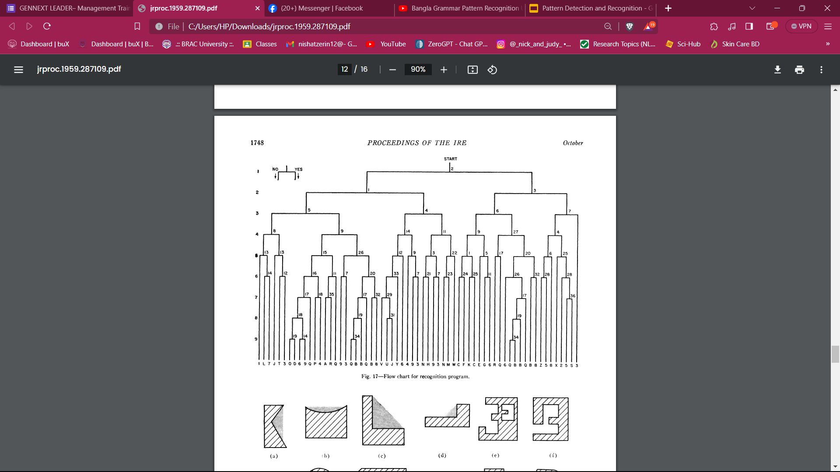
Pattern Recognition
t
Flow chart for recognition program.

Slide 10
SPAC subroutines
Specific instructions in SPAC program.
Used for tests (cavity, edges, holes).
Manipulate memory and processing registers in SPAC matrix.

Slide 11
Conclusion
IBM 704 Computer Execution
Potential of Digital Computers
Replication of Human Feats
Experiments Results
Implications for Research and Development

Slide 12
Limitations
First Limitation/Critique
Small Sample Size: Small set may lack real-world complexity.
Scalability Uncertainty: Methodologies performance on larger, complex datasets unclear. Scalability issues not discussed.
Second Limitation/Critique
Lack of Computational Analysis: No detailed analysis of computational resources, impacting practicality of methodology.
.

Slide 13
Synthesis
Transmit handwritten data to computers without key punch operators
Automatic mail sorting.
Read telephone toll tickets.
Automated translation.
Potential in biological studies and organic chemistry.

Slide 14

THANK YOU !!!

