Slide 1
myEHR
CSE - 618

Slide 2
Presented to
Dr. Md. Hanif Seddiqui
Professor
Department of Computer Science and Engineering
University of Chittagong

Slide 3
Presented by - Mohammad Minhaj Reza Hasan (17701099)
Nishat Soultana Chowdhury (17701021)
Mamun Al Imran (17701072)
Group G

Slide 4
Contents
Motivation
Information Gathering
Features of Our App
Use Case Diagram
Activity Diagram
Class Diagram
System Development Approach
Used Tools / Technologies
Screenshots
Future Works
Questions?

Slide 5
Contents
Motivation
Information Gathering
Features of Our App
Use Case Diagram
Activity Diagram
Class Diagram
System Development Approach
Used Tools / Technologies
Screenshots
Future Works
Questions?

Slide 6
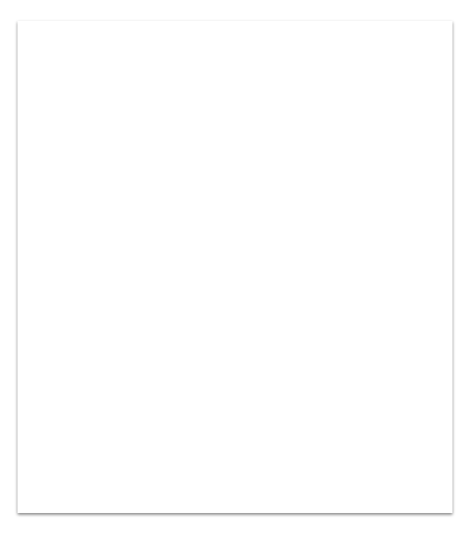
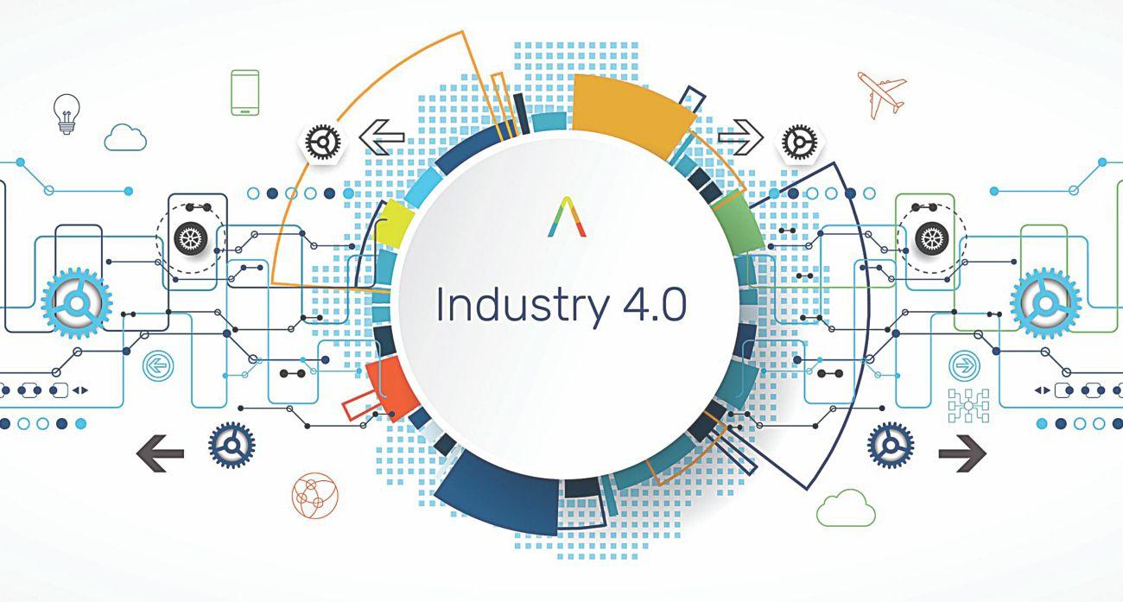
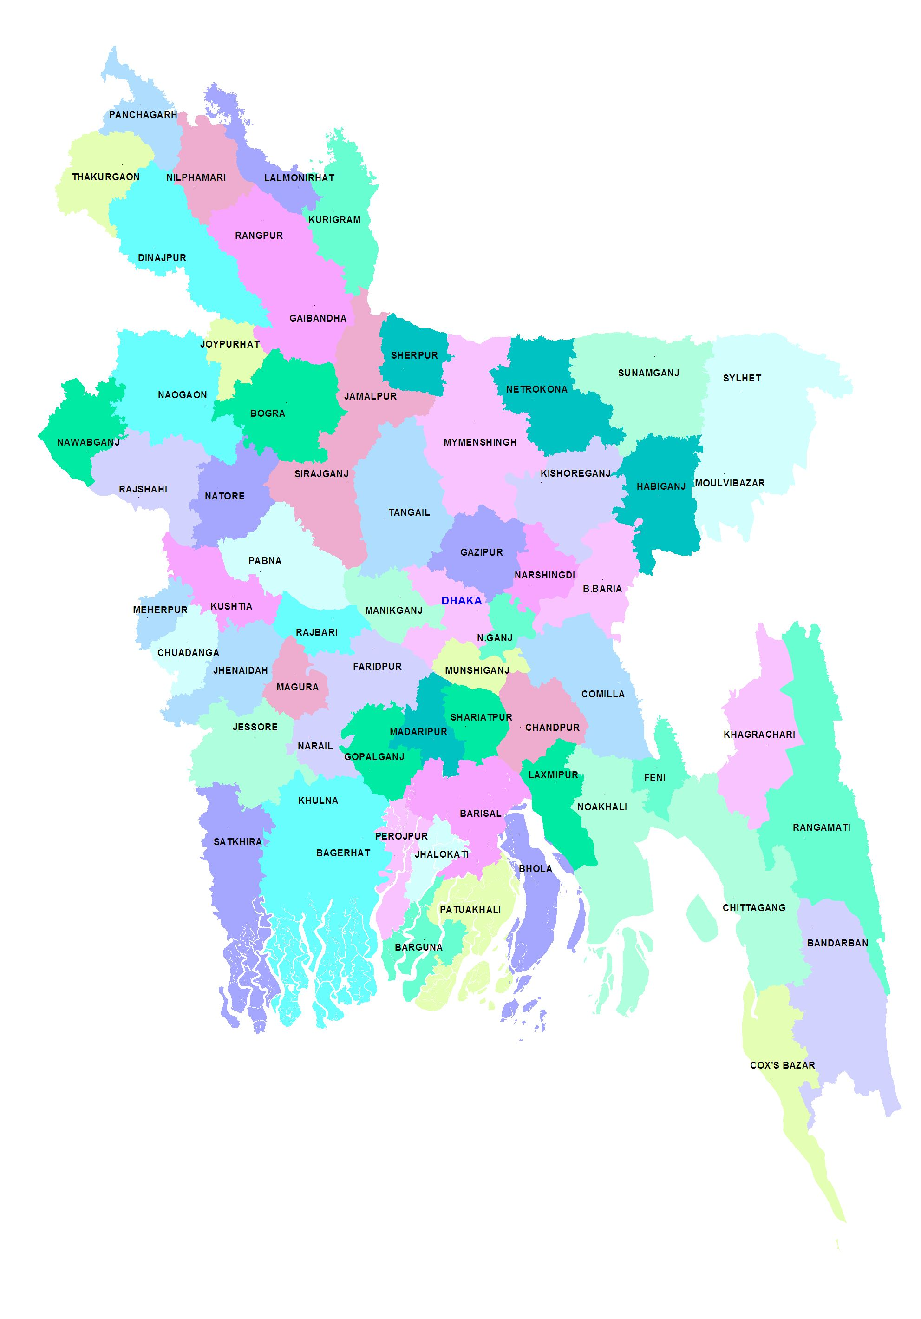
Motivation
Our country conspicuously needs a lot more technological approach for the healthcare sector in the age of 4th Industrial Revolution.
Doctors and patients both suffer due to all the cumbersome healthcare activities here.
Lack of interaction and communication facilities result in huge waste of time and labor. Thus, actual needs of the patients remain unfulfilled.

Slide 7

Motivation
We need
Superior and safer care through the digitally health information exchanging ability.
Faster and secure access to clinical information for empowering both patients and doctors to increase engagement and to improve health outcomes.
We propose an EHR (Electronic Health Records) app for securely recording, storing, retrieving, sharing and analyzing records of individual patient’s healthcare.

Slide 8
Contents
Motivation
Information Gathering
Features of Our App
Use Case Diagram
Activity Diagram
Class Diagram
System Development Approach
Used Tools / Technologies
Screenshots
Future Works
Questions?

Slide 9
Information Gathering
For the solution of our problem we have analyzed these resources:
1. US Health IT Website (www.healthit.gov)
2. US National Center for Biotechnology Information (www.ncbi.nlm.nih.gov)
3. Wikipedia (www.wikipedia.org)
4. Some YouTube (www.youtube.com) videos etc.

Slide 10
Contents
Motivation
Information Gathering
Features of Our App
Use Case Diagram
Activity Diagram
Class Diagram
System Development Approach
Used Tools / Technologies
Screenshots
Future Works
Questions?

Slide 11
Features of Our App
User friendly and simple interface
Easy registration and login
Graphical representation of vital patient data
Patient’s progress notes
E-prescribing capabilities
Maintaining appointments and patient’s lab results
Managing data using real-time database

Slide 12
Contents
Motivation
Information Gathering
Features of Our App
Use Case Diagram
Activity Diagram
Class Diagram
System Development Approach
Used Tools / Technologies
Screenshots
Future Works
Questions?

Slide 13
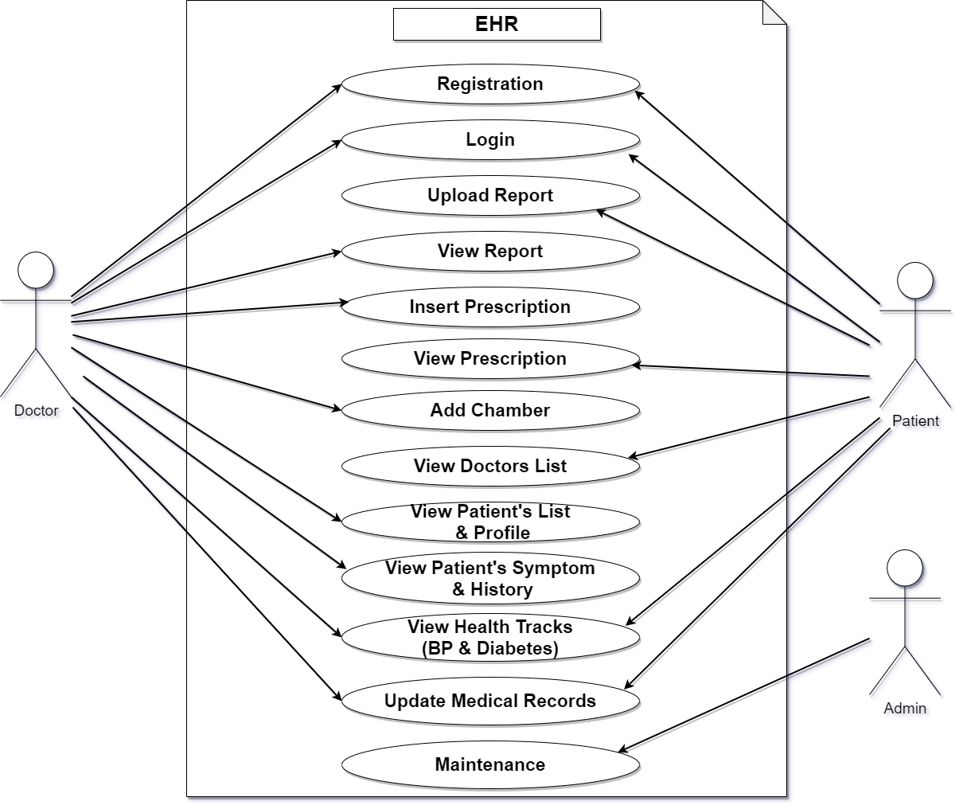
Use Case Diagram

Slide 14
Contents
Motivation
Information Gathering
Features of Our App
Use Case Diagram
Activity Diagram
Class Diagram
System Development Approach
Used Tools / Technologies
Screenshots
Future Works
Questions?

Slide 15
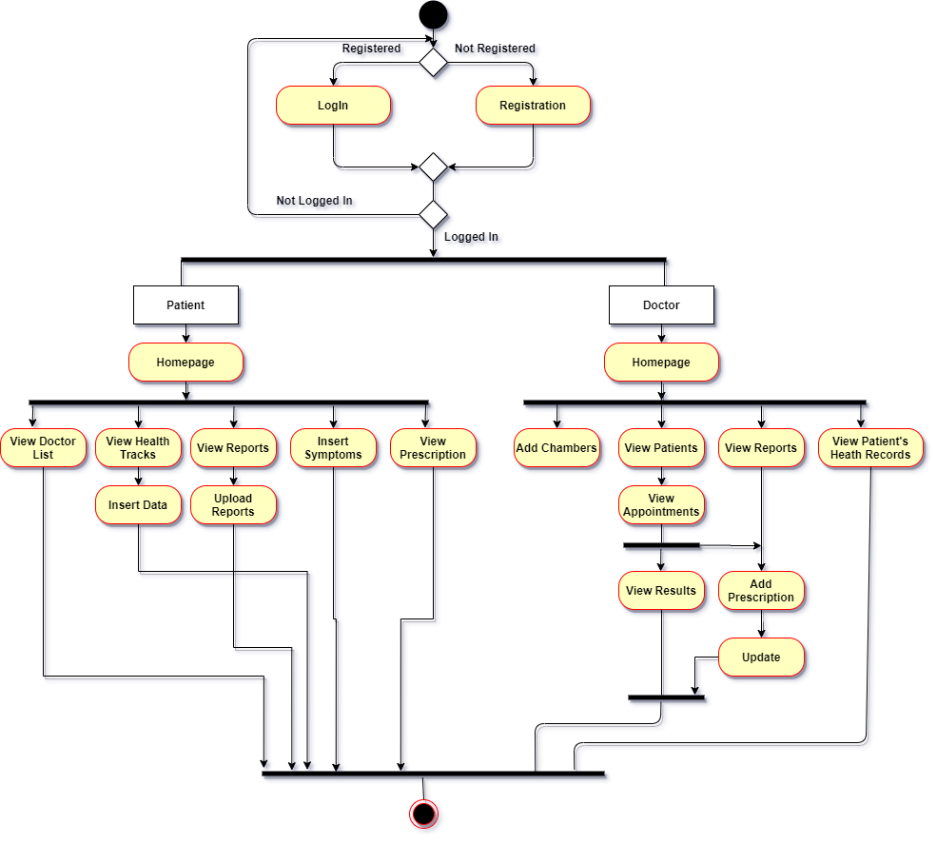
Activity Diagram

Slide 16
Contents
Motivation
Information Gathering
Features of Our App
Use Case Diagram
Activity Diagram
Class Diagram
System Development Approach
Used Tools / Technologies
Screenshots
Future Works
Questions?

Slide 17
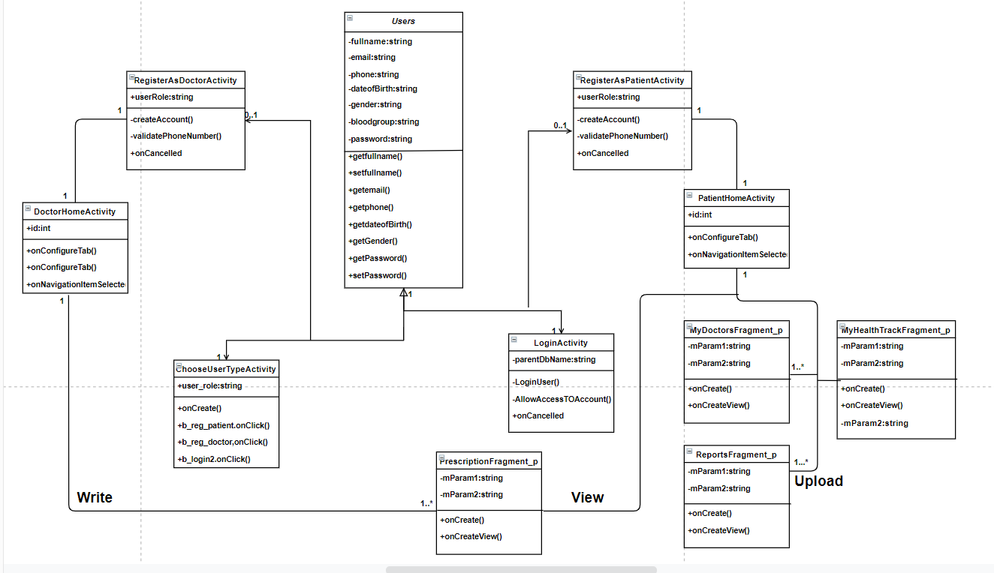
Class Diagram

Slide 18
Contents
Motivation
Information Gathering
Features of Our App
Use Case Diagram
Activity Diagram
Class Diagram
System Development Approach
Used Tools / Technologies
Screenshots
Future Works
Questions?

Slide 19
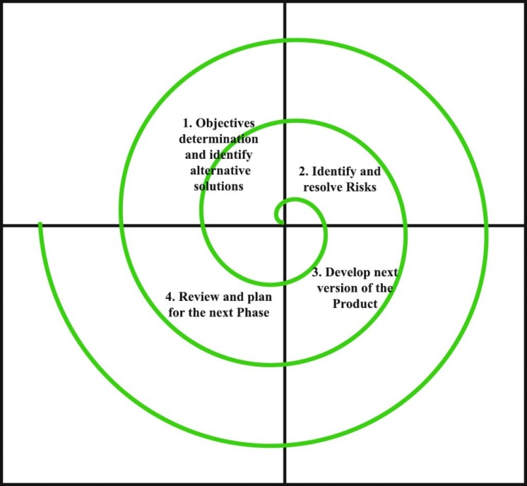
System Development Approach
We’ve used spiral approach for developing our app.

Slide 20
Contents
Motivation
Information Gathering
Features of Our App
Use Case Diagram
Activity Diagram
Class Diagram
System Development Approach
Used Tools / Technologies
Screenshots
Future Works
Questions?

Slide 21
Used
Tools / Techniques
Android Studio
Android Emulator
Live USB Debugging
Firebase Real-time Database
Firebase Storage
Java
XML

Slide 22
Contents
Motivation
Information Gathering
Features of Our App
Use Case Diagram
Activity Diagram
Class Diagram
System Development Approach
Used Tools / Technologies
Screenshots
Future Works
Questions?

Slide 23
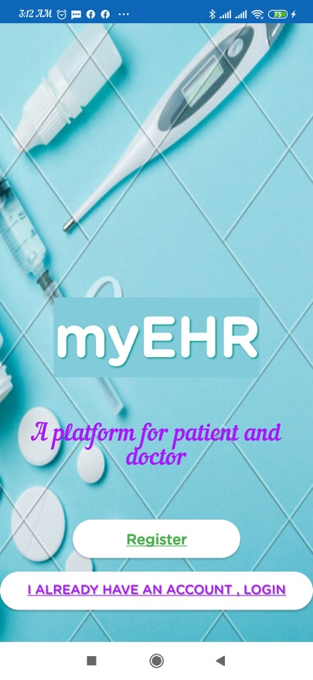
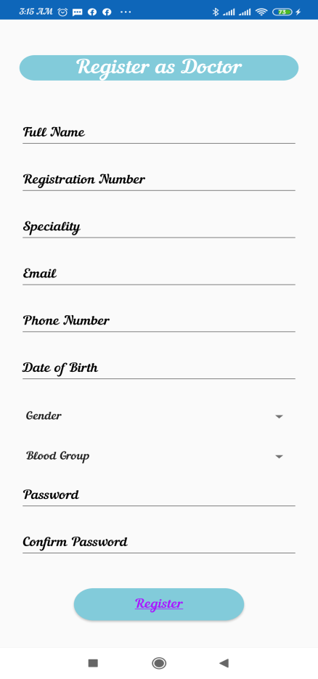
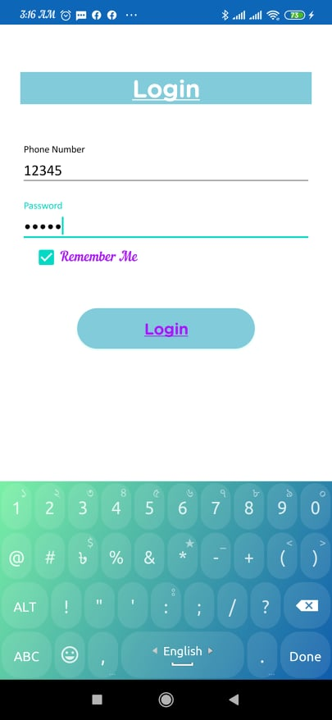
Screenshots
Opening
Doctor Registration
User Login

Slide 24
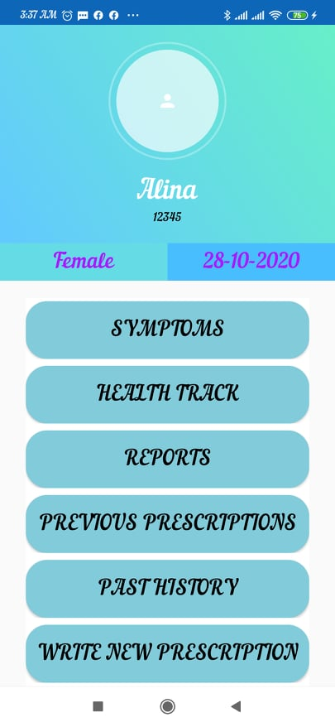
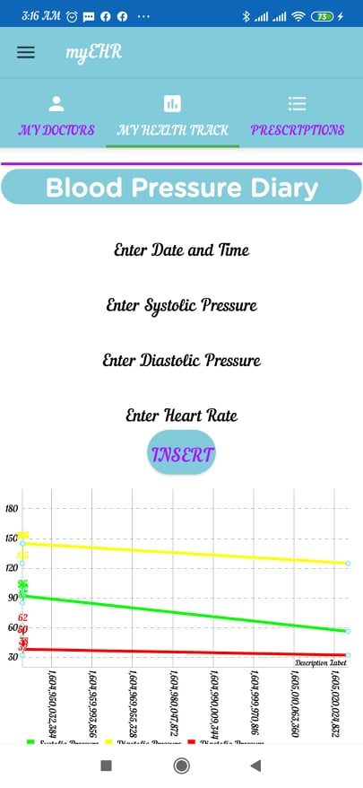
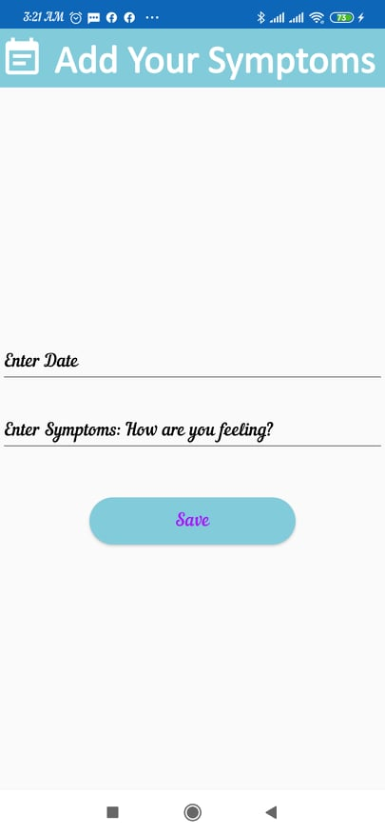
Screenshots
Patient Data
View Health Track
Adding Symptoms

Slide 25
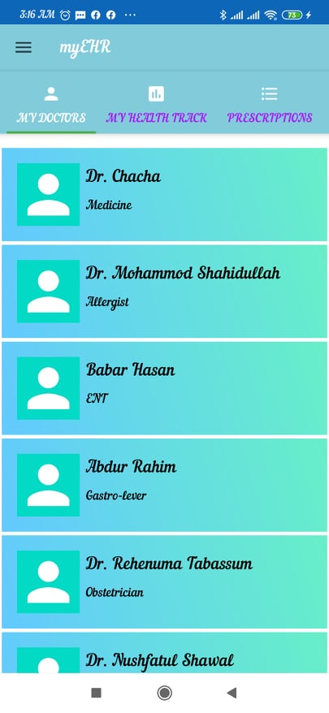
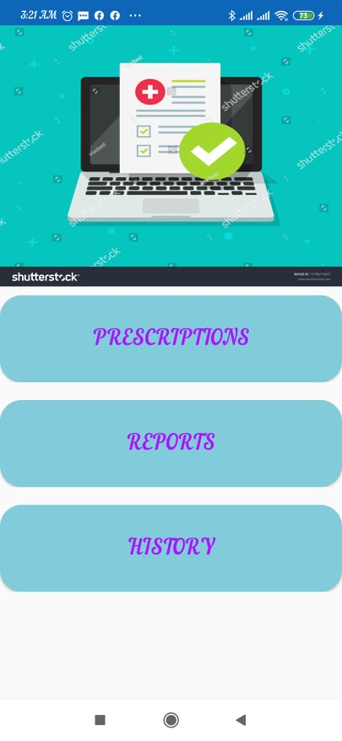
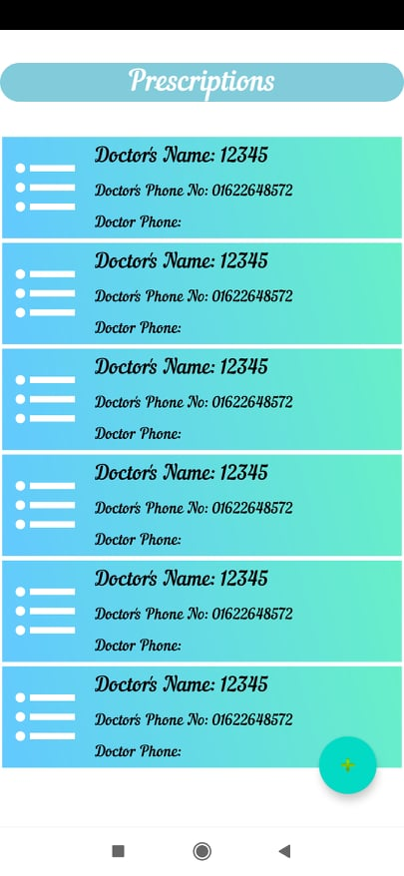
Screenshots
Doctor List
Patient’s History
Prescriptions

Slide 26
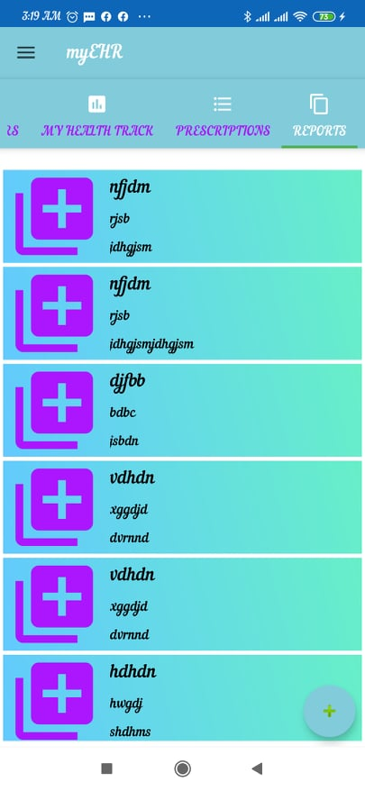
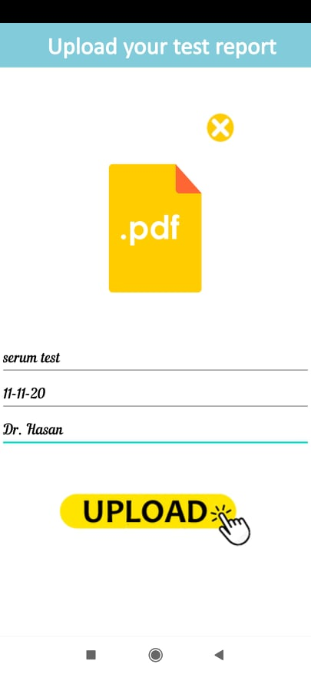
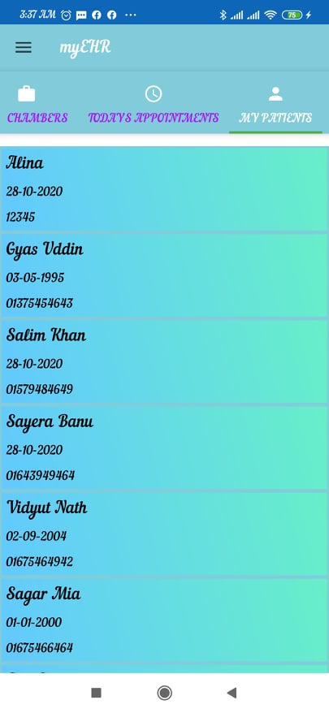
Screenshots
Reports
Report Uploading
Patients List

Slide 27
Contents
Motivation
Information Gathering
Features of Our App
Use Case Diagram
Activity Diagram
Class Diagram
System Development Approach
Used Tools / Technologies
Screenshots
Future Works
Questions?

Slide 28
Future Works
User friendly authentication service
more functions for creating more customer and user values

Slide 29
Contents
Motivation
Information Gathering
Features of Our App
Use Case Diagram
Activity Diagram
Class Diagram
System Development Approach
Used Tools / Technologies
Screenshots
Future Works
Questions?

Slide 30

Questions?

Slide 31
Thank
You

